Slide 1
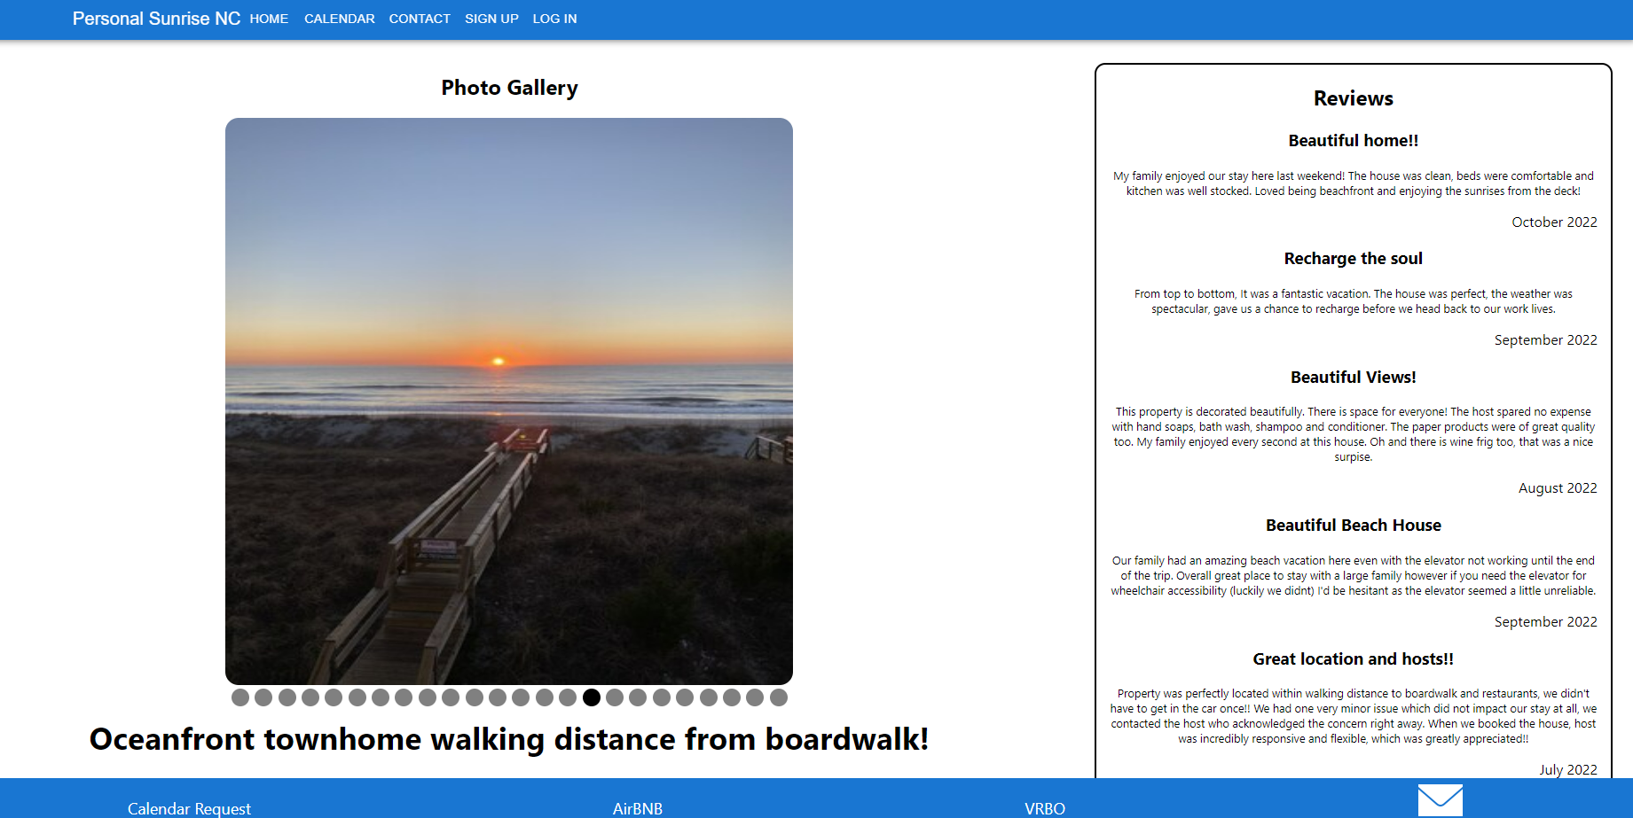
Personal sunrise
Presented by:
Aaron Key, Chris Erickson, Lucas Blackwell
Notes:
Chris to introduce

Slide 2
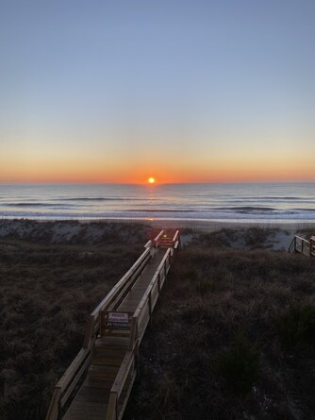
“Personal Sunrise” is the perfect getaway from the business of life. Located on the coast and walking distance from the boardwalk, it’s the perfect place to unwind, slow down, and reconnect.
Our application provides a central advertising hub to direct potential tenants. While also allowing tenants to create an account, request a booking, and contact the owners.
Notes:
Chris

Slide 3
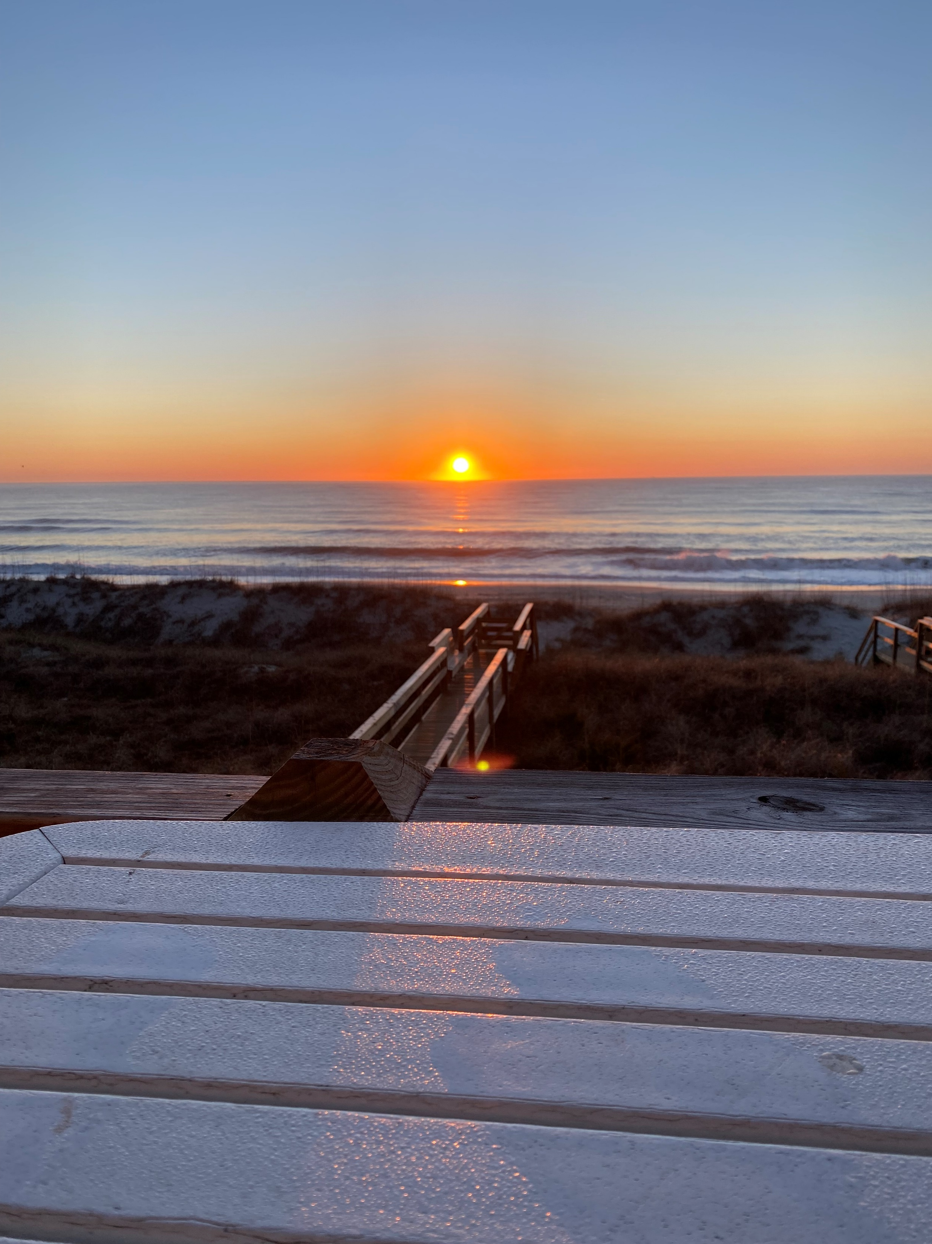
Concept
Owner:
Administrative access
Add Calendar Events
Tenant:
Platform to contact Owner
Check calendar availability
Create an account to Request a stay
Notes:
Chris

Slide 4
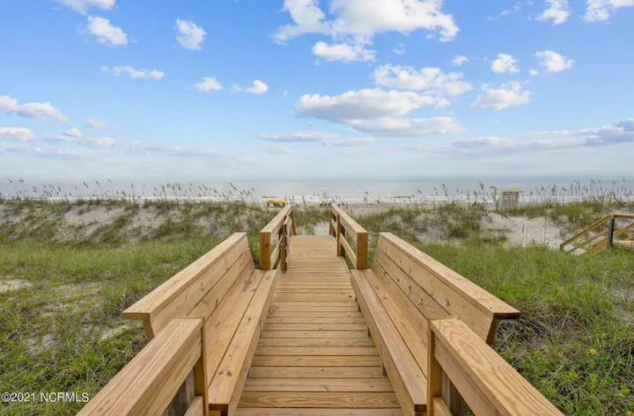
Process
Technologies
Apollo Server, Express
MongoDB and Mongoose
GraphQL
React and React-router
Full Calendar
JSON Web Token (JWT)
Materialize
Notes:
Lucas

Slide 5
Process cont.
Task Breakdown
Server: Chris
Front End: Lucas and Aaron
Challenges
Schedules
FullCalendar integration
Owner vs Tenant login
Successes
Smaller group
Owner/Tenant differentiation
Notes:
Lucas

Slide 6
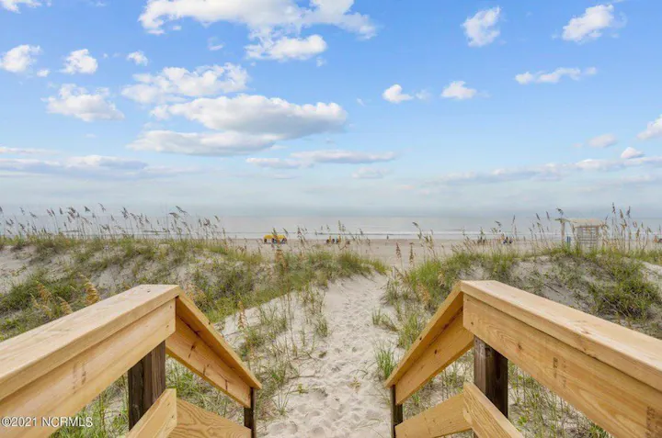
DEMO
Notes:
Aaron

Slide 7
Future Development
Better Calendar integration solution – iCal for sync
Owner account creation
Owner cache to review requests
Upload reviews – added to database and dynamically/randomnly pulled
Notes:
Aaron

Slide 8
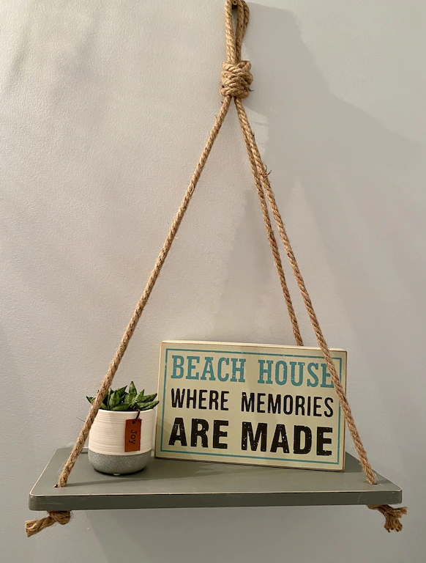
LINKS
Heroku Deployed:
personal-sunrise-test.herokuapp.com
GitHub Repository:
https://github.com/EricksonVIK/Personal_Sunrise_NC

