Slide 1
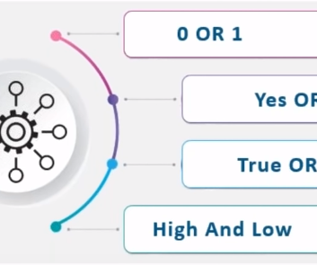
Logistic Regression
CSEL302-Introduction to Intelligent System
Bridging Statistics and Machine Learning
MARK P. BERNARDINO

Slide 2

Overview
"Today, we will explore Logistic Regression, a pivotal statistical method for binary classification. We'll uncover how it differentiates from linear regression, delve into its mathematical foundation, and showcase its wide array of applications in various fields."

Slide 3
What is Logistic Regression?
"Logistic Regression is a statistical technique used for predicting the outcome of a categorical dependent variable based on one or more predictor variables. It models the probability of a binary event occurring, such as success/failure, yes/no, or pass/fail scenarios."

Slide 4
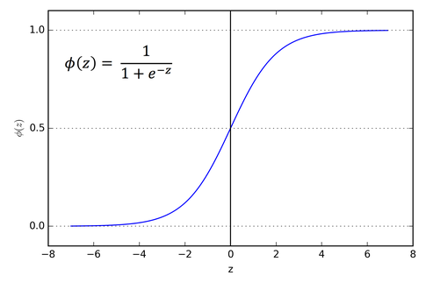
The Logistic Function (Sigmoid Function)
At the heart of Logistic Regression lies the Sigmoid Function:
This function maps any input to a value between 0 and 1, representing a probability."

Slide 5
Mathematics Behind Logistic Regression
"Logistic Regression is based on the concept of odds and log-odds. The odds of an event is the ratio of the probability of the event to its complement. The logistic model uses these odds, transformed via the logarithm, to predict the probability of the target class."

Slide 6

Model Development Process
"Developing a Logistic Regression model involves several key steps: First, selecting relevant features. Second, using a training dataset to fit the model. Finally, interpreting the model coefficients to understand the influence of each predictor."

Slide 7
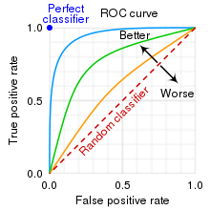
Model Evaluation Metrics
"Evaluating the performance of a Logistic Regression model involves metrics such as Accuracy, Precision, Recall, and the F1 Score. The ROC Curve and AUC provide insights into the model's ability to distinguish between classes."

Slide 8
Applications of Logistic Regression
"Logistic Regression's flexibility makes it applicable in many fields. In medicine, it predicts disease presence or absence. In finance, it assesses credit risk. In marketing, it helps predict customer churn. These examples underscore its versatility."

Slide 9
Applications of Logistic Regression
Healthcare
Disease Diagnosis: Predicting the likelihood of a patient having a particular disease (e.g., diabetes, heart disease) based on risk factors such as age, weight, cholesterol levels, and blood pressure.
Patient Readmission: Estimating the probability of a patient being readmitted to the hospital within 30 days after discharge, based on their medical history, the nature of their ailment, and treatment received.

Slide 10
Applications of Logistic Regression
Finance
Credit Scoring: Assessing the probability that a borrower will default on a loan based on their credit history, income, debt levels, and other financial characteristics.
Fraud Detection: Identifying potentially fraudulent transactions by analyzing patterns and characteristics of transactions, such as amount, location, and frequency.

Slide 11
Applications of Logistic Regression
Marketing
Customer Churn Prediction: Predicting whether a customer will leave a service or subscription based on usage patterns, customer service interactions, payment history, and other factors.
Campaign Response Modeling: Estimating the likelihood that a customer will respond to a marketing campaign, enabling targeted marketing efforts to increase response rates and ROI.

Slide 12
Applications of Logistic Regression
Social Sciences
Election Outcomes: Predicting the probability of a candidate winning an election based on polling data, demographic information, and historical voting patterns.
Survey Analysis: Analyzing responses from surveys to determine the factors that influence opinions or decisions on social and political issues.

Slide 13
Applications of Logistic Regression
Education
Student Performance Prediction: Estimating the likelihood of a student passing or failing an exam based on study habits, attendance records, and previous grades.
Admission Prediction: Assessing the probability of an applicant being admitted to a college or university based on their grades, test scores, extracurricular activities, and other factors.

Slide 14
Applications of Logistic Regression
Human Resources
Employee Attrition: Predicting the likelihood of an employee leaving the company, helping HR to identify potential leavers early and develop strategies to retain talent.
Candidate Selection: Estimating the suitability of job candidates for positions based on their resumes, interview performance, and test scores.

Slide 15
Applications of Logistic Regression
E-commerce
Product Recommendation: Predicting the likelihood of a customer liking and buying a product based on their browsing and purchase history.
Customer Lifetime Value Prediction: Estimating the probability of long-term engagement and the overall value a customer brings to the business, guiding customer relationship management strategies.

Slide 16
Software and Tools for Logistic Regression
"Implementing Logistic Regression can be done using various software and libraries. Python's scikit-learn and R are popular choices for their robustness and ease of use, offering functions for fitting, evaluating, and interpreting models."

Slide 17
Challenges and Considerations
"While powerful, Logistic Regression faces challenges like multicollinearity among predictors and the risk of overfitting. Techniques such as regularization and careful feature selection can mitigate these issues, enhancing model reliability."

Slide 18
Case Study/Example
"Consider a study aiming to predict university admission based on test scores and GPA. Logistic Regression can model the probability of admission, helping institutions make data-driven decisions. Through analysis, we find that both GPA and test scores significantly influence admission chances."

