Slide 1
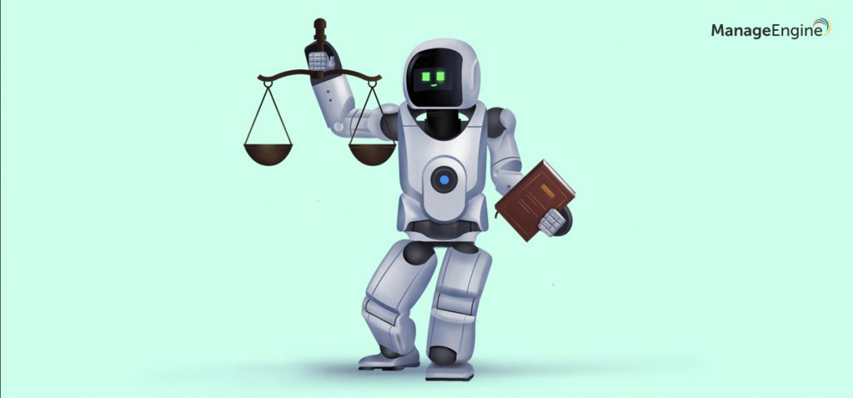
Principles and ethics of Artificial Intelligence

Slide 2
Autonomy in AI:
Ability of AI systems to operate and make decisions without continuous human intervention.
Perform tasks, learn from data, and make decisions independently.
Hypothetical future AI with human-like cognitive abilities, would possess a high degree of autonomy.

Slide 3
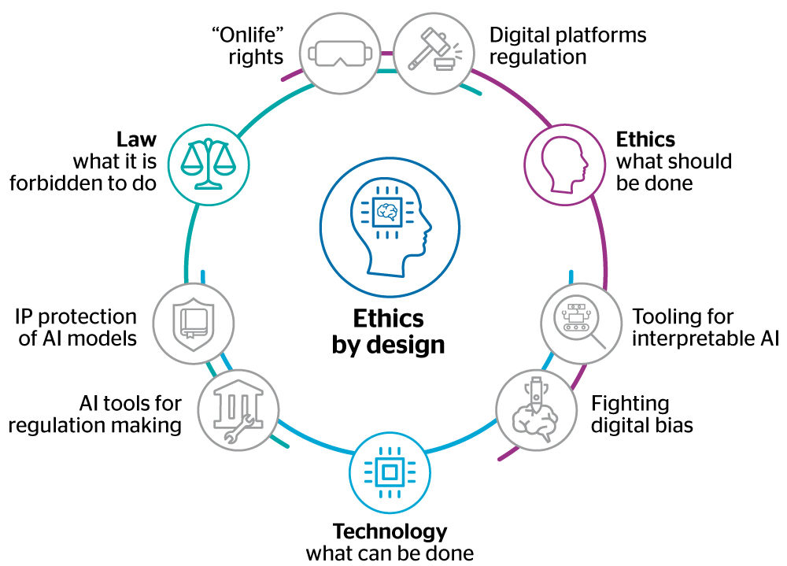

Slide 4
Responsibility in AI:
Considering the ethical implications of creating and deploying AI systems.
It includes ensuring that AI is developed and used in a manner that aligns with human values and societal norms.
Must be responsible for the design, deployment, and maintenance of AI systems.
Addressing issues like bias, transparency, accountability, and the impact of AI on employment and privacy.

Slide 5
Ethical Considerations:
The potential for bias in algorithms, and the social implications of automation.
Ethical guidelines and frameworks are being developed to guide the responsible development and use of AI.
Includes principles like fairness, transparency, accountability, and the consideration of societal impacts

Slide 6
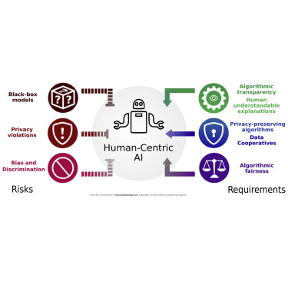

Slide 7
Accountability in AI:
It involves identifying who is responsible for the actions and decisions made by AI systems.
Establishing clear lines of accountability helps address issues when AI systems make errors or exhibit biased behavior.
It may involve holding developers, organizations, or even regulatory bodies accountable for ensuring the ethical use of AI.

Slide 8
Regulation and Governance:
Governments and international organizations are increasingly recognizing the need for regulations to govern the development and deployment of AI.
Regulatory frameworks can help set standards, ensure transparency, and establish accountability for AI systems.

Slide 9
Public Engagement:
Inclusive public engagement is essential to address the societal impacts of AI.
Including diverse perspectives in the development and deployment of AI systems can help identify potential biases and mitigate negative consequences

Slide 10
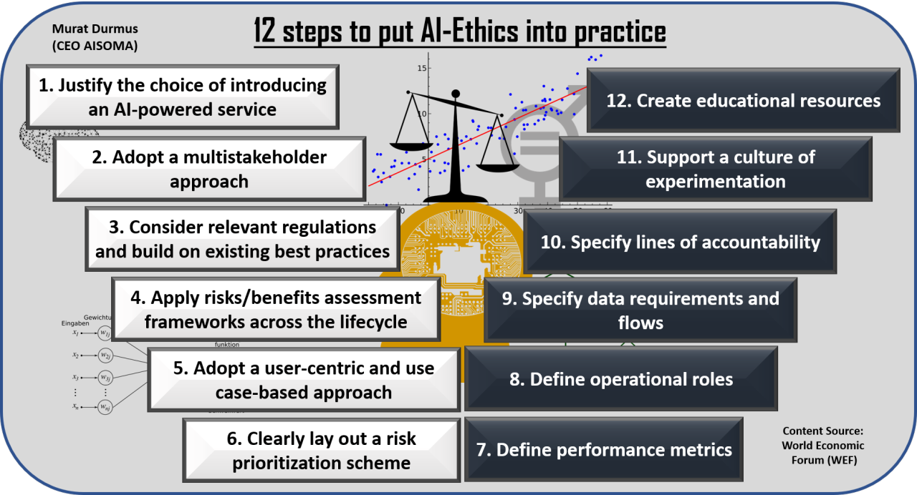

Slide 11
Key points related to the singularity in AI include:
Artificial General Intelligence (AGI):
  A form of AI that has the ability to understand, learn, and apply knowledge across a wide range of tasks at a level comparable to human intelligence.
Exponential Growth:
  Once AGI reaches a certain level, it could improve and enhance its own intelligence at an accelerating rate, leading to a cascade of advancements.

Slide 12
Unpredictability:
  Beyond a certain point, the consequences and advancements become difficult to predict, as the intelligence of the system surpasses human understanding.
Impacts on Society:
  Considerations of the potential impact on society, employment, ethics, and even the survival of the human species.

Slide 13
Ethical and Safety Concerns:
  How to ensure the responsible development and use of AGI?
Singularity
  The singularity in artificial intelligence refers to a hypothetical point in the future when technological growth, particularly in the development of AGI, becomes rapid and unpredictable, potentially leading to transformative changes in society.

Slide 14
Machine ethics
Machine ethics is a field of study that explores the ethical implications of artificial intelligence (AI) and autonomous systems.
Machine Ethics include:
  Ethical Decision-Making:
  Value Alignment:
  Transparency:
  Accountability and Responsibility:

Slide 15
Contd.
  Bias and Fairness
  Privacy
  Human-Machine Collaboration
  Development of Ethical Guidelines

Slide 16
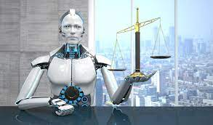
Machine Ethics: Creating an Ethical Intelligent Agent.
Moral Knowledge:
Incorporation of ethical principles, values, and rules into AI systems to guide their decision-making processes.

Slide 17
key aspects of moral knowledge
Ethical Frameworks:
AI systems can be designed to follow specific ethical frameworks, such as deontology, consequentialism, or virtue ethics.
Learning from Human Ethics:
Machine learning algorithms can be trained on datasets that reflect human ethical judgments.

Slide 18
Rule-Based Systems:
Some machine ethics approaches involve encoding explicit rules or principles into the AI system.
Explainability and Transparency:
For AI systems to be ethically sound, they should be able to explain their decisions in a human-understandable manner.
Adaptability and Learning:
Ethical considerations can evolve over time, and AI systems should be able to adapt to changes in societal norms.

Slide 19

Cont.
Value Alignment:
Ensuring that AI systems align with human values is a critical aspect of machine ethics.
Ethical Decision-Making:
AI systems can be equipped with mechanisms for ethical decision-making.

Slide 20
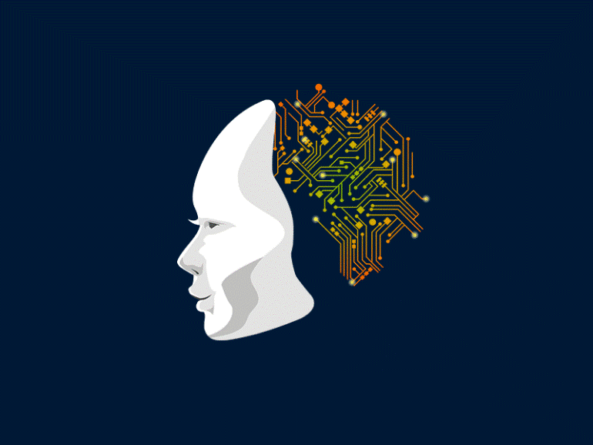
Eliminating bias in AI
Complex and multifaceted challenge.
Crucial for ensuring fair and equitable outcomes.
Bias in AI systems can arise from various sources, including biased training data, biased algorithms, and biased design decisions.

Slide 21
Strategies to address and mitigate bias in AI:
Diverse and Representative Training Data
Bias Detection and Evaluation
Transparency and Explainability
Ethical Design Principles
Human-in-the-Loop Approaches
Continuous Monitoring and Updating

Slide 22
Moral relativism
Philosophical position that moral judgments are not absolute but are instead relative to the perspectives, values, or cultural contexts from which they arise.
In the context of AI, moral relativism could manifest in the idea that ethical decisions made by AI systems should be context-dependent and may vary based on cultural, societal, or individual perspectives.

Slide 23
Contd.
Cultural Sensitivity
Customizable Ethics
Dynamic Ethical Frameworks
Value Pluralism
Ethical Uncertainty
Open-Ended Decision-Making

Slide 24
Moral justification?
“who will be held responsible for harm involving an artificial intelligence (AI) system?”
Theory of mind perception , two dimensions of mind: Perceived Agency—attributing intention, reasoning, pursuing goals, and communicating to AI.
Perceived Experience—attributing emotional states, such as feeling pain and pleasure, personality, and consciousness to AI

Slide 25
Contd.
The relationship between perceived intentional harm and blame judgments toward AI.
Some findings by showing that perceived intentional harm directed to a non-human entity did not lead to increased attributions of mind to AI.
These findings have implications for theory and practice concerning unethical outcomes and behavior associated with AI use.
Companies and developers were held responsible for moral violations involving AI, with developers received the most blame among the entities involved.

Slide 26
Moral Agents.
In contrast to a conventional vacuum cleaner, it is not directly operated by a human being. Hence, it is to a certain degree autonomous. Even such a primitive system faces basic moral challenges, for instance: should it vacuum and hence kill a ladybird that comes in its way or should it pull around it or chase it away? How about a spider? Should it extinguish the spider or save it?

Slide 28
Even if one agrees that there can be artificial moral agents, it is clear that even the most complex artificial systems differ from human beings in important respects that are central to our understanding of moral agency.
The structure of morality
It seems that in order to tackle the problem of the moral agency of artificial agents one is forced to adopt a different perspective and needs to consider the actual mechanisms behind human morality, not sophisticated normative conceptions of what does it mean to act morally.

Slide 29
The most common theoretical schema is the standard user, tool, and victim model. Here the technology mediates the moral situation between the actor who uses the technology and the victim.
In this model we typically blame the user, not the tool, when a person using some tool or technological system causes harm.
If a robot is simply a tool, then the morality of the situation resides fully with the users and/or designers of the robot.
If we follow this reasoning, then the robot is not a moral agent at best it is an instrument that advances the moral interests of others.

Slide 30
ethics
https://youtu.be/jxatQvQWY_s

