Slide 1
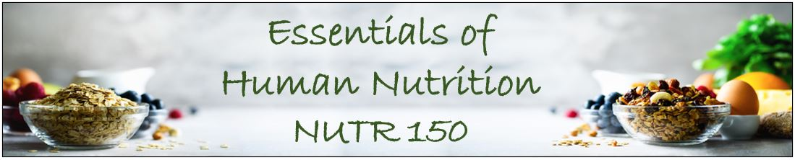
Welcome to tonight’s meeting!
We will begin at 8 pm MT
Have the DRI tables handy, we will refer to them several times tonight
Note: In W08 Health Genogram Assignment you will choose a Nutrition action to work on for 5 days.
Get started early – W09 Assignment is a reflection of this activity.

Slide 2
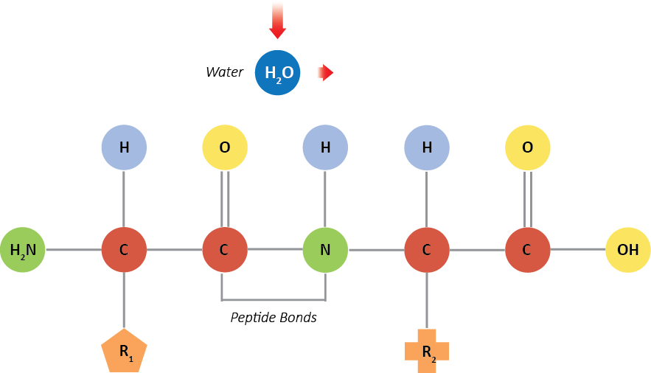
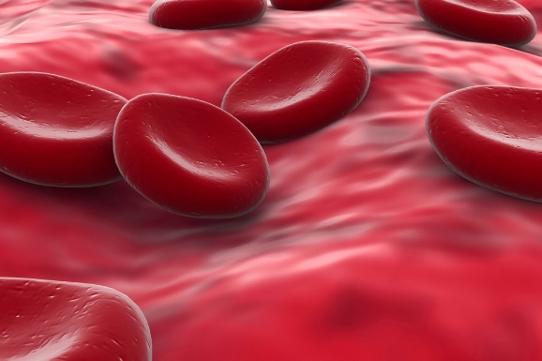

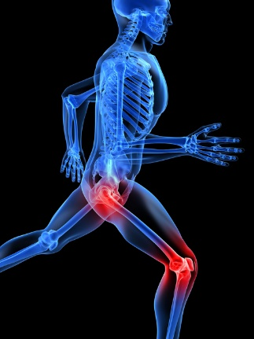
Water Functions
Transport
Chemical reactions
Cooling the body
Lubrication
Notes:
(Wikipedia Commons)

Slide 3
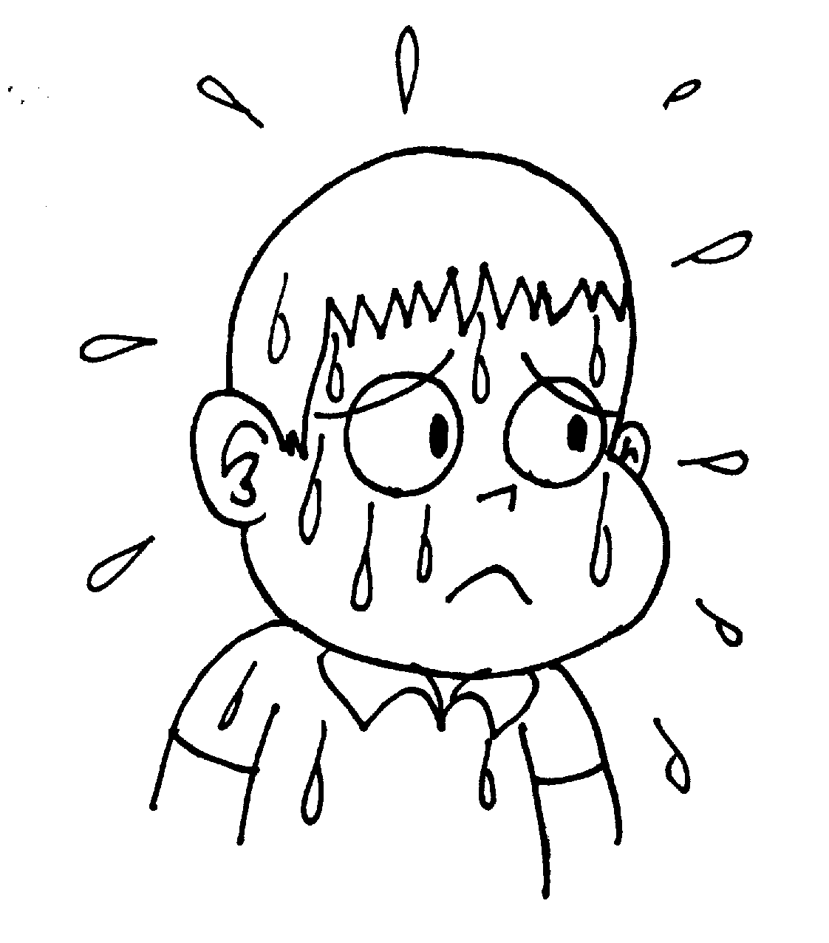
Water Functions
Sweat evaporation
cools the body

Slide 4
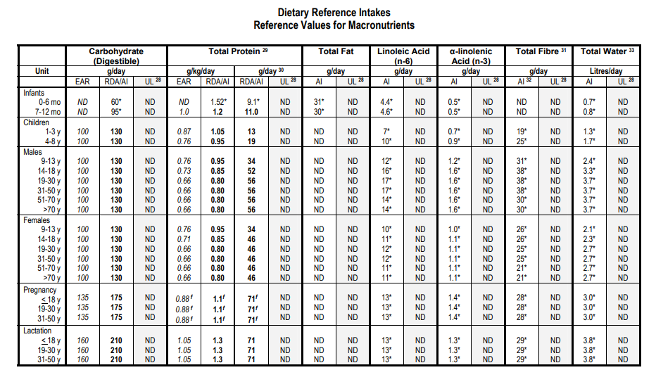

Slide 5
The Water Balance
Water Intake
Water Loss
2400 mL ≈ 10 cups
2400 mL ≈ 10 cups
Drink
1700 mL
Respiration
Metabolic water
Kidneys
1500 mL
Fecal
Food
400 mL
Skin
450 mL
300 mL
150 mL
300 mL
Fluid in
Fluid Out

Slide 6
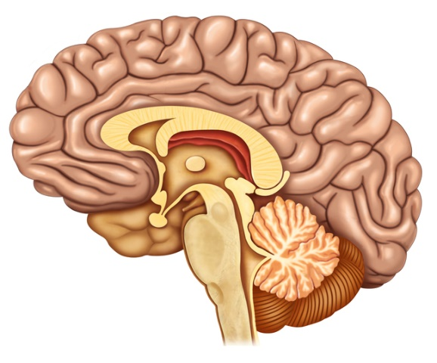
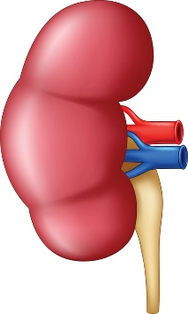
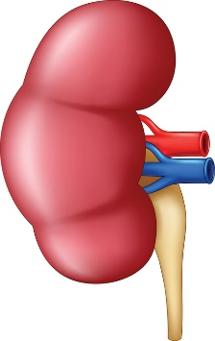

Hypothalamus
Action of Anti-Diuretic Hormone (ADH)
ADH from the pituitary increases fluid retention in the kidney

Slide 7
What would happen to ADH levels and urine volume if someone consumes an extra 4 cups of water?
Hypothalamus
ADH from the pituitary increases fluid retention in the kidney

Slide 8
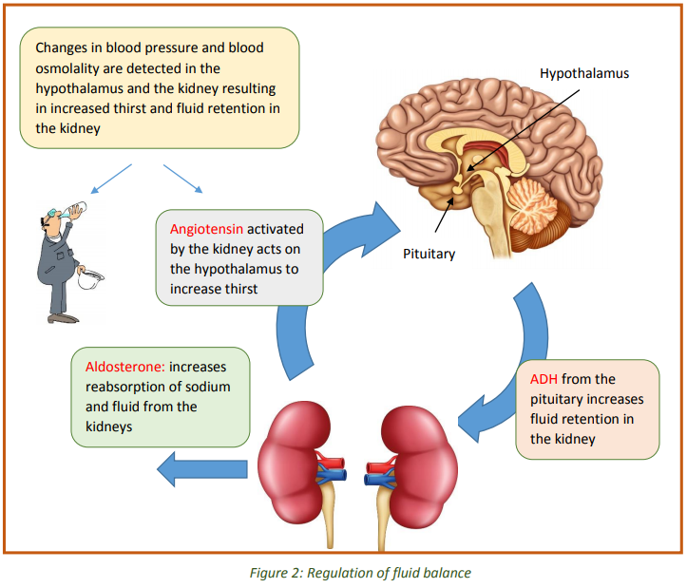
Notes:
Ask Yourself question from the textbook chapter: What would happen to ADH levels and urine volume if someone consumes an extra 4 cups of water?

Slide 9
Problems of Water Balance
Dehydration
Mild dehydration - thirst, headache, irritability
Severe dehydration – rapid heart rate, heat exhaustion
Water Intoxication
Hyponatremia (low levels of sodium in the blood)
Can cause swelling in the brain

Slide 10
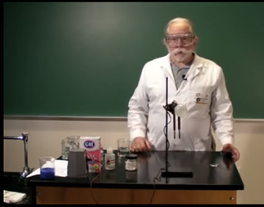
Electrolytes
Sodium
+ charge: lost a negative electron
extracellular: outside of cells
Potassium
+ charge: lost a negative electron
intracellular: inside of cells
Chloride
– charge: gained a negative electron
extracellular: outside of cells

Slide 11
Sodium and Potassium
Na⁺
Na⁺
Na⁺
Na⁺
Na⁺
Na⁺
Na⁺
Na⁺
K⁺
(Na⁺ Major positive ion in extracellular fluid)
K⁺
Na⁺
K⁺
K⁺
K⁺
K⁺
Na⁺
Na⁺
(K⁺ Major positive ion in the intracellular fluid)
K⁺
Na⁺
Na⁺
K⁺
Na⁺
K⁺
Na⁺
K⁺
Na⁺
K⁺
K⁺
Na⁺
Na⁺
Cell

Slide 12
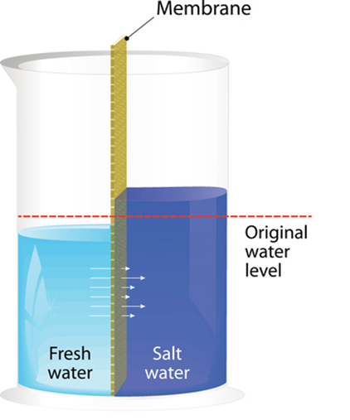
Introduction to Electrolytes
Sodium, Potassium, Chloride
Functions
Fluid Balance
Nerve Conduction
Muscle Contraction
Fig. 5, p. 171

Slide 13
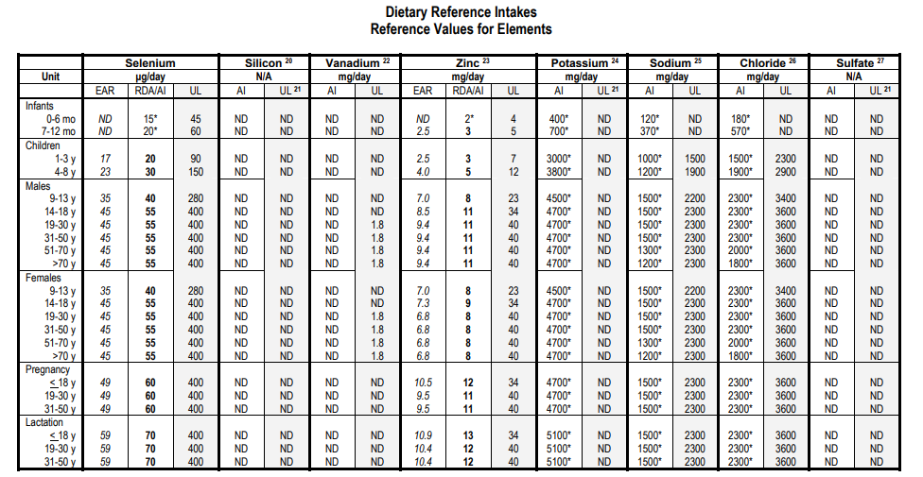

Slide 14
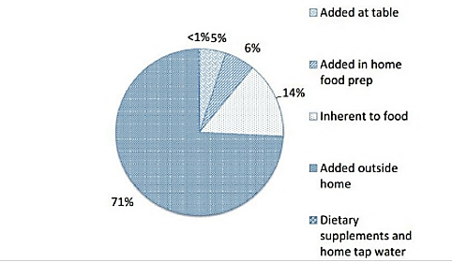
Just 5% of Daily Salt Added at the Table
Image: https://twitter.com/CircAHA/status/861685921644728321
Appel, L.J., & Foti, K. (2017). Sources of dietary sodium. Circulation, 135: 1784-1787.

Slide 15
Sodium Content of Fast Food
Food | Sodium Content per serving
Burger King Whopper w/ cheese Chipotle Barbacoa Burrito (with rice and beans) Chick Fil A Chicken Sandwich McDonald’s Big Mac Subway Club Sandwich 6” Arby’s Roast Beef Sandwich Papa John’s Pepperoni Pizza Slice Taco Bell Burrito Supreme | 1,160 mg 1,690 mg 1,390 mg 1,040 mg 840 mg 1,150 mg 809 mg 1,090 mg

Slide 16
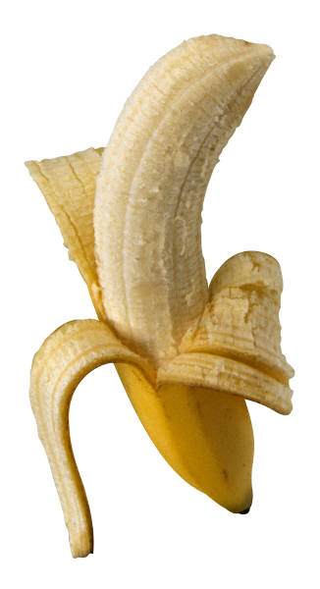



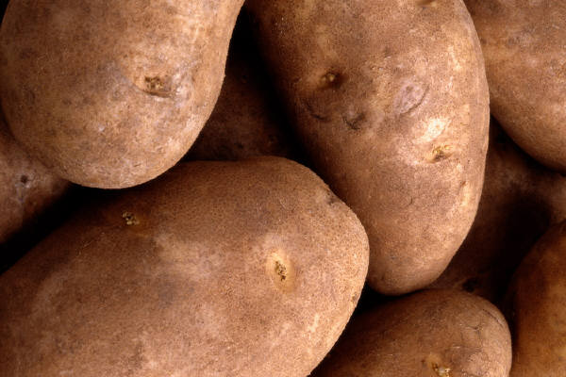
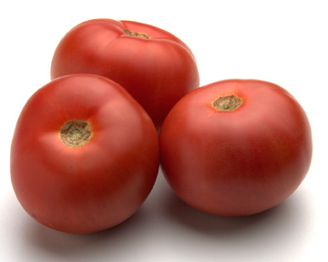
Excellent Potassium Food Sources

Slide 17
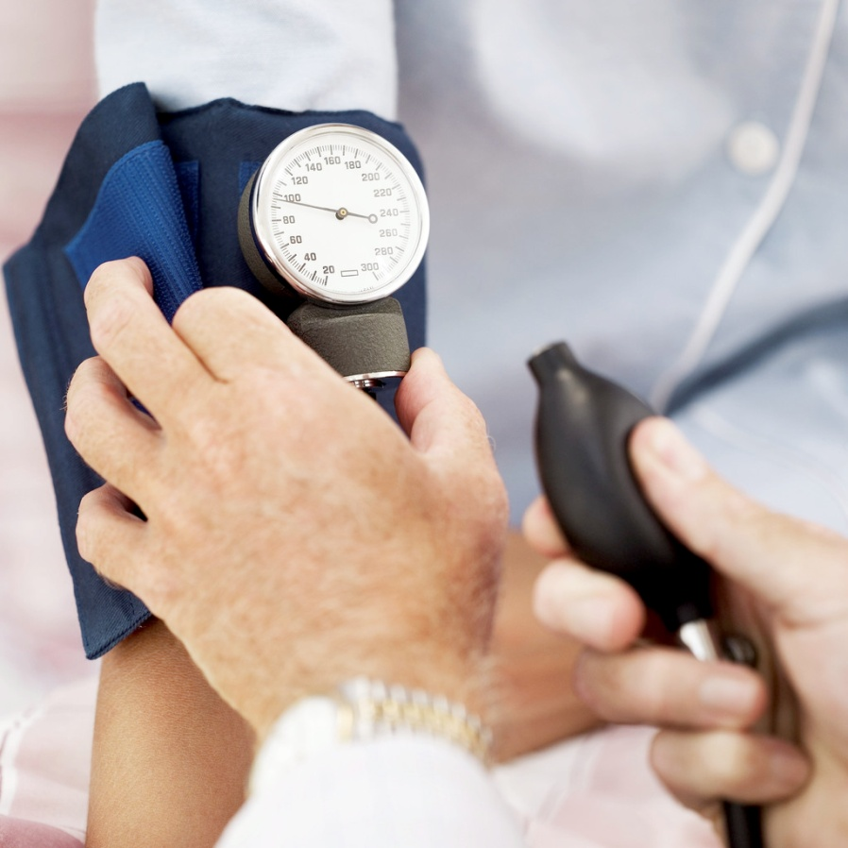
Blood Pressure
Systolic pressure:
Pressure created when your heart beats
Diastolic pressure: Pressure inside blood vessels when the heart is at rest

Slide 18
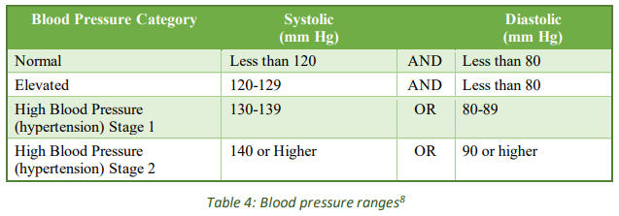
Hypertension
Risk Factors – Age, ethnicity, Overweight, Gender, Lifestyle

Slide 19
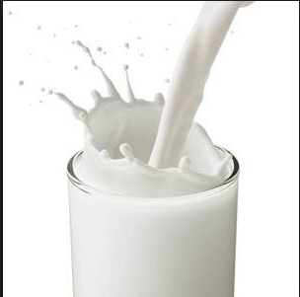
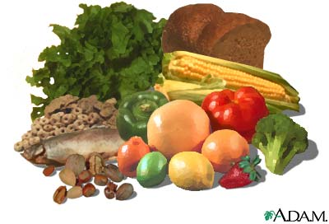
DASH Eating Plan: Dietary Approaches to Stop Hypertension
Promotes:
Good sources calcium
Good sources potassium
Good sources magnesium
Good sources of phytochemicals
Low sodium
Low added sugars
Low saturated fats
Notes:
2 to 3 servings low fat dairy products
8 to 10 servings fruits and vegetables
7 to 8 whole grains
Serving of nuts, seeds, dried beans
6 ounces or less of lean meat
Significantly and quickly (2 weeks) lowered BP
DASH diet and lifestyle changes will reduce high blood pressure
PREMIER Study
PREMIER was a randomized trial that tested whether counseling to make simultaneous lifestyle changes could prevent or control high blood pressure. High blood pressure is a major risk factor for heart disease and the chief risk factor for stroke.
The study began in 1998 and enrolled 810 adults with above-optimal blood pressure and who were not taking antihypertensive medications. Participants were randomly assigned to one of three intervention groups: Advice-Only, Established, and Established Plus DASH. All three groups received printed materials about blood pressure and lifestyle. In addition, those in the Advice-Only group received a 30-minute individual session with a nutritionist, which did not include counseling on how to make behavior changes. Participants in the Established group were counseled over 6 months to keep track of their diet, including calorie and sodium consumption, and their physical activity. Those in the Established Plus DASH group had the same intervention as the Established group, but also were taught to follow the DASH diet, which is rich in fruits, vegetables, and low fat dairy products.
After 6 months, blood pressure levels declined in all three groups but the reduction was significantly more in the groups receiving behavioral counseling and largest in the Established Plus DASH group. The results of the study indicated that adults with above-optimal blood pressure, including stage 1 hypertension, can make multiple lifestyle changes that lower blood pressure and reduce their risk of heart disease.
PREMIER was conducted at four clinical centers in Baltimore, Baton Rouge, Durham, and Portland. More information on the DASH eating plan is available at: http://www.nhlbi.nih.gov/health/resources/heart/hbp-dash-index.htm
Selected References:
Appel LJ, Champagne CM, Harsha DW, et al. Effects of comprehensive lifestyle modification on blood pressure control: main results of the PREMIER clinical trial. JAMA 2003;289:2083-93.
DASH Trial
This trial included 459 adults, some with and without confirmed high blood pressure, and compared three diets including 3,000 mg daily sodium:
Typical American diet
Typical American diet plus more fruits and vegetables
DASH diet
None of the plans were vegetarian or used specialty foods. After 2 weeks, participants who added fruits and vegetables to a typical American diet or those on the DASH diet had lower blood pressure than those who followed a typical American diet alone. However, the participants on the DASH diet had the greatest effect of lowering their high blood pressure.
Follow-up reports from the DASH trial showed that in addition to improving blood pressure, the DASH diet also lowered LDL cholesterol levels. High blood pressure and elevated LDL cholesterol are two major risk factors for cardiovascular disease.
DASH-Sodium Trial
This trial randomly assigned 412 participants to a typical American diet or the DASH diet. While on their assigned diet, participants were followed for a month at a high daily sodium level (3,300 mg) and two lower daily sodium levels (2,300 mg and 1,500 mg). Reducing daily sodium lowered blood pressure for participants on either diet. However, blood pressures were lower for participants on the DASH diet versus a typical American diet. Blood pressure decreased with each reduction of sodium. These results showed that lowering sodium intake and eating the DASH diet is more beneficial for lowering blood pressure than following the DASH diet alone.

Slide 20
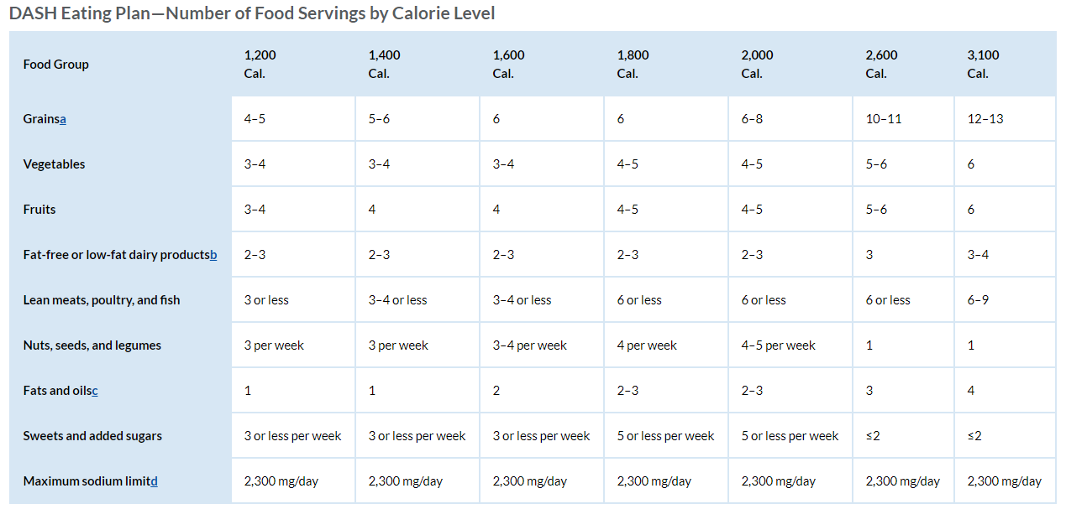

Slide 21
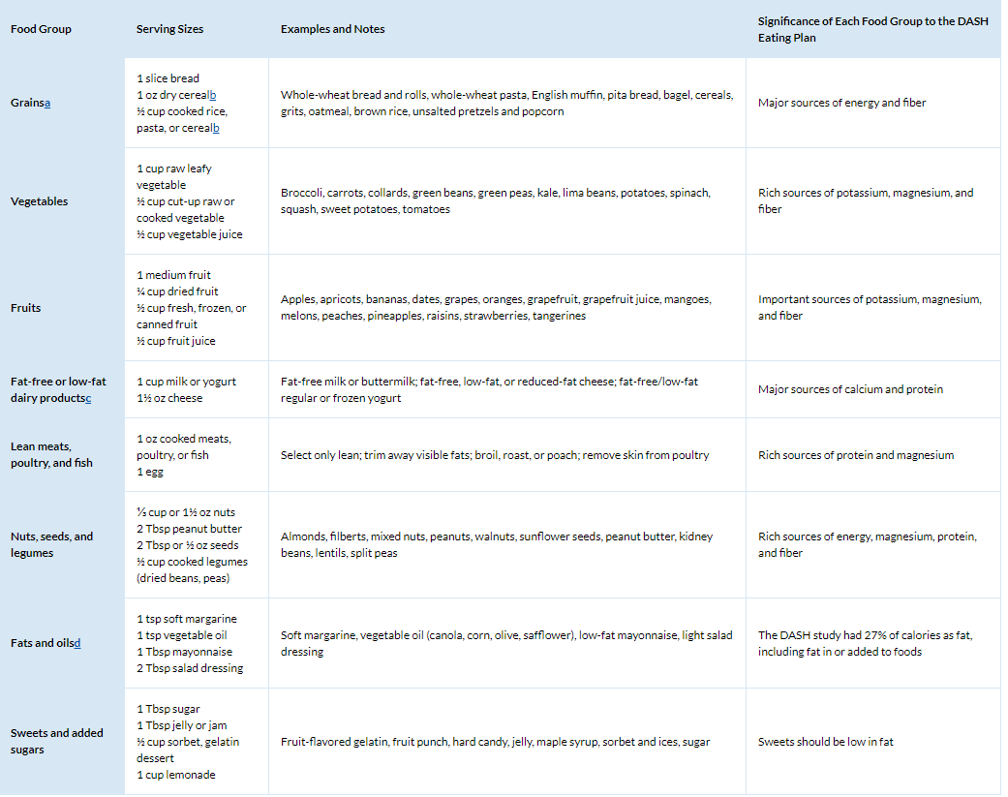
Serving Size

Slide 22
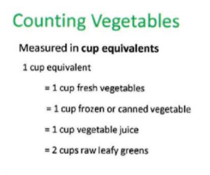
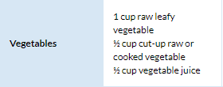
MyPlate and DASH may be different!
MyPlate Food Groups”
DASH Eating Plan

Slide 23
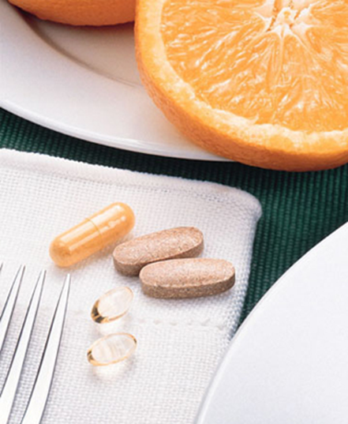
Supplements

Slide 24

Supplements
Vitamins, minerals, herbs, etc.
Supplements may be recommended (pp. 180-181)
Doesn’t replace a healthy diet
Natural does not always equal safe
Watch for USP, NSF, ConsumerLab.com on label

Slide 25
Tolerable Upper Intake Level (UL)
Safety Upper Level
STOP
THINK
Maximum intake that is unlikely to cause ADVERSE health effects
Notes:
Narrative describing the UL values

Slide 26
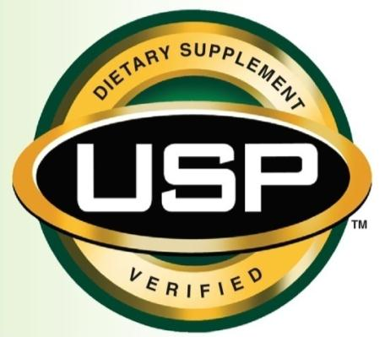
USP Label
This means that the product:
Contains the ingredients listed
Will dissolve or disintegrate in the digestive tract
Does not have harmful levels of contaminates
It does not mean that this supplement has been tested for safety or effectiveness

