Slide 1

Database Systems -
Introduction to Databases and Data Warehouses

Slide 2
INTRODUCTION
ER modeling
  A predominant technique for visualizing database requirements, used extensively for conceptual modeling of operational databases
Relational modeling
  Standard method for logical modeling of operational databases
Both of these techniques can also be used during the development of data warehouses and data marts
Dimensional modeling
  A modeling technique tailored specifically for analytical database design purposes
  Regularly used in practice for modeling data warehouses and data marts
Jukić, Vrbsky, Nestorov – Database Systems
Chapter 8 – Slide <number>

Slide 3
DIMENSIONAL MODELING
Dimensional modeling
  A data design methodology used for designing subject-oriented analytical databases, such as data warehouses or data marts
  Commonly, dimensional modeling is employed as a relational data modeling technique
  In addition to using the regular relational concepts (primary keys, foreign keys, integrity constraints, etc.) dimensional modeling distinguishes two types of tables:
    Dimensions
    Facts
Jukić, Vrbsky, Nestorov – Database Systems
Chapter 8 – Slide <number>
Notes:
As a relational modeling technique, dimensional modeling, just like standard relational modeling, designs relational tables that have primary keys and are connected to each other via foreign keys, while conforming to the standard relational integrity constraints

Slide 4
DIMENSIONAL MODELING
Dimension tables (dimensions)
  Contain descriptions of the business, organization, or enterprise to which the subject of analysis belongs
  Columns in dimension tables contain descriptive information that is often textual (e.g., product brand, product color, customer gender, customer education level), but can also be numeric (e.g., product weight, customer income level)
  This information provides a basis for analysis of the subject
Jukić, Vrbsky, Nestorov – Database Systems
Chapter 8 – Slide <number>
Notes:
For example, if the subject of the business analysis is sales, it can be analyzed by dimension columns such as product brand, customer gender, customer income level, and so on.

Slide 5
DIMENSIONAL MODELING
Fact tables
  Contain measures related to the subject of analysis and the foreign keys (associating fact tables with dimension tables)
  The measures in the fact tables are typically numeric and are intended for mathematical computation and quantitative analysis
Jukić, Vrbsky, Nestorov – Database Systems
Chapter 8 – Slide <number>
Notes:
For example, if the subject of the business analysis is sales, one of the measures in the fact table sales could be the sale’s dollar amount. The sale amounts can be calculated and recalculated using different mathematical functions across various dimension columns. For example, the total and average sale can be calculated per product brand, customer gender, customer income level, and so on.

Slide 6
DIMENSIONAL MODELING
Star schema
  The result of dimensional modeling is a dimensional schema containing facts and dimensions
  The dimensional schema is often referred to as the star schema
Jukić, Vrbsky, Nestorov – Database Systems
Chapter 8 – Slide <number>

Slide 7
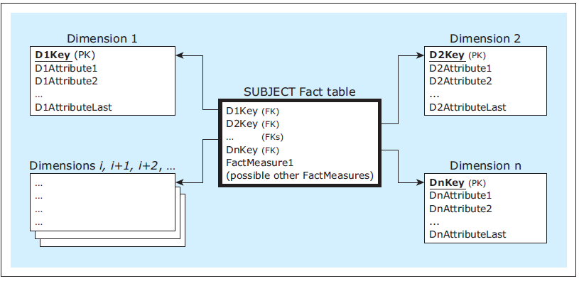
DIMENSIONAL MODELING
A dimensional model (star schema)
Jukić, Vrbsky, Nestorov – Database Systems
Chapter 8 – Slide <number>

Slide 8
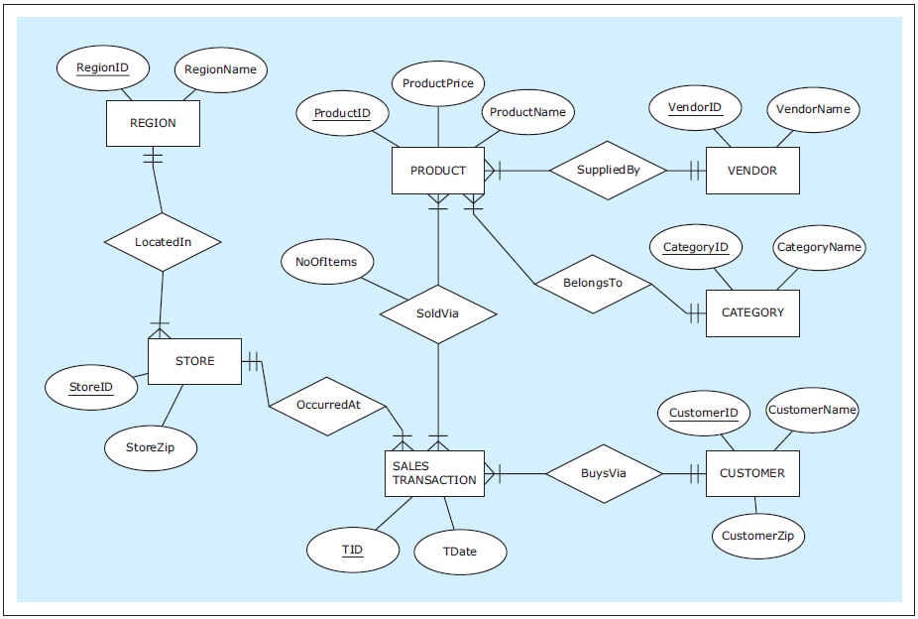
Initial Example: Dimensional Model Based on A Single Source
ER diagram : ZAGI Retail Company Sales Department Database (Source)
Jukić, Vrbsky, Nestorov – Database Systems
Chapter 8 – Slide <number>
Notes:
This example is discussed on Pages 226-229.

Slide 9
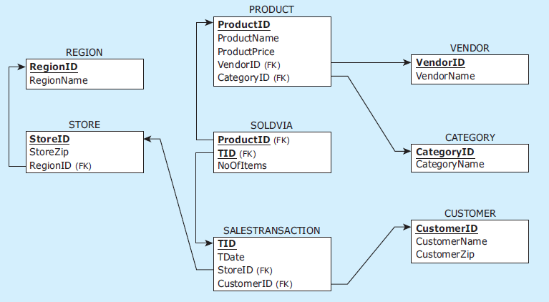
Initial Example: Dimensional Model Based on A Single Source
Relational schema : ZAGI Retail Company Sales Department Database (Source)
Jukić, Vrbsky, Nestorov – Database Systems
Chapter 8 – Slide <number>
Notes:
This example is discussed on Pages 226-229.

Slide 10
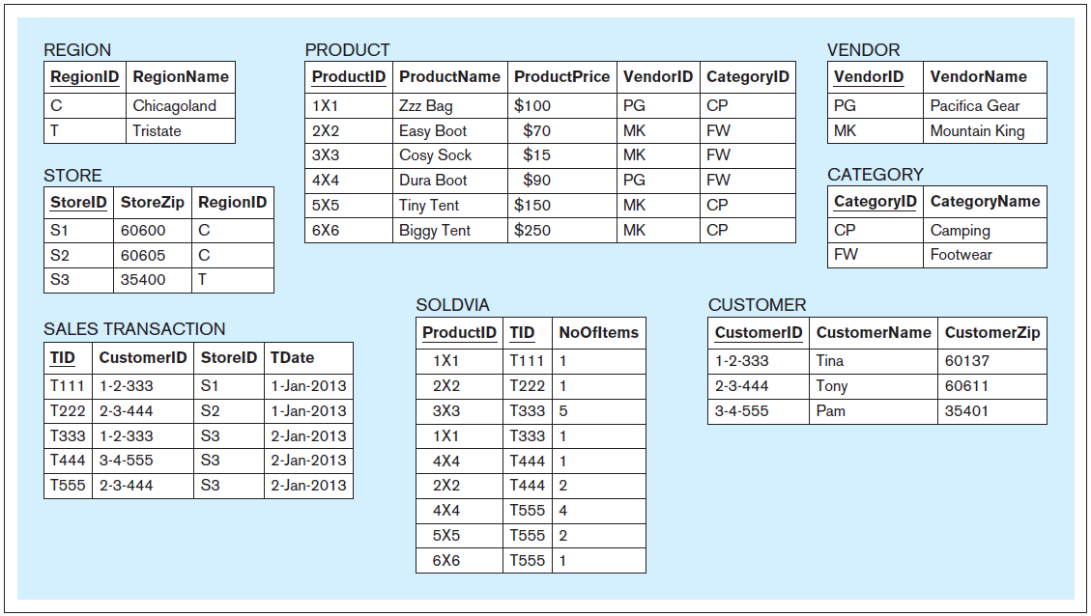
Initial Example: Dimensional Model Based on A Single Source
Data records: ZAGI Retail Company Sales Department Database (Source)
Jukić, Vrbsky, Nestorov – Database Systems
Chapter 8 – Slide <number>
Notes:
This example is discussed on Pages 226-229.

Slide 11
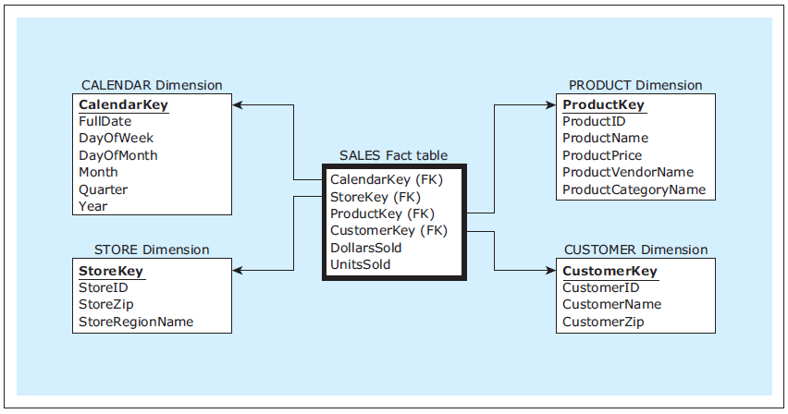
Initial Example: Dimensional Model Based on A Single Source
ZAGI Retail Company dimensional model for the subject sales
Jukić, Vrbsky, Nestorov – Database Systems
Chapter 8 – Slide <number>
Notes:
This example is discussed on Pages 226-229.

Slide 12
DIMENSIONAL MODELING
Star schema
  In the star schema, the chosen subject of analysis is represented by a fact table
  Designing the star schema involves considering which dimensions to use with the fact table representing the chosen subject
  For every dimension under consideration, two questions must be answered:
    Question 1: Can the dimension table be useful for the analysis of the chosen subject?
    Question 2: Can the dimension table be created based on the existing data sources?
Jukić, Vrbsky, Nestorov – Database Systems
Chapter 8 – Slide <number>
Notes:
In this example the chosen subject of analysis (sales) is represented by the SALES fact table.
For each of the four dimensions in the ZAGI example the answer to Question 1 and Question 2 was yes. Therefore those dimensions were included in the star schema.

Slide 13
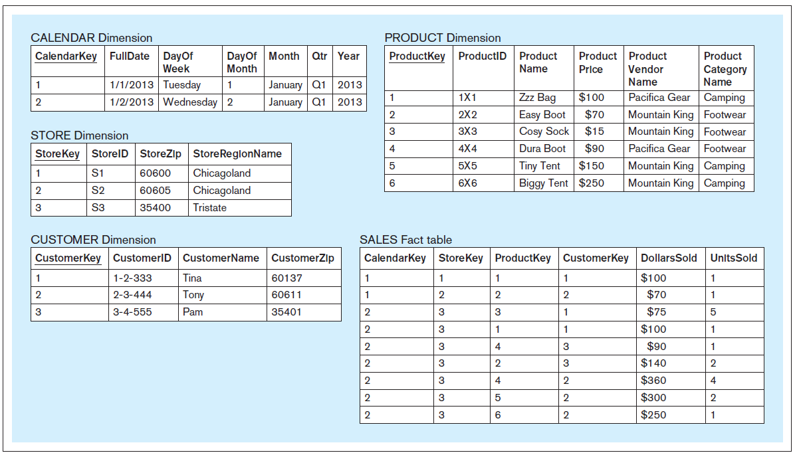
Initial Example: Dimensional Model Based on A Single Source
ZAGI Retail Company dimensional model for the subject sales, populated with the data from the operational data source
Jukić, Vrbsky, Nestorov – Database Systems
Chapter 8 – Slide <number>
Notes:
This example is discussed on Pages 226-229.

Slide 14
DIMENSIONAL MODELING
Characteristics of dimensions and facts
  A typical dimension contains relatively static data, while in a typical fact table, records are added continually, and the table rapidly grows in size.
  In a typical dimensionally modeled analytical database, dimension tables have orders of magnitude fewer records than fact tables
Jukić, Vrbsky, Nestorov – Database Systems
Chapter 8 – Slide <number>
Notes:
The discussion about the number of records in the example star schema is given on Page 230.

Slide 15
DIMENSIONAL MODELING
Surrogate key
  Typically, in a star schema all dimension tables are given a simple, non-composite system-generated key, also called a surrogate key
  Values for the surrogate keys are typically simple auto-increment integer values
  Surrogate key values have no meaning or purpose except to give each dimension a new column that serves as a primary key within the dimensional model instead of the operational key
Jukić, Vrbsky, Nestorov – Database Systems
Chapter 8 – Slide <number>
Notes:
For example, instead of using the primary key ProductID as the primary key of the PRODUCT dimension, a new surrogate key column ProductKey is created.
One of the main reasons for creating a surrogate primary key and not using the operational primary key as a primary key of the dimension, is to enable the handling of so called slowly changing dimensions (covered later in this chapter).

Slide 16
Initial Example: Dimensional Model Based on A Single Source
Example query
Query A: Compare the quantities of sold products on Saturdays in the category Camping provided by the vendor Pacifica Gear within the Tristate region between the 1st and 2nd quarter of the year 2013
Jukić, Vrbsky, Nestorov – Database Systems
Chapter 8 – Slide <number>
Notes:
This example is discussed on Pages 230-231.

Slide 17
Example query - Query A, dimensional version
SELECT SUM(SA.UnitsSold)
‚ P.ProductCategoryName
‚ P.ProductVendorName
‚ C.DayofWeek
‚ C.Qtr
FROM
Calendar C
‚ Store S
‚ Product P
‚ Sales SA
WHERE
C.CalendarKey = SA.CalendarKey
AND S.StoreKey = SA.StoreKey
AND P.ProductKey = SA.ProductKey
AND P.ProductVendorName = 'Pacifica Gear'
AND P.ProductCategoryName = 'Camping'
AND S.StoreRegionName = 'Tristate'
AND C.DayofWeek = 'Saturday'
AND C.Year = 2013
AND C.Qtr IN ( 'Q1', 'Q2' )
GROUP BY
P.ProductCategoryName,
P.ProductVendorName,
C.DayofWeek,
C.Qtr;
Jukić, Vrbsky, Nestorov – Database Systems
Chapter 8 – Slide <number>
Notes:
This example is discussed on Pages 230-231.

Slide 18
Example query - Query A, nondimensional version
SELECT SUM( SV.NoOfItems )
, C.CategoryName
, V.VendorName
, EXTRACTWEEKDAY(ST.Date)
, EXTRACTQUARTER(ST.Date)
FROM
Region R
, Store S
, SalesTransaction ST
, SoldVia SV
, Product P
, Vendor V
, Category C
WHERE
R.RegionID = S.RegionID
AND S.StoreID = ST.StoreID
AND ST.Tid = SV.Tid
AND SV.ProductID = P.ProductID
AND P.VendorID = V.VendorID
AND P.CateoryID = C.CategoryID
AND V.VendorName = 'Pacifica Gear'
AND C.CategoryName = 'Camping'
AND R.RegionName = 'Tristate'
AND EXTRACTWEEKDAY(St.Date) = 'Saturday'
AND EXTRACTYEAR(ST.Date) = 2013
AND EXTRACTQUARTER(ST.Date) IN ( 'Q1', 'Q2' )
GROUP BY
C.CategoryName,
V.VendorName,
EXTRACTWEEKDAY(ST.Date),
EXTRACTQUARTER(ST.Date);
Jukić, Vrbsky, Nestorov – Database Systems
Chapter 8 – Slide <number>
Notes:
This example is discussed on Pages 230-231.

Slide 19
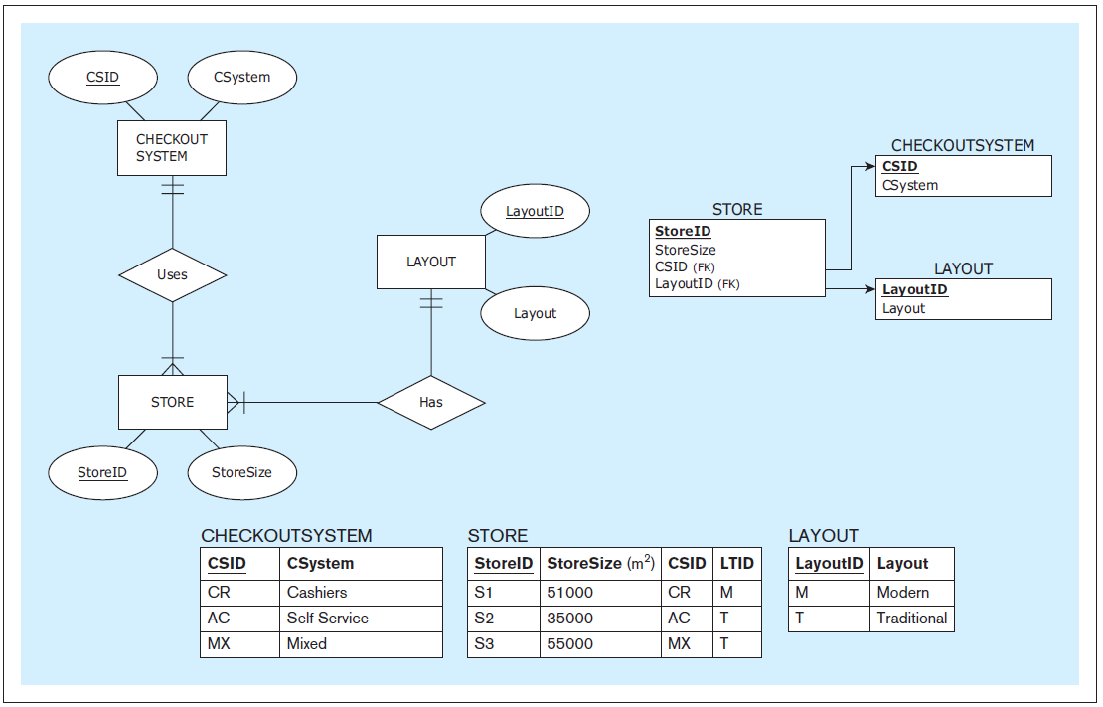
Expanded Example: Dimensional Model Based on Multiple Sources
ZAGI Retail Company Facilities Department Database (Source 2)
Jukić, Vrbsky, Nestorov – Database Systems
Chapter 8 – Slide <number>
Notes:
This example is discussed on Pages 231-234.

Slide 20
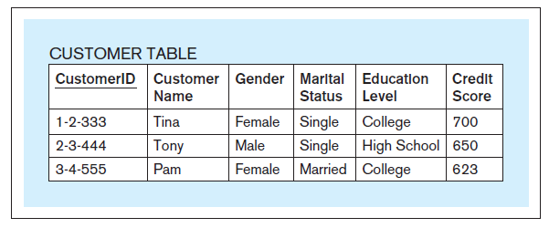
Expanded Example: Dimensional Model Based on Multiple Sources
Customer Demographic Data Table - external source acquired from a market research company (Source 3)
Jukić, Vrbsky, Nestorov – Database Systems
Chapter 8 – Slide <number>
Notes:
This example is discussed on Pages 231-234.

Slide 21
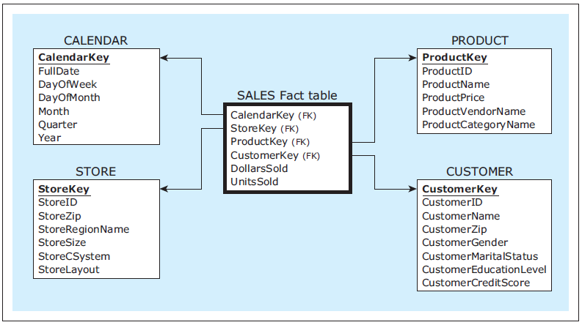
Expanded Example: Dimensional Model Based on Multiple Sources
ZAGI Retail Company dimensional model for the subject sales
Jukić, Vrbsky, Nestorov – Database Systems
Chapter 8 – Slide <number>
Notes:
This example is discussed on Pages 231-234.

Slide 22
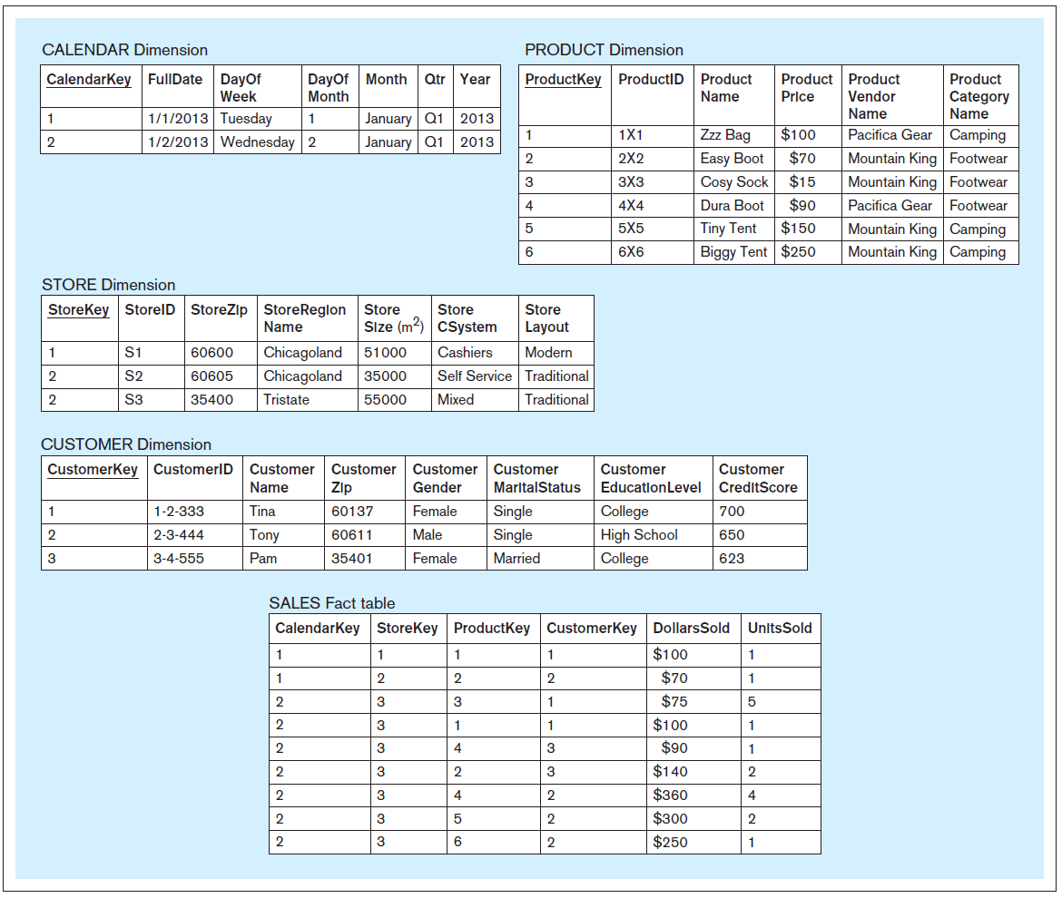
Expanded Example: Dimensional Model Based on Multiple Sources
ZAGI Retail
Company
dimensional
model for the
subject sales ,
populated with
the data from
the three
sources
Jukić, Vrbsky, Nestorov – Database Systems
Chapter 8 – Slide <number>
Notes:
This example is discussed on Pages 231-234.

Slide 23
Expanded Example: Dimensional Model Based on Multiple Sources
Example query
Query B: Compare the quantities of sold products to male customers in Modern stores on Saturdays in the category Camping provided by the vendor Pacifica Gear within the Tristate region between the 1st and 2nd quarter of the year 2013.
Jukić, Vrbsky, Nestorov – Database Systems
Chapter 8 – Slide <number>
Notes:
This example is discussed on Pages 231-234.

Slide 24
Example query - Query B, dimensional version
SELECT SUM(SA.UnitsSold)
‚ P.ProductCategoryName
‚ P.ProductVendorName
‚ C.DayofWeek
‚ C.Qtr
FROM
Calendar C
‚ Store S
‚ Product P
, Customer CU
‚ Sales SA
WHERE
C.CalendarKey = SA.CalendarKey
AND S.StoreKey = SA.StoreKey
AND P.ProductKey = SA.ProductKey
AND CU.CustomerKey = SA.CustomerKey
AND P.ProductVendorName = 'Pacifica Gear'
AND P.ProductCategoryName = 'Camping'
AND S.StoreRegionName = 'Tristate'
AND C.DayofWeek = 'Saturday'
AND C.Year = 2013
AND C.Qtr IN ( 'Q1', 'Q2' )
AND S.StoreLayout = 'Modern'
AND CU.Gender = 'Male'
GROUP BY
P.ProductCategoryName,
P.ProductVendorName,
C.DayofWeek,
C.Qtr;
Jukić, Vrbsky, Nestorov – Database Systems
Chapter 8 – Slide <number>
Notes:
This example is discussed on Pages 231-234.

Slide 25
DIMENSIONAL MODELING
Additional possible fact attributes
  A fact table contains
    Foreign keys connecting the fact table to the dimension tables
    The measures related to the subject of analysis
  In addition to the measures related to the subject of analysis, in certain cases fact tables can contain other attributes that are not measures
  Two of the most typical additional attributes that can appear in the fact table are:
    Transaction identifier
    Transaction time
Jukić, Vrbsky, Nestorov – Database Systems
Chapter 8 – Slide <number>

Slide 26
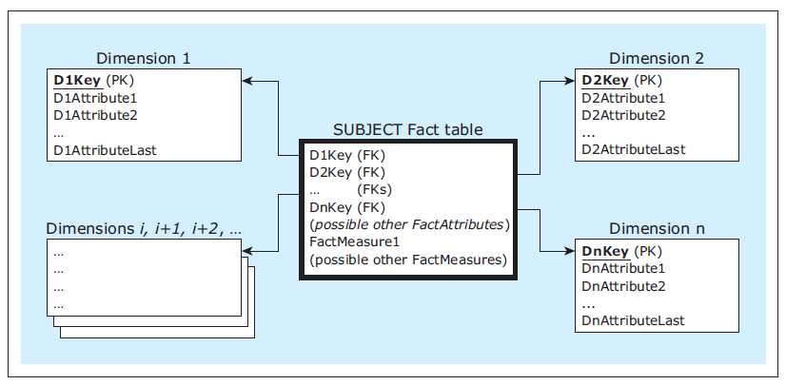
DIMENSIONAL MODELING
Additional possible fact attributes
Jukić, Vrbsky, Nestorov – Database Systems
Chapter 8 – Slide <number>

Slide 27
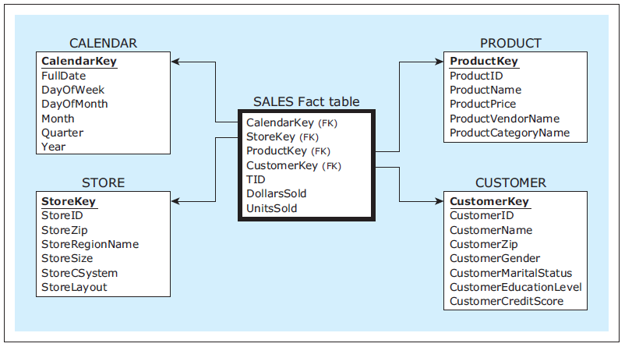
Expanded Example: Dimensional Model Based on Multiple Sources
ZAGI Retail Company dimensional model for the subject sales with transaction identifier included
Jukić, Vrbsky, Nestorov – Database Systems
Chapter 8 – Slide <number>
Notes:
This example is discussed on Pages 235-237.

Slide 28
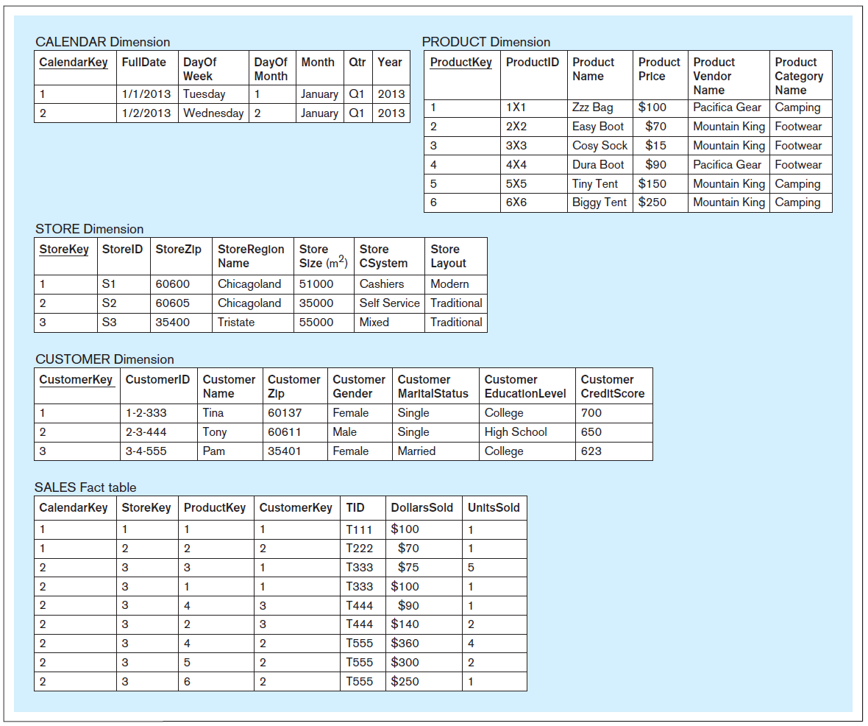
Expanded Example: Dimensional Model Based on Multiple Sources
ZAGI Retail
Company
dimensional
model for the
subject sales,
populated with
the data,
including the
transaction
identifier
values
Jukić, Vrbsky, Nestorov – Database Systems
Chapter 8 – Slide <number>
Notes:
This example is discussed on Pages 235-237.

Slide 29
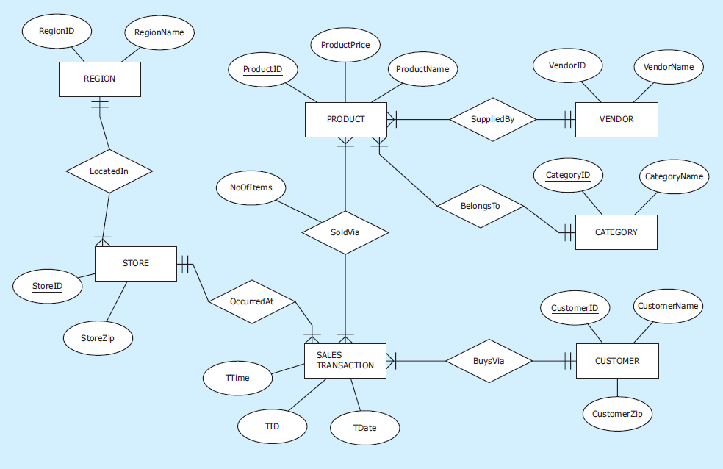
Expanded Example: Dimensional Model Based on Multiple Sources
ER diagram : ZAGI Retail Company Sales Department Database (Source 1) with the time attribute included
Jukić, Vrbsky, Nestorov – Database Systems
Chapter 8 – Slide <number>
Notes:
This example is discussed on Pages 237-239.

Slide 30
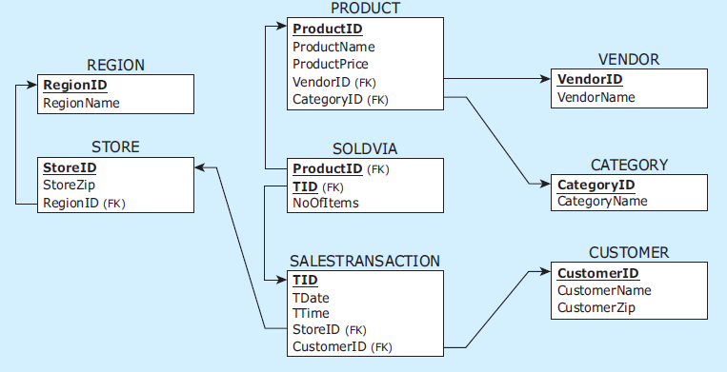
Expanded Example: Dimensional Model Based on Multiple Sources
Relational schema : ZAGI Retail Company Sales Department Database (Source 1) with the time column included
Jukić, Vrbsky, Nestorov – Database Systems
Chapter 8 – Slide <number>
Notes:
This example is discussed on Pages 237-239.

Slide 31
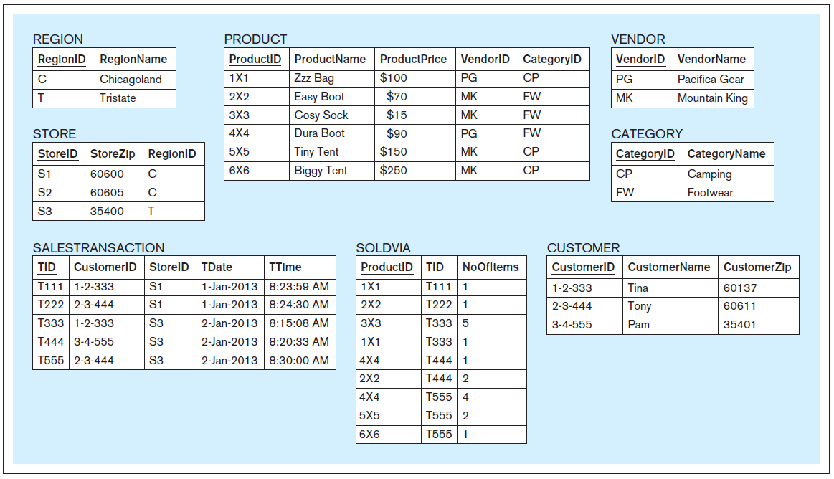
Expanded Example: Dimensional Model Based on Multiple Sources
Data records: ZAGI Retail Company Sales Department Database (Source 1) with time data included
Jukić, Vrbsky, Nestorov – Database Systems
Chapter 8 – Slide <number>
Notes:
This example is discussed on Pages 237-239.

Slide 32
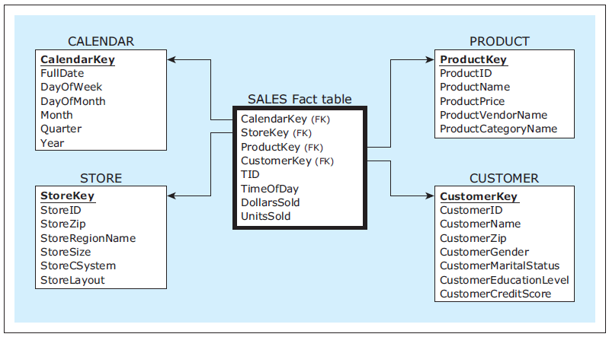
Expanded Example: Dimensional Model Based on Multiple Sources
ZAGI Retail Company dimensional model for the subject sales with time included
Jukić, Vrbsky, Nestorov – Database Systems
Chapter 8 – Slide <number>
Notes:
This example is discussed on Pages 237-239.

Slide 33
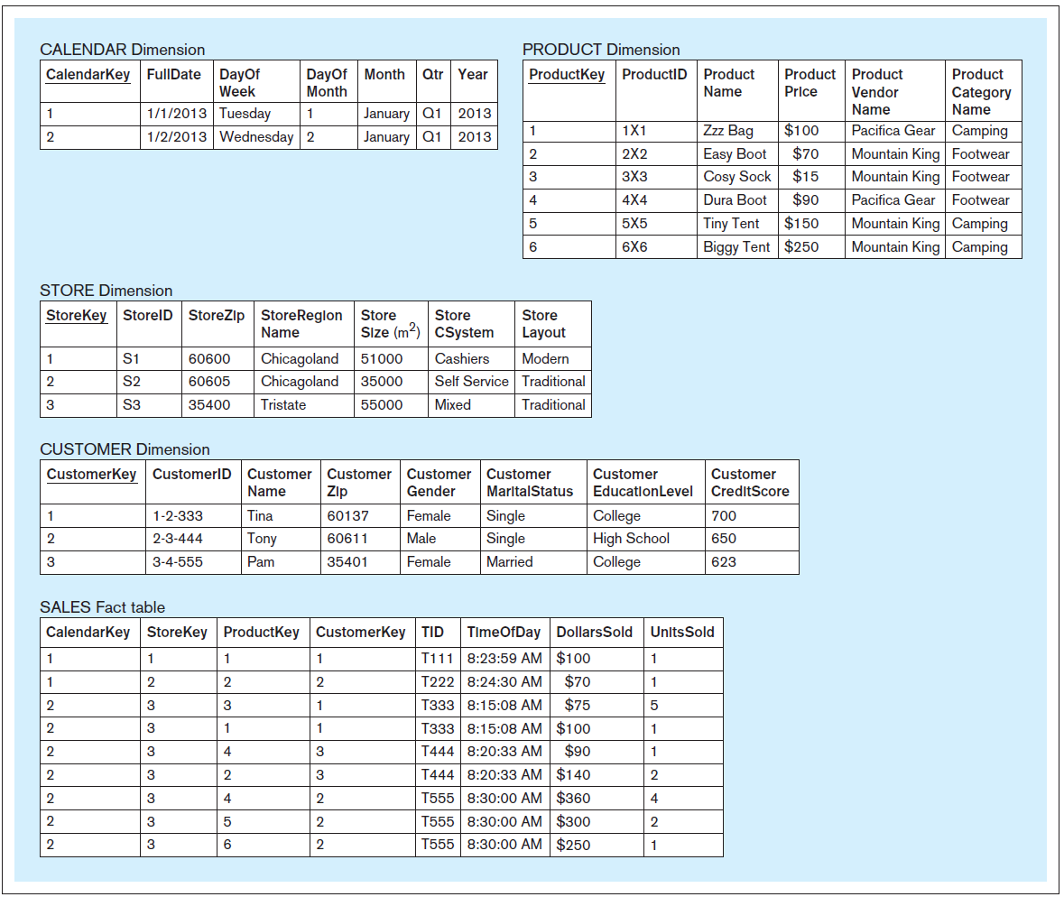
Expanded Example: Dimensional Model Based on Multiple Sources
ZAGI Retail
Company
dimensional
model for the
subject sales,
populated with
the data,
including the
time values
Jukić, Vrbsky, Nestorov – Database Systems
Chapter 8 – Slide <number>
Notes:
This example is discussed on Pages 237-239.

Slide 34
DIMENSIONAL MODELING
Multiple facts in a dimensional model
  When multiple subjects of analysis can share the same dimensions, a dimensional model contains more than one fact table
  A dimensional model with multiple fact tables is referred to as a constellation or galaxy of stars
  This approach enables:
    Quicker development of analytical databases for multiple subjects of analysis, because dimensions are re-used instead of duplicated
    Straightforward cross-fact analysis
Jukić, Vrbsky, Nestorov – Database Systems
Chapter 8 – Slide <number>

Slide 35
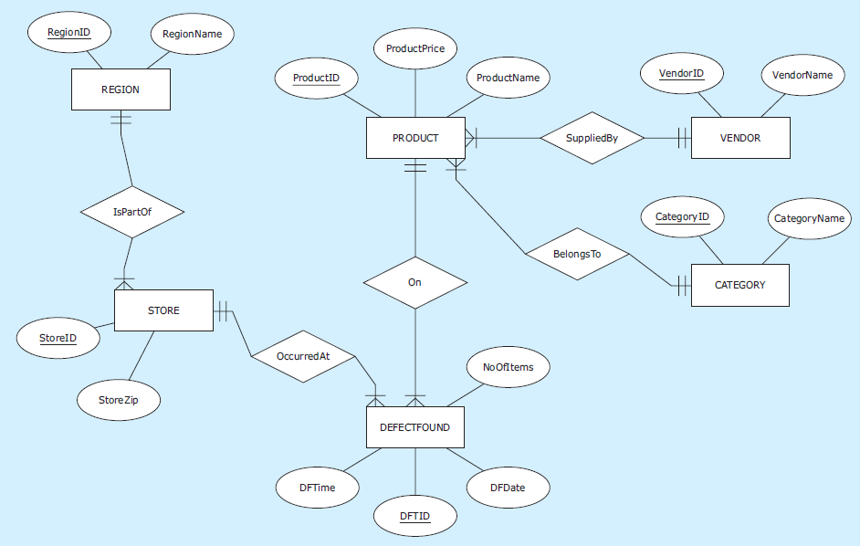
Expanded Example: Dimensional Model Based on Multiple Sources
ER diagram : ZAGI Retail Company Quality Control Database (Source 4)
Jukić, Vrbsky, Nestorov – Database Systems
Chapter 8 – Slide <number>
Notes:
This example is discussed on Pages 240-242.

Slide 36
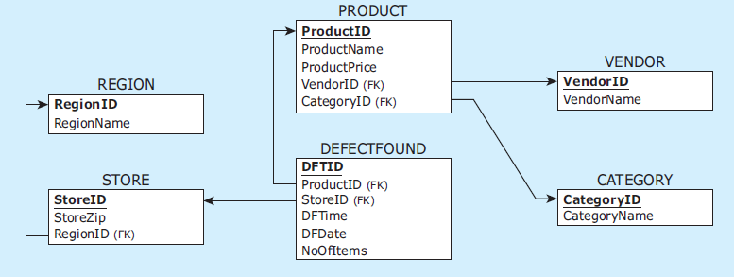
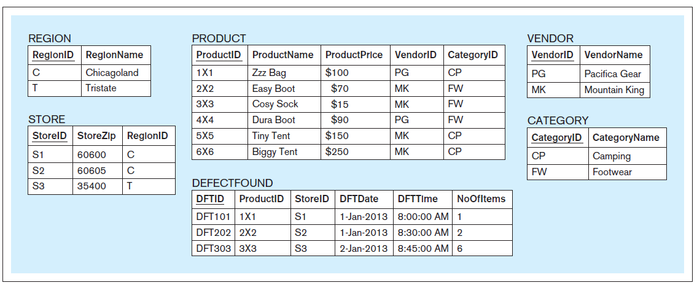
Expanded Example: Dimensional Model Based on Multiple Sources
Relational schema and data records: ZAGI Retail Company Quality Control Database
(Source 4)
Jukić, Vrbsky, Nestorov – Database Systems
Chapter 8 – Slide <number>
Notes:
This example is discussed on Pages 240-242.

Slide 37
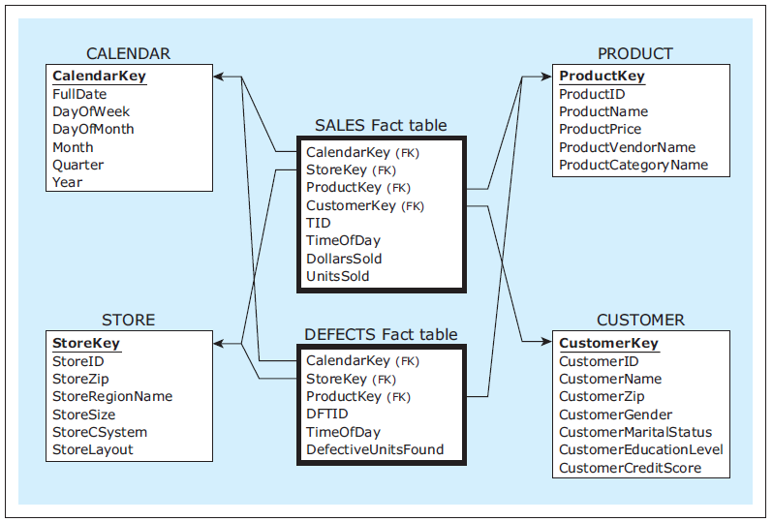
Expanded Example: Dimensional Model Based on Multiple Sources
ZAGI Retail Company dimensional model for the subjects sales and defects
Jukić, Vrbsky, Nestorov – Database Systems
Chapter 8 – Slide <number>
Notes:
This example is discussed on Pages 240-242.

Slide 38
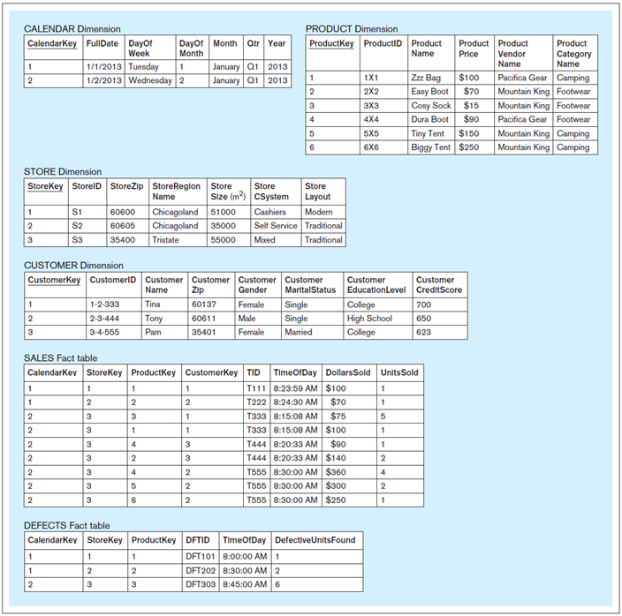
Expanded Example:
Dimensional Model
Based on Multiple
Sources
ZAGI Retail Company
dimensional model for
the subjects sales and
defects , populated
with the data from the
four sources
Jukić, Vrbsky, Nestorov – Database Systems
Chapter 8 – Slide <number>
Notes:
This example is discussed on Pages 240-242.

Slide 39
DIMENSIONAL MODELING
Detailed versus aggregated fact tables
  Fact tables in a dimensional model can contain either detailed data or aggregated data
  In detailed fact tables each record refers to a single fact
  In aggregated fact tables each record summarizes multiple facts
Jukić, Vrbsky, Nestorov – Database Systems
Chapter 8 – Slide <number>

Slide 40
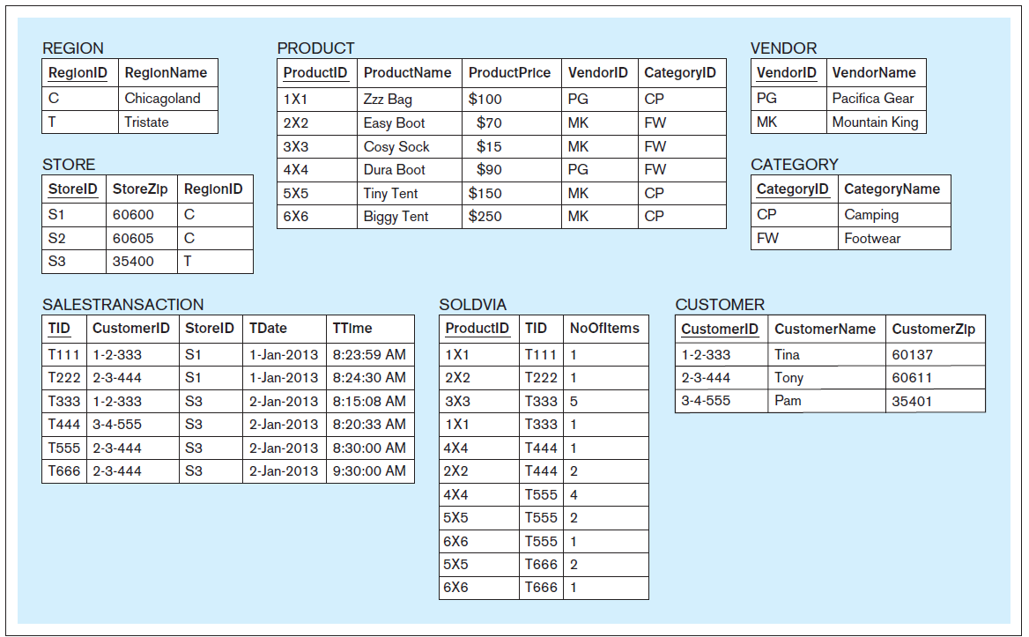
Detailed and Aggregated Fact Table Examples
ZAGI Retail Company Sales Department Database (Source 1) with additional data records included in SALESTRANSACTION and SOLDVIA tables
Jukić, Vrbsky, Nestorov – Database Systems
Chapter 8 – Slide <number>
Notes:
This example is discussed on Pages 243-248.

Slide 41
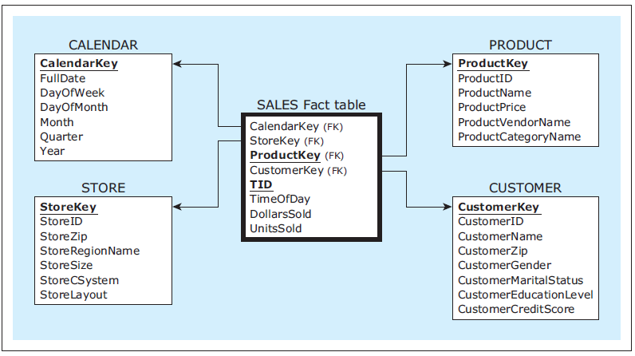
Detailed Fact Table Example
ZAGI Retail Company dimensional model for the subject sales
Jukić, Vrbsky, Nestorov – Database Systems
Chapter 8 – Slide <number>
Notes:
This example is discussed on Pages 243-248.

Slide 42
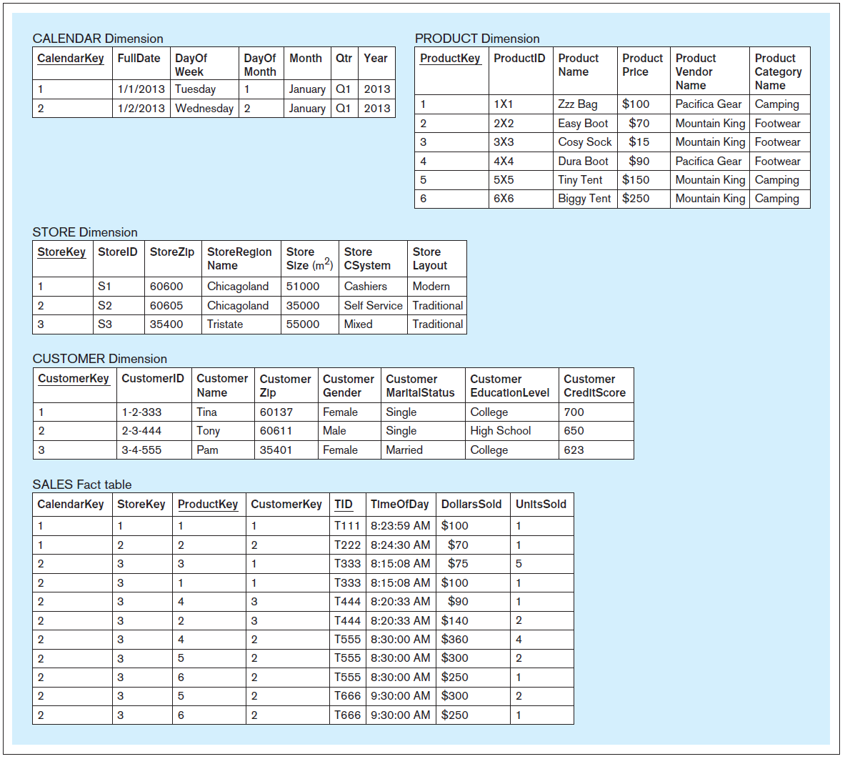
Detailed Fact Table Example
ZAGI Retail
Company
dimensional
model for the
subject sales,
populated with
the additional
data records
from Source 1
Jukić, Vrbsky, Nestorov – Database Systems
Chapter 8 – Slide <number>
Notes:
This example is discussed on Pages 243-248.

Slide 43
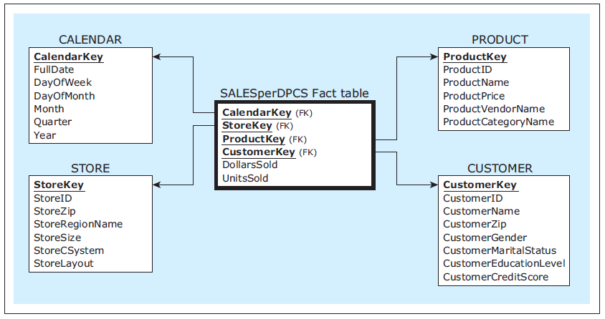
Aggregated Fact Table Example 1
ZAGI Retail Company dimensional model with an aggregated fact table Sales per day, product, customer, and store
Jukić, Vrbsky, Nestorov – Database Systems
Chapter 8 – Slide <number>
Notes:
This example is discussed on Pages 243-248.

Slide 44
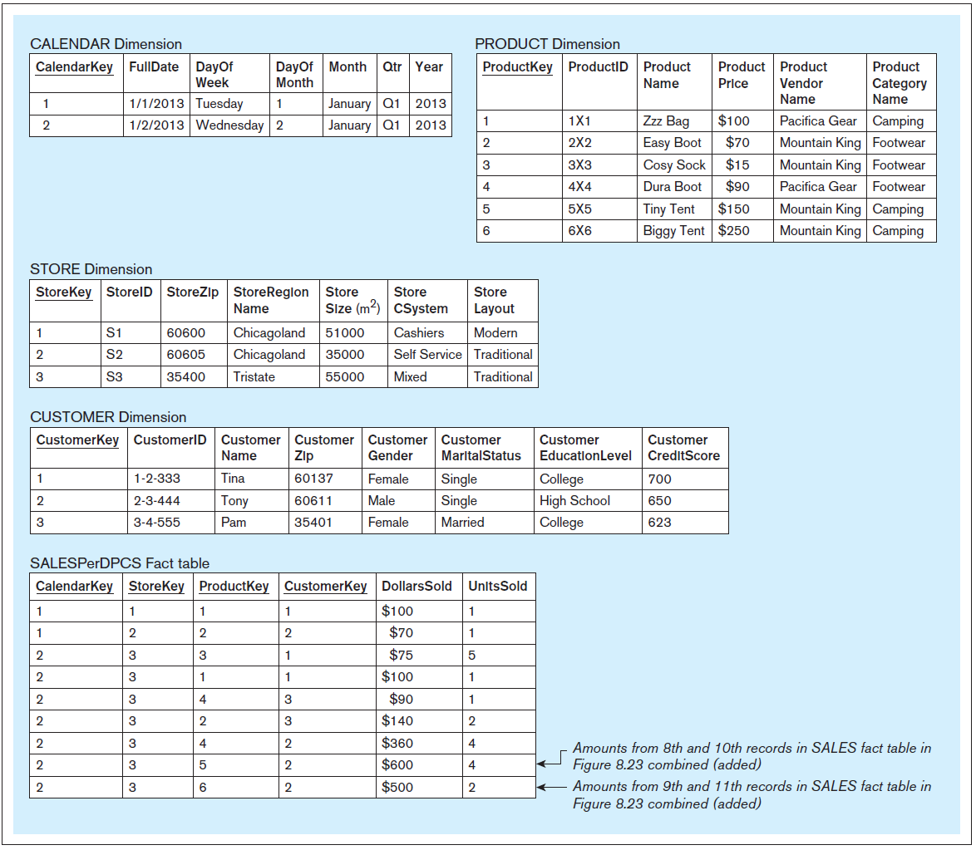
Aggregated
Fact Table
Example 1
ZAGI Retail
Company
dimensional
model for the
subject sales
with an
aggregated fact
table
Sales per
day,
product,
customer,
store,
populated with
the data
Jukić, Vrbsky, Nestorov – Database Systems
Chapter 8 – Slide <number>
Notes:
This example is discussed on Pages 243-248.

Slide 45
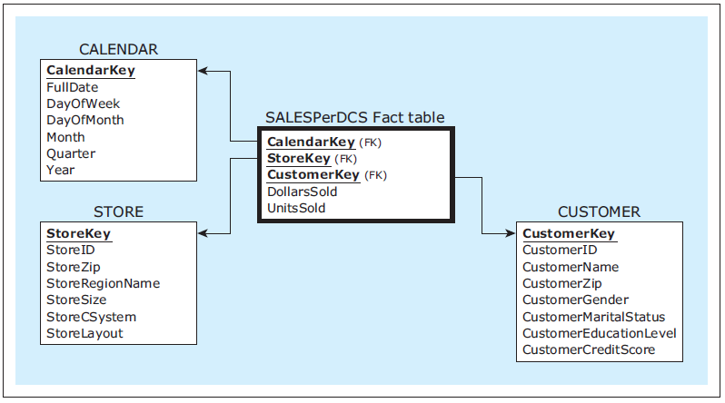
Aggregated Fact Table Example 2
ZAGI Retail Company star schema with an aggregated fact table Sales per day, customer, and store
Jukić, Vrbsky, Nestorov – Database Systems
Chapter 8 – Slide <number>
Notes:
This example is discussed on Pages 243-248.

Slide 46
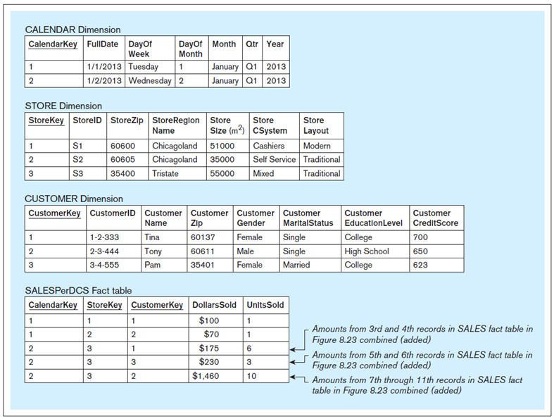
Aggregated
Fact Table
Example 2
ZAGI Retail
Company
dimensional
model for the
subject sales
with an
aggregated fact
table
Sales per
day,
customer,
store,
populated with
the data
Jukić, Vrbsky, Nestorov – Database Systems
Chapter 8 – Slide <number>
Notes:
This example is discussed on Pages 243-248.

Slide 47
DIMENSIONAL MODELING
Granularity of the fact tables
  Granularity describes what is depicted by one row in the fact table
  Detailed fact tables have fine level of granularity because each record represents a single fact
  Aggregated fact tables have a coarser level of granularity than detailed fact tables as records in aggregated fact tables always represent summarizations of multiple facts
Jukić, Vrbsky, Nestorov – Database Systems
Chapter 8 – Slide <number>
Notes:
SALES Per DPCS fact table has a coarser level of granularity than the SALES fact tables because records in the SALES Per DPCS fact table summarize records from the SALES fact table. SALES Per DCS fact table has an even coarser level of granularity, because its records summarize records from the SALES Per DPCS fact tables.

Slide 48
DIMENSIONAL MODELING
Granularity of the fact tables
  Due to their compactness, coarser granularity aggregated fact tables are quicker to query than detailed fact tables
  Coarser granularity tables are limited in terms of what information can be retrieved from them
  One way to take advantage of the query performance improvement provided by aggregated fact tables, while retaining the power of analysis of detailed fact tables, is to have both types of tables coexisting within the same dimensional model, i.e. in the same constellation
Jukić, Vrbsky, Nestorov – Database Systems
Chapter 8 – Slide <number>
Notes:
Aggregation is requirement-specific while a detailed granularity provides unlimited possibility for analysis.
You can always obtain an aggregation from the finest grain, but the reverse is not true.

Slide 49
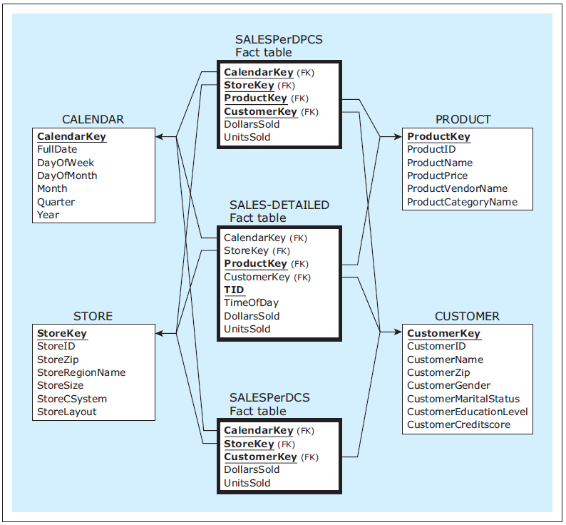
A constellation of detailed and aggregated facts - Example
Jukić, Vrbsky, Nestorov – Database Systems
Chapter 8 – Slide <number>
Notes:
This example is discussed on Pages 243-248.

Slide 50
DIMENSIONAL MODELING
Line-item versus transaction-level detailed fact table
  Line-item detailed fact table
    Each row represents a line item of a particular transaction
  Transaction-level detailed fact table
    Each row represents a particular transaction
Jukić, Vrbsky, Nestorov – Database Systems
Chapter 8 – Slide <number>

Slide 51
Line-Item Detailed Fact Table Example
Jukić, Vrbsky, Nestorov – Database Systems
Chapter 8 – Slide <number>
Notes:
This example is discussed on Page 249.

Slide 52
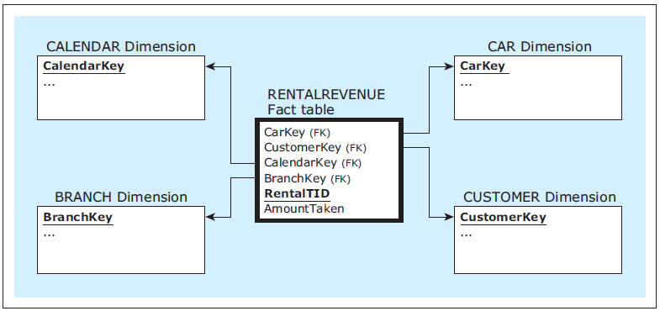
Transaction-Level Detailed Fact Table Example
Jukić, Vrbsky, Nestorov – Database Systems
Chapter 8 – Slide <number>
Notes:
This example is discussed on Pages 249-250.

Slide 53
DIMENSIONAL MODELING
Slowly Changing Dimension
  Typical dimension in a star schema contains:
    Attributes whose values do not change (or change extremely rarely) such as store size and customer gender
    Attributes whose values change occasionally and sporadically over time, such as customer zip and employee salary.
  Dimension that contains attributes whose values can change referred to as a slowly changing dimension
  Most common approaches to dealing with slowly changing dimensions
    Type 1
    Type 2
    Type 3
Jukić, Vrbsky, Nestorov – Database Systems
Chapter 8 – Slide <number>

Slide 54
DIMENSIONAL MODELING
Type 1
  Changes the value in the dimension’s record
    The new value replaces the old value.
  No history is preserved
  The simplest approach, used most often when a change in a dimension is the result of an error
Jukić, Vrbsky, Nestorov – Database Systems
Chapter 8 – Slide <number>

Slide 55
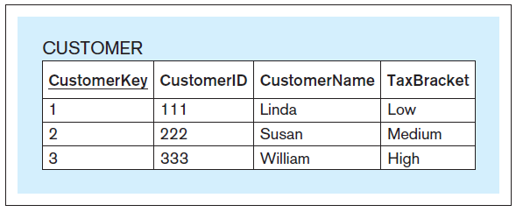
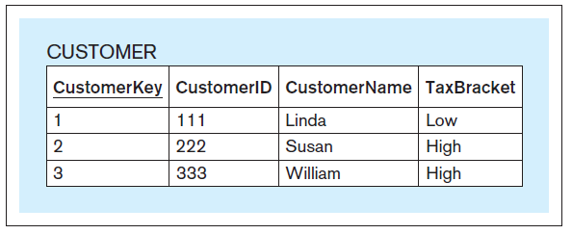
Type 1 Example
Susan's Tax Bracket attribute value changes from Medium to High
Jukić, Vrbsky, Nestorov – Database Systems
Chapter 8 – Slide <number>
Notes:
This example is discussed on Pages 250-251.

Slide 56
DIMENSIONAL MODELING
Type 2
  Creates a new additional dimension record using a new value for the surrogate key every time a value in a dimension record changes
  Used in cases where history should be preserved
  Can be combined with the use of timestamps and row indicators
    Timestamps - columns that indicates the time interval for which the values in the records are applicable
    Row indicator - column that provides a quick indicator of whether the record is currently valid
Jukić, Vrbsky, Nestorov – Database Systems
Chapter 8 – Slide <number>

Slide 57
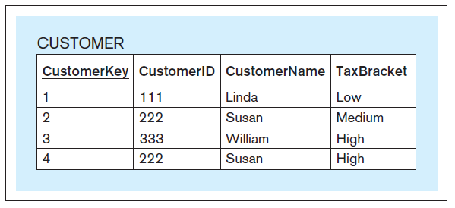
Type 2 Example
Susan's Tax Bracket attribute value changes from Medium to High
Jukić, Vrbsky, Nestorov – Database Systems
Chapter 8 – Slide <number>
Notes:
This example is discussed on Pages 251-252.

Slide 58
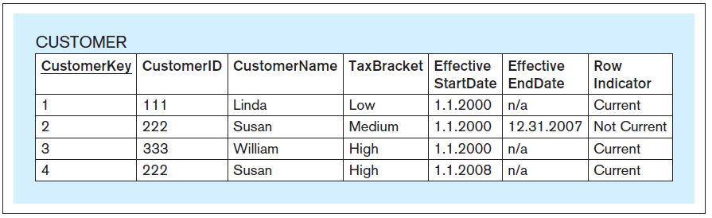
Type 2 Example (with timestamps and row indicator)
Susan's Tax Bracket attribute value changes from Medium to High
Jukić, Vrbsky, Nestorov – Database Systems
Chapter 8 – Slide <number>
Notes:
This example is discussed on Page 252.

Slide 59
DIMENSIONAL MODELING
Type 3
  Involves creating a “previous” and “current” column in the dimension table for each column where changes are anticipated
  Applicable in cases in which there is a fixed number of changes possible per column of a dimension, or in cases when only a limited history is recorded.
  Can be combined with the use of timestamps
Jukić, Vrbsky, Nestorov – Database Systems
Chapter 8 – Slide <number>

Slide 60
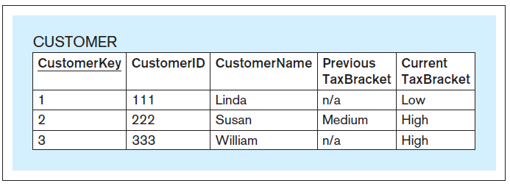
Type 3 Example
Susan's Tax Bracket attribute value changes from Medium to High
Jukić, Vrbsky, Nestorov – Database Systems
Chapter 8 – Slide <number>
Notes:
This example is discussed on Page 253.

Slide 61
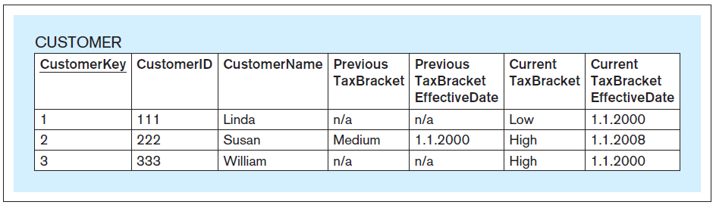
Type 3 Example (with timestamps)
Susan's Tax Bracket attribute value changes from Medium to High
Jukić, Vrbsky, Nestorov – Database Systems
Chapter 8 – Slide <number>
Notes:
This example is discussed on Page 253.

Slide 62
DIMENSIONAL MODELING
Snowflake model
  A star schema that contains the dimensions that are normalized
  Snowflaking is usually not used in dimensional modeling
    Not-normalized (not snowflaked) dimensions provide for simpler analysis
    Normalization is usually not necessary for analytical databases
Jukić, Vrbsky, Nestorov – Database Systems
Chapter 8 – Slide <number>
Notes:
Analytical databases are typically read only. Hence, no danger of update anomalies.

Slide 63
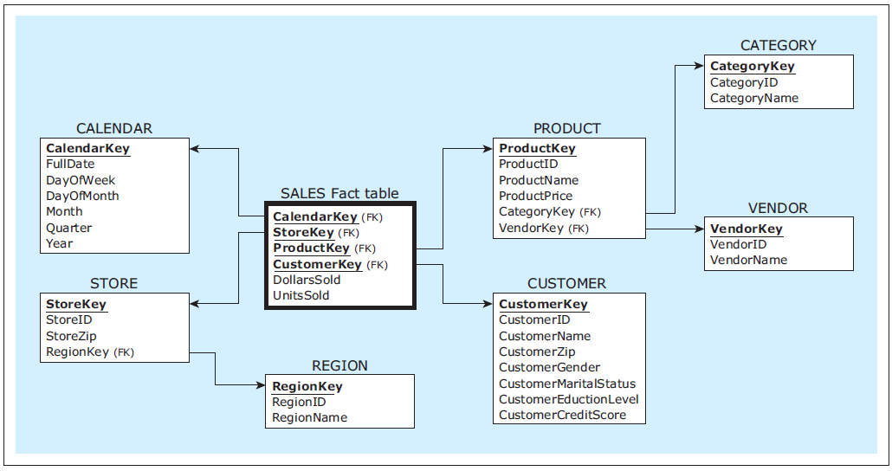
Snowflake Model - Example
A snowflaked version of the ZAGI Retail Company star schema for the subject sales
Jukić, Vrbsky, Nestorov – Database Systems
Chapter 8 – Slide <number>
Notes:
This example is discussed on Page 254.

Slide 64
DATA WAREHOUSE (DATA MART) MODELING APPROACHES
Data warehouse/data mart modeling approaches
  Three of the most common data warehouse and data mart modeling approaches:
    Normalized data warehouse
    Dimensionally modeled data warehouse
    Independent data marts
Jukić, Vrbsky, Nestorov – Database Systems
Chapter 8 – Slide <number>

Slide 65
DATA WAREHOUSE (DATA MART) MODELING APPROACHES
Normalized data warehouse
  Envisions a data warehouse as an integrated analytical database modeled by using the traditional database modeling techniques of ER modeling and relational modeling, resulting in a normalized relational database schema
  Populated with the analytically useful data from the operational data sources via the ETL process
  Serves as a source of data for dimensionally modeled data marts and for any other non-dimensional analytically useful data sets
Jukić, Vrbsky, Nestorov – Database Systems
Chapter 8 – Slide <number>
Notes:
Data warehouse as a normalized integrated analytical database was first proposed by Bill Inmon, and hence, the normalized data warehouse approach is often referred to as the Inmon approach.

Slide 66
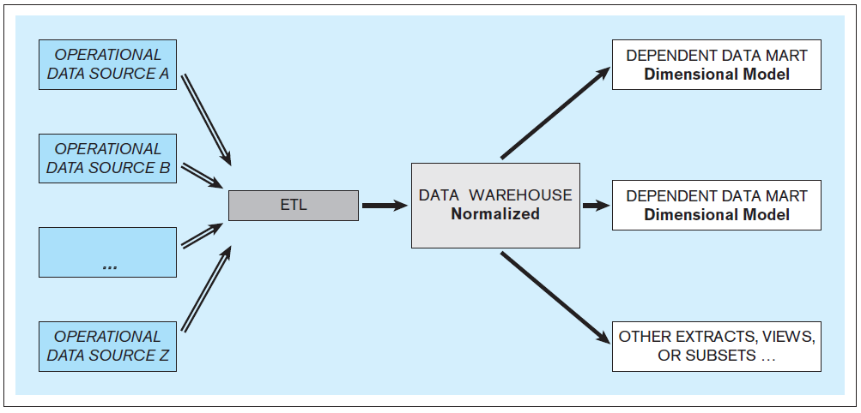
DATA WAREHOUSE (DATA MART) MODELING APPROACHES
Normalized data warehouse
Jukić, Vrbsky, Nestorov – Database Systems
Chapter 8 – Slide <number>

Slide 67
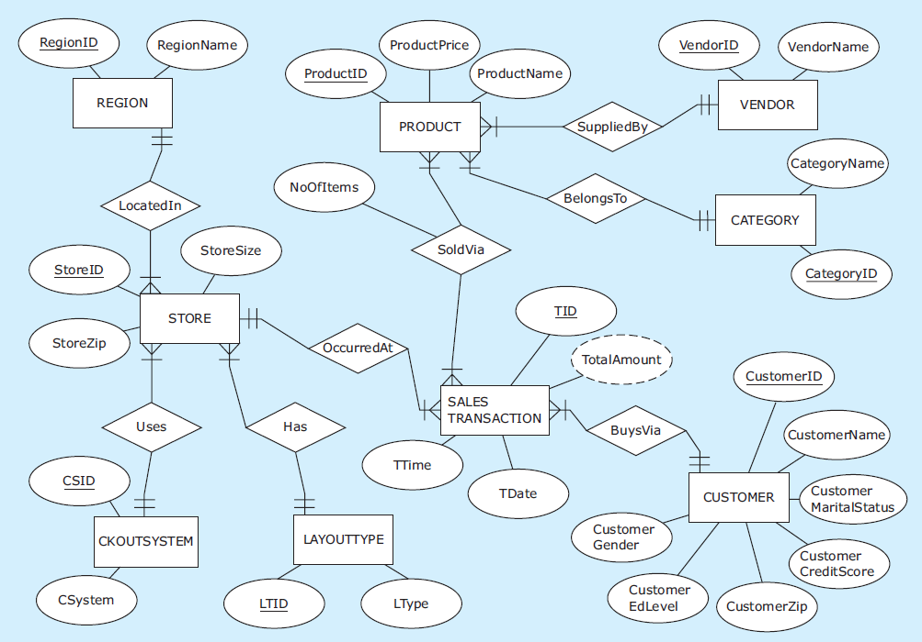
Normalized Data Warehouse - Example
ER-diagram: ZAGI Retail Company sales-analysis data warehouse
Jukić, Vrbsky, Nestorov – Database Systems
Chapter 8 – Slide <number>
Notes:
This example is discussed on Pages 256-259.

Slide 68
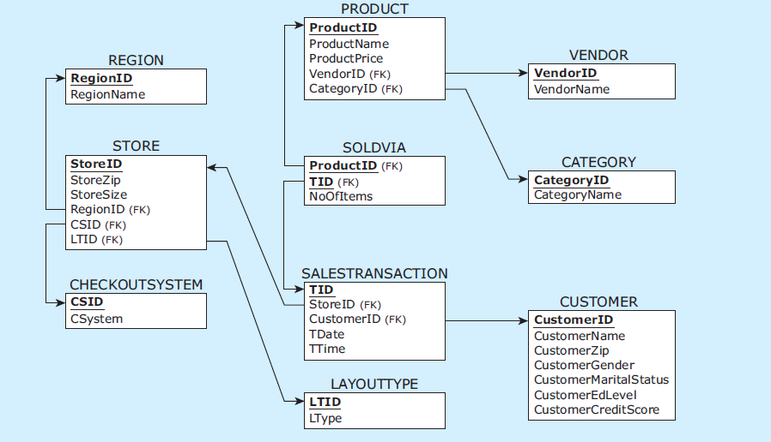
Normalized Data Warehouse - Example
Relational schema: ZAGI Retail Company sales-analysis data warehouse
Jukić, Vrbsky, Nestorov – Database Systems
Chapter 8 – Slide <number>
Notes:
This example is discussed on Pages 256-259.

Slide 69
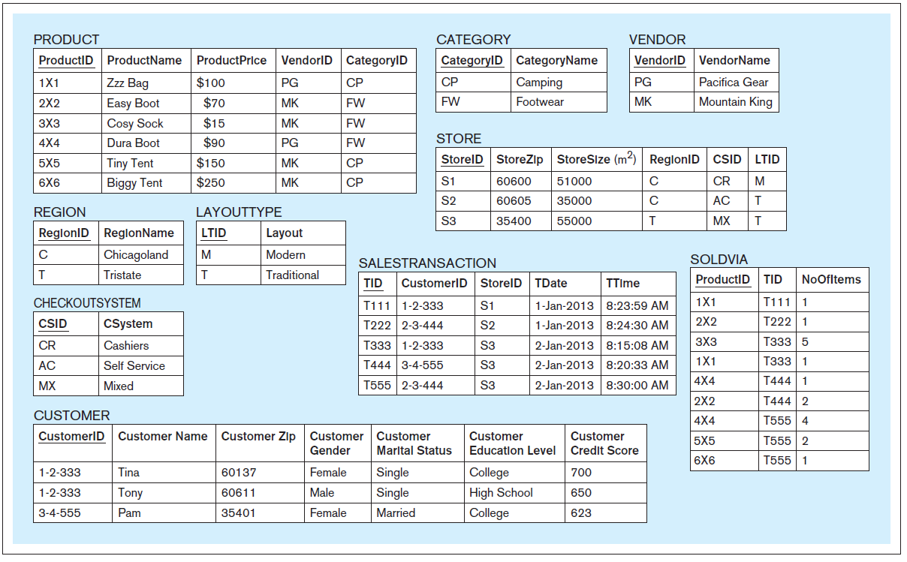
Normalized Data Warehouse - Example
Data records: ZAGI Retail Company sales-analysis data warehouse
Jukić, Vrbsky, Nestorov – Database Systems
Chapter 8 – Slide <number>
Notes:
This example is discussed on Pages 256-259.

Slide 70
DATA WAREHOUSE (DATA MART) MODELING APPROACHES
Dimensionally modeled data warehouse
  Data warehouse as a collection of dimensionally modeled intertwined data marts (i.e. constellation of dimensional models) that integrates analytically useful information from the operational data sources
  Same as the normalized data warehouse approach when it comes to the utilization of operational data sources and the ETL process
Jukić, Vrbsky, Nestorov – Database Systems
Chapter 8 – Slide <number>
Notes:
Dimensionally modeled data warehouse approach was championed by Ralph Kimball, and hence, it is often referred to as the Kimball approach.

Slide 71
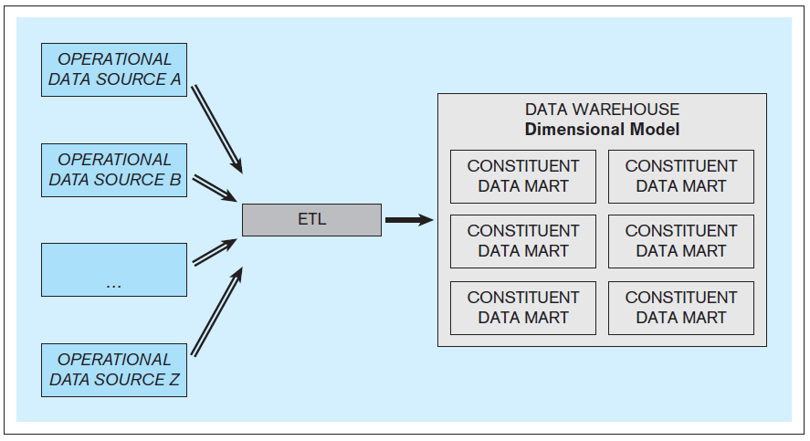
DATA WAREHOUSE (DATA MART) MODELING APPROACHES
Dimensionally modeled data warehouse
Jukić, Vrbsky, Nestorov – Database Systems
Chapter 8 – Slide <number>

Slide 72
DATA WAREHOUSE (DATA MART) MODELING APPROACHES
Dimensionally modeled data warehouse
  A set of commonly used dimensions known as conformed dimensions is designed first
  Fact tables corresponding to the subjects of analysis are then subsequently added
  A set of dimensional models is created where each fact table is connected to multiple dimensions, and some of the dimensions are shared by more than one fact table
  In addition to the originally created set of conformed dimensions, additional dimensions are included as needed
  The result is a data warehouse that is a collection of intertwined dimensionally modeled data marts, i.e. a constellation of stars
Jukić, Vrbsky, Nestorov – Database Systems
Chapter 8 – Slide <number>
Notes:
For example, in a retail company, conformed dimensions CALENDAR, PRODUCT, STORE can be designed first, as they will be commonly used by subjects of analysis.

Slide 73
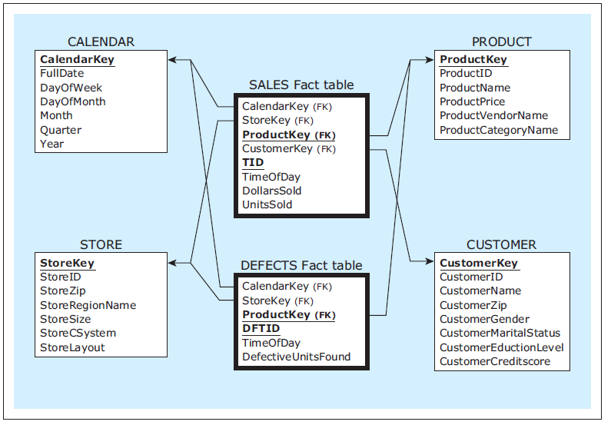
DATA WAREHOUSE (DATA MART) MODELING APPROACHES
A dimensionally modeled data warehouse with two constituent data marts using conformed dimensions
Jukić, Vrbsky, Nestorov – Database Systems
Chapter 8 – Slide <number>

Slide 74
DATA WAREHOUSE (DATA MART) MODELING APPROACHES
Dimensionally modeled data warehouse
  Can be used as a source for dependent data marts and other views, subsets, and/or extracts
Jukić, Vrbsky, Nestorov – Database Systems
Chapter 8 – Slide <number>

Slide 75
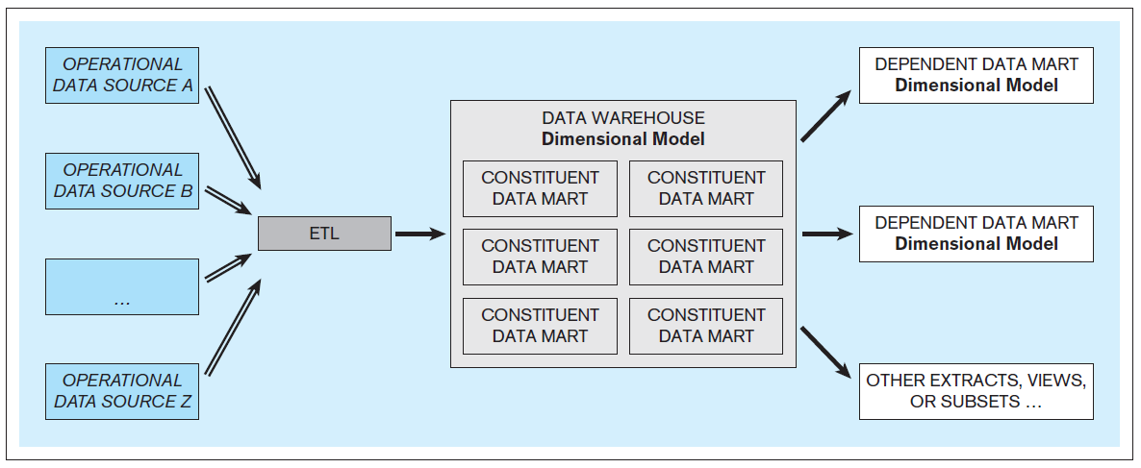
DATA WAREHOUSE (DATA MART) MODELING APPROACHES
Dimensionally modeled data warehouse
Jukić, Vrbsky, Nestorov – Database Systems
Chapter 8 – Slide <number>

Slide 76
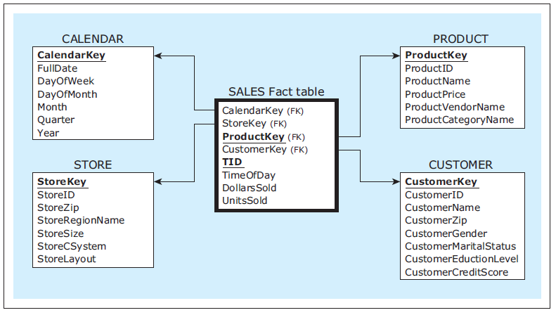
Dimensionally Modeled Data Warehouse - Example
Star schema: ZAGI Retail Company sales-analysis data warehouse
Jukić, Vrbsky, Nestorov – Database Systems
Chapter 8 – Slide <number>
Notes:
This example is discussed on Pages 260-262.

Slide 77
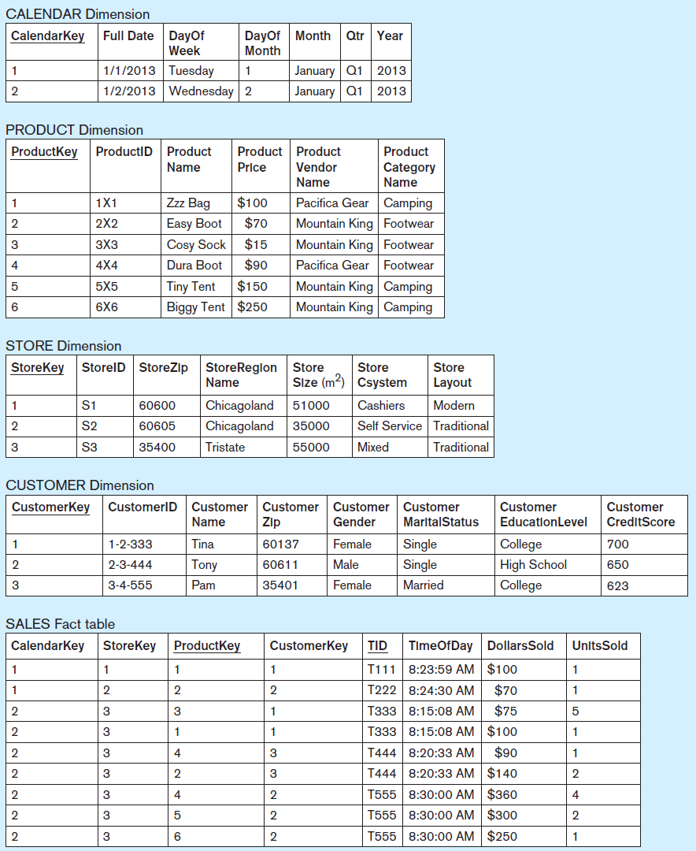
Dimensionally Modeled
Data Warehouse - Example
Data records:
ZAGI Retail Company sales-
analysis data warehouse
Jukić, Vrbsky, Nestorov – Database Systems
Chapter 8 – Slide <number>
Notes:
This example is discussed on Pages 260-262.

Slide 78
DATA WAREHOUSE (DATA MART) MODELING APPROACHES
Independent data marts
  Stand-alone data marts are created by various groups within the organization, independent of other stand-alone data marts in the organization
  Consequently, multiple ETL systems are created and maintained
Jukić, Vrbsky, Nestorov – Database Systems
Chapter 8 – Slide <number>

Slide 79
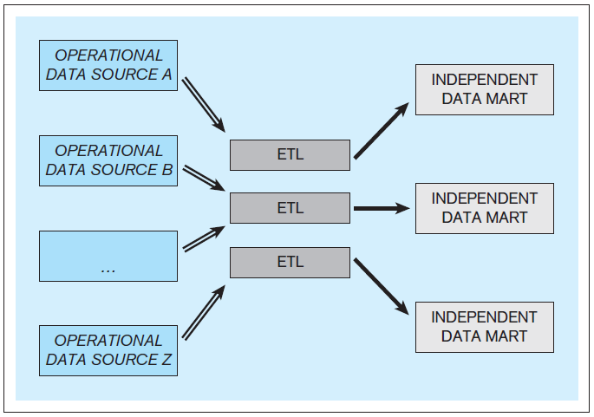
DATA WAREHOUSE (DATA MART) MODELING APPROACHES
Independent data marts
Jukić, Vrbsky, Nestorov – Database Systems
Chapter 8 – Slide <number>

Slide 80
DATA WAREHOUSE (DATA MART) MODELING APPROACHES
Independent data marts
  Independent data marts are considered an inferior strategy
    Inability for straightforward analysis across the enterprise
    The existence of multiple unrelated ETL infrastructures
  In spite of obvious disadvantages, a significant number of corporate analytical data stores are developed as a collection of independent data marts
Jukić, Vrbsky, Nestorov – Database Systems
Chapter 8 – Slide <number>
Notes:
This strategy does not result in a data warehouse, but in a collection of unrelated independent data marts. While the independent data marts within one organization may end up as a whole, containing all the necessary analytical information, such information is scattered and difficult or even impossible to analyze as one unit. A discussion on why a significant number of corporate analytical data stores are developed as a collection of independent data marts is given on Pages 263-264.

Slide 81
DATA WAREHOUSE (DATA MART) MODELING APPROACHES
Comparing dimensional modeling and ER modeling as data warehouse/data mart design techniques
  ER modeling can be used as a conceptual data warehouse/data mart design technique, followed by relational modeling as logical data warehouse/data mart design technique
  Dimensional modeling can be used both of conceptual data warehouse/data mart design and logical data warehouse/data mart design
Jukić, Vrbsky, Nestorov – Database Systems
Chapter 8 – Slide <number>

Slide 82
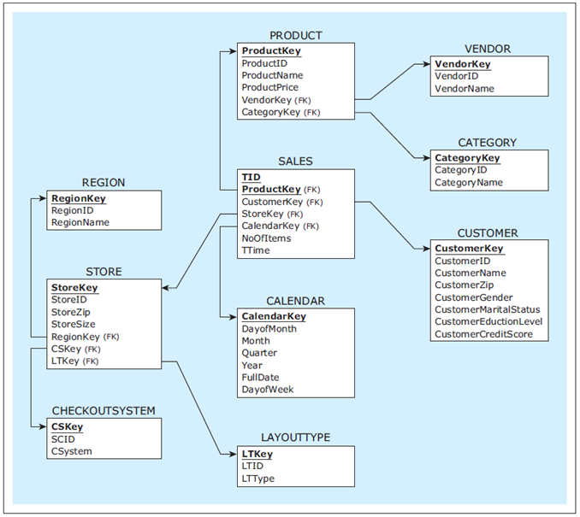
Example - A modified normalized data warehouse schema
Jukić, Vrbsky, Nestorov – Database Systems
Chapter 8 – Slide <number>
Notes:
This example is discussed on Pages 264-265.

Slide 83
DATA WAREHOUSE (DATA MART) MODELING APPROACHES
Comparing dimensional modeling and ER modeling as data warehouse/data mart design techniques
  Both ER modeling and dimensional modeling are viable alternatives for modeling data warehouses/data marts, and can be used within the same project
Jukić, Vrbsky, Nestorov – Database Systems
Chapter 8 – Slide <number>
Notes:
For example, dimensional modeling can be used during the requirements collection process for collecting, refining, and visualizing initial requirements. Based on the resulting requirements visualized as a collection of facts and dimensions, an ER model for a normalized physical data warehouse can be created if there is a preference for a normalized data warehouse. Once a normalized data warehouse is created, a series of dependent data marts can be created using dimensional modeling.

