Slide 1

Database Systems -
Introduction to Databases and Data Warehouses

Slide 2
CREATING A DATA WAREHOUSE
Creating a data warehouse
  Involves using the functionalities of database management software to implement the data warehouse model as a collection of physically created and mutually connected database tables
  Most often, data warehouses are modeled as relational databases
    Consequently, they are implemented using a relational DBMS
Jukić, Vrbsky, Nestorov – Database Systems
Chapter 9 – Slide <number>

Slide 3
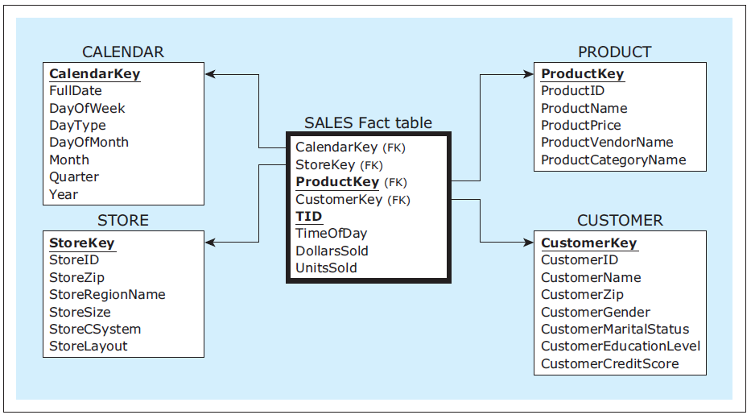
Creating a data warehouse - Example
A data warehouse model
Jukić, Vrbsky, Nestorov – Database Systems
Chapter 9 – Slide <number>
Notes:
This example is discussed on Pages 273-274.

Slide 4
Creating a data warehouse - Example
CREATE TABLE statements
CREATE TABLE calendar
( calendarkey INT,
fulldate DATE,
dayofweek CHAR(15),
daytype CHAR(20),
dayofmonth INT,
month CHAR(10),
quarter CHAR(2),
year INT,
PRIMARY KEY (calendarkey));
CREATE TABLE store
( storekey INT,
storeid CHAR(5),
storezip CHAR(5),
storeregionname CHAR(15),
storesize INT,
storecsystem CHAR(15),
storelayout CHAR(15),
PRIMARY KEY (storekey));
Jukić, Vrbsky, Nestorov – Database Systems
Chapter 9 – Slide <number>
Notes:
This example is discussed on Pages 273-274.

Slide 5
Creating a data warehouse - Example
CREATE TABLE statements
CREATE TABLE product
( productkey INT,
productid CHAR(5),
productname CHAR(25),
productprice NUMBER(7,2),
productvendorname CHAR(25),
productcategoryname CHAR(25),
PRIMARY KEY (productkey));
CREATE TABLE customer
( customerkey INT,
customerid CHAR(7),
customername CHAR(15),
customerzip CHAR(5),
customergender CHAR(15),
customermaritalstatus CHAR(15),
customereducationlevel CHAR(15),
customercreditscore INT,
PRIMARY KEY (customerkey));
Jukić, Vrbsky, Nestorov – Database Systems
Chapter 9 – Slide <number>
Notes:
This example is discussed on Pages 273-274.

Slide 6
Creating a data warehouse - Example
CREATE TABLE statements
CREATE TABLE sales
( calendarkey INT,
storekey INT,
productkey INT,
customerkey INT,
tid CHAR(15),
timeofday TIME,
dollarssold NUMBER(10,2),
unitssold INT,
PRIMARY KEY (productkey, tid),
FOREIGN KEY (calendarkey) REFERENCES calendar,
FOREIGN KEY (storekey) REFERENCES store,
FOREIGN KEY (productkey) REFERENCES product,
FOREIGN KEY (customerkey) REFERENCES customer);
Jukić, Vrbsky, Nestorov – Database Systems
Chapter 9 – Slide <number>
Notes:
This example is discussed on Pages 273-274.

Slide 7
ETL
Extraction - the retrieval of analytically useful data from the operational data sources that will eventually be loaded into the data warehouse
  The data to be extracted is data that is analytically useful in the data warehouse
  What to extract is determined within the requirements and modeling stages
    Requirements and modeling stages of the data warehouse include the examination of the available sources
    During the process of creation of the ETL infrastructure the data model provides a blueprint for the extraction procedures
Jukić, Vrbsky, Nestorov – Database Systems
Chapter 9 – Slide <number>
Notes:
It is possible that, in the process of creating the ETL infrastructure, the data warehouse development team may realize that certain ETL actions should be done differently from what is prescribed by the given data model. In such cases the project will move iteratively back from the creation of ETL infrastructure to the requirement stage.

Slide 8
ETL
Transformation - transforming the structure of extracted data in order to fit the structure of the target data warehouse model
  E.g. adding surrogate keys
Jukić, Vrbsky, Nestorov – Database Systems
Chapter 9 – Slide <number>

Slide 9
ETL
Transformation
  The data quality control and improvement are included in the transformation process
    Commonly, some of the data in the data sources exhibit data quality problems
    Data sources often contain overlapping information
  Data cleansing (scrubbing) - the detection and correction of low-quality data
Jukić, Vrbsky, Nestorov – Database Systems
Chapter 9 – Slide <number>

Slide 10
ETL
Load - loading the extracted, transformed, and quality assured data into the target data warehouse
  A batch process that inserts the data into the data warehouse tables in an automatic fashion without user involvement
Jukić, Vrbsky, Nestorov – Database Systems
Chapter 9 – Slide <number>

Slide 11
ETL
Load
  The initial load (first load), populates initially empty data warehouse tables
    It can involve large amounts of data, depending on what is the desired time horizon of the data in the newly initiated data warehouse
  Every subsequent load is referred to as a refresh load
  Refresh cycle is the period in which the data warehouse is reloaded with the new data (e.g. hourly, daily)
    Determined in advance, based on the analytical needs of the business users of the data warehouse and the technical feasibility of the system
  In active data warehouses the loads occur in micro batches that occur continuously
Jukić, Vrbsky, Nestorov – Database Systems
Chapter 9 – Slide <number>

Slide 12
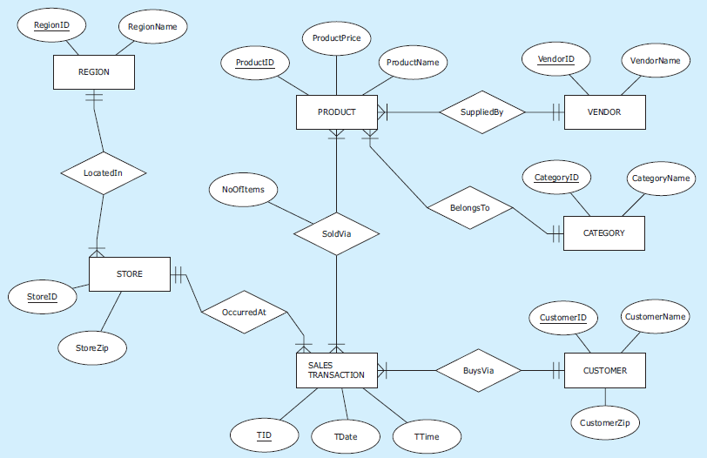
ETL - Example
Source 1 – ER diagram
Jukić, Vrbsky, Nestorov – Database Systems
Chapter 9 – Slide <number>
Notes:
This example is discussed on Pages 275-280.

Slide 13
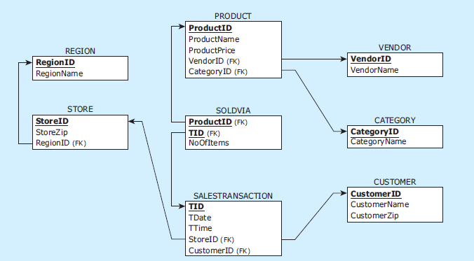
ETL - Example
Source 1 – Relational schema
Jukić, Vrbsky, Nestorov – Database Systems
Chapter 9 – Slide <number>
Notes:
This example is discussed on Pages 275-280.

Slide 14
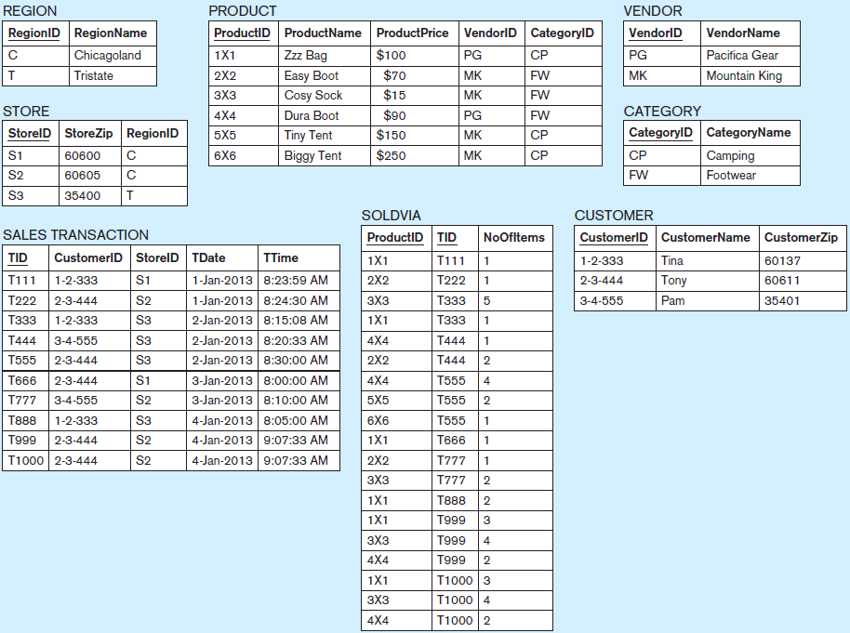
ETL - Example Source 1 – Data records
Jukić, Vrbsky, Nestorov – Database Systems
Chapter 9 – Slide <number>
Notes:
This example is discussed on Pages 275-280.

Slide 15
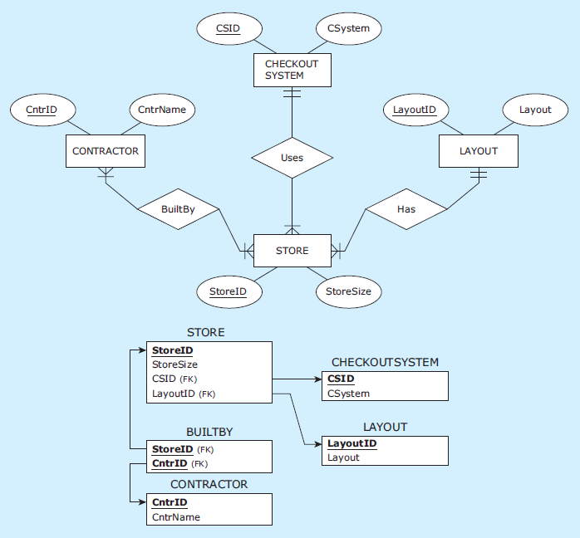
ETL - Example
Source 2 – ER diagram and relational schema
Jukić, Vrbsky, Nestorov – Database Systems
Chapter 9 – Slide <number>
Notes:
This example is discussed on Pages 275-280.

Slide 16
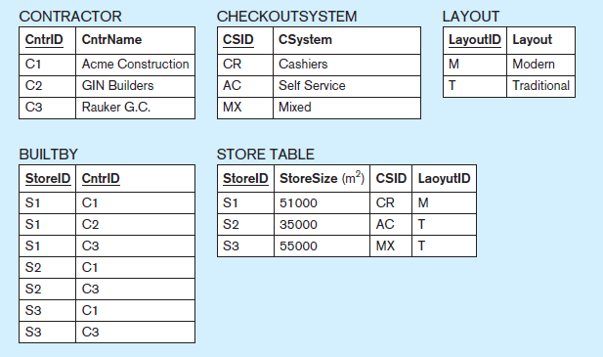
ETL - Example
Source 2 – data records
Jukić, Vrbsky, Nestorov – Database Systems
Chapter 9 – Slide <number>
Notes:
This example is discussed on Pages 275-280.

Slide 17
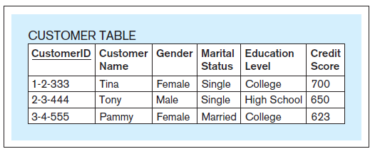
ETL - Example
Source 3
Jukić, Vrbsky, Nestorov – Database Systems
Chapter 9 – Slide <number>
Notes:
This example is discussed on Pages 275-280.

Slide 18
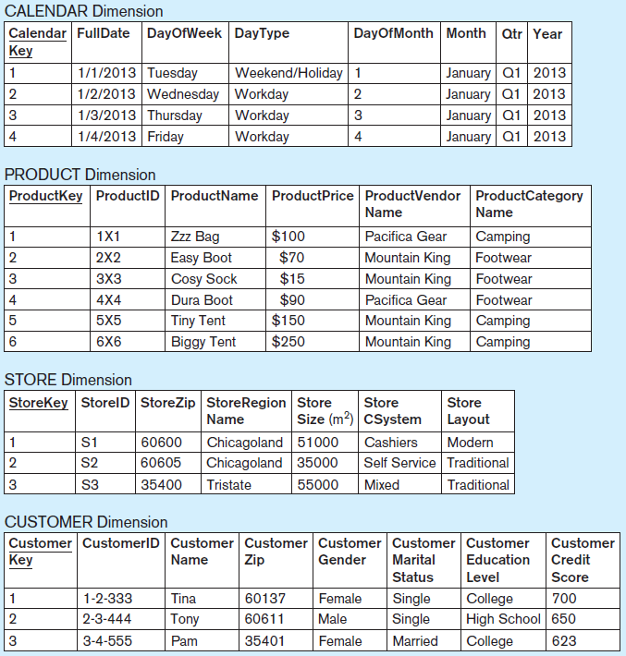
ETL - Example
Data warehouse populated with the data from Sources 1, 2, and 3
Jukić, Vrbsky, Nestorov – Database Systems
Chapter 9 – Slide <number>
Notes:
This example is discussed on Pages 275-280.

Slide 19
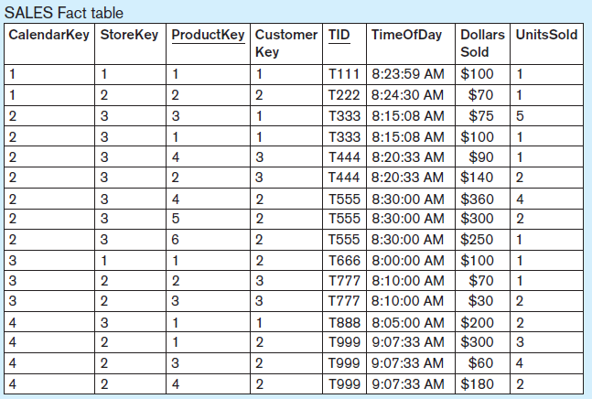
ETL - Example
Data warehouse populated with the data from Sources 1, 2, and 3
Jukić, Vrbsky, Nestorov – Database Systems
Chapter 9 – Slide <number>
Notes:
This example is discussed on Pages 275-280.

Slide 20
ETL
ETL Infrastructure
  Typically, the process of creating the ETL infrastructure includes using specialized ETL software tools and/or writing code
  Due to the amount of detail that has to be considered, creating ETL infrastructure is often the most time and resource consuming part in the data warehouse development process
  Although labor intensive, the process of creating the ETL infrastructure is essentially predetermined by the results of the requirements collection and data warehouse modeling processes which specify the sources and the target
Jukić, Vrbsky, Nestorov – Database Systems
Chapter 9 – Slide <number>

Slide 21
OLAP
Online transaction processing (OLTP) - updating (i.e. inserting, modifying and deleting), querying and presenting data from databases for operational purposes
Online analytical processing (OLAP) - querying and presenting data from data warehouses and/or data marts for analytical purposes
Jukić, Vrbsky, Nestorov – Database Systems
Chapter 9 – Slide <number>

Slide 22
OLAP
OLAP/BI Tools
  Designed for analysis of dimensionally modeled data
  Regardless of which data warehousing approach is chosen, the data that is accessible by the end user is typically structured as a dimensional model
    OLAP/BI tools can be used on analytical data stores created with different modeling approaches
Jukić, Vrbsky, Nestorov – Database Systems
Chapter 9 – Slide <number>

Slide 23
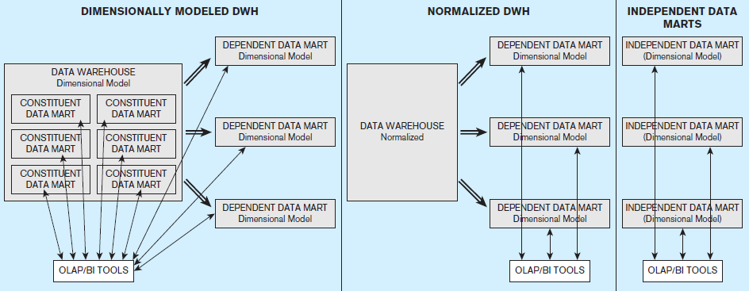
OLAP/BI tools as an interface to data warehouses modeled using different approaches
Jukić, Vrbsky, Nestorov – Database Systems
Chapter 9 – Slide <number>
Notes:
This example is discussed on Pages 275-280.

Slide 24
OLAP
OLAP/BI Tools
  Allow users to query fact and dimension tables by using simple point-and-click query-building applications
  Based on the point-and-click actions by the user of the OLAP/BI tool, the tool writes and executes the code in the language of the data management system (e.g. SQL) that hosts the data warehouse or data mart that is being queried
Jukić, Vrbsky, Nestorov – Database Systems
Chapter 9 – Slide <number>

Slide 25
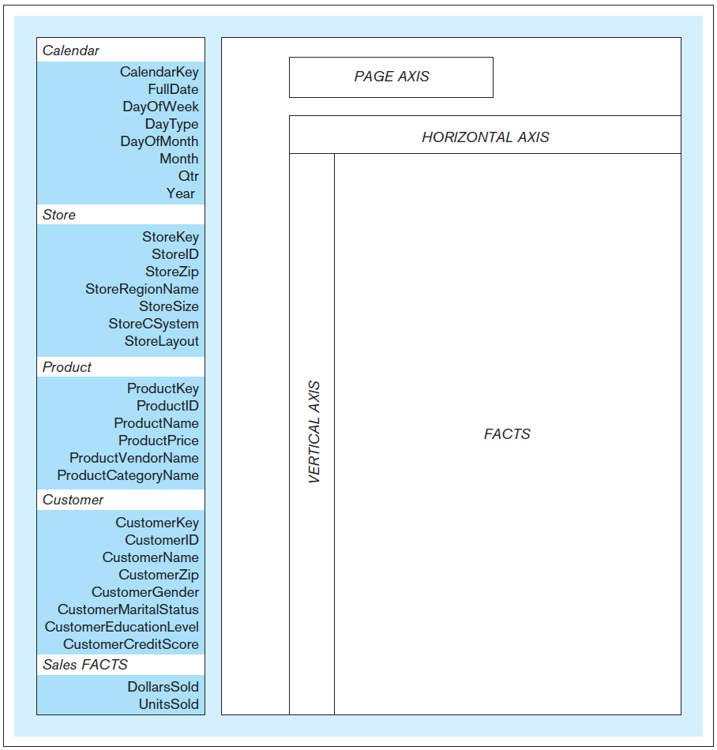
A typical OLAP/BI tool query construction space
Jukić, Vrbsky, Nestorov – Database Systems
Chapter 9 – Slide <number>
Notes:
This example is discussed on Pages 282-283.

Slide 26
OLAP Query 1 - Text
OLAP Query 1: For each individual store, show separately for male and female shoppers the number of product units sold for each product category
Jukić, Vrbsky, Nestorov – Database Systems
Chapter 9 – Slide <number>
Notes:
This example is discussed on Pages 282-283.

Slide 27
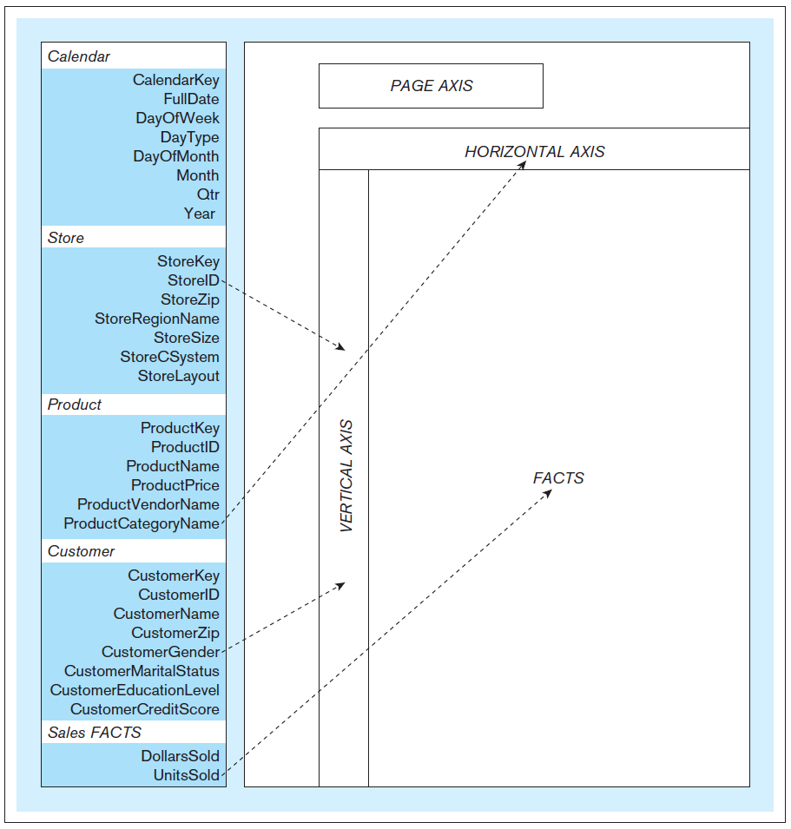
OLAP Query 1 - OLAP/BI tool query construction actions
Jukić, Vrbsky, Nestorov – Database Systems
Chapter 9 – Slide <number>
Notes:
This example is discussed on Pages 282-283.

Slide 28
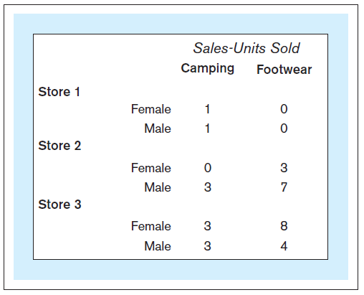
OLAP Query 1 - Result
Jukić, Vrbsky, Nestorov – Database Systems
Chapter 9 – Slide <number>
Notes:
This example is discussed on Pages 282-283.

Slide 29
OLAP
OLAP/BI Tools
  Basic OLAP/BI tool features:
    Slice and Dice
    Pivot (Rotate)
    Drill Down / Drill Up
Jukić, Vrbsky, Nestorov – Database Systems
Chapter 9 – Slide <number>

Slide 30
OLAP
Slice and Dice
  Adds, replaces, or eliminates specified dimension attributes (or particular values of the dimension attributes) from the already displayed result
Jukić, Vrbsky, Nestorov – Database Systems
Chapter 9 – Slide <number>

Slide 31
Slice and Dice – Example (Query 1 starting point)
OLAP Query 1 - Result
Jukić, Vrbsky, Nestorov – Database Systems
Chapter 9 – Slide <number>
Notes:
This example is discussed on Pages 283-285.

Slide 32
Slice and Dice - Example
OLAP Query 2 - Text
OLAP Query 2: For stores 1 and 2, show separately for male and female shoppers the number of product units sold for each product category
Jukić, Vrbsky, Nestorov – Database Systems
Chapter 9 – Slide <number>
Notes:
This example is discussed on Pages 283-285.

Slide 33
Slice and Dice - Example (Query 1 starting point)
OLAP Query 1 - Result
Jukić, Vrbsky, Nestorov – Database Systems
Chapter 9 – Slide <number>
Notes:
This example is discussed on Pages 283-285.

Slide 34
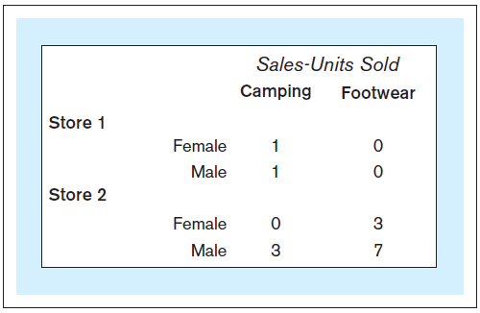
Slice and Dice - Example
OLAP Query 2 - Result
Jukić, Vrbsky, Nestorov – Database Systems
Chapter 9 – Slide <number>
Notes:
This example is discussed on Pages 283-285.

Slide 35
Slice and Dice – Another Example
OLAP Query 3 - Text
OLAP Query 3: For each individual store, show separately for male and female shoppers the number of product units sold on workdays and on weekends/holidays
Jukić, Vrbsky, Nestorov – Database Systems
Chapter 9 – Slide <number>
Notes:
This example is discussed on Pages 283-285.

Slide 36
Slice and Dice – Another Example (Query 1 starting point)
OLAP Query 1 - Result
Jukić, Vrbsky, Nestorov – Database Systems
Chapter 9 – Slide <number>
Notes:
This example is discussed on Pages 283-285.

Slide 37
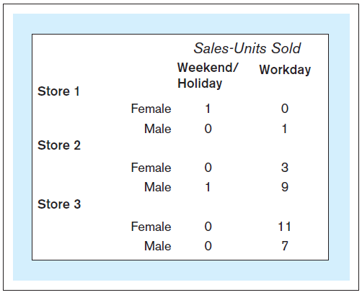
Slice and Dice – Another Example
OLAP Query 3 - Result
Jukić, Vrbsky, Nestorov – Database Systems
Chapter 9 – Slide <number>
Notes:
This example is discussed on Pages 283-285.

Slide 38
OLAP
Pivot (Rotate)
  Reorganizes the values displayed in the original query result by moving values of a dimension column from one axis to another
Jukić, Vrbsky, Nestorov – Database Systems
Chapter 9 – Slide <number>

Slide 39
Pivot – Example
OLAP Query 1 - Result
Jukić, Vrbsky, Nestorov – Database Systems
Chapter 9 – Slide <number>
Notes:
This example is discussed on Pages 285-286.

Slide 40
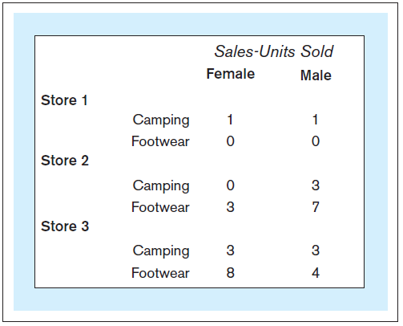
Pivot – Example
OLAP Query 1 – Result pivoted
Jukić, Vrbsky, Nestorov – Database Systems
Chapter 9 – Slide <number>
Notes:
This example is discussed on Pages 285-286.

Slide 41
OLAP
Drill Down
  Makes the granularity of the data in the query result finer
Drill Up
  Makes the granularity of the data in the query result coarser
Jukić, Vrbsky, Nestorov – Database Systems
Chapter 9 – Slide <number>

Slide 42
OLAP
Drill hierarchy
  Set of attributes within a dimension where an attribute is related to one or more attributes at a lower level but only related to one item at a higher level
    For example: StoreRegionName → StoreZip → StoreID
  Used for drill down/drill up operations
Jukić, Vrbsky, Nestorov – Database Systems
Chapter 9 – Slide <number>

Slide 43
Drill Down – Example
OLAP Query 4 - Text
OLAP Query 4: For each individual store, show separately for male and female shoppers the number of product units sold for each individual product in each category.
Jukić, Vrbsky, Nestorov – Database Systems
Chapter 9 – Slide <number>
Notes:
This example is discussed on Pages 286-287.

Slide 44
Drill Down – Example (Query 1 starting point)
OLAP Query 1 - Result
Jukić, Vrbsky, Nestorov – Database Systems
Chapter 9 – Slide <number>
Notes:
This example is discussed on Pages 286-287.

Slide 45
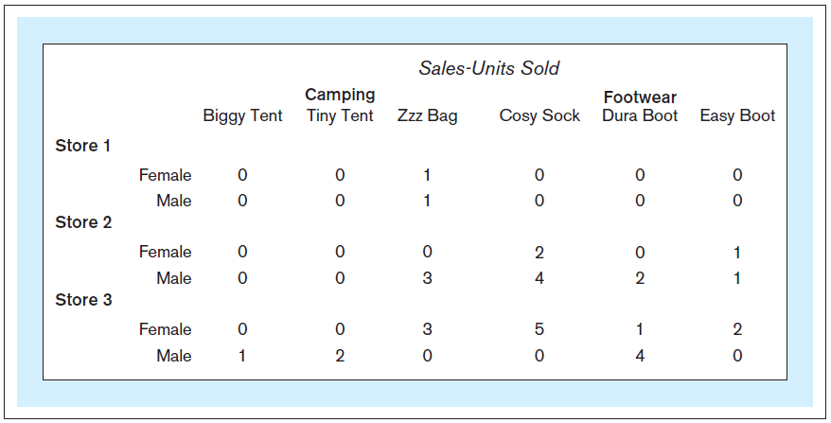
Drill Down – Example
OLAP Query 4 - Result
Jukić, Vrbsky, Nestorov – Database Systems
Chapter 9 – Slide <number>
Notes:
This example is discussed on Pages 286-287.

Slide 46
Drill Up – Example (Query 4 starting point)
OLAP Query 1 - Result
Jukić, Vrbsky, Nestorov – Database Systems
Chapter 9 – Slide <number>
Notes:
This example is discussed on Pages 286-287.

Slide 47
OLAP
OLAP/BI Tools
  Require dimensional organization of underlying data for performing basic OLAP operations (slice, pivot, drill)
  Additional OLAP/BI Tool functionalities:
    Graphically visualizing the answers
    Creating and examining calculated data
    Determining comparative or relative differences
    Performing exception analysis, trend analysis, forecasting, and regression analysis
    Number of other analytical functions
  Many OLAP/BI tools are web-based
Jukić, Vrbsky, Nestorov – Database Systems
Chapter 9 – Slide <number>
Notes:
The listed additional functionalities are found in other non-OLAP applications, such as statistical tools or spreadsheet software. What truly distinguishes OLAP/BI tools from other applications is the capability to easily interact with the dimensionally modeled data marts and data warehouses and, consequently, the capability to perform OLAP functions on large amounts of data.

Slide 48
Result Visualization Example
OLAP Query 1 – Result
Jukić, Vrbsky, Nestorov – Database Systems
Chapter 9 – Slide <number>
Notes:
This example is discussed on Page 288.

Slide 49
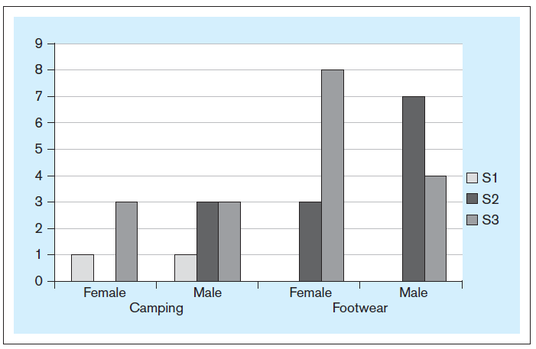
Result Visualization Example
OLAP Query 1 – Result, visualized as a chart
Jukić, Vrbsky, Nestorov – Database Systems
Chapter 9 – Slide <number>
Notes:
This example is discussed on Page 288.

Slide 50
OLAP
OLAP/BI Tools – two purposes:
  Ad-hoc direct analysis of dimensionally modeled data
  Creation of front-end (BI) applications
Jukić, Vrbsky, Nestorov – Database Systems
Chapter 9 – Slide <number>
Notes:
Ad-hoc direct analysis of dimensionally modeled data - occurs when a user accesses the data in the data warehouse via an OLAP/BI tool, and performs actions, such as pivoting, slicing and drilling. This process is also sometimes referred to as data interrogation, because often the answers to one query lead into new questions. For example, an analyst may create a query using an OLAP/BI tool. The answer to that query may prompt an additional question which is then answered by pivoting, slicing or drilling the result of the original query.
Creation of front-end (BI) applications - the data warehouse front end application can be created simply as a collection of the OLAP/BI tool queries created by OLAP/BI tool expert users. Such a collection can be accompanied with a menu structure for navigation and then provided to the users of the data warehouse who do not have the access privilege, expertise and/or the time to use OLAP/BI tools directly.

Slide 51
DATA WAREHOUSE/DATA MART
FRONT-END (BI) APPLICATIONS
Data Warehouse/Data Mart Front-End (BI) Applications
  Provide access for indirect use
Jukić, Vrbsky, Nestorov – Database Systems
Chapter 9 – Slide <number>
Notes:
In most cases, a portion of intended users (often a majority of the users) of the data warehouse lack the time and/or expertise to engage in open-ended direct analysis of the data. It is not reasonable to expect every person who needs to use the data from the data warehouse as a part of their workplace responsibilities, to develop their own queries by writing the SQL code or engaging in the ad-hoc use of OLAP/BI tools. Instead, many of the data warehouse and data mart end-users access the data through front-end (BI) applications.

Slide 52
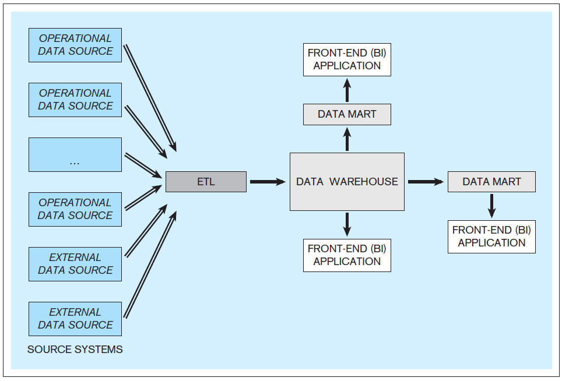
DATA WAREHOUSE/DATA MART
FRONT-END (BI) APPLICATIONS
A data warehousing system with front-end applications
Jukić, Vrbsky, Nestorov – Database Systems
Chapter 9 – Slide <number>

Slide 53
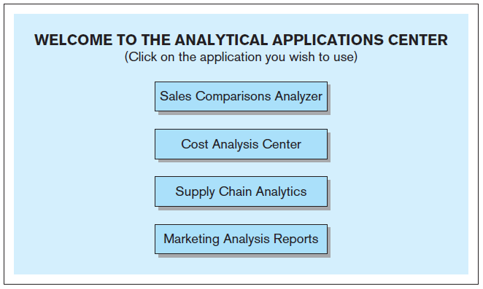
Example – An interface to a collection of data warehouse front-end applications
Jukić, Vrbsky, Nestorov – Database Systems
Chapter 9 – Slide <number>
Notes:
This example is discussed on Pages 290-291.

Slide 54
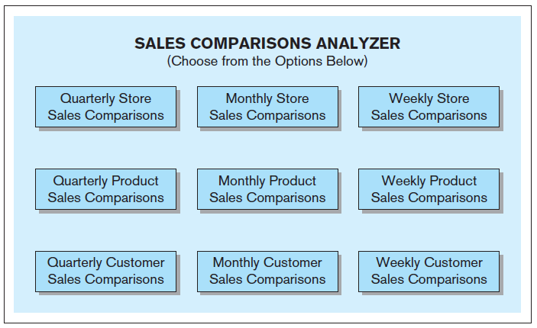
Example – An interface to a data warehouse front-end application
Jukić, Vrbsky, Nestorov – Database Systems
Chapter 9 – Slide <number>
Notes:
This example is discussed on Pages 290-291.

Slide 55
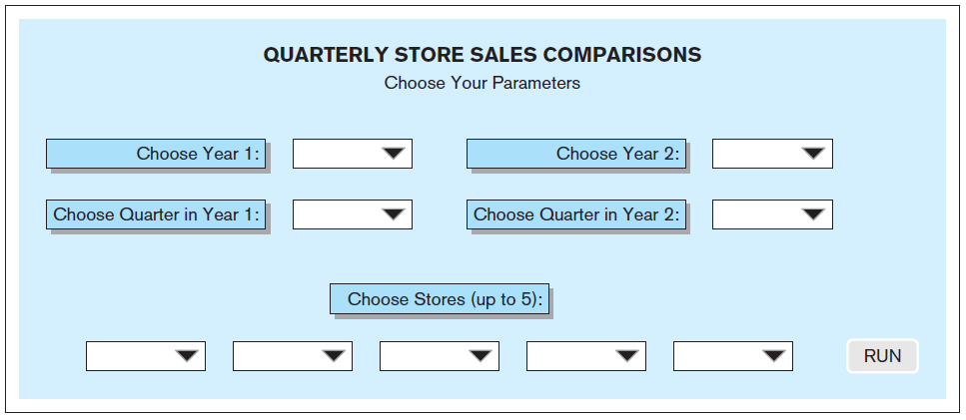
Example – An interface to a predeveloped data warehouse query
Jukić, Vrbsky, Nestorov – Database Systems
Chapter 9 – Slide <number>
Notes:
This example is discussed on Pages 290-291.

Slide 56
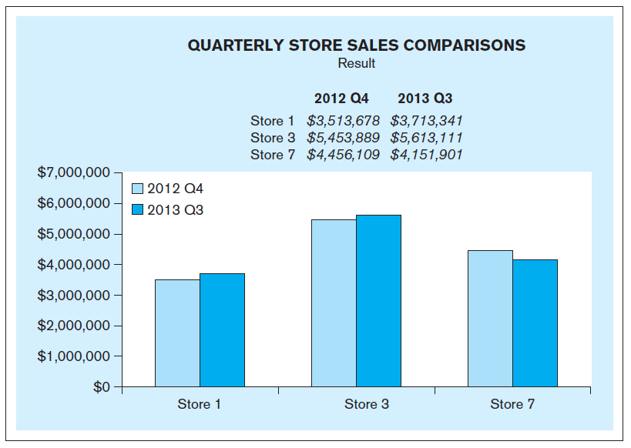
Example – The results of selecting particular parameter values in the interface to the predeveloped data warehouse query
Jukić, Vrbsky, Nestorov – Database Systems
Chapter 9 – Slide <number>
Notes:
This example is discussed on Pages 290-291.

Slide 57
DATA WAREHOUSE/DATA MART
FRONT-END (BI) APPLICATIONS
Executive dashboard
  Intended for use by higher level decision makers within an organization
  Contains an organized easy-to-read display of a number of critically important queries describing the performance of the organization
  In general, the usage of executive dashboards should require little or no effort or training
  Executive dashboards can be web-based
Jukić, Vrbsky, Nestorov – Database Systems
Chapter 9 – Slide <number>

Slide 58
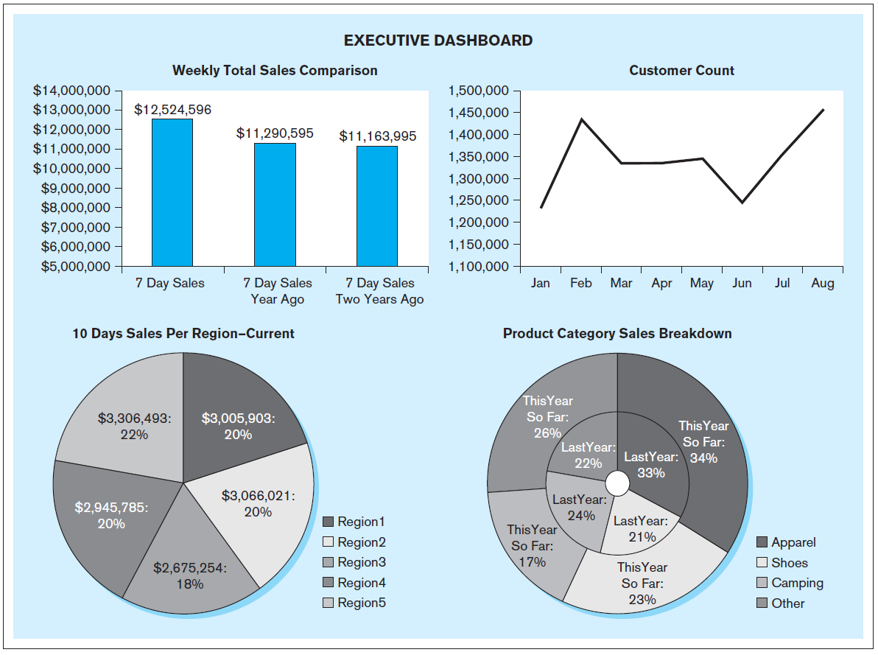
Example – Executive Dashboard
Jukić, Vrbsky, Nestorov – Database Systems
Chapter 9 – Slide <number>

Slide 59
DATA WAREHOUSE DEPLOYMENT
Data warehouse deployment
  Releasing the created and populated data warehouse and its front-end (BI) applications for use by the end-users
  Alpha release
    Internal deployment of a system to the members of the development team for initial testing of its functionalities
  Beta release
    Deployment of a system to a selected group of users to test the usability of the system
  Production release
    The actual deployment of a functioning system
Jukić, Vrbsky, Nestorov – Database Systems
Chapter 9 – Slide <number>
Notes:
The feedback from the testing phases may result in making modifications to the system prior to the actual deployment of a functioning data warehousing system.
Typically, the deployment does not occur all at once for the entire population of the intended end-users instead the deployment process is more gradual.

Slide 60
OLAP/BI TOOLS DATABASE MODELS
OLAP/BI Tools database models
  OLAP/BI tools are designed for access of dimensionally modeled data
  Dimensionally modeled data stores can be implemented as
    Relational database model (database is a collection of tables)
    Multidimensional database model (database is a collection of cubes )
Jukić, Vrbsky, Nestorov – Database Systems
Chapter 9 – Slide <number>
Notes:
Conceptually, there is no difference in dimensional modeling for relational models or cubes. The conceptual design still involves creating star schemas with dimensions and facts. The difference is in the physical implementation.

Slide 61
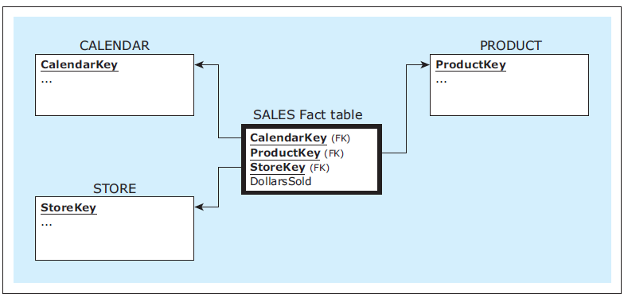
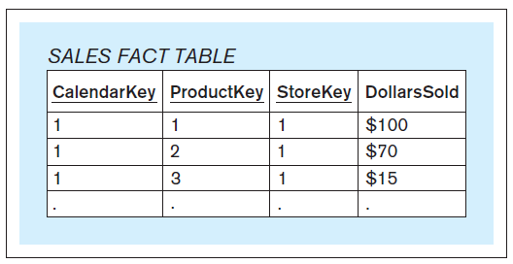
Example – Relational implementation of a fact table in a dimensional model
Jukić, Vrbsky, Nestorov – Database Systems
Chapter 9 – Slide <number>
Notes:
This example is discussed on Pages 293-295.

Slide 62
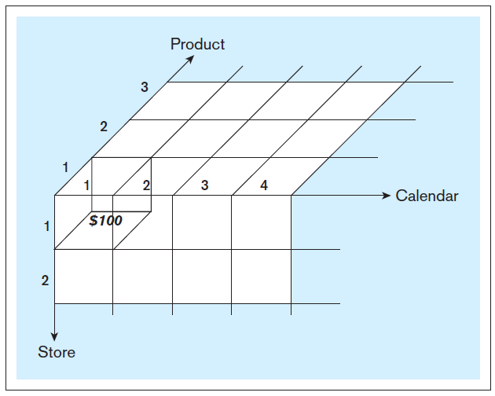
Example – Multidimensional (cube) implementation of a fact table in a dimensional model
Jukić, Vrbsky, Nestorov – Database Systems
Chapter 9 – Slide <number>
Notes:
This example is discussed on Pages 293-295.

Slide 63
OLAP/BI TOOLS DATA ARCHITECTURE OPTIONS
OLAP/BI Tools Data Architecture Options
  Three common categories
    Multidimensional online analytical processing - MOLAP
    Relational online analytical processing - ROLAP
    Hybrid online analytical processing - HOLAP
Jukić, Vrbsky, Nestorov – Database Systems
Chapter 9 – Slide <number>

Slide 64
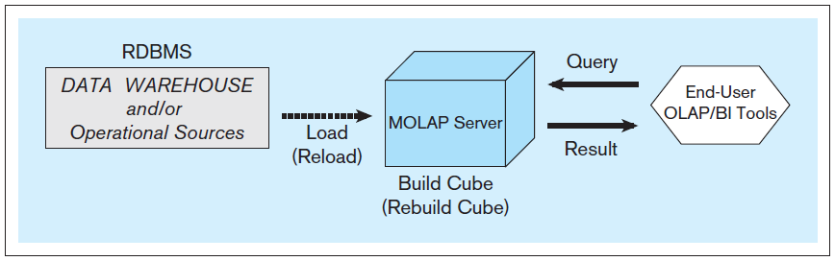
MOLAP architecture
Jukić, Vrbsky, Nestorov – Database Systems
Chapter 9 – Slide <number>
Notes:
MOLAP architecture is discussed on Pages 295-296.

Slide 65
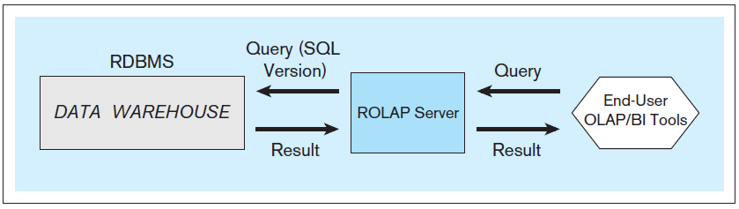
ROLAP architecture
Jukić, Vrbsky, Nestorov – Database Systems
Chapter 9 – Slide <number>
Notes:
ROLAP architecture is discussed on Pages 296-297.

Slide 66
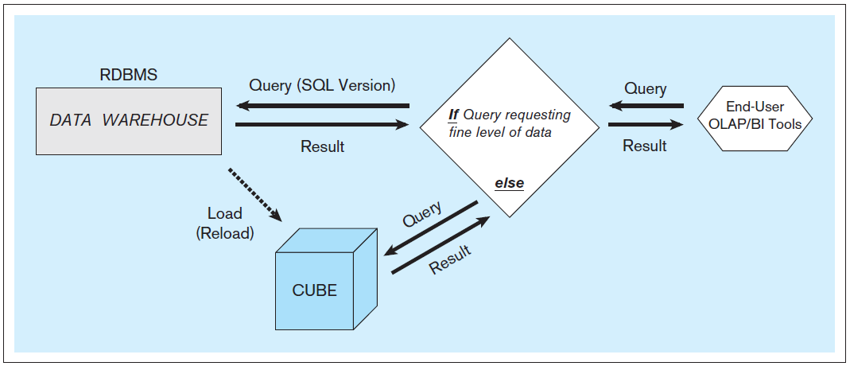
HOLAP architecture
Jukić, Vrbsky, Nestorov – Database Systems
Chapter 9 – Slide <number>
Notes:
HOLAP architecture is discussed on Page 297.

