Slide 1
MTH 2215
Applied Discrete Mathematics
Chapter 9, Section 9.1
Introduction to Graphs
These class notes are based on material from our textbook, Discrete Mathematics and Its Applications, 6th ed., by Kenneth H. Rosen, published by McGraw Hill, Boston, MA, 2006. They are intended for classroom use only and are not a substitute for reading the textbook.

Slide 2
Problem
The Seven bridges of Königsberg
C
c
D
A
d
a
B
b

Slide 3
Simple Graph
A graph consists of
  a nonempty set of vertices called V
  a set of edges (unordered pairs of distinct elements of V) called E
Notation: G = (V,E)
A graph is simple if there is at most one edge linking two vertices.

Slide 4
Simple Graph Example
Detroit
New York
San Francisco
Chicago
Denver
Washington
Los Angeles
This simple graph represents a network.
The network is made up of computers and telephone links between computers

Slide 5
Multigraph
A multigraph can have multiple edges (two or more edges connecting the same pair of vertices).
Detroit
New York
San Francisco
Chicago
Denver
Washington
Los Angeles
There can be multiple telephone lines between two computers in the network.

Slide 6
Pseudograph
A Pseudograph can have multiple edges and loops (an edge connecting a vertex to itself).
Detroit
San Francisco
Chicago
New York
Denver
Washington
Los Angeles
There can be telephone lines in the network from a computer to itself.

Slide 7
Types of Undirected Graphs
Pseudographs
Multigraphs
Simple Graphs

Slide 8
Directed Graph
The edges are ordered pairs of (not necessarily distinct) vertices.
Detroit
Chicago
New York
San Francisco
Denver
Washington
Los Angeles
Some telephone lines in the network may operate in only one direction. Those that operate in two directions are represented by pairs of edges in opposite directions.

Slide 9
Directed Multigraph
A directed multigraph is a directed graph with multiple edges between the same two distinct vertices.
Detroit
New York
Chicago
San Francisco
Denver
Washington
Los Angeles
There may be several one-way lines in the same direction from one computer to another in the network.

Slide 10
Types of Directed Graphs
Directed
Multigraphs
Directed Graphs

Slide 11
Graph Models
Graphs can be used to model structures, sequences, and other relationships.
Example: ecological niche overlay graph
  Species are represented by vertices
  If two species compete for food, they are connected by a vertex

Slide 12
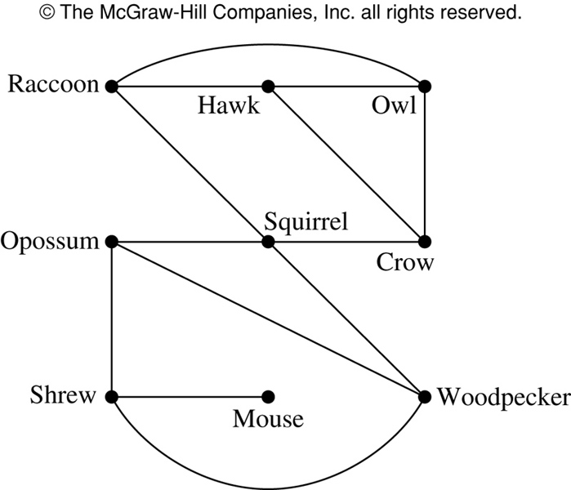
Niche Overlay Graph

Slide 13
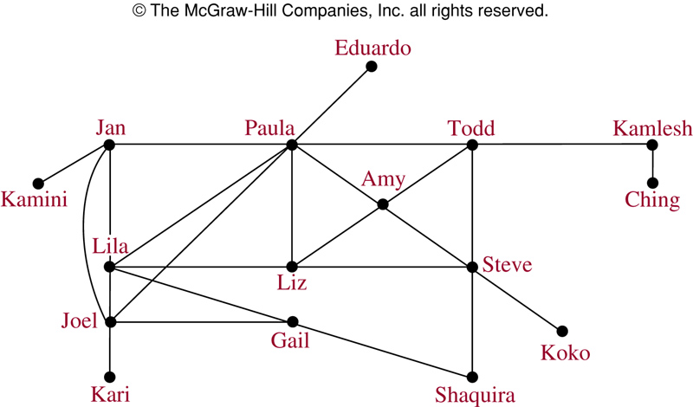
Acquaintanceship Graph

Slide 14
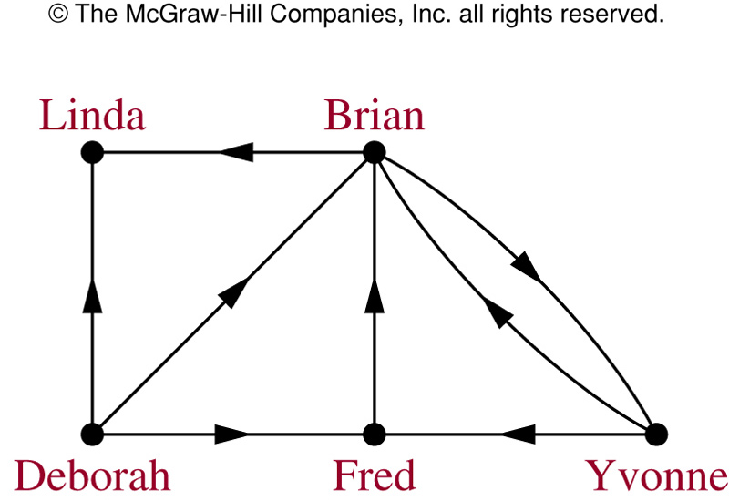
Influence Graph

Slide 15
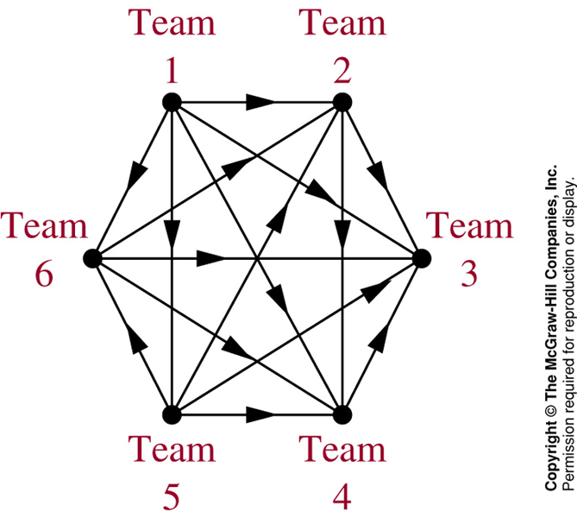
Round-Robin Tournament Graph

Slide 16
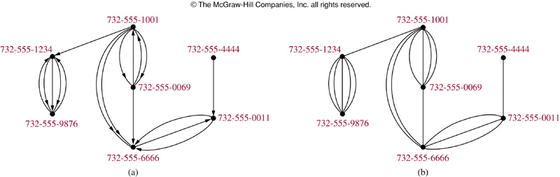
Call Graphs
Directed graph (a) represents calls from a telephone number to another.
Undirected graph (b) represents called between two numbers.

Slide 17
Hollywood Graph
In the Hollywood graph:
  Vertices represent actors
  Edges represent the fact that the two actors have worked together on some movie
As of October 2007, this graph had 893,283 vertices, and over 20 million edges.

Slide 18
Shortest-path Algorithms
A decade or so ago a game called "Six Degrees of Kevin Bacon" was popular on college campuses.
The idea, based on the idea that “it’s a small world”, was to try to find the fewest number of connections to link any other actor with Kevin Bacon.
It was discovered that you could connect Kevin Bacon with just about any other actor in 6 links or so.

Slide 19
Bacon Numbers
In the Hollywood Graph, the Bacon Number of an actor x is defined as the length of the shortest path connecting x and the actor Kevin Bacon.
The average Kevin Bacon number is 2.957
For more information, see the Oracle of Bacon website at the University of Virginia Computer Science Department.

Slide 20
Bacon Numbers
Kevin Bacon Number | Number of People
0 | 1 (Kevin Bacon himself)
1 | 2030
2 | 190213
3 | 557245
4 | 133450
5 | 9232
6 | 958
7 | 137
8 | 17

Slide 21
Shortest-path Algorithms
Writing an efficient program for finding the shortest path in a graph is an important optimizing task in Computer Science.
For futher information about shortest-path algorithms, take CSE 4833, or read the course textbook, Introduction to Algorithms by Cormen, Leiserson, Rivest, and Stein.

Slide 22
Summary
Type | Edges | Loops | Multiple Edges
Simple Graph | Undirected | NO | NO
Multigraph | Undirected | NO | YES
Pseudograph | Undirected | YES | YES
Directed Graph | Directed | YES | NO

Slide 23
MTH 2215
Applied discrete mathematics
Chapter 9.2
Graph Terminology
These class notes are based on material from our textbook, Discrete Mathematics and Its Applications, 6th ed., by Kenneth H. Rosen, published by McGraw Hill, Boston, MA, 2006. They are intended for classroom use only and are not a substitute for reading the textbook.

Slide 24
Adjacent Vertices in Undirected Graphs
Two vertices, u and v in an undirected graph G are called adjacent (or neighbors) in G, if {u,v} is an edge of G.
An edge e connecting u and v is called incident with vertices u and v, or is said to connect u and v.
The vertices u and v are called endpoints of edge {u,v}.

Slide 25
Degree of a Vertex
The degree of a vertex in an undirected graph is the number of edges incident with it
  except that a loop at a vertex contributes twice to the degree of that vertex
The degree of a vertex v is denoted by deg(v).

Slide 26
Example
c
d
b
a
g
f
e
Find the degrees of all the vertices:
deg(a) = 2, deg(b) = 6, deg(c) = 4, deg(d) = 1,
deg(e) = 0, deg(f) = 3, deg(g) = 4

Slide 27
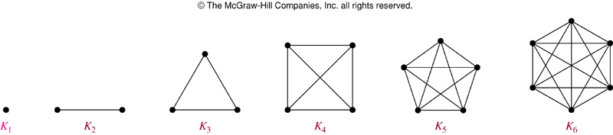
Complete Graph
The complete graph on n vertices (K_{n}) is the simple graph that contains exactly one edge between each pair of distinct vertices.
The figures above represent the complete graphs, K_{n}, for n = 1, 2, 3, 4, 5, and 6.

Slide 28
Cycle
The cycle C_{n} (n ≥ 3), consists of n vertices v₁, v₂, …, v_{n} and edges {v₁,v₂}, {v₂,v₃}, …, {v_{n-1},v_{n}}, and {v_{n},v₁}.
Cycles:
C₃
C₄
C₅
C₆

Slide 29
Wheel
When a new vertex is added to a cycle C_{n} and this new vertex is connected to each of the n vertices in C_{n}, we obtain a wheel W_{n}.
Wheels:
W₃
W₄
W₅
W₆

Slide 30
Subgraph
A subgraph of a graph G = (V,E) is a graph H = (W,F) where W ⊆ V and F ⊆ E.
K₅
C₅
Is C₅ a subgraph of K₅?

Slide 31
Union
The union of 2 simple graphs G₁ = (V₁, E₁) and G₂ = (V₂, E₂) is the simple graph with vertex set V = V₁∪V₂ and edge set E = E₁∪E₂. The union is denoted by G₁∪G₂.
c
c
c
b
d
f
f
b
d
b
d
a
e
e
a
e
a
S₅
C₅
W₅
S₅ ∪ C₅ = W₅

Slide 32
MTH 2215
Applied discrete mathematics
Chapter 9.4
Connectivity
These class notes are based on material from our textbook, Discrete Mathematics and Its Applications, 6th ed., by Kenneth H. Rosen, published by McGraw Hill, Boston, MA, 2006. They are intended for classroom use only and are not a substitute for reading the textbook.

Slide 33
Paths in Undirected Graphs
There is a path from vertex v₀ to vertex v_{n} if there is a sequence of edges from v₀ to v_{n}
  This path is labeled as v₀,v₁,v₂,…,v_{n} and has a length of n.
The path is a circuit if the path begins and ends with the same vertex.
A path is simple if it does not contain the same edge more than once.

Slide 34
Paths in Undirected Graphs
A path or circuit is said to pass through the vertices v₀, v₁, v₂, …, v_{n} or traverse the edges e₁, e₂, …, e_{n}.

Slide 35
Example
u₁, u₄, u₂, u₃
  Is it simple?
  yes
  What is the length?
  3
  Does it have any circuits?
  no
u₁ u₂
u₅ u₄ u₃

Slide 36
Example
u₁, u₅, u₄, u₁, u₂, u₃
  Is it simple?
  yes
  What is the length?
  5
  Does it have any circuits?
  Yes; u₁, u₅, u₄, u₁
u₁ u₂
u₅ u₃
u₄

Slide 37
Example
u₁, u₂, u₅, u₄, u₃
  Is it simple?
  yes
  What is the length?
  4
  Does it have any circuits?
  no
u₁ u₂
u₅ u₃
u₄

Slide 38
Connectedness
An undirected graph is called connected if there is a path between every pair of distinct vertices of the graph.
There is a simple path between every pair of distinct vertices of a connected undirected graph.

Slide 39
Example
Are the following graphs connected?
a
b
a
b
c
e
f
d
c
d
f
g
e
Yes No

Slide 40
Connectedness (Cont.)
A graph that is not connected is the union of two or more disjoint connected subgraphs (called the connected components of the graph).

Slide 41
Example
What are the connected components of the following graph?
b
d
e
f
a
c
h
g

Slide 42
Example
What are the connected components of the following graph?
b
d
e
f
a
c
h
g
{a, b, c}, {d, e}, {f, g, h}

Slide 43
Cut edges and vertices
If one can remove a vertex (and all incident edges) and produce a graph with more connected components, the vertex is called a cut vertex.
If removal of an edge creates more connected components the edge is called a cut edge or bridge.

Slide 44
Example
Find the cut vertices and cut edges in the following graph.
a
d
f
g
b
c
e
h

Slide 45
Example
Find the cut vertices and cut edges in the following graph.
a
d
f
g
b
c
e
h
Cut vertices: c, e and b
Cut edge: (c, e)

Slide 46
MTH 2215
Applied discrete mathematics
Chapter 9.5
Euler and Hamilton Paths
These class notes are based on material from our textbook, Discrete Mathematics and Its Applications, 6th ed., by Kenneth H. Rosen, published by McGraw Hill, Boston, MA, 2006. They are intended for classroom use only and are not a substitute for reading the textbook.

Slide 47
Euler Paths and Circuits
The Seven bridges of Königsberg
C
c
D
A
a
d
B
b

Slide 48
Euler Paths and Circuits
An Euler path is a path using every edge of the graph G exactly once.
An Euler circuit is an Euler path that returns to its start.
C
Does this graph have an Euler circuit?
No.
A
D
B

Slide 49
Necessary and Sufficient Conditions
How about multigraphs?
A connected multigraph has a Euler circuit iff each of its vertices has an even degree.
A connected multigraph has a Euler path but not an Euler circuit iff it has exactly two vertices of odd degree.

Slide 50
Example
Which of the following graphs has an Euler circuit?
a
b
a
b
a
b
e
e
d
c
d
c
c
d
e
yes no no
(a, e, c, d, e, b, a)

Slide 51
Example
Which of the following graphs has an Euler path?
a
b
a
b
a
b
e
e
d
c
d
c
c
d
e
yes no yes
(a, e, c, d, e, b, a ) (a, c, d, e, b, d, a, b)

Slide 52
Hamilton Paths and Circuits
A Hamilton path in a graph G is a path which visits every vertex in G exactly once.
A Hamilton circuit is a Hamilton path that returns to its start.

Slide 53
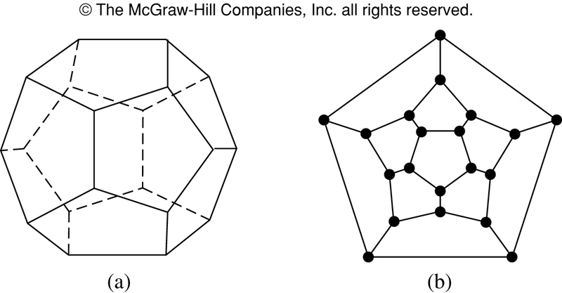
Hamilton Circuits
Is there a circuit in this graph that passes through each vertex exactly once?

Slide 54
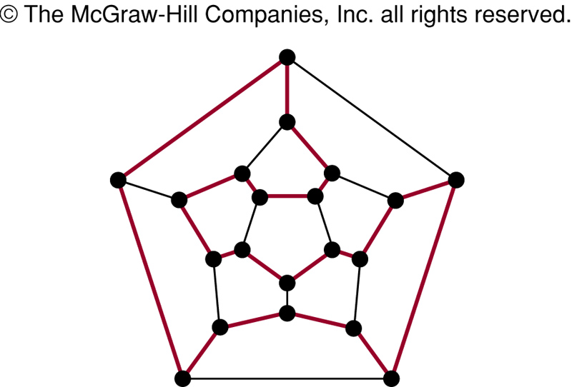
Hamilton Circuits
Yes; this is a circuit that passes through each vertex exactly once.

Slide 55
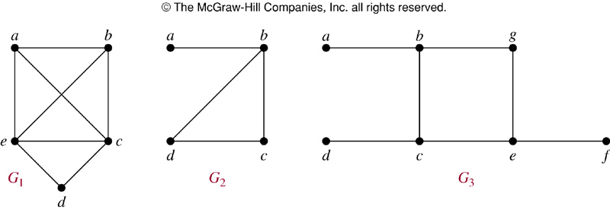
Finding Hamilton Circuits
Which of these three figures has a Hamilton circuit? Of, if no Hamilton circuit, a Hamilton path?

Slide 56
Finding Hamilton Circuits
G₁ has a Hamilton circuit: a, b, c, d, e, a
G₂ does not have a Hamilton circuit, but does have a Hamilton path: a, b, c, d
G₃ has neither.

Slide 57
Finding Hamilton Circuits
Unlike the Euler circuit problem, finding Hamilton circuits is hard.
There is no simple set of necessary and sufficient conditions, and no simple algorithm.

Slide 58
Properties to look for ...
No vertex of degree 1
If a node has degree 2, then both edges incident to it must be in any Hamilton circuit.
No smaller circuits contained in any Hamilton circuit (the start/endpoint of any smaller circuit would have to be visited twice).

Slide 59
A Sufficient Condition
Let G be a connected simple graph with n vertices with n ≥ 3.
G has a Hamilton circuit if the degree of each vertex is ≥ n/2.

Slide 60
Travelling Salesman Problem
A Hamilton circuit or path may be used to solve practical problems that require visiting “vertices”, such as:
road intersections
pipeline crossings
communication network nodes
A classic example is the Travelling Salesman Problem – finding a Hamilton circuit in a complete graph such that the total weight of its edges is minimal.

Slide 61
Summary
Property | Euler | Hamilton
Repeated visits to a given node allowed? | Yes | No
Repeated traversals of a given edge allowed? | No | No
Omitted nodes allowed? | No | No
Omitted edges allowed? | No | Yes

