Slide 1

Database Systems -
Introduction to Databases and Data Warehouses

Slide 2
INTRODUCTION
A typical organization maintains and utilizes a number of operational data sources.
  The operational data sources include the databases and other data repositories which are used to support the organization’s day-to-day operations
A data warehouse is created within an organization as a separate data store whose primary purpose is data analysis.
Jukić, Vrbsky, Nestorov – Database Systems
Chapter 7 – Slide <number>
Notes:
Often, the same fact can have both an operational and an analytical purpose. For example, data describing that customer X bought product Y in store Z can be stored in an operational database for business-process support purposes, such as inventory monitoring or financial transaction record keeping. That same fact can also be stored in a data warehouse where, combined with a vast number of similar facts accumulated over a period of time, it serves to reveal important trends, such as sale patterns or customer behavior.

Slide 3
INTRODUCTION
Two main reasons for the creation of a data warehouse as a separate analytical database
  The performance of operational day-to-day tasks involving data use can be severely diminished if such tasks have to compete for computing resources with analytical queries
  It is often impossible to structure a database which can be used in an efficient manner for both operational and analytical purposes
Jukić, Vrbsky, Nestorov – Database Systems
Chapter 7 – Slide <number>

Slide 4
INTRODUCTION
Operational information (transactional information) - the information collected and used in support of day to day operational needs in businesses and other organizations
Analytical information - the information collected and used in support of analytical tasks
  Analytical information is based on operational (transactional) information
Jukić, Vrbsky, Nestorov – Database Systems
Chapter 7 – Slide <number>
Notes:
Examples of operational information and analytical information are given on Pages 207-208.

Slide 5
OPERATIONAL VS. ANALYTICAL INFORMATION
  Operational Data Analytical Data
  Data Makeup Differences
  Typical Time-Horizon: Days/Months Typical Time-Horizon: Years
  Detailed Summarized (and/or Detailed)
  Current Values over time (Snapshots)
  Technical Differences
  Small Amounts used in a Process Large Amounts used in a Process
  High frequency of Access Low/Modest frequency of Access
  Can be Updated Read (and Append) Only
  Non-Redundant Redundancy not an Issue
  Functional Differences
  Used by all types of employees Used by a narrower set of
  for tactical purposes users for decision making
  Application Oriented Subject Oriented
Jukić, Vrbsky, Nestorov – Database Systems
Chapter 7 – Slide <number>
Notes:
The discussion and examples of these differences is given on Pages 208-210.

Slide 6
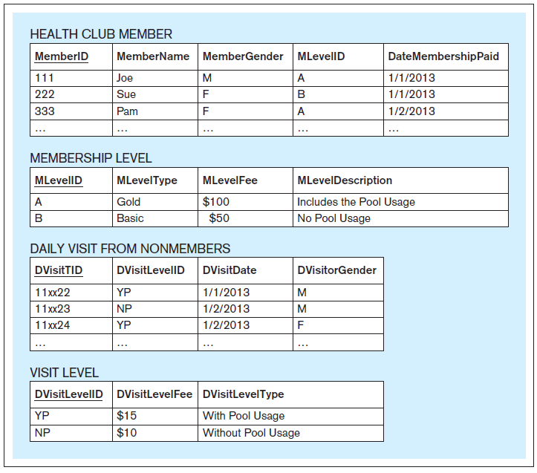
Application Oriented vs. Subject Oriented– Example
An application-oriented database serving the Vitality Health Club Visits and Payments Application
Jukić, Vrbsky, Nestorov – Database Systems
Chapter 7 – Slide <number>
Notes:
This example is discussed on Pages 210-212.

Slide 7
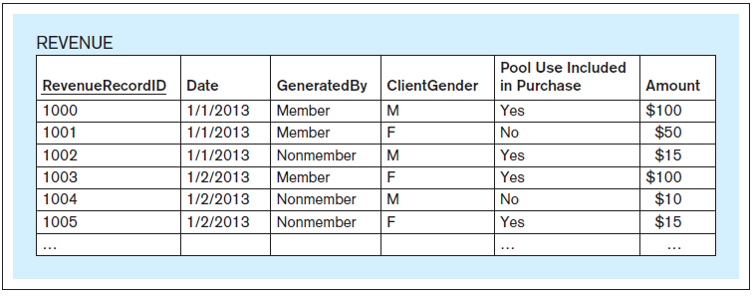
Application Oriented vs. Subject Oriented– Example
A subject-oriented database for the analysis of the subject revenue in the Vitality Health Club
Jukić, Vrbsky, Nestorov – Database Systems
Chapter 7 – Slide <number>
Notes:
This example is discussed on Pages 210-212.

Slide 8
THE DATA WAREHOUSE DEFINITION
The data warehouse is a structured repository of integrated, subject-oriented, enterprise-wide, historical, and time-variant data. The purpose of the data warehouse is the retrieval of analytical information. A data warehouse can store detailed and/or summarized data.
Jukić, Vrbsky, Nestorov – Database Systems
Chapter 7 – Slide <number>

Slide 9
THE DATA WAREHOUSE DEFINITION
Structured repository
  The data warehouse is a database containing analytically useful information
  Any database is a structured repository with its structure represented in its metadata
Jukić, Vrbsky, Nestorov – Database Systems
Chapter 7 – Slide <number>
Notes:
The data warehouse, being a database, is a structured repository. In other words, the data warehouse is not a disorganized random mass of data.

Slide 10
THE DATA WAREHOUSE DEFINITION
Integrated
  The data warehouse integrates the analytically useful data from the various operational databases (and possibly other sources)
  Integration refers to this process of bringing the data from multiple data sources into a singular data warehouse.
Jukić, Vrbsky, Nestorov – Database Systems
Chapter 7 – Slide <number>
Notes:
In the process of bringing the data from operational databases into the data warehouse, no data is actually removed from the operational sources. Instead, the analytically useful data from various operational databases is copied and brought into the data warehouse.

Slide 11
THE DATA WAREHOUSE DEFINITION
Subject-oriented
  The term subject-oriented refers to the fundamental difference in the purpose of an operational database system and a data warehouse.
    An operational database system is developed in order to support a specific business operation
    A data warehouse is developed to analyze specific business subject areas
Jukić, Vrbsky, Nestorov – Database Systems
Chapter 7 – Slide <number>

Slide 12
THE DATA WAREHOUSE DEFINITION
Enterprise-wide
  The term enterprise-wide refers to the fact that the data warehouse provides an organization-wide view of the analytically useful information it contains
Jukić, Vrbsky, Nestorov – Database Systems
Chapter 7 – Slide <number>
Notes:
For example, if one of the subjects of the data warehouse is cost, than all of the analytically useful data regarding cost within the operational data sources in the entire organization will be brought into the data warehouse.

Slide 13
THE DATA WAREHOUSE DEFINITION
Historical
  The term historical refers to the larger time horizon in the data warehouse than in the operational databases
Jukić, Vrbsky, Nestorov – Database Systems
Chapter 7 – Slide <number>
Notes:
For example, many traditional operational databases have a time horizon of 60 to 90 days, where it is quite common for data warehouses to contain multiple years’ worth of data.

Slide 14
THE DATA WAREHOUSE DEFINITION
Time variant
  The term time variant refers to the fact that a data warehouse contains slices or snapshots of data from different periods of time across its time horizon
    With the data slices, the user can create reports for various periods of time within the time horizon
Jukić, Vrbsky, Nestorov – Database Systems
Chapter 7 – Slide <number>
Notes:
For example, if the subject of analysis is cost and the time horizon is a number of years, we can analyze and compare the cost for the first quarter from a year ago versus the cost for the first quarter from two years ago.

Slide 15
THE DATA WAREHOUSE DEFINITION
Retrieval of analytical information
  A data warehouse is developed for the retrieval of analytical information, and it is not meant for direct data entry by the users.
    The only functionality available to the users of the data warehouse is retrieval
    The data in the data warehouse is not subject to changes.
    The data in the data warehouse is referred to as non-volatile, static, or read-only
Jukić, Vrbsky, Nestorov – Database Systems
Chapter 7 – Slide <number>
Notes:
The data in the data warehouse is not subject to modifications, insertions or deletions by the users.
New data in the data warehouse is periodically loaded from the operational data sources and appended to the existing data, in an automatic fashion.
The data that eventually gets older than the required time horizon is purged from the data warehouse.

Slide 16
THE DATA WAREHOUSE DEFINITION
Detailed and/or summarized data
  A data warehouse, depending on its purpose, may include the detailed data or summary data or both
  A data warehouse that contains the data at the finest level of detail is the most powerful
Jukić, Vrbsky, Nestorov – Database Systems
Chapter 7 – Slide <number>
Notes:
Examples of detailed and summarized data in the data warehouse are given on page 214. The discussion about the level of detail in data warehouses in various circumstances is given on Page 214.

Slide 17
DATA WAREHOUSE COMPONENTS
Data warehouse components
  Source systems
  Extraction-transformation-load (ETL) infrastructure
  Data warehouse
  Front-end applications
Jukić, Vrbsky, Nestorov – Database Systems
Chapter 7 – Slide <number>

Slide 18
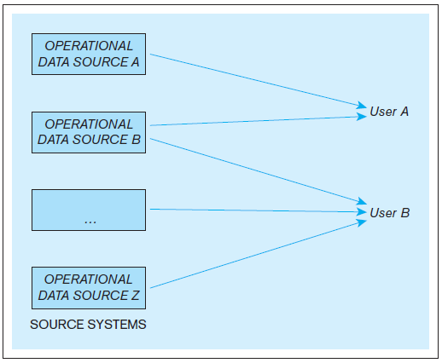
Example - The use of operational data sources for operational purposes in an organization
Jukić, Vrbsky, Nestorov – Database Systems
Chapter 7 – Slide <number>
Notes:
This example is discussed on Pages 214-215.

Slide 19
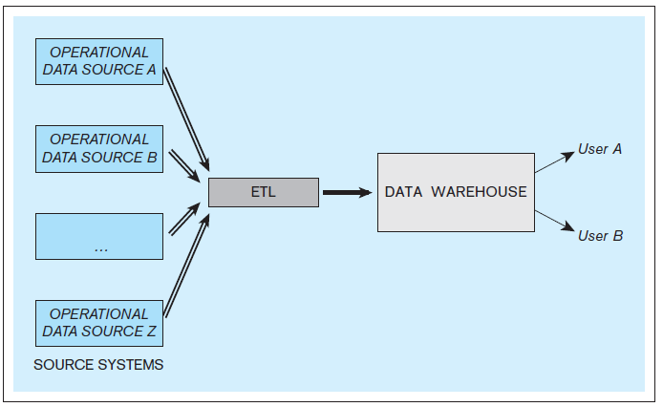
Example - The core components of a data warehousing system
Jukić, Vrbsky, Nestorov – Database Systems
Chapter 7 – Slide <number>
Notes:
This example is discussed on Pages 214-215.

Slide 20
DATA WAREHOUSE COMPONENTS
Source systems
  In the context of data warehousing, source systems are operational databases and other operational data repositories (in other words, any sets of data used for operational purposes) that provide analytically useful information for the data warehouse’s subjects of analysis
  Every operational data store that is used as a source system for the data warehouse has two purposes:
    The original operational purpose
    As a source system for the data warehouse
  Source systems can include external data sources
Jukić, Vrbsky, Nestorov – Database Systems
Chapter 7 – Slide <number>
Notes:
External data sources examples include market research data, census data, stock market data, weather data.

Slide 21
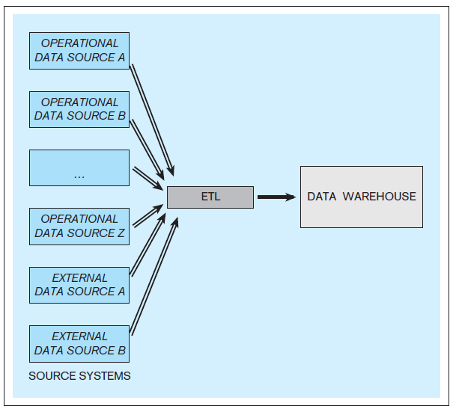
Example - A data warehouse with internal and external source systems
Jukić, Vrbsky, Nestorov – Database Systems
Chapter 7 – Slide <number>
Notes:
This example is discussed on Page 215.

Slide 22
DATA WAREHOUSE COMPONENTS
Data warehouse
  The data warehouse is sometimes referred to as the target system, to indicate the fact that it is a destination for the data from the source systems
  A typical data warehouse periodically retrieves selected analytically useful data from the operational data sources
Jukić, Vrbsky, Nestorov – Database Systems
Chapter 7 – Slide <number>
Notes:
In so-called “active” data warehouses, the retrieval of data from operational data sources is continuous.

Slide 23
DATA WAREHOUSE COMPONENTS
ETL infrastructure
  The infrastructure that facilitates the retrieval of data from operational databases into the data warehouses
  ETL includes the following tasks:
    Extracting analytically useful data from the operational data sources
    Transforming such data so that it conforms to the structure of the subject-oriented target data warehouse model (while ensuring the quality of the transformed data)
    Loading the transformed and quality assured data into the target data warehouse
Jukić, Vrbsky, Nestorov – Database Systems
Chapter 7 – Slide <number>

Slide 24
DATA WAREHOUSE COMPONENTS
Data warehouse front-end (BI) applications
  Used to provide access to the data warehouse for users who are engaging in indirect use
Jukić, Vrbsky, Nestorov – Database Systems
Chapter 7 – Slide <number>

Slide 25
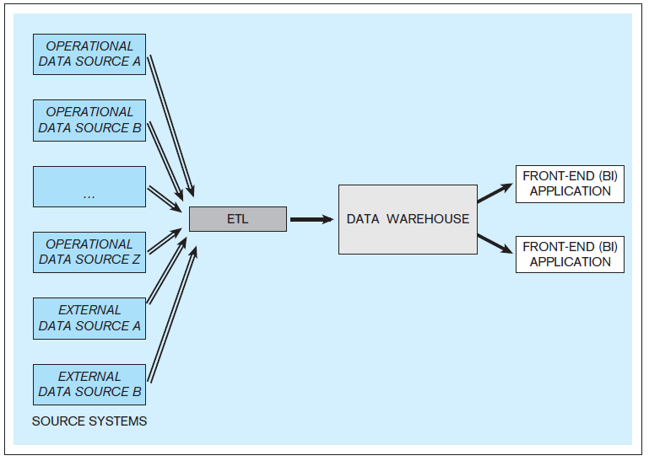
Example - A data warehouse with front-end applications
Jukić, Vrbsky, Nestorov – Database Systems
Chapter 7 – Slide <number>

Slide 26
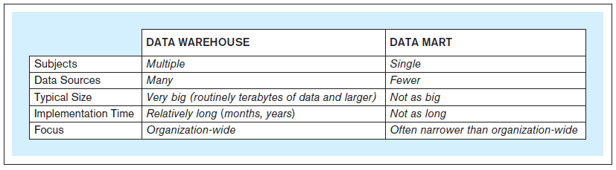
DATA MARTS
Data mart
  A data store based on the same principles as a data warehouse, but with a more limited scope
Jukić, Vrbsky, Nestorov – Database Systems
Chapter 7 – Slide <number>

Slide 27
DATA MARTS
Independent data mart
  Stand-alone data mart, created in the same fashion as the data warehouse
  Independent data mart has its own source systems and ETL infrastructure
Jukić, Vrbsky, Nestorov – Database Systems
Chapter 7 – Slide <number>

Slide 28
DATA MARTS
Dependent data mart
  Does not have its own source systems
  The data comes from the data warehouse
Jukić, Vrbsky, Nestorov – Database Systems
Chapter 7 – Slide <number>
Notes:
Dependent data marts provide users with a subset of the data from the data warehouse, in cases when users or applications do not want, need, or are not allowed to have access to all the data in the entire data warehouse.

Slide 29
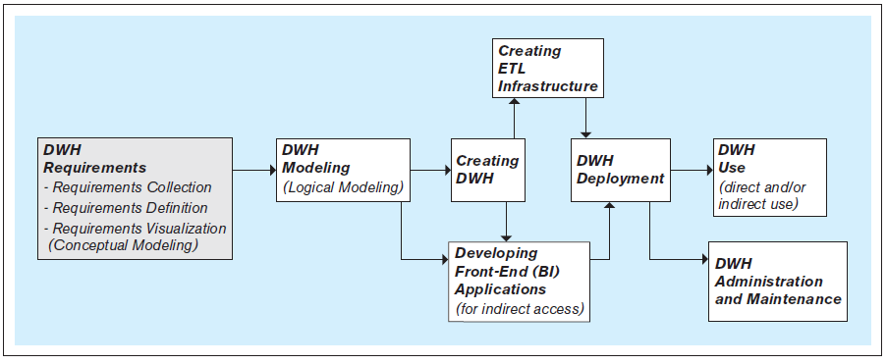
STEPS IN THE DEVELOPMENT OF DATA WAREHOUSES
Jukić, Vrbsky, Nestorov – Database Systems
Chapter 7 – Slide <number>

Slide 30
STEPS IN THE DEVELOPMENT OF DATA WAREHOUSES
Requirements collection, definition, and visualization - results in the requirements specifying the desired capabilities and functionalities of the future data warehouse
  The requirements are based on the analytical needs that can be met by the data in the internal data source systems and available external data sources
  The requirements are collected through interviewing various stakeholders of the data warehouse
  In addition to interviews, additional methods for eliciting requirements from the stakeholders can be used
Jukić, Vrbsky, Nestorov – Database Systems
Chapter 7 – Slide <number>
Notes:
The first and most critical step in the development of the data warehouse.
The requirements collection process aspires to analytically take advantage of all data available for consideration, but it cannot be based on data that is not available or does not exist.
Additional methods for eliciting requirements include focus groups, questionnaires, surveys, and observations of existing analytical practices to determine what users really do with data and what data they actually use and need

Slide 31
STEPS IN THE DEVELOPMENT OF DATA WAREHOUSES
Requirements collection, definition, and visualization
  The collected requirements should be clearly defined and stated in a written document, and then visualized as a conceptual data model
Jukić, Vrbsky, Nestorov – Database Systems
Chapter 7 – Slide <number>
Notes:
Conceptual data warehouse modeling techniques include ER modeling (covered earlier in Chapter 2) and dimensional modeling (covered later in Chapter 8).

Slide 32
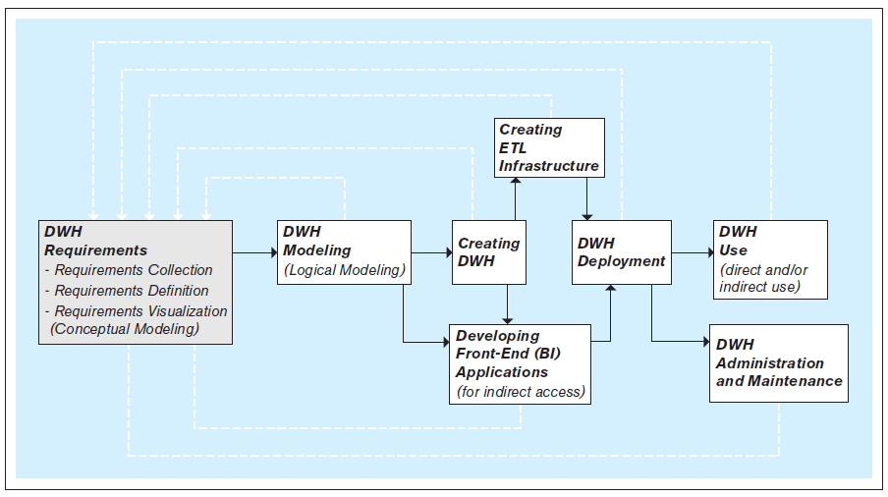
STEPS IN THE DEVELOPMENT OF DATA WAREHOUSES
Iterative nature of the data warehouse requirements collection, definition, and visualization process
Jukić, Vrbsky, Nestorov – Database Systems
Chapter 7 – Slide <number>
Notes:
The discussion about iterative nature of the data warehouse requirements collection, definition, and visualization process is given on Pages 218-219.

Slide 33
STEPS IN THE DEVELOPMENT OF DATA WAREHOUSES
Data warehouse modeling (logical data warehouse modeling ) - creation of the data warehouse data model that is implementable by the DBMS software
Jukić, Vrbsky, Nestorov – Database Systems
Chapter 7 – Slide <number>

Slide 34
STEPS IN THE DEVELOPMENT OF DATA WAREHOUSES
Creating the data warehouse - using a DBMS to implement the data warehouse data model as an actual data warehouse
  Typically, data warehouses are implemented using a relational DBMS (RDBMS) software
Jukić, Vrbsky, Nestorov – Database Systems
Chapter 7 – Slide <number>
Notes:
Regular relational DBMS packages, such as Microsoft SQL Server or Oracle, can be used for implementing both operational databases and data warehouses. However, other relational DBMS packages, such as Teradata, that are specialized for processing large amounts of data typically found in data warehouses are also available for implementation of data warehouses.
Creating data marts can be accomplished in the same fashion as creating data warehouses by using relational DBMS packages. In some cases, data marts can also be implemented as so-called “cubes,” using a data management technology different from relational DBMS as described in Chapter 9.

Slide 35
STEPS IN THE DEVELOPMENT OF DATA WAREHOUSES
Creating ETL infrastructure
  Creating necessary procedures and code for:
    Automatic extraction of relevant data from the operational data sources
    Transformation of the extracted data, so that its quality is assured and its structure conforms to the structure of the modeled and implemented data warehouse
    The seamless load of the transformed data into the data warehouse
  Due to the amount of details that have to be considered, creating ETL infrastructure is often the most time- and resource-consuming part of the data warehouse development process
Jukić, Vrbsky, Nestorov – Database Systems
Chapter 7 – Slide <number>
Notes:
ETL infrastructure has to account for and reconcile all of the differences in the metadata and the data between the operational sources and the target data warehouses. In many cases, organizations have multiple separate operational sources with overlapping information. In such cases, the process of creating the ETL infrastructure involves deciding how to bring in such information without creating misleading duplicates (i.e., how to bring in all the useful information while avoiding the uniqueness data quality problem).

Slide 36
STEPS IN THE DEVELOPMENT OF DATA WAREHOUSES
Developing front-end (BI) applications - designing and creating applications for indirect use by the end-users
  Front-end applications are included in most data warehousing systems and are often referred to as business intelligence (BI) applications
  Front-end applications contain interfaces (such as forms and reports) accessible via a navigation mechanism (such as a menu)
Jukić, Vrbsky, Nestorov – Database Systems
Chapter 7 – Slide <number>
Notes:
The design and creation of data warehouse front-end applications can take place in parallel with data warehouse creation. For example, the look and feel of the front-end applications, as well as the number and functionalities of particular components (e.g., forms and reports), can be determined before the data warehouse is implemented. This can be done based on the data warehouse model and the requirements specifying the capabilities and functionalities of the system needed by the end users. The actual creation of the front-end application involves connecting it to the implemented data warehouse, which can only be done once the data warehouse is implemented.

Slide 37
STEPS IN THE DEVELOPMENT OF DATA WAREHOUSES
Data warehouse deployment - releasing the data warehouse and its front-end (BI) applications for use by the end users
Jukić, Vrbsky, Nestorov – Database Systems
Chapter 7 – Slide <number>
Notes:
Typically, prior to this step, the initial load populating the created data warehouse with an initial set of data from the operational data sources via the ETL infrastructure is executed.

Slide 38
STEPS IN THE DEVELOPMENT OF DATA WAREHOUSES
Data warehouse use - the retrieval of the data in the data warehouse
  Indirect use
    Via the front-end (BI) applications
  Direct use
    Via the DBMS
    Via the OLAP (BI) tools
Jukić, Vrbsky, Nestorov – Database Systems
Chapter 7 – Slide <number>

Slide 39
STEPS IN THE DEVELOPMENT OF DATA WAREHOUSES
Data warehouse administration and maintenance - performing activities that support the data warehouse end user, including dealing with technical issues, such as:
  Providing security for the information contained in the data warehouse
  Ensuring sufficient hard-drive space for the data warehouse content
  Implementing the backup and recovery procedures
Jukić, Vrbsky, Nestorov – Database Systems
Chapter 7 – Slide <number>

Slide 40
THE NEXT VERSION OF THE DATA WAREHOUSE
The new version of the data warehouse follows the same development steps as the initial version
Jukić, Vrbsky, Nestorov – Database Systems
Chapter 7 – Slide <number>
Notes:
In most cases, after a certain period of use, the need for modifications and expansion of the existing data warehouse becomes apparent, and the development of a new version of the existing data warehouse system is initiated.

Slide 41
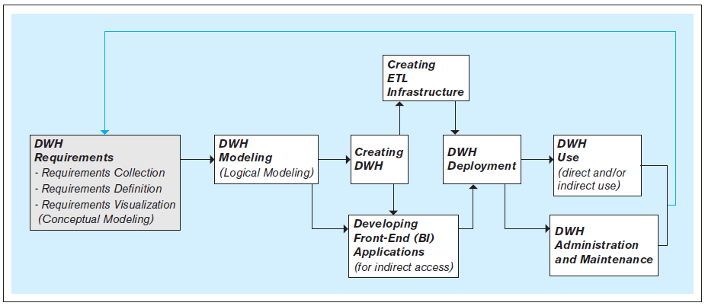
THE NEXT VERSION OF THE DATA WAREHOUSE
Jukić, Vrbsky, Nestorov – Database Systems
Chapter 7 – Slide <number>
Notes:
The difference between developing the initial and subsequent versions of the data warehouse is discussed on Page 221.

