Slide 1
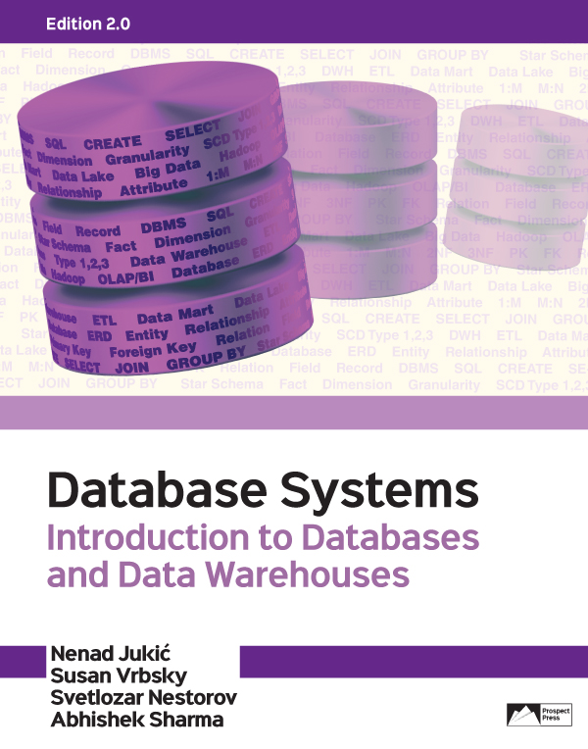
Chapter 10 - Big Data and Data Lakes
For exclusive use with:

Slide 2
INTRODUCTION
Broad categories of large corporate data sets:
Operational Database Data Sets
Data Warehouse Data Sets
Big Data Sets
Jukić, Vrbsky, Nestorov, Sharma – Database Systems

Slide 3
INTRODUCTION
Examples of sources generating large amounts of data:
Smartphones that broadcast their location every few seconds
Chips built into cars that perform thousands of diagnostic tests per second
Cameras that are continuously recording public and private spaces
Radio-frequency identification (RFID) tags that send a wireless signal that is read at various points as the carts of merchandise to which the RFID tags are attached travel in the supply chain from the manufacturer to the customer
Jukić, Vrbsky, Nestorov, Sharma – Database Systems
Notes:
These are all examples that fit into category of Big Data. Large amounts of data that do not easily fit into operational databases or data warehouses.

Slide 4
BIG DATA
Big data
Data sets in corporations and organizations that contain massive volumes of diverse and rapidly growing data that, unlike operational databases and data warehouses, are not formally modeled for querying and retrieval and are not accompanied with detailed metadata
Jukić, Vrbsky, Nestorov, Sharma – Database Systems

Slide 5
BIG DATA
Big data
Typically unstructured or semi-structured
Unstructured data
no explicit structure
e.g. text document
Semi-structured data
some structure (but not completely structured)
e.g. collection of e-mails has a simple structure that distinguishes the sender, recipient, subject, and body of the message, but the message itself is unstructured
Jukić, Vrbsky, Nestorov, Sharma – Database Systems

Slide 6
BIG DATA
Big data
Unstructured data, semi-structured data, low-structure data, and lightly structured data are all various terms that describe data with little or no formal metadata
The lack of formal metadata in big data sets is caused by the fact that, unlike operational databases and data warehouses, the repositories of big data are not created through the process of formal database modeling
Consequently, big data does not easily fit into tables with rows and columns
Jukić, Vrbsky, Nestorov, Sharma – Database Systems

Slide 7
V’s od BIG DATA
In the literature, big data has been characterized with a varying number of V’s
Three, four, five, six, or even seven V’s: Volume, Variety, Velocity, Veracity, Variability, Value, and Visualization
While expressive, describing big data with simple V’s can also be somewhat confusing and misleading
These V’s stated on their own, without context or an example, can be applied to operational databases and data warehouses as well, and therefore are not completely and exclusively descriptive of big data
Jukić, Vrbsky, Nestorov, Sharma – Database Systems

Slide 8
V’s od BIG DATA
In the literature, big data has been characterized with a varying number of V’s
Volume
Large size of data
Variety
Abundance of different types of data sources
Velocity
High speed of incoming data
Veracity
Data quality issues in data
Jukić, Vrbsky, Nestorov, Sharma – Database Systems

Slide 9
V’s od BIG DATA
In the literature, big data has been characterized with a varying number of V’s
Variability
Possibility of interpreting the data in different ways
Value
Usefulness and actionability of data
Visualization
Necessity for illustrative and rich visualization of data
Jukić, Vrbsky, Nestorov, Sharma – Database Systems

Slide 10
V’s od BIG DATA
V’s of Big Data
There are examples of V’s that are applicable to operational databases, data warehouses and big data
In order to avoid vagueness in describing big data with simple V’s, a more precise definition of big data using such V’s is needed
Jukić, Vrbsky, Nestorov, Sharma – Database Systems
Notes:
Examples given on Pages 318-319.

Slide 11
BIG DATA DEFINITION
Big data refers to the massive volumes of diverse and rapidly growing data sets which when compared with operational databases and data warehouses:
are considerably less structured, with little or no metadata
in general, exhibit larger Volume, Velocity, and Variety
have a higher likelihood of having data quality (Veracity) issues
have a higher possibility of different interpretations (Variability)
need a more explorative and experimental approach to yield Value, if any
are as likely (if not even more so) to benefit from rich and innovative Visualization
Jukić, Vrbsky, Nestorov, Sharma – Database Systems

Slide 12
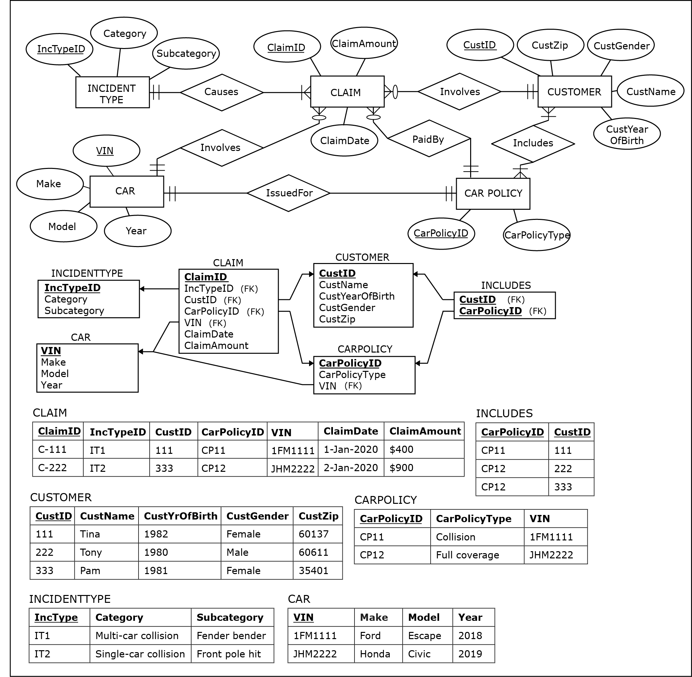
EXAMPLE : Three Types of Data Sets in a Corporation Insurance Company Operational Database (ER Diagram and Relational Schema)
Jukić, Vrbsky, Nestorov, Sharma – Database Systems
Notes:
This example is discussed on Pages 319-322.

Slide 13
EXAMPLE : Three Types of Data Sets in a Corporation Insurance Company Operational Database (Sample Data)
Jukić, Vrbsky, Nestorov, Sharma – Database Systems
Notes:
This example is discussed on Pages 319-322.

Slide 14
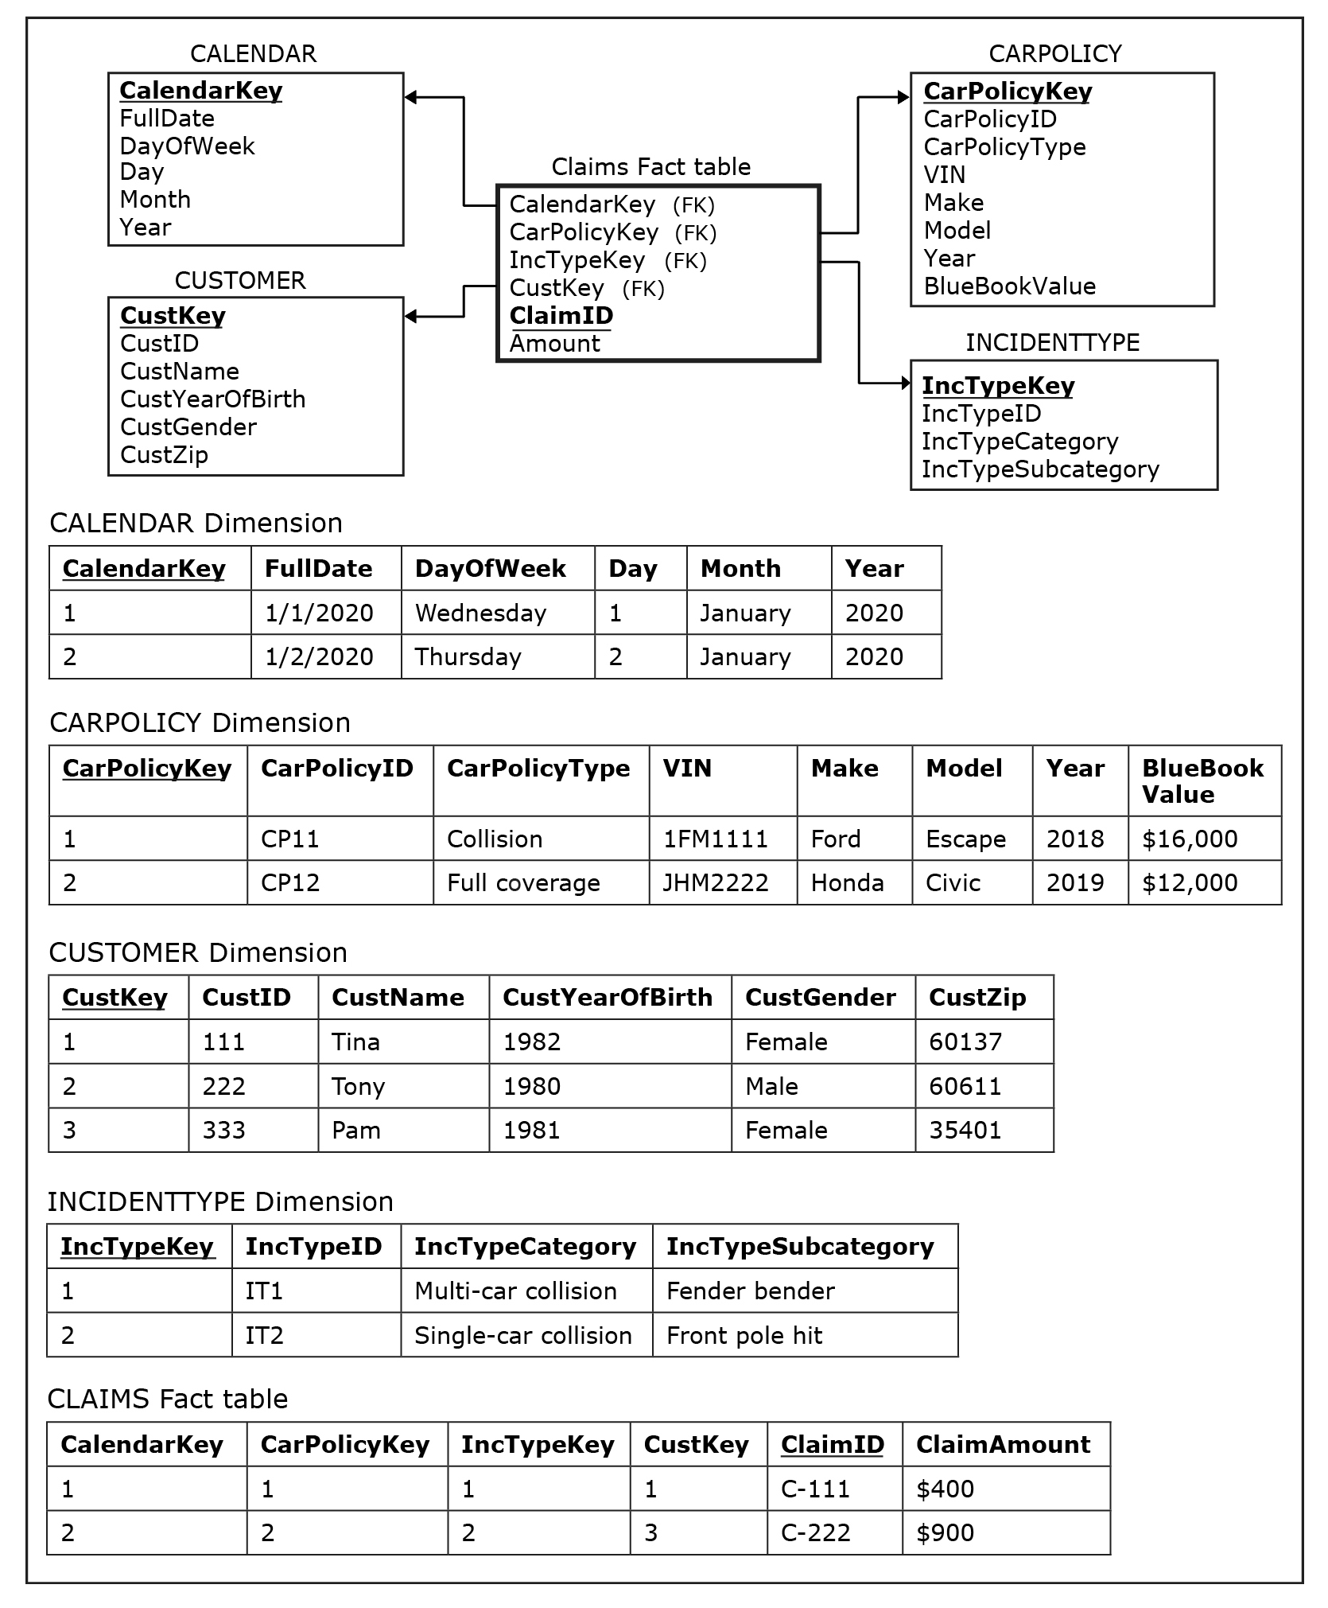
EXAMPLE : Three Types of Data Sets in a Corporation Insurance Company Data Warehouse (Star Schema)
Jukić, Vrbsky, Nestorov, Sharma – Database Systems
Notes:
This example is discussed on Pages 319-322.

Slide 15
EXAMPLE : Three Types of Data Sets in a Corporation Insurance Company Data Warehouse (Sample Data)
Jukić, Vrbsky, Nestorov, Sharma – Database Systems
Notes:
This example is discussed on Pages 319-322.

Slide 16
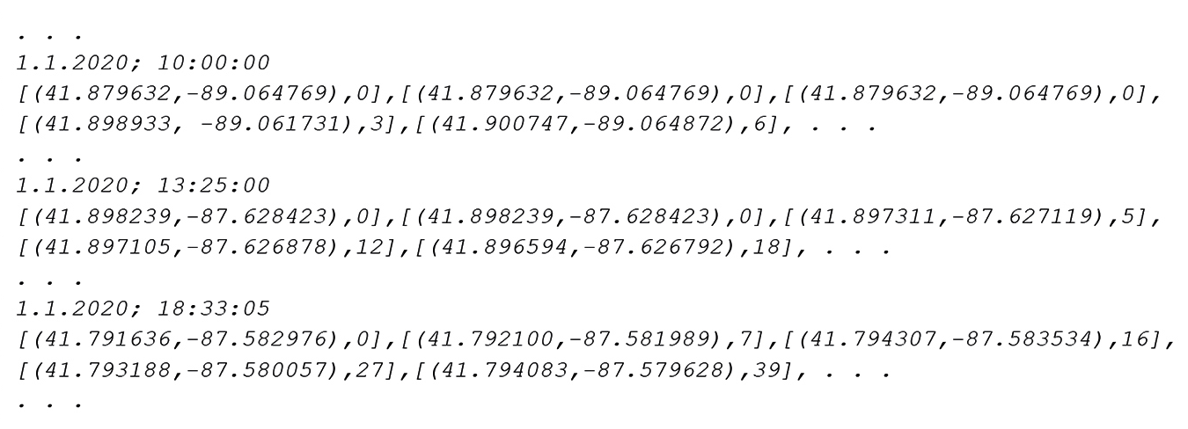
EXAMPLE : Three Types of Data Sets in a Corporation Insurance Company Big Data Set (Sample Data generated by a Telemetry Device)
Jukić, Vrbsky, Nestorov, Sharma – Database Systems
Notes:
This example is discussed on Pages 319-322.

Slide 17
MAPREDUCE AND HADOOP
Standard database and data warehousing technologies cannot adequately
Capture the unstructuredness of big data
Process big data sets and achieve satisfactory performance handling complex queries over big data
MapReduce
An approach for dealing with big data
Map – maps every record into a key-value pair
Reduce - gathers all records with the same key and generates a single output record for every key
Hadoop
Open-source MapReduce implementation
Jukić, Vrbsky, Nestorov, Sharma – Database Systems

Slide 18
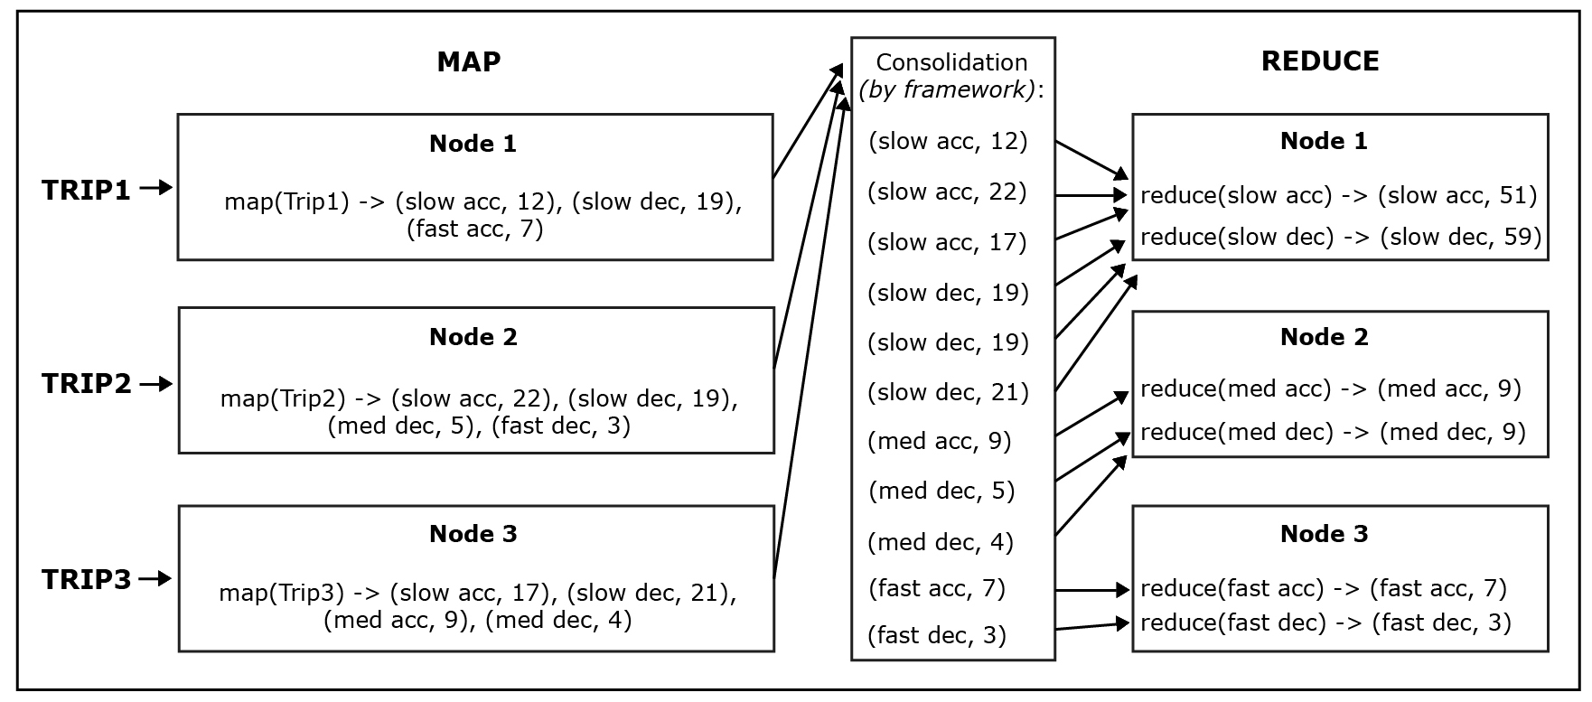
EXAMPLE : MapReduce Processing Insurance Company Big Data Set (Telemetry Data)
Jukić, Vrbsky, Nestorov, Sharma – Database Systems
Notes:
This example is discussed on Pages 322-324.

Slide 19
V’s od BIG DATA
Example – Examining V’s of Big Data
Volume - consider the volume of telemetry data
Variety - consider the variety of devices capable of generating big data
Velocity - consider the velocity of telemetry data
Veracity - consider the possible data quality issues in telemetry data
Variability – consider the possibilities of interpreting telemetry data in different ways
Visualization – consider the possibilities of visualizing and superimposing telemetry data
Value – consider the value provided by telemetry data
Jukić, Vrbsky, Nestorov, Sharma – Database Systems
Notes:
This example is discussed on Page 324.

Slide 20
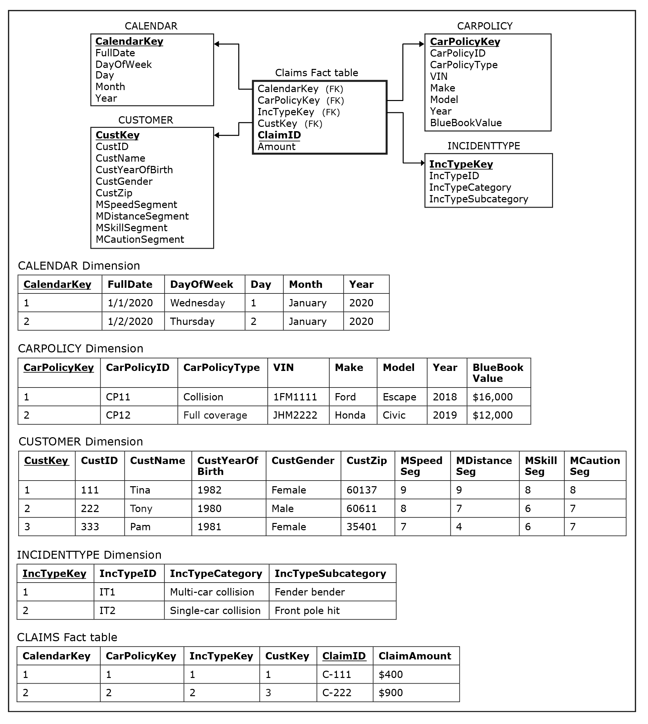
EXAMPLE : Big Data as a Source for a Data Warehouse (Star Schema)
Jukić, Vrbsky, Nestorov, Sharma – Database Systems
Notes:
This example is discussed on Pages 324-326.

Slide 21
EXAMPLE : Big Data as a Source for a Data Warehouse (Sample Data)
Jukić, Vrbsky, Nestorov, Sharma – Database Systems
Notes:
This example is discussed on Pages 324-326.

Slide 22
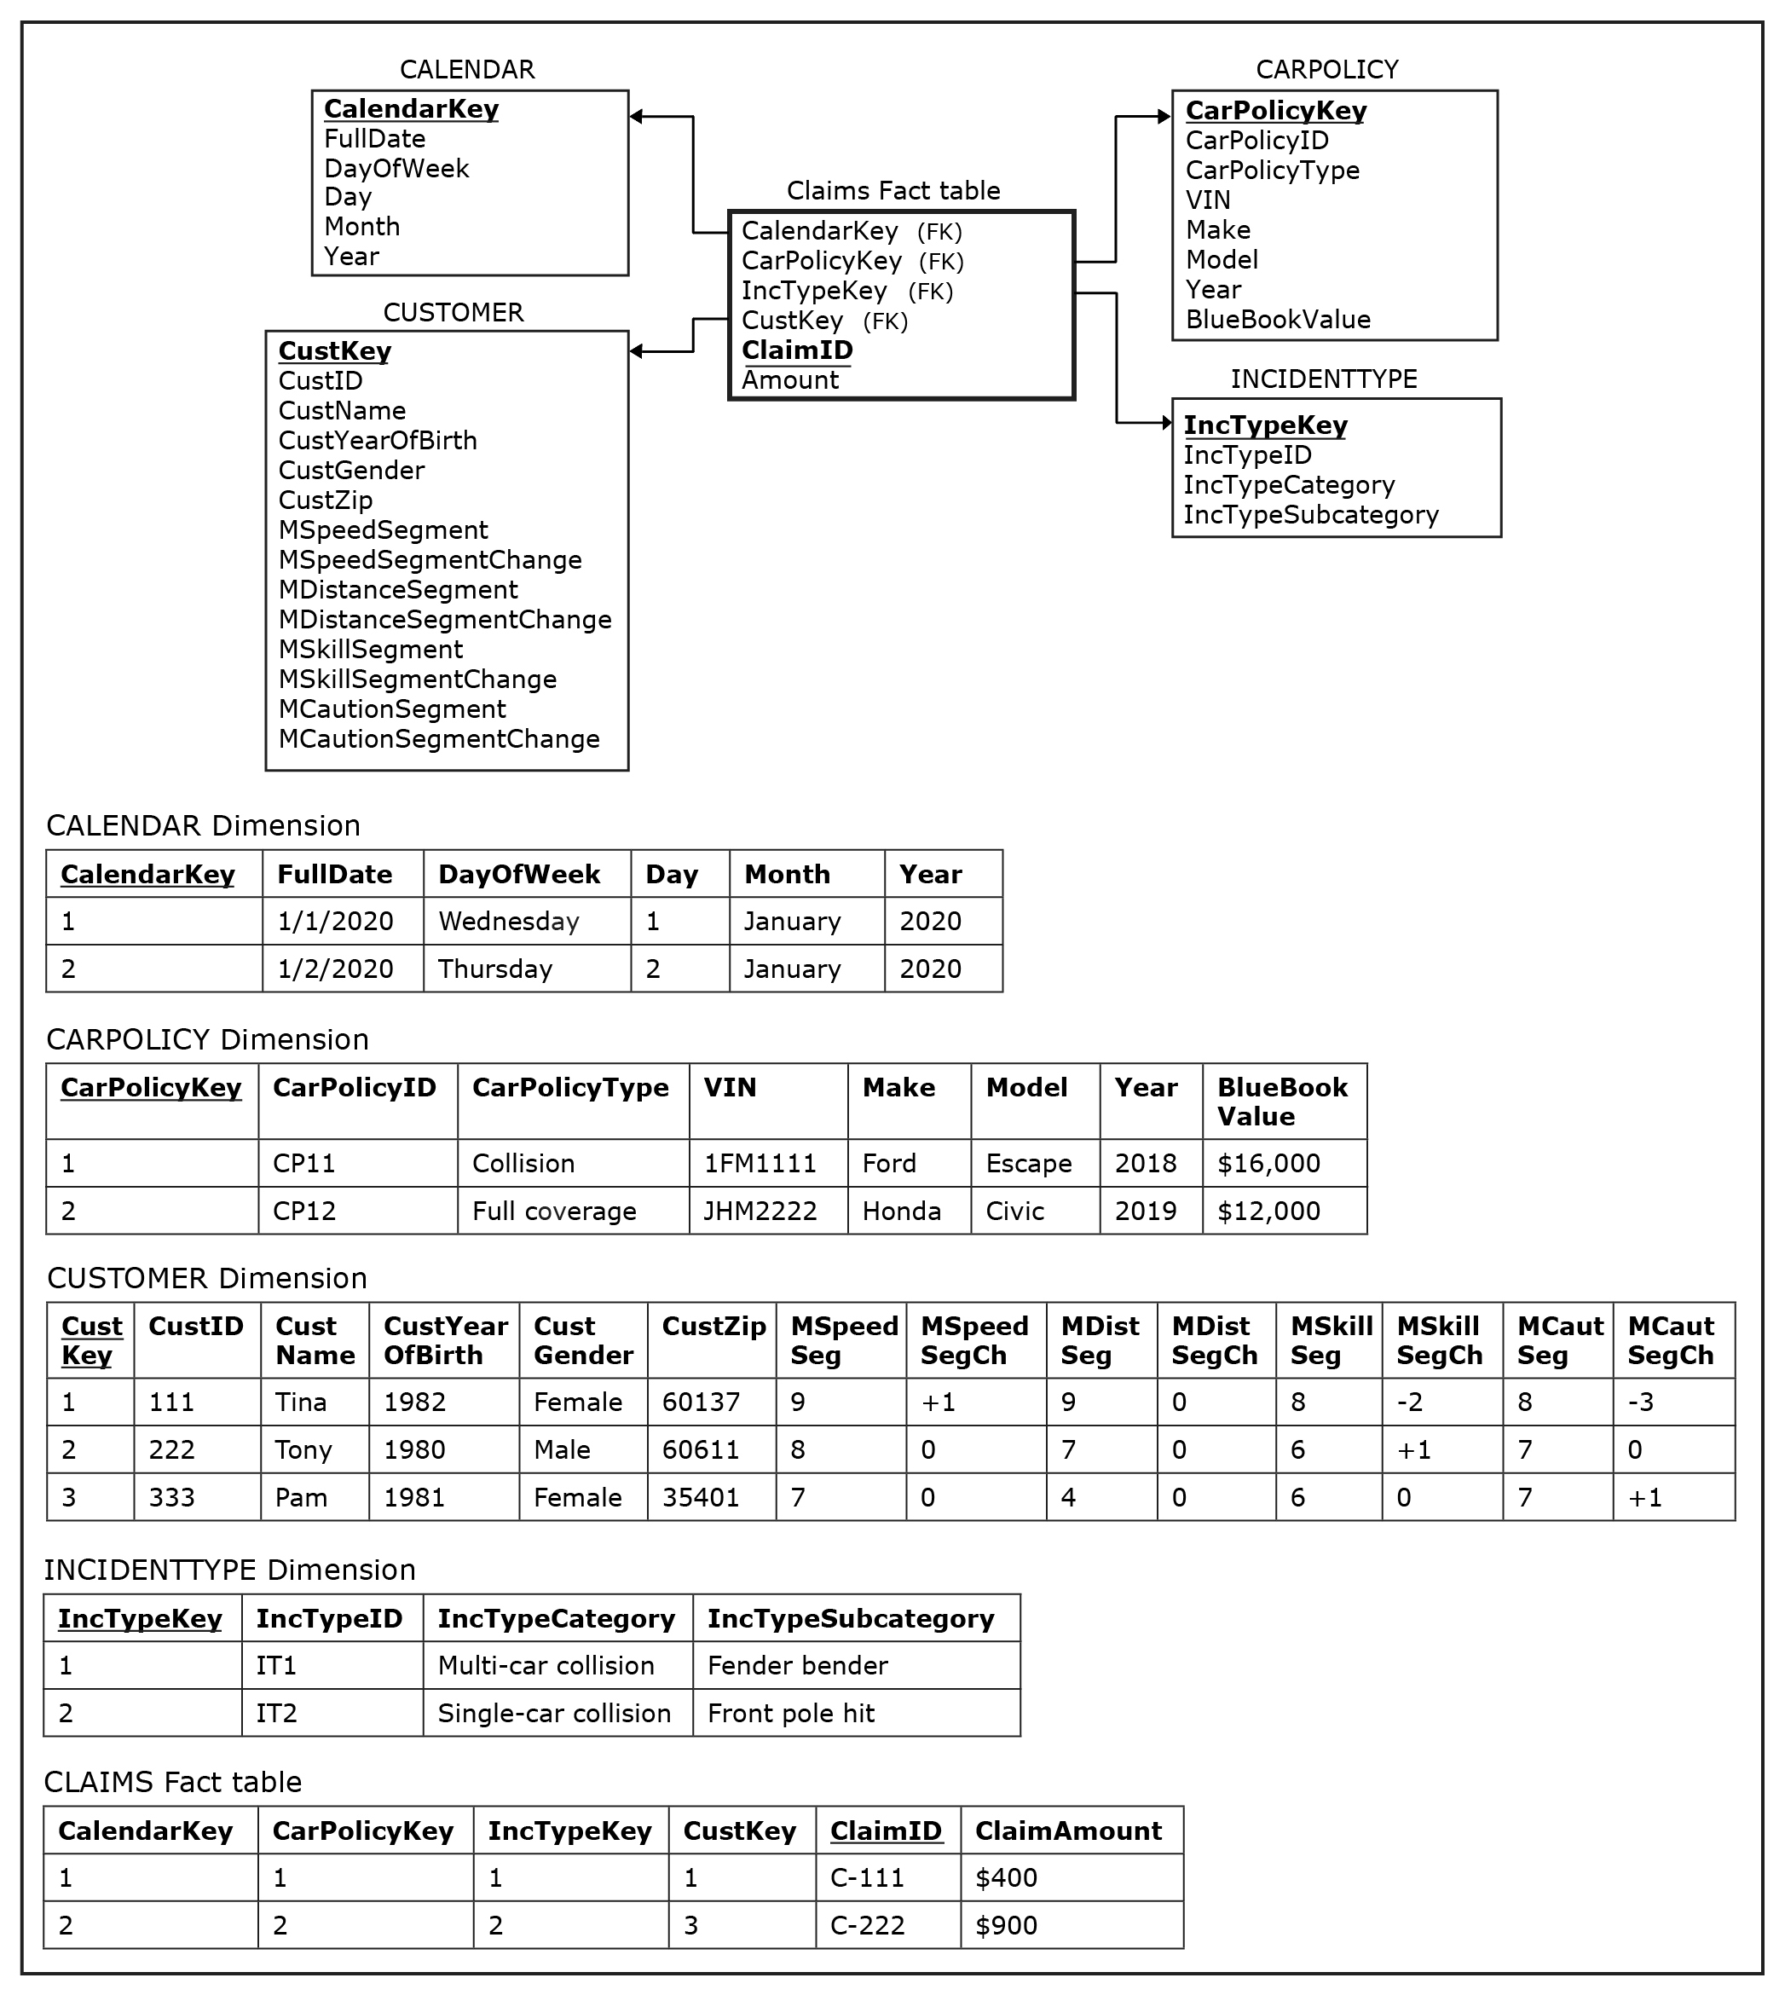
EXPANDED EXAMPLE : Big Data as a Source for a Data Warehouse (Star Schema)
Jukić, Vrbsky, Nestorov, Sharma – Database Systems
Notes:
This example is discussed on Pages 324-327.

Slide 23
EXPANDED EXAMPLE : Big Data as a Source for a Data Warehouse (Sample Data)
Jukić, Vrbsky, Nestorov, Sharma – Database Systems
Notes:
This example is discussed on Pages 324-327.

Slide 24
CORPORATE USE OF BIG DATA
Big data methods:
Increase the ability to analyze the data that the organization owns or to which it has access
It is a mistake to treat big data as a completely separate and distinct data issue
Integrated approach, where a big data initiative goes hand-in-hand with other data projects, is more beneficial
Do not replace database and data warehousing approaches developed for managing and utilizing formally modeled data assets
Instead, they allow organizations to analyze and get insight from the kinds of data that are not suited for regular database and data warehouse technologies
Jukić, Vrbsky, Nestorov, Sharma – Database Systems

Slide 25
DATA LAKE
Data Warehouse
Stores data in a predefined target structure with detailed metadata (e.g., star schemas)
Users retrieve and analyze data
Data Lake
A large data pool in which the schema and data requirements are not defined until the data is queried
Data lake stores vast amount of raw data in its native format until it is needed
This approach is often referred to as schema on read or schema on demand
Users have to prepare and transform data, prior to analyzing it
Jukić, Vrbsky, Nestorov, Sharma – Database Systems

Slide 26
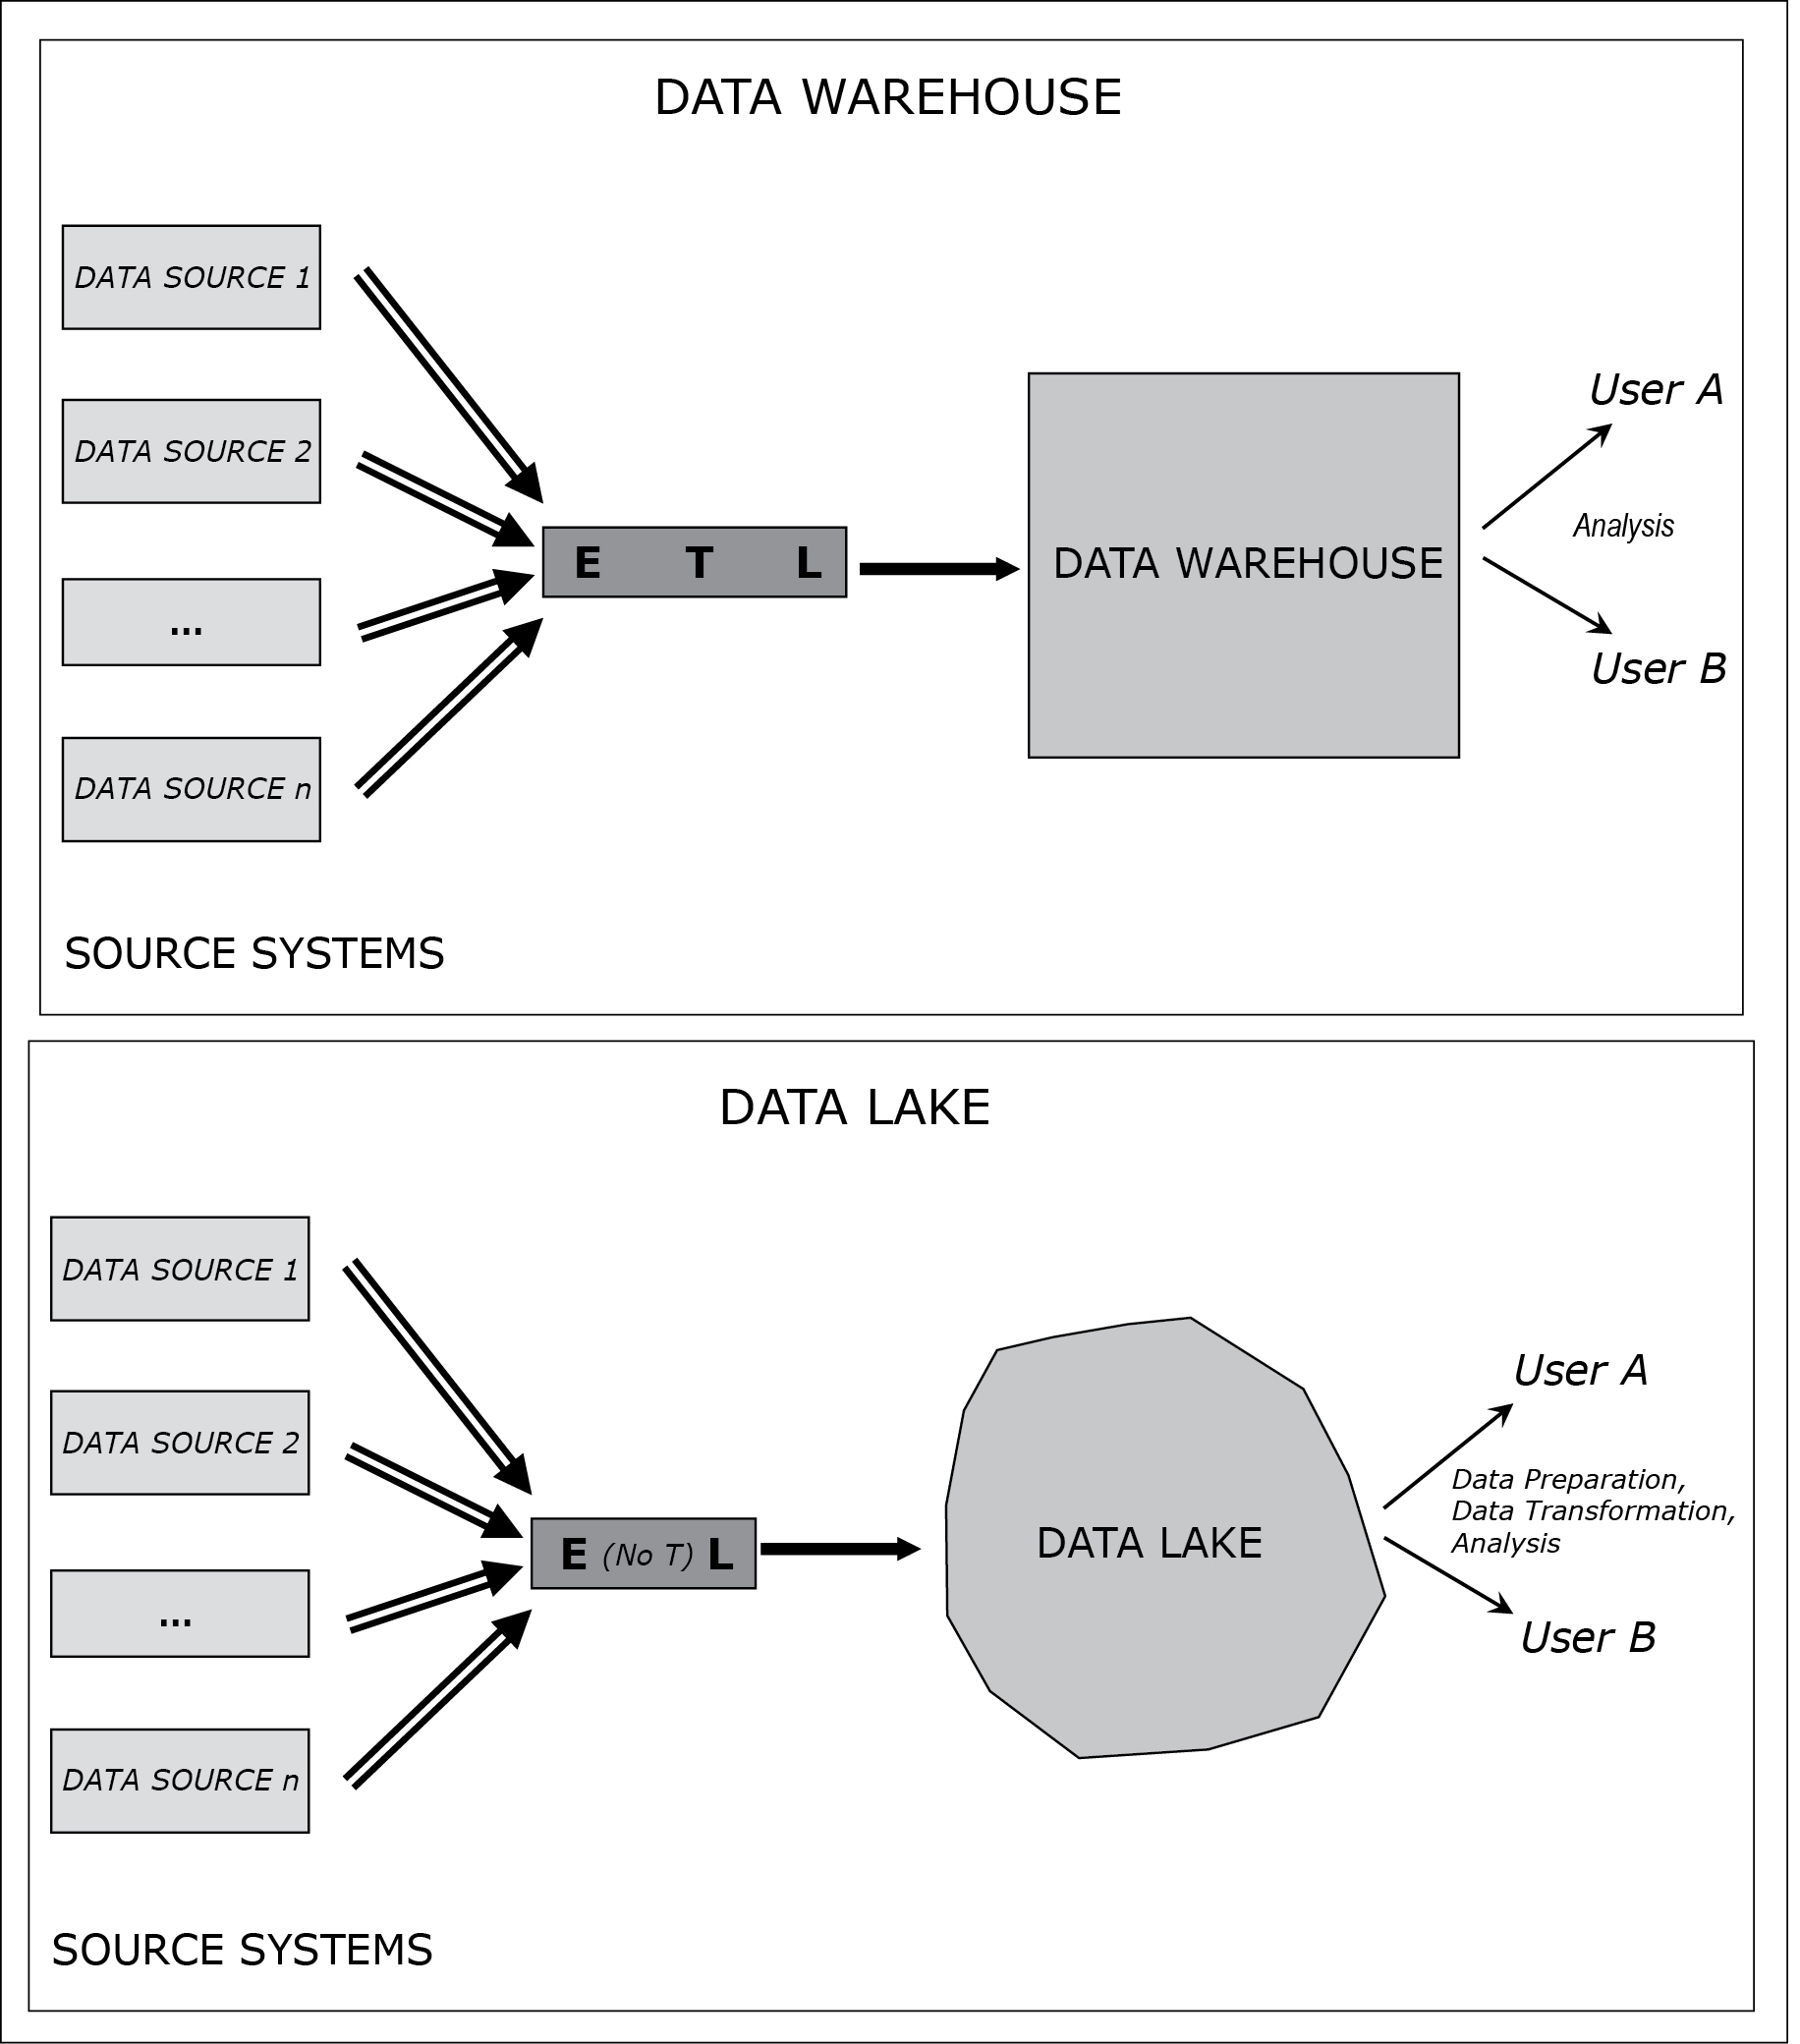
DATA LAKE vs DATA WAREHOUSE
Jukić, Vrbsky, Nestorov, Sharma – Database Systems
Notes:
This example is discussed on Pages 328-329.

Slide 27
DATA LAKE vs DATA WAREHOUSE
Jukić, Vrbsky, Nestorov, Sharma – Database Systems
Notes:
This example is discussed on Pages 328-329.

Slide 28
DATA LAKE
A suitable concept for the storage of big data
Jukić, Vrbsky, Nestorov, Sharma – Database Systems

Slide 29
DATA LAKE
Is Data Lake a suitable alternative for a data warehouse?
OK, if companies consciously and deliberately want to have a cheaper and more flexible approach, while at the same time a less organized and less powerful approach to the analysis of some of their structured data
Not OK, if companies take a superficial view of data lakes as an equivalent (and yet somehow magically cheaper) alternative to data warehouses,
In such cases, companies end up with an unwieldy mass of disparate data (i.e. data jungle or data swamp)
This requires analysts to devote most of their efforts to locating and preparing the needed data, while sacrificing the amount of time they can devote to actual analysis
Jukić, Vrbsky, Nestorov, Sharma – Database Systems

Slide 30
DATA LAKE
Data Warehouse vs Data Lake
Analogy: agriculture vs hunting/gathering
Jukić, Vrbsky, Nestorov, Sharma – Database Systems
Notes:
This example is discussed on Page 329.

Slide 31
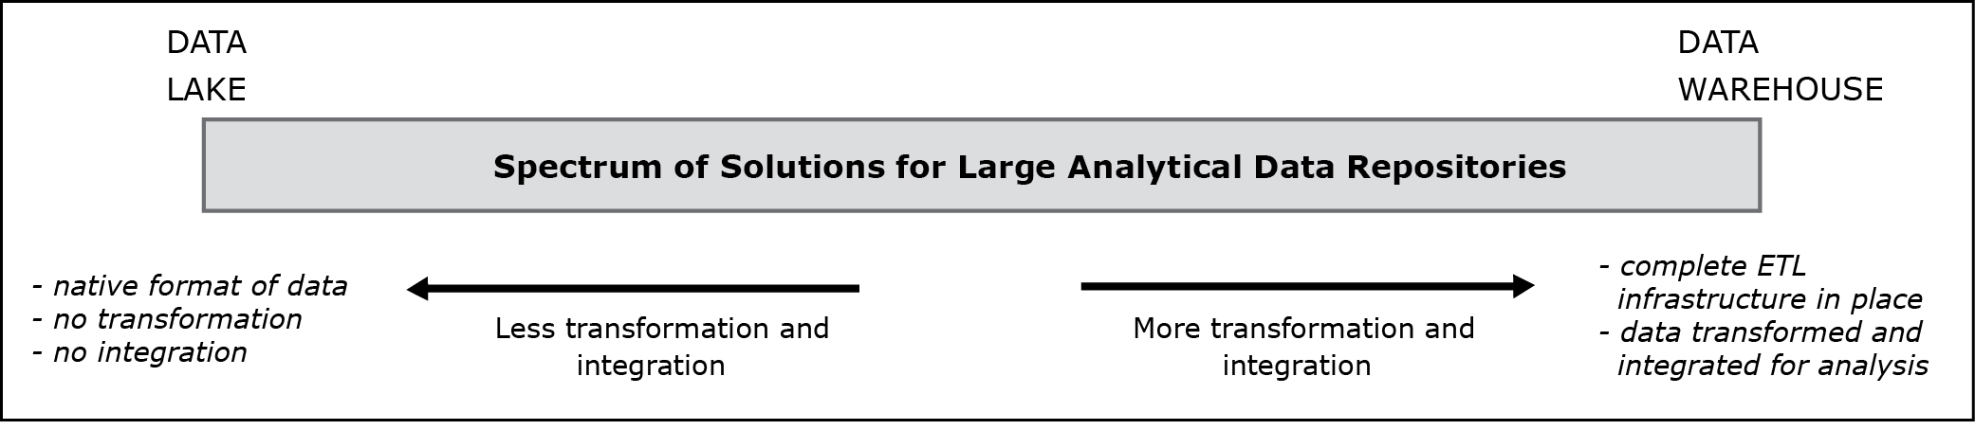
DATA LAKE
Spectrum of Solutions for Large Analytical Data Repositories
Jukić, Vrbsky, Nestorov, Sharma – Database Systems
Notes:
Fully developed data warehouse and a data lake are at the opposite ends of a broad spectrum of solutions for large analytical data repositories.

Slide 32
DATA LAKE
Spectrum of Solutions for Large Analytical Data Repositories
A fully developed data warehouse and a data lake are at the opposite ends of a broad spectrum of solutions for large analytical data repositories
An example inside the spectrum
Quick and simple transformations of source data to merge data into a standardized form for ad-hoc use, without necessarily having elaborate star schemas and surrogate keys
In practice, within this spectrum, it is common to hear the terms “data warehouse” or “data lake” used loosely (by people not adhering to proper definitions of these terms) to describe solutions that do not necessarily refer to the ends of the spectrum
Jukić, Vrbsky, Nestorov, Sharma – Database Systems
Notes:
This example is discussed on Page 329.

Slide 33
DATA LAKE
Spectrum of Solutions for Large Analytical Data Repositories
Allows for solutions that combine the use of data warehouses and data lakes
Example:
The most commonly used analytical data is kept in a data warehouse
As needed, this data can be combined with the data from a data lake for more complex and explorative analytical solutions
Jukić, Vrbsky, Nestorov, Sharma – Database Systems
Notes:
This example is discussed on Pages 329-330.

