Slide 1


1
Functions and Limits
Copyright © Cengage Learning. All rights reserved.

Slide 2

The Tangent and Velocity Problems
1.4
Copyright © Cengage Learning. All rights reserved.

Slide 3
The Tangent Problem

Slide 4
The Tangent Problems
The word tangent is derived from the Latin word tangens, which means “touching.”
Thus a tangent to a curve is a line that touches the curve.
In other words, a tangent line should have the same direction as the curve at the point of contact.

Slide 5
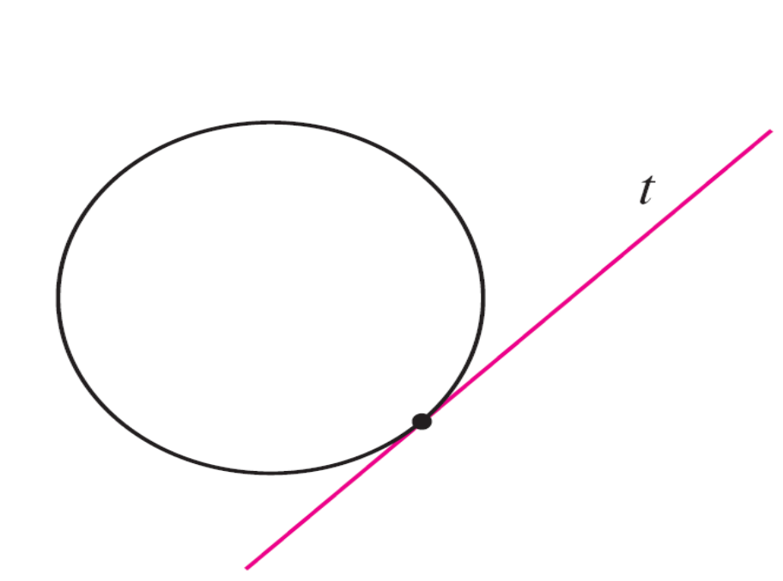
The Tangent Problems
For a circle we could simply follow Euclid and say that a tangent is a line that intersects the circle once and only once, as in Figure 1(a).
Figure 1(a)

Slide 6
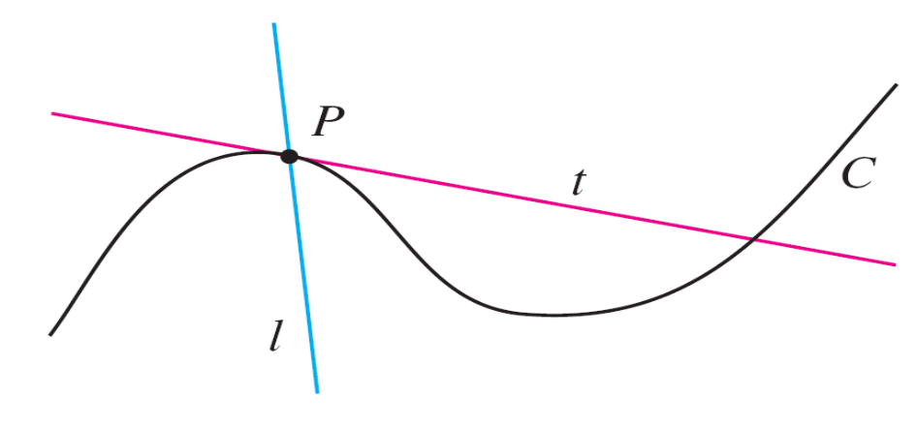
The Tangent Problems
For more complicated curves this definition is inadequate. Figure 1(b) shows two lines l and t passing through a point
P on a curve C.
The line l intersects
C only once, but it
certainly does not look
like what we think of
as a tangent.
The line t, on the other hand, looks like a tangent but it
intersects C twice.
Figure 1(b)

Slide 7
Example 1
Find an equation of the tangent line to the parabola y = x² at the point P(1, 1).
Solution:
We will be able to find an equation of the tangent line t as soon as we know its slope m.
The difficulty is that we know only one point, P, on t, whereas we need two points to compute the slope.

Slide 8
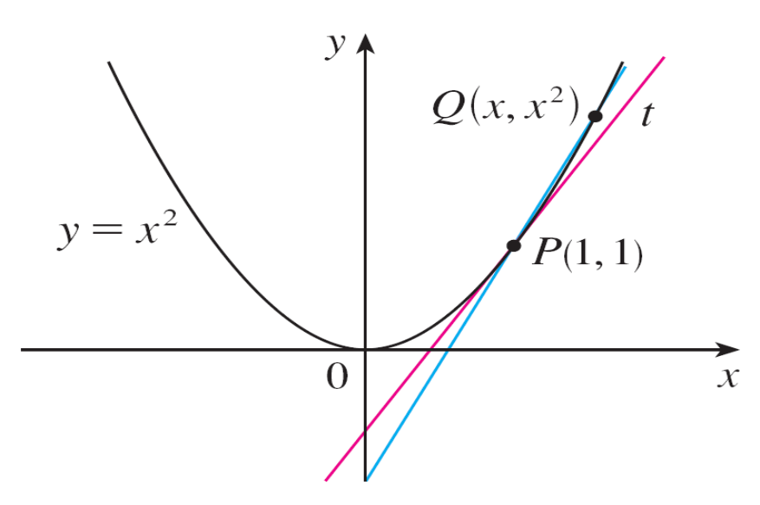
Example 1 – Solution
cont’d
But observe that we can compute an approximation to m by
choosing a near by point Q (x, x²) on the parabola (as in Figure 2) and computing the slope m_{PQ} of the secant line PQ. [A secant line, from the Latin word secans, meaning cutting, is a line that cuts (intersects) a curve more than once.]
Figure 2

Slide 9
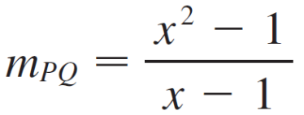
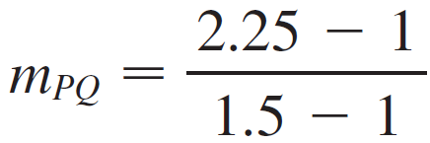
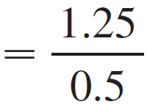

Example 1 – Solution
cont’d
We choose x ≠ 1 so that Q ≠ P . Then
For instance, for the point Q(1.5, 2.25) we have

Slide 10
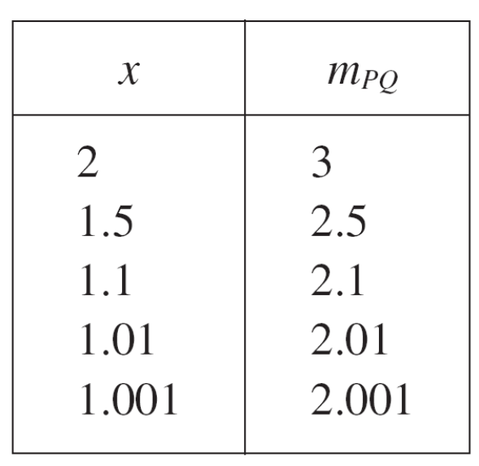
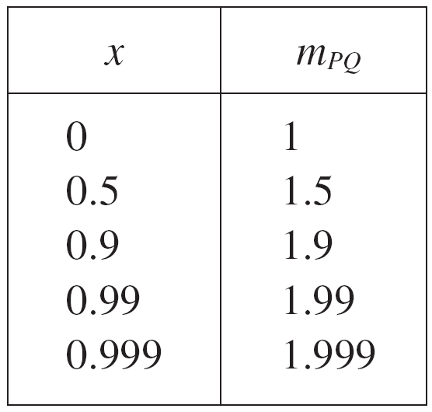
Example 1 – Solution
cont’d
The tables in the margin show the values of m_{PQ} for several values of x close to 1.
The closer Q is to P, the closer x is to 1 and, it appears from the tables, the closer m_{PQ} is to 2.

Slide 11
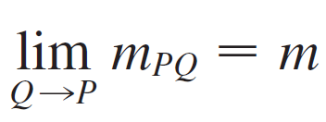
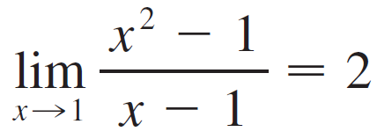
Example 1 – Solution
cont’d
This suggests that the slope of the tangent line t should be
m = 2.
We say that the slope of the tangent line is the limit of the slopes of the secant lines, and we express this symbolically by writing
and
Assuming that the slope of the tangent line is indeed 2, we use the point-slope form of the equation of a line to write the equation of the tangent line through (1, 1) as
y – 1 = 2(x – 1) or y = 2x – 1

Slide 12
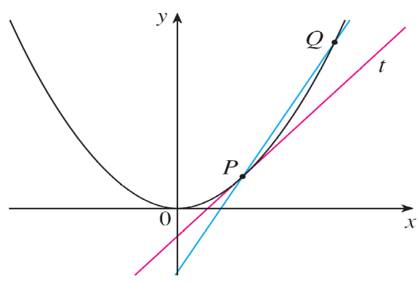
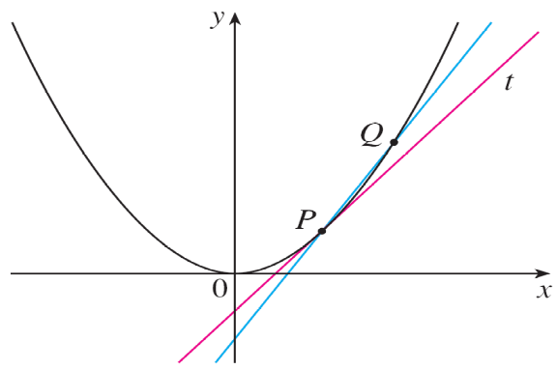
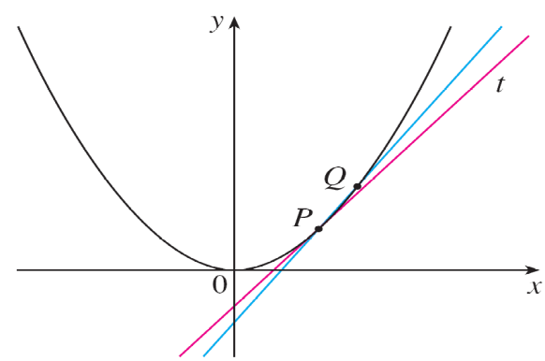
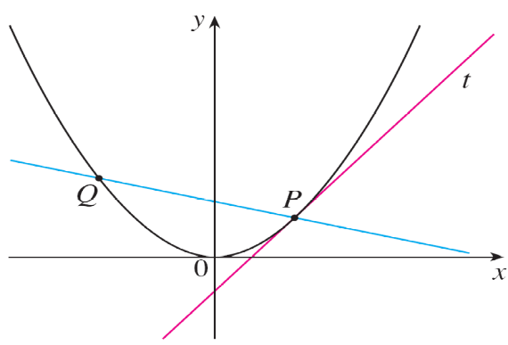
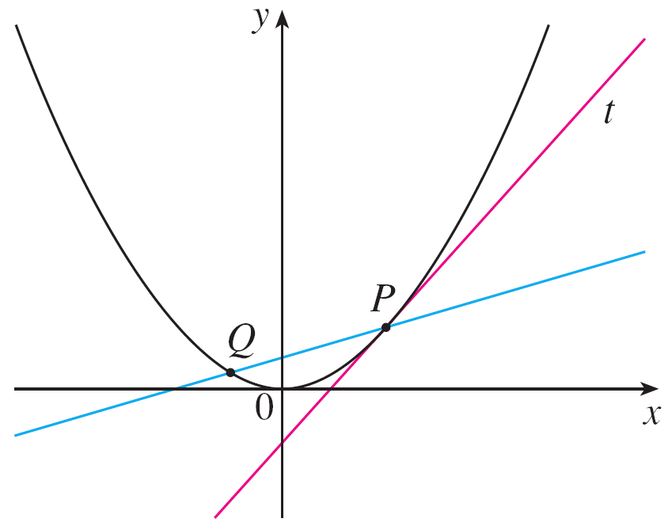
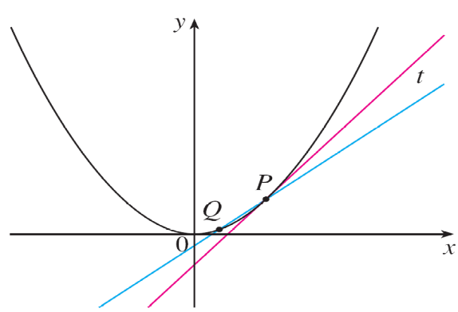
Example 1 – Solution
cont’d
Figure 3 illustrates the limiting process that occurs in this example.
Q approaches P from the right
Q approaches P from the left
Figure 3

Slide 13
Example 1 – Solution
cont’d
As Q approaches P along the parabola, the corresponding secant lines rotate about P and approach the tangent line t.

Slide 14
The Velocity Problem

Slide 15
Example 3
Suppose that a ball is dropped from the upper observation deck of the CN Tower in Toronto, 450 m above the ground. Find the velocity of the ball after 5 seconds.
Solution:
Through experiments carried out four centuries ago, Galileo discovered that the distance fallen by any freely falling body is proportional to the square of the time it has been falling. (This model for free fall neglects air resistance.)
If the distance fallen after t seconds is denoted by s (t) and measured in meters, then Galileo’s law is expressed by the equation s (t) = 4.9t ²

Slide 16
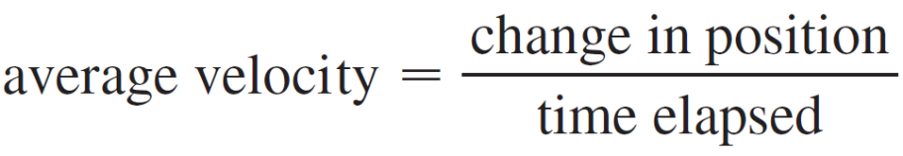
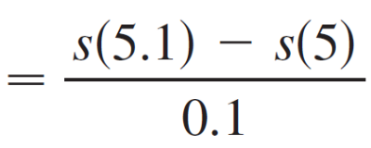
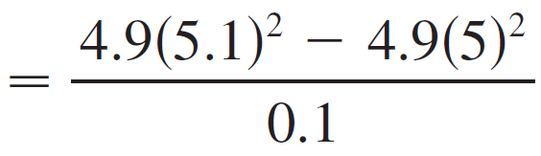

Example 3 – Solution
cont’d
The difficulty in finding the velocity after 5 s is that we are dealing with a single instant of time (t = 5), so no time interval is involved.
However, we can approximate the desired quantity by computing the average velocity over the brief time interval of a tenth of a second from t = 5 to t = 5.1:

Slide 17
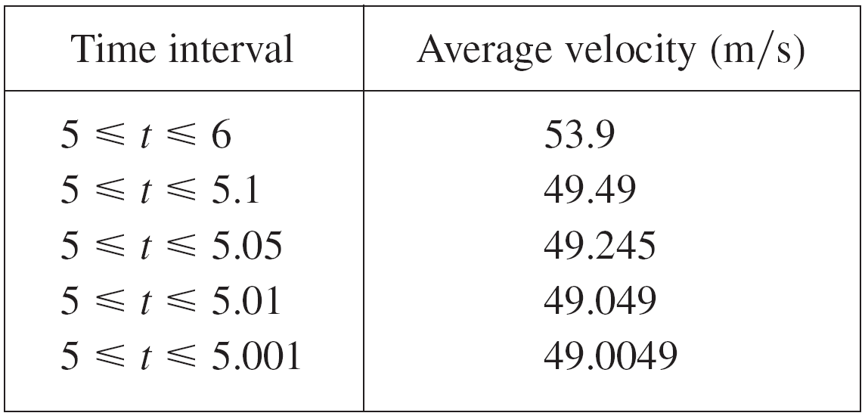
Example 3 – Solution
cont’d
The following table shows the results of similar calculations of the average velocity over successively smaller time periods.

Slide 18
Example 3 – Solution
cont’d
It appears that as we shorten the time period, the average velocity is becoming closer to 49 m/s.
The instantaneous velocity when t = 5 is defined to be the limiting value of these average velocities over shorter and shorter time periods that start at t = 5.
Thus the (instantaneous) velocity after 5 s is
v = 49 m/s

