Slide 1


1
Functions and Limits
Copyright © Cengage Learning. All rights reserved.

Slide 2

The Precise Definition
of a Limit
1.7
Copyright © Cengage Learning. All rights reserved.

Slide 3
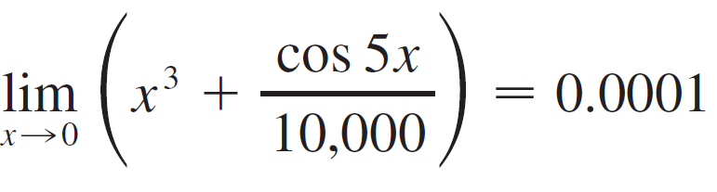
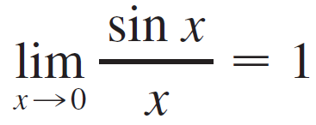
The Precise Definition of a Limit
The intuitive definition of a limit is inadequate for some purposes because such phrases as “x is close to 2” and “f ( x) gets closer and closer to L” are vague.
In order to be able to prove conclusively that
or
we must make the definition of a limit precise.

Slide 4
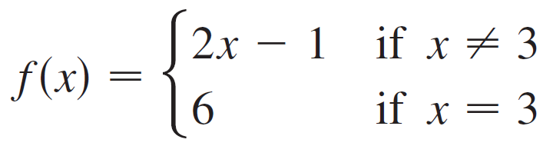
The Precise Definition of a Limit
To motivate the precise definition of a limit, let’s consider the function
Intuitively, it is clear that when x is close to 3 but x ≠ 3, then f (x) is close to 5, and so lim_{x → 3}f (x) = 5.
To obtain more detailed information about how f (x) varies when x is close to 3, we ask the following question:
How close to 3 does x have to be so that f (x) differs from 5 by less than 0.1?

Slide 5
The Precise Definition of a Limit
The distance from x to 3 is | x – 3 | and the distance from
f (x) to 5 is | f (x) – 5 |, so our problem is to find a number δ such that
| f ( x) – 5 | < 0.1 if | x – 3 | < δ but x ≠ 3
If | x – 3 | > 0, then x ≠ 3, so an equivalent formulation of our problem is to find a number δ such that
| f ( x) – 5 | < 0.1 if 0 < | x – 3 | < δ

Slide 6
The Precise Definition of a Limit
Notice that if 0 < | x – 3 | < (0.1)/2 = 0.05 then
| f ( x) – 5 | = | (2x – 1) – 5 | = | 2x – 6 |
= 2| x – 3 | < 2(0.05) = 0.1
that is,
| f ( x) – 5 | < 0.1 if 0 < | x – 3 | < 0.05
Thus an answer to the problem is given by δ = 0.05; that is, if x is within a distance of 0.05 from 3, then f ( x) will be within a distance of 0.1 from 5.

Slide 7
The Precise Definition of a Limit
If we change the number 0.1 in our problem to the smaller number 0.01, then by using the same method we find that
f ( x) will differ from 5 by less than 0.01 provided that x differs from 3 by less than (0.01)/2 = 0.005:
| f ( x) – 5 | < 0.01 if 0 < | x – 3 | < 0.005
Similarly,
| f ( x) – 5 | < 0.001 if 0 < | x – 3 | < 0.0005
The numbers 0.1, 0.01 and 0.001 that we have considered are error tolerances that we might allow.

Slide 8


The Precise Definition of a Limit
For 5 to be the precise limit of f ( x) as x approaches 3, we must not only be able to bring the difference between f ( x) and 5 below each of these three numbers; we must be able to bring it below any positive number.
And, by the same reasoning, we can! If we write ε (the Greek letter epsilon) for an arbitrary positive number, then we find as before that
| f ( x) – 5 | < ε if 0 < | x – 3 | < δ =

Slide 9

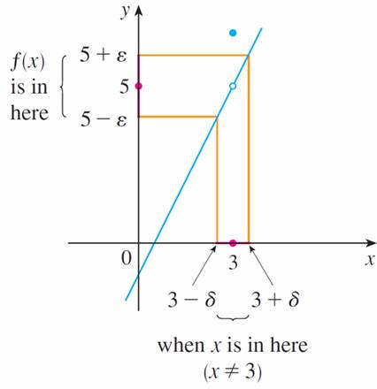
The Precise Definition of a Limit
This is a precise way of saying that f (x) is close to 5 when x is close to 3 because says that we can make the values of f (x) within an arbitrary distance ε from 5 by taking the values of x within a distance ε/2 from 3 (but x ≠ 3).
Note that can be rewritten as
follows: if
3 – δ < x < 3 + δ (x ≠ 3)
then
5 – ε < f ( x) < 5 + ε
and this is illustrated in Figure 1.
Figure 1

Slide 10
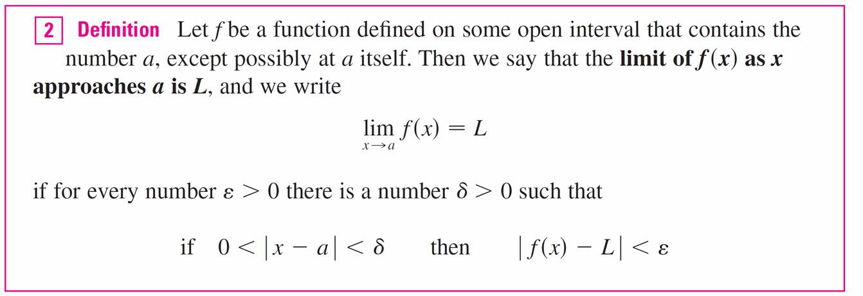
The Precise Definition of a Limit
By taking the values of x (≠ 3) to lie in the interval
(3 – δ, 3 + δ) we can make the values of f (x) lie in the interval (5 – ε, 5 + ε).
Using as a model, we give a precise definition of a limit.

Slide 11
The Precise Definition of a Limit
Since | x – a | is the distance from x to a and | f ( x) – L | is the distance from f ( x) to L, and since ε can be arbitrarily small, the definition of a limit can be expressed in words as follows:
lim_{x → a} f ( x) = L
means that the distance between f ( x) and L can be made
arbitrarily small by taking the distance from x to a sufficiently small (but not 0).

Slide 12
The Precise Definition of a Limit
Alternatively,
lim_{x → a} f ( x) = L
the values of f (x) can be made as close as we please to L by taking x close enough to a (but not equal to a).

Slide 13
The Precise Definition of a Limit
We can also reformulate Definition 2 in terms of intervals by observing that the inequality | x – a | < δ is equivalent to –δ < x – a < δ, which in turn can be written as
a – δ < x < a + δ.
Also 0 < | x – a | is true if and only if x – a ≠ 0, that is, x ≠ a.

Slide 14
The Precise Definition of a Limit
Similarly, the inequality | f ( x) – L | < ε is equivalent to the pair of inequalities L – ε < f ( x) < L + ε. Therefore, in terms of intervals, Definition 2 can be stated as follows:
lim_{x → a} f (x) = L
means that for every ε > 0 (no matter how small ε is) we can find δ > 0 such that if x lies in the open interval
(a – δ, a + δ) and x ≠ a, then f ( x) lies in
the open interval (L – ε, L + ε).

Slide 15

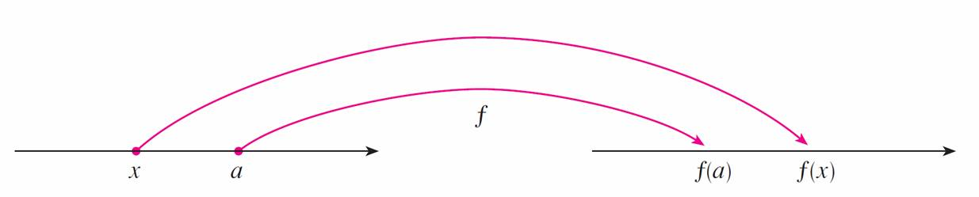
The Precise Definition of a Limit
We interpret this statement geometrically by representing a function by an arrow diagram as in Figure 2, where f maps a subset of onto another subset of .
Figure 2

Slide 16
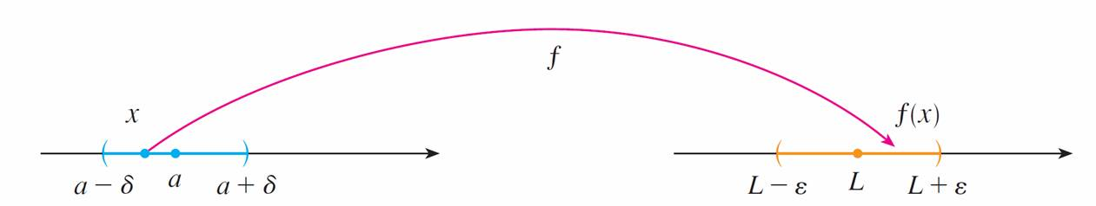
The Precise Definition of a Limit
The definition of limit says that if any small interval
(L – ε, L + ε) is given around L, then we can find an interval (a – δ, a + δ) around a such that f maps all the points in
(a – δ, a + δ) (except possibly a) into the interval
(L – ε, L + ε). (See Figure 3.)
Figure 3

Slide 17
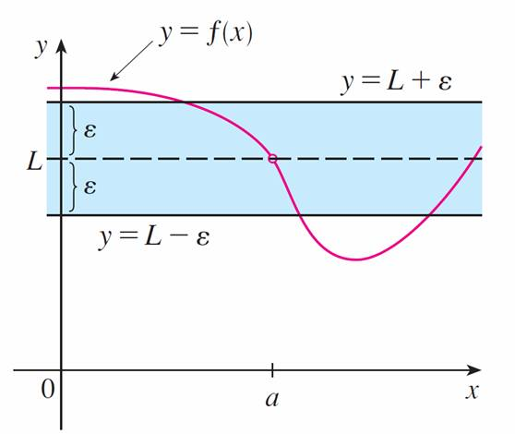
The Precise Definition of a Limit
Another geometric interpretation of limits can be given in terms of the graph of a function. If ε > 0 is given, then we draw the horizontal lines y = L + ε and y = L – ε and the graph of f. (See Figure 4.)
Figure 4

Slide 18
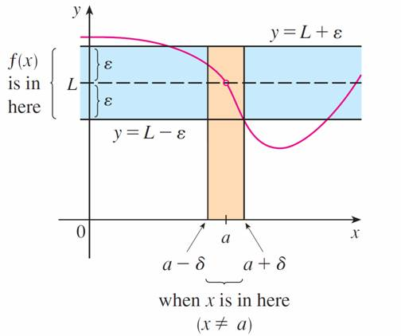
The Precise Definition of a Limit
If lim_{x → a} f (x) = L, then we can find a number δ > 0 such that if we restrict x to lie in the interval (a – δ, a + δ) and take
x ≠ a, then the curve y = f ( x) lies between the lines
y = L – ε and y = L + ε (See Figure 5.) You can see that if such a δ has been found, then any smaller δ will also work.
Figure 5

Slide 19
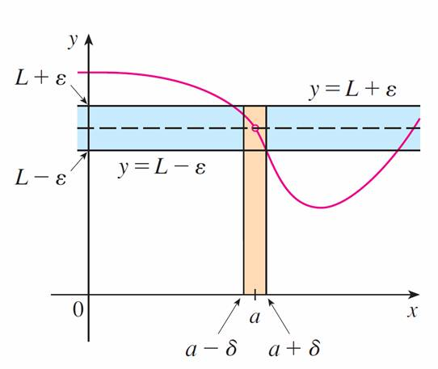
The Precise Definition of a Limit
It is important to realize that the process illustrated in Figures 4 and 5 must work for every positive number ε, no matter how small it is chosen. Figure 6 shows that if a smaller ε is chosen, then a smaller δ may be required.
Figure 6

Slide 20
Example 1
Use a graph to find a number δ such that
if | x – 1 | < δ then | (x³ – 5x + 6) – 2 | < 0.2
In other words, find a number δ that corresponds to ε = 0.2 in the definition of a limit for the function f (x) = x³ – 5x + 6 with a = 1 and L = 2.

Slide 21
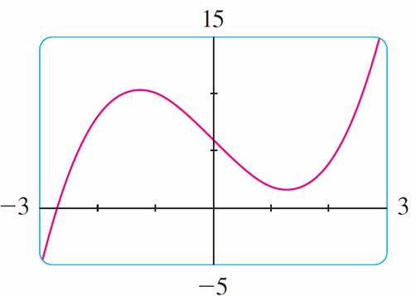
Example 1 – Solution
cont’d
A graph of f is shown in Figure 7; we are interested in the region near the point (1, 2).
Notice that we can rewrite the inequality
| (x³ – 5x + 6) – 2 | < 0.2
as 1.8 < x³ – 5x + 6 < 2.2
Figure 7

Slide 22
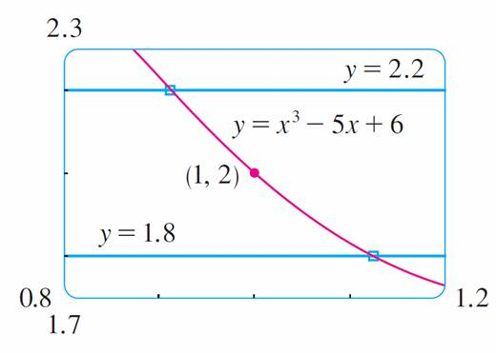
Example 1 – Solution
cont’d
So we need to determine the values of for x which the curve y = x³ – 5x + 6 lies between the horizontal lines
y = 1.8 and y = 2.2.
Therefore we graph the curves y = x³ – 5x + 6, y = 1.8, and y = 2.2 near the point (1,2) in Figure 8.
Figure 8

Slide 23
Example 1 – Solution
cont’d
Then we use the cursor to estimate that the x-coordinate of the point of intersection of the line y = 2.2 and the curve y = x³ – 5x + 6 is about 0.911. Similarly, y = x³ – 5x + 6 intersects the line y = 1.8 when x ≈ 1.124. So, rounding to be safe, we can say that
if 0.92 < x < 1.12 then 1.8 < x³ – 5x + 6 < 2.2
This interval (0.92, 1.12) is not symmetric about x = 1. The distance from x = 1 to the left endpoint is 1 – 0.92 = 0.08 and the distance to the right endpoint is 0.12. We can choose δ to be the smaller of these numbers, that is,
δ = 0.08.

Slide 24
Example 1 – Solution
cont’d
Then we can rewrite our inequalities in terms of distances as follows:
if | x – 1 | < 0.08 then | ( x³ – 5x + 6) – 2 | < 0.2
This just says that by keeping x within 0.08 of 1, we are able to keep f ( x) within 0.2 of 2.
Although we chose δ = 0.08, any smaller positive value of δ would also have worked.

Slide 25

Example 2
Prove that
Solution:
1. Preliminary analysis of the problem (guessing a value
for δ). Let ε be a given positive number. We want to find
a number δ such that
if 0 < | x – 3 | < δ then | (4x – 5) – 7 | < ε
But | (4x – 5) – 7 | = | 4x – 12 | = | 4(x – 3) | = 4| x – 3 |.

Slide 26

Example 2 – Solution
cont’d
Therefore we want δ such that
if 0 < | x – 3 | < δ then 4| x – 3 | < ε
that is, if 0 < | x – 3 | < δ then | x – 3 | <
This suggests that we should choose δ = ε/4.

Slide 27
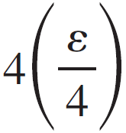
Example 2 – Solution
cont’d
2. Proof (showing that this works). Given ε > 0, choose δ = ε/4. If 0 < | x – 3 | < δ, then
| (4x – 5) – 7 | = | 4x – 12 | = 4| x – 3 | < 4δ = = ε
Thus
if 0 < | x – 3 | < δ then | (4x – 5) – 7 | < ε

Slide 28
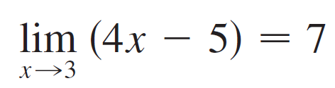
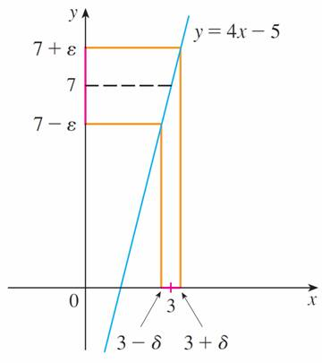
Example 2 – Solution
cont’d
Therefore, by the definition of a limit,
This example is illustrated by Figure 9.
Figure 9

Slide 29
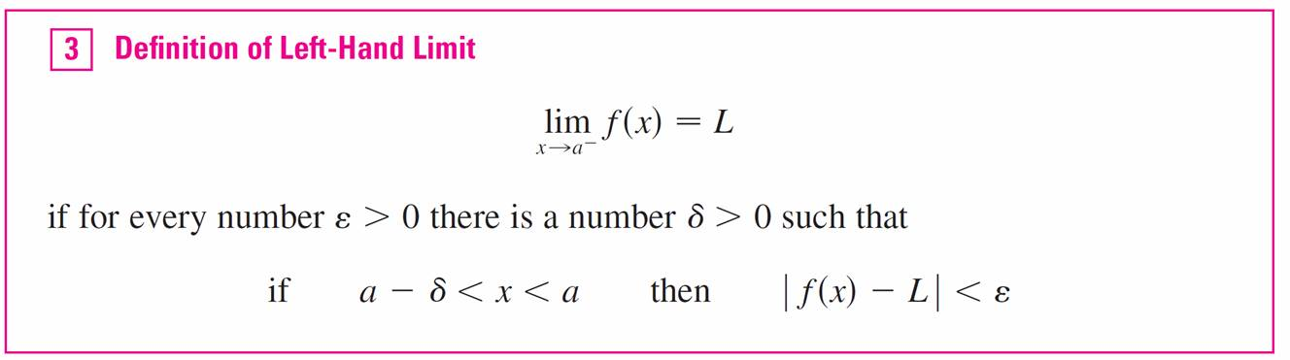
The Precise Definition of a Limit
The intuitive definitions of one-sided limits can be precisely reformulated as follows.

Slide 30
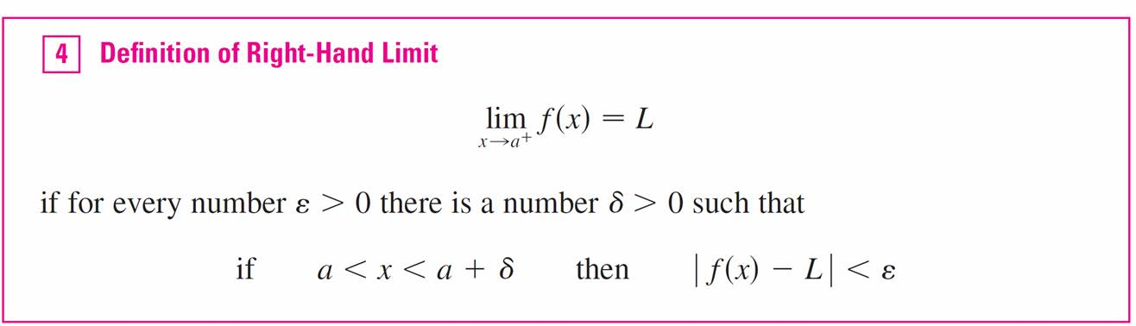
The Precise Definition of a Limit

Slide 31
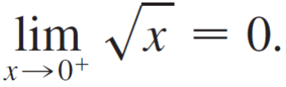
Example 3
Use Definition 4 to prove that

Slide 32

Example 3 – Solution
1. Guessing a value for δ. Let ε be a given positive number.
Here a = 0 and L = 0, so we want to find a number δ
such that
if 0 < x < δ then | – 0 | < ε
that is,
if 0 < x < δ then < ε
or, squaring both sides of the inequality < ε, we get
if 0 < x < δ then x < ε²
This suggests that we should choose δ = ε².

Slide 33
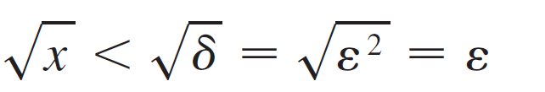

Example 3 – Solution
cont’d
2. Showing that this δ works. Given ε > 0, let δ = ε². If
0 < x < δ, then
so | – 0 | < ε
According to Definition 4, this shows that

Slide 34
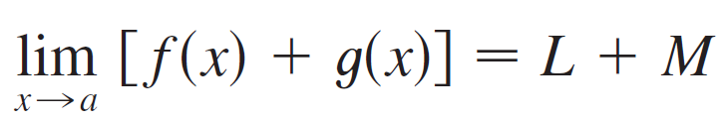
The Precise Definition of a Limit
If lim_{x → a} f ( x) = L and lim_{x → a} g ( x) = M both exist, then

Slide 35
Infinite Limits

Slide 36
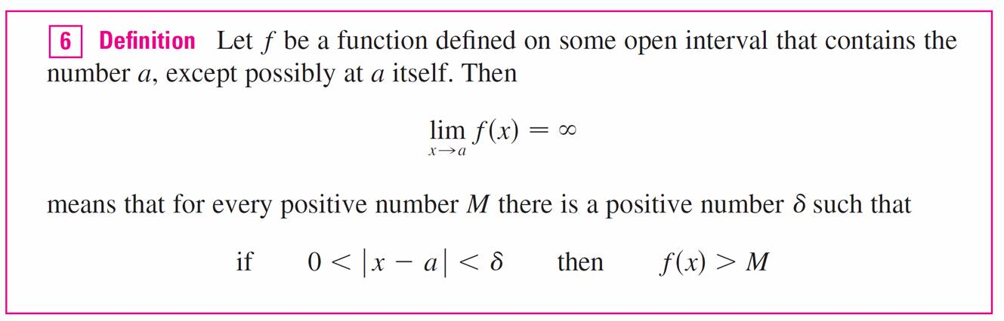
Infinite Limits
Infinite limits can also be defined in a precise way.

Slide 37
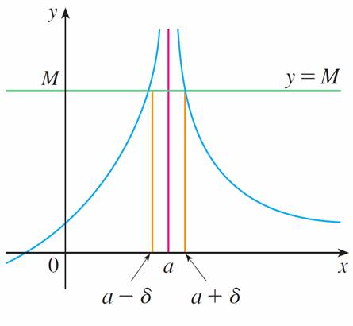
Infinite Limits
This says that the values of f ( x) can be made arbitrarily large (larger than any given number M) by taking x close enough to a (within a distance δ, where δ depends on M, but with
x ≠ a). A geometric illustration is shown in Figure 10.
Figure 10

Slide 38
Infinite Limits
Given any horizontal line y = M, we can find a number δ > 0 such that if we restrict to x lie in the interval (a – δ, a + δ) but x ≠ a, then the curve y = f ( x) lies above the line y = M.
You can see that if a larger M is chosen, then a smaller δ may be required.

Slide 39
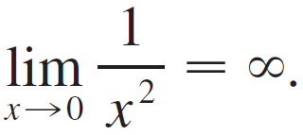
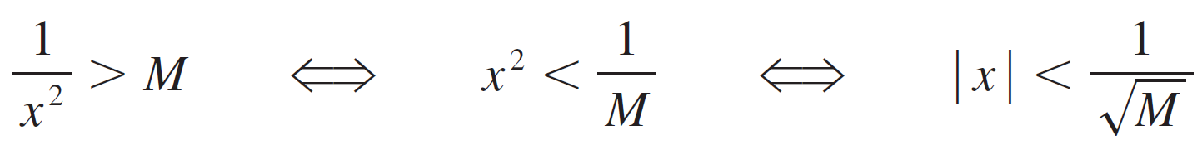


Example 5
Use Definition 6 to prove that
Solution:
Let M be a given positive number. We want to find a number δ such that
if 0 < | x | < δ then 1/x² > M
But
So if we choose δ = and 0 < | x | < δ = , then 1/x² > M. This shows that as 1/x² → as x → 0.

Slide 40
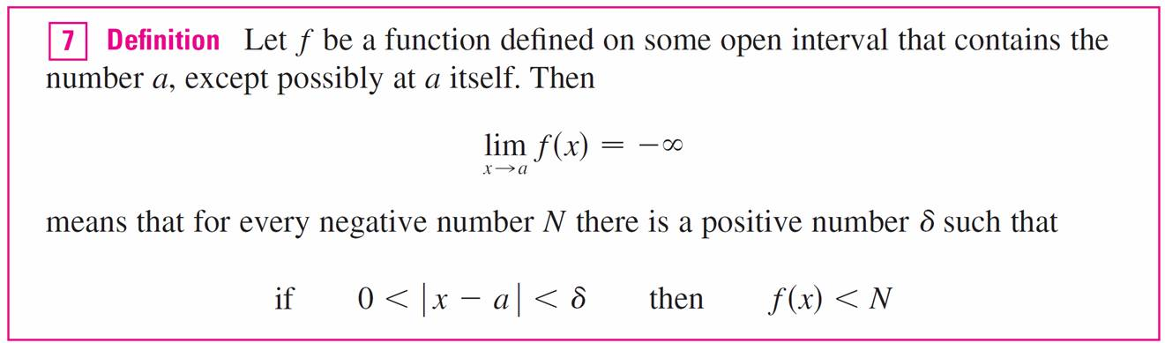
Infinite Limits

