Slide 1


2
Derivatives
Copyright © Cengage Learning. All rights reserved.

Slide 2

2.3
Differentiation Formulas
Copyright © Cengage Learning. All rights reserved.

Slide 3
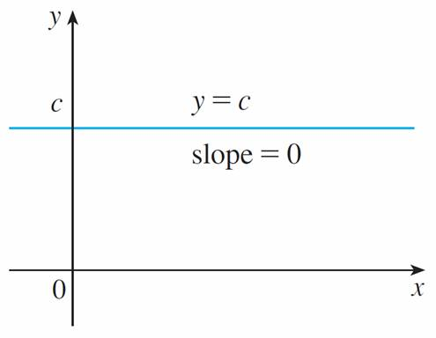
Differentiation Formulas
Let’s start with the simplest of all functions, the constant function f (x) = c. The graph of this function is the horizontal line y = c, which has slope 0, so we must have f ′(x) = 0.
See Figure 1.
The graph of f (x) = c is the line y = c, so f ′(x) = 0.
Figure 1

Slide 4
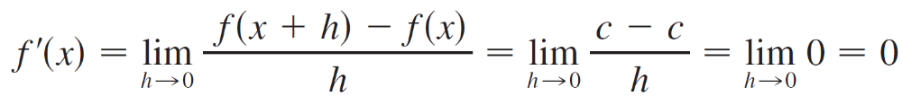

Differentiation Formulas
A formal proof, from the definition of a derivative, is also easy:
In Leibniz notation, we write this rule as follows.

Slide 5
Power Functions

Slide 6
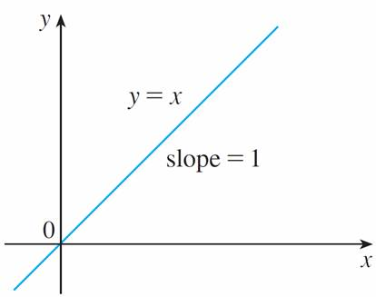
Power Functions
We next look at the functions f (x) = x^{n}, where n is a positive integer. If n = 1, the graph of f (x) = x is the line y = x, which has slope 1.
(See Figure 2.)
The graph of f (x) = x is the line y = x, so f ′(x) = 1.
Figure 2

Slide 7
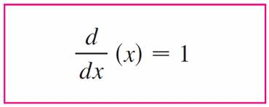



Power Functions
So
We have already investigated the cases n = 2 and n = 3. In fact, we found that
(x²) = 2x (x³) = 3x²

Slide 8
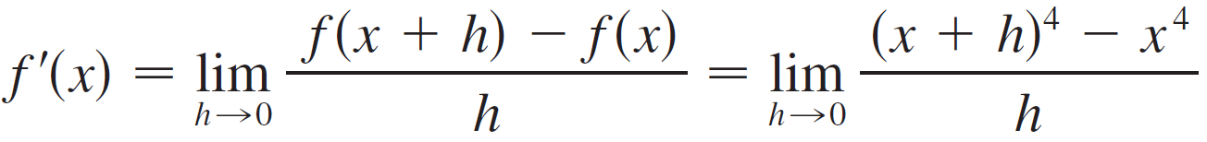
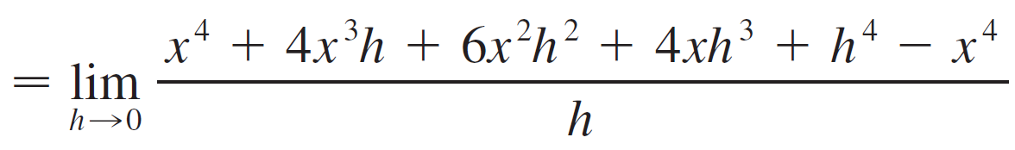
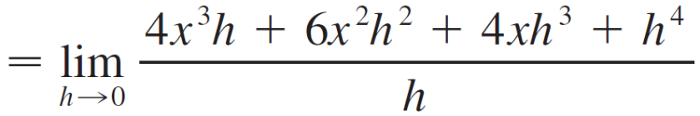
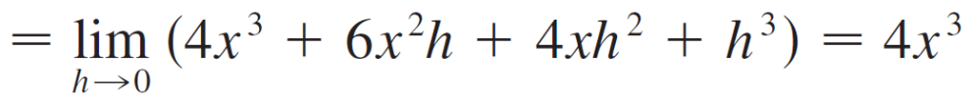
Power Functions
For n = 4 we find the derivative of f (x) = x⁴ as follows:

Slide 9





Power Functions
Thus
(x⁴) = 4x³
Comparing the equations in , , and , we see a pattern emerging. It seems to be a reasonable guess that, when n is a positive integer, (d/dx)(x^{n}) = nx ^{n – 1}.
This turns out to be true. We prove it in two ways; the second proof uses the Binomial Theorem.

Slide 10


Example 1
(a) If f (x) = x⁶, then f ′(x) = 6x⁵.
(b) If y = x¹⁰⁰⁰, then y′ = 1000x⁹⁹⁹.
(c) If y = t ⁴, then = 4t ³.
(d) (r³) = 3r²

Slide 11
New Derivatives from Old

Slide 12
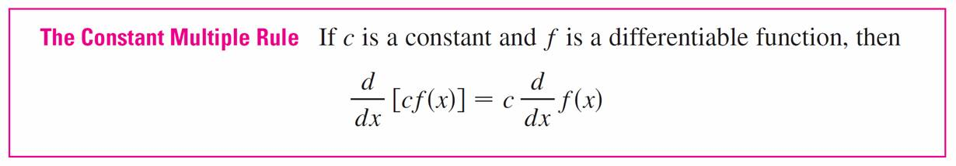
New Derivatives from Old
When new functions are formed from old functions by addition, subtraction, or multiplication by a constant, their derivatives can be calculated in terms of derivatives of the old functions.
In particular, the following formula says that the derivative of a constant times a function is the constant times the derivative of the function.

Slide 13

Example 2
(a) (3x⁴) = 3 (x⁴)
= 3(4x³)
= 12x³
(b) (–x) = [(–1)x]
= (–1) (x)
= –1(1)
= –1

Slide 14

New Derivatives from Old
The next rule tells us that the derivative of a sum of functions is the sum of the derivatives.
The Sum Rule can be extended to the sum of any number of functions. For instance, using this theorem twice, we get
(f + g + h)′ = [(f + g) + h]′ = (f + g)′ + h′ = f ′ + g′ + h′

Slide 15

New Derivatives from Old
By writing f – g as f + (–1)g and applying the Sum Rule and the Constant Multiple Rule, we get the following formula.
The Constant Multiple Rule, the Sum Rule, and the Difference Rule can be combined with the Power Rule to differentiate any polynomial, as the following examples demonstrate.

Slide 16
Example 3
(x⁸ + 12x⁵ – 4x⁴ + 10x³ – 6x + 5)
= (x⁸) + 12 (x⁵) – 4 (x⁴) + 10 (x³) – 6 (x) + (5)
= 8x⁷ + 12(5x⁴) – 4(4x³) + 10(3x²) – 6(1) + 0
= 8x⁷ + 60x⁴ – 16x³ + 30x² – 6

Slide 17

New Derivatives from Old
Next we need a formula for the derivative of a product of two functions. By analogy with the Sum and Difference Rules, one might be tempted to guess, as Leibniz did three centuries ago, that the derivative of a product is the product of the derivatives.
We can see, however, that this guess is wrong by looking at a particular example. Let f (x) = x and g (x) = x². Then the Power Rule gives f ′(x) = 1 and g ′(x) = 2x. But (fg)(x) = x³, so
(fg)′(x) = 3x².
Thus (fg)′ ≠ f ′g ′.

Slide 18

New Derivatives from Old
The correct formula was discovered by Leibniz and is called the Product Rule.
In words, the Product Rule says that the derivative of a product of two functions is the first function times the derivative of the second function plus the second function times the derivative of the first function.

Slide 19
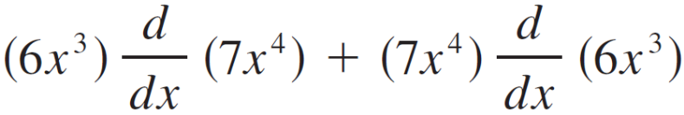
Example 6
Find F′(x) if F (x) = (6x³)(7x⁴).
Solution:
By the Product Rule, we have
F′(x) =
= (6x³)(28x³) + (7x⁴)(18x²)
= 168x⁶ + 126x⁶
= 294x⁶

Slide 20

New Derivatives from Old
In words, the Quotient Rule says that the derivative of a quotient is the denominator times the derivative of the numerator minus the numerator times the derivative of the denominator, all divided by the square of the denominator.

Slide 21
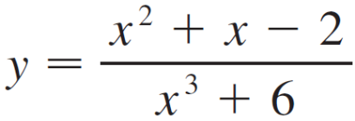
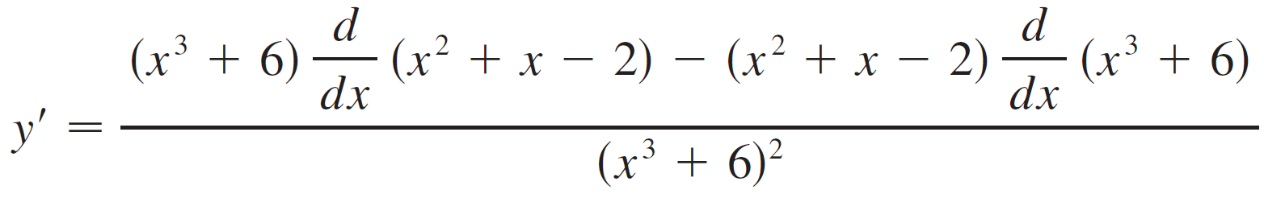
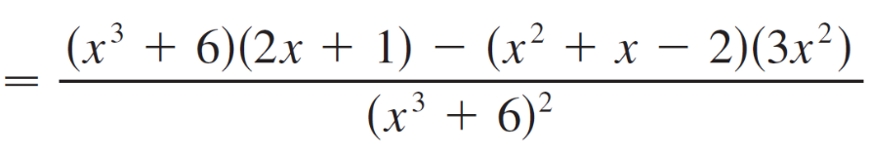
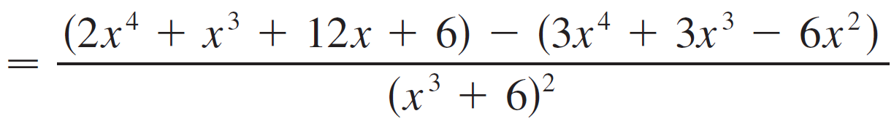
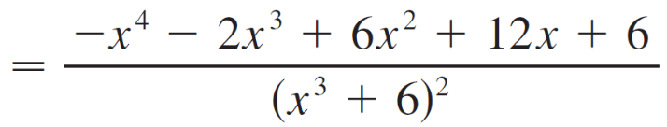
Example 8
Let . Then

Slide 22
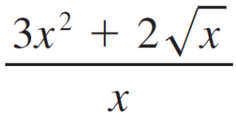
New Derivatives from Old
Note:
Don’t use the Quotient Rule every time you see a quotient.
Sometimes it’s easier to rewrite a quotient first to put it in a form that is simpler for the purpose of differentiation.
For instance, although it is possible to differentiate the function
F(x) =
using the Quotient Rule.

Slide 23
New Derivatives from Old
It is much easier to perform the division first and write the function as
F(x) = 3x + 2x ^{–1/2}
before differentiating.

Slide 24
General Power Functions

Slide 25
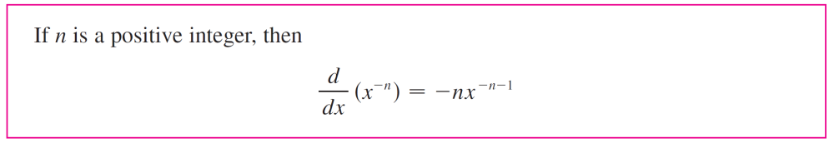
General Power Functions
The Quotient Rule can be used to extend the Power Rule to the case where the exponent is a negative integer.

Slide 26

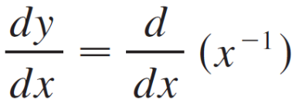
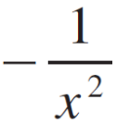
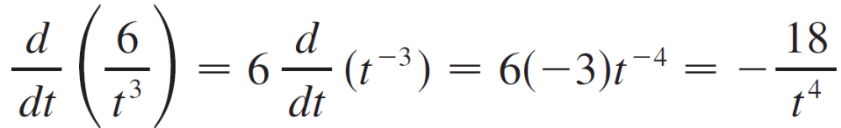
Example 9
(a) If y = , then
= –x ^{–2}
=
(b)

Slide 27

General Power Functions

Slide 28

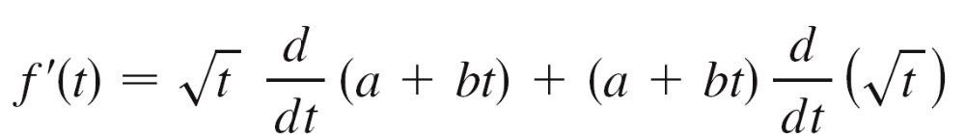

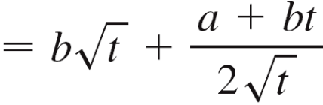
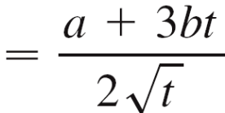
Example 11
Differentiate the function f (t) = (a + bt).
Solution 1:
Using the Product Rule, we have

Slide 29



Example 11 – Solution 2
cont’d
If we first use the laws of exponents to rewrite f (t), then we can proceed directly without using the Product Rule.

Slide 30
General Power Functions
The differentiation rules enable us to find tangent lines without having to resort to the definition of a derivative.
They also enable us to find normal lines.
The normal line to a curve C at point P is the line through
P that is perpendicular to the tangent line at P.

Slide 31


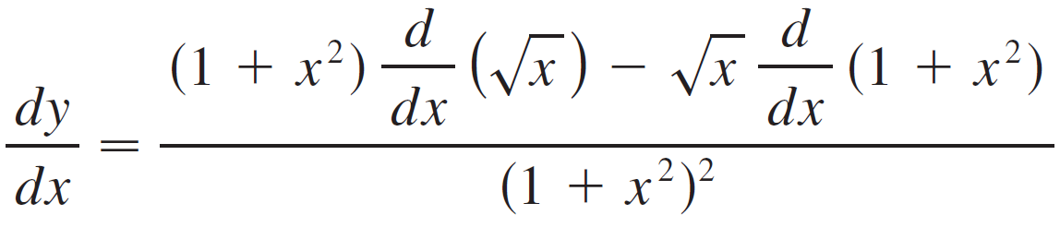
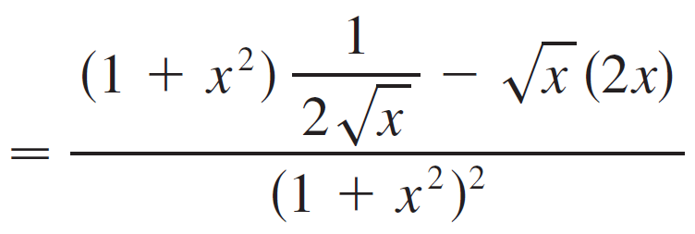
Example 12
Find equations of the tangent line and normal line to the curve
y = /(1 + x²) at the point (1, ).
Solution:
According to the Quotient Rule, we have

Slide 32
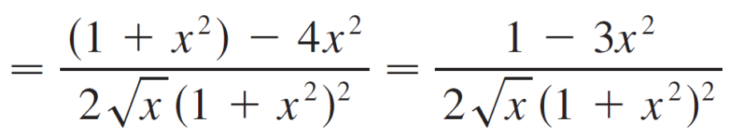
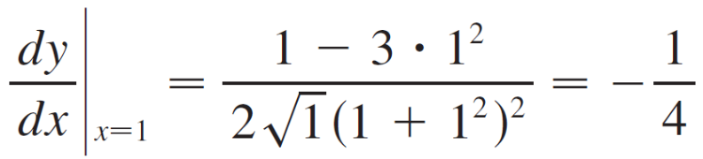

Example 12 – Solution
cont’d
So the slope of the tangent line at (1, ) is
We use the point-slope form to write an equation of the tangent line at (1, ):
y – = – (x – 1) or y =

Slide 33


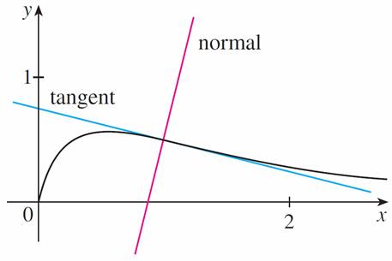
Example 12 – Solution
cont’d
The slope of the normal line at (1, ) is the negative reciprocal of , namely 4, so an equation is
y – = 4(x – 1) or y = 4x –
The curve and its tangent and normal lines are graphed in Figure 5.
Figure 5

Slide 34
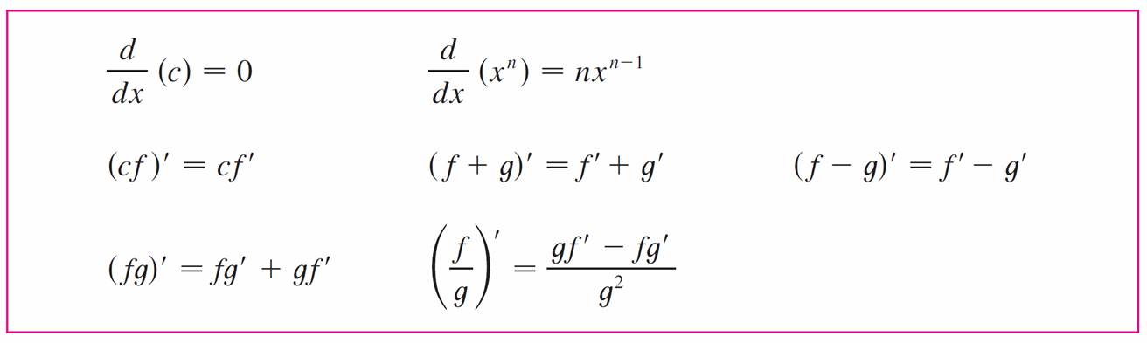
General Power Functions
We summarize the differentiation formulas we have learned so far as follows.
Table of Differentiation Formulas

