Slide 1


2
Derivatives
Copyright © Cengage Learning. All rights reserved.

Slide 2

2.6
Implicit Differentiation
Copyright © Cengage Learning. All rights reserved.

Slide 3



Implicit Differentiation
The functions that we have met so far can be described by expressing one variable explicitly in terms of another variable—for example,
y = or y = x sin x
or, in general, y = f (x).
Some functions, however, are defined implicitly by a relation between x and y such as
x² + y² = 25
or
x³ + y³ = 6xy

Slide 4



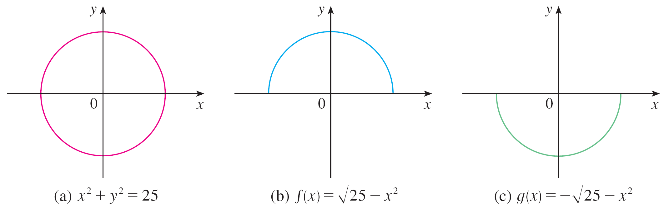
Implicit Differentiation
In some cases it is possible to solve such an equation for y as an explicit function (or several functions) of x.
For instance, if we solve Equation 1 for y, we get
y = , so two of the functions determined by the implicit Equation 1 are f (x) = and g (x) = .
The graphs of f and g are the upper and lower semicircles of the circle x² + y² = 25. (See Figure 1.)
Figure 1

Slide 5
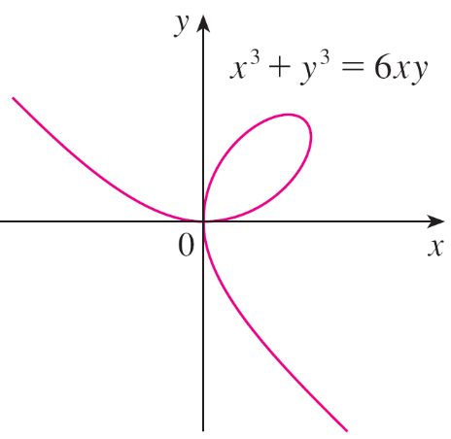
Implicit Differentiation
It’s not easy to solve Equation 2 for y explicitly as a function of x by hand. (A computer algebra system has no trouble, but the expressions it obtains are very complicated.)
Nonetheless, (2) is the equation of a curve called the folium of Descartes shown in Figure 2 and it implicitly defines y as several functions of x.
The folium of Descartes
Figure 2

Slide 6
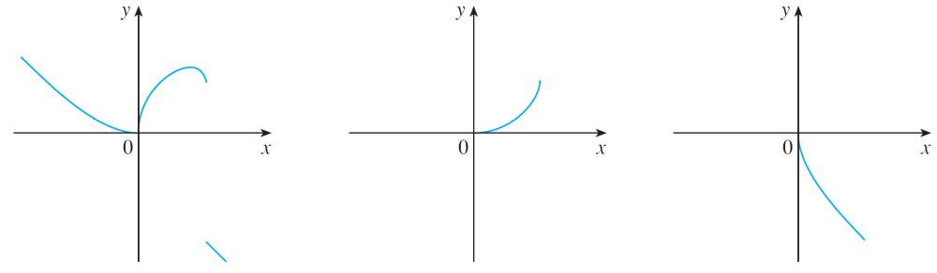
Implicit Differentiation
The graphs of three such functions are shown in Figure 3.
When we say that f is a function defined implicitly by Equation 2, we mean that the equation
x³ + [f (x)]³ = 6x f (x)
is true for all values of x in the domain of f.
Graphs of three functions defined by the folium of Descartes
Figure 3

Slide 7
Implicit Differentiation
Fortunately, we don’t need to solve an equation for y in terms of x in order to find the derivative of y. Instead we can use the method of implicit differentiation.
This consists of differentiating both sides of the equation with respect to x and then solving the resulting equation for y'.
In the examples and exercises of this section it is always assumed that the given equation determines y implicitly as a differentiable function of x so that the method of implicit differentiation can be applied.

Slide 8

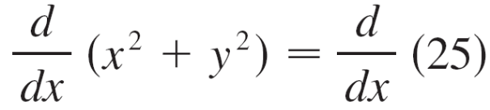
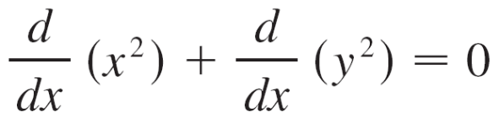
Example 1
If x² + y² = 25, find .
(b) Find an equation of the tangent to the circle x² + y² = 25
at the point (3, 4).
Solution 1:
Differentiate both sides of the equation x² + y² = 25:

Slide 9
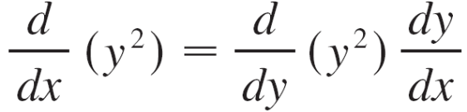
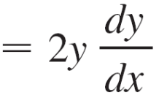
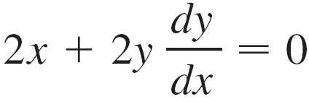
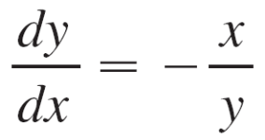
Example 1 – Solution
cont’d
Remembering that y is a function of x and using the Chain Rule, we have
Thus
Now we solve this equation for dy/dx:

Slide 10
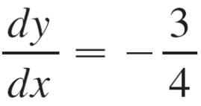




Example 1 – Solution
cont’d
(b) At the point (3, 4) we have x = 3 and y = 4, so
An equation of the tangent to the circle at (3, 4) is therefore
y – 4 = (x – 3) or 3x + 4y = 25
Solution 2:
(b) Solving the equation x² + y² = 25, we get y = .
The point (3, 4) lies on the upper semicircle y = and so we consider the function f (x) = .

Slide 11
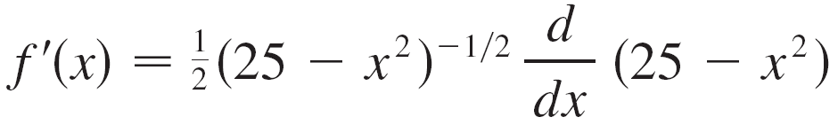

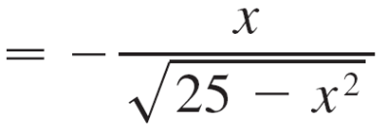
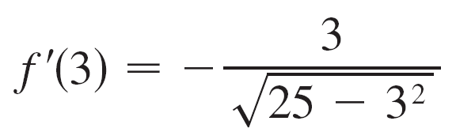
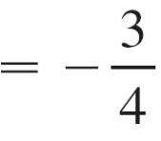
Example 1 – Solution
cont’d
Differentiating f using the Chain Rule, we have
So
and, as in Solution 1, an equation of the tangent is 3x + 4y = 25.

