Slide 1


2
Derivatives
Copyright © Cengage Learning. All rights reserved.

Slide 2

Linear Approximations and Differentials
2.9
Copyright © Cengage Learning. All rights reserved.

Slide 3
Linear Approximations and Differentials
We have seen that a curve lies very close to its tangent line near the point of tangency. In fact, by zooming in toward a point on the graph of a differentiable function, we noticed that the graph looks more and more like its tangent line.
This observation is the basis for a method of finding approximate values of functions.
The idea is that it might be easy to calculate a value f (a) of a function, but difficult (or even impossible) to compute nearby values of f.

Slide 4
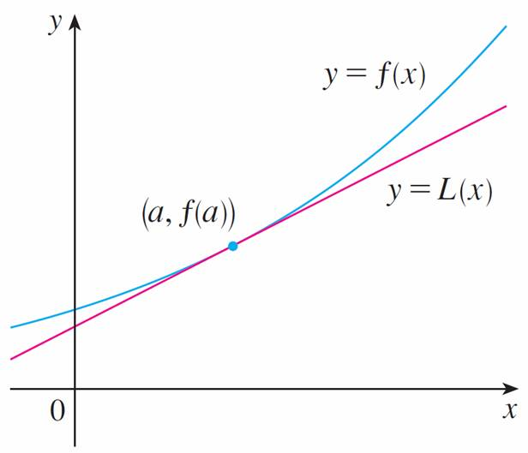
Linear Approximations and Differentials
So we settle for the easily computed values of the linear function L whose graph is the tangent line of f at (a, f (a)). (See Figure 1.)
Figure 1

Slide 5

Linear Approximations and Differentials
In other words, we use the tangent line at (a, f (a)) as an approximation to the curve y = f (x) when x is near a. An equation of this tangent line is
y = f (a) + f ′ (a)(x – a)
and the approximation
f (x) ≈ f (a) + f ′ (a)(x – a)
is called the linear approximation or tangent line approximation of f at a.

Slide 6

Linear Approximations and Differentials
The linear function whose graph is this tangent line, that is,
L (x) = f (a) + f ′(a)(x – a)
is called the linearization of f at a.

Slide 7



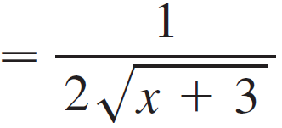

Example 1
Find the linearization of the function f (x) = at a = 1 and use it to approximate the numbers and . Are these approximations overestimates or underestimates?
Solution:
The derivative of f (x) = (x + 3)^{1/2} is
f ′(x) = (x + 3)^{–1/2}
and so we have f (1) = 2 and f ′(1) = .

Slide 8

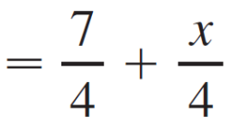

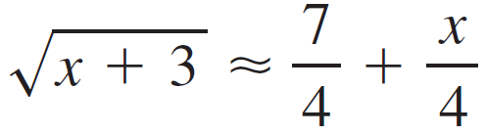
Example 1 – Solution
cont’d
Putting these values into Equation 2, we see that the linearization is
L (x) = f (1) + f ′(1) (x – 1)
= 2 + (x – 1)
The corresponding linear approximation is
(when x is near 1)

Slide 9


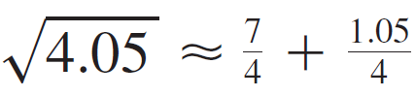

Example 1 – Solution
cont’d
In particular, we have
and

Slide 10
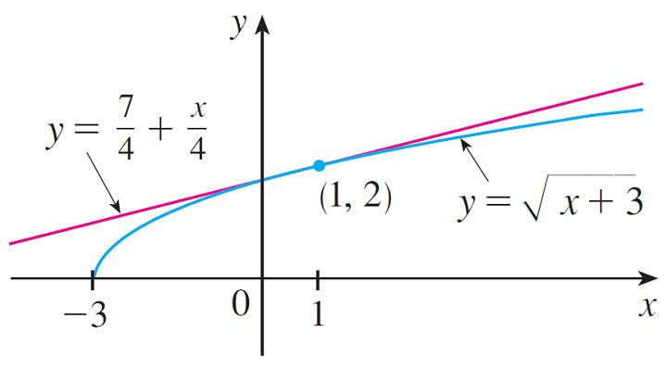
Example 1 – Solution
cont’d
The linear approximation is illustrated in Figure 2.
Figure 2

Slide 11
Example 1 – Solution
cont’d
We see that, indeed, the tangent line approximation is a good approximation to the given function when x is near 1.
We also see that our approximations are overestimates because the tangent line lies above the curve.
Of course, a calculator could give us approximations for
and , but the linear approximation gives an approximation over an entire interval.

Slide 12
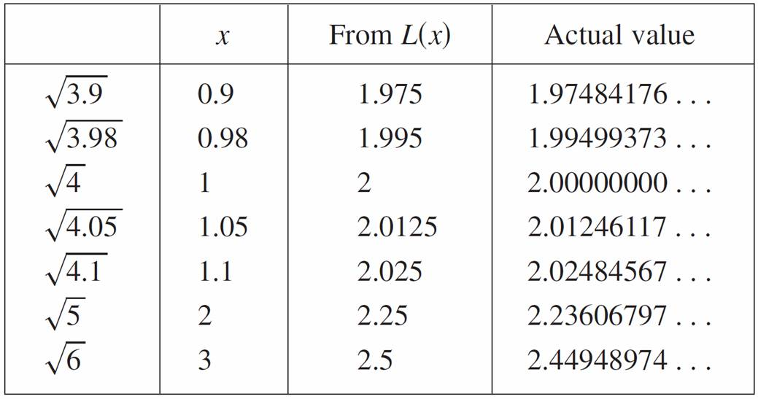
Linear Approximations and Differentials
In the following table we compare the estimates from the linear approximation in Example 1 with the true values.

Slide 13
Linear Approximations and Differentials
Notice from this table, and also from Figure 2, that the tangent line approximation gives good estimates when x is close to 1 but the accuracy of the approximation deteriorates when x is farther away from 1.
Figure 2

Slide 14
Linear Approximations and Differentials
The next example shows that by using a graphing calculator or computer we can determine an interval throughout which a linear approximation provides a specified accuracy.

Slide 15
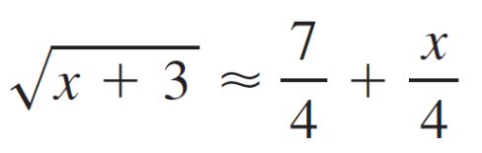
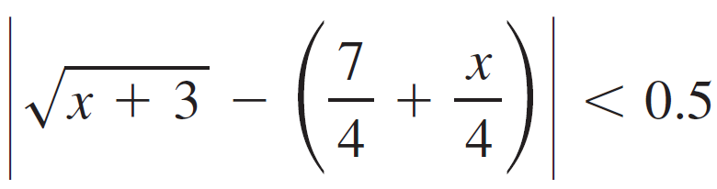
Example 2
For what values of x is the linear approximation
accurate to within 0.5? What about accuracy to within 0.1?
Solution:
Accuracy to within 0.5 means that the functions should differ by less than 0.5:

Slide 16
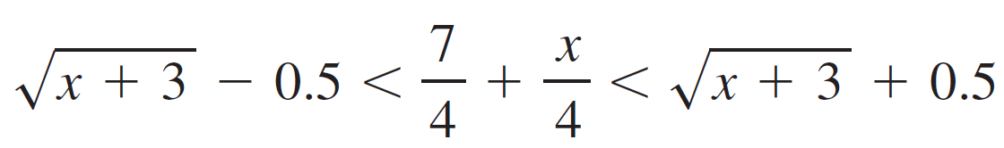

Example 2 – Solution
cont’d
Equivalently, we could write
This says that the linear approximation should lie between the curves obtained by shifting the curve upward and downward by an amount 0.5.

Slide 17

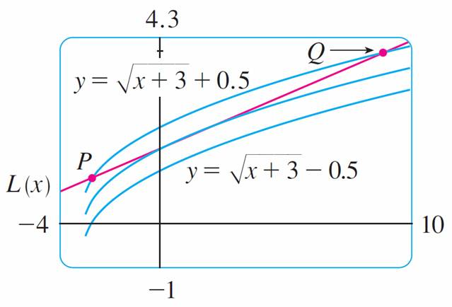
Example 2 – Solution
cont’d
Figure 3 shows the tangent line y = (7 + x)/4 intersecting the upper curve y = + 0.5 at P and Q.
Figure 3

Slide 18
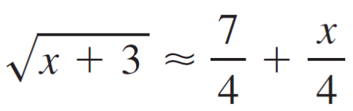
Example 2 – Solution
cont’d
Zooming in and using the cursor, we estimate that the
x-coordinate of P is about –2.66 and the x-coordinate of Q is about 8.66.
Thus we see from the graph that the approximation
is accurate to within 0.5 when –2.6 < x < 8.6. (We have rounded to be safe.)

Slide 19
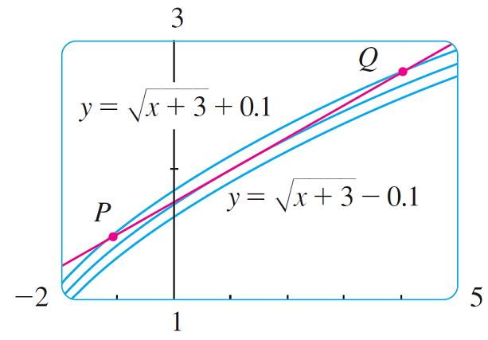
Example 2 – Solution
cont’d
Similarly, from Figure 4 we see that the approximation is accurate to within 0.1 when –1.1 < x < 3.9.
Figure 4

Slide 20
Applications to Physics

Slide 21
Applications to Physics
Linear approximations are often used in physics. In analyzing the consequences of an equation, a physicist sometimes needs to simplify a function by replacing it with its linear approximation.
For instance, in deriving a formula for the period of a pendulum, physics textbooks obtain the expression
a_{T} = –g sin θ for tangential acceleration and then replace
θ by θ with the remark that sin θ is very close to θ if θ is not too large.

Slide 22
Applications to Physics
You can verify that the linearization of the function
f (x) = sin x at a = 0 is L (x) = x and so the linear approximation at 0 is
sin x ≈ x
So, in effect, the derivation of the formula for the period of a pendulum uses the tangent line approximation for the sine function.

Slide 23
Applications to Physics
Another example occurs in the theory of optics, where light rays that arrive at shallow angles relative to the optical axis are called paraxial rays.
In paraxial (or Gaussian) optics, both sin θ and cos θ are replaced by their linearizations. In other words, the linear approximations
sin θ ≈ θ and cos θ ≈ 1
are used because θ is close to 0.

Slide 24
Differentials

Slide 25

Differentials
The ideas behind linear approximations are sometimes formulated in the terminology and notation of differentials.
If y = f (x), where f is a differentiable function, then the differential dx is an independent variable; that is, dx can be given the value of any real number.
The differential dy is then defined in terms of dx by the equation
dy = f ′(x) dx

Slide 26
Differentials
So dy is a dependent variable; it depends on the values of x and dx.
If dx is given a specific value and x is taken to be some specific number in the domain of f, then the numerical value of dy is determined.

Slide 27
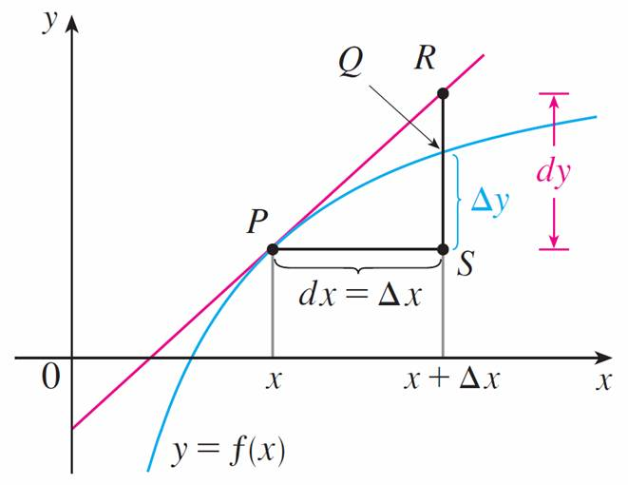
Differentials
The geometric meaning of differentials is shown in
Figure 5.
Figure 5

Slide 28
Differentials
Let P(x, f (x)) and Q(x + Δx, f (x + Δx)) be points on the graph of f and let dx = Δx. The corresponding change in y is
Δy = f (x + Δx) – f (x)
The slope of the tangent line PR is the derivative f ′(x). Thus the directed distance from S to R is f ′ (x) dx = dy.
Therefore dy represents the amount that the tangent line rises or falls (the change in the linearization), whereas Δy represents the amount that the curve y = f (x) rises or falls when x changes by an amount dx.

Slide 29
Example 3
Compare the values of Δy and dy if
y = f (x) = x³ + x² – 2x + 1 and x changes (a) from 2 to 2.05 and (b) from 2 to 2.01.
Solution:
(a) We have
f (2) = 2³ + 2² – 2(2) + 1
= 9
f (2.05) = (2.05)³ + (2.05)² – 2(2.05) + 1
= 9.717625

Slide 30
Example 3 – Solution
cont’d
Δy = f (2.05) – f (2)
= 0.717625
In general,
dy = f ′(x) dx
= (3x² + 2x – 2) dx
When x = 2 and dx = Δx = 0.05, this becomes
dy = [3(2)² + 2(2) – 2]0.05
= 0.7

Slide 31
Example 3 – Solution
cont’d
(b) f (2.01) = (2.01)³ + (2.01)² – 2(2.01) + 1
= 9.140701
Δy = f (2.01) – f (2)
= 0.140701
When dx = Δx = 0.01,
dy = [3(2)² + 2(2) – 2]0.01
= 0.14

Slide 32
Differentials
Our final example illustrates the use of differentials in estimating the errors that occur because of approximate measurements.

Slide 33

Example 4
The radius of a sphere was measured and found to be
21 cm with a possible error in measurement of at most
0.05 cm. What is the maximum error in using this value of the radius to compute the volume of the sphere?
Solution:
If the radius of the sphere is r, then its volume is V = πr³. If the error in the measured value of r is denoted by dr = Δr, then the corresponding error in the calculated value of V is ΔV, which can be approximated by the differential
dV = 4πr² dr

Slide 34
Example 4 – Solution
cont’d
When r = 21 and dr = 0.05, this becomes
dV = 4π(21)²0.05
≈ 277
The maximum error in the calculated volume is about
277 cm³.

Slide 35
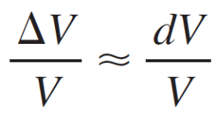
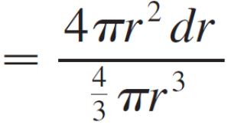
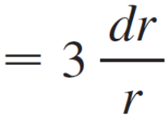
Differentials
Note:
Although the possible error in Example 4 may appear to be rather large, a better picture of the error is given by the relative error, which is computed by dividing the error by the total volume:

Slide 36
Differentials
Thus the relative error in the volume is about three times the relative error in the radius.
In Example 4 the relative error in the radius is approximately dr/r = 0.05/21 ≈ 0.0024 and it produces a relative error of about 0.007 in the volume.
The errors could also be expressed as percentage errors of 0.24% in the radius and 0.7% in the volume.

