Slide 1


3
Applications of
Differentiation
Copyright © Cengage Learning. All rights reserved.

Slide 2

3.7
Optimization Problems
Copyright © Cengage Learning. All rights reserved.

Slide 3
Optimization Problems
In solving such practical problems the greatest challenge is often to convert the word problem into a mathematical optimization problem by setting up the function that is to be maximized or minimized.
Let’s recall the problem-solving principles.

Slide 4
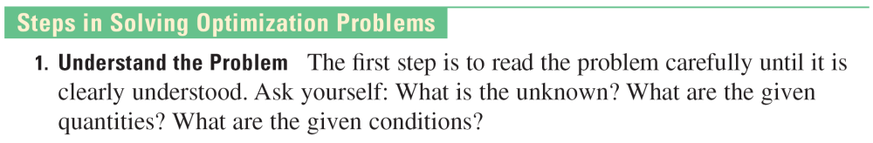
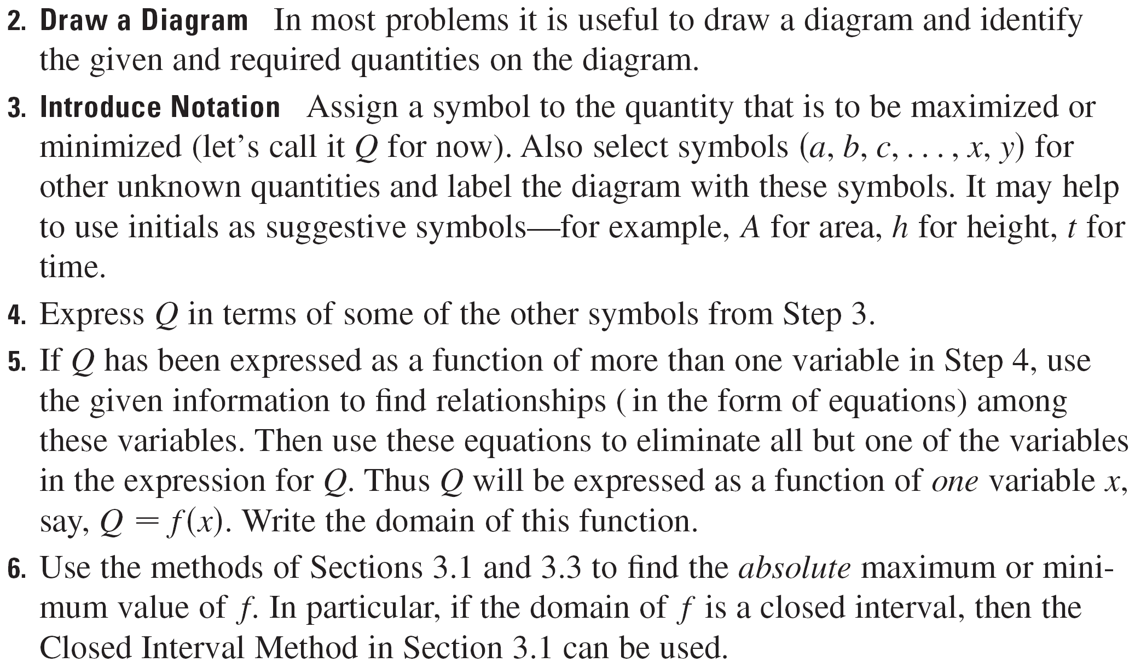
Optimization Problems

Slide 5
Example 1
A farmer has 2400 ft of fencing and wants to fence off a rectangular field that borders a straight river. He needs no fence along the river. What are the dimensions of the field that has the largest area?

Slide 6
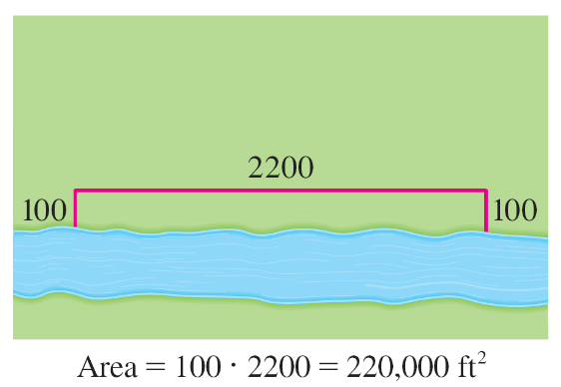
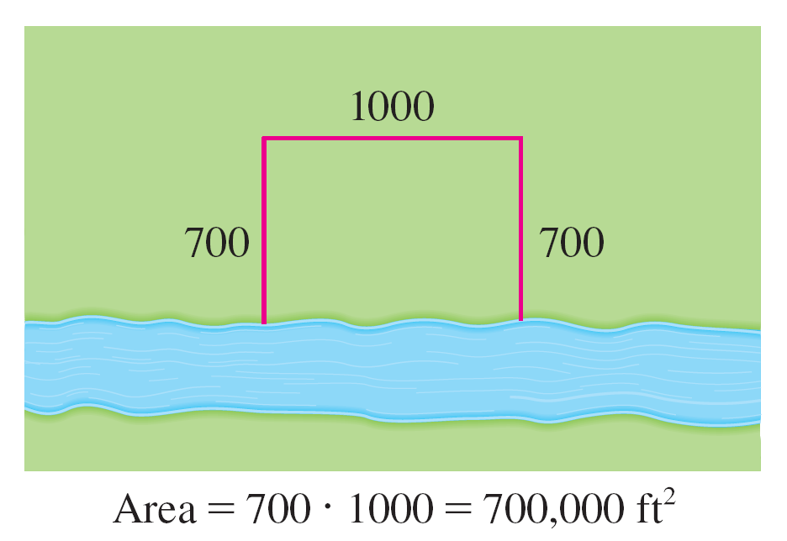
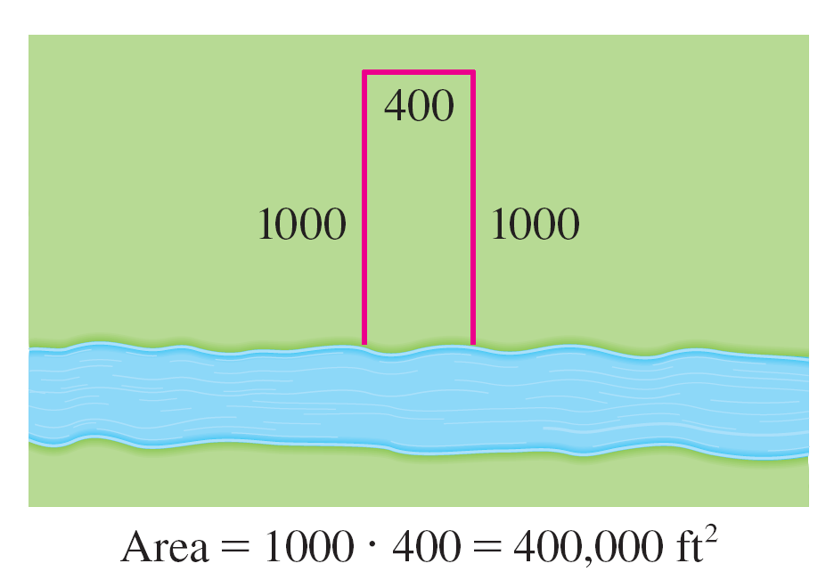
Example 1 – Solution
In order to get a feeling for what is happening in this problem, let’s experiment with some special cases. Figure 1 (not to scale) shows three possible ways of laying out the 2400 ft of fencing.
Figure 1

Slide 7
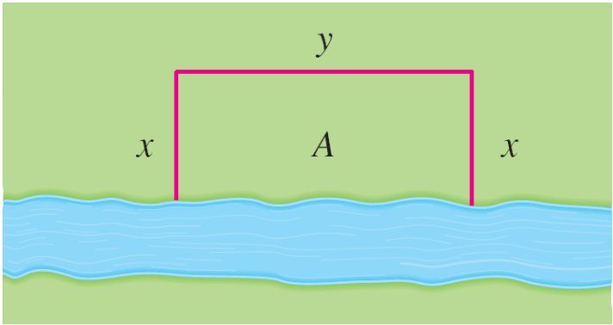
Example 1 – Solution
cont’d
We see that when we try shallow, wide fields or deep, narrow fields, we get relatively small areas. It seems plausible that there is some intermediate configuration that produces the largest area.
Figure 2 illustrates the general case. We wish to maximize the area A of the rectangle.
Figure 2

Slide 8
Example 1 – Solution
cont’d
Let x and y be the depth and width of the rectangle (in feet). Then we express A in terms of x and y:
A = xy
We want to express A as a function of just one variable, so we eliminate y by expressing it in terms of x. To do this we use the given information that the total length of the fencing is 2400 ft.
Thus
2x + y = 2400
From this equation we have y = 2400 – 2x, which gives
A = x(2400 – 2x) = 2400x – 2x²

Slide 9
Example 1 – Solution
cont’d
Note that x ≥ 0 and x ≤ 1200 (otherwise A < 0). So the function that we wish to maximize is
A(x) = 2400x – 2x² 0 ≤ x ≤ 1200
The derivative is A ′(x) = 2400 – 4x, so to find the critical numbers we solve the equation
2400 – 4x = 0
which gives x = 600.
The maximum value of A must occur either at this critical number or at an endpoint of the interval.

Slide 10
Example 1 – Solution
cont’d
Since A(0) = 0, A(600) = 720,000, and A(1200) = 0, the Closed Interval Method gives the maximum value as
A(600) = 720,000.
[Alternatively, we could have observed that A ′′ (x) = –4 < 0 for all x, so A is always concave downward and the local maximum at x = 600 must be an absolute maximum.]
Thus the rectangular field should be 600 ft deep and 1200 ft wide.

Slide 11
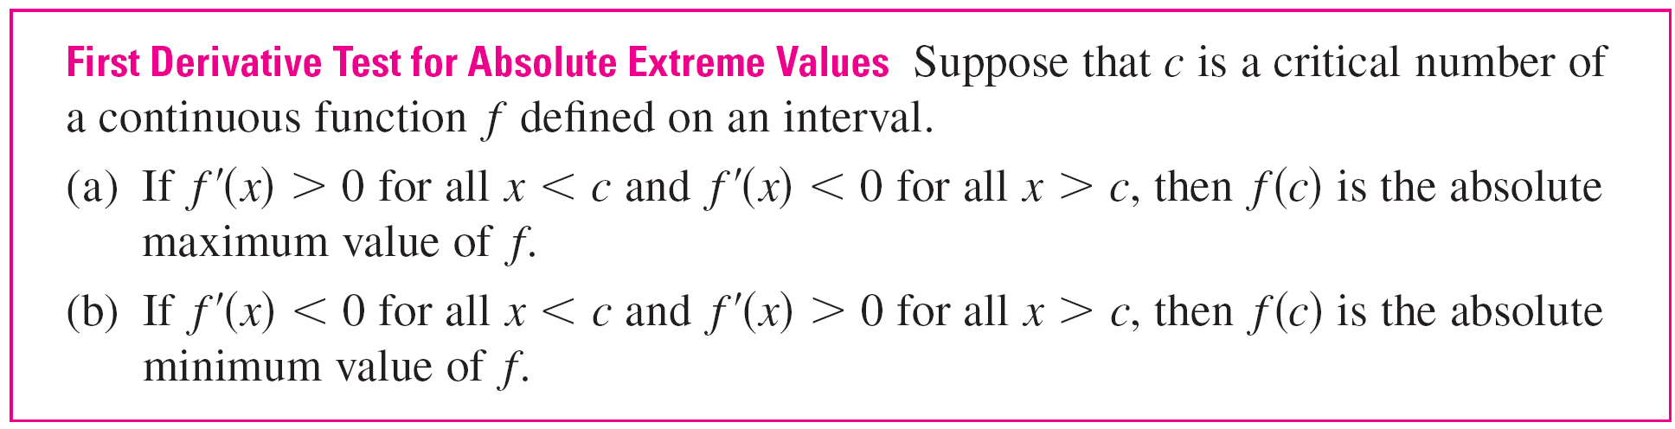
Optimization Problems

Slide 12
Applications to Business and Economics

Slide 13
Applications to Business and Economics
We know that if C (x), the cost function, is the cost of producing x units of a certain product, then the marginal cost is the rate of change of C with respect to x.
In other words, the marginal cost function is the derivative, C ′(x), of the cost function.
Now let’s consider marketing. Let p(x) be the price per unit that the company can charge if it sells x units.
Then p is called the demand function (or price function) and we would expect it to be a decreasing function of x.

Slide 14
Applications to Business and Economics
If x units are sold and the price per unit is p(x), then the total revenue is
R(x) = xp(x)
and R is called the revenue function.
The derivative R ′ of the revenue function is called the marginal revenue function and is the rate of change of revenue with respect to the number of units sold.

Slide 15
Applications to Business and Economics
If x units are sold, then the total profit is
P (x) = R (x) – C (x)
and P is called the profit function.
The marginal profit function is P ′, the derivative of the profit function.

Slide 16
Example 6
A store has been selling 200 Blu-ray disc players a week at $350 each. A market survey indicates that for each $10 rebate offered to buyers, the number of units sold will increase by 20 a week. Find the demand function and the revenue function. How large a rebate should the store offer to maximize its revenue?
Solution:
If x is the number of Blu-ray players sold per week, then the weekly increase in sales is x – 200.
For each increase of 20 units sold, the price is decreased by $10.

Slide 17



Example 6 – Solution
cont’d
So for each additional unit sold, the decrease in price will be and the demand function is
p(x) = 350 – (x – 200) = 450 – x
The revenue function is
R(x) = xp(x) = 450x – x²
Since R ′(x) = 450 – x, we see that R ′(x) = 0 when x = 450. This value of x gives an absolute maximum by the First Derivative Test (or simply by observing that the graph of R is a parabola that opens downward).

Slide 18
Example 6 – Solution
cont’d
The corresponding price is
p(450) = 450 – (450) = 225
and the rebate is 350 – 225 = 125.
Therefore, to maximize revenue, the store should offer a
rebate of $125.

