Slide 1


3
Applications of
Differentiation
Copyright © Cengage Learning. All rights reserved.

Slide 2

3.8
Newton’s Method
Copyright © Cengage Learning. All rights reserved.

Slide 3

Newton’s Method
Suppose that a car dealer offers to sell you a car for $18,000 or for payments of $375 per month for five years. You would like to know what monthly interest rate the dealer is, in effect, charging you.
To find the answer, you have to solve the equation
48x(1 + x)⁶⁰ – (1 + x)⁶⁰ + 1 = 0
We can find an approximate solution to Equation 1 by plotting the left side of the equation.

Slide 4
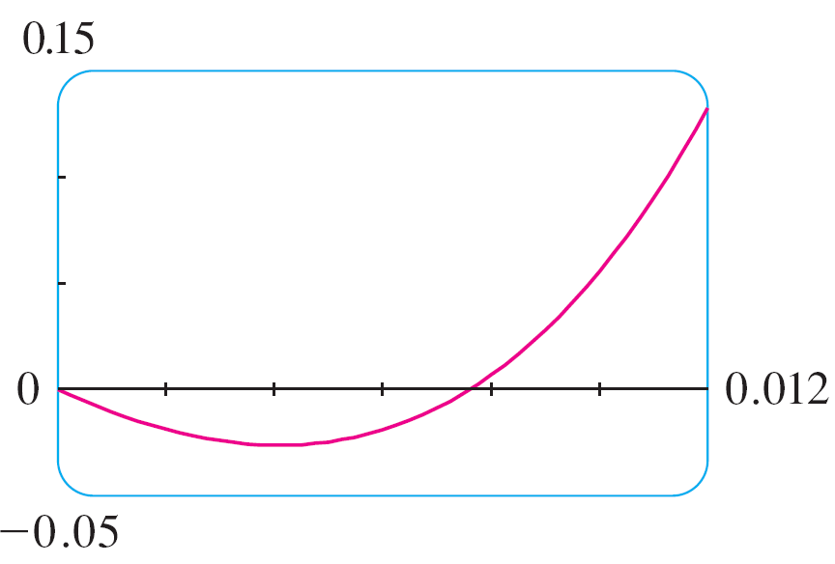
Newton’s Method
Using a graphing device, and after experimenting with viewing rectangles, we produce the graph in Figure 1.
We see that in addition to the solution x = 0, which doesn’t interest us, there is a solution between 0.007 and 0.008. Zooming in shows that the root is approximately 0.0076. If we need more accuracy we could zoom in repeatedly, but that becomes tiresome.
Figure 1

Slide 5
Newton’s Method
A faster alternative is to use a numerical rootfinder on a calculator or computer algebra system. If we do so, we find that the root, correct to nine decimal places, is 0.007628603.
How do those numerical rootfinders work? They use a variety of methods, but most of them make some use of Newton’s method, also called the Newton-Raphson method.
We will explain how this method works, partly to show what happens inside a calculator or computer, and partly as an application of the idea of linear approximation.

Slide 6
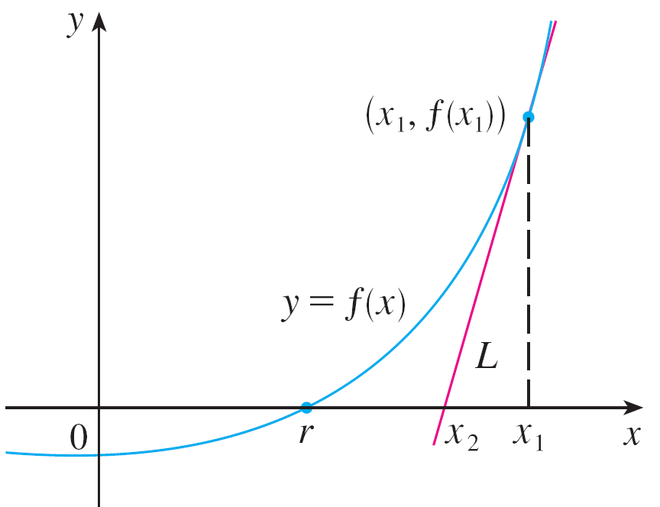
Newton’s Method
The geometry behind Newton’s method is shown in Figure 2, where the root that we are trying to find is labeled r.
We start with a first approximation x₁, which is obtained by guessing, or from a rough sketch of the graph of f, or from a computer-generated graph of f.
Figure 2

Slide 7
Newton’s Method
Consider the tangent line L to the curve y = f (x) at the point (x₁, f (x₁)) and look at the x-intercept of L, labeled x₂.
The idea behind Newton’s method is that the tangent line is close to the curve and so its x-intercept, x₂, is close to the x-intercept of the curve (namely, the root r that we are seeking). Because the tangent is a line, we can easily find its x-intercept.
To find a formula for x₂ in terms of x₁ we use the fact that the slope of L is f ′(x₁), so its equation is
y – f (x₁) = f ′(x₁)(x – x₁)

Slide 8
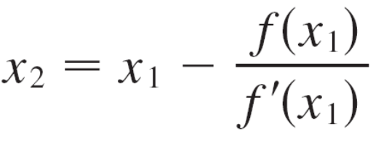
Newton’s Method
Since the x-intercept of L is x₂, we set y = 0 and obtain
0 – f (x₁) = f ′(x₁)(x₂ – x₁)
If f ′(x₁) ≠ 0, we can solve this equation for x₂:
We use x₂ as a second approximation to r.
Next we repeat this procedure with x₁ replaced by the second approximation x₂, using the tangent line at (x₂, f (x₂)).

Slide 9
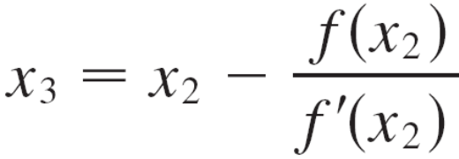
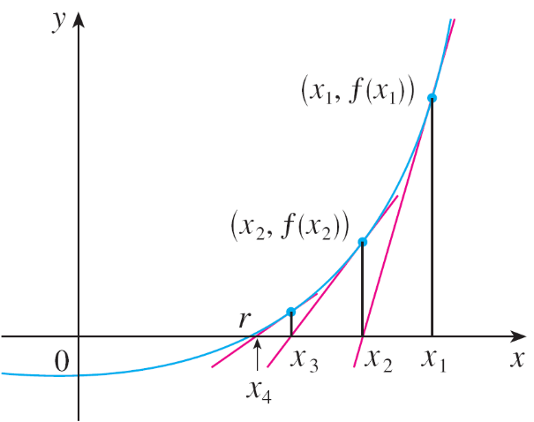
Newton’s Method
This gives a third approximation:
If we keep repeating this process, we obtain a sequence of approximations x₁, x₂, x₃, x₄, . . . as shown in Figure 3.
Figure 3

Slide 10

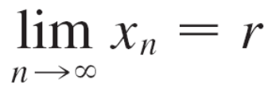
Newton’s Method
In general, if the nth approximation is x_{n} and f ′(x_{n}) ≠ 0, then the next approximation is given by
If the numbers x_{n} become closer and closer to r as n becomes large, then we say that the sequence converges to r and we write

Slide 11
Example 1
Starting with x₁ = 2, find the third approximation x₃ to the root of the equation x³ – 2x – 5 = 0.
Solution:
We apply Newton’s method with
f (x) = x³ – 2x – 5 and f ′(x) = 3x² – 2
Newton himself used this equation to illustrate his method and he chose x₁ = 2 after some experimentation because f (1) = –6, f (2) = –1, and f (3) = 16.

Slide 12
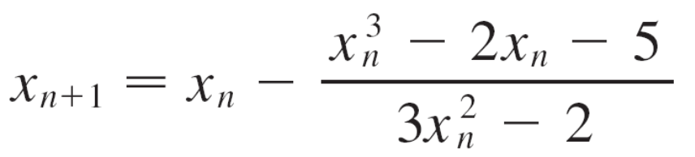
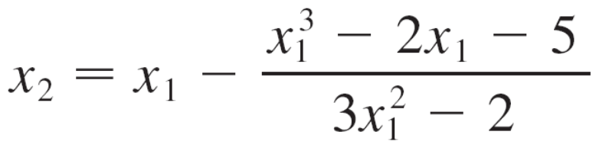
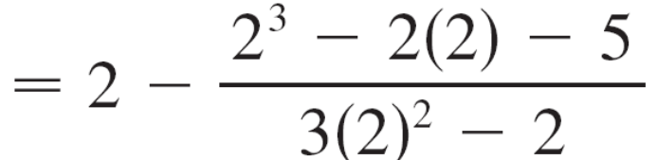

Example 1 – Solution
cont’d
Equation 2 becomes
With n = 1 we have

Slide 13
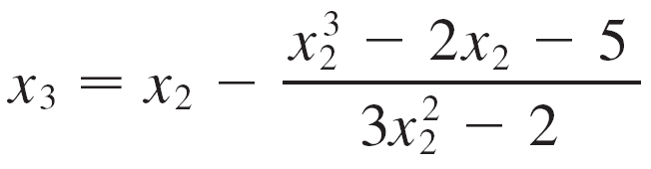
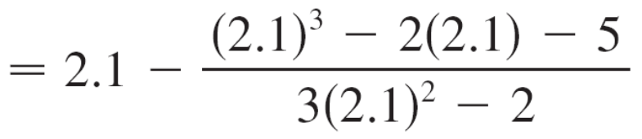

Example 1 – Solution
cont’d
Then with n = 2 we obtain
It turns out that this third approximation x₃ ≈ 2.0946 is accurate to four decimal places.

