Slide 1


4
Integrals
Copyright © Cengage Learning. All rights reserved.

Slide 2

4.2
The Definite Integral
Copyright © Cengage Learning. All rights reserved.

Slide 3

The Definite Integral
We have seen that a limit of the form
arises when we compute an area.
We also have seen that it arises when we try to find the distance traveled by an object.
It turns out that this same type of limit occurs in a wide variety of situations even when f is not necessarily a positive function.

Slide 4
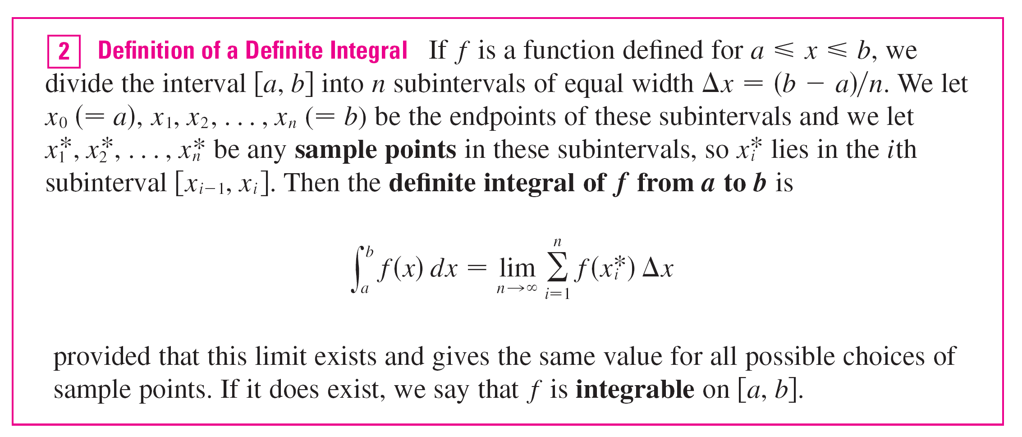
The Definite Integral
Note 1: The symbol ∫ was introduced by Leibniz and is called an integral sign.
It is an elongated S and was chosen because an integral is a limit of sums.

Slide 5


The Definite Integral
In the notation f (x) is called the integrand and
a and b are called the limits of integration; a is the lower limit and b is the upper limit.
For now, the symbol dx has no meaning by itself;
is all one symbol.
The dx simply indicates that the independent variable is x. The procedure of calculating an integral is called integration.

Slide 6
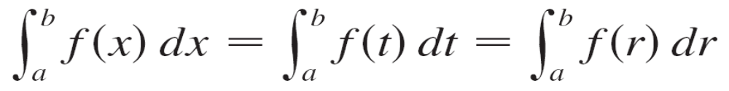
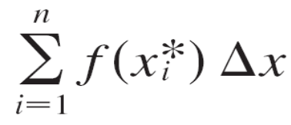
The Definite Integral
Note 2: The definite integral is a number; it does not depend on x. In fact, we could use any letter in place of x without changing the value of the integral:
Note 3: The sum
that occurs in Definition 2 is called a Riemann sum after the German mathematician Bernhard Riemann (1826–1866).

Slide 7
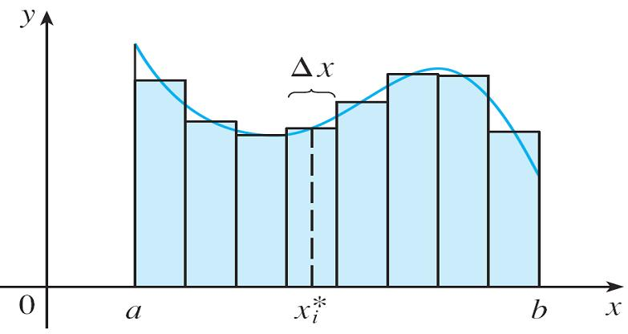
The Definite Integral
So Definition 2 says that the definite integral of an integrable function can be approximated to within any desired degree of accuracy by a Riemann sum.
We know that if f happens
to be positive, then the
Riemann sum can be
interpreted as a sum of
areas of approximating
rectangles (see Figure 1).
Figure 1
If f (x) ≥ 0, the Riemann sum Σf (x_{i}*) Δx
is the sum of areas of rectangles.

Slide 8
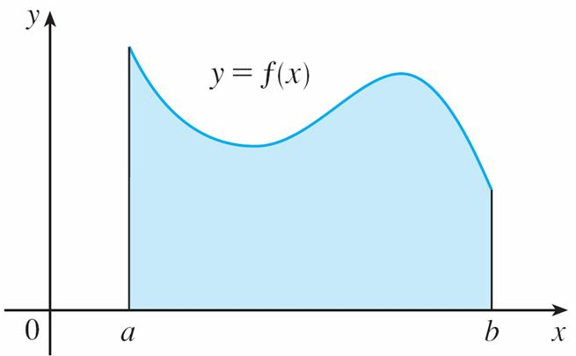
The Definite Integral
We see that the definite integral can be interpreted as the area under the curve y = f (x) from a to b. (See Figure 2.)
Figure 2
If f (x) ≥ 0, the integral is the area under the curve y = f (x) from a to b.

Slide 9
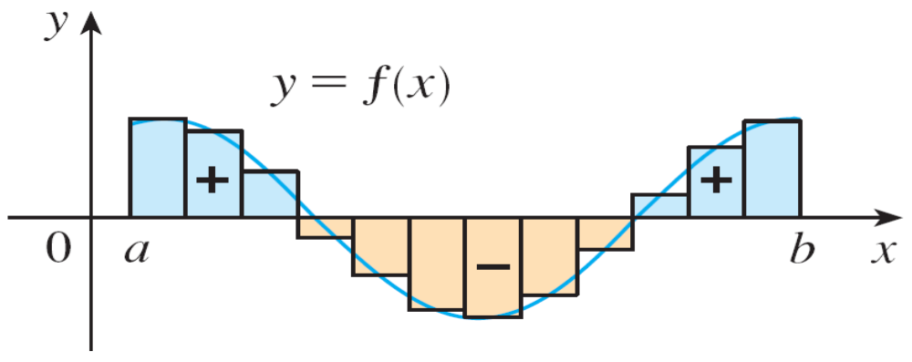
The Definite Integral
If f takes on both positive and negative values, as in
Figure 3, then the Riemann sum is the sum of the areas of the rectangles that lie above the x-axis and the negatives of the areas of the rectangles that lie below the x-axis (the areas of the blue rectangles minus the areas of the gold rectangles).
Figure 3
Σf (x_{i}*) Δx is an approximation to
the net area.

Slide 10
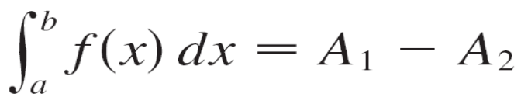
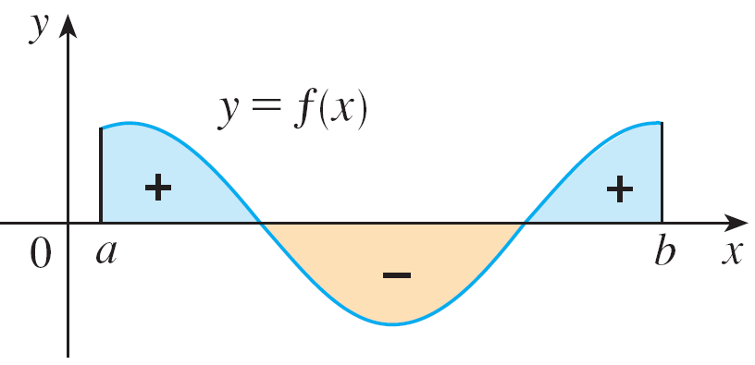
The Definite Integral
When we take the limit of such Riemann sums, we get the situation illustrated in Figure 4. A definite integral can be interpreted as a net area, that is, a difference of areas:
where A₁ is the area of the
region above the x-axis
and below the graph of f,
and A₂ is the area of the
region below the x-axis and
above the graph of f.
Figure 4
is the net area.

Slide 11
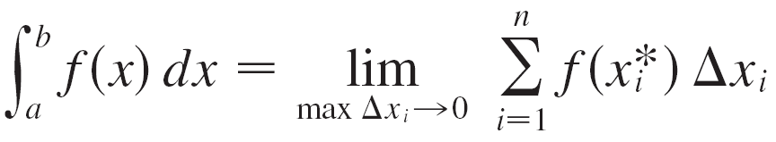
The Definite Integral
Note 4: Although we have defined by dividing [a, b] into subintervals of equal width, there are situations in which it is advantageous to work with subintervals of unequal width.
If the subinterval widths are Δx₁, Δx₂, . . . , Δx_{n}, we have to ensure that all these widths approach 0 in the limiting process. This happens if the largest width, max Δx_{i},
approaches 0. So in this case the definition of a definite integral becomes

Slide 12
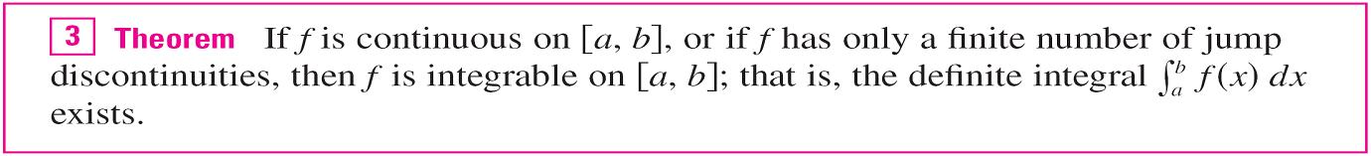
The Definite Integral
Note 5: We have defined the definite integral for an integrable function, but not all functions are integrable. The following theorem shows that the most commonly occurring functions are in fact integrable. It is proved in more advanced courses.
If f is integrable on [a, b], then the limit in Definition 2 exists and gives the same value no matter how we choose the sample points x_{i}*.

Slide 13
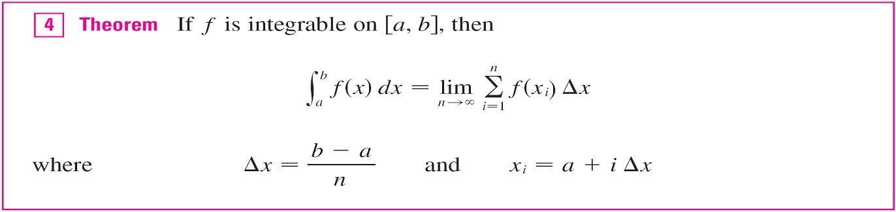
The Definite Integral
To simplify the calculation of the integral we often take the sample points to be right endpoints. Then x_{i}* = x_{i} and the definition of an integral simplifies as follows.

Slide 14
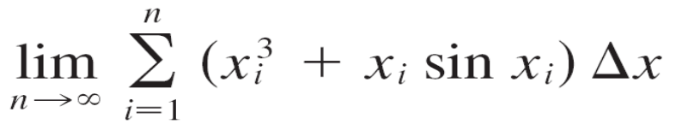
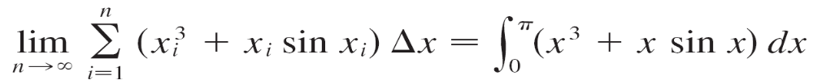
Example 1
Express
as an integral on the interval [0, π].
Solution:
Comparing the given limit with the limit in Theorem 4, we see that they will be identical if we choose f (x) = x³ + x sin x. We are given that a = 0 and b = π.
Therefore, by Theorem 4, we have

Slide 15
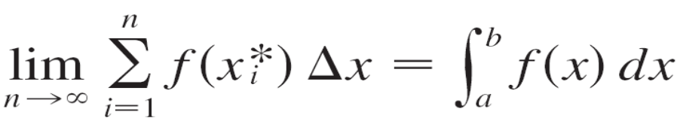
The Definite Integral
When Leibniz chose the notation for an integral, he chose
the ingredients as reminders of the limiting process.
In general, when we write
we replace lim Σ by ∫, x_{i}* by x, and Δx by dx.

Slide 16
Evaluating Integrals

Slide 17

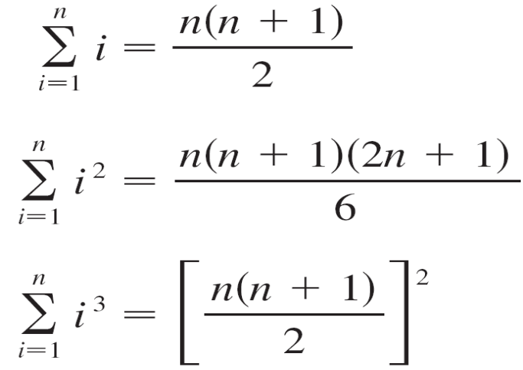
Evaluating Integrals
When we use a limit to evaluate a definite integral, we need
to know how to work with sums. The following three
equations give formulas for sums of powers of positive
integers.

Slide 18

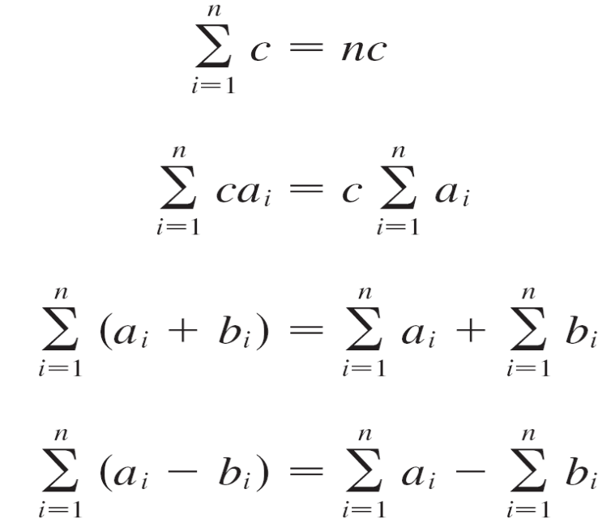
Evaluating Integrals
The remaining formulas are simple rules for working with sigma notation:

Slide 19
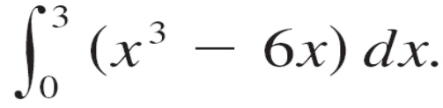
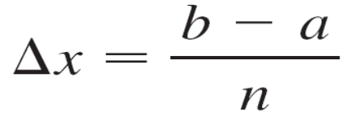
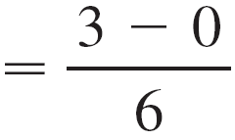
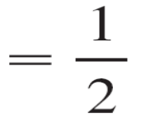
Example 2
Evaluate the Riemann sum for f (x) = x³ – 6x, taking the
sample points to be right endpoints and a = 0, b = 3,
and n = 6.
(b) Evaluate
Solution:
With n = 6 the interval width is
and the right endpoints are x₁ = 0.5, x₂ = 1.0 , x₃ = 1.5,
x₄ = 2.0, x₅ = 2.5, and x₆ = 3.0.

Slide 20
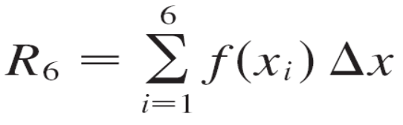

Example 2 – Solution
cont’d
So the Riemann sum is
R₆ = f(x_{i}) Δx
= f (0.5) Δx + f (1.0) Δx + f (1.5) Δx + f (2.0) Δx
+ f (2.5) Δx + f (3.0) Δx
= (–2.875 – 5 – 5.625 – 4 + 0.625 + 9)
= –3.9375

Slide 21
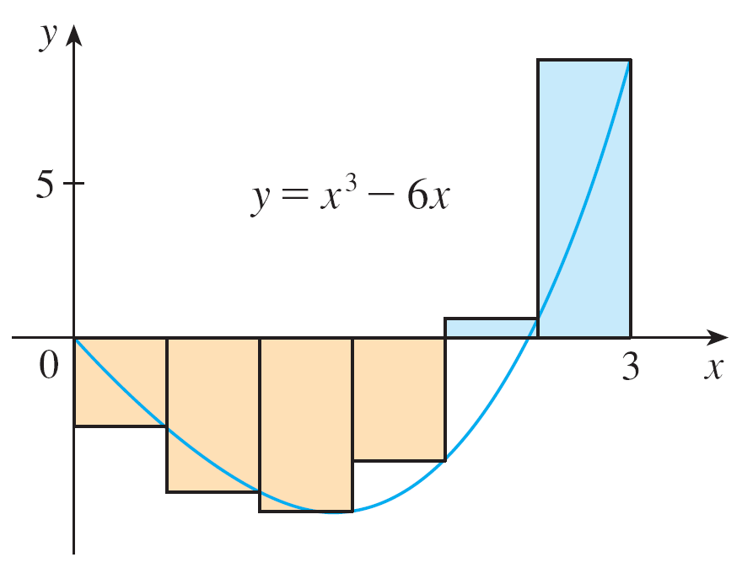
Example 2 – Solution
cont’d
Notice that f is not a positive function and so the Riemann sum does not represent a sum of areas of rectangles. But it does represent the sum of the areas of the blue rectangles
(above the x-axis) minus the sum of the areas of the gold rectangles (below the x-axis) in Figure 5.
Figure 5

Slide 22
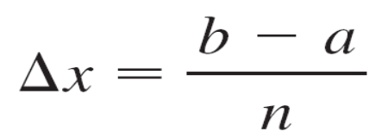
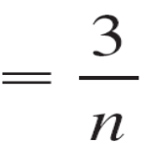
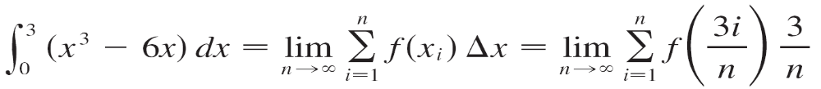
Example 2 – Solution
cont’d
(b) With n subintervals we have
Thus x₀ = 0, x₁ = 3/n, x₂ = 6/n, x₃ = 9/n, and, in general,
x_{i} = 3i/n.
Since we are using right endpoints, we can use
Theorem 4:

Slide 23
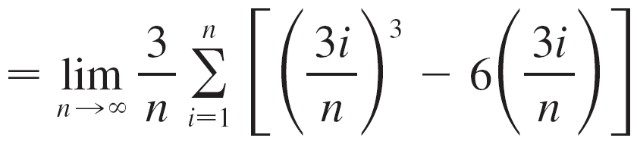
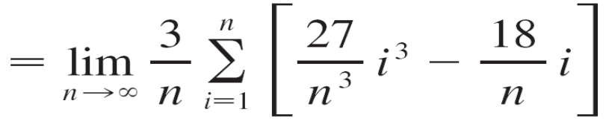
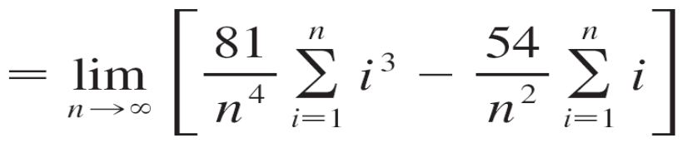
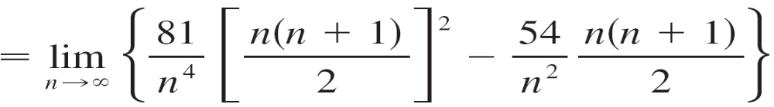
Example 2 – Solution
cont’d
(Equation 9 with c = 3/n)
(Equations 11 and 9)
(Equations 7 and 5)

Slide 24
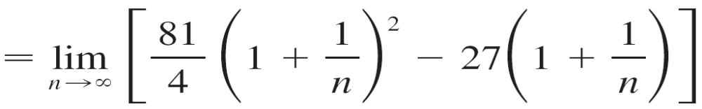
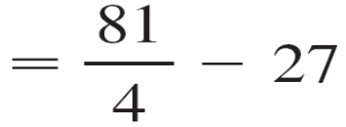
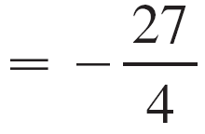

Example 2 – Solution
cont’d

Slide 25
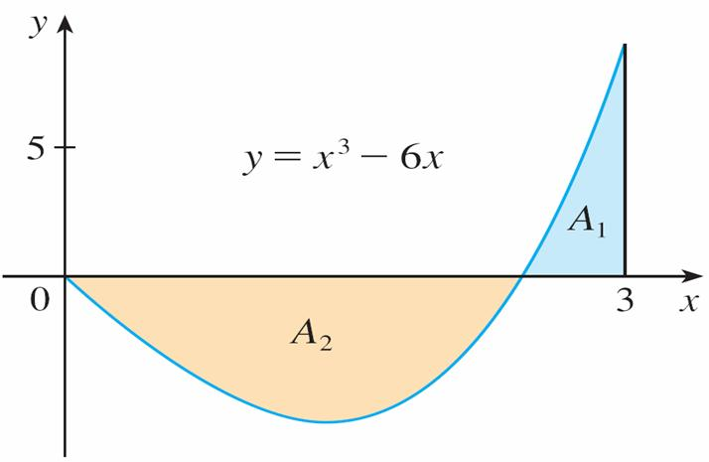

Example 2 – Solution
cont’d
This integral can’t be interpreted as an area because f takes on both positive and negative values. But it can be interpreted as the difference of areas A₁ – A₂, where
A₁ and A₂ are shown in Figure 6.
Figure 6

Slide 26
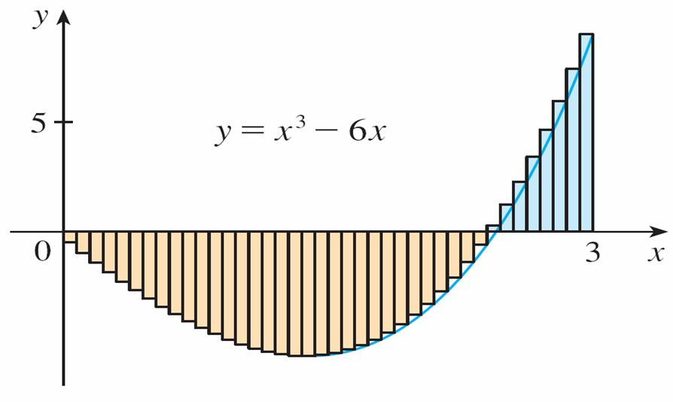
Example 2 – Solution
cont’d
Figure 7 illustrates the calculation by showing the positive and negative terms in the right Riemann sum R_{n} for n = 40.
Figure 7
R₄₀ ≈ –6.3998

Slide 27

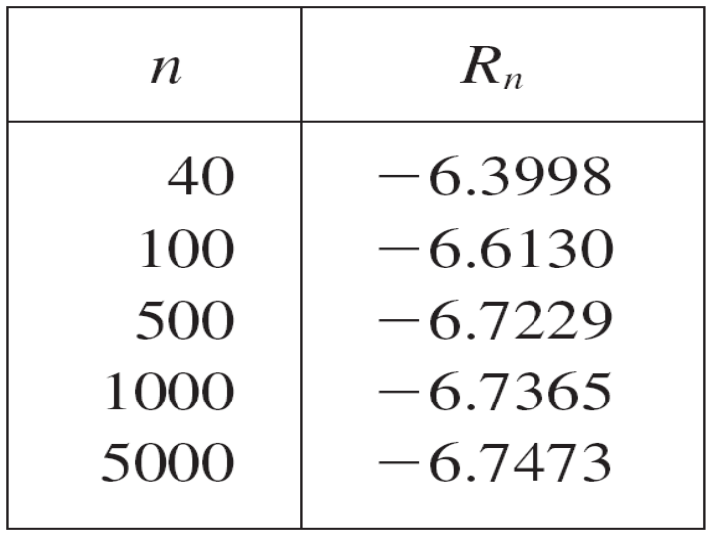
Example 2 – Solution
cont’d
The values in the table show the Riemann sums approaching the exact value of the integral, –6.75, as n →

Slide 28
The Midpoint Rule

Slide 29

The Midpoint Rule
We often choose the sample point x_{i}* to be the right endpoint of the i th subinterval because it is convenient for computing the limit.
But if the purpose is to find an approximation to an integral, it is usually better to choose x_{i}* to be the midpoint of the interval, which we denote by

Slide 30
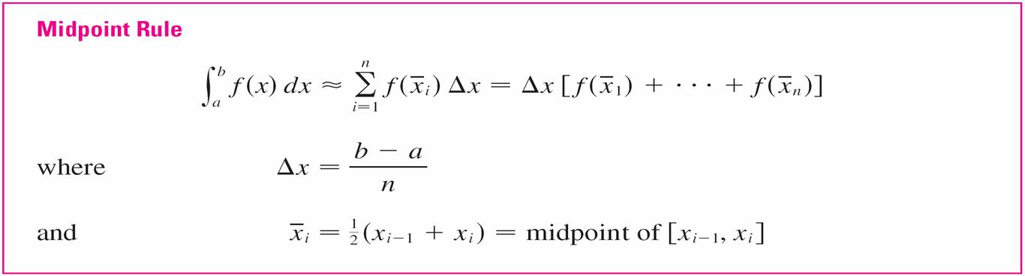
The Midpoint Rule
Any Riemann sum is an approximation to an integral, but if we use midpoints we get the following approximation.

Slide 31
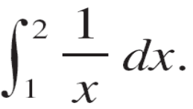

Example 5
Use the Midpoint Rule with n = 5 to approximate
Solution:
The endpoints of the five subintervals are 1, 1.2, 1.4, 1.6, 1.8, and 2.0, so the midpoints are 1.1, 1.3, 1.5, 1.7, and 1.9.
The width of the subintervals is Δx = (2 – 1)/5 = so the Midpoint Rule gives

Slide 32
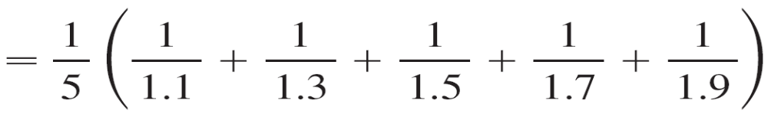
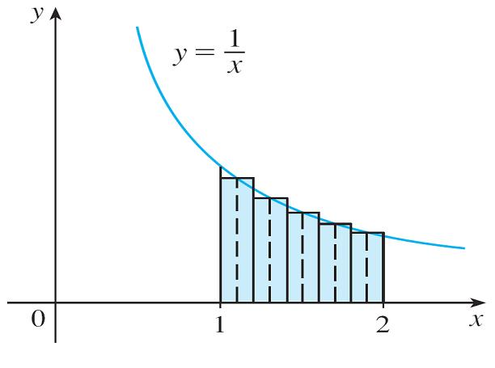
Example 5 – Solution
cont’d
≈ 0.691908
Since f (x) = 1/x > 0 for 1 ≤ x ≤ 2,
the integral represents an area,
and the approximation given by
the Midpoint Rule is the sum of
the areas of the rectangles
shown in Figure 11.
Figure 11

Slide 33
Properties of the Definite Integral

Slide 34
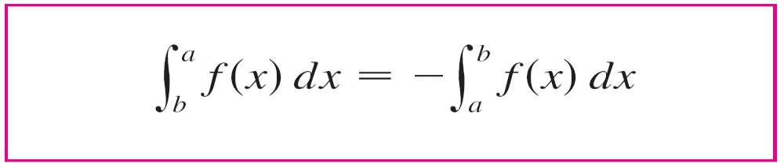
Properties of the Definite Integral
When we defined the definite integral , we implicitly assumed that a < b.
But the definition as a limit of Riemann sums makes sense even if a > b.
Notice that if we reverse a and b, then Δx changes from
(b – a)/n to (a – b)/n. Therefore

Slide 35

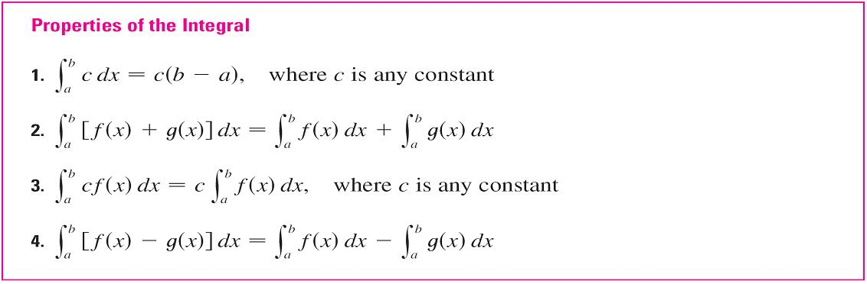
Properties of the Definite Integral
If a = b, then Δx = 0 and so
We now develop some basic properties of integrals that will help us to evaluate integrals in a simple manner. We assume that f and g are continuous functions.

Slide 36
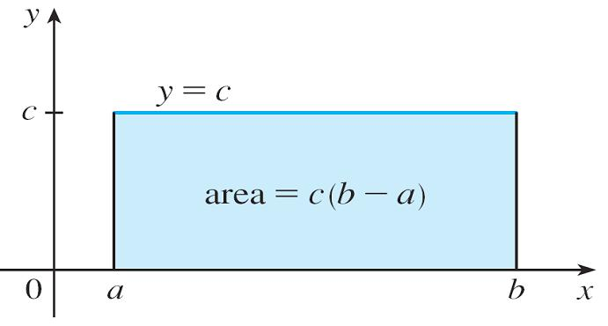

Properties of the Definite Integral
Property 1 says that the integral of a constant function f (x) = c is the constant times the length of the interval.
If c > 0 and a < b, this
is to be expected because
c(b – a) is the area of the
shaded rectangle in
Figure 13.
Figure 13

Slide 37
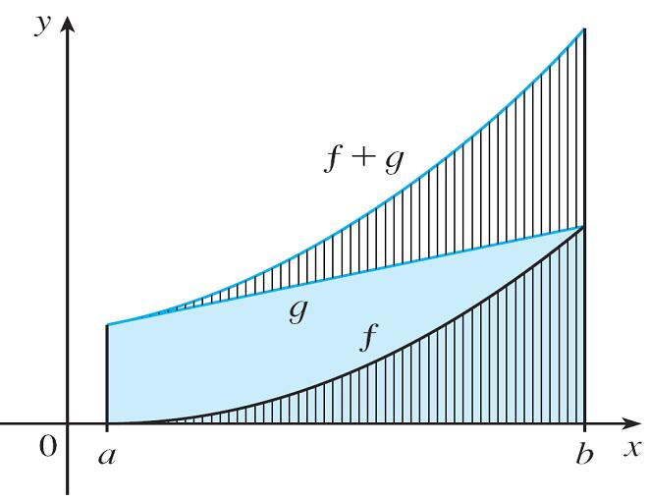


Properties of the Definite Integral
Property 2 says that the integral of a sum is the sum of the integrals.
For positive functions it
says that the area under
f + g is the area under f
plus the area under g.
Figure 14 helps us understand
why this is true: In view of how
graphical addition works, the
corresponding vertical line
segments have equal height.
Figure 14

Slide 38
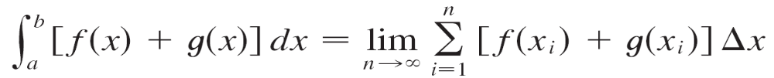
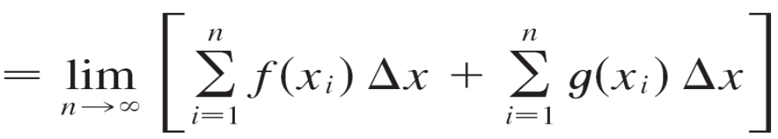
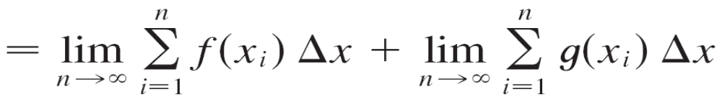
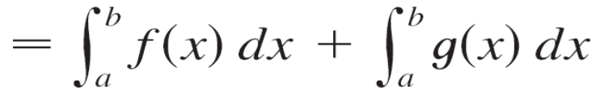
Properties of the Definite Integral
In general, Property 2 follows from Theorem 4 and the fact that the limit of a sum is the sum of the limits:

Slide 39
Properties of the Definite Integral
Property 3 can be proved in a similar manner and says that the integral of a constant times a function is the constant times the integral of the function.
In other words, a constant (but only a constant) can be taken in front of an integral sign.
Property 4 is proved by writing f – g = f + (–g) and using Properties 2 and 3 with c = –1.

Slide 40
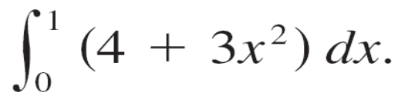
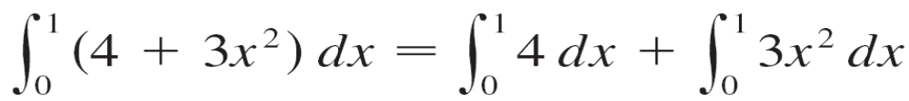
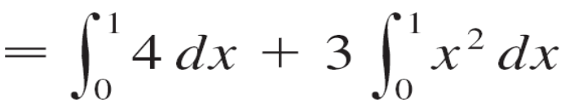



Example 6
Use the properties of integrals to evaluate
Solution:
Using Properties 2 and 3 of integrals, we have
We know from Property 1 that
and we have found that

Slide 41



Example 6 – Solution
cont’d
So

Slide 42
Properties of the Definite Integral
The next property tells us how to combine integrals of the same function over adjacent intervals:

Slide 43

Properties of the Definite Integral
This is not easy to prove in general, but for the case
where f (x) ≥ 0 and a < c < b Property 5 can be seen from
the geometric interpretation in Figure 15: The area under
y = f (x) from a to c plus the area from c to b is equal to
the total area from a to b.
Figure 15

Slide 44

Properties of the Definite Integral
Properties 1–5 are true whether a < b, a = b, or a > b. The following properties, in which we compare sizes of functions and sizes of integrals, are true only if a ≤ b.

Slide 45
Properties of the Definite Integral
If f (x) ≥ 0, then represents the area under the graph of f, so the geometric interpretation of Property 6 is simply that areas are positive. (It also follows directly from
the definition because all the quantities involved are positive.)
Property 7 says that a bigger function has a bigger integral.
It follows from Properties 6 and 4 because f – g ≥ 0.

Slide 46

Properties of the Definite Integral
Property 8 is illustrated by Figure 16 for the case where
f (x) ≥ 0.
If f is continuous we could
take m and M to be the
absolute minimum and
maximum values of f on
the interval [a, b].
Figure 16

Slide 47
Properties of the Definite Integral
In this case Property 8 says that the area under the graph of f is greater than the area of the rectangle with height m and less than the area of the rectangle with height M.
Property 8 is useful when all we want is a rough estimate of the size of an integral without going to the bother of using the Midpoint Rule.

