Slide 1

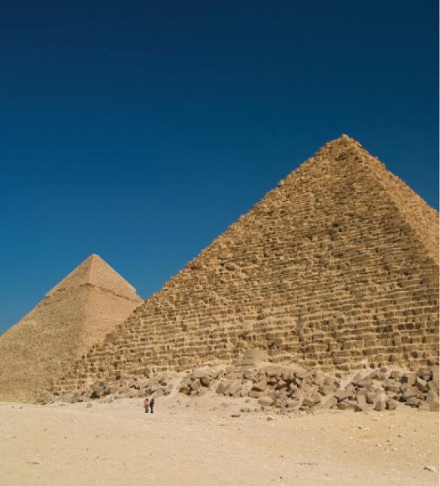
5
Applications of
Integration
Copyright © Cengage Learning. All rights reserved.

Slide 2

5.2
Volumes
Copyright © Cengage Learning. All rights reserved.

Slide 3
Volumes
In trying to find the volume of a solid we face the same type of problem as in finding areas.
We have an intuitive idea of what volume means, but we must make this idea precise by using calculus to give an exact definition of volume.

Slide 4
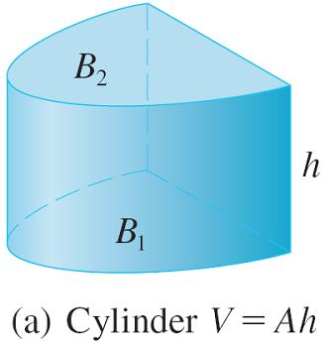
Volumes
We start with a simple type of solid called a cylinder (or, more precisely, a right cylinder).
As illustrated in Figure 1(a),
a cylinder is bounded by a
plane region B₁, called the
base, and a congruent
region B₂ in a parallel plane.
The cylinder consists of all points on line segments that are perpendicular to the base and join B₁ to B₂. If the area of the base is A and the height of the cylinder (the distance from B₁ to B₂) is h, then the volume V of the cylinder is defined as V = Ah
Figure 1(a)

Slide 5
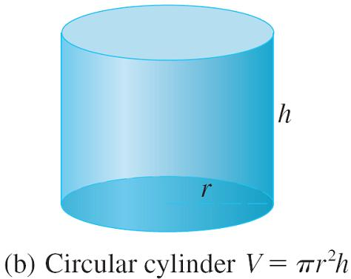
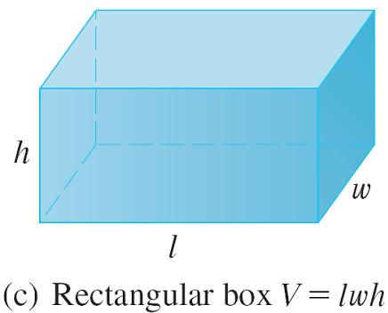
Volumes
In particular, if the base is a circle with radius r, then the cylinder is a circular cylinder with volume V = πr²h [see Figure 1(b)], and if the base is a rectangle with length l and width w, then the cylinder is a rectangular box (also called a rectangular parallelepiped) with volume V = lwh [see Figure 1(c)].
Figure 1(b)
Figure 1(c)

Slide 6
Volumes
For a solid S that isn’t a cylinder we first “cut” S into pieces and approximate each piece by a cylinder. We estimate the volume of S by adding the volumes of the cylinders. We arrive at the exact volume of S through a limiting process in which the number of pieces becomes large.
We start by intersecting S with a plane and obtaining a plane region that is called a cross-section of S.

Slide 7
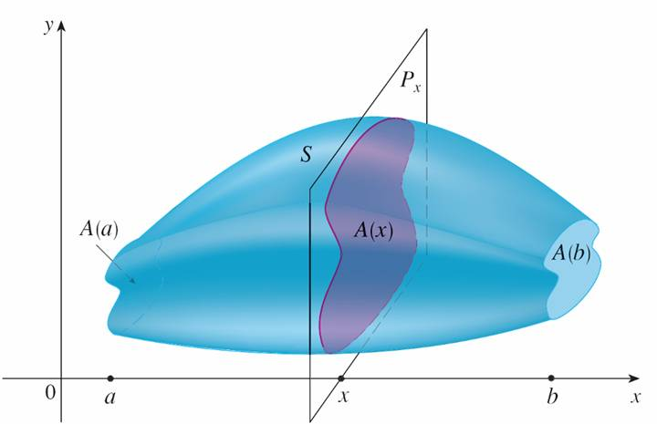
Volumes
Let A(x) be the area of the cross-section of S in a plane P_{x} perpendicular to the x-axis and passing through the point x, where a ≤ x ≤ b. (See Figure 2. Think of slicing S with a knife through x and computing the area of this slice.)
The cross-sectional area A(x) will vary as x increases from a to b.
Figure 2

Slide 8
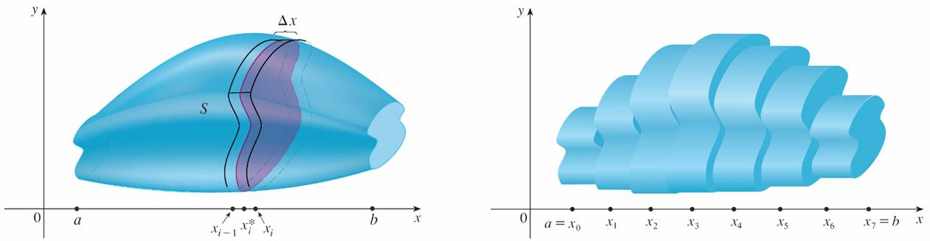
Volumes
Let’s divide S into n “slabs” of equal width Δx by using the planes P_{x1}, P_{x2}, . . . to slice the solid. (Think of slicing a loaf of bread.)
If we choose sample points x_{i}* in [x_{i – 1}, x_{i}], we can approximate the i th slab S_{i} (the part of S that lies between the planes P_{xi–1} and P_{xi} ) by a cylinder with base area A (x_{i}*) and “height” Δx. (See Figure 3.)
Figure 3

Slide 9
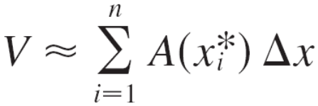
Volumes
The volume of this cylinder is A (x_{i}*) Δx, so an approximation to our intuitive conception of the volume of the i th slab S_{i} is
V (S_{i}) ≈ A (x_{i}*) Δx
Adding the volumes of these slabs, we get an approximation to the total volume (that is, what we think of intuitively as the volume):

Slide 10

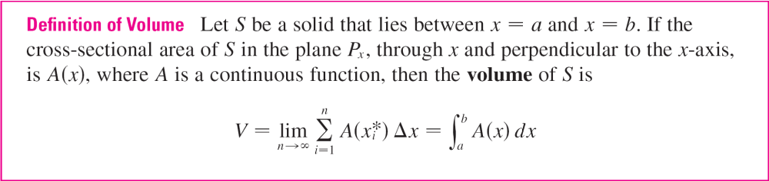
Volumes
This approximation appears to become better and better as n → . (Think of the slices as becoming thinner and thinner.)
Therefore we define the volume as the limit of these sums as n → .
But we recognize the limit of Riemann sums as a definite integral and so we have the following definition.

Slide 11


Volumes
When we use the volume formula it is important to remember that A(x) is the area of a moving cross-section obtained by slicing through x perpendicular to the x-axis.
Notice that, for a cylinder, the cross-sectional area is constant: A(x) = A for all x. So our definition of volume gives ; this agrees with the formula
V = Ah.

Slide 12

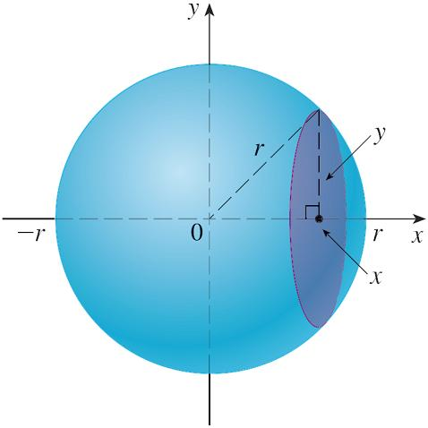

Example 1
Show that the volume of a sphere of radius r is .
Solution:
If we place the sphere so that
its center is at the origin
(see Figure 4), then the plane
P_{x} intersects the sphere in a
circle whose radius (from the
Pythagorean Theorem) is
So the cross-sectional area is
A(x) = πy²
Figure 4
= π(r² – x²)

Slide 13
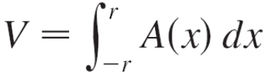
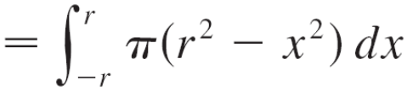
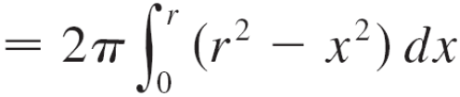
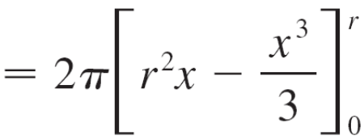
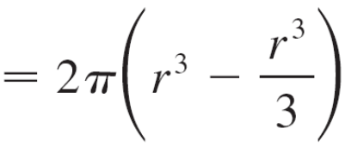

Example 1 – Solution
cont’d
Using the definition of volume with a = –r and b = r, we have
(The integrand is even.)

Slide 14
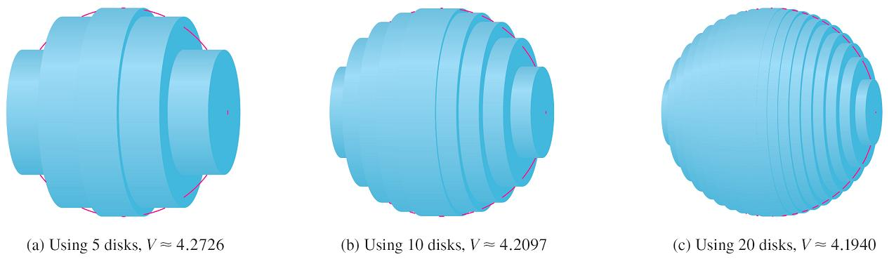
Volumes
Figure 5 illustrates the definition of volume when the solid is a sphere with radius r = 1.
From the result of Example 1, we know that the volume of the sphere is π, which is approximately 4.18879.
Figure 5
Approximating the volume of a sphere with radius 1

Slide 15
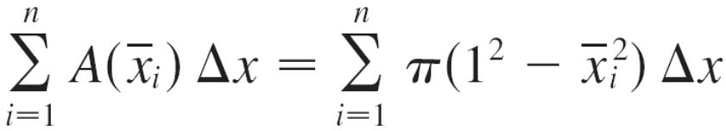

Volumes
Here the slabs are circular cylinders, or disks, and the three parts of Figure 5 show the geometric interpretations of the Riemann sums
when n = 5, 10, and 20 if we choose the sample points x_{i}* to be the midpoints
Notice that as we increase the number of approximating cylinders, the corresponding Riemann sums become closer to the true volume.

Slide 16
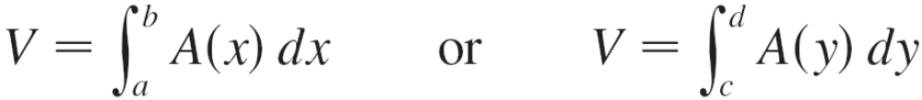
Volumes
The solids as in Example 1 are all called solids of revolution because they are obtained by revolving a region about a line. In general, we calculate the volume of a solid of revolution by using the basic defining formula
and we find the cross-sectional area A(x) or A(y) in one of the following ways:
If the cross-section is a disk, we find the radius of the disk (in terms of x or y) and use
A = π(radius)²

Slide 17
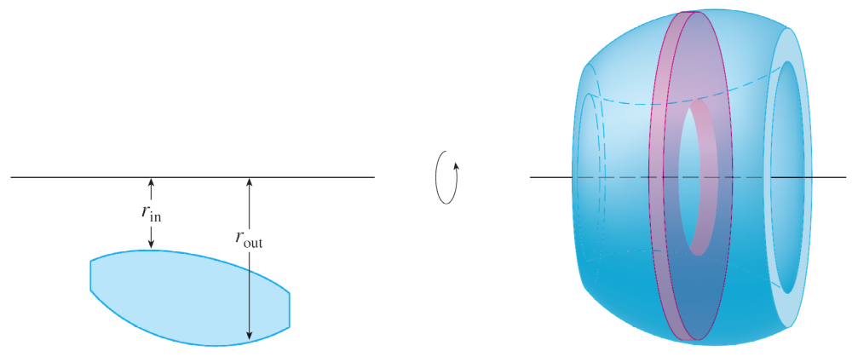
Volumes
If the cross-section is a washer, we find the inner radius r_{in} and outer radius r_{out} from a sketch (as in Figure 10) and compute the area of the washer by subtracting the area of the inner disk from the area of the outer disk:
A = π(outer radius)² – π(inner radius)²
Figure 10

