Slide 1

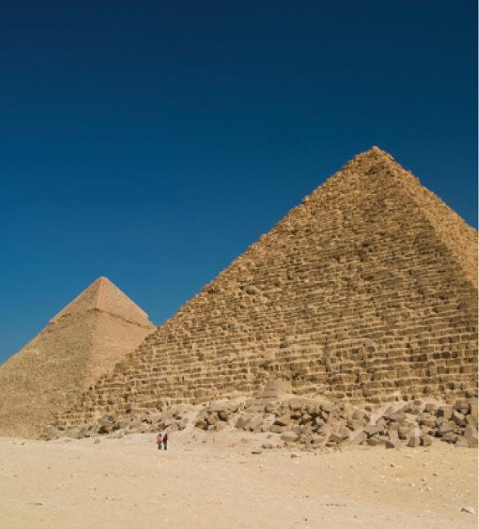
5
Applications of
Integration
Copyright © Cengage Learning. All rights reserved.

Slide 2

5.3
Volumes by Cylindrical Shells
Copyright © Cengage Learning. All rights reserved.

Slide 3
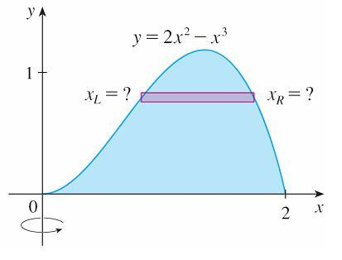
Volumes by Cylindrical Shells
Let’s consider the problem of finding the volume of the solid obtained by rotating about the y-axis the region bounded by y = 2x² – x³ and y = 0. (See Figure 1.)
If we slice perpendicular to the y-axis, we get a washer.
Figure 1

Slide 4
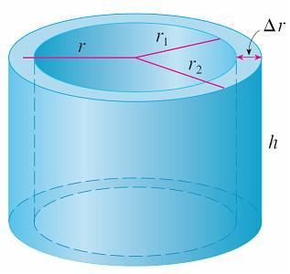
Volumes by Cylindrical Shells
But to compute the inner radius and the outer radius of the washer, we’d have to solve the cubic equation y = 2x² – x³ for x in terms of y; that’s not easy.
Fortunately, there is a method,
called the method of cylindrical
shells, that is easier to use in
such a case. Figure 2 shows a
cylindrical shell with inner radius r₁,
outer radius r₂, and height h.
Figure 2

Slide 5
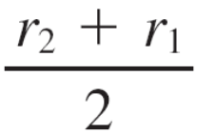
Volumes by Cylindrical Shells
Its volume V is calculated by subtracting the volume V₁ of the inner cylinder from the volume V₂ of the outer cylinder:
V = V₂ – V₁
= πr₂²h – πr₁²h = π(r₂² – r₁²⁾h
= π(r₂ + r₁)(r₂ – r₁)h
= 2π h(r₂ – r₁)

Slide 6


Volumes by Cylindrical Shells
If we let Δr = r₂ – r₁ (the thickness of the shell) and r = (r₂ + r₁) (the average radius of the shell), then this formula for the volume of a cylindrical shell becomes
and it can be remembered as
V = [circumference] [height] [thickness]

Slide 7
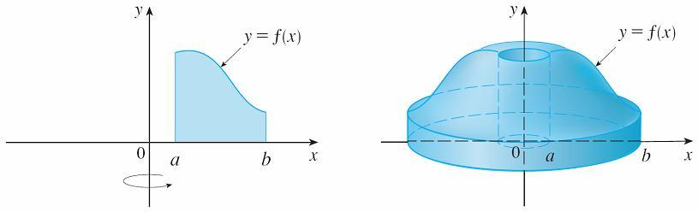

Volumes by Cylindrical Shells
Now let S be the solid obtained by rotating about the y-axis the region bounded by y = f (x) [where f (x) ≥ 0], y = 0, x = a and x = b, where b > a ≥ 0. (See Figure 3.)
We divide the interval [a, b] into n subintervals [x_{i} – ₁, x_{i}] of equal width Δx and let be the midpoint of the i th subinterval.
Figure 3

Slide 8


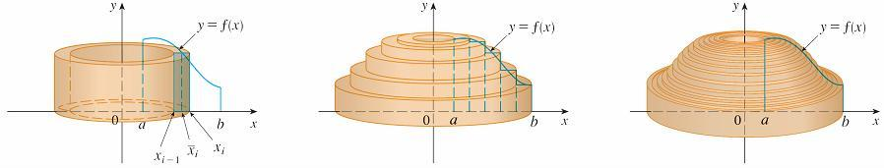
Volumes by Cylindrical Shells
If the rectangle with base [x _{i} – ₁, x_{i}] and height is rotated about the y-axis, then the result is a cylindrical shell with average radius , height , and thickness Δx (see Figure 4), so by Formula 1 its volume is
Figure 4

Slide 9
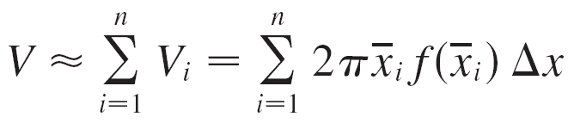

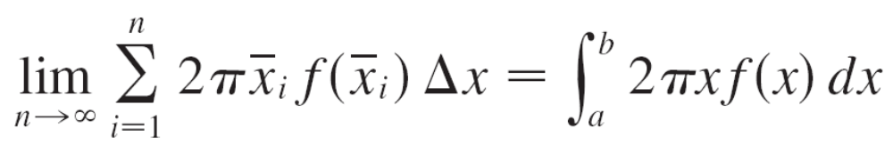
Volumes by Cylindrical Shells
Therefore an approximation to the volume V of S is given by the sum of the volumes of these shells:
This approximation appears to become better as n → .
But, from the definition of an integral, we know that

Slide 10
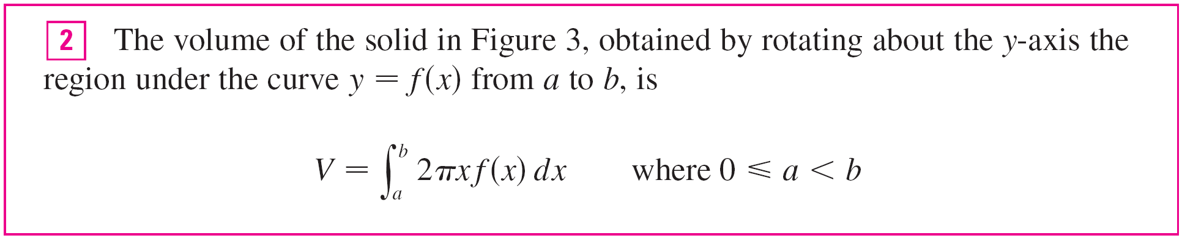
Volumes by Cylindrical Shells
Thus the following appears plausible:

Slide 11
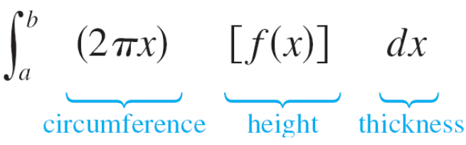
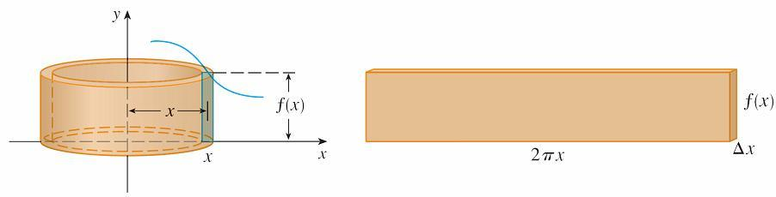
Volumes by Cylindrical Shells
The best way to remember Formula 2 is to think of a typical shell, cut and flattened as in Figure 5, with radius x, circumference 2πx, height f (x), and thickness Δx or dx:
This type of reasoning will be helpful in other situations, such as when we rotate about lines other than the y-axis.
Figure 5

Slide 12
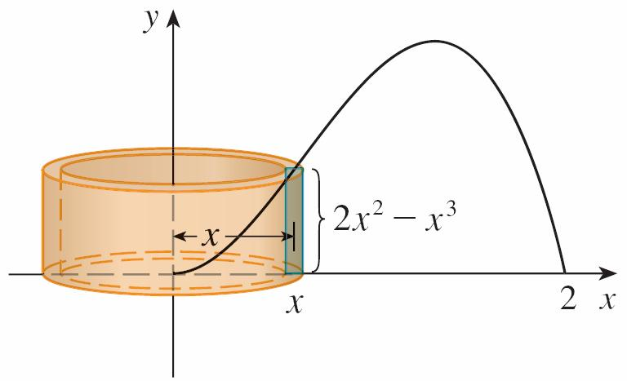
Example 1
Find the volume of the solid obtained by rotating
about the y-axis the region bounded by y = 2x² – x³ and y = 0.
Solution:
From the sketch in Figure 6 we see that a typical shell has radius x, circumference 2πx, and height f (x) = 2x² – x³.
Figure 6

Slide 13
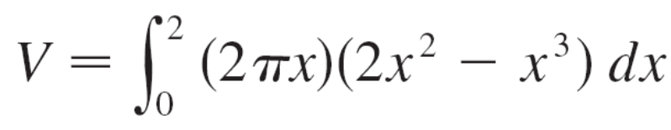
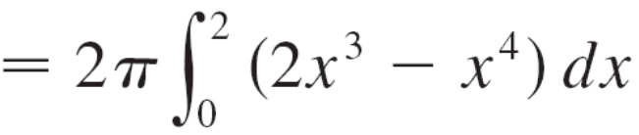

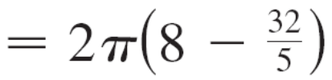
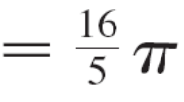
Example 1 – Solution
cont’d
So, by the shell method, the volume is
It can be verified that the shell method gives the same answer as slicing.

