Slide 1


5
Applications of
Integration
Copyright © Cengage Learning. All rights reserved.

Slide 2

5.4
Work
Copyright © Cengage Learning. All rights reserved.

Slide 3
Work
The term work is used in everyday language to mean the total amount of effort required to perform a task.
In physics it has a technical meaning that depends on the idea of a force.
Intuitively, you can think of a force as describing a push or pull on an object—for example, a horizontal push of a book across a table or the downward pull of the earth’s gravity on a ball.

Slide 4

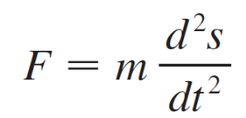
Work
In general, if an object moves along a straight line with position function s (t), then the force F on the object (in the same direction) is given by Newton’s Second Law of Motion as the product of its mass m and its acceleration:
In the SI metric system, the mass is measured in kilograms (kg), the displacement in meters (m), the time in seconds (s), and the force in newtons (N = kgm/s²). Thus a force of 1 N acting on a mass of 1 kg produces an acceleration
of 1 m/s².

Slide 5

Work
In the US Customary system the fundamental unit is chosen to be the unit of force, which is the pound.
In the case of constant acceleration, the force F is also constant and the work done is defined to be the product of the force F and the distance d that the object moves:
W = Fd work = force × distance

Slide 6
Work
If F is measured in newtons and d in meters, then the unit for W is a newton-meter, which is called a joule (J).
If F is measured in pounds and d in feet, then the unit for W is a foot-pound (ft-lb), which is about 1.36 J.

Slide 7
Example 1
How much work is done in lifting a 1.2-kg book off the floor to put it on a desk that is 0.7 m high? Use the fact that the acceleration due to gravity is g = 9.8 m/s².
(b) How much work is done in lifting a 20-lb weight 6 ft off the ground?

Slide 8
Example 1(a) – Solution
The force exerted is equal and opposite to that exerted by gravity, so Equation 1 gives
F = mg = (1.2)(9.8)
= 11.76 N
and then Equation 2 gives the work done as
W = Fd = (11.76)(0.7)
≈ 8.2 J

Slide 9
Example 1(b) – Solution
cont’d
Here the force is given as F = 20 lb, so the work done is
W = Fd = 20  6
= 120 ft-lb
Notice that in part (b), unlike part (a), we did not have to multiply by g because we were given the weight (which is a force) and not the mass of the object.

Slide 10
Work
Equation 2 defines work as long as the force is constant, but what happens if the force is variable? Let’s suppose that the object moves along the x-axis in the positive direction, from x = a to x = b, and at each point x between a and b a force f (x) acts on the object, where f is a continuous function.
We divide the interval [a, b] into n subintervals with endpoints x₀, x₁, . . . , x_{n} and equal width Δx.
We choose a sample point x_{i}∗ in the ith subinterval
[x^{i – 1}, x_{i}]. Then the force at that point is f(x_{i}∗).

Slide 11
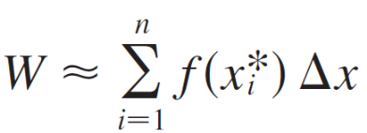

Work
If n is large, then Δx is small, and since f is continuous, the values of f don’t change very much over the interval [x_{i –1}, x_{i}].
In other words, f is almost constant on the interval and so the work W_{i} that is done in moving the particle from x_{i –1} to x_{i} is approximately given by Equation2:
W_{i} ≈ f (x_{i} ∗) Δx
Thus we can approximate the total work by

Slide 12


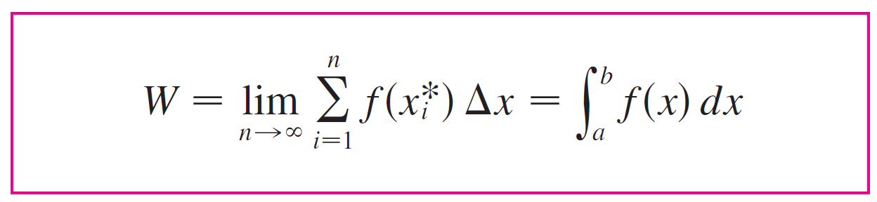

Work
It seems that this approximation becomes better as we make n larger. Therefore we define the work done in moving the object from a to b as the limit of this quantity as n → .
Since the right side of is a Riemann sum, we recognize its limit as being a definite integral and so

Slide 13
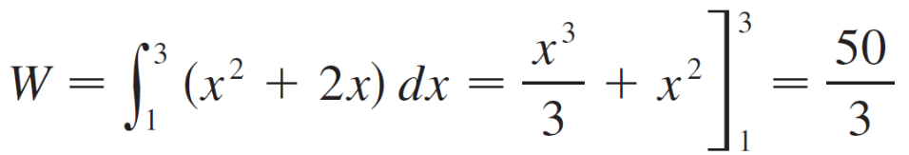
Example 2
When a particle is located a distance x feet from the origin, a force of x² + 2x pounds acts on it. How much work is done in moving it from x = 1 to x = 3?
Solution:
The work done is 16 ft-lb.

Slide 14
Work
In the next example we use a law from physics:
Hooke’s Law states that the force required to maintain a spring stretched units beyond its natural length is proportional to x:
f (x) = kx
where k is a positive constant (called the spring constant).

Slide 15
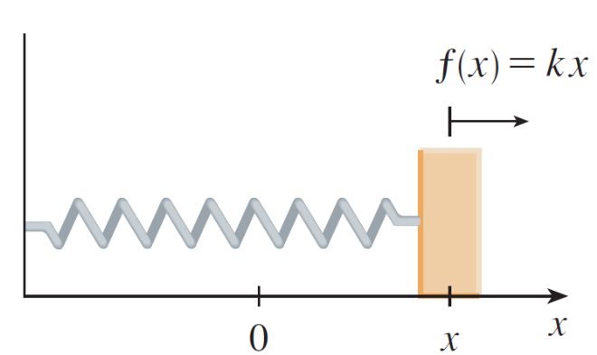
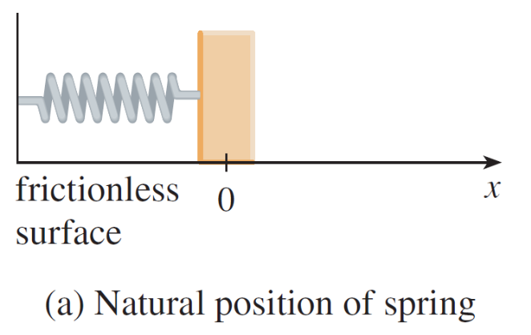
Work
Hooke’s Law holds provided that x is not too large
(see Figure 1).
(a) Natural position of spring
(b) Stretched position of spring
Hooke’s Law
Figure 1

Slide 16
Example 3
A force of 40 N is required to hold a spring that has been stretched from its natural length of 10 cm to a length of
15 cm. How much work is done in stretching the spring from 15 cm to 18 cm?
Solution:
According to Hooke’s Law, the force required to hold the spring stretched x meters beyond its natural length is
f (x) = kx.

Slide 17
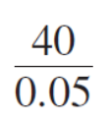
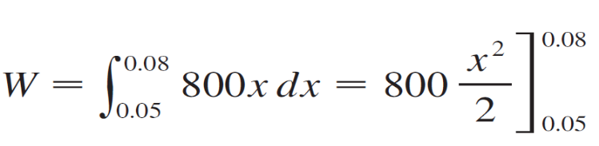
Example 3 – Solution
cont’d
When the spring is stretched from 10 cm to 15 cm, the amount stretched is 5 cm = 0.05 m. This means that
f (0.05) = 40, so
0.05k = 40 k = = 800
Thus f (x) = 800x and the work done in stretching the spring from 15 cm to 18 cm is
= 400[(0.08)² – 0.05)²]
= 1.56 J

