Slide 1


6
Inverse Functions
Copyright © Cengage Learning. All rights reserved.

Slide 2

Derivatives of Logarithmic Functions
6.4
Copyright © Cengage Learning. All rights reserved.

Slide 3
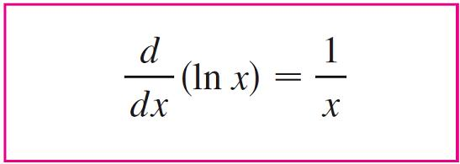

Derivatives of Logarithmic Functions
In this section we find the derivatives of the logarithmic functions y = log_{a}x and the exponential functions y = a^{x}.
We start with the natural logarithmic function y = ln x.
We know that it is differentiable because it is the inverse of the differentiable function y = e^{x}.

Slide 4
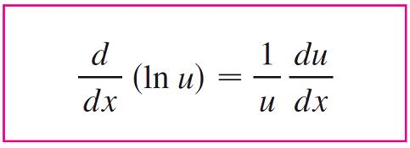
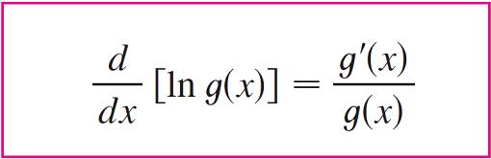

Derivatives of Logarithmic Functions
In general, if we combine Formula 1 with the Chain Rule, we get
or

Slide 5


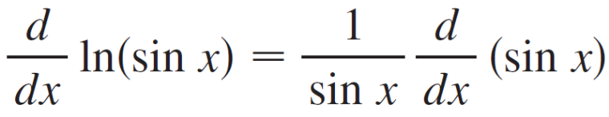
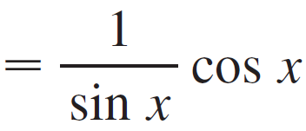

Example 2
Find ln(sin x).
Solution:
Using , we have

Slide 6
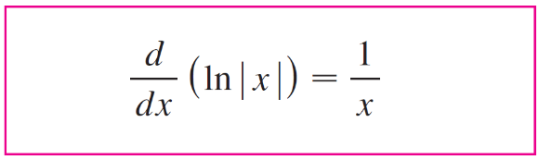

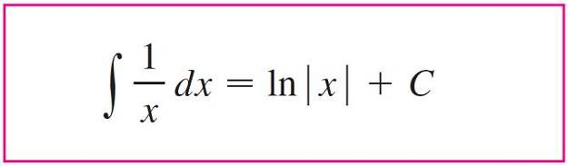

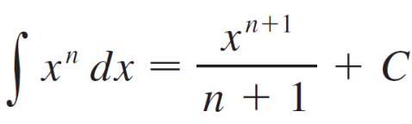
Derivatives of Logarithmic Functions
The corresponding integration formula is
Notice that this fills the gap in the rule for integrating power functions:
if n ≠ –1
The missing case (n = –1) is supplied by Formula 4.

Slide 7
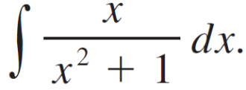

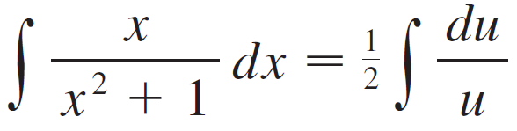


Example 9
Evaluate
Solution:
We make the substitution u = x² + 1 because the differential du = 2xdx occurs (except for the constant factor 2).
Thus x dx = du and

Slide 8


Example 9 – Solution
cont’d
Notice that we removed the absolute value signs because x² + 1 > 0 for all x.
We could use the properties of logarithms to write the answer as
but this isn’t necessary.

Slide 9
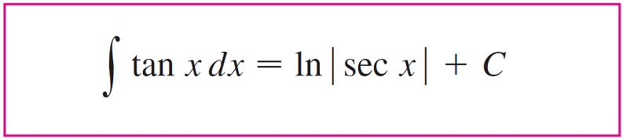

Derivatives of Logarithmic Functions

Slide 10
General Logarithmic and Exponential
Functions

Slide 11
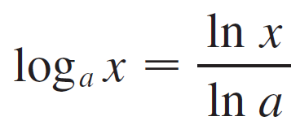
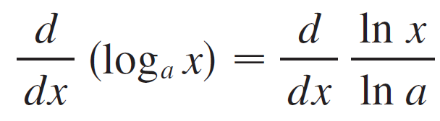
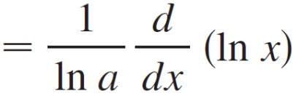
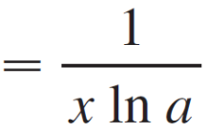
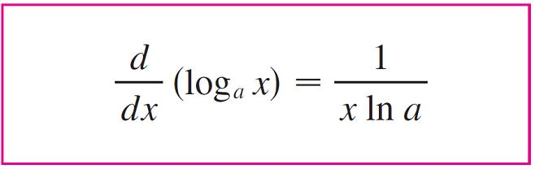

General Logarithmic and Exponential Functions
The logarithmic function with base a in terms of the natural logarithmic function:
Since ln a is a constant, we can differentiate as follows:

Slide 12
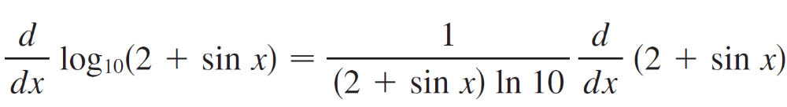
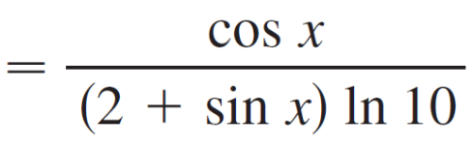
Example 12

Slide 13
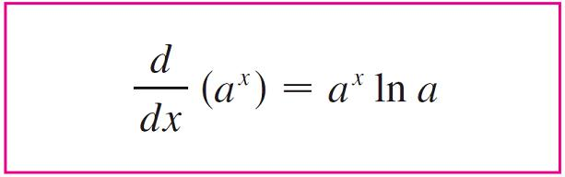

General Logarithmic and Exponential Functions

Slide 14
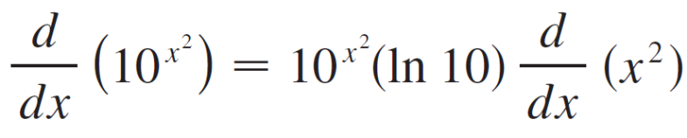

Example 13

Slide 15
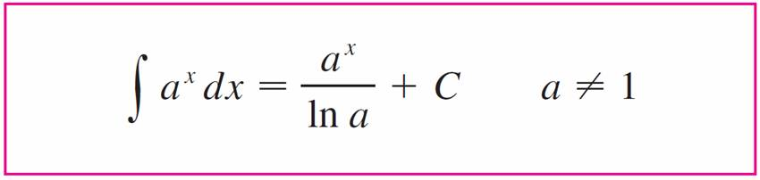
General Logarithmic and Exponential Functions
The integration formula that follows from Formula 7 is

Slide 16
Logarithmic Differentiation

Slide 17
Logarithmic Differentiation
The calculation of derivatives of complicated functions involving products, quotients, or powers can often be simplified by taking logarithms.
The method used in the next example is called logarithmic differentiation.

Slide 18
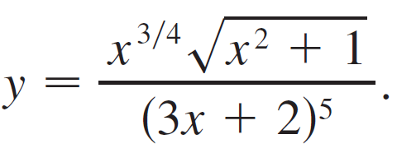


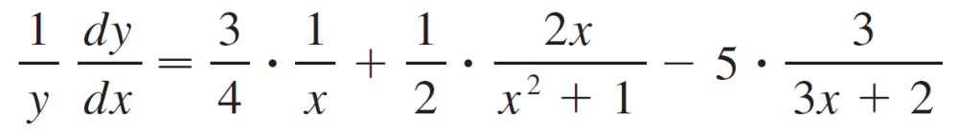
Example 15
Differentiate
Solution:
We take logarithms of both sides of the equation and use the properties of logarithms to simplify:
ln y = ln x + ln(x² + 1) – 5 ln(3x + 2)
Differentiating implicitly with respect to x gives

Slide 19
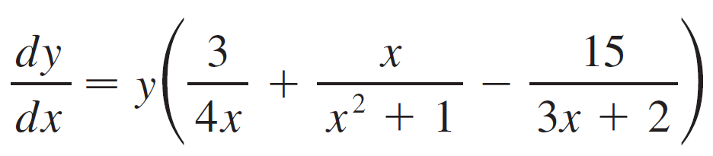
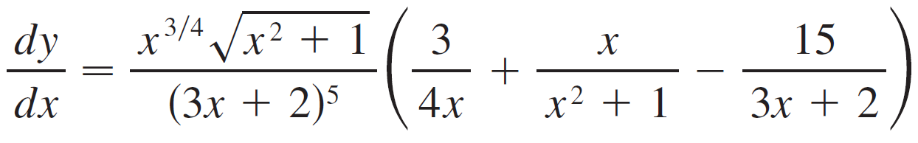
Example 15 – Solution
cont’d
Solving for dy/dx, we get
Because we have an explicit expression for y, we can substitute and write

Slide 20
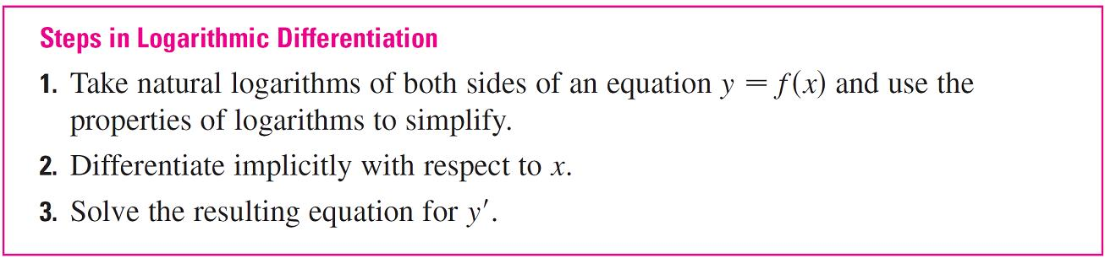

Logarithmic Differentiation

Slide 21
The Number e as a Limit

Slide 22
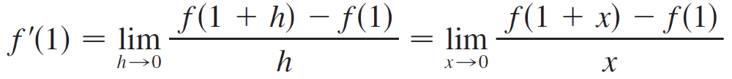
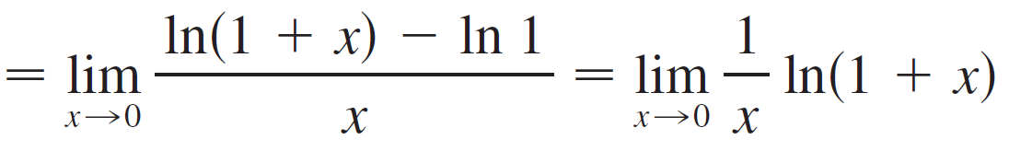
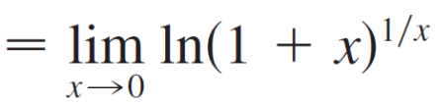
The Number e as a Limit
If f (x) = ln x, then f ′(x) = 1/x. Thus f ′(1) = 1. We now use this fact to express the number e as a limit.
From the definition of a derivative as a limit, we have

Slide 23
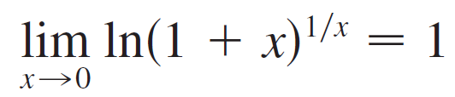
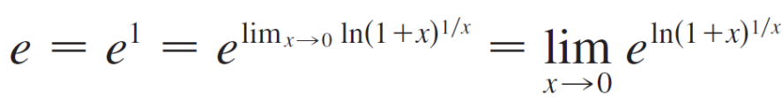
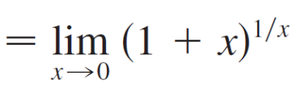
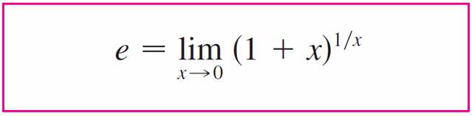

The Number e as a Limit
Because f ′(1) = 1, we have
Then, by the continuity of the exponential function, we have

Slide 24
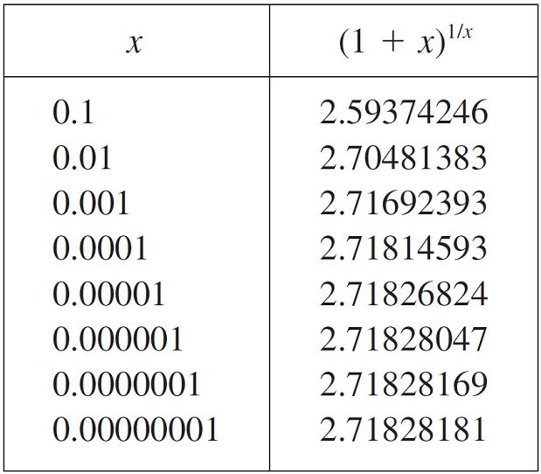
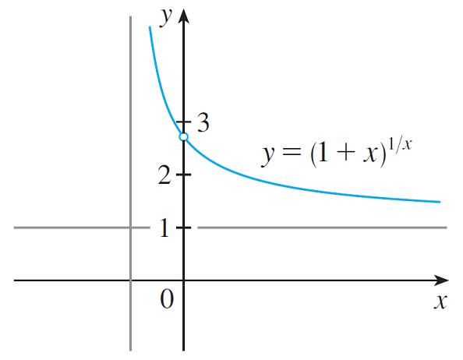
The Number e as a Limit
Formula 8 is illustrated by the graph of the function
y = (1 + x)^{1/x} in Figure 6 and a table of values for small values of x.
Figure 6

Slide 25

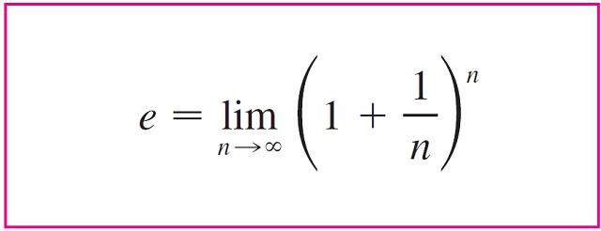

The Number e as a Limit
If we put n = 1/x in Formula 8, then n → as x → 0⁺ and so an alternative expression for e is

