Slide 1


6
Inverse Functions
Copyright © Cengage Learning. All rights reserved.

Slide 2

6.6
Inverse Trigonometric Functions
Copyright © Cengage Learning. All rights reserved.

Slide 3
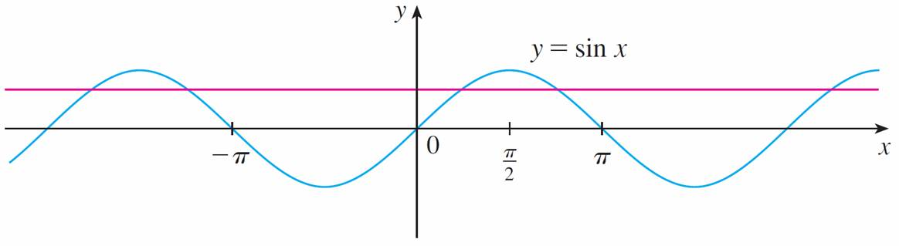
Inverse Trigonometric Functions
You can see from Figure 1 that the sine function y = sin x is not one-to-one (use the Horizontal Line Test).
Figure 1

Slide 4
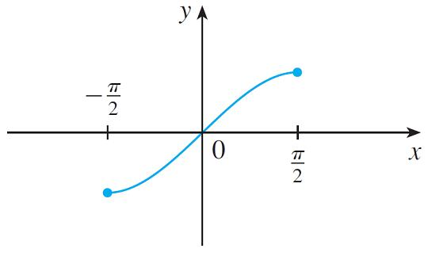

Inverse Trigonometric Functions
But the function f (x) = sin x, –π /2 ≤ x ≤ π /2 is one-to-one (see Figure 2).The inverse function of this restricted sine function f exists and is denoted by sin^{–1} or arcsin. It is called the inverse sine function or the arcsine function.
y = sin x,
Figure 2

Slide 5

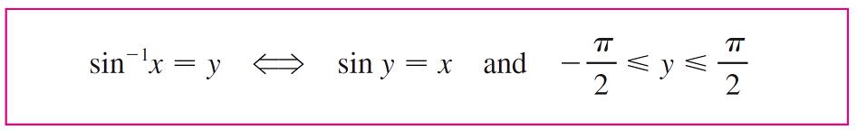

Inverse Trigonometric Functions
Since the definition of an inverse function says that
f ^{–1}(x) = y f (y) = x
we have
Thus, if –1 ≤ x ≤ 1, sin^{–1}x is the number between –π /2 and
π /2 whose sine is x.

Slide 6

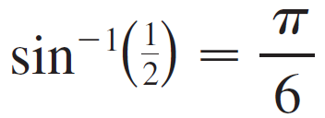

Example 1
Evaluate (a) sin^{–1} and (b) tan(arcsin ).
Solution:
We have
Because sin(π/6) = and π /6 lies between –π /2 and
π /2.

Slide 7

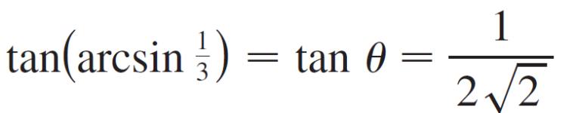
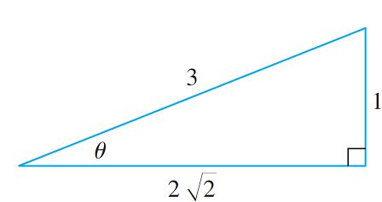
Example 1 – Solution
(b) Let θ = arcsin , so sin θ = . Then we can draw a right triangle with angle θ as in Figure 3 and deduce from the Pythagorean Theorem that the third side has length
This enables us to read from the triangle
that
Figure 3

Slide 8
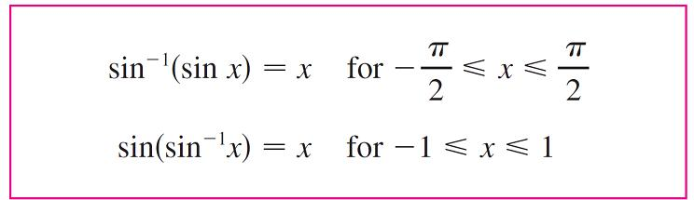

Inverse Trigonometric Functions
The cancellation equations for inverse functions become, in this case,

Slide 9
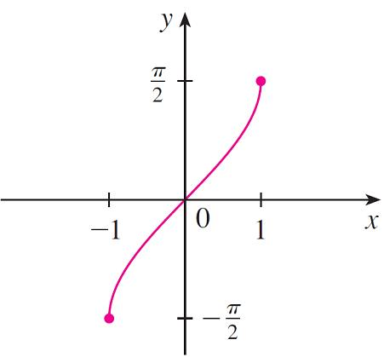
Inverse Trigonometric Functions
The inverse sine function, sin^{–1}, has domain [–1, 1] and range [–π /2, π /2], and its graph, shown in Figure 4, is obtained from that of the restricted sine function (Figure 2)
by reflection about the line y = x.
y = sin^{–1} x = arcsin x
Figure 4

Slide 10
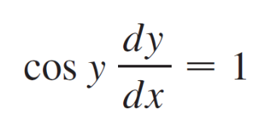
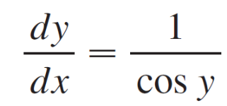
Inverse Trigonometric Functions
We know that the sine function f is continuous, so the inverse sine function is also continuous. The sine function is differentiable, so the inverse sine function is also differentiable.
Let y = sin^{–1}x. Then sin y = x and –π /2 ≤ y ≤ π /2. Differentiating sin y = x implicitly with respect to x, we obtain
and

Slide 11

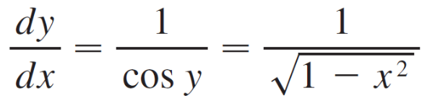
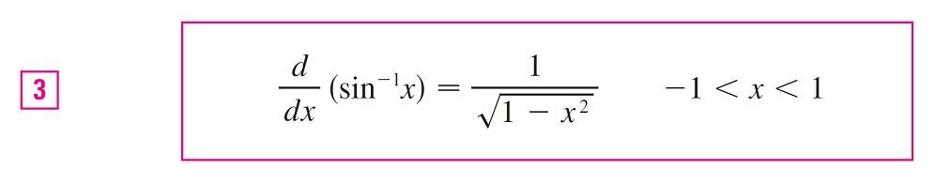
Inverse Trigonometric Functions
Now cos y ≥ 0 since –π /2 ≤ y ≤ π /2, so
Therefore

Slide 12
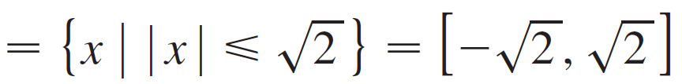
Example 2
If f (x) = sin^{–1}(x² – 1), find (a) the domain of f, (b) f ′(x), and (c) the domain of f ′.
Solution:
Since the domain of the inverse sine function is [–1, 1],
the domain of f is
{x| –1 ≤ x² – 1 ≤ 1} = {x | 0 ≤ x² ≤ 2}

Slide 13
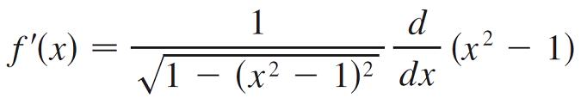
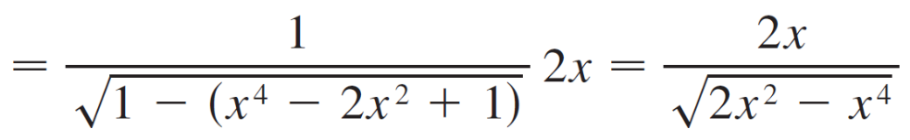
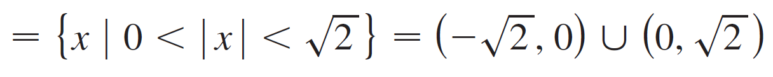
Example 2 – Solution
cont’d
(b) Combining Formula 3 with the Chain Rule, we have
(c) The domain of f ′ is
{x | –1 < x² – 1 < 1} = {x | 0 < x² < 2}

Slide 14

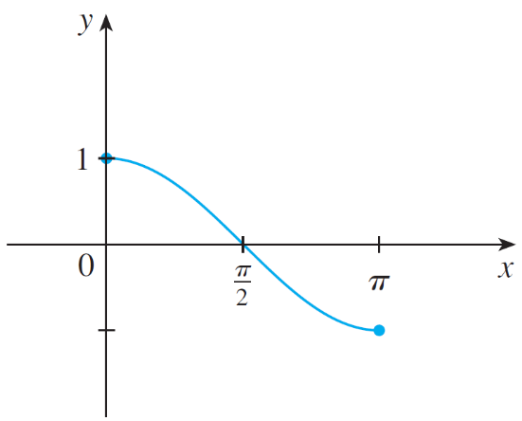
Inverse Trigonometric Functions
The inverse cosine function is handled similarly. The restricted cosine function f (x) = cos x, 0 ≤ x ≤ π is
one-to-one (see Figure 6) and so it has an inverse function denoted by cos^{–1} or arccos.
y = cos x, 0 ≤ x ≤ π
Figure 6

Slide 15
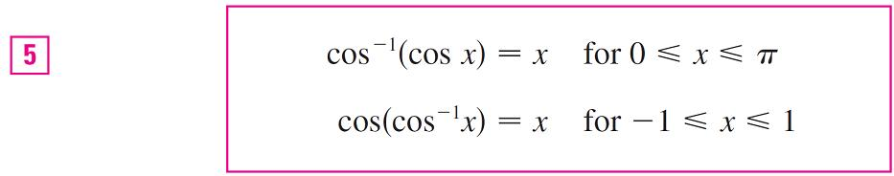
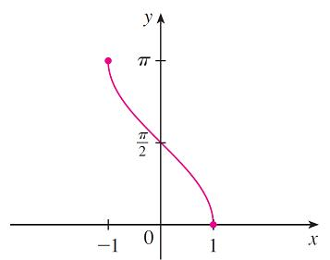
Inverse Trigonometric Functions
The cancellation equations are
The inverse cosine function, cos^{–1}, has domain [–1, 1] and range [0, π] and is a continuous function whose graph is shown in Figure 7.
y = cos^{–1}x = arccos x
Figure 7

Slide 16
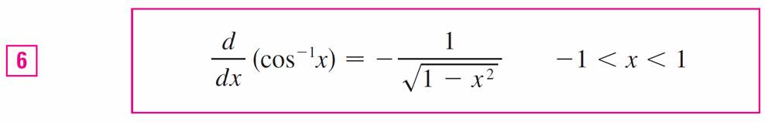
Inverse Trigonometric Functions
Its derivative is given by
The tangent function can be made one-to-one by restricting it to the interval (–π /2 , π /2).
Thus the inverse tangent function is defined as the inverse of the function f (x) = tan x, –π /2 < x < π /2.

Slide 17
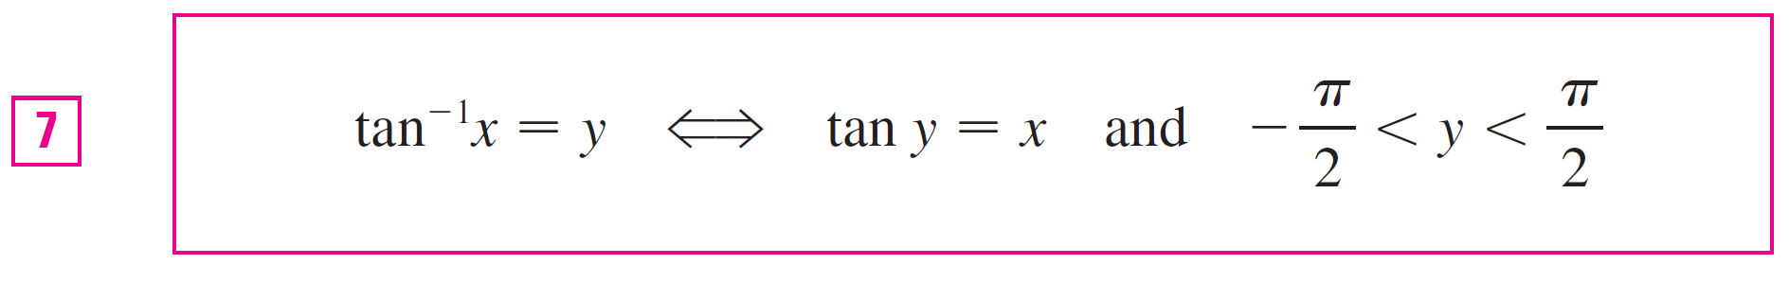
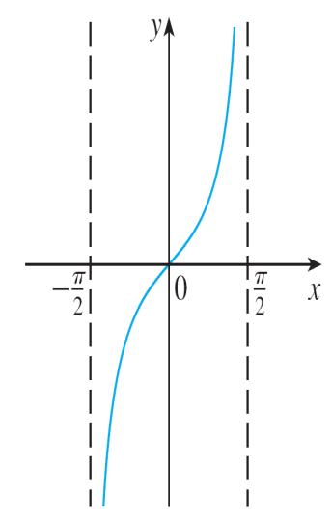


Inverse Trigonometric Functions
It is denoted by tan^{–1} or arctan. (See Figure 8.)
y = tan x, < x <
Figure 8

Slide 18

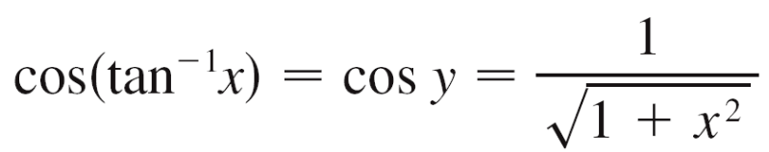
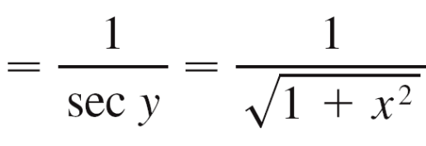
Example 3
Simplify the expression cos(tan^{–1}x).
Solution1:
Let y = tan^{–1}x. Then tan y = x and –π /2 < y < π /2. We want to find cos y but, since tan y is known, it is easier to find sec y first:
sec²y = 1 + tan²y
= 1 + x²
Thus
(since sec y > 0 for –π /2 < y < π /2)

Slide 19
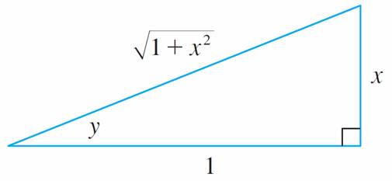
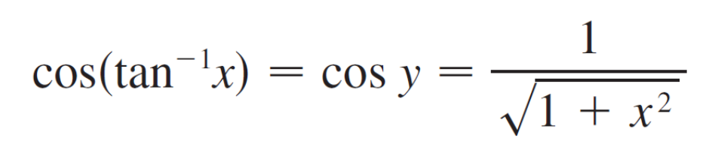
Example 3 – Solution 2
cont’d
Instead of using trigonometric identities as in Solution 1, it is perhaps easier to use a diagram.
If y = tan^{–1}x, then, tan y = x and we can read from Figure 9
(which illustrates the case y > 0) that
Figure 9

Slide 20

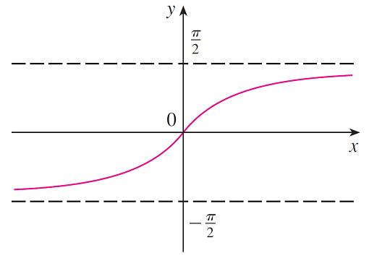
Inverse Trigonometric Functions
The inverse tangent function, tan^{–1}x = arctan, has domain
and range (–π /2, π /2). Its graph is shown in Figure 10.
y = tan^{–1}x = arctan x
Figure 10

Slide 21
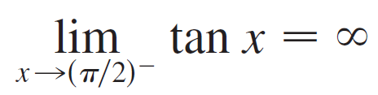

Inverse Trigonometric Functions
We know that
and
and so the lines x = ±π /2 are vertical asymptotes of the graph of tan.
Since the graph of tan^{–1} is obtained by reflecting the graph of the restricted tangent function about the line y = x, it follows that the lines y = π /2 and y = –π /2 are horizontal asymptotes of the graph of tan^{–1}.

Slide 22
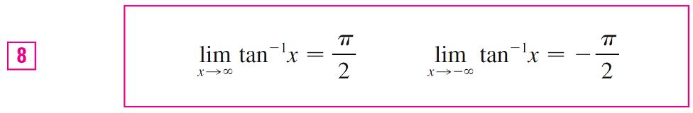
Inverse Trigonometric Functions
This fact is expressed by the following limits:

Slide 23
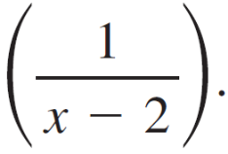



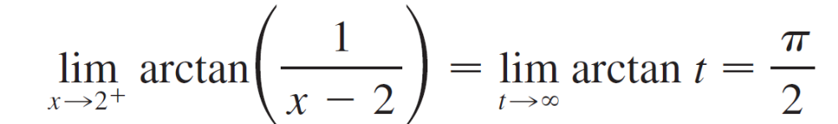
Example 4
Evaluate arctan
Solution:
If we let t = 1/(x – 2), we know that t → as x → 2⁺. Therefore, by the first equation in , we have

Slide 24
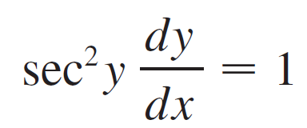
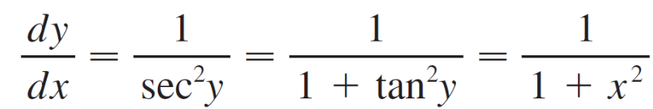
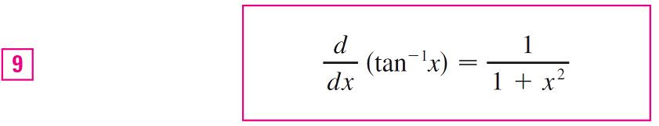
Inverse Trigonometric Functions
Because tan is differentiable, tan^{–1} is also differentiable. To find its derivative, we let y = tan^{–1}x.
Then tan y = x. Differentiating this latter equation implicitly with respect to x, we have
and so

Slide 25
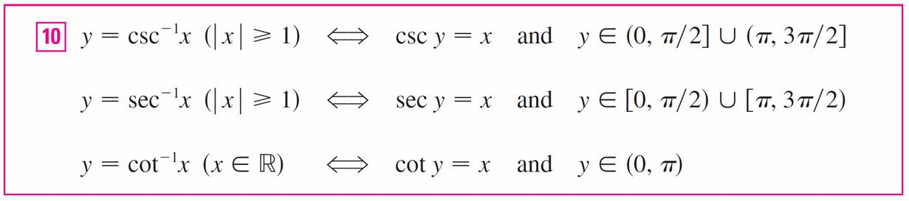
Inverse Trigonometric Functions
The remaining inverse trigonometric functions are not used as frequently and are summarized here.

Slide 26
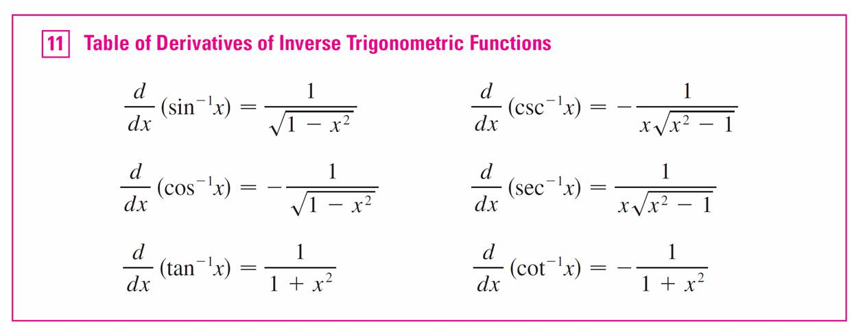
Inverse Trigonometric Functions
We collect in Table 11 the differentiation formulas for all of the inverse trigonometric functions.

Slide 27
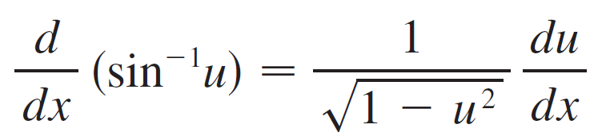
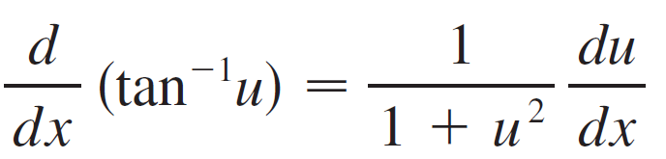
Inverse Trigonometric Functions
Each of these formulas can be combined with the Chain Rule. For instance, if u is a differentiable function of x, then
and

Slide 28
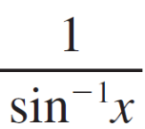

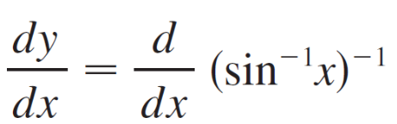
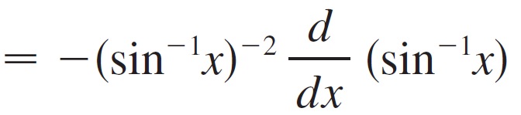
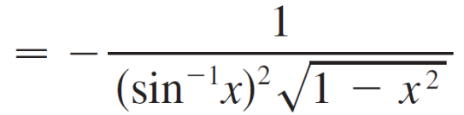
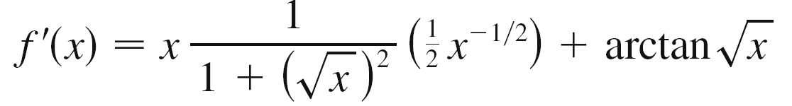
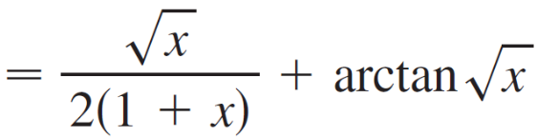
Example 5
Differentiate (a) y = and (b) f (x) = x arctan .
Solution:
(a)
(b)

Slide 29
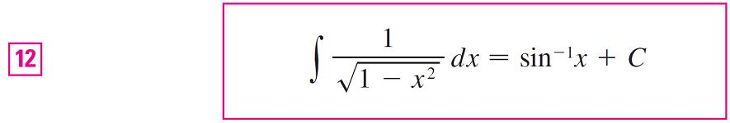
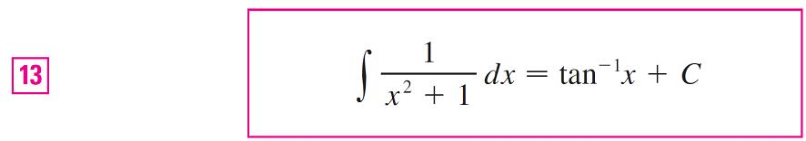
Inverse Trigonometric Functions

Slide 30
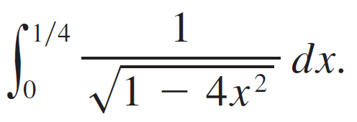
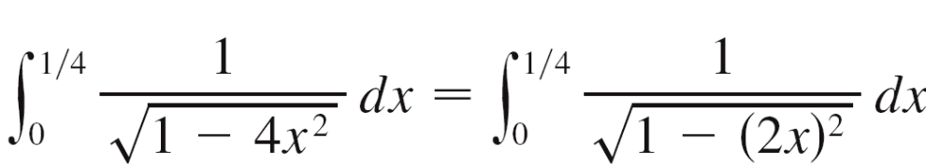
Example 7
Find
Solution:
If we write
then the integral resembles Equation 12 and the substitution u = 2x is suggested.

Slide 31

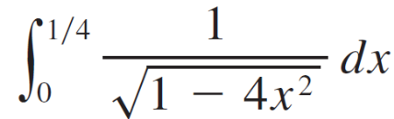
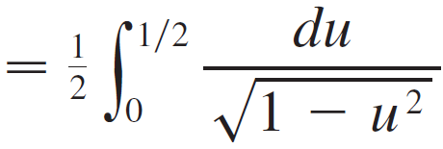



Example 7 – Solution
cont’d
This gives du = 2dx, so dx = du /2. When x = 0, u = 0; when x = , u = . So

Slide 32


Inverse Trigonometric Functions

Slide 33





Example 9
Find
Solution:
We substitute u = x² because then du = 2xdx and we can use Equation 14 with a = 3:

