Slide 1


6
Inverse Functions
Copyright © Cengage Learning. All rights reserved.

Slide 2

Indeterminate Forms and l’Hospital’s Rule
6.8
Copyright © Cengage Learning. All rights reserved.

Slide 3
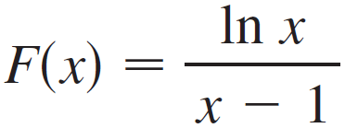
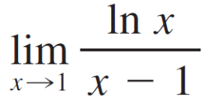

Indeterminate Forms and l’Hospital’s Rule
Suppose we are trying to analyze the behavior of the function
Although F is not defined when x = 1, we need to know how F behaves near 1. In particular, we would like to know the value of the limit

Slide 4

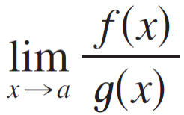

Indeterminate Forms and l’Hospital’s Rule
In computing this limit we can’t apply Law 5 of limits because the limit of the denominator is 0. In fact, although the limit in exists, its value is not obvious because both numerator and denominator approach 0 and is not defined.
In general, if we have a limit of the form
where both f (x) → 0 and g (x) → 0 as x → a, then this limit may or may not exist and is called an indeterminate form of type .

Slide 5
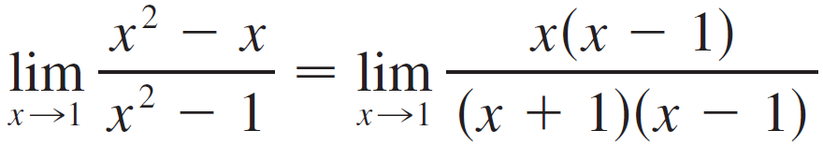
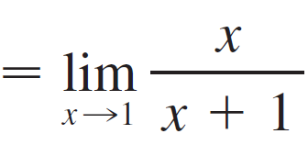
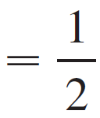
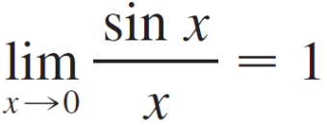
Indeterminate Forms and l’Hospital’s Rule
For rational functions, we can cancel common factors:
We used a geometric argument to show that

Slide 6
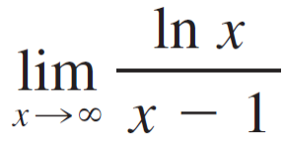


Indeterminate Forms and l’Hospital’s Rule
But these methods do not work for limits such as , so in this section we introduce a systematic method, known as l’Hospital’s Rule, for the evaluation of indeterminate forms.
Another situation in which a limit is not obvious occurs when we look for a horizontal asymptote of F and need to evaluate its limit at infinity:
It isn’t obvious how to evaluate this limit because both numerator and denominator become large as x → .

Slide 7
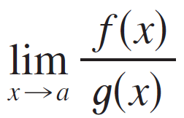
Indeterminate Forms and l’Hospital’s Rule
There is a struggle between numerator and denominator. If the numerator wins, the limit will be ; if the denominator wins, the answer will be 0. Or there may be some compromise, in which case the answer will be some finite positive number.
In general, if we have a limit of the form
where both f (x) → (or – ) and g (x) → (or – ), then the limit may or may not exist and is called an indeterminate form of type / .

Slide 8
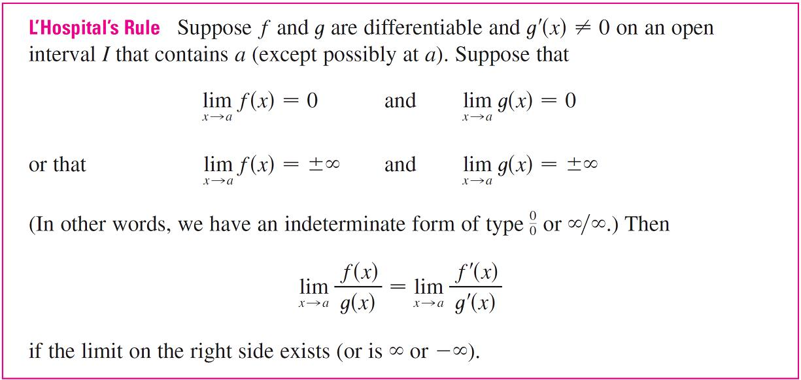
Indeterminate Forms and l’Hospital’s Rule
L’Hospital’s Rule applies to this type of indeterminate form.

Slide 9
Indeterminate Forms and l’Hospital’s Rule
Note 1:
L’Hospital’s Rule says that the limit of a quotient of functions is equal to the limit of the quotient of their derivatives, provided that the given conditions are satisfied. It is especially important to verify the conditions regarding the limits of f and g before using l’Hospital’s Rule.
Note 2:
L’Hospital’s Rule is also valid for one-sided limits and for limits at infinity or negative infinity; that is, “x → a” can be replaced by any of the symbols x → a⁺, x → a–, x → , or
x → – .

Slide 10
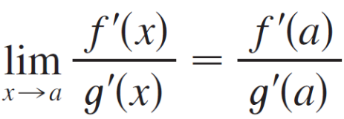
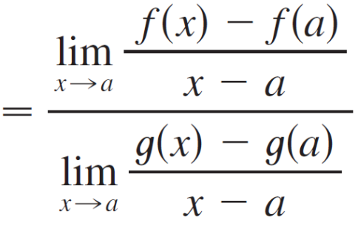
Indeterminate Forms and l’Hospital’s Rule
Note 3:
For the special case in which f (a) = g(a) = 0, f ′ and g ′ are continuous, and g ′(a) ≠ 0, it is easy to see why l’Hospital’s Rule is true. In fact, using the alternative form of the definition of a derivative, we have

Slide 11
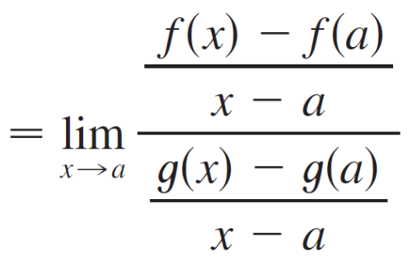
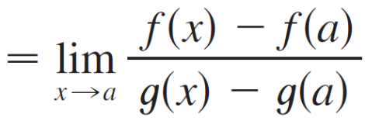
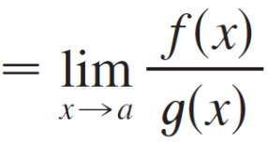

Indeterminate Forms and l’Hospital’s Rule
The general version of l’Hospital’s Rule for the indeterminate form is somewhat more difficult and its proof is deferred to the end of this section. The proof for the indeterminate form / can be found in more advanced books.

Slide 12
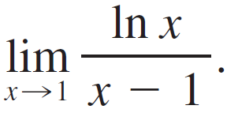
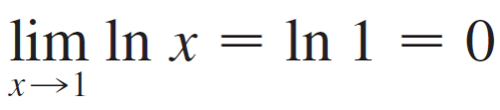
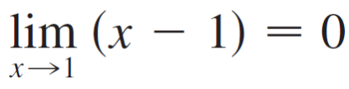
Example 1
Find
Solution:
Since
and

Slide 13
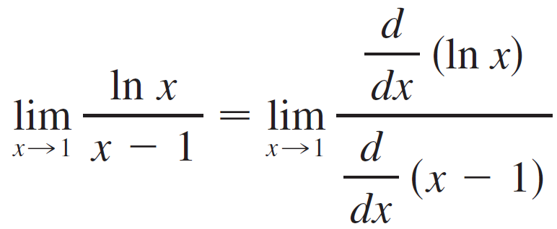
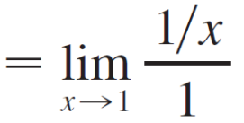
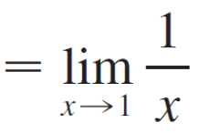

Example 1 – Solution
cont’d
we can apply l’Hospital’s Rule:

Slide 14
Indeterminate Products

Slide 15
Indeterminate Products
If lim_{x→a} f (x) = 0 and lim_{x→a} g(x) = (or – ), then it isn’t clear what the value of lim_{x→a} [f (x) g(x)], if any, will be. There is a struggle between f and g. If f wins, the answer will be 0; if g wins, the answer will be (or – ).
Or there may be a compromise where the answer is a finite nonzero number. This kind of limit is called an indeterminate form of type 0  .

Slide 16
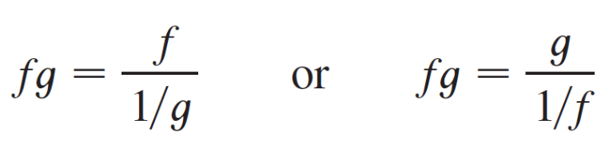

Indeterminate Products
We can deal with it by writing the product fg as a quotient:
This converts the given limit into an indeterminate form of type or / so that we can use l’Hospital’s Rule.

Slide 17
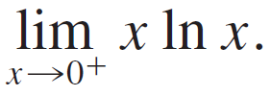
Example 6
Evaluate
Solution:
The given limit is indeterminate because, as x → 0⁺, the first factor (x) approaches 0 while the second factor (ln x) approaches – .

Slide 18
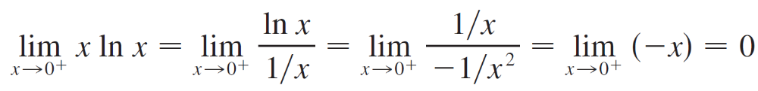
Example 6 – Solution
cont’d
Writing x = 1/(1/x), we have 1/x → as x → 0⁺, so l’Hospital’s Rule gives

Slide 19
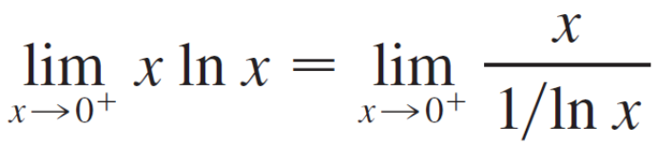
Indeterminate Products
Note:
In solving Example 6 another possible option would have been to write
This gives an indeterminate form of the type 0/0, but if we apply l’Hospital’s Rule we get a more complicated expression than the one we started with.
In general, when we rewrite an indeterminate product, we try to choose the option that leads to the simpler limit.

Slide 20
Indeterminate Differences

Slide 21
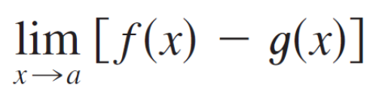
Indeterminate Differences
If lim_{x→a} f (x) = and lim_{x→a} g(x) = , then the limit
is called an indeterminate form of type – .

Slide 22

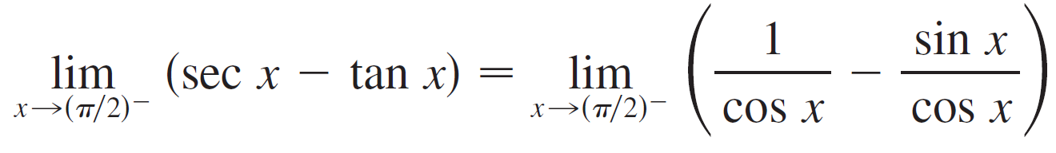
Example 8
Compute
Solution:
First notice that sec x → and tan x → as x → (π /2)–, so the limit is indeterminate.
Here we use a common denominator:

Slide 23
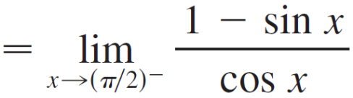
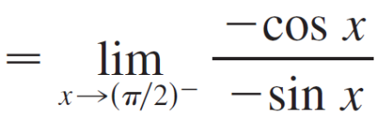

Example 8 – Solution
cont’d
Note that the use of l’Hospital’s Rule is justified because
1 – sin x → 0 and cos x → 0 as x → (π /2)–.

Slide 24
Indeterminate Powers

Slide 25
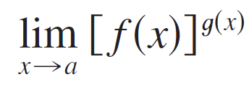
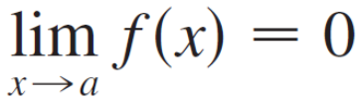
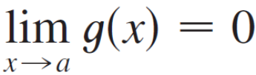
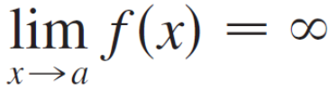
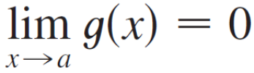

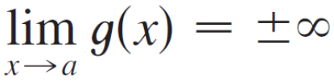

Indeterminate Powers
Several indeterminate forms arise from the limit
1. and type 0⁰
2. and type ⁰
3. and type

Slide 26
Indeterminate Powers
Each of these three cases can be treated either by taking the natural logarithm:
let y = [f (x)]^{g(x)}, then ln y = g(x) ln f (x)
or by writing the function as an exponential:
[f (x)]^{g(x)} = e^{g (x) ln f (x)}
In either method we are led to the indeterminate product
g(x) ln f (x), which is of type 0  .

Slide 27
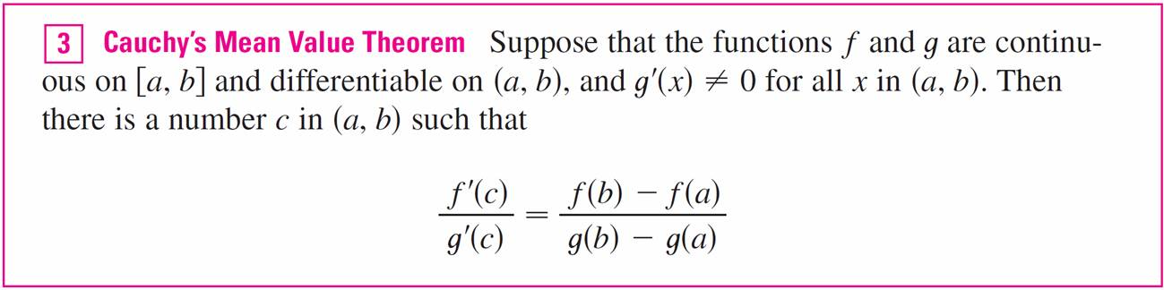
Indeterminate Powers

