Slide 1


7
Techniques of Integration
Copyright © Cengage Learning. All rights reserved.

Slide 2

7.2
Trigonometric Integrals
Copyright © Cengage Learning. All rights reserved.

Slide 3
Trigonometric Integrals
In this section we use trigonometric identities to integrate certain combinations of trigonometric functions.
We start with powers of sine and cosine.

Slide 4
Example 2
Find ∫ sin⁵x cos²x dx.
Solution:
We could convert cos²x to 1 – sin²x, but we would be left with an expression in terms of sin x with no extra cos x factor.
Instead, we separate a single sine factor and rewrite the remaining sin⁴x factor in terms of cos x:
sin⁵ x cos²x = (sin²x)² cos²x sin x
= (1 – cos²x)² cos²x sin x

Slide 5
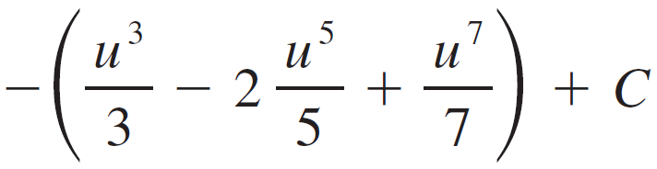
Example 2 – Solution
cont’d
Substituting u = cos x, we have du = –sin x dx and so
∫ sin⁵x cos²x dx = ∫ (sin²x)² cos²x sin x dx
= ∫ (1 – cos²x)² cos²x sin x dx
= ∫ (1 – u²)² u² (–du) = –∫ (u² – 2u⁴ + u⁶)du
=
= – cos³x + cos⁵x – cos⁷x + C

Slide 6
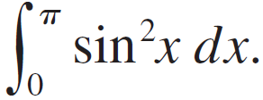
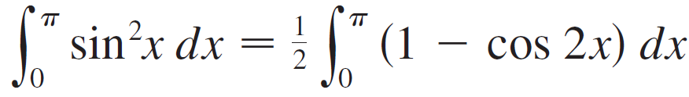
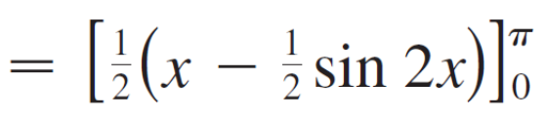
Example 3
Evaluate
Solution:
If we write sin²x = 1 – cos²x, the integral is no simpler to evaluate. Using the half-angle formula for sin²x, however, we have

Slide 7
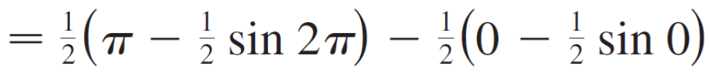
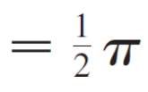
Example 3 – Solution
cont’d
Notice that we mentally made the substitution u = 2x when integrating cos 2x.

Slide 8
Trigonometric Integrals
To summarize, we list guidelines to follow when evaluating integrals of the form ∫ sin^{m}x cos^{n}x dx, where m ≥ 0 and
n ≥ 0 are integers.

Slide 9
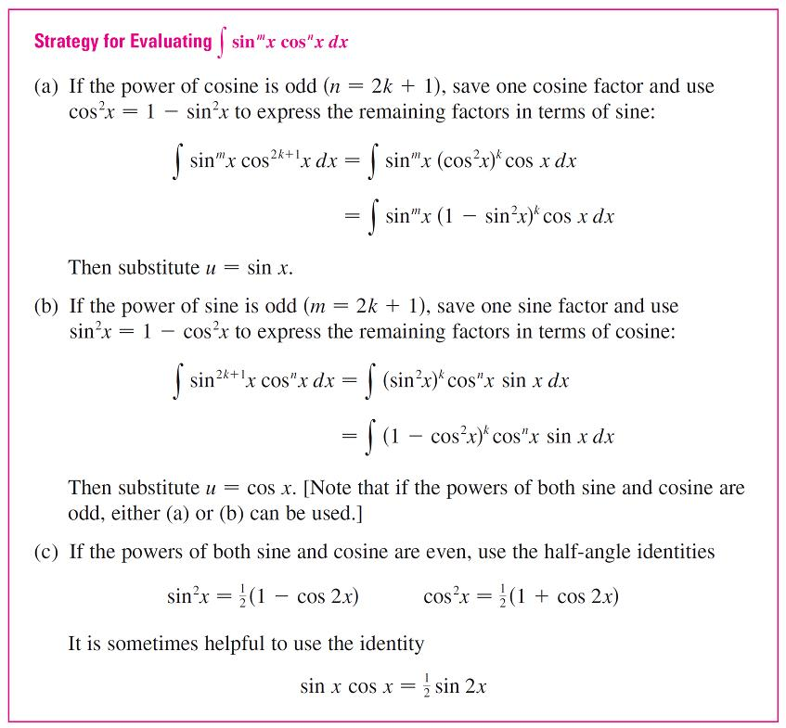
Trigonometric Integrals

Slide 10
Trigonometric Integrals
We can use a similar strategy to evaluate integrals of the form ∫ tan^{m}x sec^{n}x dx.
Since (d/dx) tan x = sec²x, we can separate a sec²x factor and convert the remaining (even) power of secant to an expression involving tangent using the identity
sec²x = 1 + tan²x.
Or, since (d/dx) sec x = sec x tan x, we can separate a
sec x tan x factor and convert the remaining (even) power of tangent to secant.

Slide 11
Example 5
Evaluate ∫ tan⁶x sec⁴x dx.
Solution:
If we separate one sec²x factor, we can express the remaining sec²x factor in terms of tangent using the identity sec²x = 1 + tan²x.
We can then evaluate the integral by substituting u = tan x so that du = sec²x dx:
∫ tan⁶x sec⁴x dx = ∫ tan⁶x sec²x sec²x dx

Slide 12
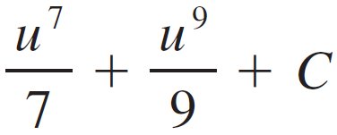

Example 5 – Solution
cont’d
= ∫ tan⁶x (1 + tan²x) sec²x dx
= ∫ u⁶(1 + u²)du = ∫ (u⁶ + u⁸)du
=
= tan⁷x + tan⁹x + C

Slide 13
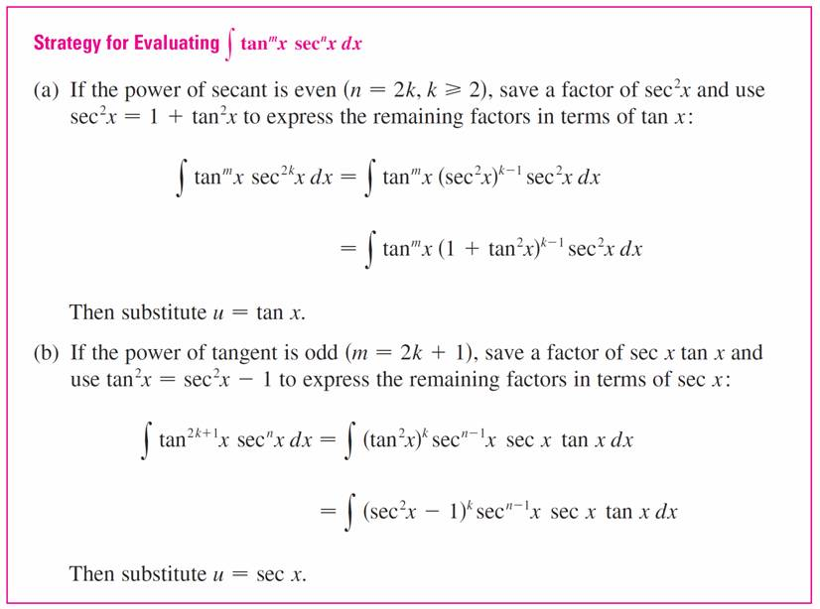
Trigonometric Integrals
The preceding examples demonstrate strategies for evaluating integrals of the form ∫ tan^{m}x sec^{n}x dx for two cases, which we summarize here.

Slide 14
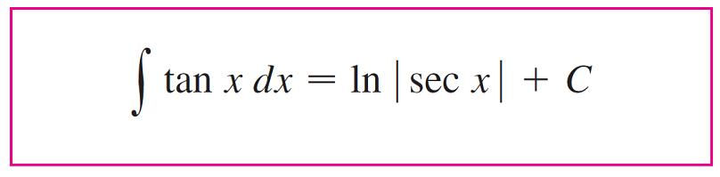
Trigonometric Integrals
For other cases, the guidelines are not as clear-cut. We may need to use identities, integration by parts, and occasionally a little ingenuity.
We will sometimes need to be able to integrate tan x by using the formula given below:

Slide 15
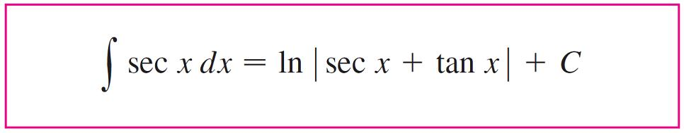

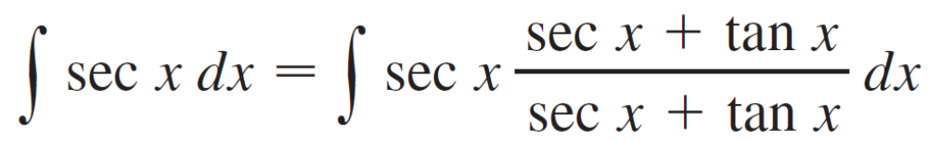
Trigonometric Integrals
We will also need the indefinite integral of secant:
We could verify Formula 1 by differentiating the right side, or as follows. First we multiply numerator and denominator by sec x + tan x:

Slide 16
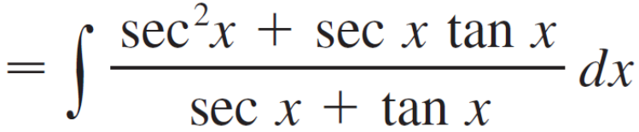
Trigonometric Integrals
If we substitute u = sec x + tanx, then
du = (sec x tan x + sec²x)dx, so the integral becomes
∫ (1/u) du = ln | u | + C.
Thus we have
∫ sec x dx = ln |sec x + tan x | + C

Slide 17
Example 7
Find ∫ tan³x dx.
Solution:
Here only tan x occurs, so we use tan²x = sec²x – 1 to rewrite a tan²x factor in terms of sec²x:
∫ tan³x dx = ∫ tan x tan²x dx
= ∫ tan x (sec²x – 1) dx
= ∫ tan x sec²x dx – ∫ tan x dx

Slide 18
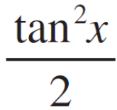
Example 7 – Solution
cont’d
= – ln | sec x | + C
In the first integral we mentally substituted u = tan x so that
du = sec²x dx.

Slide 19
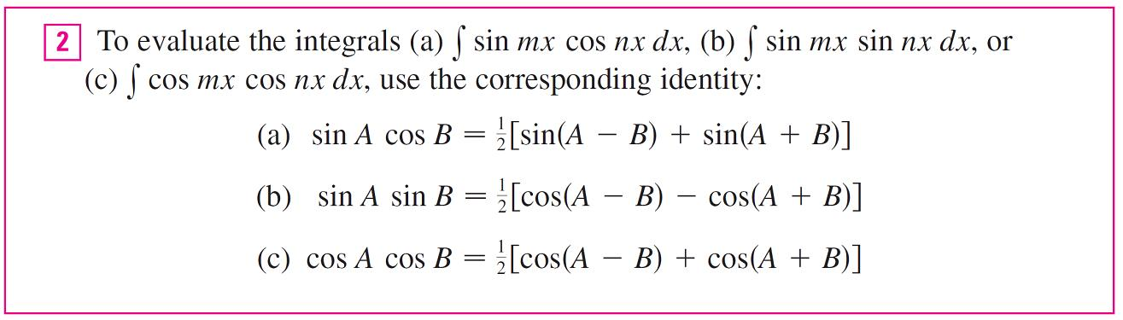
Trigonometric Integrals
Finally, we can make use of another set of trigonometric identities:

Slide 20


Example 9
Evaluate ∫ sin 4x cos 5x dx.
Solution:
This integral could be evaluated using integration by parts, but it’s easier to use the identity in Equation 2(a) as follows:
∫ sin 4x cos 5x dx = ∫ [sin(–x) + sin 9x] dx
= ∫ (–sin x + sin 9x) dx
= (cos x – cos 9x) + C

