Slide 1


7
Techniques of Integration
Copyright © Cengage Learning. All rights reserved.

Slide 2

7.6
Integration Using Tables and Computer Algebra Systems
Copyright © Cengage Learning. All rights reserved.

Slide 3
Tables of Integrals

Slide 4
Tables of Integrals
Tables of indefinite integrals are very useful when we are confronted by an integral that is difficult to evaluate by hand and we don’t have access to a computer algebra system.
Usually we need to use the Substitution Rule or algebraic manipulation to transform a given integral into one of the forms in the table.

Slide 5
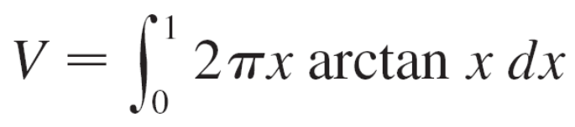
Example 1
The region bounded by the curves y = arctan x, y = 0, and x = 1 is rotated about the y-axis. Find the volume of the resulting solid.
Solution:
Using the method of cylindrical shells, we see that the volume is

Slide 6
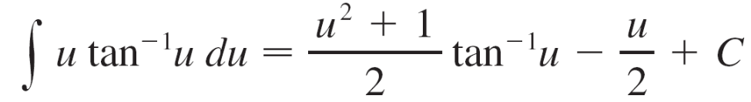
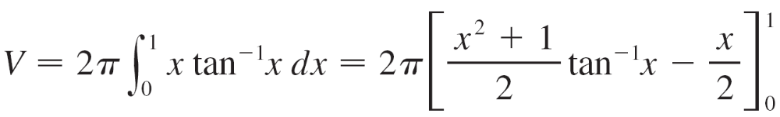
Example 1 – Solution
cont’d
In the section of the Table of Integrals titled Inverse Trigonometric Forms we locate Formula 92:
Thus the volume is

Slide 7
Computer Algebra Systems

Slide 8
Computer Algebra Systems
Computers are particularly good at matching patterns. And just as we used substitutions in conjunction with tables, a CAS can perform substitutions that transform a given integral into one that occurs in its stored formulas.
So it isn’t surprising that computer algebra systems excel at integration.
To begin, let’s see what happens when we ask a machine to integrate the relatively simple function y = 1/(3x – 2).

Slide 9
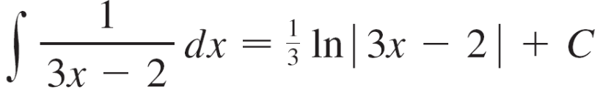

Computer Algebra Systems
Using the substitution u = 3x – 2, an easy calculation by hand gives
whereas Derive, Mathematica, and Maple all return the answer
ln(3x – 2)
The first thing to notice is that computer algebra systems omit the constant of integration.

Slide 10

Computer Algebra Systems
In other words, they produce a particular antiderivative, not the most general one.
Therefore, when making use of a machine integration, we might have to add a constant.
Second, the absolute value signs are omitted in the machine answer. That is fine if our problem is concerned only with values of x greater than .
But if we are interested in other values of x, then we need to insert the absolute value symbol.

Slide 11
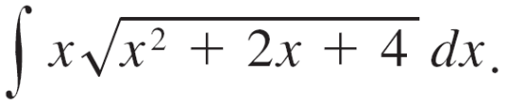

Example 5
Use a computer algebra system to find
Solution:
Maple responds with the answer
The third term can be rewritten using the identity
arcsinh x = ln(x + )

Slide 12
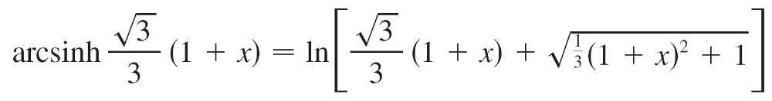
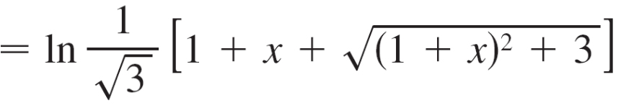
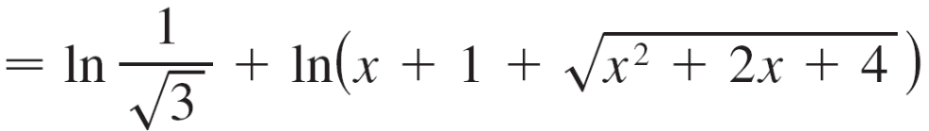


Example 5 – Solution
cont’d
Thus
The resulting extra term ln(1/ ) can be absorbed into the constant of integration.

Slide 13
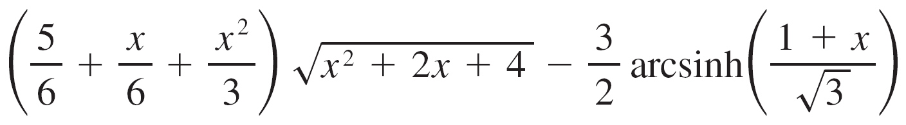
Example 5 – Solution
cont’d
Mathematica gives the answer
Mathematica combined the first two terms of the Maple result into a single term by factoring.
Derive gives the answer

