Slide 1


7
Techniques of Integration
Copyright © Cengage Learning. All rights reserved.

Slide 2

7.7
Approximate Integration
Copyright © Cengage Learning. All rights reserved.

Slide 3

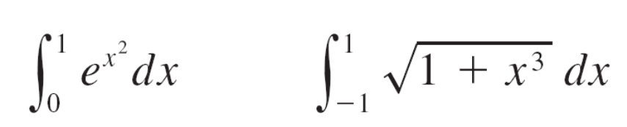
Approximate Integration
There are two situations in which it is impossible to find the exact value of a definite integral.
The first situation arises from the fact that in order to evaluate Fundamental Theorem of Calculus we need to know an antiderivative of f.
Sometimes, however, it is difficult, or even impossible, to find an antiderivative. For example, it is impossible to evaluate the following integrals exactly:

Slide 4
Approximate Integration
The second situation arises when the function is determined from a scientific experiment through instrument readings or collected data.
There may be no formula for the function.
In both cases we need to find approximate values of definite integrals. We already know one such method.

Slide 5
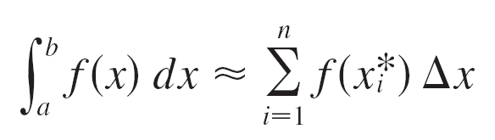
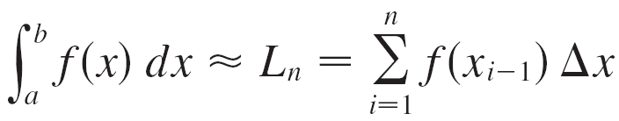

Approximate Integration
Recall that the definite integral is defined as a limit of Riemann sums, so any Riemann sum could be used as an approximation to the integral: If we divide [a, b] into n subintervals of equal length Δx = (b – a)/n, then we have
where x_{i}* is any point in the i th subinterval [x_{i – 1}, x_{i}]. If x_{i}* is chosen to be the left endpoint of the interval, then x_{i}* = x_{i – 1} and we have

Slide 6
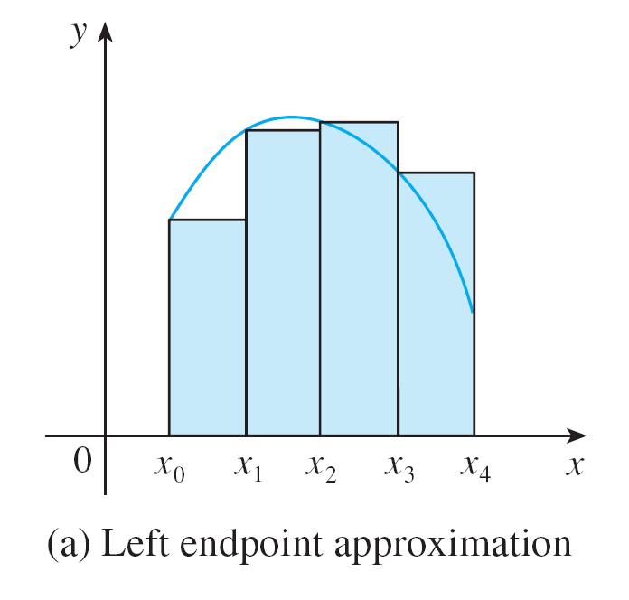
Approximate Integration
If f (x) ≥ 0, then the integral represents an area and (1) represents an approximation of this area by the rectangles shown in Figure 1(a).
Figure 1(a)

Slide 7
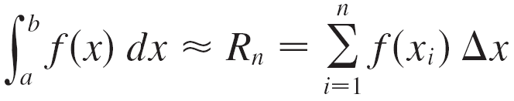

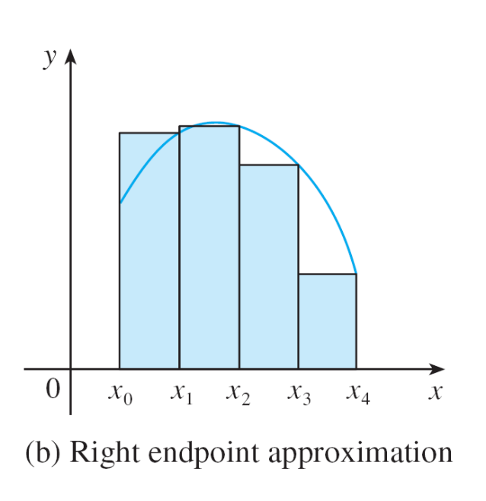
Approximate Integration
If we choose x_{i}* to be the right endpoint, then x_{i}* = x_{i} and we have
[See Figure 1(b).]
The approximations L_{n} and R_{n}
defined by Equations 1 and 2
are called the left endpoint
approximation and right endpoint
approximation, respectively.
Figure 1(b)

Slide 8

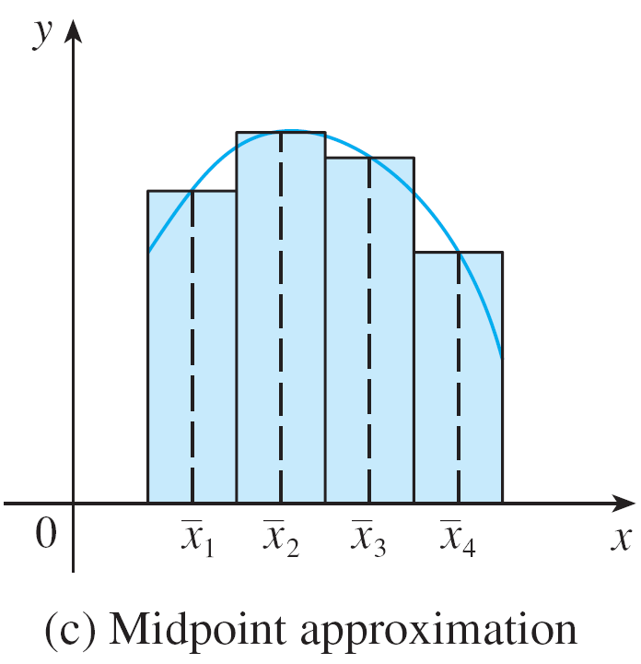
Approximate Integration
We also considered the case where x_{i}* is chosen to be the midpoint of the subinterval [x_{i – 1}, x_{i}]. Figure 1(c) shows the midpoint approximation M_{n}, which appears to be better than either L_{n} or R_{n}.
Figure 1(c)

Slide 9
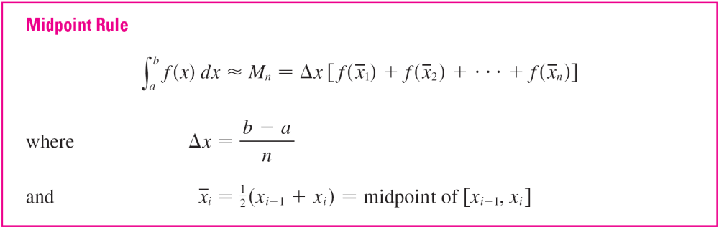
Approximate Integration

Slide 10
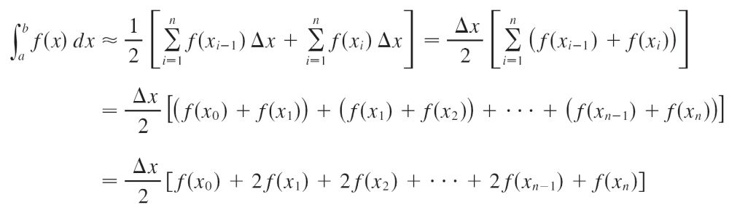
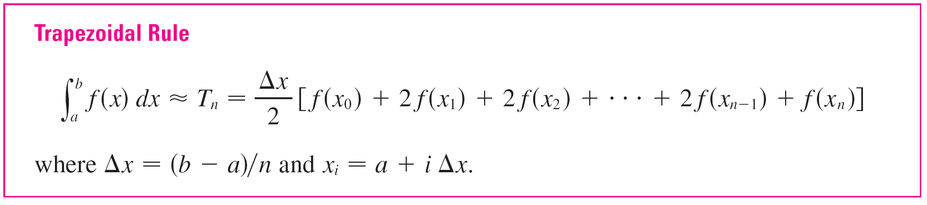
Approximate Integration
Another approximation, called the Trapezoidal Rule, results from averaging the approximations in Equations 1 and 2:

Slide 11
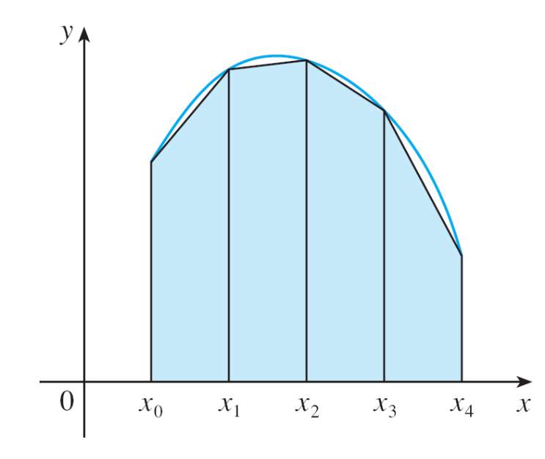
Approximate Integration
The reason for the name Trapezoidal Rule can be seen from Figure 2, which illustrates the case with f (x) ≥ 0 and
n = 4.
Figure 2
Trapezoidal approximation

Slide 12
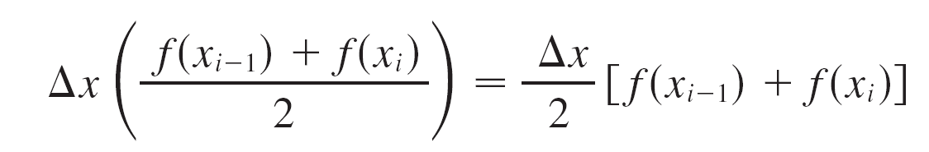
Approximate Integration
The area of the trapezoid that lies above the i th subinterval is
and if we add the areas of all these trapezoids, we get the right side of the Trapezoidal Rule.

Slide 13

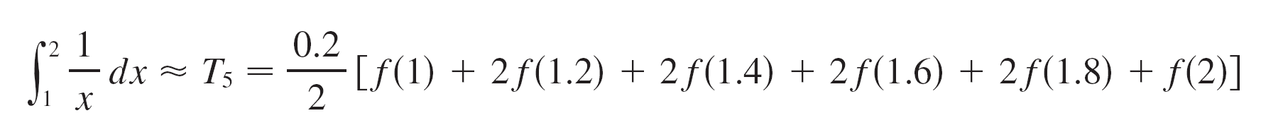
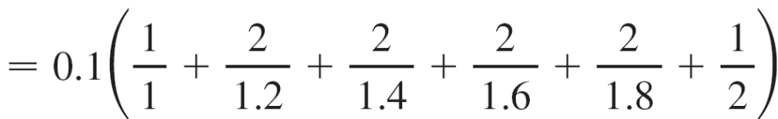
Example 1
Use (a) the Trapezoidal Rule and (b) the Midpoint Rule with
n = 5 to approximate the integral
Solution:
(a) With n = 5, a = 1 and b = 2, we have
Δx = (2 – 1)/5 = 0.2,
and so the Trapezoidal Rule gives
≈ 0.695635

Slide 14
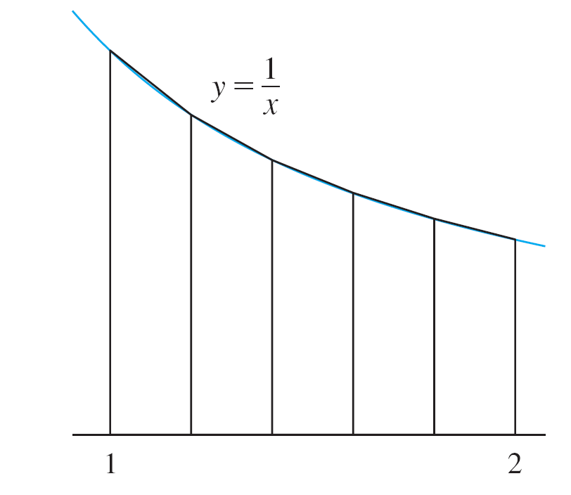
Example 1 – Solution
cont’d
This approximation is illustrated in Figure 3.
Figure 3

Slide 15
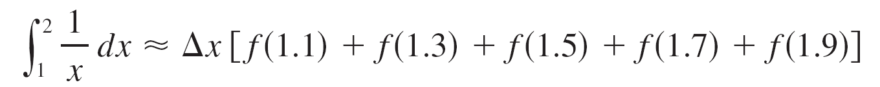
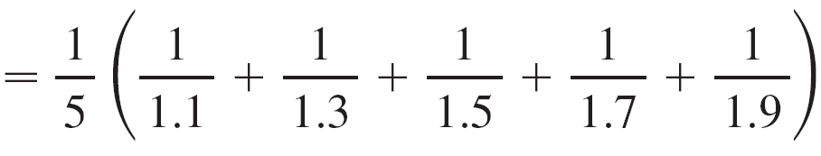
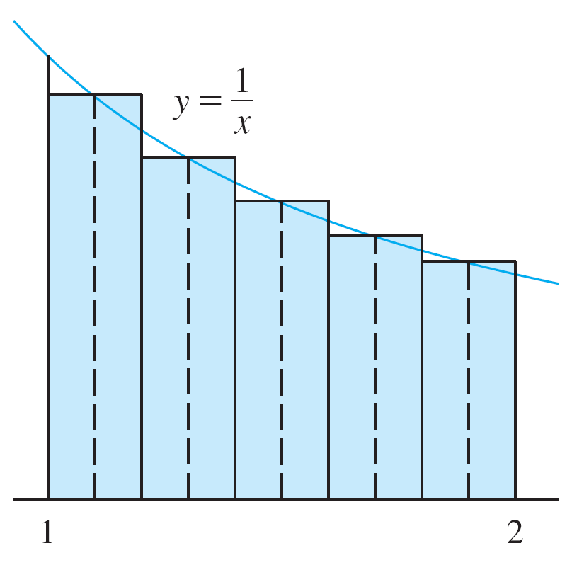
Example 1 – Solution
cont’d
(b) The midpoints of the five subintervals are 1.1, 1.3, 1.5,
1.7, and 1.9, so the Midpoint Rule gives
≈ 0.691908
This approximation is
illustrated in Figure 4.
Figure 4

Slide 16
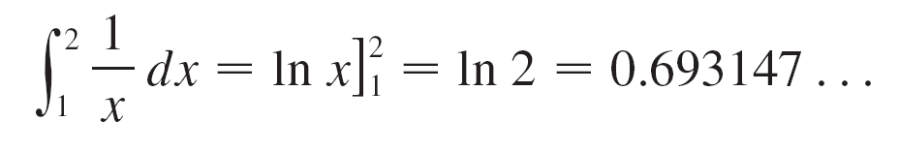
Approximate Integration
In Example 1 we deliberately chose an integral whose value can be computed explicitly so that we can see how accurate the Trapezoidal and Midpoint Rules are.
By the fundamental Theorem of Calculus,
The error in using an approximation is defined to be the amount that needs to be added to the approximation to make it exact.

Slide 17
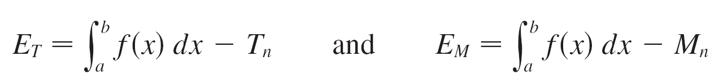
Approximate Integration
From the values in Example 1 we see that the errors in the Trapezoidal and Midpoint Rule approximations for n = 5 are
E_{T} ≈ –0.002488 and E_{M} ≈ 0.001239
In general, we have

Slide 18
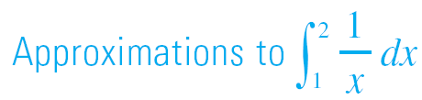
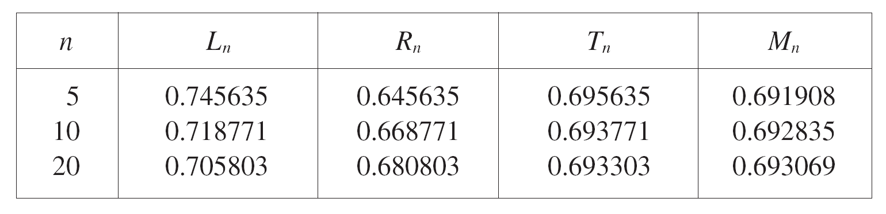
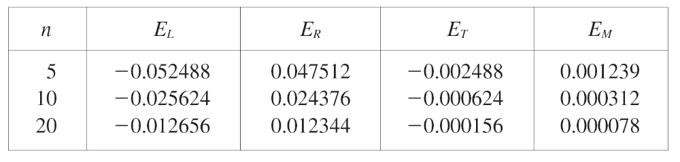

Approximate Integration
The following tables show the results of calculations similar to those in Example 1, but for n = 5, 10, and 20 and for the left and right endpoint approximations as well as the Trapezoidal and Midpoint Rules.

Slide 19
Approximate Integration
We can make several observations from these tables:
1. In all of the methods we get more accurate
approximations when we increase the value of n. (But
very large values of n result in so many arithmetic operations that we have to beware of accumulated
round-off error.)
2. The errors in the left and right endpoint approximations are opposite in sign and appear to decrease by a factor of about 2 when we double the value of n.

Slide 20
Approximate Integration
3. The Trapezoidal and Midpoint Rules are much more
accurate than the endpoint approximations.
4. The errors in the Trapezoidal and Midpoint Rules are
opposite in sign and appear to decrease by a factor of
about 4 when we double the value of n.
5. The size of the error in the Midpoint Rule is about half
the size of the error in the Trapezoidal Rule.

Slide 21
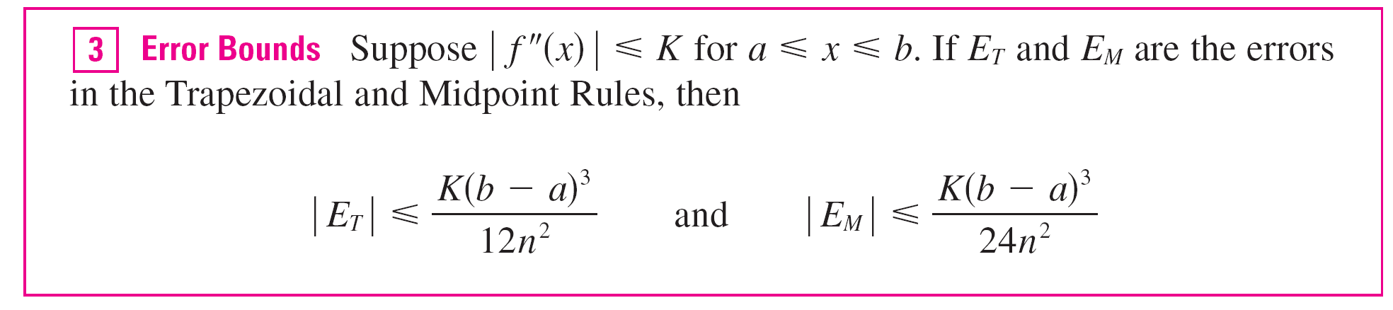
Approximate Integration
Let’s apply this error estimate to the Trapezoidal Rule approximation in Example 1.
If f (x) = 1/x, then f ′(x) = –1/x² and f ′′(x) = 2/x³.

Slide 22
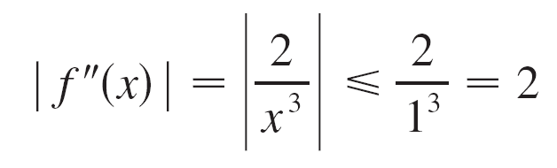
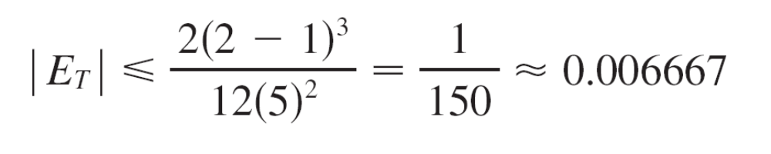
Approximate Integration
Since 1 ≤ x ≤ 2, we have 1/x ≤ 1, so
Therefore, taking K = 2, a = 1, b = 2, and n = 5 in the error estimate (3), we see that
Comparing this error estimate of 0.006667 with the actual error of about 0.002488, we see that it can happen that the actual error is substantially less than the upper bound for the error given by (3).

Slide 23
Simpson’s Rule

Slide 24
Simpson’s Rule
Another rule for approximate integration results from using parabolas instead of straight line segments to approximate a curve.
As before, we divide [a, b] into n subintervals of equal length h = Δx = (b – a)/n, but this time we assume that n is an even number.

Slide 25
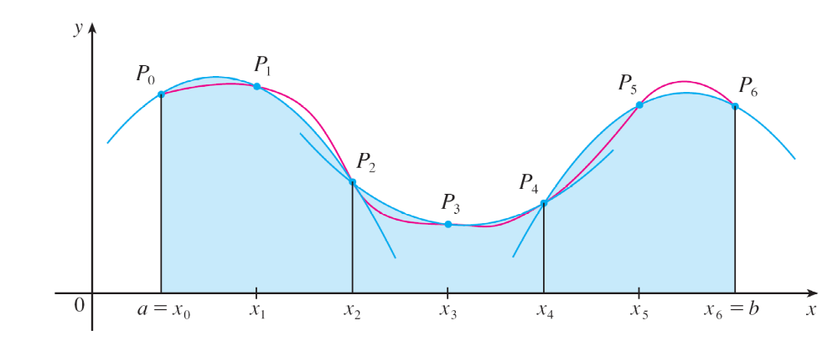
Simpson’s Rule
Then on each consecutive pair of intervals we approximate the curve y = f (x) ≥ 0 by a parabola as shown in Figure 7.
If y_{i} = f (x_{i}), then P_{i} (x_{i}, y_{i}) is the point on the curve lying
above x_{i} .
Figure 7

Slide 26
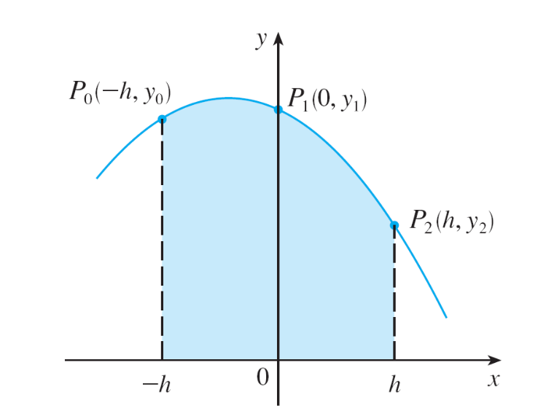
Simpson’s Rule
A typical parabola passes through three consecutive points P_{i} , P_{i + 1}, and P_{i + 2}.
To simplify our calculations, we first consider the case where x₀ = –h, x₁ = 0, and x₂ = h. (See Figure 8.)
Figure 8

Slide 27
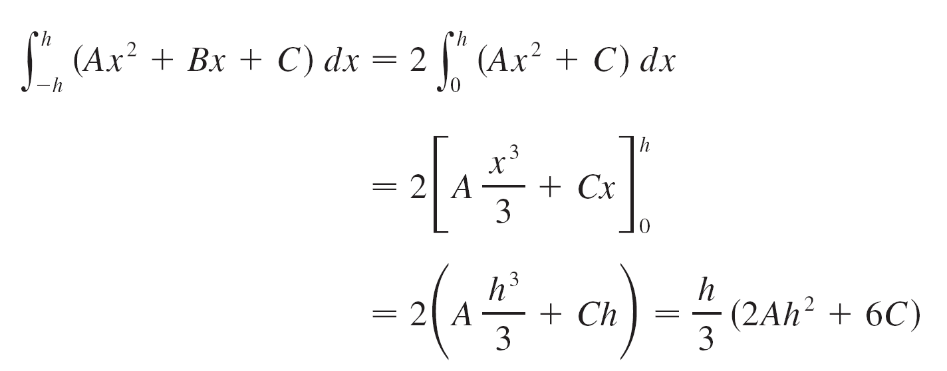
Simpson’s Rule
We know that the equation of the parabola through
P₀, P₁, and P₂ is of the form y = Ax² + Bx + C and so the area under the parabola from x = –h to x = h is

Slide 28

Simpson’s Rule
But, since the parabola passes through P₀(–h, y₀), P₁(0, y₁), and P₂(h, y₂), we have
y₀ = A(–h)² + B(–h) + C = Ah² – Bh + C
y₁ = C
y₂ = Ah² + Bh + C
and therefore y₀ + 4y₁ + y₂ = 2Ah² + 6C
Thus we can rewrite the area under the parabola as
(y₀ + 4y₁ + y₂)

Slide 29
Simpson’s Rule
Now, by shifting this parabola horizontally we do not change the area under it.
This means that the area under the parabola through
P₀, P₁, and P₂ from x = x₀ to x = x₂ in Figure 7 is still
(y₀ + 4y₁ + y₂)
Figure 7

Slide 30
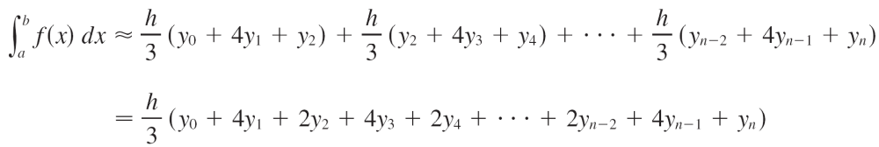
Simpson’s Rule
Similarly, the area under the parabola through P₂, P₃, and P₄ from x = x₂ to x = x₄ is
(y₂ + 4y₃ + y₄)
If we compute the areas under all the parabolas in this manner and add the results, we get

Slide 31
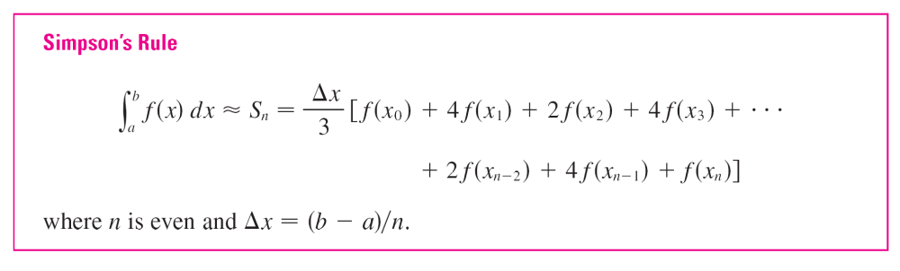
Simpson’s Rule
Although we have derived this approximation for the case in which f (x) ≥ 0, it is a reasonable approximation for any continuous function f and is called Simpson’s Rule after the English mathematician Thomas Simpson (1710–1761).
Note the pattern of coefficients:
1, 4, 2, 4, 2, 4, 2, . . . , 4, 2, 4, 1.

Slide 32
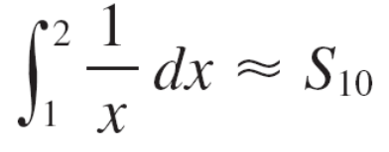
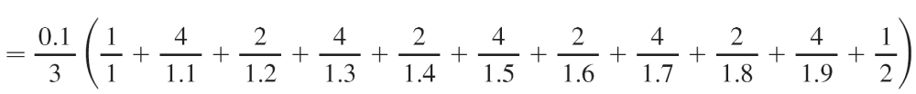

Example 4
Use Simpson’s Rule with n = 10 to approximate
Solution:
Putting f (x) = 1/x, n = 10, and Δx = 0.1 in Simpson’s Rule, we obtain

Slide 33


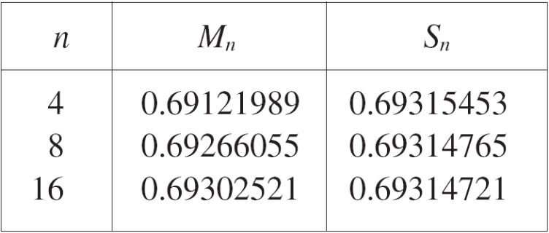
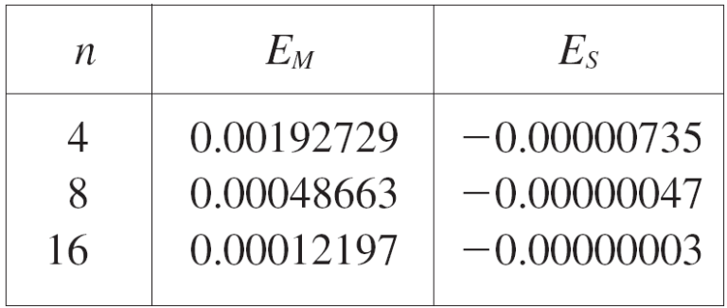
Simpson’s Rule
The Trapezoidal Rule or Simpson’s Rule can still be used to find an approximate value for the integral of y with respect to x.
The table below shows how Simpson’s Rule compares with the Midpoint Rule for the integral whose true value is about 0.69314718.
The second table shows how the error E_{s} in Simpson’s Rule decreases by a factor of about 16 when n is doubled.

Slide 34
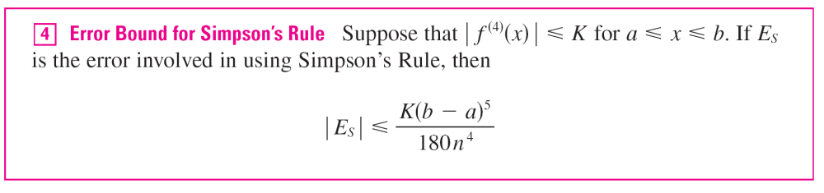
Simpson’s Rule
That is consistent with the appearance of n⁴ in the denominator of the following error estimate for Simpson’s Rule.
It is similar to the estimates given in (3) for the Trapezoidal and Midpoint Rules, but it uses the fourth derivative of f.

