Slide 1
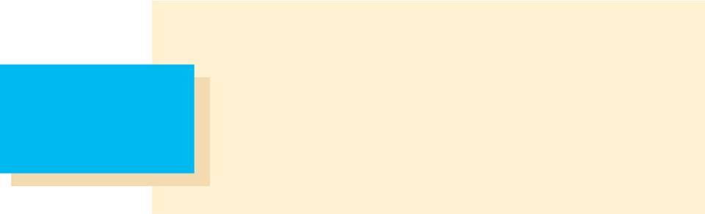
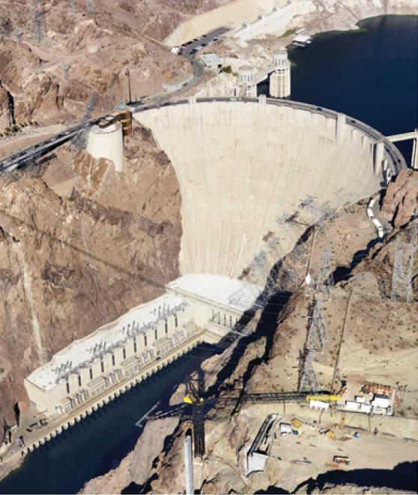
Further Applications
of Integration
8
Copyright © Cengage Learning. All rights reserved.

Slide 2
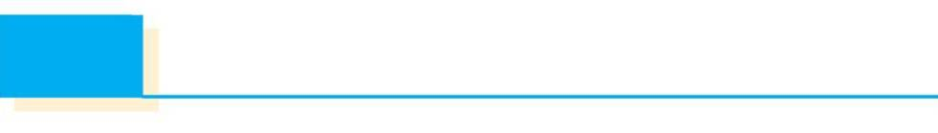
8.3
Applications to Physics and Engineering
Copyright © Cengage Learning. All rights reserved.

Slide 3
Applications to Physics and Engineering
Among the many applications of integral calculus to physics and engineering, we consider two here: force due to water pressure, and centers of mass.

Slide 4
Hydrostatic Pressure and Force

Slide 5
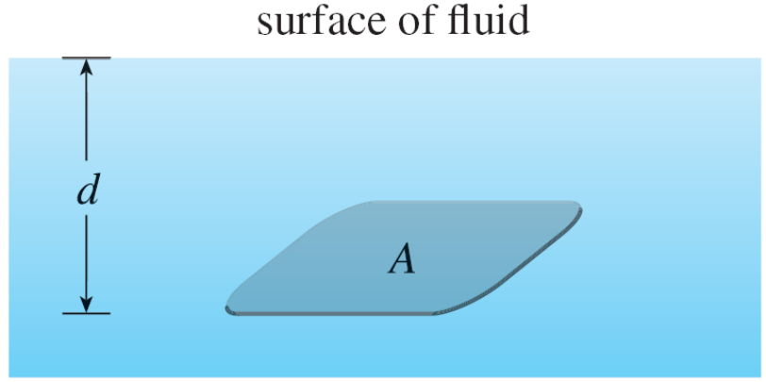
Hydrostatic Pressure and Force
Deep-sea divers realize that water pressure increases as they dive deeper. This is because the weight of the water above them increases.
In general, suppose that a thin horizontal plate with area A square meters is submerged in a fluid of density ρ kilograms per cubic meter at a depth d meters below the surface of the fluid as in Figure 1.
Figure 1

Slide 6
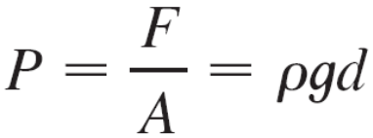
Hydrostatic Pressure and Force
The fluid directly above the plate has volume V = Ad, so its mass is m = ρV = ρ Ad. The force exerted by the fluid on the plate is therefore
F = mg = ρ gAd
where g is the acceleration due to gravity. The pressure P on the plate is defined to be the force per unit area:
The SI unit for measuring pressure is newtons per square meter, which is called a pascal (abbreviation: 1 N/m² = 1 Pa). Since this is a small unit, the kilopascal (kPa) is often used.

Slide 7
Hydrostatic Pressure and Force
For instance, because the density of water is ρ = 1000 kg/m³, the pressure at the bottom of a swimming pool 2 m deep is
P = ρ gd = 1000 kg/m³ × 9.8 m/s² × 2 m
= 19,600 Pa = 19.6 kPa
An important principle of fluid pressure is the experimentally verified fact that at any point in a liquid the pressure is the same in all directions. (A diver feels the same pressure on nose and both ears.)

Slide 8

Hydrostatic Pressure and Force
Thus the pressure in any direction at a depth d in a fluid with mass density ρ is given by
P = ρ gd = δd
This helps us determine the hydrostatic force against a vertical plate or wall or dam in a fluid.
This is not a straightforward problem because the pressure is not constant but increases as the depth increases.

Slide 9
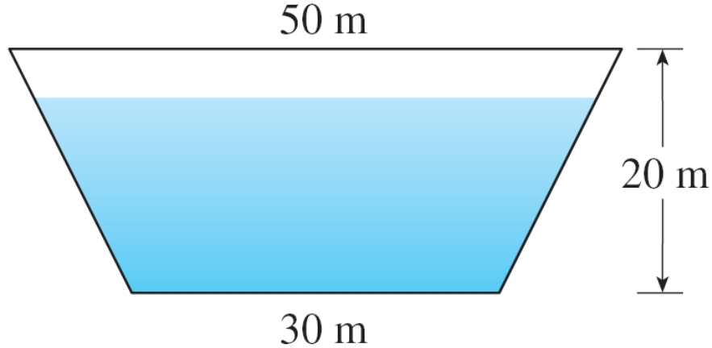
Example 1
A dam has the shape of the trapezoid shown in Figure 2. The height is 20 m and the width is 50 m at the top and 30 m at the bottom. Find the force on the dam due to hydrostatic pressure if the water level is 4 m from the top of the dam.
Figure 2

Slide 10
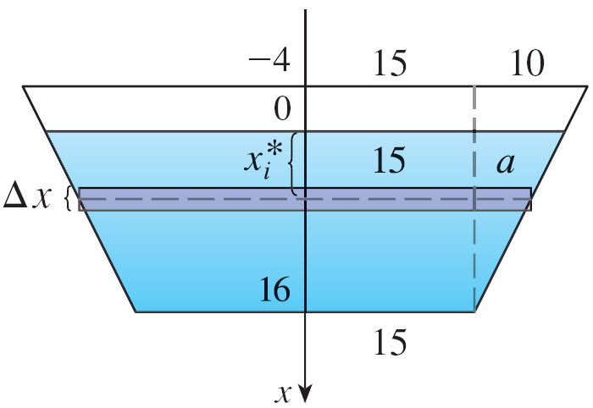
Example 1 – Solution
We choose a vertical x-axis with origin at the surface of the water as in Figure 3(a).
The depth of the water is 16 m, so we divide the interval
[0, 16] into subintervals of equal length with endpoints x_{i} and we choose x_{i}* ∈ [x_{i – 1}, x_{i}].
Figure 3(a)

Slide 11
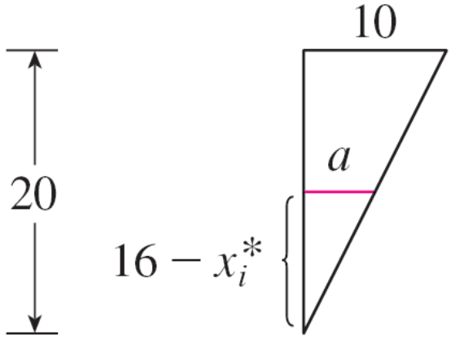
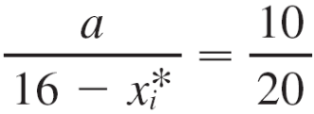
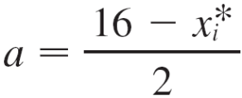
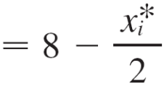

Example 1 – Solution
cont’d
The ith horizontal strip of the dam is approximated by a rectangle with height Δx and width w_{i}, where, from similar triangles in Figure 3(b),
or
and so w_{i} = 2(15 + a)
= 2(15 + 8 – x_{i}*)
= 46 – x_{i}*
Figure 3(b)

Slide 12
Example 1 – Solution
cont’d
If A_{i} is the area of the i th strip, then
A_{i} ≈ w_{i} Δx
= (46 – x_{i}*) Δx
If Δx is small, then the pressure P_{i} on the i th strip is almost constant and we can use Equation 1 to write
P_{i} ≈ 1000gx_{i}*
The hydrostatic force F_{i} acting on the i th strip is the product of the pressure and the area:
F_{i} = P_{i} A_{i}
≈ 1000gx_{i}*(46 – x_{i}*) Δx

Slide 13

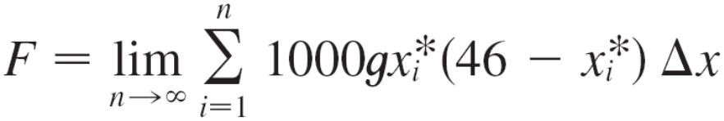
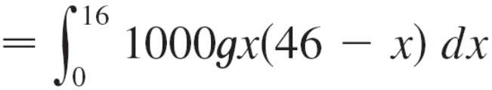
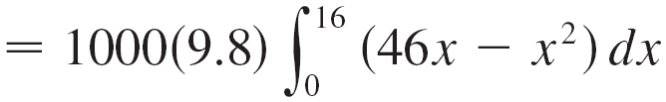
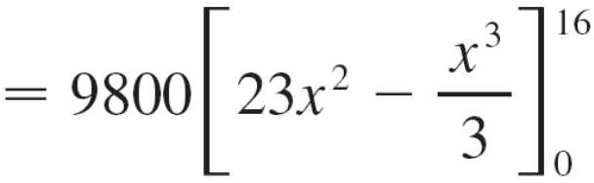

Example 1 – Solution
cont’d
Adding these forces and taking the limit as n → , we obtain the total hydrostatic force on the dam:

Slide 14
Moments and Centers of Mass

Slide 15
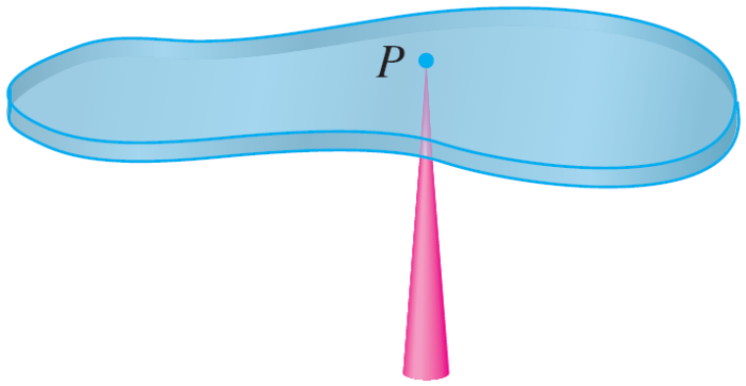
Moments and Centers of Mass
Our main objective here is to find the point P on which a thin plate of any given shape balances horizontally as in Figure 8.
This point is called the center of mass (or center of gravity) of the plate.
Figure 5

Slide 16
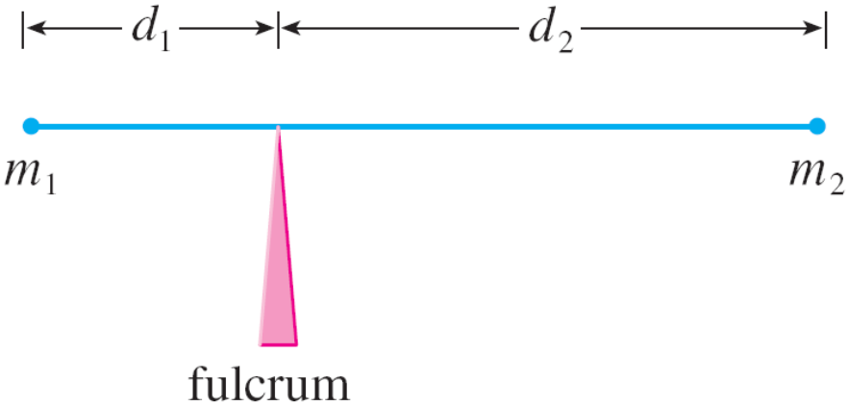

Moments and Centers of Mass
We first consider the simpler situation illustrated in Figure 6, where two masses m₁ and m₂ are attached to a rod of negligible mass on opposite sides of a fulcrum and at distances d₁ and d₂ from the fulcrum.
The rod will balance if
m₁d₁ = m₂d₂
Figure 6

Slide 17

Moments and Centers of Mass
This is an experimental fact discovered by Archimedes and called the Law of the Lever. (Think of a lighter person balancing a heavier one on a seesaw by sitting farther away from the center.)
Now suppose that the rod lies along the x-axis with m₁ at x₁ and m₂ at x₂ and the center of mass at

Slide 18



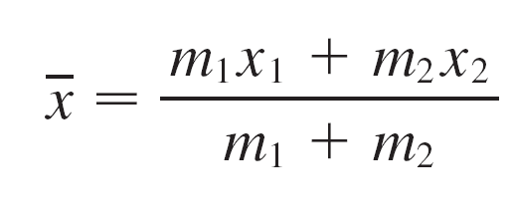
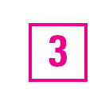
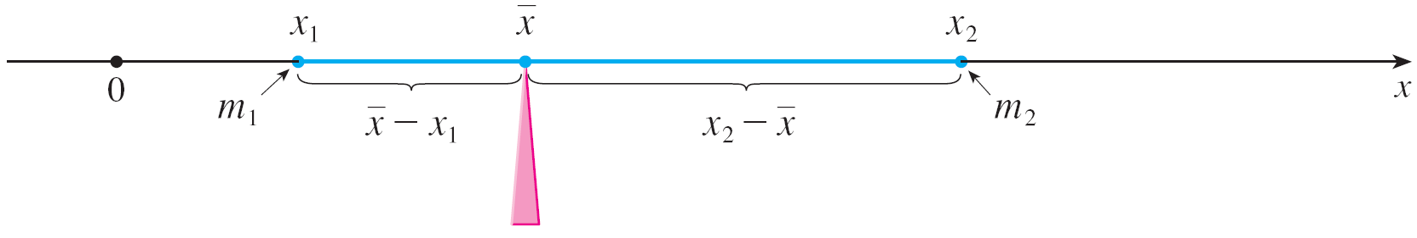
Moments and Centers of Mass
If we compare Figures 6 and 7, we see that and and so Equation 2 gives
Figure 6
Figure 7

Slide 19

Moments and Centers of Mass
The numbers m₁x₁ and m₂x₂ are called the moments of the masses m₁ and m₂ (with respect to the origin), and
Equation 3 says that the center of mass is obtained by adding the moments of the masses and dividing by the total mass m = m₁ + m₂.

Slide 20
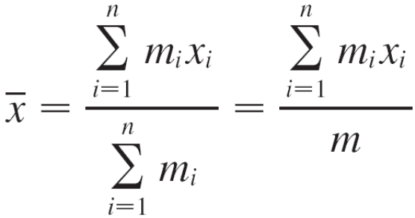

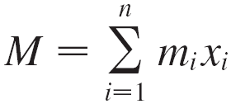
Moments and Centers of Mass
In general, if we have a system of n particles with masses
m₁, m₂, . . . , m_{n} located at the points x₁, x₂, . . . , x_{n} on the
x-axis, it can be shown similarly that the center of mass of the system is located at
where m = Σ m_{i} is the total mass of the system, and the sum of the individual moments
is called the moment of the system about the origin.

Slide 21
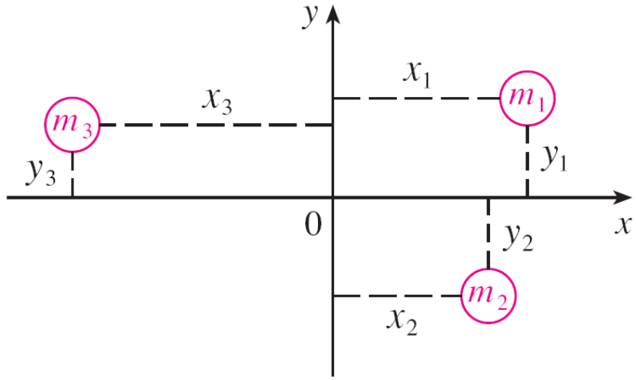
Moments and Centers of Mass
Then Equation 4 could be rewritten as m = M, which says that if the total mass were considered as being concentrated at the center of mass , then its moment would be the same as the moment of the system.
Now we consider a system
of n particles with masses
m₁, m₂, . . . , m_{n} located
at the points
(x₁, y₁), (x₂, y₂), . . . , (x_{n}, y_{n})
in the xy-plane as shown
in Figure 8.
Figure 8

Slide 22

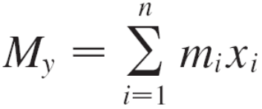
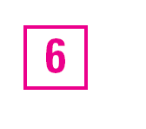
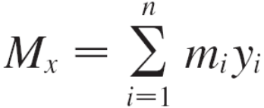
Moments and Centers of Mass
By analogy with the one-dimensional case, we define the moment of the system about the y-axis to be
and the moment of the system about the x-axis as
Then M_{y} measures the tendency of the system to rotate about the y-axis and M_{x} measures the tendency to rotate about the x-axis.

Slide 23


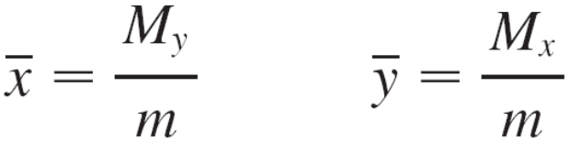

Moments and Centers of Mass
As in the one-dimensional case, the coordinates of the center of mass are given in terms of the moments by the formulas
where m = Σ m_{i} is the total mass. Since m = M_{y} and
m = M_{x}, the center of mass is the point where a single particle of mass m would have the same moments as the system.

Slide 24
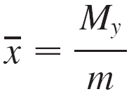
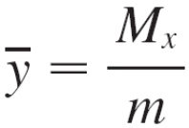
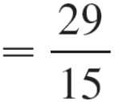
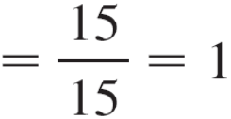
Example 3
Find the moments and center of mass of the system of objects that have masses 3, 4, and 8 at the points (–1, 1),
(2, –1), and (3, 2), respectively.
Solution:
We use Equations 5 and 6 to compute the moments:
M_{y} = 3(–1) + 4(2) + 8(3) = 29
M_{x} = 3(1) + 4(–1) + 8(2) = 15
Since m = 3 + 4 + 8 = 15, we use Equations 11 to obtain

Slide 25

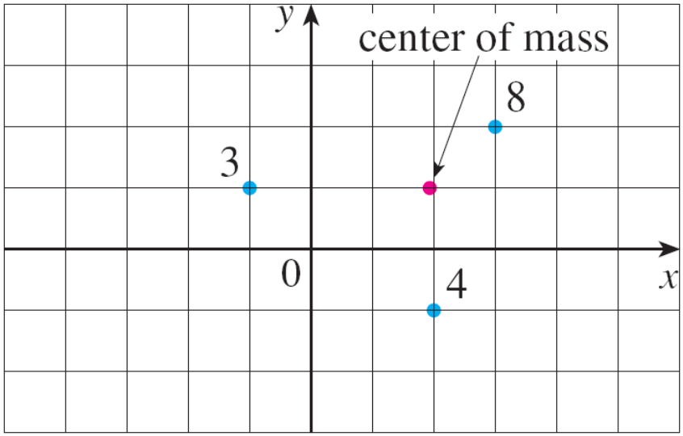
Example 3 – Solution
cont’d
Thus the center of mass is (See Figure 9.)
Figure 9

Slide 26
Moments and Centers of Mass
Next we consider a flat plate (called a lamina) with uniform density ρ that occupies a region R of the plane.
We wish to locate the center of mass of the plate, which is called the centroid of R.
In doing so we use the following physical principles: The symmetry principle says that if R is symmetric about a line l, then the centroid of R lies on l. (If R is reflected about l, then R remains the same so its centroid remains fixed. But the only fixed points lie on l.)
Thus the centroid of a rectangle is its center.

Slide 27
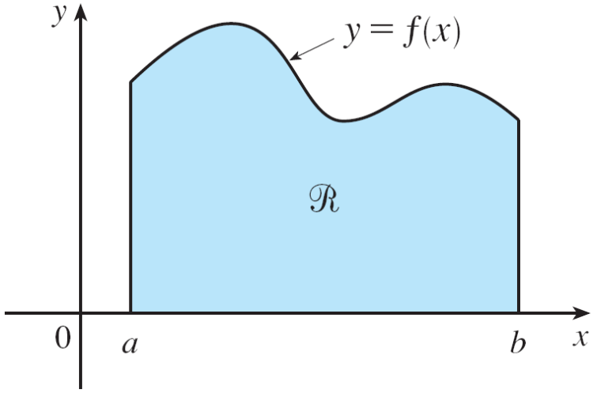
Moments and Centers of Mass
Moments should be defined so that if the entire mass of a region is concentrated at the center of mass, then its moments remain unchanged.
Also, the moment of the union of two nonoverlapping regions should be the sum of the moments of the individual regions.
Suppose that the region R is of
the type shown in Figure 10(a);
that is, R lies between the
lines x = a and x = b, above
the x-axis, and beneath the graph
of f, where f is a continuous
function.
Figure 10(a)

Slide 28


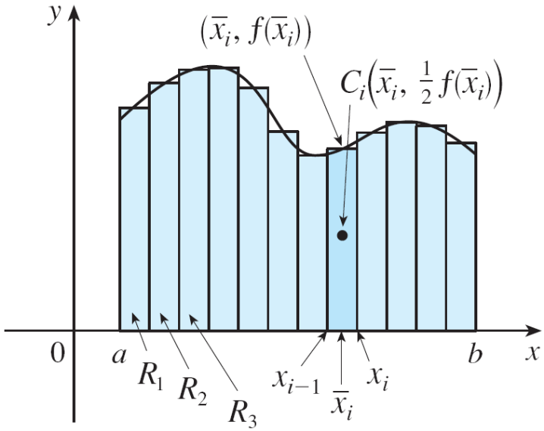
Moments and Centers of Mass
We divide the interval [a, b] into n subintervals with endpoints x₀, x₁, . . . , x_{n} and equal width Δx. We choose the sample point x_{i}* to be the midpoint of the i th subinterval, that is,
This determines the polygonal approximation to R shown in Figure 10(b).
Figure 10(b)

Slide 29




Moments and Centers of Mass
The centroid of the i th approximating rectangle R_{i} is its center Its area is so its mass is
The moment of R_{i} about the y-axis is the product of its mass and the distance from C_{i} to the y-axis, which is Thus
Adding these moments, we obtain the moment of the polygonal approximation to R, and then by taking the limit as n → we obtain the moment of R itself about the y-axis:

Slide 30
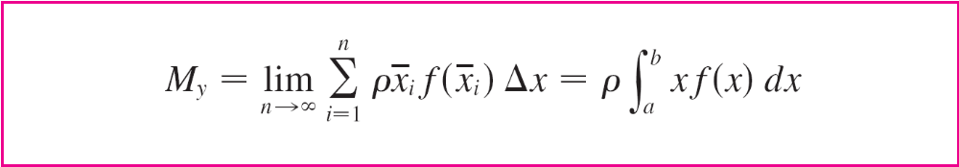
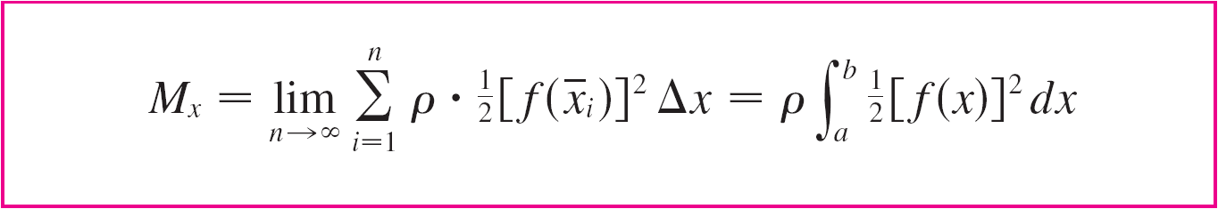
Moments and Centers of Mass
In a similar fashion we compute the moment of R_{i} about the
x-axis as the product of its mass and the distance from C_{i} to the x-axis:
Again we add these moments and take the limit to obtain the moment of R about the x-axis:

Slide 31


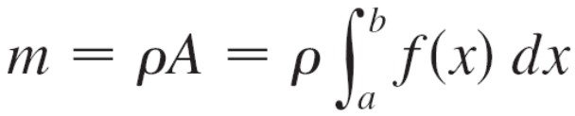
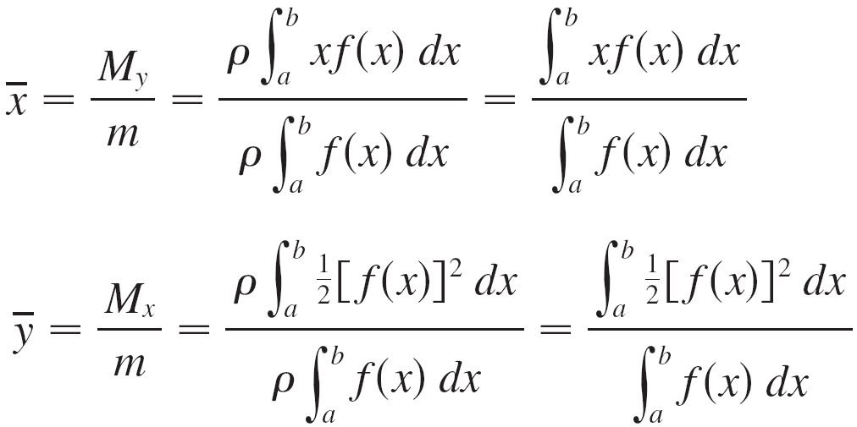
Moments and Centers of Mass
Just as for systems of particles, the center of mass of the plate is defined so that and But the mass of the plate is the product of its density and its area:
and so

Slide 32
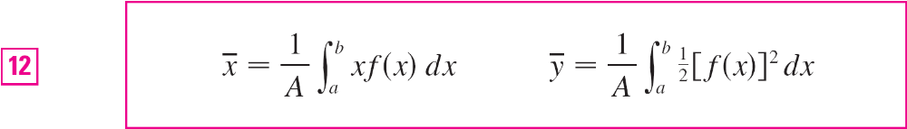
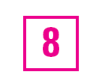
Moments and Centers of Mass
Notice the cancellation of the ρ’s. The location of the center of mass is independent of the density.
In summary, the center of mass of the plate (or the centroid of R) is located at the point , where

Slide 33

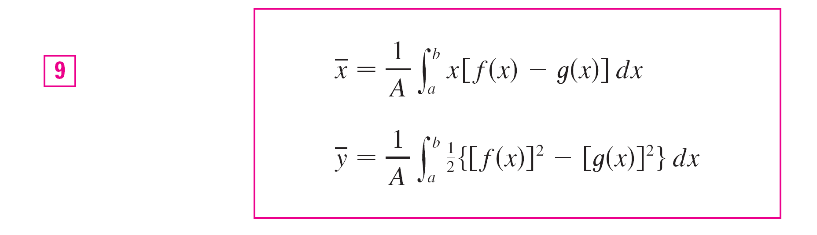
Moments and Centers of Mass
If the region R lies between two curves y = f(x) and y = g(x), where f(x) ≥ g(x), as illustrated in Figure 13, then the same sort of argument that led to Formulas 8 can be used to show that the centroid of R is where

Slide 34
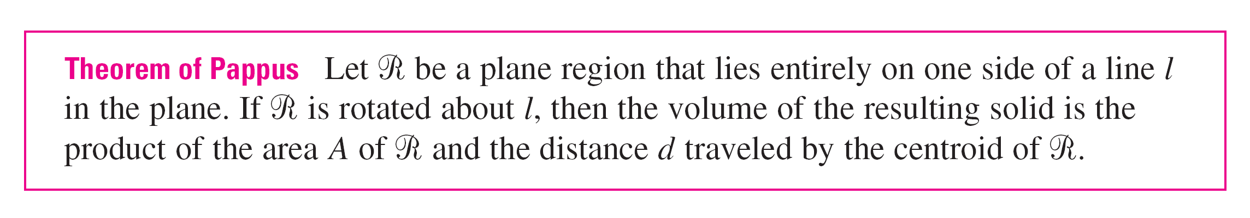
Moments and Centers of Mass
We end this section by showing a surprising connection between centroids and volumes of revolution.

