Slide 1


Further Applications
of Integration
8
Copyright © Cengage Learning. All rights reserved.

Slide 2

8.4
Applications to Economics and Biology
Copyright © Cengage Learning. All rights reserved.

Slide 3
Applications to Economics and Biology
In this section we consider some applications of integration to economics (consumer surplus) and biology (blood flow, cardiac output).

Slide 4
Consumer Surplus

Slide 5
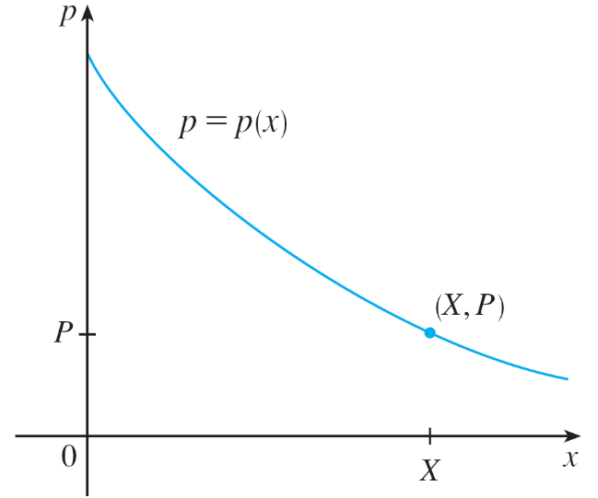
Consumer Surplus
Recall that the demand function p(x) is the price that a company has to charge in order to sell x units of a commodity.
Usually, selling larger quantities
requires lowering prices, so the
demand function is a decreasing
function. The graph of a typical
demand function, called a
demand curve, is shown in Figure 1.
If X is the amount of the commodity that
is currently available, then P = p(X) is
the current selling price.
Figure 1
A typical demand curve

Slide 6
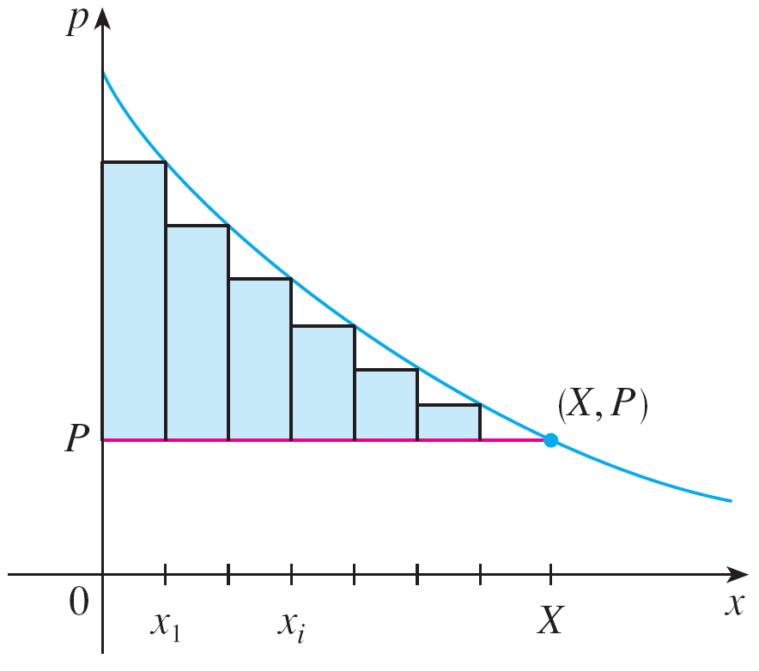
Consumer Surplus
We divide the interval [0, X ] into n subintervals, each of
length Δx = X/n, and let x_{i}* = x_{i} be the right endpoint of the
i th subinterval, as in Figure 2.
If, after the first x_{i – 1} units were
sold, a total of only x_{i} units had
been available and the price per
unit had been set at p(x_{i}) dollars,
then the additional Δx units could
have been sold (but no more).
Figure 2

Slide 7
Consumer Surplus
The consumers who would have paid p(x_{i}) dollars placed a high value on the product; they would have paid what it was worth to them.
So, in paying only P dollars they have saved an amount of
(savings per unit) (number of units) = [p(x_{i}) – P] Δx

Slide 8

Consumer Surplus
Considering similar groups of willing consumers for each of the subintervals and adding the savings, we get the total savings:
[p(x_{i}) – P] Δx
(This sum corresponds to
the area enclosed by the
rectangles in Figure 2.)
Figure 2

Slide 9


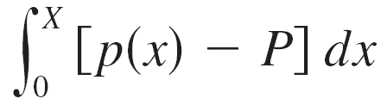
Consumer Surplus
If we let n → , this Riemann sum approaches the integral
which economists call the consumer surplus for the commodity.
The consumer surplus represents the amount of money saved by consumers in purchasing the commodity at
price P, corresponding to an amount demanded of X.

Slide 10
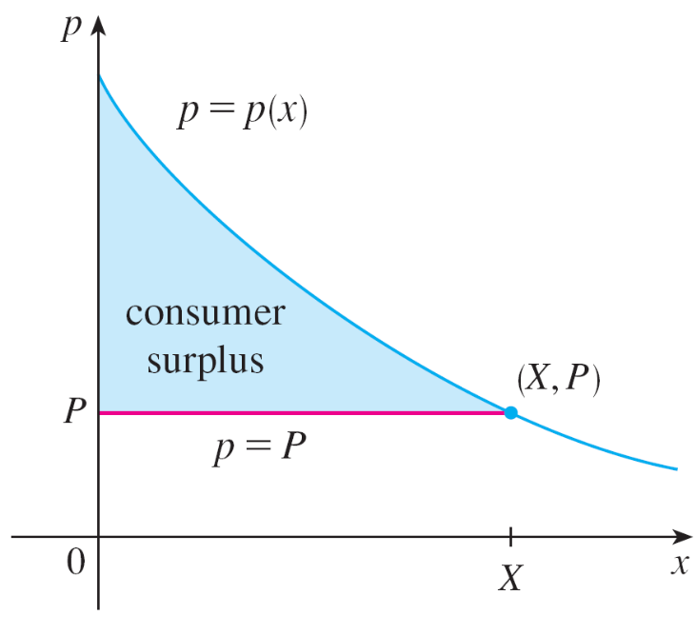
Consumer Surplus
Figure 3 shows the interpretation of the consumer surplus as the area under the demand curve and above the line p = P.
Figure 3

Slide 11
Example 1
The demand for a product, in dollars, is
p = 1200 – 0.2x – 0.0001x²
Find the consumer surplus when the sales level is 500.
Solution:
Since the number of products sold is X = 500, the corresponding price is
P = 1200 – (0.2)(500) – (0.0001)(500)²
= 1075

Slide 12
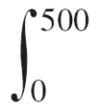
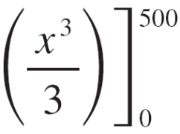
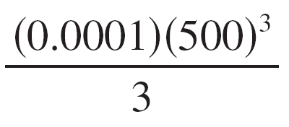
Example 1 – Solution
cont’d
Therefore, from Definition 1, the consumer surplus is
[p(x) – P] dx = (1200 – 0.2x – 0.0001x² – 1075)dx
= (125 – 0.2x – 0.0001x²) dx
= 125x – 0.1x² – (0.0001)
= (125)(500) – (0.1)(500)² –
= $33,333.33

Slide 13
Blood Flow

Slide 14
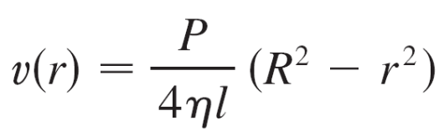
Blood Flow
We have discussed the law of laminar flow:
which gives the velocity v of blood that flows along a blood vessel with radius R and length l at a distance r from the central axis, where P is the pressure difference between the ends of the vessel and η is the viscosity of the blood.
Now, in order to compute the rate of blood flow, or flux (volume per unit time), we consider smaller, equally spaced radii r₁, r₂, . . . .

Slide 15
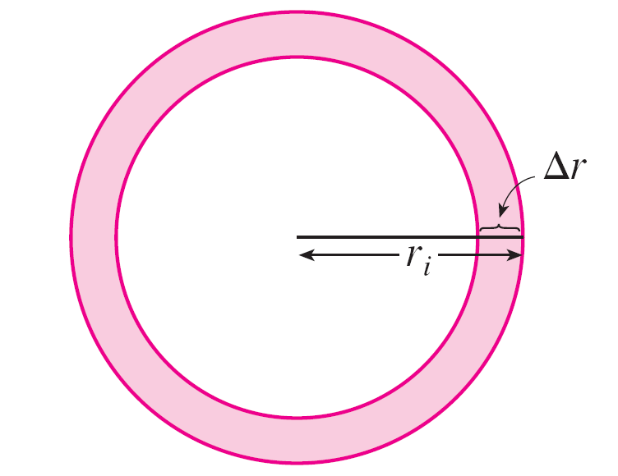
Blood Flow
The approximate area of the ring (or washer) with inner radius r_{i – 1} and outer radius r_{i} is
2πr_{i} Δr where Δr = r_{i} – r_{i –1}
(See Figure 4.)
Figure 4

Slide 16

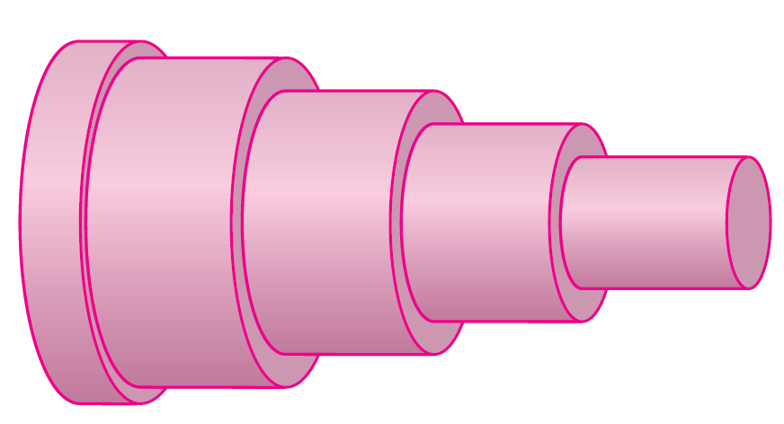
Blood Flow
If Δr is small, then the velocity is almost constant throughout this ring and can be approximated by v(r_{i}).
Thus the volume of blood per unit time that flows across the ring is approximately
(2πr_{i} Δr) v(r_{i}) = 2πr_{i} v(r_{i}) Δr
and the total volume of blood that flows across a
cross-section per unit time is about
2πr_{i} v(r_{i}) Δr
This approximation is
illustrated in Figure 5.
Figure 5

Slide 17
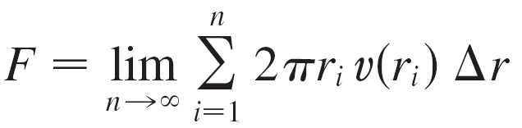
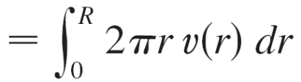
Blood Flow
Notice that the velocity (and hence the volume per unit time) increases toward the center of the blood vessel.
The approximation gets better as n increases.
When we take the limit we get the exact value of the flux (or discharge), which is the volume of blood that passes a cross-section per unit time:

Slide 18
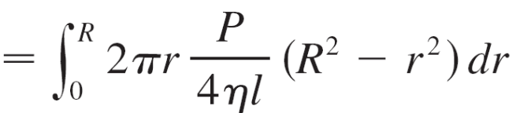
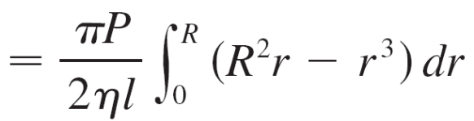
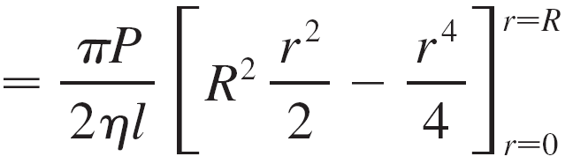
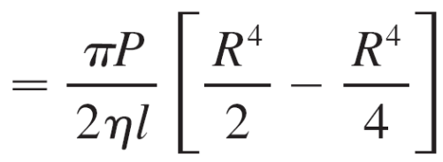
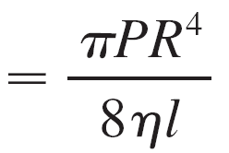
Blood Flow

Slide 19
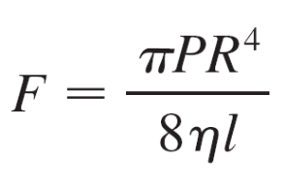

Blood Flow
The resulting equation
is called Poiseuille’s Law; it shows that the flux is proportional to the fourth power of the radius of the blood vessel.

Slide 20
Cardiac Output

Slide 21
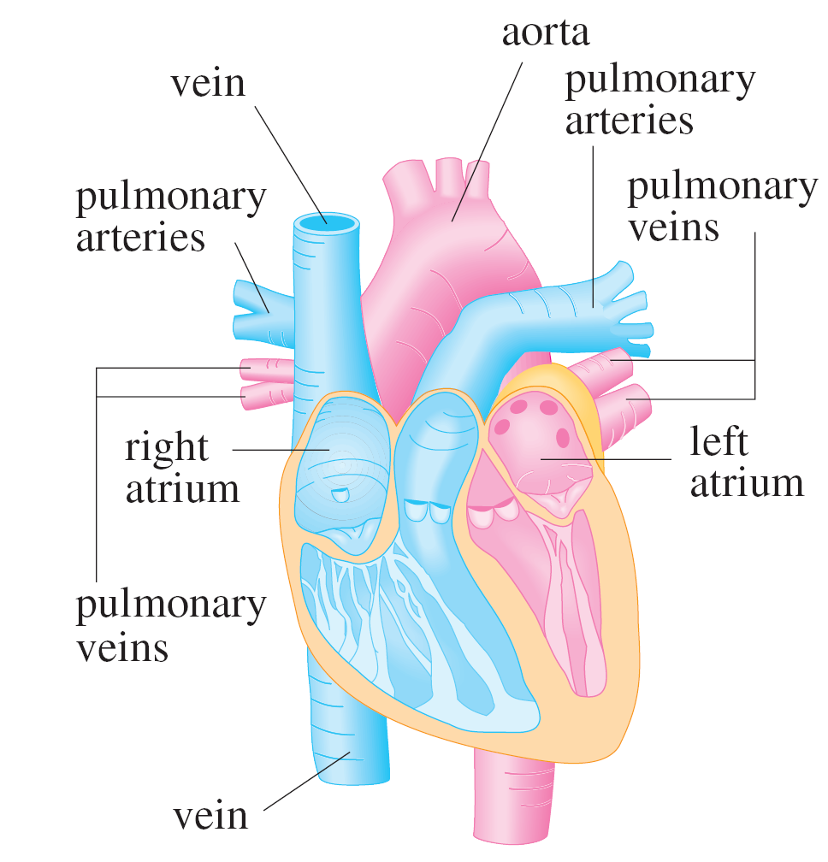
Cardiac Output
Figure 6 shows the human cardiovascular system.
Figure 6

Slide 22
Cardiac Output
Blood returns from the body through the veins, enters the right atrium of the heart, and is pumped to the lungs through the pulmonary arteries for oxygenation.
It then flows back into the left atrium through the pulmonary veins and then out to the rest of the body through the aorta.
The cardiac output of the heart is the volume of blood pumped by the heart per unit time, that is, the rate of flow into the aorta.
The dye dilution method is used to measure the cardiac output.

Slide 23
Cardiac Output
Dye is injected into the right atrium and flows through the heart into the aorta. A probe inserted into the aorta measures the concentration of the dye leaving the heart at equally spaced times over a time interval [0, T ] until the dye has cleared.
Let c(t) be the concentration of the dye at time t. If we divide [0, T ] into subintervals of equal length Δt, then the amount of dye that flows past the measuring point during the subinterval from t = t_{i–1} to t = t_{i} is approximately
(concentration) (volume) = c(t_{i}) (F Δt)
where F is the rate of flow that we are trying to determine.

Slide 24


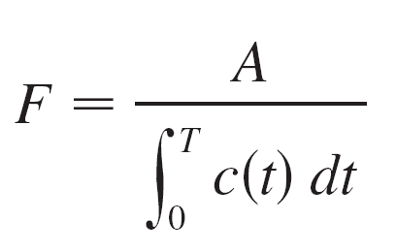

Cardiac Output
Thus the total amount of dye is approximately
c(t_{i})F Δt = F c(t_{i}) Δt
and, letting n → , we find that the amount of dye is
A = F c(t) dt
Thus the cardiac output is given by
where the amount of dye A is known and the integral can be approximated from the concentration readings.

Slide 25
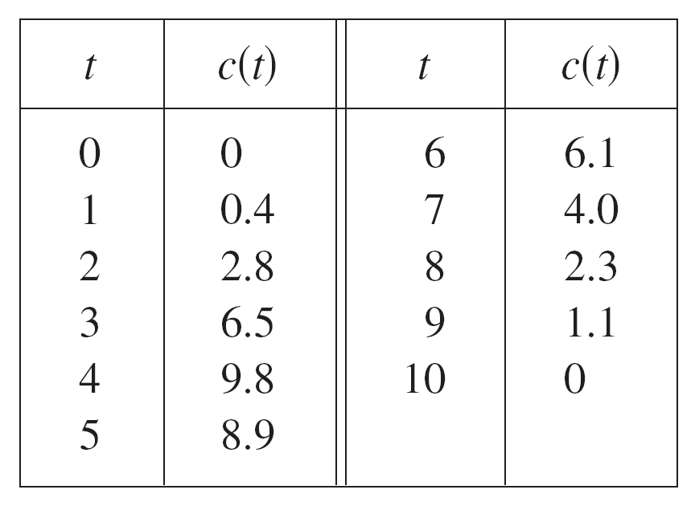
Example 2
A 5-mg bolus of dye is injected into a right atrium. The concentration of the dye (in milligrams per liter) is measured in the aorta at one-second intervals as shown in the chart. Estimate the cardiac output.

Slide 26


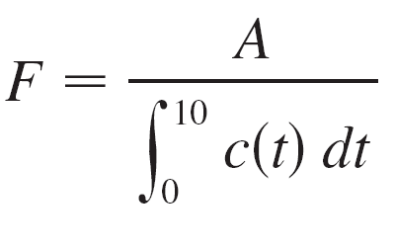
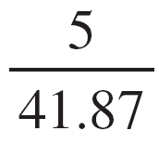
Example 2 – Solution
Here A = 5, Δt = 1, and T = 10. We use Simpson’s Rule to approximate the integral of the concentration:
c(t) dt ≈ [0 + 4(0.4) + 2(2.8) + 4(6.5) + 2(9.8) + 4(8.9)
+ 2(6.1) + 4(4.0) + 2(2.3) + 4(1.1) + 0]
≈ 41.87
Thus Formula 3 gives the cardiac output to be
≈
≈ 0.12 L/s
= 7.2 L/min

