Slide 1


9
Differential Equations
Copyright © Cengage Learning. All rights reserved.

Slide 2

9.1
Direction Fields and Euler's Method
Copyright © Cengage Learning. All rights reserved.

Slide 3
Direction Fields and Euler's Method
Unfortunately, it’s impossible to solve most differential equations in the sense of obtaining an explicit formula for the solution.
In this section we show that, despite the absence of an explicit solution, we can still learn a lot about the solution through a graphical approach (direction fields) or a numerical approach (Euler’s method).

Slide 4
Direction Fields

Slide 5
Direction Fields
Suppose we are asked to sketch the graph of the solution of the initial-value problem
y ′ = x + y y(0) = 1
We don’t know a formula for the solution, so how can we possibly sketch its graph? Let’s think about what the differential equation means.

Slide 6
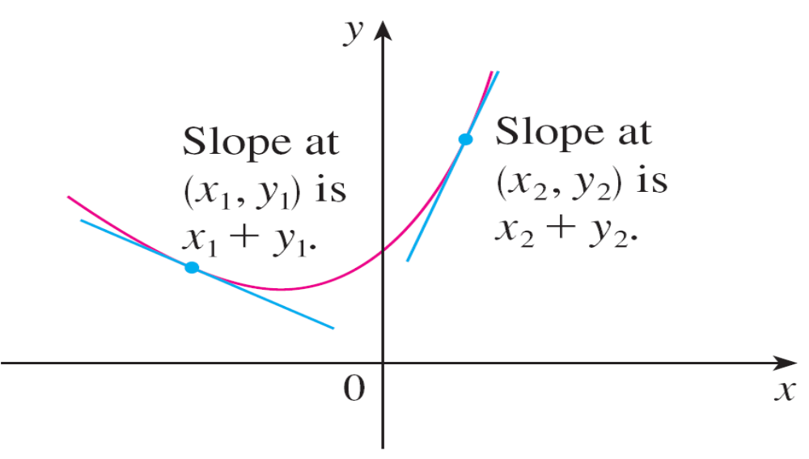
Direction Fields
The equation y ′ = x + y tells us that the slope at any point (x, y) on the graph (called the solution curve) is equal to the sum of the x- and y-coordinates of the point (see Figure 1).
A solution of y ′ = x + y
Figure 1

Slide 7
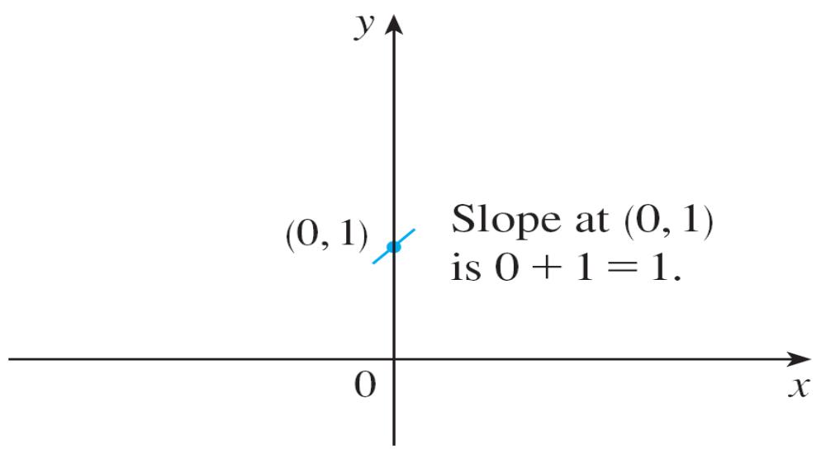
Direction Fields
In particular, because the curve passes through the point (0, 1), its slope there must be 0 + 1 = 1. So a small portion of the solution curve near the point (0, 1) looks like a short line segment through (0, 1) with slope 1. (See Figure 2.)
Beginning of the solution curve through (0, 1)
Figure 2

Slide 8
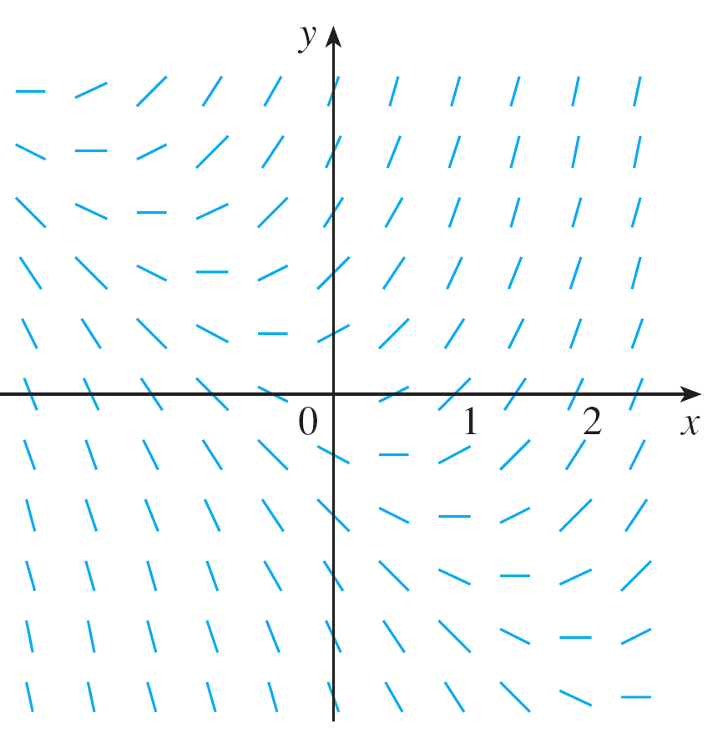
Direction Fields
As a guide to sketching the rest of the curve, let’s draw short line segments at a number of points (x, y) with slope x + y. The result is called a direction field and is shown in Figure 3.
Direction field for y ′ = x + y
Figure 3

Slide 9
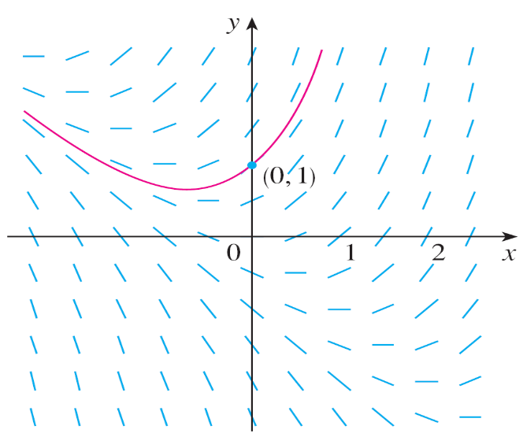
Direction Fields
For instance, the line segment at the point (1, 2) has slope
1 + 2 = 3.
The direction field allows us to visualize the general shape of the solution curves by indicating the direction in which the curves proceed at each point.
Now we can sketch the
solution curve through the
point (0, 1) by following the
direction field as in Figure 4.
The solution curve through (0, 1)
Figure 4

Slide 10
Direction Fields
Notice that we have drawn the curve so that it is parallel to
nearby line segments.
In general, suppose we have a first-order differential equation of the form
y ′ = F (x, y)
where F (x, y) is some expression in x and y.
The differential equation says that the slope of a solution curve at a point (x, y) on the curve is F (x, y).

Slide 11
Direction Fields
If we draw short line segments with slope F (x, y) at several points (x, y), the result is called a direction field (or slope field).
These line segments indicate the direction in which a solution curve is heading, so the direction field helps us visualize the general shape of these curves.

Slide 12
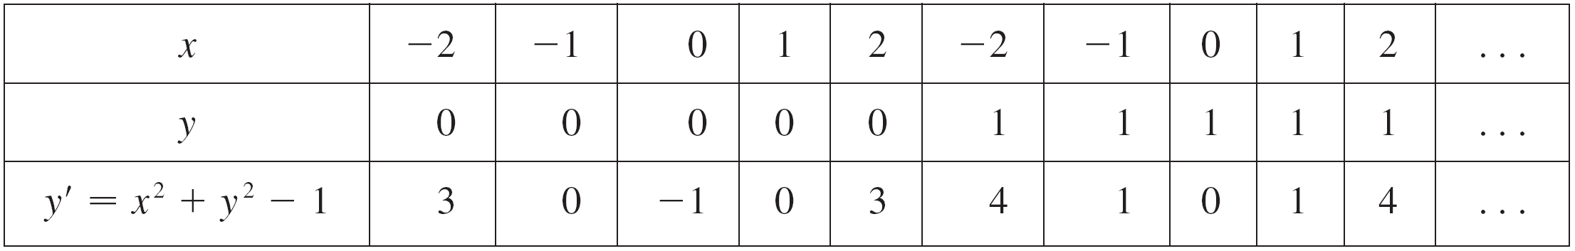
Example 1
(a) Sketch the direction field for the differential equation
y ′ = x² + y² – 1.
(b) Use part (a) to sketch the solution curve that passes
through the origin.
Solution:
(a) We start by computing the slope at several points in the
following chart:

Slide 13
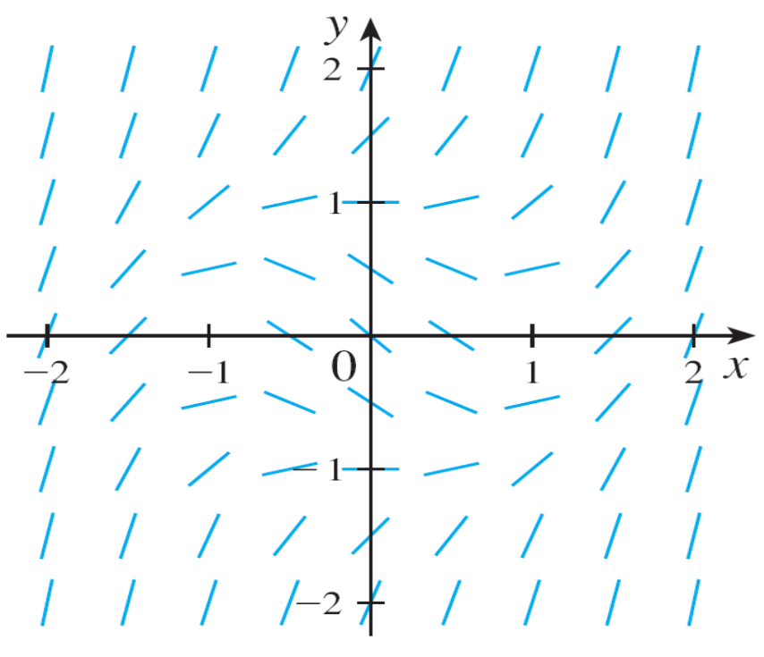
Example 1 – Solution
cont’d
Now we draw short line segments with these slopes at these points. The result is the direction field shown in Figure 5.
Figure 5

Slide 14
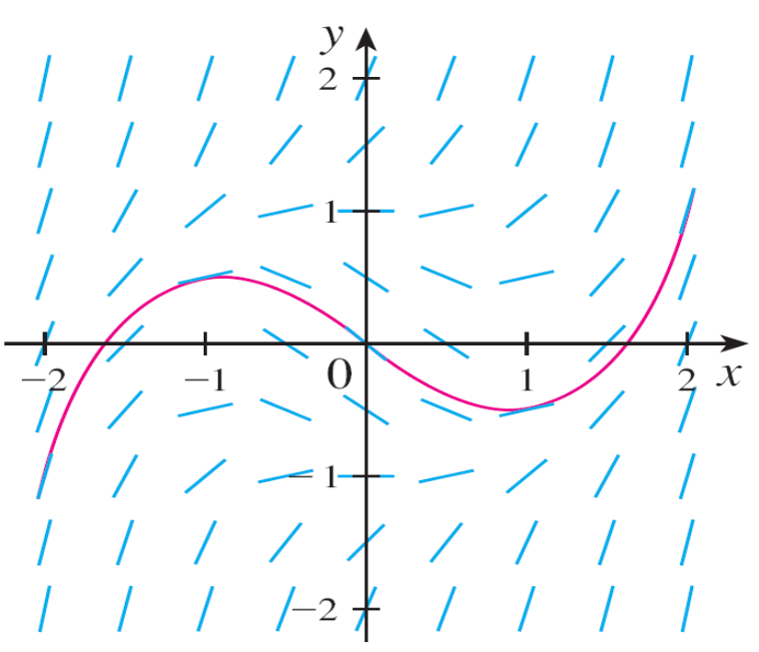
Example 1 – Solution
cont’d
(b) We start at the origin and move to the right in the
direction of the line segment (which has slope –1).
We continue to draw the solution curve so that it moves
parallel to the nearby line segments.
The resulting solution curve
is shown in Figure 6.
Returning to the origin, we
draw the solution curve to
the left as well.
Figure 6

Slide 15
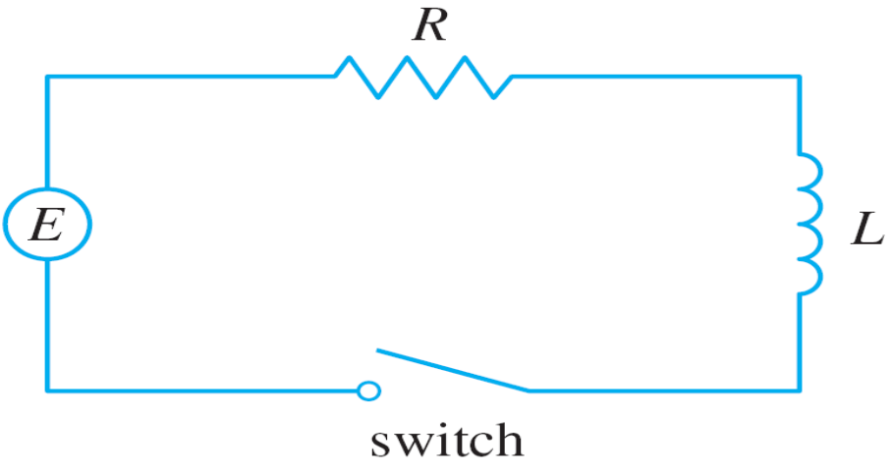
Direction Fields
Now let’s see how direction fields give insight into physical situations.
The simple electric circuit shown in Figure 9 contains an electromotive force (usually a battery or generator) that produces a voltage of E(t) volts (V) and a current of I(t) amperes (A) at time t.
Figure 9

Slide 16

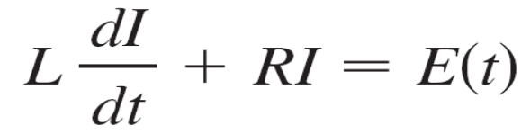

Direction Fields
The circuit also contains a resistor with a resistance of
R ohms and an inductor with an inductance of
L henries (H).
Ohm’s Law gives the drop in voltage due to the resistor as RI. The voltage drop due to the inductor is L(dI/dt). One of Kirchhoff’s laws says that the sum of the voltage drops is
equal to the supplied voltage E(t). Thus we have
which is a first-order differential equation that models the current I at time t.

Slide 17
Direction Fields
A differential equation of the form
y ′ = f (y)
in which the independent variable is missing from the right side, is called autonomous.
For such an equation, the slopes corresponding to two different points with the same y-coordinate must be equal.
This means that if we know one solution to an autonomous
differential equation, then we can obtain infinitely many others just by shifting the graph of the known solution to the right or left.

Slide 18
Euler’s Method

Slide 19
Euler’s Method
The basic idea behind direction fields can be used to find numerical approximations to solutions of differential equations.
We illustrate the method on the initial-value problem
that we used to introduce direction fields:
y ′ = x + y y(0) =1
The differential equation tells us that y ′(0) = 0 + 1 = 1, so the solution curve has slope 1 at the point (0, 1).
As a first approximation to the solution we could use the linear approximation L(x) = x + 1.

Slide 20
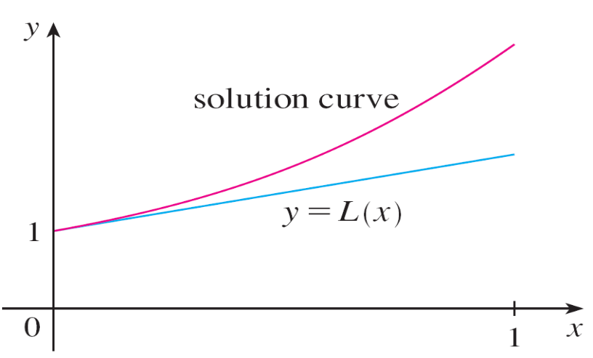
Euler’s Method
In other words, we could use the tangent line at (0, 1) as a rough approximation to the solution curve (see Figure 12).
Euler’s idea was to improve on this approximation by proceeding only a short distance along this tangent line and then making a midcourse correction by changing direction as indicated by the direction field.
First Euler approximation
Figure 12

Slide 21
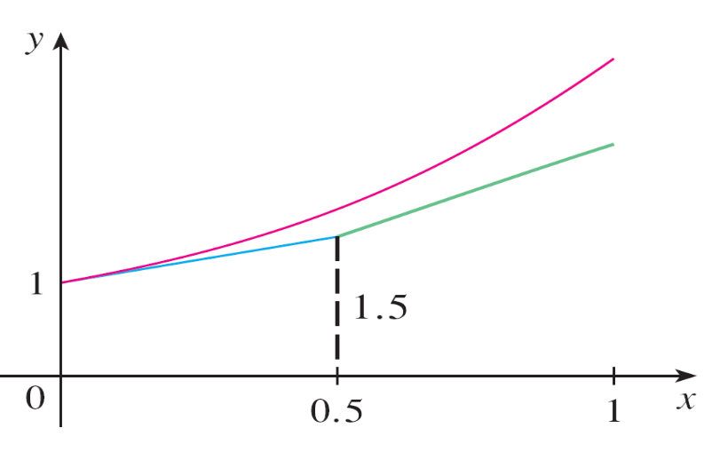
Euler’s Method
Figure 13 shows what happens if we start out along the
tangent line but stop when x = 0.5.
(This horizontal distance traveled is called the step size.)
Since L(0.5) = 1.5, we have y(0.5) ≈ 1.5 and we take
(0.5, 1.5) as the starting point for a new line segment.
Euler approximation with step size 0.5
Figure 13

Slide 22
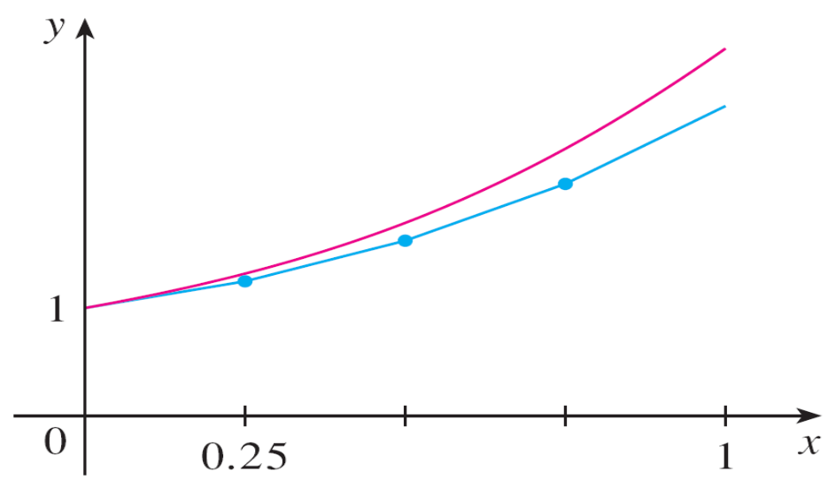
Euler’s Method
The differential equation tells us that y ′(0.5) = 0.5 + 1.5 = 2, so we use the linear function
y = 1.5 + 2(x – 0.5) = 2x + 0.5
as an approximation to the solution for x > 0.5 (the green segment in Figure 13).
If we decrease the step
size from 0.5 to 0.25,
we get the better Euler
approximation shown in
Figure 14.
Euler approximation with step size 0.25
Figure 14

Slide 23
Euler’s Method
In general, Euler’s method says to start at the point given by the initial value and proceed in the direction indicated by the direction field.
Stop after a short time, look at the slope at the new location, and proceed in that direction.
Keep stopping and changing direction according to the direction field.
Euler’s method does not produce the exact solution to an initial-value problem—it gives approximations.

Slide 24
Euler’s Method
But by decreasing the step size (and therefore increasing the number of midcourse corrections), we obtain
successively better approximations to the exact solution.
(Compare Figures 12, 13, and 14.)
For the general first-order initial-value problem y ′ = F (x, y),
y(x₀) = y₀, our aim is to find approximate values for the
solution at equally spaced numbers x₀, x₁ = x₀ + h,
x₂ = x₁ + h,…, where h is the step size.
Figure 12
Figure 13
Figure 14

Slide 25
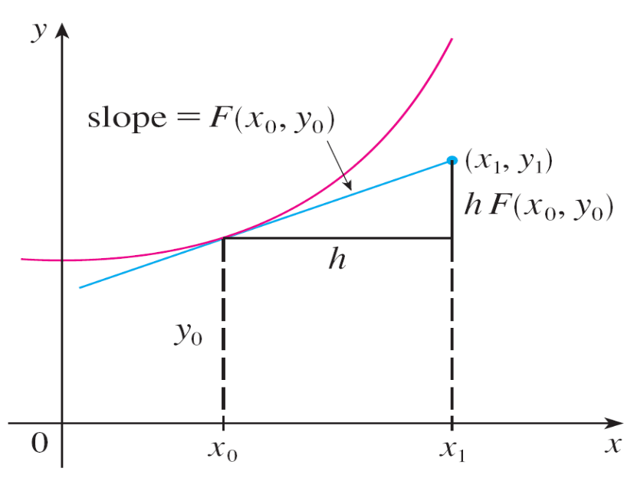
Euler’s Method
The differential equation tells us that the slope at (x₀, y₀) is
y ′ = F (x₀, y₀), so Figure 15 shows that the approximate value of the solution when x = x₁ is
y₁ = y₀ + hF (x₀, y₀)
Similarly,
y₂ = y₁ + hF (x₁, y₁)
In general,
y_{n} = y_{n – 1} + hF (x_{n – 1}, y_{n – 1})
Figure 15

Slide 26
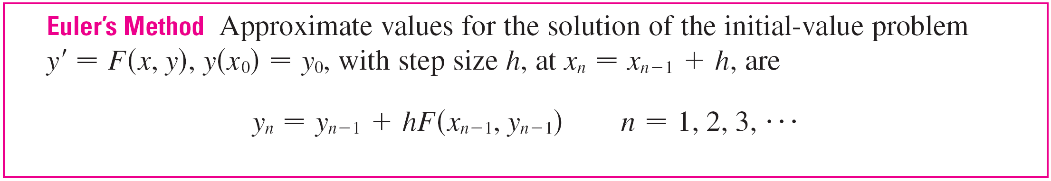
Euler’s Method

Slide 27
Example 3
Use Euler’s method with step size 0.1 to construct a table of approximate values for the solution of the initial-value problem
y ′ = x + y y(0) = 1
Solution:
We are given that h = 0.1, x₀ = 0, y₀ = 1, and F (x, y) = x + y. So we have
y₁ = y₀ + hF(x₀, y₀) = 1 + 0.1(0 + 1) = 1.1
y₂ = y₁ + hF(x₁, y₁) = 1.1 + 0.1(0.1 + 1.1) = 1.22
y₃ = y₂ + hF(x₂, y₂) = 1.22 + 0.1(0.2 + 1.22) = 1.362
This means that if y(x) is the exact solution, then
y(0.3) ≈ 1.362.

Slide 28
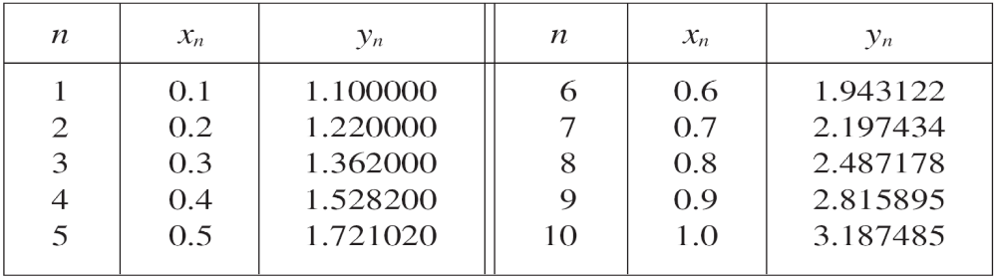
Example 3 – Solution
cont’d
Proceeding with similar calculations, we get the values in the table:

Slide 29
Euler’s Method
For a more accurate table of values in Example 3 we could decrease the step size.
But for a large number of small steps the amount of computation is considerable and so we need to program a calculator or computer to carry out these calculations.

Slide 30
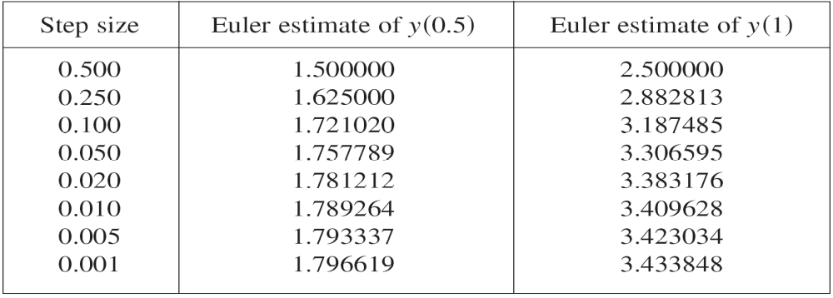
Euler’s Method
The following table shows the results of applying Euler’s method with decreasing step size to the initial-value problem of Example 3.
Notice that the Euler estimates in the table seem to be
approaching limits, namely, the true values of y(0.5) and y(1).

Slide 31
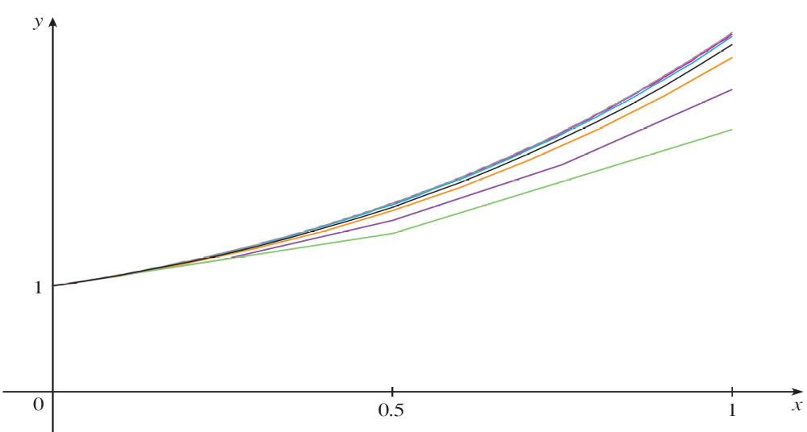
Euler’s Method
Figure 16 shows graphs of the Euler approximations with step sizes 0.5, 0.25, 0.1, 0.05, 0.02, 0.01, and 0.005.
They are approaching the exact solution curve as the
step size h approaches 0.
Euler approximations approaching the exact solution
Figure 16

