Slide 1

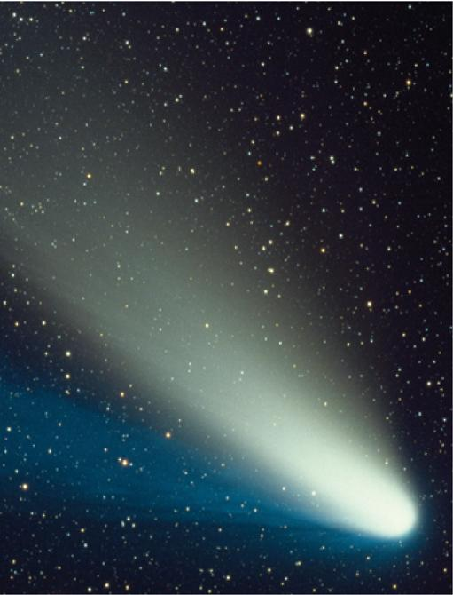
10
Parametric Equations
and Polar Coordinates
Copyright © Cengage Learning. All rights reserved.

Slide 2

10.3
Polar Coordinates
Copyright © Cengage Learning. All rights reserved.

Slide 3
Polar Coordinates
A coordinate system represents a point in the plane by an ordered pair of numbers called coordinates. Usually we use Cartesian coordinates, which are directed distances from two perpendicular axes.
Here we describe a coordinate system introduced by Newton, called the polar coordinate system, which is more convenient for many purposes.
We choose a point in the plane that is called the pole
(or origin) and is labeled O. Then we draw a ray (half-line) starting at O called the polar axis.

Slide 4
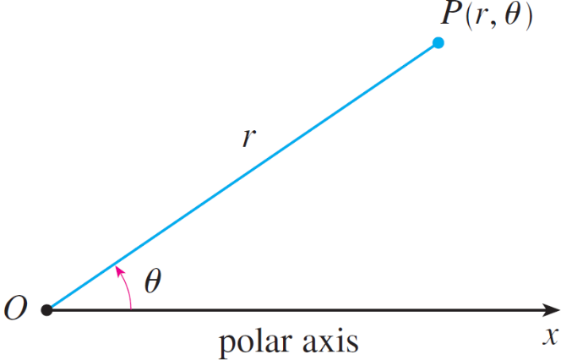
Polar Coordinates
This axis is usually drawn horizontally to the right and corresponds to the positive x-axis in Cartesian coordinates. If P is any other point in the plane, let r be the distance from O to P and let θ be the angle (usually measured in radians) between the polar axis and the line OP as in Figure 1.
Figure 1

Slide 5
Polar Coordinates
Then the point P is represented by the ordered pair (r, θ) and r, θ are called polar coordinates of P.
We use the convention that an angle is positive if measured in the counterclockwise direction from the polar axis and negative in the clockwise direction.
If P = O, then r = 0 and we agree that (0, θ) represents the pole for any value of θ.

Slide 6
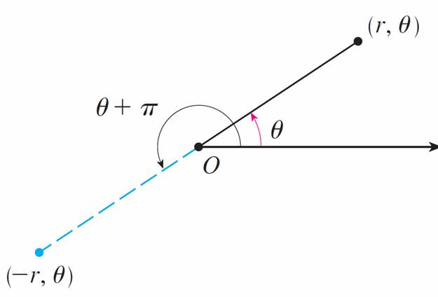
Polar Coordinates
We extend the meaning of polar coordinates (r, θ) to the case in which r is negative by agreeing that, as in Figure 2, the points (–r, θ) and (r, θ) lie on the same line through O and at the same distance | r | from O, but on opposite sides of O.
Figure 2

Slide 7
Polar Coordinates
If r > 0, the point (r, θ) lies in the same quadrant as θ ;
if r < 0, it lies in the quadrant on the opposite side of the pole. Notice that (–r, θ) represents the same point as
(r, θ + π).

Slide 8
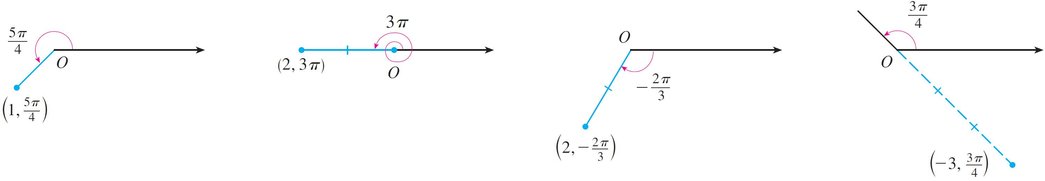
Example 1
Plot the points whose polar coordinates are given.
(a) (1, 5π /4) (b) (2, 3π) (c) (2, –2π /3) (d) (–3, 3π /4)
Solution:
The points are plotted in Figure 3.
Figure 3

Slide 9
Example 1 – Solution
cont’d
In part (d) the point (–3, 3π /4) is located three units from the pole in the fourth quadrant because the angle 3π /4 is in the second quadrant and r = –3 is negative.

Slide 10
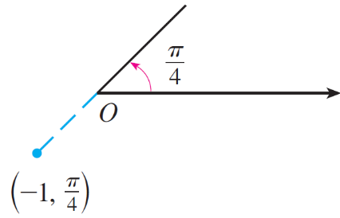
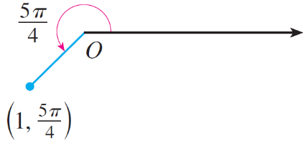
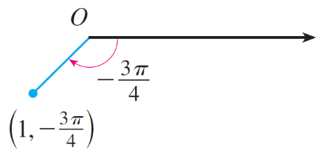
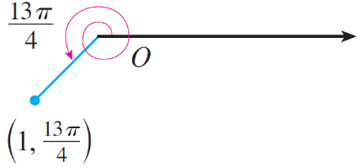
Polar Coordinates
In the Cartesian coordinate system every point has only one representation, but in the polar coordinate system each point has many representations. For instance, the point in (1, 5π /4) Example 1(a) could be written as (1, –3π /4) or
(1, 13π /4) or (–1, π /4). (See Figure 4.)
Figure 4

Slide 11
Polar Coordinates
In fact, since a complete counterclockwise rotation is given by an angle 2π, the point represented by polar coordinates (r, θ) is also represented by
(r, θ + 2nπ) and (–r, θ + (2n + 1) π)
where n is any integer.

Slide 12
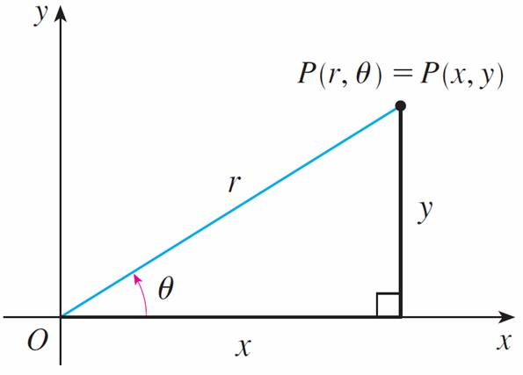
Polar Coordinates
The connection between polar and Cartesian coordinates can be seen from Figure 5, in which the pole corresponds to the origin and the polar axis coincides with the positive
x-axis.
Figure 5

Slide 13
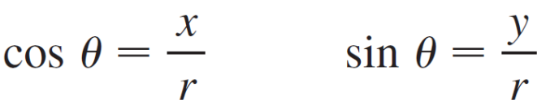
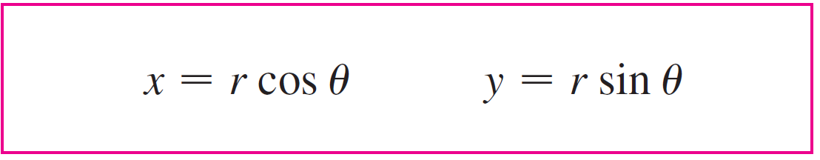

Polar Coordinates
If the point P has Cartesian coordinates (x, y) and polar coordinates (r, θ), then, from the figure, we have
and so
Although Equations 1 were deduced from Figure 5, which illustrates the case where r > 0 and 0 < θ < π /2, these equations are valid for all values of r and θ.

Slide 14
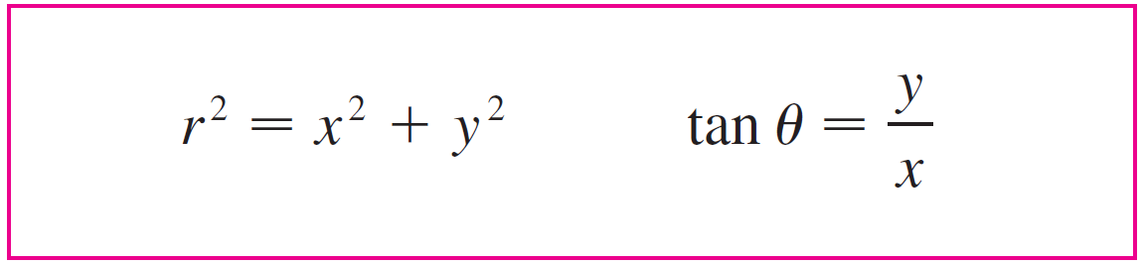

Polar Coordinates
Equations 1 allow us to find the Cartesian coordinates of a point when the polar coordinates are known. To find r and θ when x and y are known, we use the equations
which can be deduced from Equations 1 or simply read from Figure 5.

Slide 15
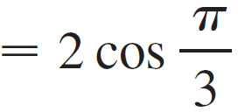
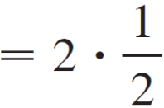

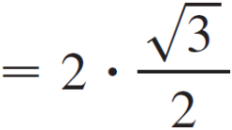
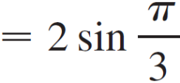

Example 2
Convert the point (2, π /3) from polar to Cartesian coordinates.
Solution:
Since r = 2 and θ = π /3, Equations 1 give
x = r cos θ
y = r sin θ
Therefore the point is (1, ) in Cartesian coordinates.

Slide 16



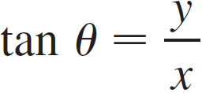

Example 3
Represent the point with Cartesian coordinates (1, –1) in terms of polar coordinates.
Solution:
If we choose r to be positive, then Equations 2 give
Since the point (1, –1) lies in the fourth quadrant, we can choose θ = –π /4 or θ = 7π /4. Thus one possible answer is
( , –π /4); another is ( , 7π /4).

Slide 17
Polar Coordinates
Note:
Equations 2 do not uniquely determine θ when x and y are given because, as θ increases through the interval
0 ≤ θ < 2π, each value of tan θ occurs twice.
Therefore, in converting from Cartesian to polar coordinates, it’s not good enough just to find r and θ that satisfy Equations 2.
As in Example 3, we must choose θ so that the point (r, θ) lies in the correct quadrant.

Slide 18
Polar Curves

Slide 19
Polar Curves
The graph of a polar equation r = f (θ), or more generally F (r, θ) = 0, consists of all points P that have at least one polar representation (r, θ) whose coordinates satisfy the equation.

Slide 20
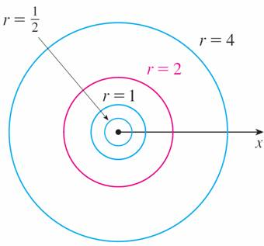
Example 4
What curve is represented by the polar equation r = 2?
Solution:
The curve consists of all points (r, θ) with r = 2. Since r represents the distance from the point to the pole, the curve r = 2 represents the circle with center O
and radius 2. In general, the equation r = a represents a circle with center O and radius |a|. (See Figure 6.)
Figure 6

Slide 21
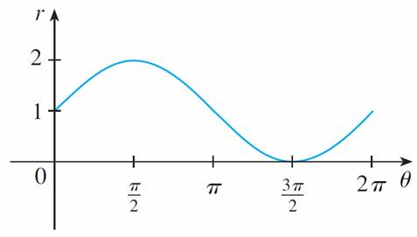
Example 7
Sketch the curve r = 1 + sin θ.
Solution:
We first sketch the graph of r = 1 + sinθ in Cartesian coordinates in Figure 10 by shifting the sine curve up one unit.
r = 1 + sin θ in Cartesian coordinates, 0 ≤ θ ≤ 2π
Figure 10

Slide 22
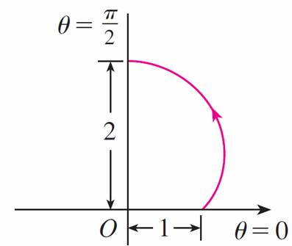
Example 7 – Solution
cont’d
This enables us to read at a glance the values of r that correspond to increasing values of θ. For instance, we see that as θ increases from 0 to π /2, r (the distance from O) increases from 1 to 2, so we sketch the corresponding part of the polar curve in Figure 11(a).
Figure 11(a)

Slide 23
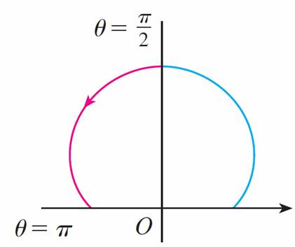
Example 7 – Solution
cont’d
As θ increases from π /2 to π, Figure 10 shows that r decreases from 2 to 1, so we sketch the next part of the curve as in Figure 11(b).
Figure 11(b)

Slide 24
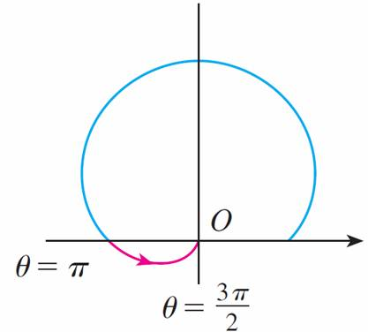
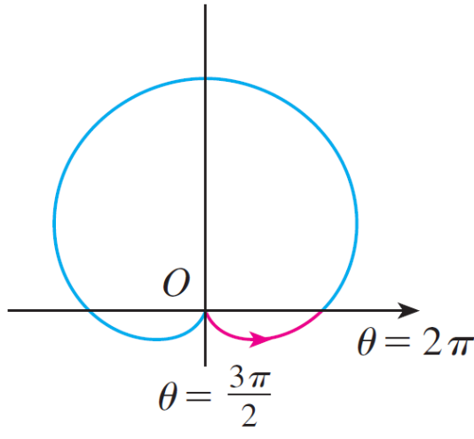
Example 7 – Solution
cont’d
As θ increases from π to 3π /2, r decreases from 1 to 0 as shown in part (c). Finally, as θ increases from 3π /2 to 2π,
r increases from 0 to 1 as shown in part (d). If we let θ increase beyond 2π or decrease beyond 0, we would simply retrace our path.
(c)
(d)
Figure 11

Slide 25
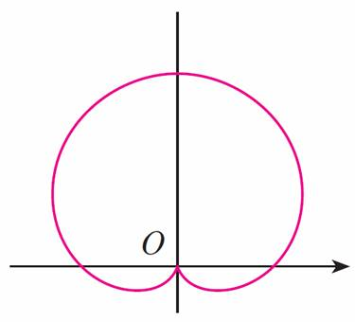
Example 7 – Solution
cont’d
Putting together the parts of the curve from
Figure 11(a)–(d), we sketch the complete curve in part (e). It is called a cardioid because it’s shaped like a heart.
Figure 11(e)

Slide 26
Polar Curves
The remainder of the curve is drawn in a similar fashion, with the arrows and numbers indicating the order in which the portions are traced out. The resulting curve has four loops and is called a four-leaved rose.

Slide 27
Symmetry

Slide 28
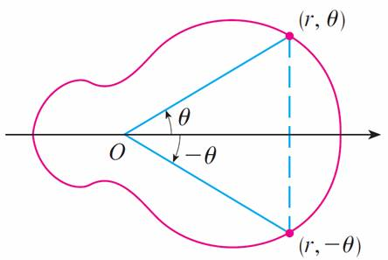
Symmetry
When we sketch polar curves it is sometimes helpful to take advantage of symmetry. The following three rules are explained by Figure 14.
(a) If a polar equation is unchanged when θ is replaced by –θ, the curve is symmetric about the polar axis.
Figure 14(a)

Slide 29
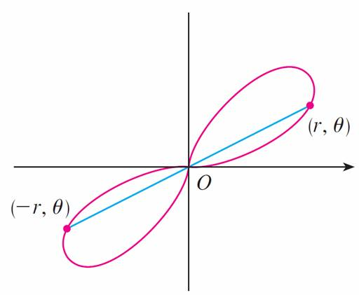
Symmetry
(b) If the equation is unchanged when r is replaced by –r, or when θ is replaced by θ + π, the curve is symmetric about the pole. (This means that the curve remains unchanged if we rotate it through 180° about the origin.)
Figure 14(b)

Slide 30
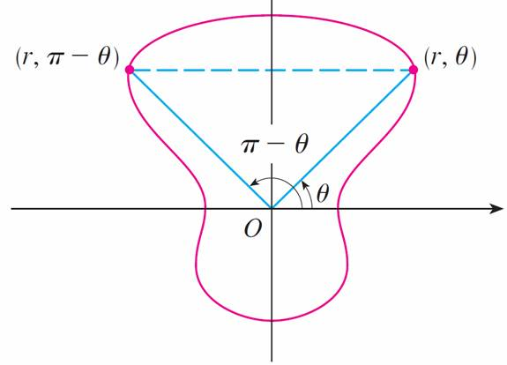
Symmetry
(c) If the equation is unchanged when θ is replaced by
π – θ, the curve is symmetric about the vertical line
θ = π/2.
Figure 14(c)

Slide 31
Symmetry
The curves sketched in Examples 6 and 8 are symmetric about the polar axis, since cos(–θ) = cos θ.
The curves in Examples 7 and 8 are symmetric about
θ = π /2 because sin(π – θ) = sin θ and cos 2(π – θ) = cos 2θ.
The four-leaved rose is also symmetric about the pole. These symmetry properties could have been used in sketching the curves.

Slide 32
Tangents to Polar Curves

Slide 33
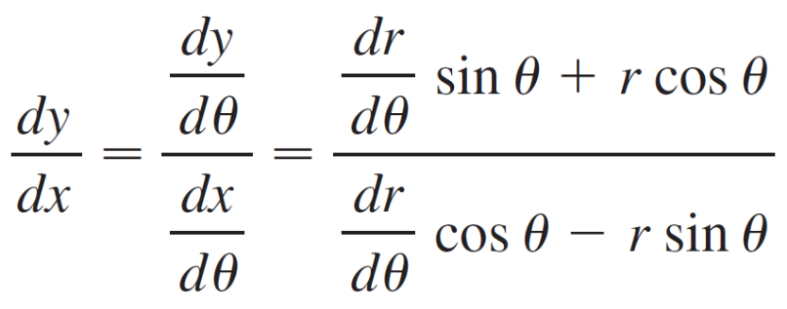

Tangents to Polar Curves
To find a tangent line to a polar curve r = f (θ), we regard θ as a parameter and write its parametric equations as
x = r cos θ = f (θ) cos θ y = r sin θ = f (θ) sin θ
Then, using the method for finding slopes of parametric curves and the Product Rule, we have

Slide 34
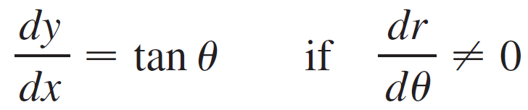
Tangents to Polar Curves
We locate horizontal tangents by finding the points where dy/dθ = 0 (provided that dy/dθ ≠ 0). Likewise, we locate vertical tangents at the points where dy/dθ = 0 (provided that dy/dθ ≠ 0). Notice that if we are looking for tangent lines at the pole, then r = 0 and Equation 3 simplifies to

Slide 35
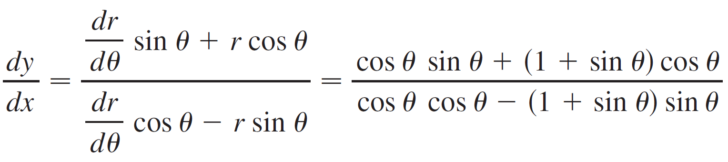
Example 9
(a) For the cardioid r = 1 + sin θ, find the slope of the tangent line when θ = π /3.
(b) Find the points on the cardioid where the tangent line is horizontal or vertical.
Solution:
Using Equation 3 with r = 1 + sin θ, we have

Slide 36
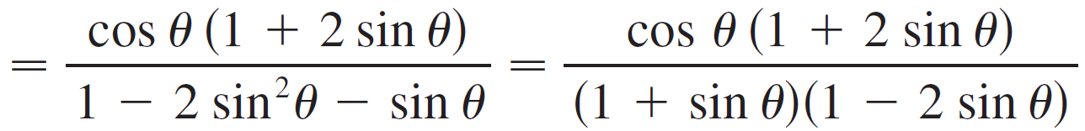
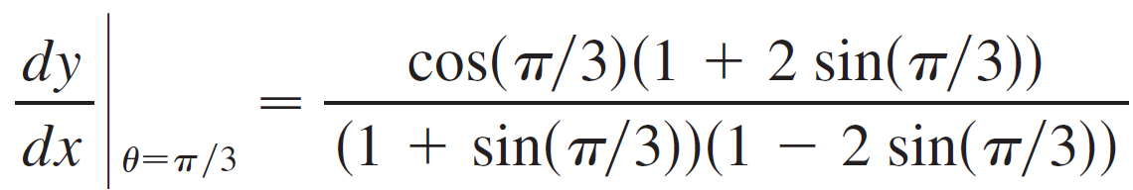
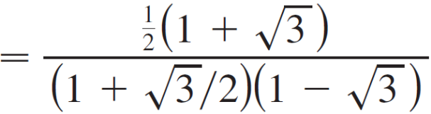
Example 9 – Solution
cont’d
(a) The slope of the tangent at the point where θ = π /3 is

Slide 37
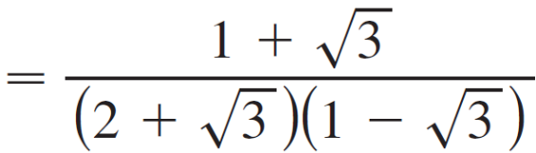
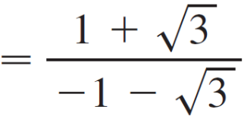

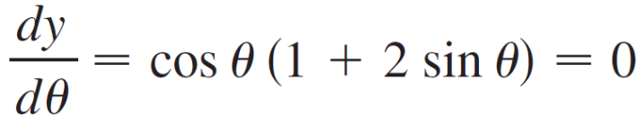
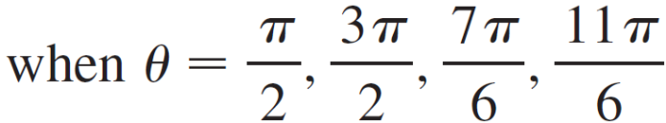
Example 9 – Solution
cont’d
(b) Observe that

Slide 38
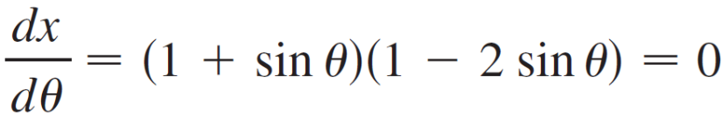
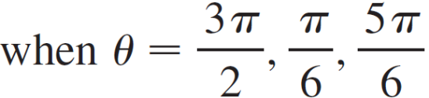



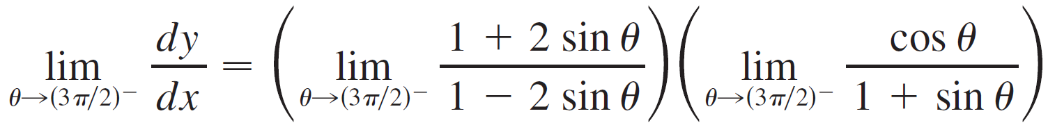
Example 9 – Solution
cont’d
Therefore there are horizontal tangents at the points
and vertical tangents at
When both dy/dθ and dx/dθ are 0, so we must be careful. Using l’Hospital’s Rule, we have

Slide 39
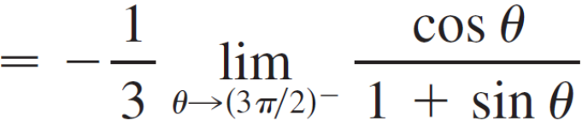
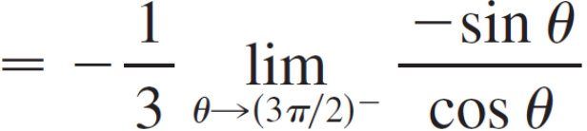

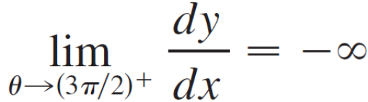
Example 9 – Solution
cont’d
By symmetry,

Slide 40
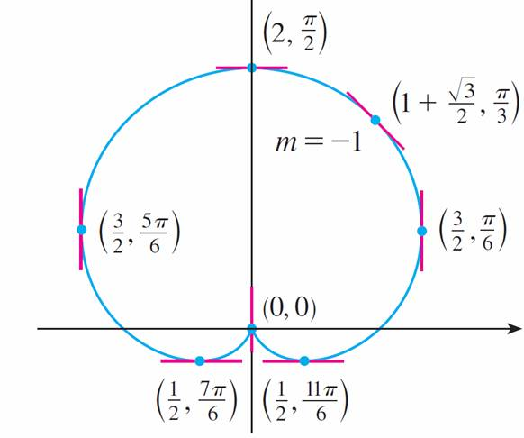
Example 9 – Solution
cont’d
Thus there is a vertical tangent line at the pole
(see Figure 15).
Tangent lines for r = 1 + sin θ
Figure 15

Slide 41

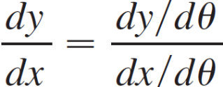
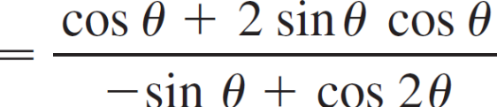
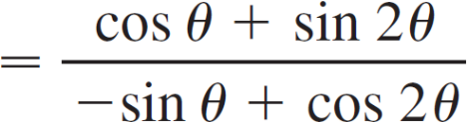
Tangents to Polar Curves
Note:
Instead of having to remember Equation 3, we could employ the method used to derive it. For instance, in Example 9 we could have written
x = r cos θ = (1 + sin θ) cos θ = cos θ + sin 2θ
y = r sin θ = (1 + sin θ) sin θ = sin θ + sin²θ
Then we have

Slide 42
Graphing Polar Curves with
Graphing Devices

Slide 43
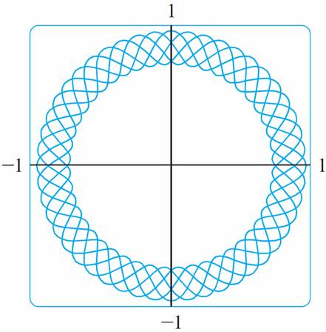
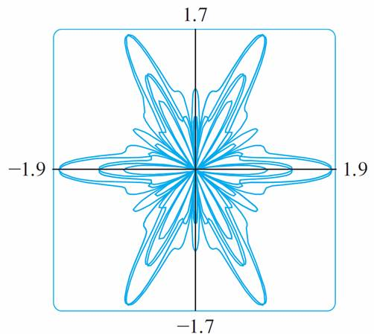
Graphing Polar Curves with Graphing Devices
Although it’s useful to be able to sketch simple polar curves by hand, we need to use a graphing calculator or computer when we are faced with a curve as complicated as the ones shown in Figures 16 and 17.
r = sin²(2.4θ) + cos⁴(2.4θ)
r = sin²(1.2θ) + cos³(6θ)
Figure 16
Figure 17

Slide 44
Graphing Polar Curves with Graphing Devices
Some graphing devices have commands that enable us to graph polar curves directly. With other machines we need to convert to parametric equations first. In this case we take the polar equation r = f (θ) and write its parametric equations as
x = r cos θ = f (θ) cos θ y = r sin θ = f (θ) sin θ
Some machines require that the parameter be called t rather than θ.

Slide 45
Example 10
Graph the curve r = sin(8θ/5).
Solution:
Let’s assume that our graphing device doesn’t have a
built-in polar graphing command.
In this case we need to work with the corresponding parametric equations, which are
x = r cos θ = sin(8θ/5) cos θ x = r sin θ = sin(8θ/5) sin θ

Slide 46
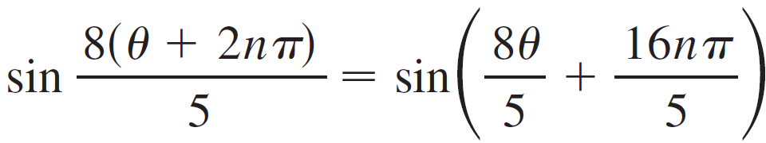

Example 10 – Solution
cont’d
In any case we need to determine the domain for θ. So we ask ourselves: How many complete rotations are required until the curve starts to repeat itself? If the answer is n, then
and so we require that 16nπ/5 be an even multiple of π. This will first occur when n = 5. Therefore we will graph the entire curve if we specify that 0 ≤ θ ≤ 10π.

Slide 47

Example 10 – Solution
cont’d
Switching from θ to t, we have the equations
x = sin(8t/5) cos t y = sin(8t/5) sin t 0 ≤ t ≤ 10π
and Figure 18 shows the resulting curve. Notice that this rose has 16 loops.
r = sin(8θ /5)
Figure 18

