Slide 1

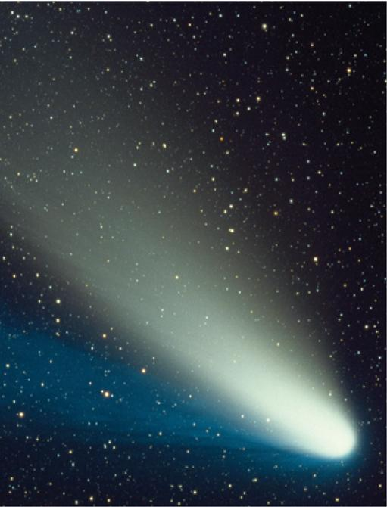
10
Parametric Equations
and Polar Coordinates
Copyright © Cengage Learning. All rights reserved.

Slide 2

Areas and Lengths in Polar Coordinates
10.4
Copyright © Cengage Learning. All rights reserved.

Slide 3

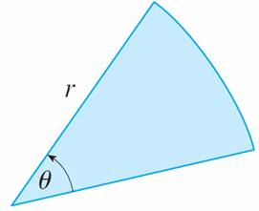
Areas and Lengths in Polar Coordinates
In this section we develop the formula for the area of a region whose boundary is given by a polar equation. We need to use the formula for the area of a sector of a circle:
A = r²θ
where, as in Figure 1, r is the radius and θ is the radian measure of the central angle.
Figure 1

Slide 4
Areas and Lengths in Polar Coordinates
Formula 1 follows from the fact that the area of a sector is proportional to its central angle:
A = (θ /2π)π r² = r²θ.

Slide 5

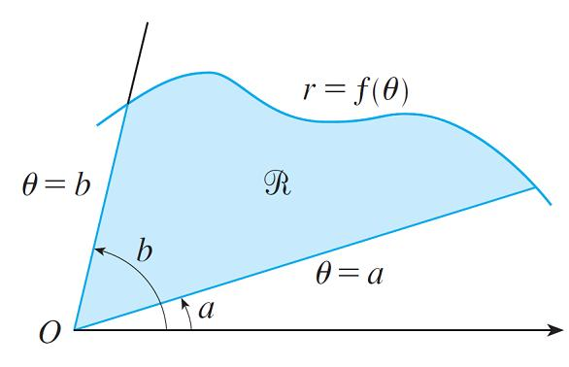
Areas and Lengths in Polar Coordinates
Let be the region, illustrated in Figure 2, bounded by the polar curve r = f (θ ) and by the rays θ = a and θ = b, where f is a positive continuous function and where 0 < b – a ≤ 2π.
We divide the interval [a, b] into subintervals with endpoints θ₀, θ₁, θ₂, . . . , θ_{n} and equal width Δθ.
Figure 2

Slide 6

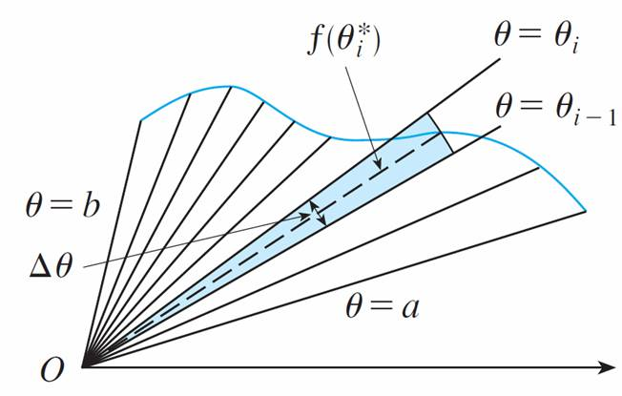
Areas and Lengths in Polar Coordinates
The rays θ = θ_{i} then divide into n smaller regions with central angle Δθ = θ_{i} – θ_{i – 1}. If we choose in the ith subinterval [θ_{i – 1}, θ_{i}], then the area ΔA_{i} of the ith region is approximated by the area of the sector of a circle with central angle Δθ and radius f ( ). (See Figure 3.)
Figure 3

Slide 7
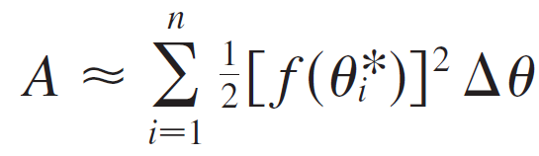



Areas and Lengths in Polar Coordinates
Thus from Formula 1 we have
ΔA_{i} ≈ [f ( )]² Δθ
and so an approximation to the total area A of is
It appears from Figure 3 that the approximation in improves as n → .

Slide 8
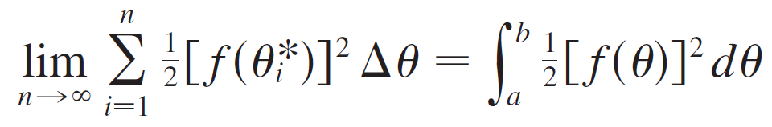
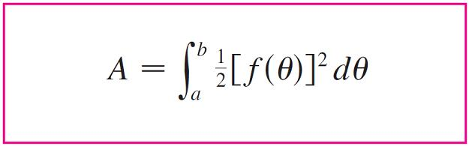

Areas and Lengths in Polar Coordinates
But the sums in are Riemann sums for the function
g(θ) = [f (θ)]², so
It therefore appears plausible that the formula for the area A of the polar region is

Slide 9
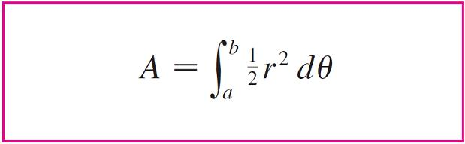

Areas and Lengths in Polar Coordinates
Formula 3 is often written as
with the understanding that r = f (θ). Note the similarity between Formulas 1 and 4.
When we apply Formula 3 or 4 it is helpful to think of the area as being swept out by a rotating ray through O that starts with angle a and ends with angle b.

Slide 10
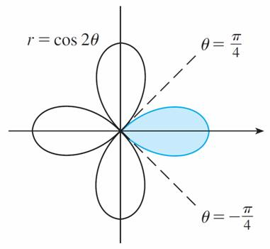
Example 1
Find the area enclosed by one loop of the four-leaved rose r = cos 2θ.
Solution:
Notice from Figure 4 that the region enclosed by the right loop is swept out by a ray that rotates from θ = –π /4 to
θ = π /4.
Figure 4

Slide 11
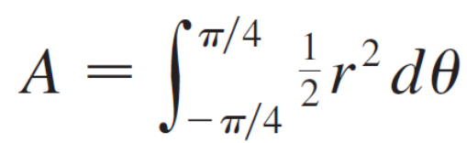
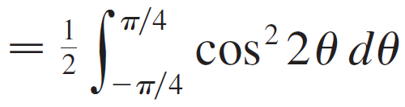
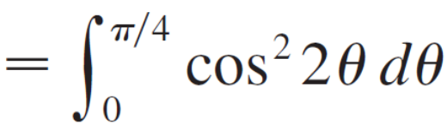
Example 1 – Solution
cont’d
Therefore Formula 4 gives

Slide 12
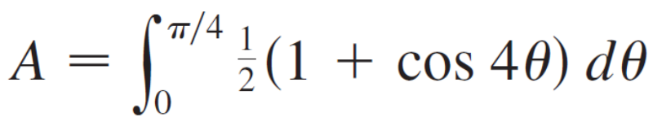
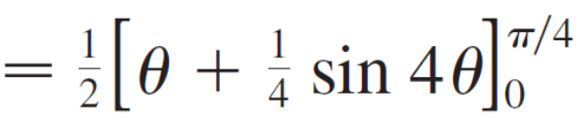
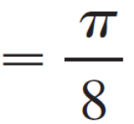
Example 1 – Solution
cont’d

Slide 13
Arc Length

Slide 14
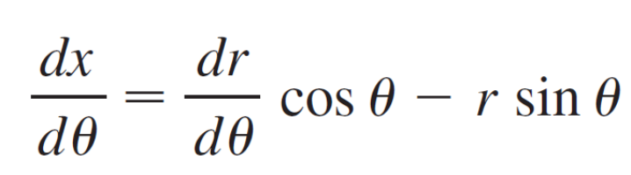
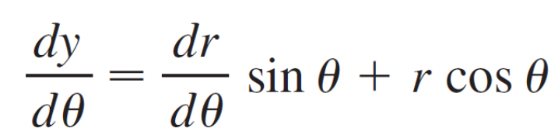
Arc Length
To find the length of a polar curve r = f (θ), a ≤ θ ≤ b, we
regard θ as a parameter and write the parametric equations
of the curve as
x = r cos θ = f (θ ) cos θ y = r sin θ = f (θ ) sin θ
Using the Product Rule and differentiating with respect to θ, we obtain

Slide 15
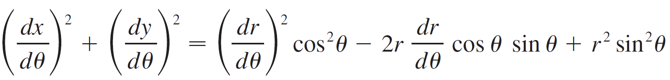
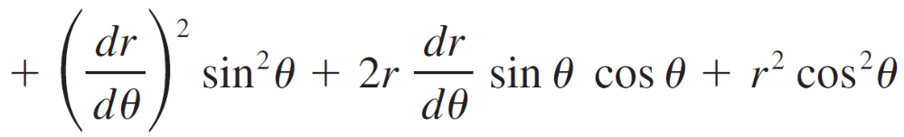
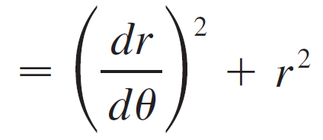
Arc Length
so, using cos²θ + sin²θ = 1, we have

Slide 16
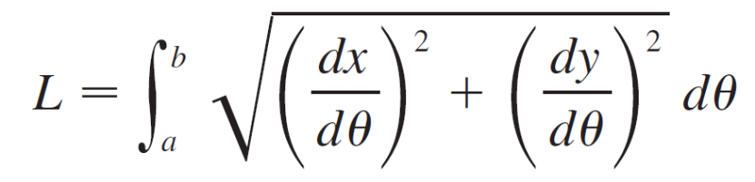
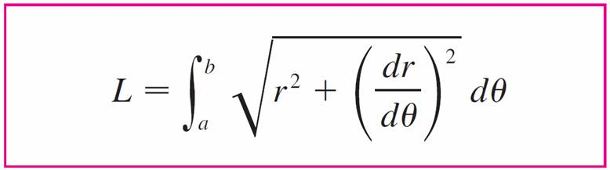

Arc Length
Assuming that f ′ is continuous, we can write the arc length as
Therefore the length of a curve with polar equation
r = f (θ), a ≤ θ ≤ b, is

Slide 17
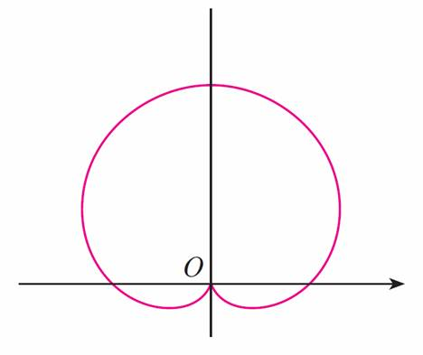
Example 4
Find the length of the cardioid r = 1 + sin θ.
Solution:
The cardioid is shown in Figure 8.
r = 1 + sin θ
Figure 8

Slide 18

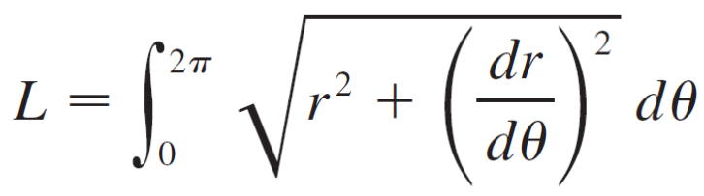
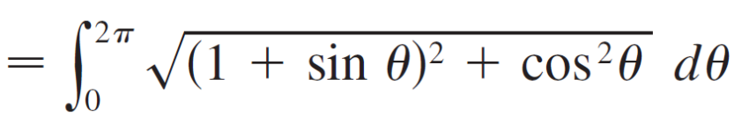
Example 4 – Solution
cont’d
Its full length is given by the parameter interval 0 ≤ θ ≤ 2π, so Formula 5 gives

Slide 19
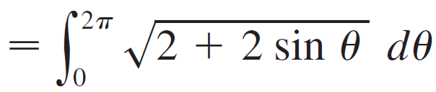

Example 4 – Solution
cont’d
We could evaluate this integral by multiplying and dividing the integrand by , or we could use a computer algebra system.
In any event, we find that the length of the cardioid is L = 8.

