Slide 1


Infinite Sequences
and Series
11
Copyright © Cengage Learning. All rights reserved.

Slide 2

11.2
Series
Copyright © Cengage Learning. All rights reserved.

Slide 3
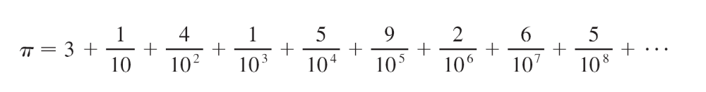
Series
What do we mean when we express a number as an infinite decimal? For instance, what does it mean to write
π = 3.14159 26535 89793 23846 26433 83279 50288 . . .
The convention behind our decimal notation is that any number can be written as an infinite sum. Here it means that
where the three dots (. . .) indicate that the sum continues forever, and the more terms we add, the closer we get to the actual value of π.

Slide 4


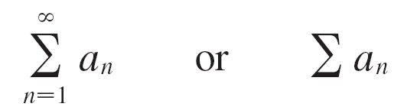
Series
In general, if we try to add the terms of an infinite sequence
we get an expression of the form
a₁ + a₂ + a₃ + . . . + a_{n} + . . .
which is called an infinite series (or just a series) and is denoted, for short, by the symbol

Slide 5
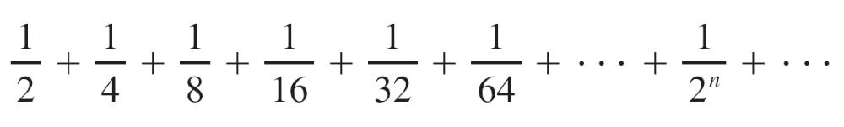
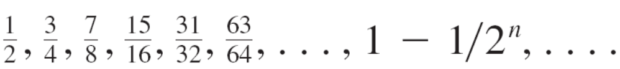
Series
It would be impossible to find a finite sum for the series
1 + 2 + 3 + 4 + 5 + . . . + n + . . .
because if we start adding the terms we get the cumulative sums 1, 3, 6, 10, 15, 21, . . . and, after the nth term, we get n(n + 1)/2, which becomes very large as n increases.
However, if we start to add the terms of the series
we get

Slide 6
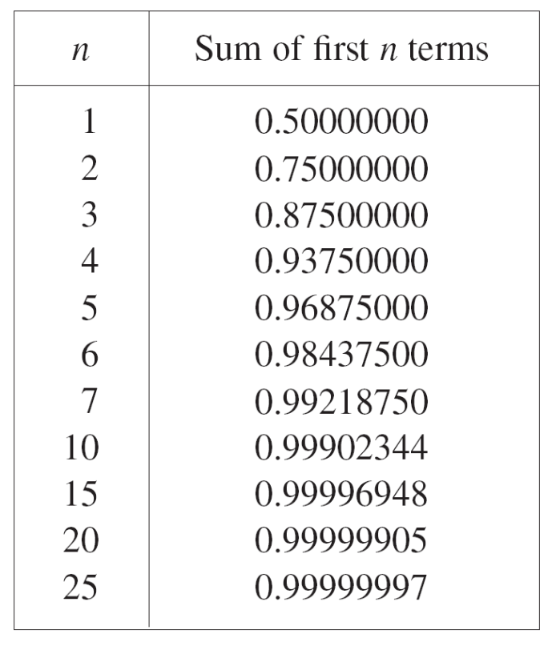
Series
The table shows that as we add more and more terms, these partial sums become closer and closer to 1.

Slide 7
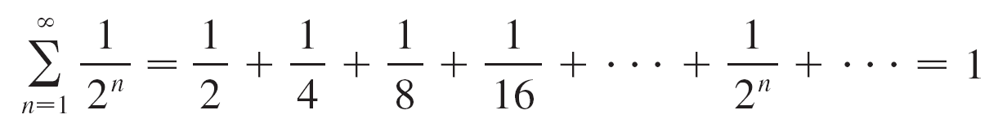
Series
In fact, by adding sufficiently many terms of the series we can make the partial sums as close as we like to 1.
So it seems reasonable to say that the sum of this infinite series is 1 and to write
We use a similar idea to determine whether or not a general series (1) has a sum.

Slide 8
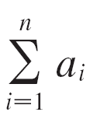
Series
We consider the partial sums
s₁ = a₁
s₂ = a₁ + a₂
s₃ = a₁ + a₂ + a₃
s₄ = a₁ + a₂ + a₃ + a₄
and, in general,
s_{n} = a₁ + a₂ + a₃ + . . . + a_{n} =
These partial sums form a new sequence {s_{n}}, which may or may not have a limit.

Slide 9

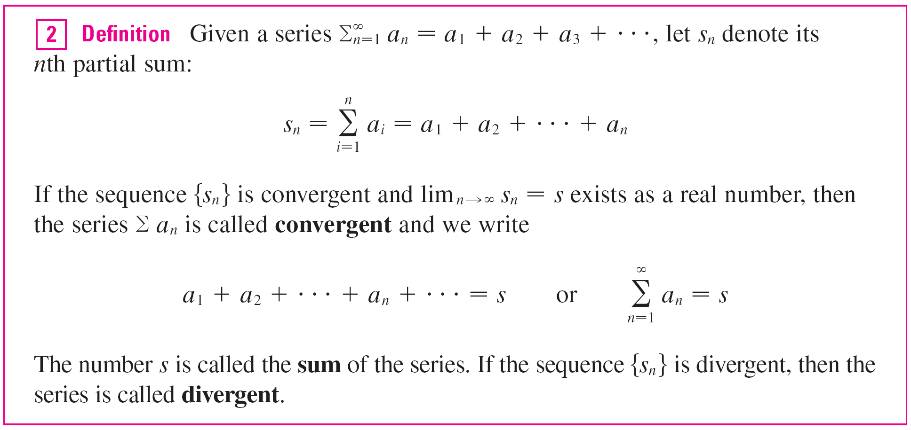
Series
If lim_{n →} s_{n} = s exists (as a finite number), then, as in the preceding example, we call it the sum of the infinite series
Σ a_{n}.

Slide 10

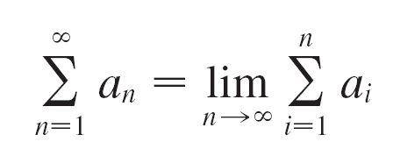
Series
Thus the sum of a series is the limit of the sequence of partial sums.
So when we write we mean that by adding sufficiently many terms of the series we can get as close as we like to the number s.
Notice that

Slide 11
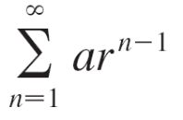

Example 2
An important example of an infinite series is the geometric series
a + ar + ar² + ar³ + . . . + ar ^{n–1} + . . . = a ≠ 0
Each term is obtained from the preceding one by multiplying it by the common ratio r.
If r = 1, then s_{n} = a + a + . . . + a = na →
Since lim_{n →} s_{n} doesn’t exist, the geometric series diverges in this case.

Slide 12
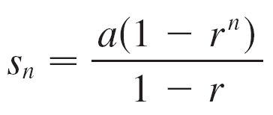

Example 2
cont’d
If r ≠ 1, we have
s_{n} = a + ar + ar² + . . . + ar ^{n-1}
and rs_{n} = ar + ar² + . . . + ar ^{n-1} + ar ^{n}
Subtracting these equations, we get
s_{n} – rs_{n} = a – ar ^{n}

Slide 13
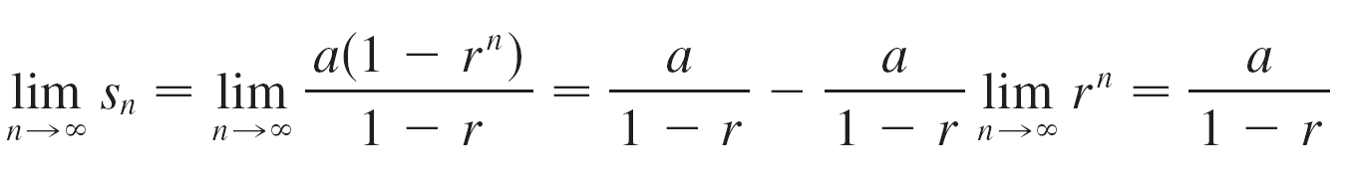
Example 2
cont’d
If –1< r < 1, we know that as r ^{n} → 0 as n → ,
so
Thus when | r | < 1 the geometric series is convergent and its sum is a/(1 – r ).
If r ≤ –1 or r > 1, the sequence {r ^{n}} is divergent and so, by Equation 3, lim_{n →} s_{n} does not exist.
Therefore the geometric series diverges in those cases.

Slide 14
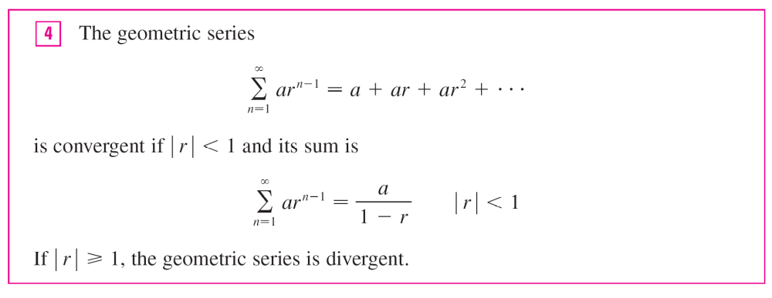
Series
We summarize the results of Example 2 as follows.

Slide 15
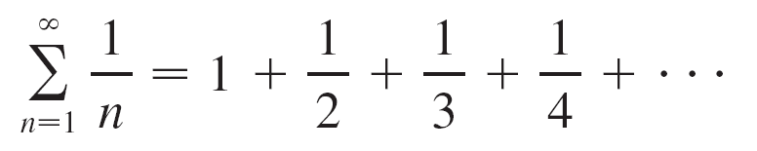
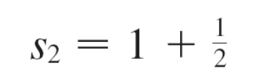
Example 8
Show that the harmonic series
is divergent.
Solution:
For this particular series it’s convenient to consider the partial sums s₂, s₄, s₈, s₁₆, s₃₂, . . . and show that they become large.

Slide 16


Example 8 – Solution
cont’d

Slide 17
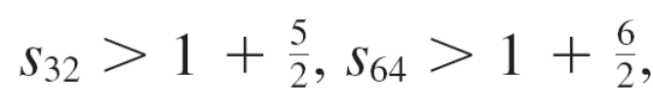
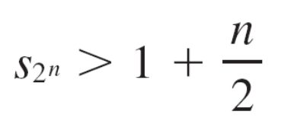

Example 8 – Solution
cont’d
Similarly, and in general
This shows that and so {s_{n}} is divergent.
Therefore the harmonic series diverges.

Slide 18


Series
The converse of Theorem 6 is not true in general.
If lim_{n→} a_{n} = 0, we cannot conclude that Σ a_{n} is convergent.

Slide 19
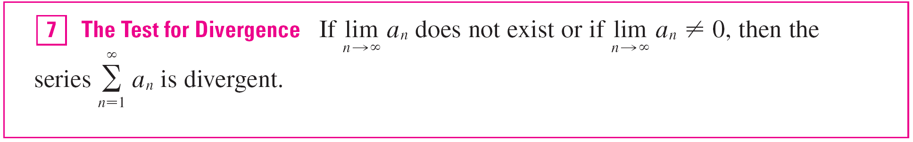
Series
The Test for Divergence follows from Theorem 6 because, if the series is not divergent, then it is convergent, and so
lim_{n →} a_{n} = 0.

Slide 20
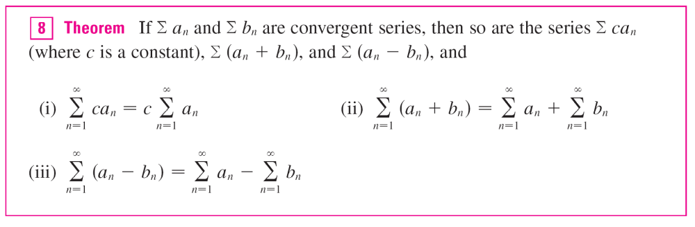
Series

