Slide 1


Infinite Sequences
and Series
11
Copyright © Cengage Learning. All rights reserved.

Slide 2

11.5
Alternating Series
Copyright © Cengage Learning. All rights reserved.

Slide 3
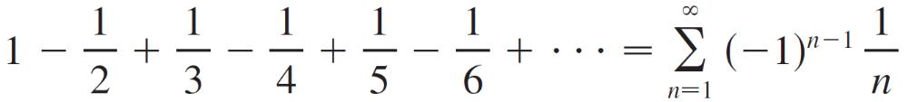
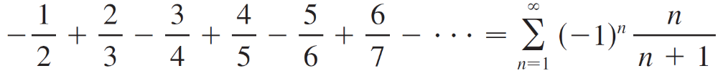
Alternating Series
In this section we learn how to deal with series whose terms are not necessarily positive. Of particular importance are alternating series, whose terms alternate in sign.
An alternating series is a series whose terms are alternately positive and negative. Here are two examples:

Slide 4
Alternating Series
We see from these examples that the nth term of an alternating series is of the form
a_{n} = (–1)^{n – 1}b_{n} or a_{n} = (–1)^{n}b_{n}
where b_{n} is a positive number. (In fact, b_{n} = | a_{n} |.)
The following test says that if the terms of an alternating series decrease toward 0 in absolute value, then the series converges.

Slide 5
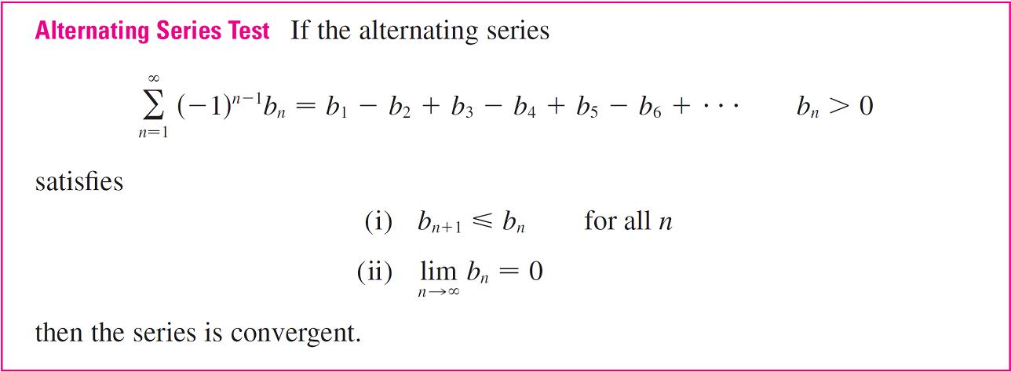
Alternating Series

Slide 6
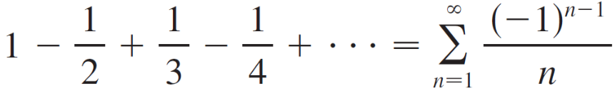
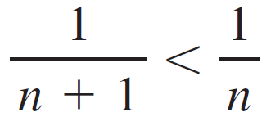
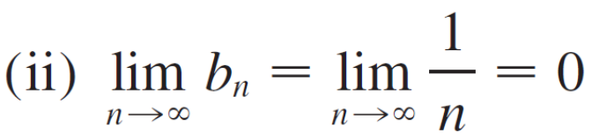
Example 1
The alternating harmonic series
satisfies
(i) b_{n + 1} < b_{n} because
so the series is convergent by the Alternating Series Test.

Slide 7
Estimating Sums

Slide 8
Estimating Sums
A partial sum s_{n} of any convergent series can be used as an approximation to the total sum s, but this is not of much use unless we can estimate the accuracy of the approximation. The error involved in using s ≈ s_{n} is the remainder R_{n} = s – s_{n}.
The next theorem says that for series that satisfy the conditions of the Alternating Series Test, the size of the error is smaller than b_{n + 1}, which is the absolute value of the first neglected term.

Slide 9
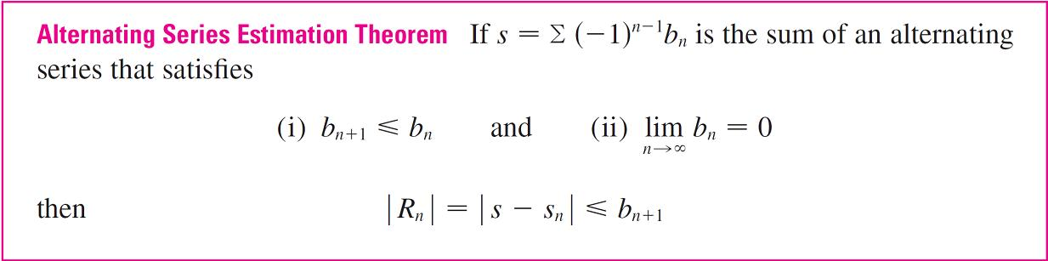
Estimating Sums

Slide 10

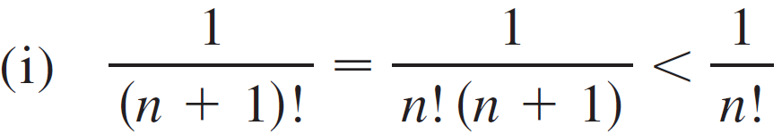
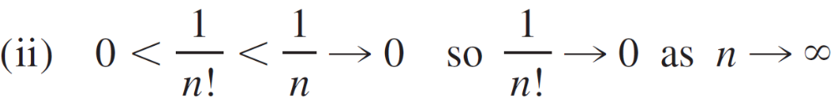
Example 4
Find the sum of the series correct to three decimal places.
Solution:
We first observe that the series is convergent by the Alternating Series Test because

Slide 11
Example 4 – Solution
cont’d
To get a feel for how many terms we need to use in our approximation, let’s write out the first few terms of the series:

Slide 12

Example 4 – Solution
cont’d
Notice that
and

Slide 13
Example 4 – Solution
cont’d
By the Alternating Series Estimation Theorem we know that
| s – s₆ | ≤ b₇ < 0.0002
This error of less than 0.0002 does not affect the third decimal place, so we have s ≈ 0.368 correct to three decimal places.

Slide 14
Estimating Sums
Note:
The rule that the error (in using s_{n} to approximate s) is smaller than the first neglected term is, in general, valid only for alternating series that satisfy the conditions of the Alternating Series Estimation Theorem. The rule does not apply to other types of series.

