Slide 1


Infinite Sequences
and Series
11
Copyright © Cengage Learning. All rights reserved.

Slide 2

Absolute Convergence and the Ratio and Root Tests
11.6
Copyright © Cengage Learning. All rights reserved.

Slide 3
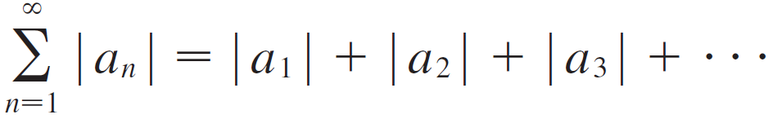

Absolute Convergence and the Ratio and Root Tests
Given any series Σ a_{n}, we can consider the corresponding series
whose terms are the absolute values of the terms of the original series.

Slide 4
Absolute Convergence and the Ratio and Root Tests
Notice that if Σ a_{n} is a series with positive terms, then
| a_{n} | = a_{n} and so absolute convergence is the same as convergence in this case.

Slide 5
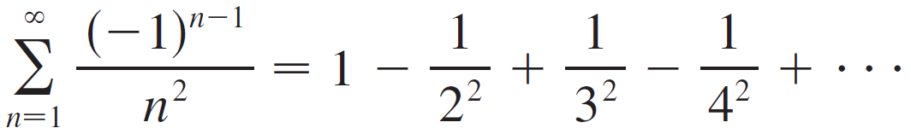
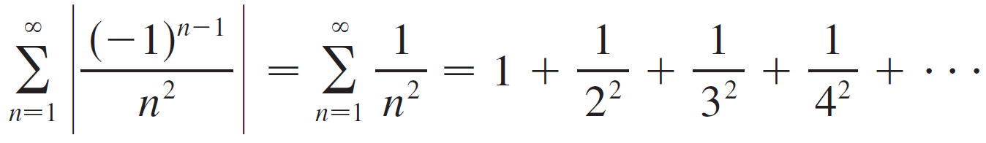
Example 1
The series
is absolutely convergent because
is a convergent p-series (p = 2).

Slide 6
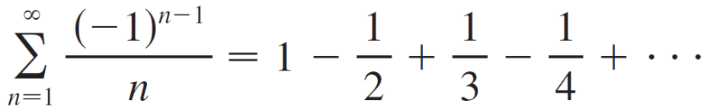
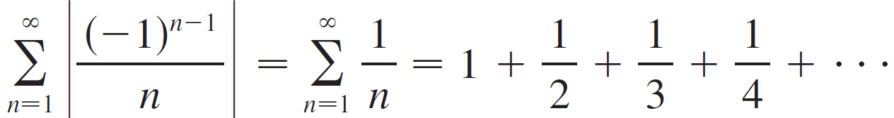
Example 2
We know that the alternating harmonic series
is convergent, but it is not absolutely convergent because the corresponding series of absolute values is
which is the harmonic series (p-series with p = 1) and is
therefore divergent.

Slide 7

Absolute Convergence and the Ratio and Root Tests
Example 2 shows that the alternating harmonic series is conditionally convergent. Thus it is possible for a series to be convergent but not absolutely convergent. However, the next theorem shows that absolute convergence implies convergence.

Slide 8
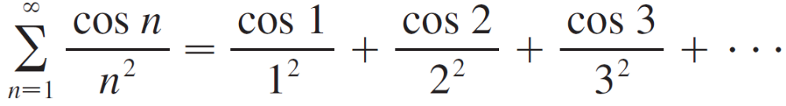
Example 3
Determine whether the series
is convergent or divergent.
Solution:
This series has both positive and negative terms, but it is not alternating. (The first term is positive, the next three are negative, and the following three are positive: The signs change irregularly.)

Slide 9
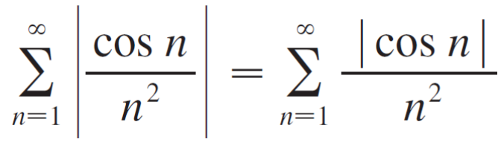
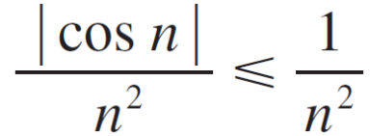
Example 3 – Solution
cont’d
We can apply the Comparison Test to the series of absolute values
Since | cos n | ≤ 1 for all n, we have
We know that Σ 1/n² is convergent (p-series with p = 2) and
therefore Σ | cos n |/n² is convergent by the Comparison Test.

Slide 10
Example 3 – Solution
cont’d
Thus the given series Σ (cos n)/n² is absolutely convergent and therefore convergent by Theorem 3.

Slide 11
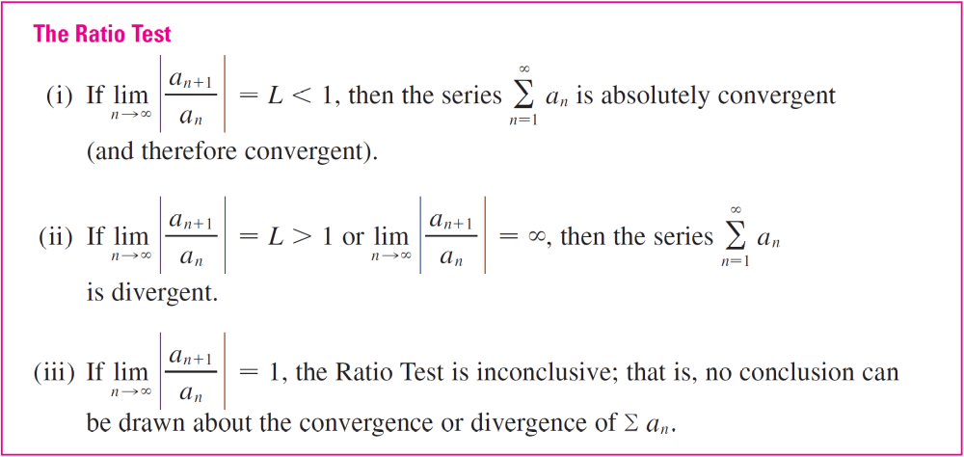
Absolute Convergence and the Ratio and Root Tests
The following test is very useful in determining whether a given series is absolutely convergent.

Slide 12

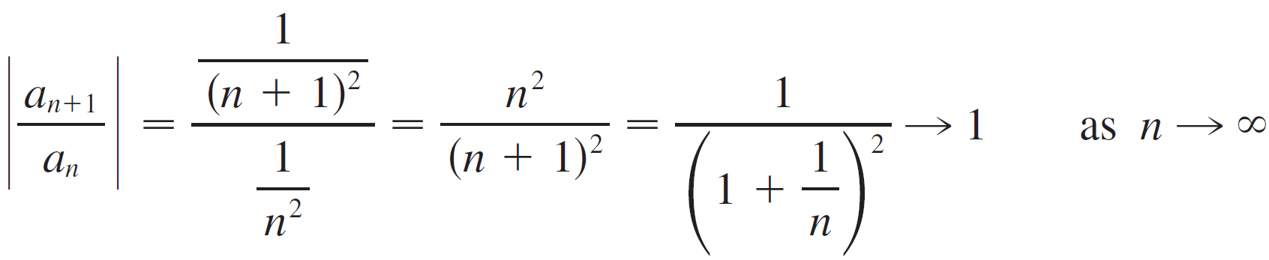
Absolute Convergence and the Ratio and Root Tests
Note:
Part (iii) of the Ratio Test says that if the test gives no information. For instance, for the convergent series Σ 1/n² we have

Slide 13
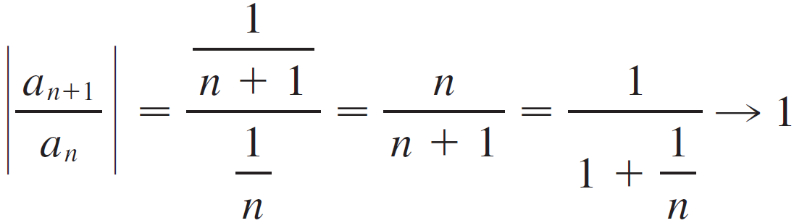

Absolute Convergence and the Ratio and Root Tests
whereas for the divergent series Σ 1/n we have
Therefore, if the series Σ a_{n} might converge or it might diverge. In this case the Ratio Test fails and we must use some other test.

Slide 14
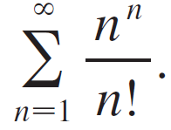
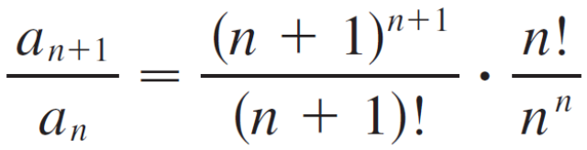
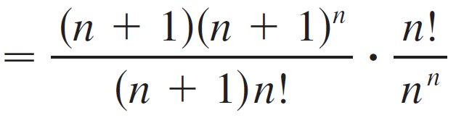
Example 5
Test the convergence of the series
Solution:
Since the terms a_{n} = n^{n} /n! are positive, we don’t need the absolute value signs.

Slide 15
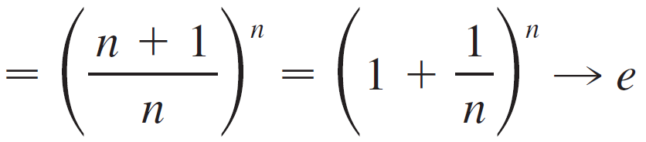

Example 5 – Solution
cont’d
as n
Since e > 1, the given series is divergent by the Ratio Test.

Slide 16
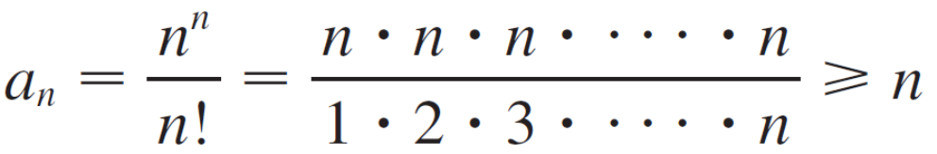

Absolute Convergence and the Ratio and Root Tests
Note:
Although the Ratio Test works in Example 5, an easier method is to use the Test for Divergence. Since
it follows that a_{n} does not approach 0 as n . Therefore the given series is divergent by the Test for Divergence.

Slide 17
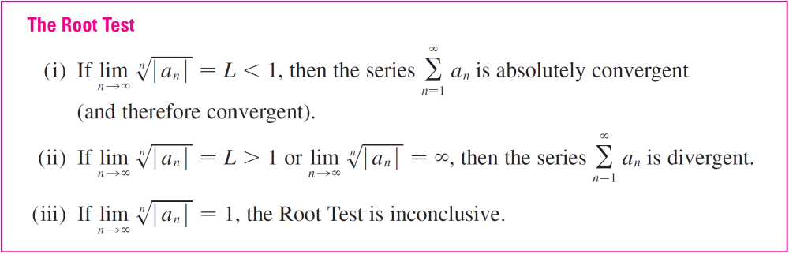
Absolute Convergence and the Ratio and Root Tests
The following test is convenient to apply when n th powers occur.

Slide 18

Absolute Convergence and the Ratio and Root Tests
If then part (iii) of the Root Test says that the test gives no information. The series Σ a_{n} could converge or diverge.
(If L = 1 in the Ratio Test, don’t try the Root Test because L will again be 1. And if L = 1 in the Root Test, don’t try the Ratio Test because it will fail too.)

Slide 19
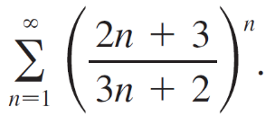
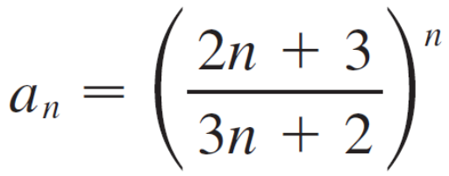
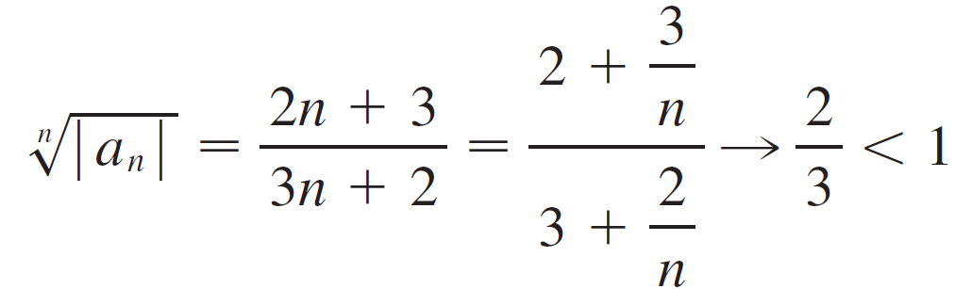
Example 6
Test the convergence of the series
Solution:
Thus the given series converges by the Root Test.

Slide 20
Rearrangements

Slide 21
Rearrangements
The question of whether a given convergent series is absolutely convergent or conditionally convergent has a bearing on the question of whether infinite sums behave like finite sums.
If we rearrange the order of the terms in a finite sum, then of course the value of the sum remains unchanged. But this is not always the case for an infinite series.

Slide 22
Rearrangements
By a rearrangement of an infinite series Σ a_{n} we mean a series obtained by simply changing the order of the terms. For instance, a rearrangement of Σ a_{n} could start as follows:
a₁ + a₂ + a₅ + a₃ + a₄ + a₁₅ + a₆ + a₇ + a₂₀ +…
It turns out that
if Σ a_{n} is absolutely convergent series with sum s,
then any rearrangement of Σ a_{n} has the same sum s.

Slide 23



Rearrangements
However, any conditionally convergent series can be rearranged to give a different sum. To illustrate this fact let’s consider the alternating harmonic series
If we multiply this series by we get

Slide 24


Rearrangements
Inserting zeros between the terms of this series, we have
Now we add the series in Equations 6 and 7:

Slide 25


Rearrangements
Notice that the series in contains the same terms as in but rearranged so that one negative term occurs after each pair of positive terms. The sums of these series, however, are different. In fact, Riemann proved that
if Σ a_{n} is a conditionally convergent series and r is any real number whatsoever, then there is a rearrangement of Σ a_{n} that has a sum equal to r.

