Slide 1


Infinite Sequences
and Series
11
Copyright © Cengage Learning. All rights reserved.

Slide 2

11.7
Strategy for Testing Series
Copyright © Cengage Learning. All rights reserved.

Slide 3
Strategy for Testing Series
We now have several ways of testing a series for convergence or divergence; the problem is to decide which test to use on which series. In this respect, testing series is similar to integrating functions.
Again there are no hard and fast rules about which test to apply to a given series, but you may find the following advice of some use.
It is not wise to apply a list of the tests in a specific order until one finally works. That would be a waste of time and effort. Instead, as with integration, the main strategy is to classify the series according to its form.

Slide 4
Strategy for Testing Series
1. If the series is of the form Σ 1/n^{p}, it is a p-series, which we know to be convergent if p > 1 and divergent if p ≤ 1.
2. If the series has the form or Σ ar^{n – 1} or Σ ar^{n}, it is a geometric series, which converges if | r | < 1 and diverges if | r | ≥ 1. Some preliminary algebraic manipulation may be required to bring the series into this form.

Slide 5
Strategy for Testing Series
3. If the series has a form that is similar to a p-series or a geometric series, then one of the comparison tests should be considered. In particular, if a_{n} is a rational function or an algebraic function of n (involving roots of polynomials), then the series should be compared with a p-series.
The comparison tests apply only to series with positive terms, but if Σa_{n} has some negative terms, then we terms, then we can apply the Comparison Test to Σ |a_{n}| and test for absolute convergence.

Slide 6

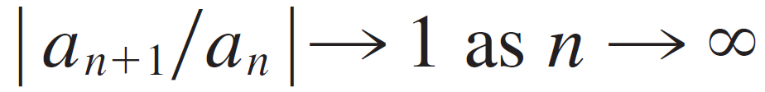
Strategy for Testing Series
4. If you can see at a glance that , then the
Test for Divergence should be used.
5. If the series is of the form Σ(–1)^{n – 1}b_{n} or Σ(–1)^{n}b_{n}, then
the Alternating Series Test is an obvious possibility.
6. Series that involve factorials or other products
(including a constant raised to the nth power) are often
conveniently tested using the Ratio Test. Bear in mind
that for all p-series and
therefore all rational or algebraic functions of n.
Thus the Ratio Test should not be used for such
series.

Slide 7

Strategy for Testing Series
7. If a_{n} is of the form (b_{n})^{n}, then the Root Test may be
useful.
8. If a_{n} = f(n), where is easily evaluated, then the
Integral Test is effective (assuming the hypotheses of
this test are satisfied).
In the following examples we don’t work out all the details but simply indicate which tests should be used.

Slide 8
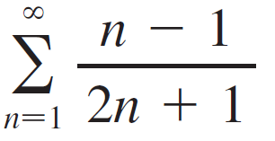

Example 1
Since as a_{n} → ≠ as n → , we should use the Test for Divergence.

Slide 9
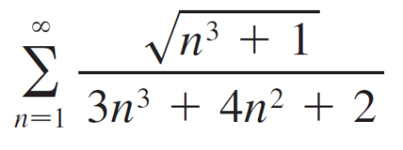

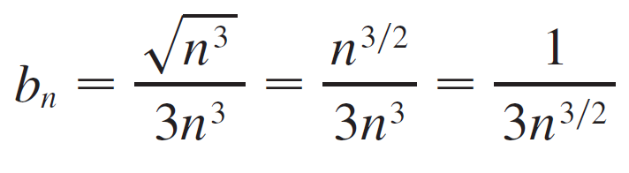
Example 2
Since a_{n} is an algebraic function of, we compare the given series with a p-series.
The comparison series for the Limit Comparison Test is
where

Slide 10
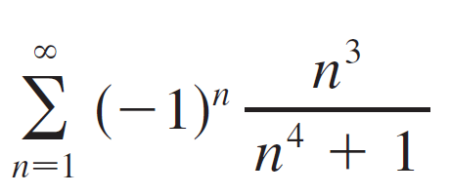
Example 4
Since the series is alternating, we use the Alternating Series Test.

Slide 11
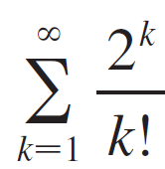
Example 5
Since the series involves k!, we use the Ratio Test.

Slide 12
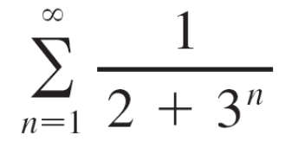

Example 6
Since the series is closely related to the geometric series
, we use the Comparison Test.

