Slide 1


Infinite Sequences
and Series
11
Copyright © Cengage Learning. All rights reserved.

Slide 2

11.8
Power Series
Copyright © Cengage Learning. All rights reserved.

Slide 3
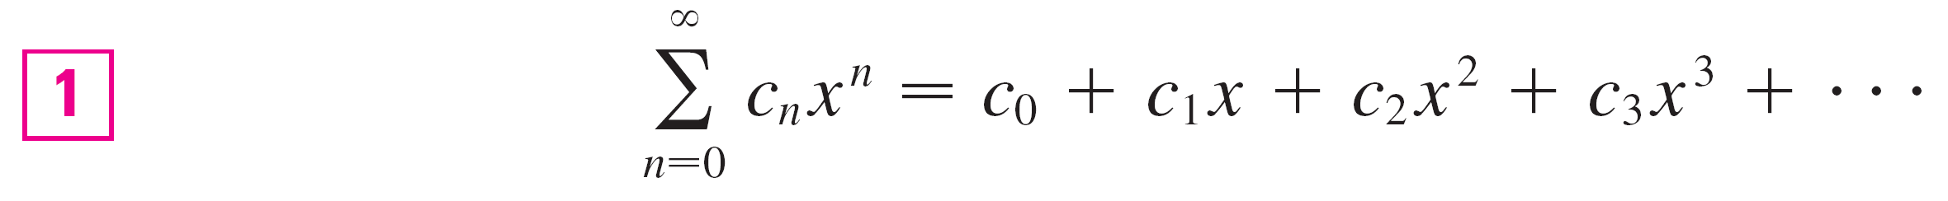
Power Series
A power series is a series of the form
where x is a variable and the c_{n}’s are constants called the coefficients of the series.
For each fixed x, the series (1) is a series of constants that we can test for convergence or divergence.
A power series may converge for some values of x and diverge for other values of x.

Slide 4

Power Series
The sum of the series is a function
f (x) = c₀ + c₁x + c₂x² + . . . + c_{n}x^{n} + . . .
whose domain is the set of all x for which the series converges. Notice that f resembles a polynomial. The only difference is that f has infinitely many terms.
For instance, if we take c_{n} = 1 for all n, the power series becomes the geometric series
x^{n} = 1 + x + x² + . . . + x^{n} + . . .
which converges when –1 < x < 1 and diverges when | x | ≥ 1.

Slide 5
Power Series
More generally, a series of the form
is called a power series in (x – a) or a power series centered at a or a power series about a.
Notice that in writing out the term corresponding to n = 0 in Equations 1 and 2 we have adopted the convention that (x – a)⁰ = 1 even when x = a.
Notice also that when x = a all of the terms are 0 for n ≥ 1 and so the power series (2) always converges when x = a.

Slide 6
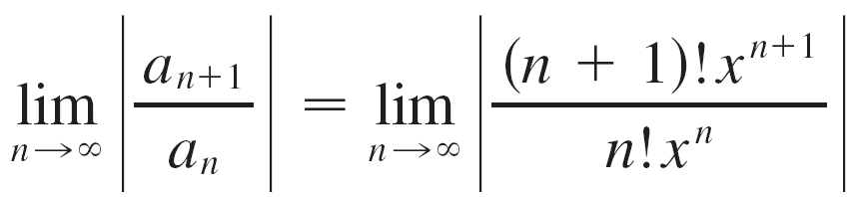


Example 1
For what values of x is the series n!x^{n} convergent?
Solution:
We use the Ratio Test. If we let a_{n}, as usual, denote the nth term of the series, then a_{n} = n!x^{n}. If x ≠ 0, we have
By the Ratio Test, the series diverges when x ≠ 0. Thus the given series converges only when x = 0.

Slide 7
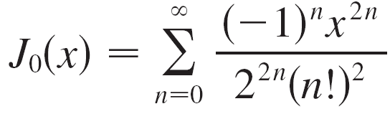
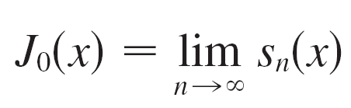
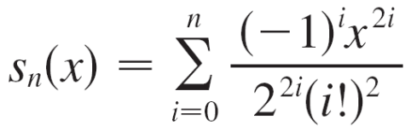
Power Series
We will see that the main use of a power series is that it provides a way to represent some of the most important functions that arise in mathematics, physics, and chemistry.
In particular, the sum of the power series,
, is called a Bessel function.
Recall that the sum of a series is equal to the limit of the sequence of partial sums. So when we define the Bessel function as the sum of a series we mean that, for every real
number x, where

Slide 8
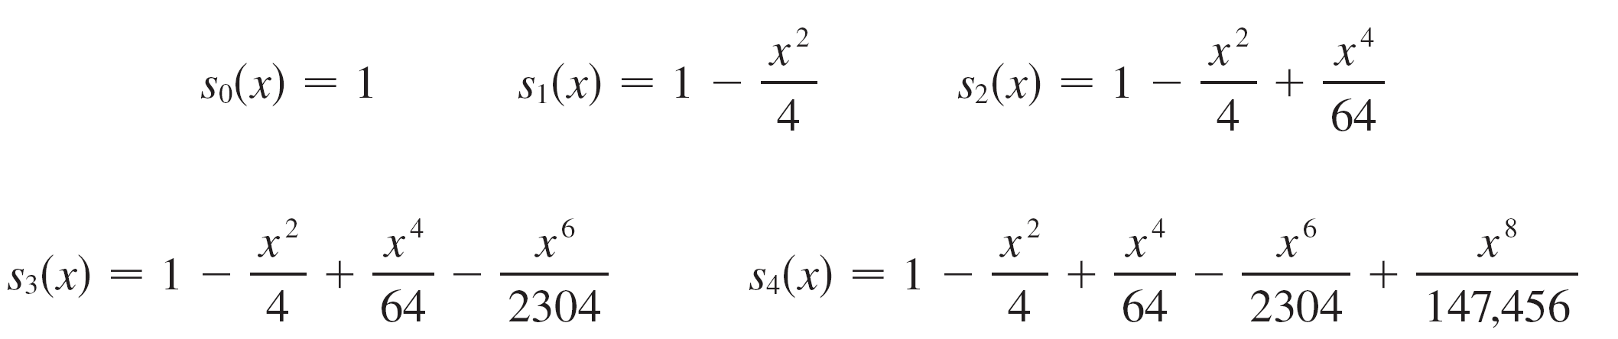
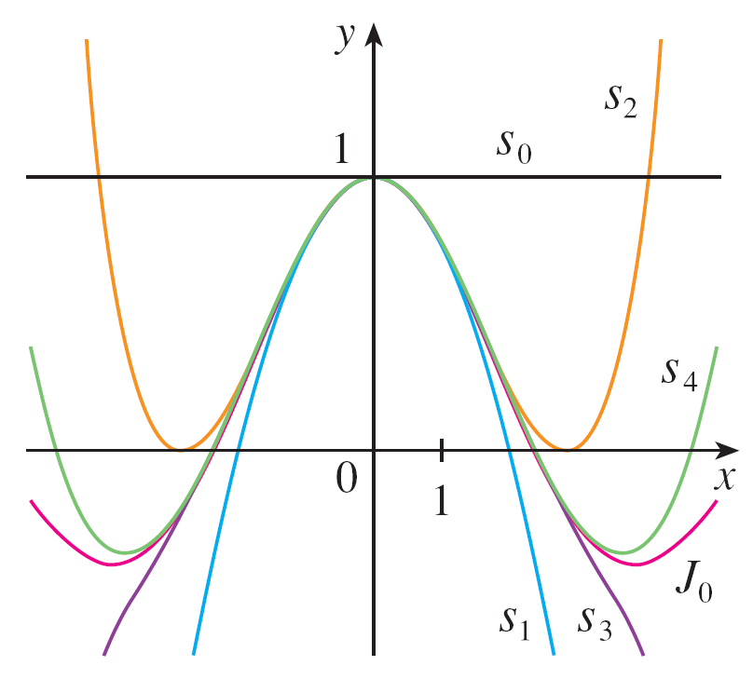
Power Series
The first few partial sums are
Figure 1 shows the graphs
of these partial sums, which
are polynomials. They are all
approximations to the function
J₀, but notice that the
approximations become better
when more terms are included.
Partial sums of the Bessel function J₀
Figure 1

Slide 9
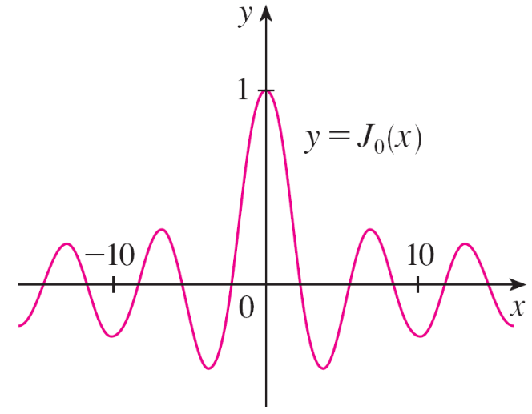
Power Series
Figure 2 shows a more complete graph of the Bessel function.
For the power series that we have looked at so far, the set of values of x for which the series is convergent has always turned out to be an interval.
Figure 2

Slide 10
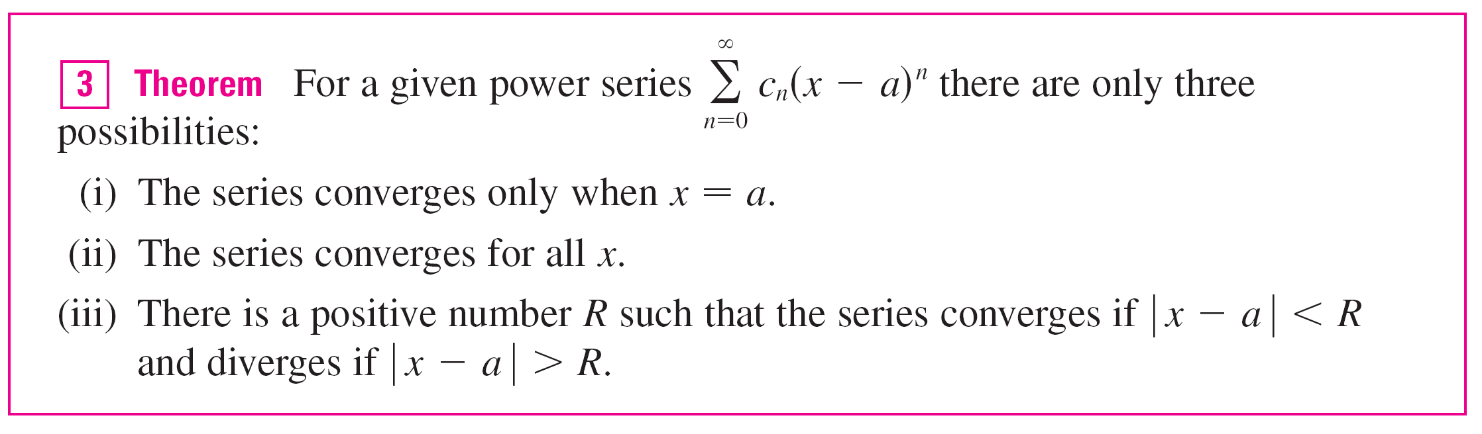

Power Series
The following theorem says that this is true in general.
The number R in case (iii) is called the radius of convergence of the power series. By convention, the radius of convergence is R = 0 in case (i) and R = in case (ii).

Slide 11
Power Series
The interval of convergence of a power series is the interval that consists of all values of x for which the series converges.
In case (i) the interval consists of just a single point a.
In case (ii) the interval is ( , ).
In case (iii) note that the inequality | x – a | < R can be rewritten as a – R < x < a + R.

Slide 12
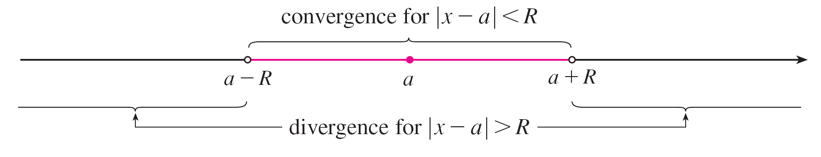
Power Series
When x is an endpoint of the interval, that is, x = a ±R, anything can happen—the series might converge at one or both endpoints or it might diverge at both endpoints.
Thus in case (iii) there are four possibilities for the interval of convergence:
(a – R, a + R) (a – R, a + R] [a – R, a + R) [a – R, a + R]
The situation is illustrated in Figure 3.
Figure 3

Slide 13
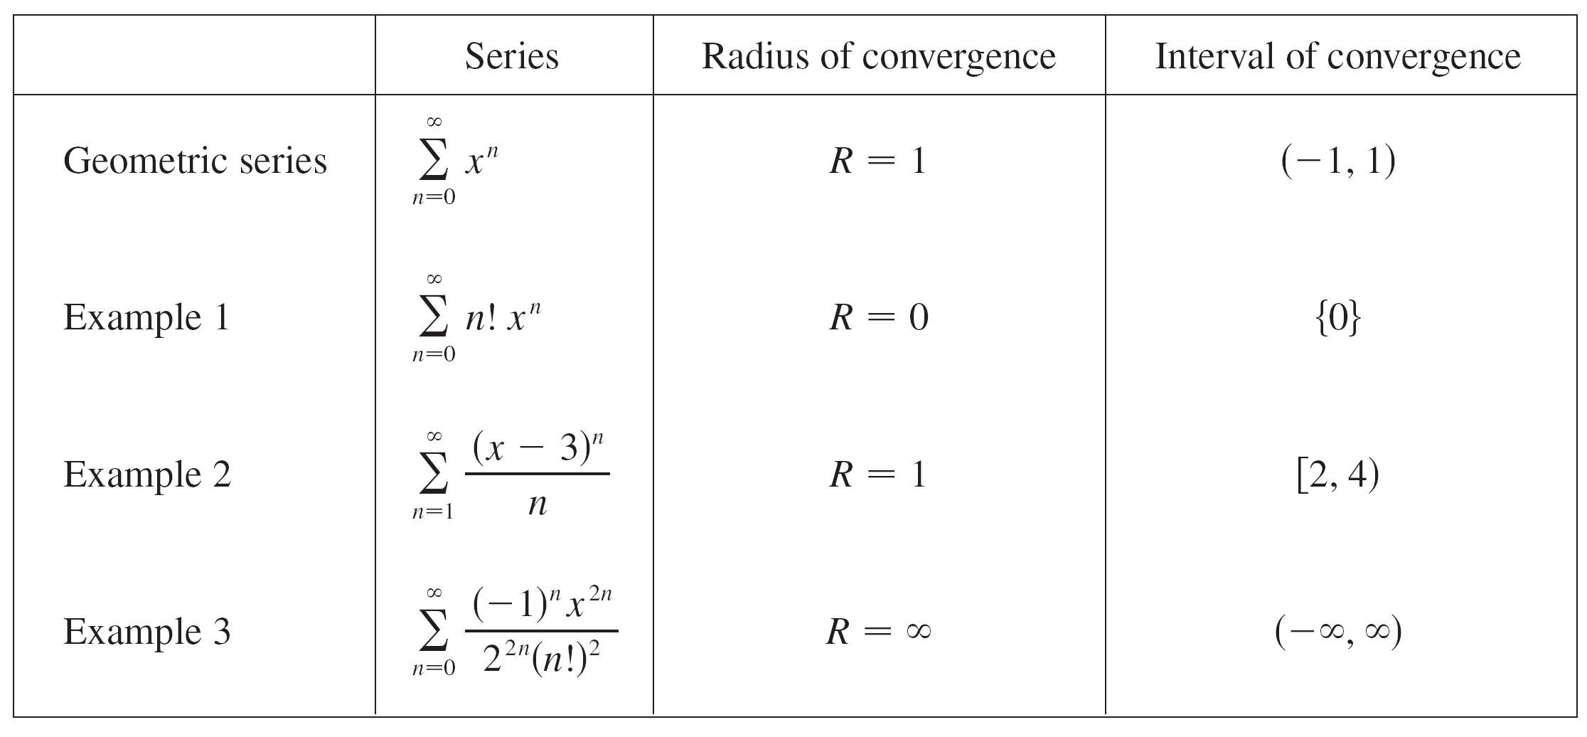
Power Series
We summarize here the radius and interval of convergence for each of the examples already considered in this section.

