Slide 1


Infinite Sequences
and Series
11
Copyright © Cengage Learning. All rights reserved.

Slide 2

11.9
Representations of Functions as Power Series
Copyright © Cengage Learning. All rights reserved.

Slide 3
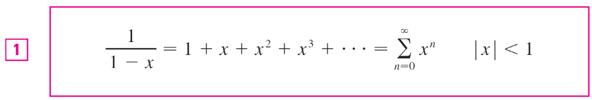
Representations of Functions as Power Series
We start with an equation that we have seen before:
We have obtained this equation by observing that the series is a geometric series with a = 1 and r = x.
But here our point of view is different. We now regard Equation 1 as expressing the function f (x) = 1/(1 – x) as a sum of a power series.

Slide 4
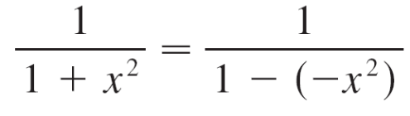
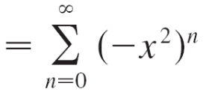
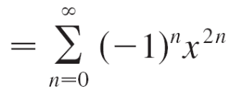

Example 1
Express 1/(1 + x²) as the sum of a power series and find the interval of convergence.
Solution:
Replacing x by –x² in Equation 1, we have
Because this is a geometric series, it converges when | –x² | < 1, that is, x² < 1, or | x | < 1.

Slide 5
Example 1 – Solution
cont’d
Therefore the interval of convergence is (–1, 1).
(Of course, we could have determined the radius of convergence by applying the Ratio Test, but that much work is unnecessary here.)

Slide 6
Differentiation and Integration of Power Series

Slide 7

Differentiation and Integration of Power Series
The sum of a power series is a function
whose domain is the interval of convergence of the series.
We would like to be able to differentiate and integrate such functions, and the following theorem says that we can do so by differentiating or integrating each individual term in the series, just as we would for a polynomial.
This is called term-by-term differentiation and integration.

Slide 8
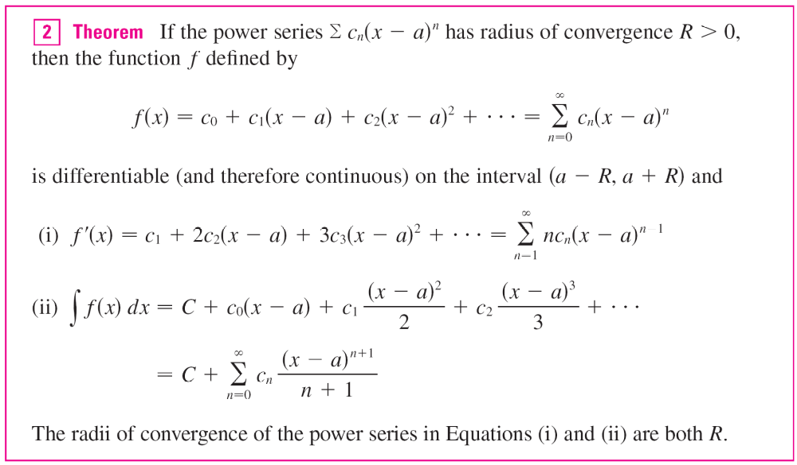
Differentiation and Integration of Power Series

Slide 9
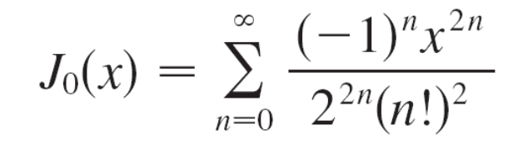
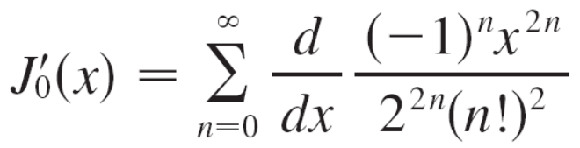
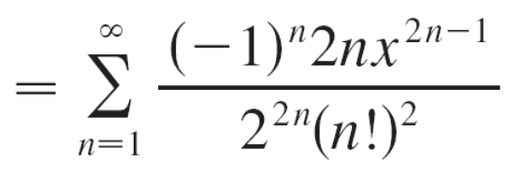
Example 4
We have seen the Bessel function
is defined for all x.
Thus, by Theorem 2, J₀ is differentiable for all x and its derivative is found by term-by-term differentiation as follows:

