Slide 1


Infinite Sequences
and Series
11
Copyright © Cengage Learning. All rights reserved.

Slide 2

Taylor and Maclaurin Series
11.10
Copyright © Cengage Learning. All rights reserved.

Slide 3

Taylor and Maclaurin Series
We start by supposing that f is any function that can be
represented by a power series
f (x) = c₀ + c₁(x – a) + c₂(x – a)² + c₃(x – a)³ + c₄(x – a)⁴ + . . . | x – a | < R
Let’s try to determine what the coefficients c_{n} must be in terms of f.
To begin, notice that if we put x = a in Equation 1, then all terms after the first one are 0 and we get
f (a) = c₀

Slide 4


Taylor and Maclaurin Series
We can differentiate the series in Equation 1 term by term:
f ′(x) = c₁ + 2c₂(x – a) + 3c₃(x – a)² + 4c₄(x – a)³ + . . . | x – a | < R
and substitution of x = a in Equation 2 gives
f ′(a) = c₁
Now we differentiate both sides of Equation 2 and obtain
f ″(x) = 2c₂ + 2  3c₃(x – a) + 3  4c₄(x – a)² + . . . | x – a | < R
Again we put x = a in Equation 3. The result is
f ″(a) = 2c₂

Slide 5

Taylor and Maclaurin Series
Let’s apply the procedure one more time. Differentiation of the series in Equation 3 gives
f '''(x) = 2  3c₃ + 2  3  4c₄(x – a) + 3  4  5c₅(x – a)² + . . . | x – a | < R
and substitution of x = a in Equation 4 gives
f '''(a) = 2  3c₃ = 3!c₃
By now you can see the pattern. If we continue to differentiate and substitute x = a, we obtain
f ^{(n)}(a) = 2  3  4  . . .  nc_{n} = n!c_{n}

Slide 6
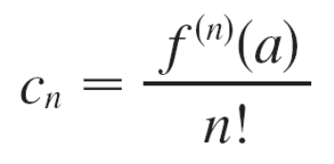
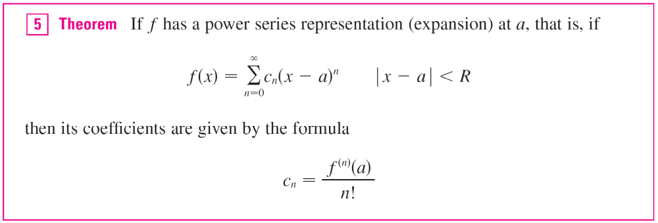
Taylor and Maclaurin Series
Solving this equation for the nth coefficient c_{n}, we get
This formula remains valid even for n = 0 if we adopt the conventions that 0! = 1 and f ⁽⁰⁾ = f. Thus we have proved
the following theorem.

Slide 7
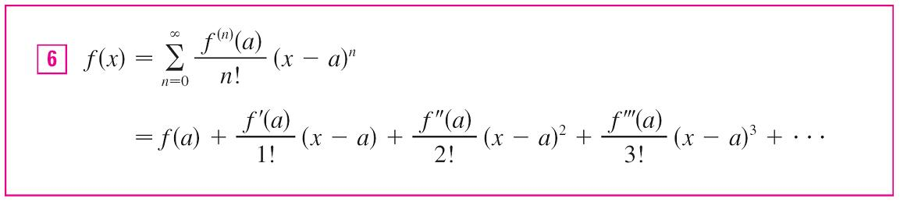
Taylor and Maclaurin Series
Substituting this formula for c_{n} back into the series, we see that if f has a power series expansion at a, then it must be of the following form.
The series in Equation 6 is called the Taylor series of the function f at a (or about a or centered at a).

Slide 8

Taylor and Maclaurin Series
For the special case a = 0 the Taylor series becomes
This case arises frequently enough that it is given the special name Maclaurin series.

Slide 9
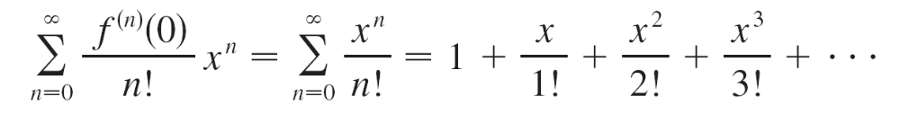
Example 1
Find the Maclaurin series of the function f (x) = e^{x} and its radius of convergence.
Solution:
If f (x) = e^{x}, then f ^{(n)}(x) = e^{x}, so f ^{(n)}(0) = e⁰ = 1 for all n. Therefore the Taylor series for f at 0 (that is, the Maclaurin series) is

Slide 10
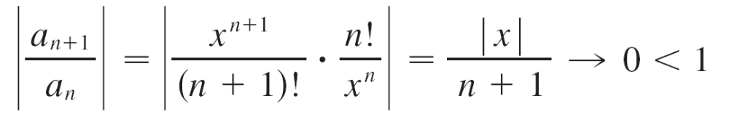

Example 1 – Solution
cont’d
To find the radius of convergence we let a_{n} = x^{n}/n!. Then
so, by the Ratio Test, the series converges for all x and the radius of convergence is R = .

Slide 11
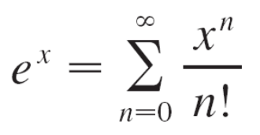
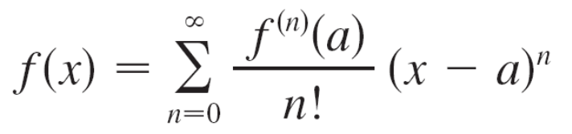
Taylor and Maclaurin Series
The conclusion we can draw from Theorem 5 and Example 1 is that if e^{x} has a power series expansion at 0, then
So how can we determine whether e^{x} does have a power series representation?
Let’s investigate the more general question: Under what circumstances is a function equal to the sum of its Taylor series? In other words, if f has derivatives of all orders, when is it true that

Slide 12
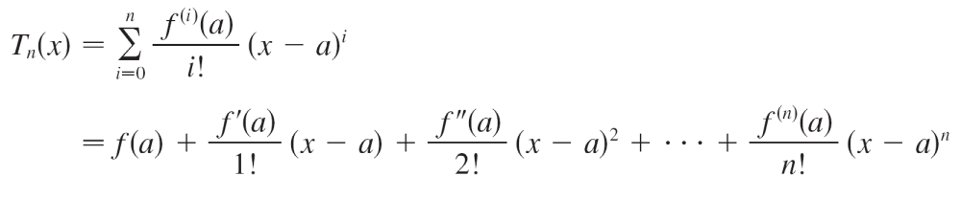
Taylor and Maclaurin Series
As with any convergent series, this means that f (x) is the limit of the sequence of partial sums. In the case of the Taylor series, the partial sums are
Notice that T_{n} is a polynomial of degree n called the
nth-degree Taylor polynomial of f at a.

Slide 13
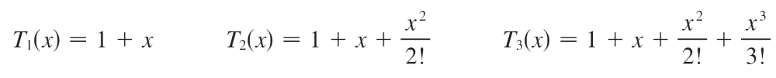
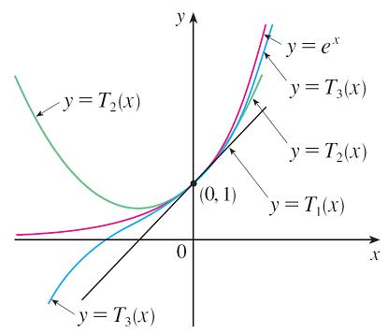
Taylor and Maclaurin Series
For instance, for the exponential function f (x) = e^{x}, the result of Example 1 shows that the Taylor polynomials at 0 (or Maclaurin polynomials) with n = 1, 2, and 3 are
The graphs of the exponential
function and these three
Taylor polynomials are drawn
in Figure 1.
Figure 1
As n increases, T_{n}(x) appears to approach e^{x} in Figure 1. This suggests that e^{x} is equal to the sum of its Taylor series.

Slide 14
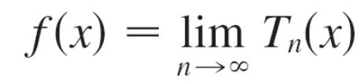
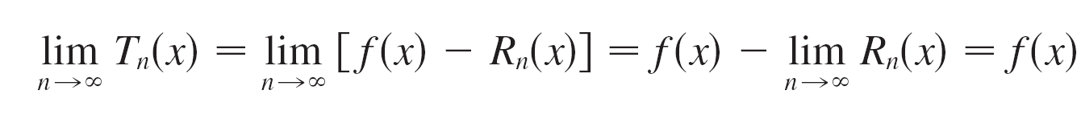
Taylor and Maclaurin Series
In general, f (x) is the sum of its Taylor series if
If we let
R_{n}(x) = f (x) – T_{n}(x) so that f (x) = T_{n}(x) + R_{n}(x)
then R_{n}(x) is called the remainder of the Taylor series. If we can somehow show that lim_{n →} R_{n}(x) = 0, then it follows that

Slide 15
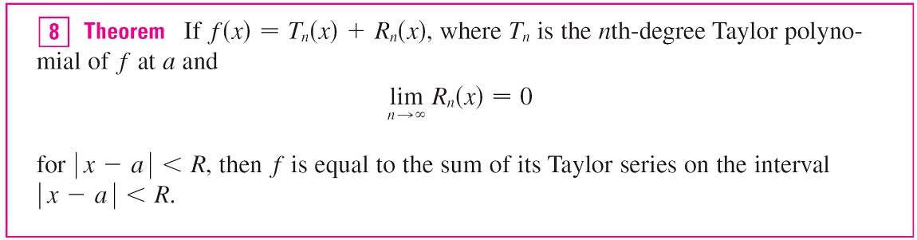
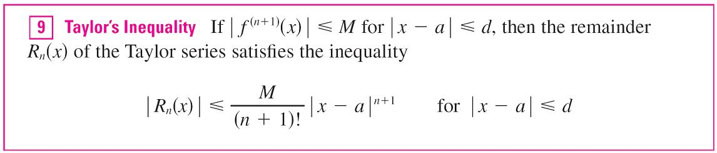
Taylor and Maclaurin Series
We have therefore proved the following.
In trying to show that lim_{n →} R_{n}(x) = 0 for a specific function f, we usually use the following Theorem.

Slide 16
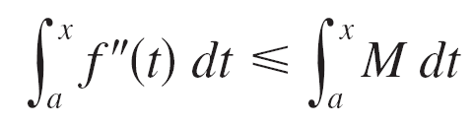
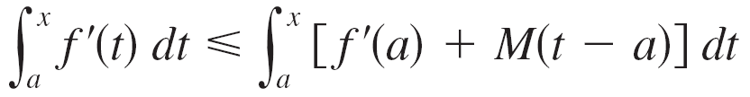
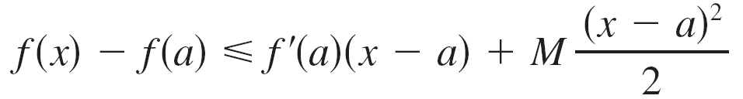
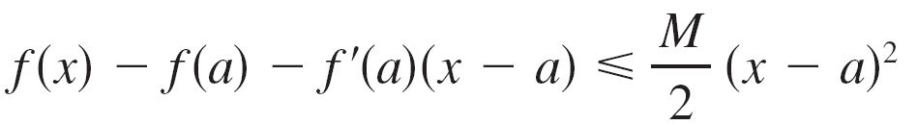
Taylor and Maclaurin Series
To see why this is true for n = 1, we assume that
| f ″(x) | ≤ M. In particular, we have f″(x) ≤ M, so for
a ≤ x ≤ a + d we have
An antiderivative of f ″ is f ′, so by Part 2 of the Fundamental Theorem of Calculus, we have
f ′(x) – f ′(a) ≤ M(x – a) or f′(x) ≤ f ′(a) + M(x – a)
Thus

Slide 17
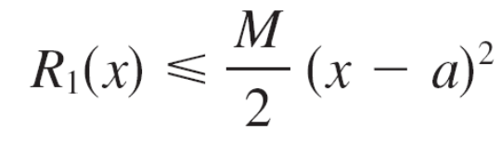
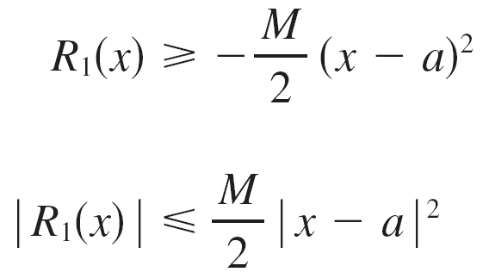
Taylor and Maclaurin Series
But R₁(x) = f (x) – T₁(x) = f (x) – f (a) – f ′(a)(x – a). So
A similar argument, using f ″(x) ≥ –M, shows that
So

Slide 18

Taylor and Maclaurin Series
Although we have assumed that x > a, similar calculations show that this inequality is also true for x < a.
This proves Taylor’s Inequality for the case where n = 1. The result for any n is proved in a similar way by integrating
n + 1 times.
In applying Theorems 8 and 9 it is often helpful to make use of the following fact.
This is true because we know from Example 1 that the series Σ x^{n}/n! converges for all x and so its nth term approaches 0.

Slide 19
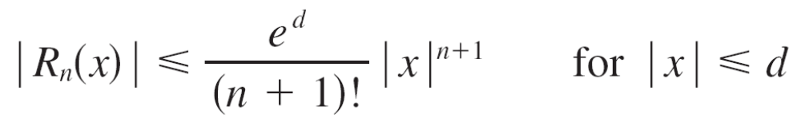
Example 2
Prove that e^{x} is equal to the sum of its Maclaurin series.
Solution:
If f (x) = e^{x}, then f ^{(n + 1)}(x) = e^{x} for all n. If d is any positive number and | x | ≤ d, then | f ^{(n + 1)}(x) | = e^{x} ≤ e^{d}.
So Taylor’s Inequality, with a = 0 and M = e^{d}, says that

Slide 20
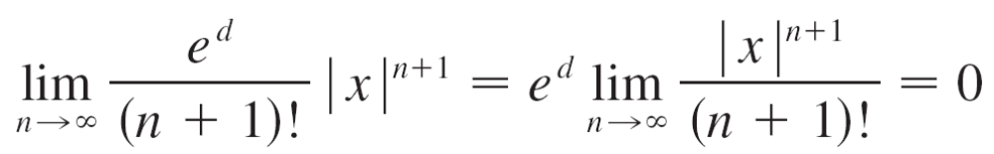

Example 2 – Solution
cont’d
Notice that the same constant M = e^{d} works for every value of n. But, from Equation 10, we have
It follows from the Squeeze Theorem that
lim _{n→} | R_{n}(x) | = 0 and therefore lim_{n→} R_{n}(x) = 0 for all values of x.
By Theorem 8, e^{x} is equal to the sum of its Maclaurin series, that is,

Slide 21

Taylor and Maclaurin Series
In particular, if we put x = 1 in Equation 11, we obtain the following expression for the number e as a sum of an infinite series:

Slide 22
Example 8
Find the Maclaurin series for f (x) = (1 + x)^{k}, where k is any real number.
Solution:
Arranging our work in columns, we have
f (x) = (1 + x)^{k} f (0) = 1
f ′(x) = k(1 + x)^{k – 1} f ′(0) = k
f″(x) = k(k – 1)(1 + x)^{k – 2} f ″(0) = k(k – 1)
f '''(x) = k(k – 1)(k – 2)(1 + x)^{k – 3} f '''(0) = k(k – 1)(k – 2)
. .
. .
. .
f ^{(n)}(x) = k(k – 1) . . . (k – n + 1)(1 + x)^{k – n} f^{(n)}(0) = k(k – 1) . . . (k – n + 1)

Slide 23
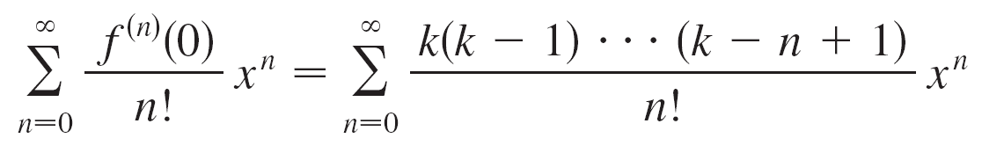
Example 8 – Solution
cont’d
Therefore the Maclaurin series of f (x) = (1 + x)^{k} is
This series is called the binomial series.

Slide 24
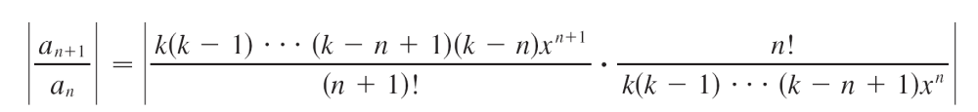
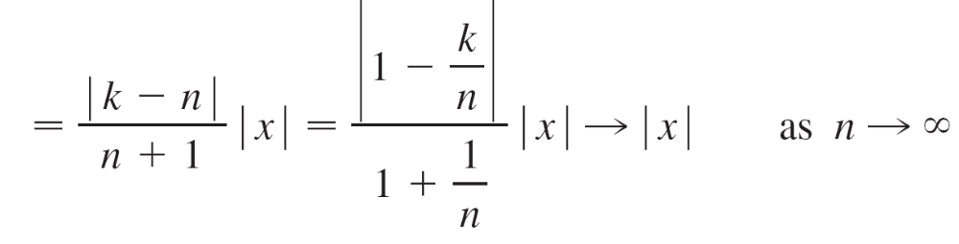
Example 8 – Solution
cont’d
If its nth term is a_{n}, then
Thus, by the Ratio Test, the binomial series converges if
| x | < 1 and diverges if | x | > 1.

Slide 25
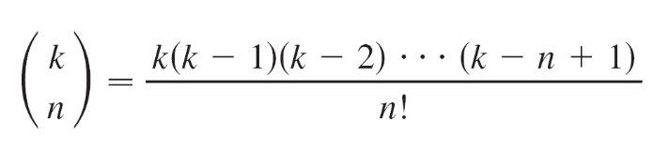
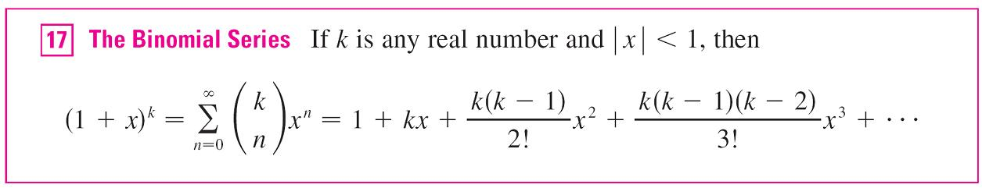
Taylor and Maclaurin Series
The traditional notation for the coefficients in the binomial series is
and these numbers are called the binomial coefficients. The following theorem states that (1 + x)^{k} is equal to the sum of its Maclaurin series.
It is possible to prove this by showing that the remainder term R_{n}(x) approaches 0, but that turns out to be quite difficult.

Slide 26


Taylor and Maclaurin Series
Although the binomial series always converges when
| x | < 1, the question of whether or not it converges at the endpoints, ±1, depends on the value of k.
It turns out that the series converges at 1 if –1 < k ≤ 0 and at both endpoints if k ≥ 0.
Notice that if k is a positive integer and n > k, then the expression for contains a factor (k – k), so for
n > k.
This means that the series terminates and reduces to the ordinary Binomial Theorem when k is a positive integer.

Slide 27
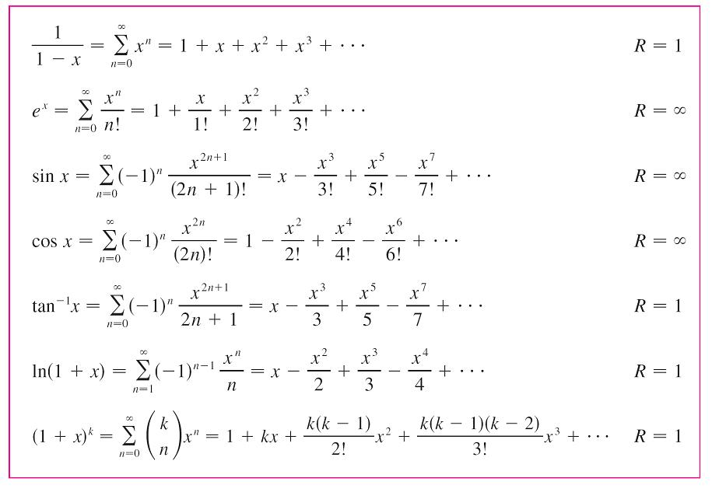
Taylor and Maclaurin Series
We collect in the following table, for future reference, some important Maclaurin series that we have derived in this section and the preceding one.
Important Maclaurin Series and
Their Radii of Convergence
Table 1

Slide 28
Multiplication and Division of Power Series

Slide 29
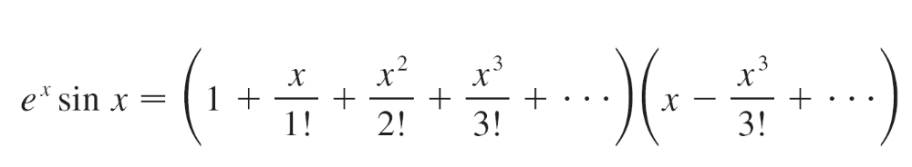
Example 13
Find the first three nonzero terms in the Maclaurin series for (a) e^{x} sin x and (b) tan x.
Solution:
(a) Using the Maclaurin series for e^{x} and sin x in Table 1,
we have

Slide 30
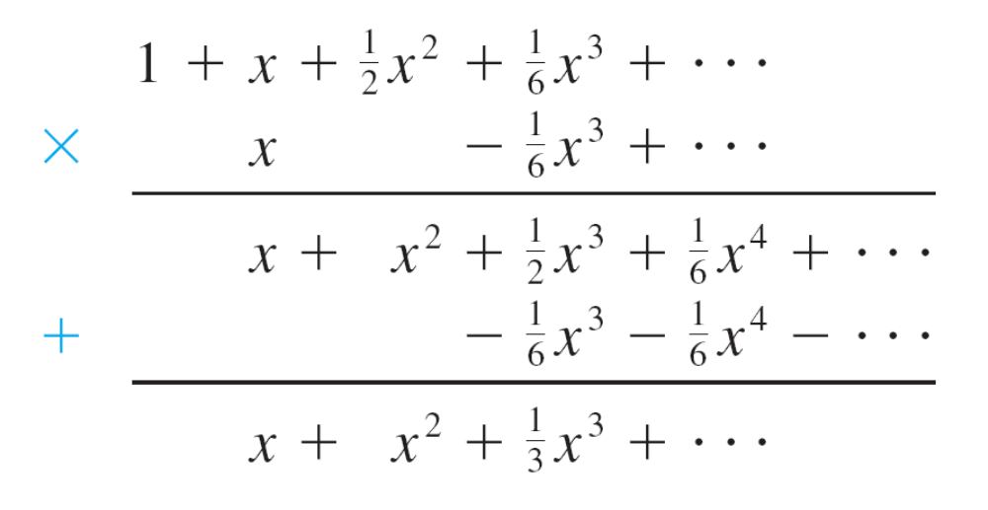
Example 13 – Solution
cont’d
We multiply these expressions, collecting like terms just as for polynomials:

Slide 31
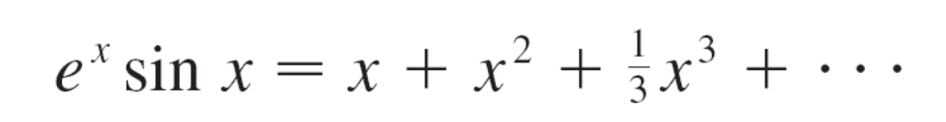
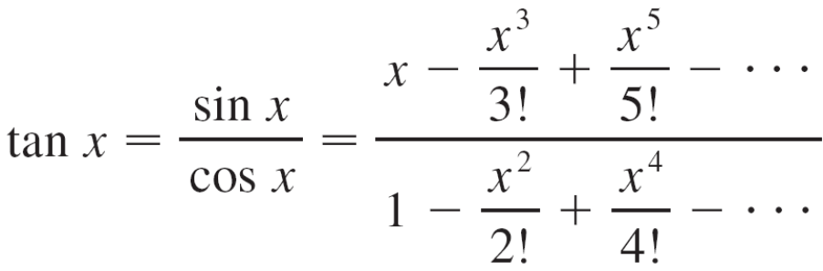
Example 13 – Solution
cont’d
Thus
(b) Using the Maclaurin series in Table 1, we have

Slide 32
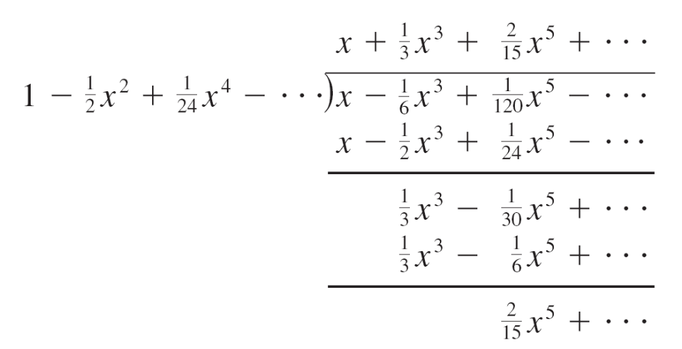

Example 13 – Solution
cont’d
We use a procedure like long division:
Thus

