Slide 1

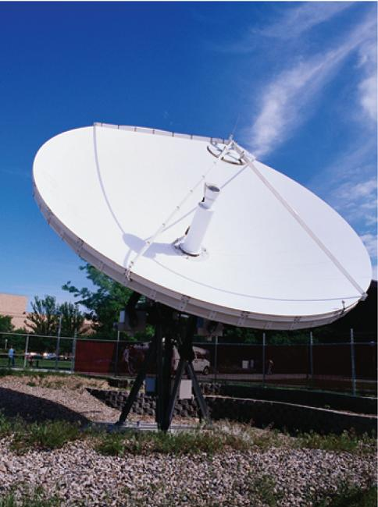
12
Vectors and the Geometry
of Space
Copyright © Cengage Learning. All rights reserved.

Slide 2

12.1
Three-Dimensional Coordinate Systems
Copyright © Cengage Learning. All rights reserved.

Slide 3
Three-Dimensional Coordinate Systems
To locate a point in a plane, two numbers are necessary.
We know that any point in the plane can be represented as an ordered pair (a, b) of real numbers, where a is the x-coordinate and b is the y-coordinate.
For this reason, a plane is called two-dimensional. To locate a point in space, three numbers are required.
We represent any point in space by an ordered triple
(a, b, c) of real numbers.

Slide 4
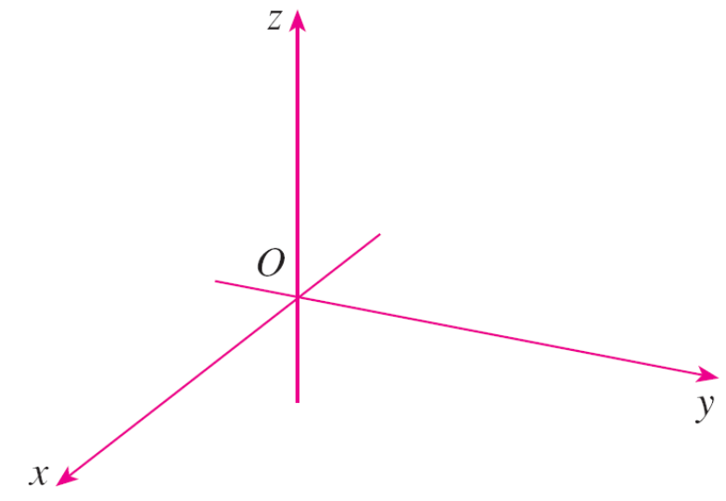
Three-Dimensional Coordinate Systems
In order to represent points in space, we first choose a fixed point O (the origin) and three directed lines through O that are perpendicular to each other, called the coordinate axes and labeled the x-axis, y-axis, and z-axis.
Usually we think of the
x- and y-axes as being
horizontal and the z-axis
as being vertical, and we
draw the orientation of
the axes as in Figure 1.
Coordinate axes
Figure 1

Slide 5
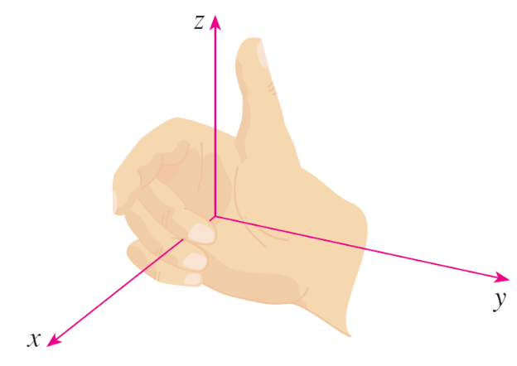
Three-Dimensional Coordinate Systems
The direction of the z-axis is determined by the right-hand rule as illustrated in Figure 2:
If you curl the fingers of your right hand around the z-axis in the direction of a 90° counterclockwise rotation from the positive x-axis to the positive y-axis, then your thumb points in the positive direction of the z-axis.
Right-hand rule
Figure 2

Slide 6
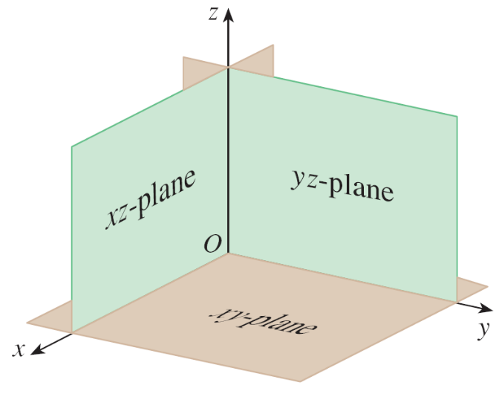

Three-Dimensional Coordinate Systems
The three coordinate axes determine the three coordinate planes illustrated in Figure 3(a).
The xy-plane is the plane that
contains the x- and y-axes;
the yz-plane contains the
y- and z-axes; the xz-plane
contains the x- and z-axes.
These three coordinate planes
divide space into eight parts,
called octants. The first octant,
in the foreground, is determined
by the positive axes.
Figure 3(a)

Slide 7
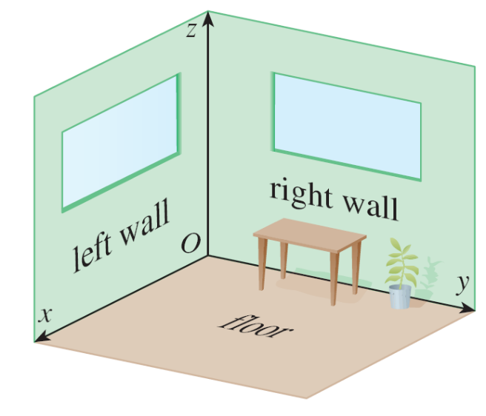
Three-Dimensional Coordinate Systems
Because many people have some difficulty visualizing diagrams of three-dimensional figures, you may find it helpful to do the following [see Figure 3(b)].
Look at any bottom corner of
a room and call the corner the
origin.
The wall on your left is in the
xz-plane, the wall on your right
is in the yz-plane, and the floor
is in the xy-plane.
Figure 3(b)

Slide 8
Three-Dimensional Coordinate Systems
The x-axis runs along the intersection of the floor and the left wall.
The y-axis runs along the intersection of the floor and the right wall.
The z-axis runs up from the floor toward the ceiling along the intersection of the two walls.
You are situated in the first octant, and you can now imagine seven other rooms situated in the other seven octants (three on the same floor and four on the floor below), all connected by the common corner point O.

Slide 9
Three-Dimensional Coordinate Systems
Now if P is any point in space, let a be the (directed) distance from the yz-plane to P, let b be the distance from the xz-plane to P, and let c be the distance from the
xy-plane to P.
We represent the point P by the ordered triple (a, b, c) of real numbers and we call a, b, and c the coordinates of P; a is the x-coordinate, b is the y-coordinate, and c is the
z-coordinate.

Slide 10
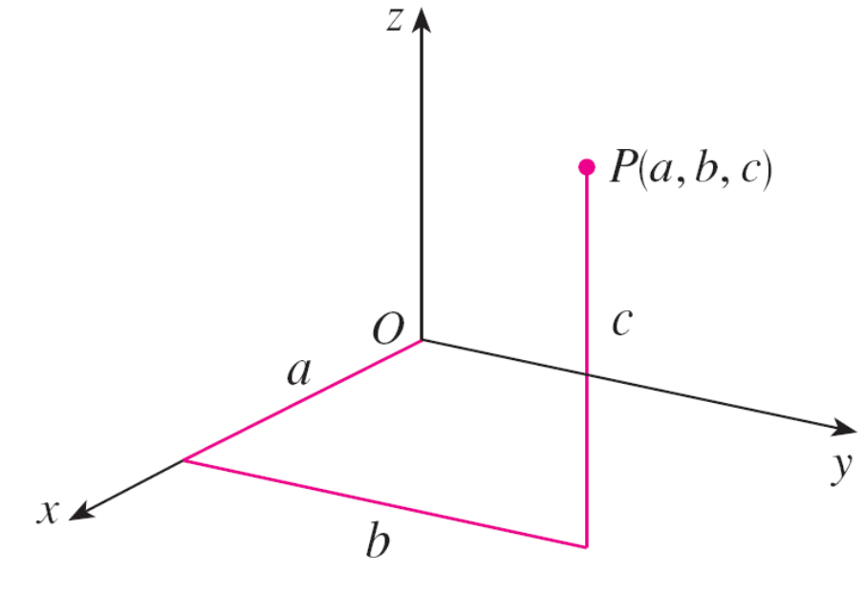
Three-Dimensional Coordinate Systems
Thus, to locate the point (a, b, c), we can start at the origin O and move a units along the x-axis, then b units parallel to the y-axis, and then c units parallel to the z-axis as in Figure 4.
Figure 4

Slide 11
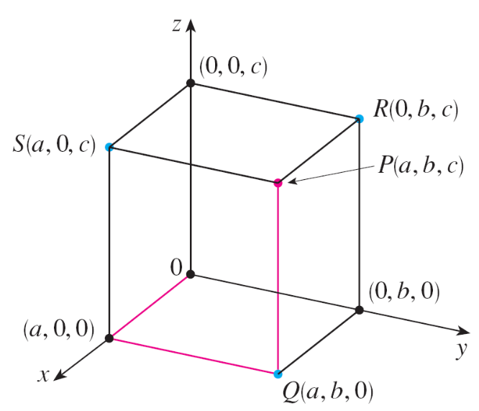
Three-Dimensional Coordinate Systems
The point P(a, b, c) determines a rectangular box as in Figure 5.
If we drop a perpendicular from P
to the xy-plane, we get a point Q
with coordinates (a, b, 0) called
the projection of P onto the
xy-plane.
Similarly, R(0, b, c) and S(a, 0, c)
are the projections of P onto the
yz-plane and xz-plane, respectively.
Figure 5

Slide 12
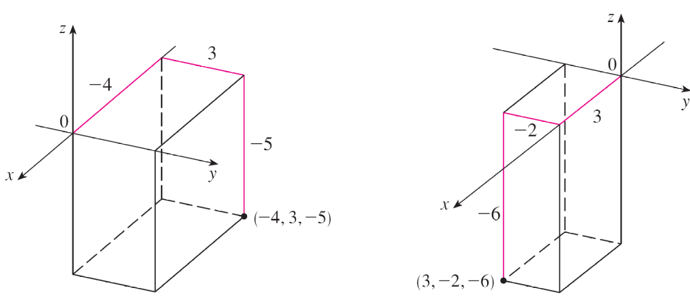
Three-Dimensional Coordinate Systems
As numerical illustrations, the points (–4, 3, –5) and (3, –2, –6) are plotted in Figure 6.
Figure 6

Slide 13


Three-Dimensional Coordinate Systems
The Cartesian product × × = {(x, y, z) | x, y, z ∈ } is
the set of all ordered triples of real numbers and is denoted
by .
We have given a one-to-one correspondence between points P in space and ordered triples (a, b, c) in . It is called a three-dimensional rectangular coordinate system.
Notice that, in terms of coordinates, the first octant can be described as the set of points whose coordinates are all positive.

Slide 14

Three-Dimensional Coordinate Systems
In two-dimensional analytic geometry, the graph of an equation involving x and y is a curve in .
In three-dimensional analytic geometry, an equation in x, y, and z represents a surface in .

Slide 15
Example 1
What surfaces in are represented by the following equations?
(a) z = 3
(b) y = 5

Slide 16
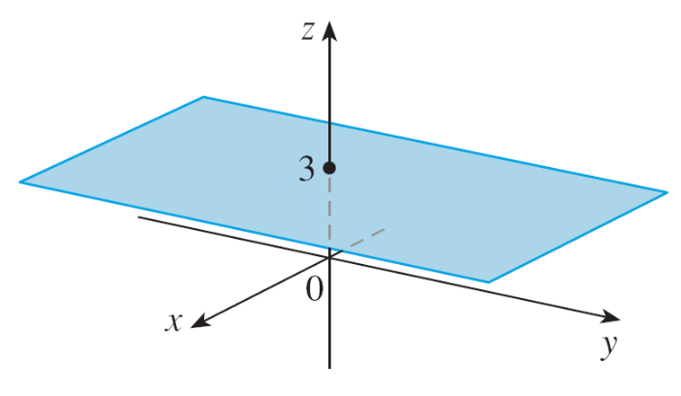

Example 1(a) – Solution
The equation z = 3 represents the set {(x, y, z) | z = 3},
which is the set of all points in whose z-coordinate is 3.
This is the horizontal plane that is parallel to the xy–plane and three units above it as in Figure 7(a).
Figure 7(a)

Slide 17
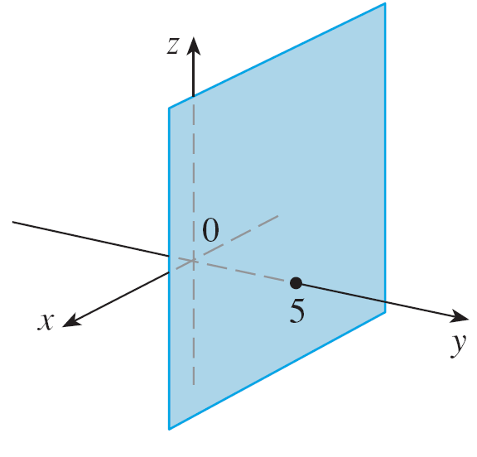

Example 1(b) – Solution
cont’d
The equation y = 5 represents the set of all points in
whose y-coordinate is 5. This is the vertical plane that is parallel to the xz-plane and five units to the right of it as in Figure 7(b).
Figure 7(b)

Slide 18
Three-Dimensional Coordinate Systems
In general, if k is a constant, then x = k represents a plane parallel to the yz-plane, y = k is a plane parallel to the xz-plane, and z = k is a plane parallel to the xy-plane.
In Figure 5, the faces of the
rectangular box are formed
by the three coordinate planes
x = 0 (the yz-plane),
y = 0 (the xz-plane), and
z = 0 (the xy-plane), and the
planes x = a, y = b, and z = c.
Figure 5

Slide 19
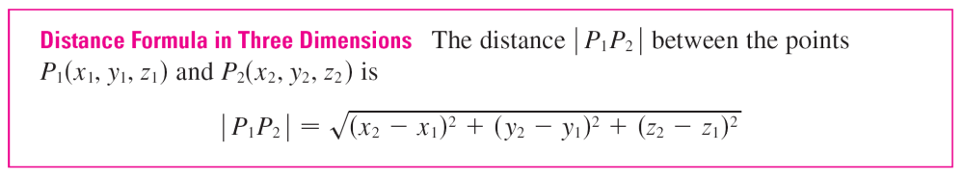
Three-Dimensional Coordinate Systems
The familiar formula for the distance between two points in
a plane is easily extended to the following
three-dimensional formula.

Slide 20
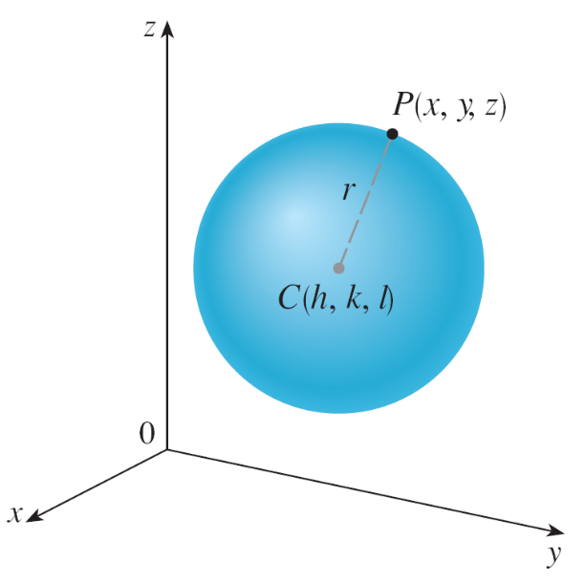
Example 5
Find an equation of a sphere with radius r and center C(h, k, l ).
Solution:
By definition, a sphere is the set of all points P(x, y, z)
whose distance from C is r. (See Figure 12.)
Figure 12

Slide 21
Example 5 – Solution
cont’d
Thus P is on the sphere if and only if | PC | = r.
Squaring both sides, we have
| PC |² = r²
or
(x – h)² + (y – k)² + (z – l )² = r²

Slide 22
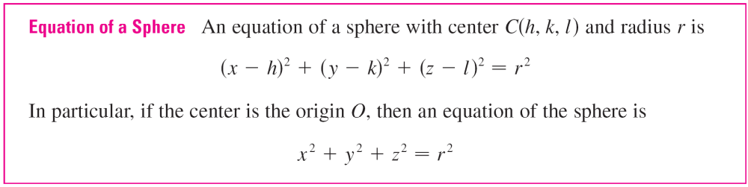
Three-Dimensional Coordinate Systems
The result of Example 5 is worth remembering.

