Slide 1

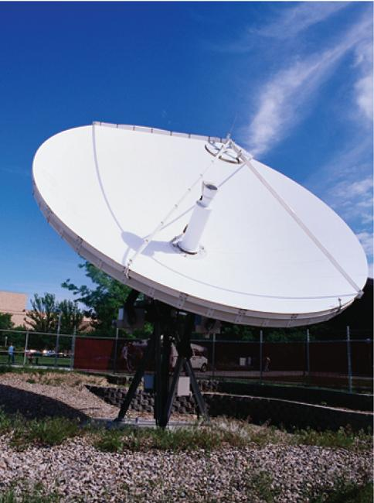
12
Vectors and the Geometry
of Space
Copyright © Cengage Learning. All rights reserved.

Slide 2

12.2
Vectors
Copyright © Cengage Learning. All rights reserved.

Slide 3

Vectors
The term vector is used by scientists to indicate a quantity (such as displacement or velocity or force) that has both magnitude and direction.
A vector is often represented by an arrow or a directed line segment. The length of the arrow represents the magnitude of the vector and the arrow points in the direction of the vector.
We denote a vector by printing a letter in boldface (v) or by putting an arrow above the letter .

Slide 4

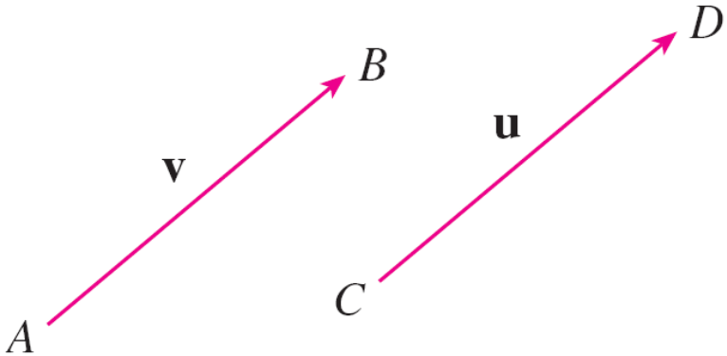
Vectors
For instance, suppose a particle moves along a line segment from point A to point B.
The corresponding displacement vector v, shown in
Figure 1, has initial point A (the tail) and terminal point B
(the tip) and we indicate this by writing
Figure 1
Equivalent vectors

Slide 5

Vectors
Notice that the vector has the same length and the same direction as v even though it is in a different position.
We say that u and v are equivalent (or equal) and we write u = v.
The zero vector, denoted by 0, has length 0. It is the only vector with no specific direction.

Slide 6
Combining Vectors

Slide 7


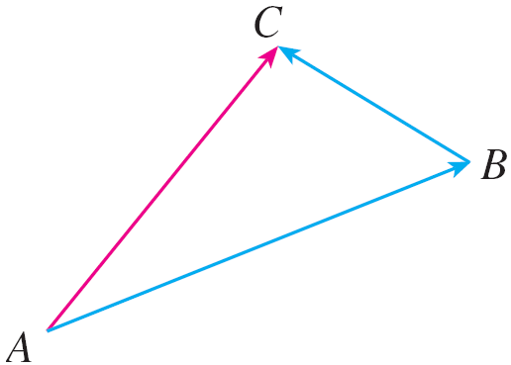


Combining Vectors
Suppose a particle moves from A to B, so its displacement
vector is . Then the particle changes direction and moves from B to C, with displacement vector as in Figure 2.
The combined effect of these
displacements is that the particle
has moved from A to C.
The resulting displacement
vector is called the sum of
and and we write
Figure 2

Slide 8
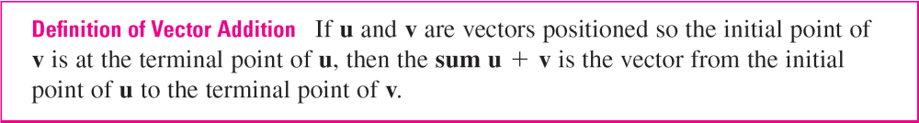
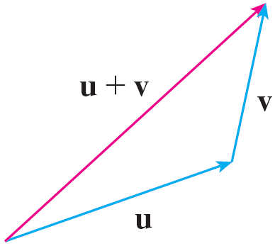
Combining Vectors
In general, if we start with vectors u and v, we first move v so that its tail coincides with the tip of u and define the sum of u and v as follows.
The definition of vector addition
is illustrated in Figure 3. You can
see why this definition is
sometimes called the Triangle Law.
Figure 3
The Triangle Law

Slide 9
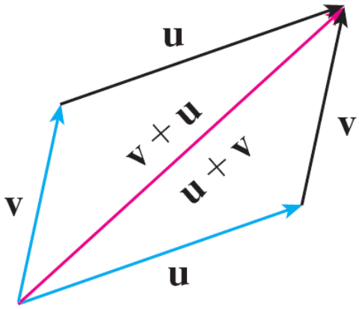
Combining Vectors
In Figure 4 we start with the same
vectors u and v as in Figure 3
and draw another copy of v with
the same initial point as u.
Completing the parallelogram,
we see that u + v = v + u.
This also gives another way to construct the sum: If we place u and v so they start at the same point, then u + v lies along the diagonal of the parallelogram with u and v as sides. (This is called the Parallelogram Law.)
Figure 4
The Parallelogram Law

Slide 10
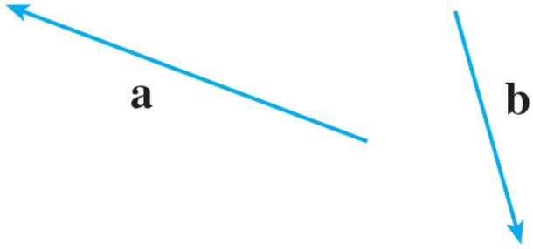
Example 1
Draw the sum of the vectors a and b shown in Figure 5.
Solution:
First we translate b and place its tail at the tip of a, being careful to draw a copy of b that has the same length and direction.
Figure 5

Slide 11
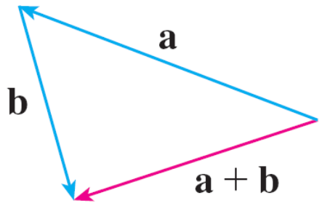
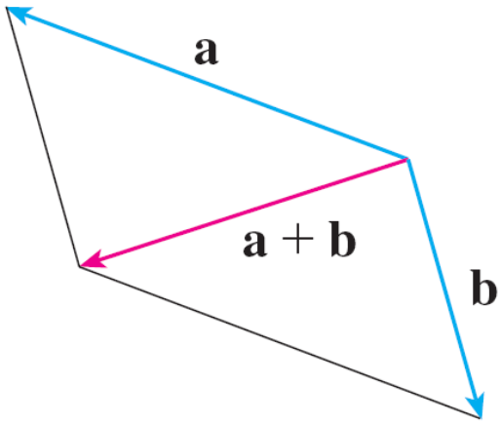
Example 1 – Solution
cont’d
Then we draw the vector a + b
[see Figure 6(a)] starting at the
initial point of a and ending at the
terminal point of the copy of b.
Alternatively, we could place b so it
starts where a starts and construct
a + b by the Parallelogram Law as in
Figure 6(b).
Figure 6(a)
Figure 6(b)

Slide 12
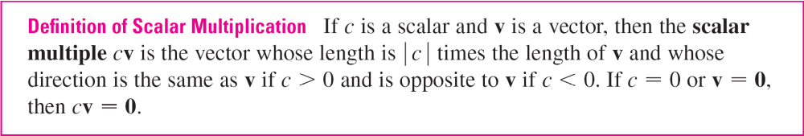
Combining Vectors
It is possible to multiply a vector by a real number c. (In this context we call the real number c a scalar to distinguish it from a vector.)
For instance, we want 2v to be the same vector as v + v, which has the same direction as v but is twice as long. In general, we multiply a vector by a scalar as follows.

Slide 13
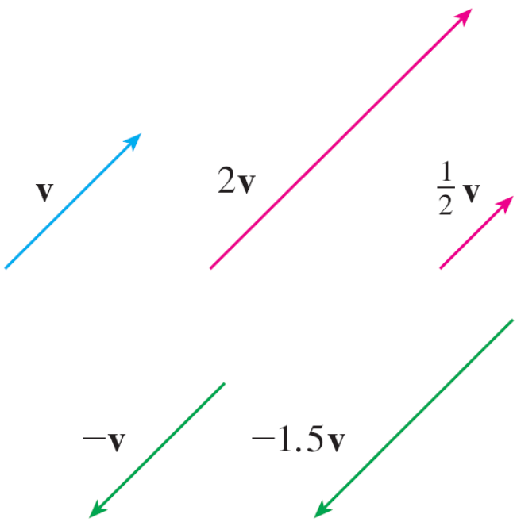
Combining Vectors
This definition is illustrated in Figure 7.
We see that real numbers work like scaling factors here; that’s why we call them scalars.
Figure 7
Scalar multiples of v

Slide 14
Combining Vectors
Notice that two nonzero vectors are parallel if they are scalar multiples of one another.
In particular, the vector –v = (–1)v has the same length as v but points in the opposite direction. We call it the negative of v.
By the difference u – v of two vectors we mean
u – v = u + (–v)

Slide 15
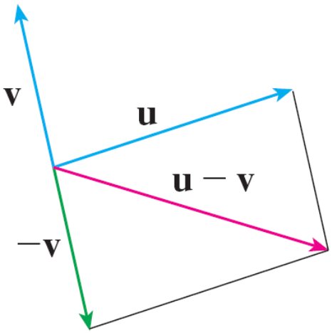
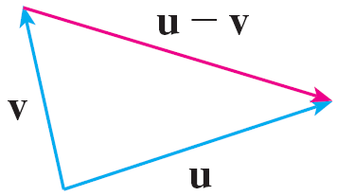
Combining Vectors
So we can construct u – v by first drawing the negative of
v, –v, and then adding it to u by the Parallelogram Law as in Figure 8(a).
Alternatively, since v + (u – v) = u, the vector u – v, when added to v, gives u. So we could construct u – v as in Figure 8(b) by means of the Triangle Law.
Figure 8(a)
Figure 8(b)
Drawing u – v

Slide 16
Components

Slide 17
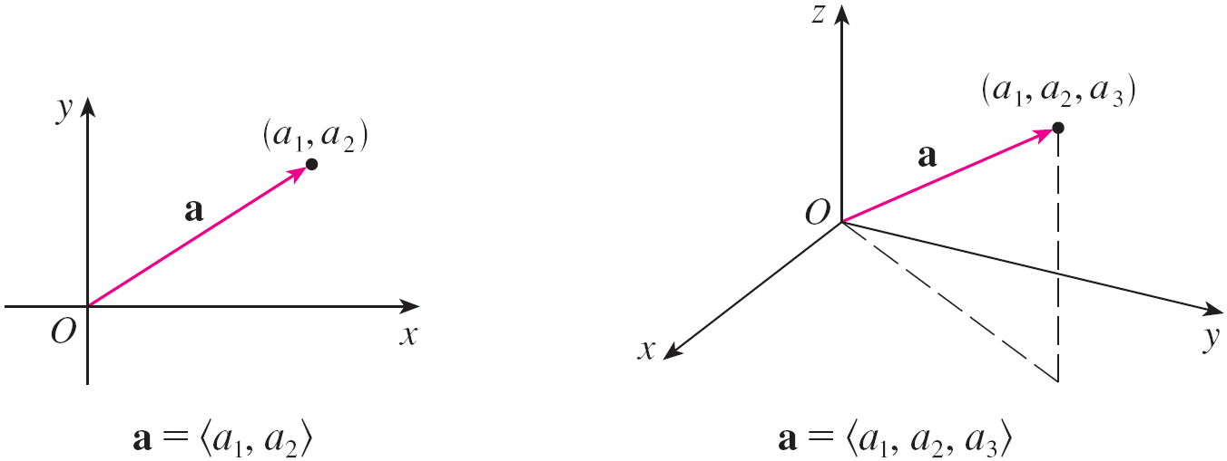
Components
For some purposes it’s best to introduce a coordinate system and treat vectors algebraically.
If we place the initial point of a vector a at the origin of a rectangular coordinate system, then the terminal point of a has coordinates of the form (a₁, a₂) or (a₁, a₂, a₃),
depending on whether our coordinate system is
two- or three-dimensional (see Figure 11).
Figure 11

Slide 18
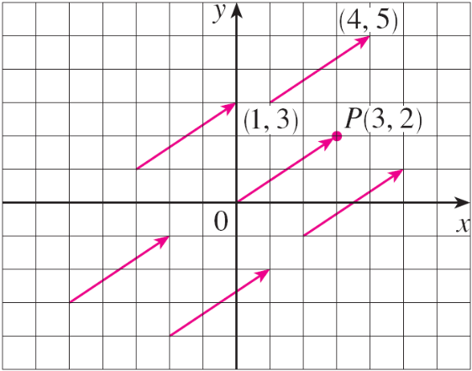

Components
These coordinates are called the components of a and we write
a = ⟨a₁, a₂⟩ or a = ⟨a₁, a₂, a₃⟩
We use the notation ⟨a₁, a₂⟩ for the ordered pair that refers to a vector so as not to confuse it with the ordered pair
(a₁, a₂) that refers to a point in the plane.
For instance, the vectors shown
in Figure 12 are all equivalent to
the vector = ⟨3, 2⟩ whose
terminal point is P(3, 2).
Figure 12
Representations of the vector a = ⟨3, 2⟩

Slide 19
Components
What they have in common is that the terminal point is reached from the initial point by a displacement of three units to the right and two upward.
We can think of all these geometric vectors as representations of the algebraic vector a = ⟨3, 2⟩ .
The particular representation from the origin to the
point P(3, 2) is called the position vector of the point P.

Slide 20

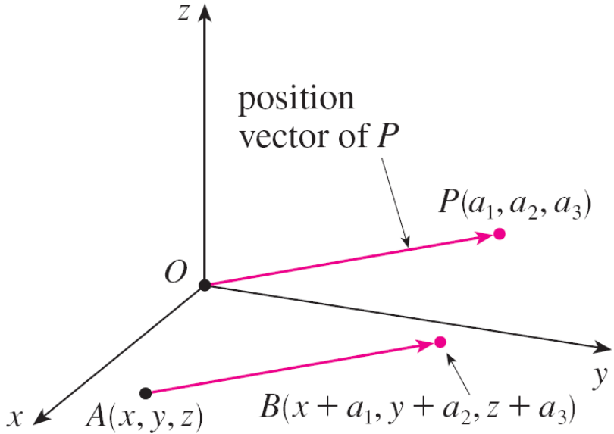
Components
In three dimensions, the vector a = = ⟨a₁, a₂, a₃⟩ is the position vector of the point P(a₁, a₂, a₃). (See Figure 13.)
Figure 13
Representations of a = ⟨a₁, a₂, a₃⟩

Slide 21

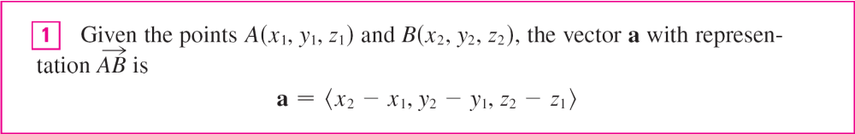
Components
Let’s consider any other representation of a, where the initial point is A(x₁, y₁, z₁) and the terminal point is
B(x₂, y₂, z₂).
Then we must have x₁ + a₁ = x₂, y₁ + a₂ = y₂, and z₁ + a₃ = z₂ and so a₁ = x₂ – x₁, a₂ = y₂ – y₁, and a₃ = z₂ – z₁.
Thus we have the following result.

Slide 22


Example 3
Find the vector represented by the directed line segment with initial point A(2, –3, 4) and terminal point B(–2, 1, 1).
Solution:
By , the vector corresponding to is
a = ⟨–2 – 2, 1 – (–3), 1 – 4⟩
= ⟨–4, 4, –3⟩

Slide 23
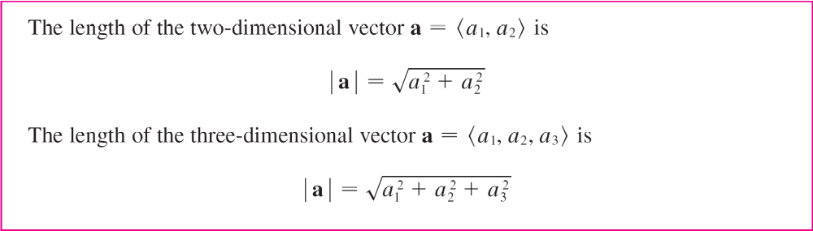
Components
The magnitude or length of the vector v is the length of any of its representations and is denoted by the symbol | v | or || v ||. By using the distance formula to compute the length of a segment OP, we obtain the following formulas.

Slide 24
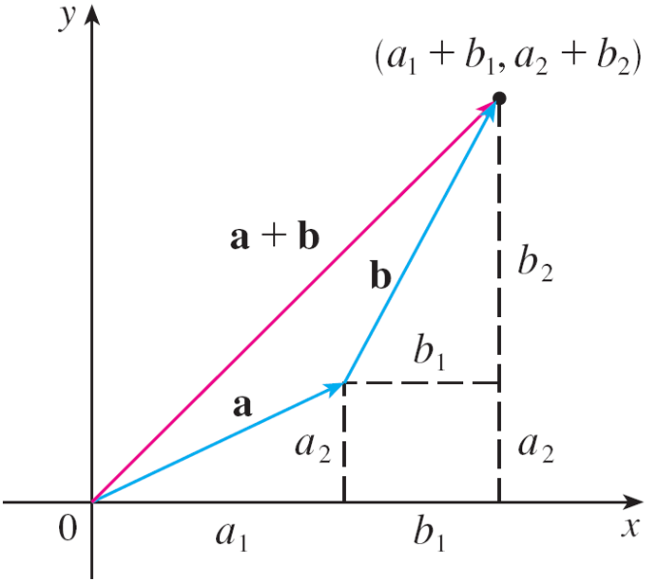
Components
How do we add vectors algebraically? Figure 14 shows that if a = ⟨a₁, a₂⟩ and b = ⟨b₁, b₂⟩, then the sum is
a + b = ⟨a₁ + b₁, a₂ + b₂⟩, at least for the case where the components are positive.
In other words, to add algebraic
vectors we add their components.
Similarly, to subtract vectors we
subtract components.
Figure 14

Slide 25
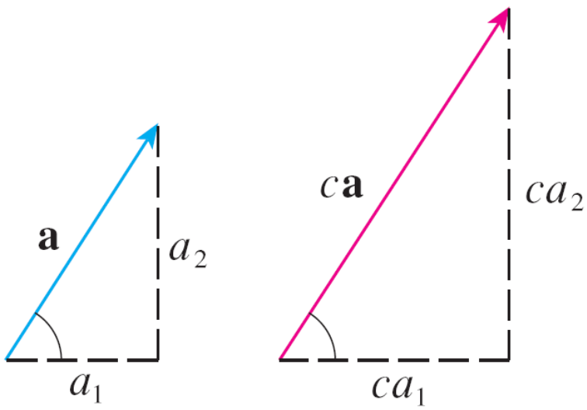
Components
From the similar triangles in Figure 15 we see that the components of ca are ca₁ and ca₂.
So to multiply a vector by a scalar we multiply each component by that scalar.
Figure 15

Slide 26
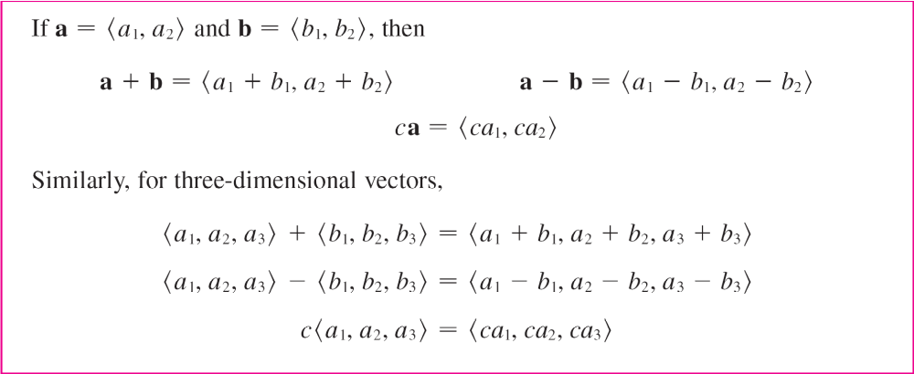
Components

Slide 27
Components
We denote by V₂ the set of all two-dimensional vectors and by V₃ the set of all three-dimensional vectors.
More generally, we will consider the set V_{n} of all
n-dimensional vectors.
An n-dimensional vector is an ordered n-tuple:
a = ⟨a₁, a₂, . . . , a_{n}⟩
where a₁, a₂, . . . , a_{n} are real numbers that are called the components of a.

Slide 28
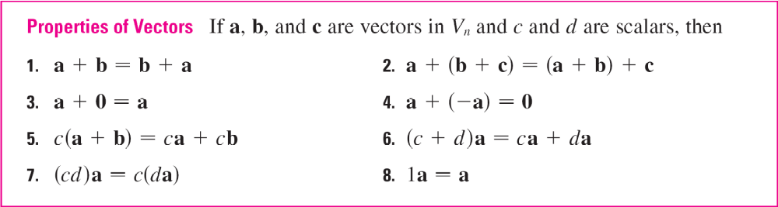
Components
Addition and scalar multiplication are defined in terms of components just as for the cases n = 2 and n = 3.

Slide 29
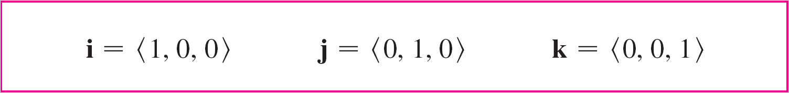
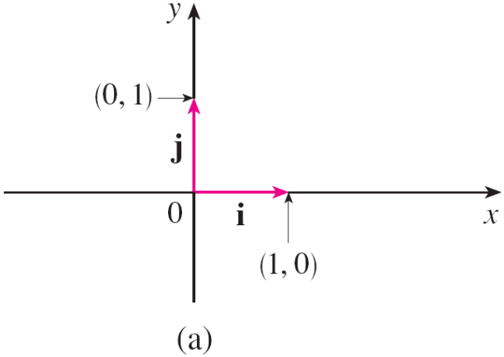
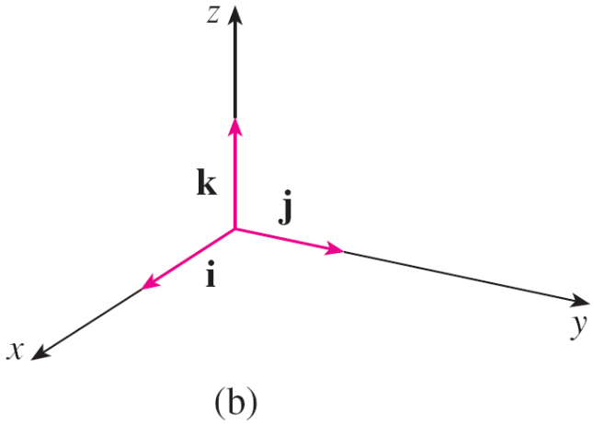
Components
Three vectors in V₃ play a special role. Let
Then i, j, and k are vectors that have length 1 and point in the directions of the positive x-, y-, and z-axes. Similarly, in two dimensions we define i = ⟨1, 0⟩ and j = ⟨0, 1⟩. (See Figure 17.)
Figure 17
Standard basis vectors in V₂ and V₃

Slide 30


Components
If a = ⟨a₁, a₂, a₃⟩, then we can write
a = ⟨a₁, a₂, a₃⟩ = ⟨a₁, 0, 0⟩ + ⟨0, a₂, 0⟩ + ⟨0, 0, a₃⟩
= a₁⟨1, 0, 0⟩ + a₂⟨0, 1, 0⟩ + a₃⟨0, 0, 1⟩
a = a₁i + a₂ j + a₃k
Thus any vector in V₃ can be expressed in terms of the standard basis vectors i, j, and k. For instance,
⟨1, –2, 6⟩ = i – 2j + 6k
Similarly, in two dimensions, we can write
a = ⟨a₁, a₂⟩ = a₁i + a₂ j

Slide 31
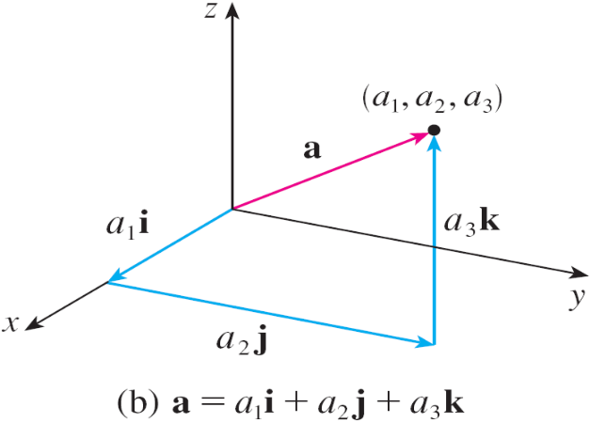
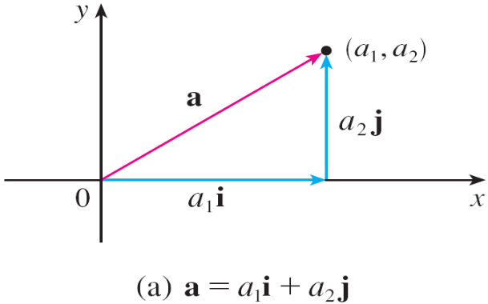
Components
See Figure 18 for the geometric interpretation of Equations 3 and 2 and compare with Figure 17.
Figure 17
Standard basis vectors in V₂ and V₃
Figure 18

Slide 32

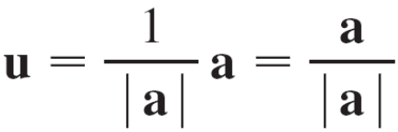
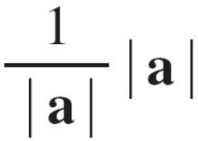
Components
A unit vector is a vector whose length is 1. For instance,
i, j, and k are all unit vectors. In general, if a ≠ 0, then the
unit vector that has the same direction as a is
In order to verify this, we let c = 1/| a |. Then u = ca and c is a positive scalar, so u has the same direction as a. Also
| u | = | ca | = | c | | a | = = 1

Slide 33
Applications

Slide 34
Applications
Vectors are useful in many aspects of physics and engineering. Here we look at forces.
A force is represented by a vector because it has both a magnitude (measured in pounds or newtons) and a direction.
If several forces are acting on an object, the resultant force experienced by the object is the vector sum of these forces.

Slide 35
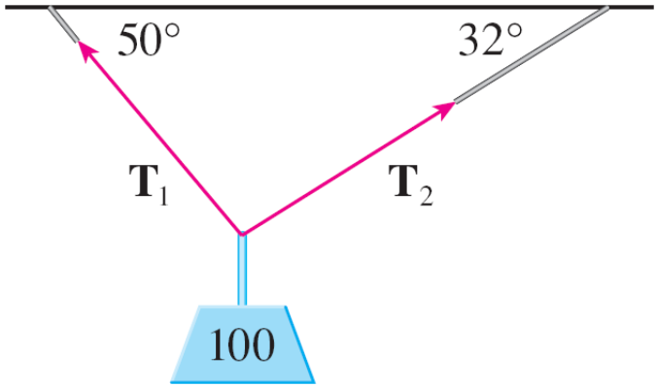
Example 7
A 100-lb weight hangs from two wires as shown in
Figure 19. Find the tensions (forces) T₁ and T₂ in both wires and the magnitudes of the tensions.
Figure 19

Slide 36
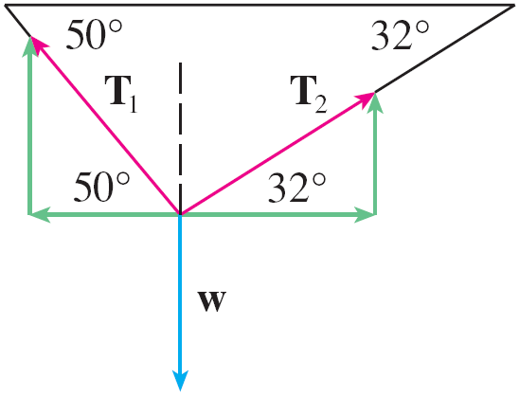


Example 7 – Solution
We first express T₁ and T₂ in terms of their horizontal and vertical components. From Figure 20 we see that
T₁ = –| T₁ | cos 50° i + | T₁ | sin 50° j
T₂ = | T₂ | cos 32° i + | T₂ | sin 32° j
The resultant T₁ + T₂ of the tensions counterbalances the weight w and so we must have
T₁ + T₂ = –w = 100 j
Figure 20

Slide 37
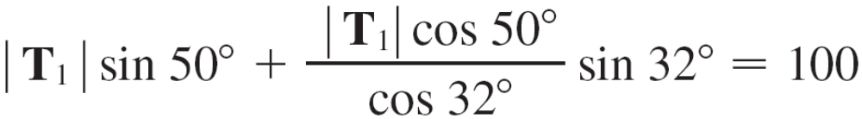
Example 7 – Solution
cont’d
Thus
(–| T₁ | cos 50° + | T₂ | cos 32°) i + (| T₁ | sin 50° + | T₂ | sin 32°) j = 100 j
Equating components, we get
–| T₁ | cos 50° + | T₂ | cos 32° = 0
| T₁ | sin 50° + | T₂ | sin 32° = 100
Solving the first of these equations for | T₂ | and substituting into the second, we get

Slide 38
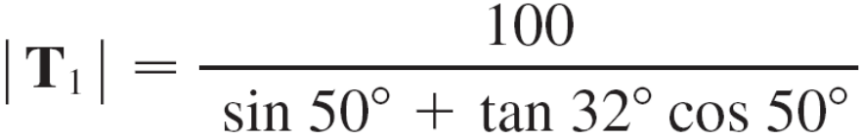

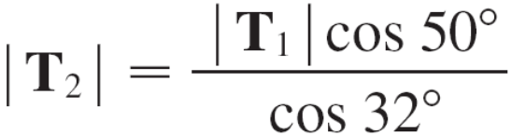



Example 7 – Solution
cont’d
So the magnitudes of the tensions are
and
Substituting these values in and we obtain the tension vectors
T₁ ≈ –55.05i + 65.60j T₂ ≈ 55.05i + 34.40j

