Slide 1

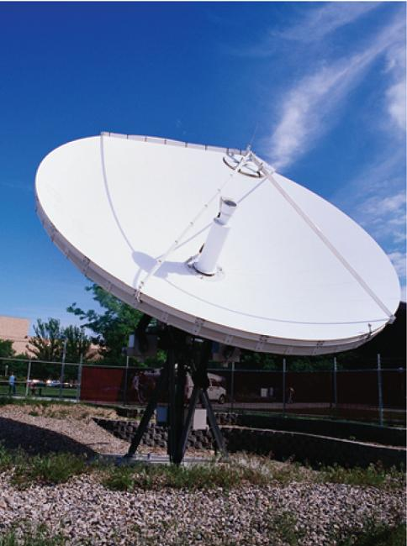
12
Vectors and the Geometry
of Space
Copyright © Cengage Learning. All rights reserved.

Slide 2

12.3
The Dot Product
Copyright © Cengage Learning. All rights reserved.

Slide 3
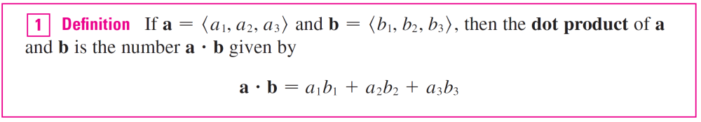
The Dot Product
So far we have added two vectors and multiplied a vector by a scalar. The question arises: Is it possible to multiply two vectors so that their product is a useful quantity? One such product is the dot product, whose definition follows.
Thus, to find the dot product of a and b, we multiply corresponding components and add.

Slide 4
The Dot Product
The result is not a vector. It is a real number, that is, a scalar. For this reason, the dot product is sometimes called the scalar product (or inner product).
Although Definition 1 is given for three-dimensional vectors, the dot product of two-dimensional vectors is defined in a similar fashion:
⟨a₁, a₂⟩  ⟨b₁, b₂⟩ = a₁b₁ + a₂b₂

Slide 5

Example 1
⟨2, 4⟩  ⟨3, –1⟩ = 2(3) + 4(–1)
= 2
⟨–1, 7, 4⟩  ⟨6, 2, ⟩ = (–1)(6) + 7(2) + 4( )
= 6
(i + 2j – 3k)  (2j – k) = 1(0) + 2(2) + (–3)(–1)
= 7

Slide 6
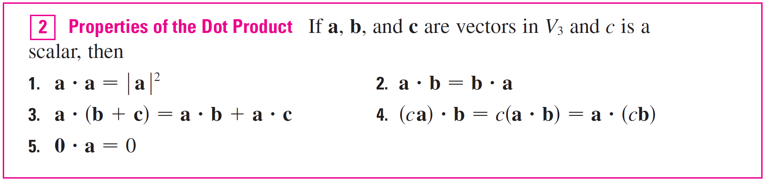
The Dot Product
The dot product obeys many of the laws that hold for ordinary products of real numbers. These are stated in the following theorem.

Slide 7
The Dot Product
These properties are easily proved using Definition 1.
For instance, here are the proofs of Properties 1 and 3:
3. a  (b + c) = ⟨a₁, a₂, a₃⟩  ⟨b₁ + c₁, b₂ + c₂, b₃ + c₃⟩
= a₁(b₁ + c₁) + a₂(b₂ + c₂) + a₃(b₃ + c₃)
= a₁b₁ + a₁c₁ + a₂b₂ + a₂c₂ + a₃b₃ + a₃c₃
= (a₁b₁ + a₂b₂ + a₃b₃) + (a₁c₁ + a₂c₂ + a₃c₃)
= a  b + a  c

Slide 8
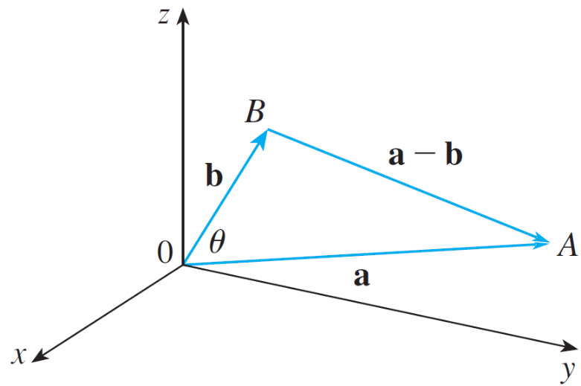
The Dot Product
The dot product a  b can be given a geometric interpretation in terms of the angle θ between a and b, which is defined to be the angle between the representations of a and b that start at the origin, where
0 ≤ θ ≤ π.
In other words, θ is the angle
between the line segments
OA and OB in Figure 1. Note
that if a and b are parallel
vectors, then θ = 0 or θ = π.
Figure 1

Slide 9
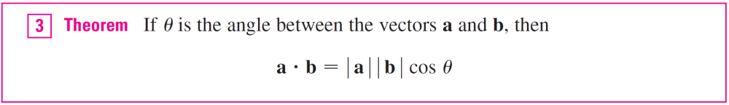
The Dot Product
The formula in the following theorem is used by physicists as the definition of the dot product.

Slide 10

Example 2
If the vectors a and b have lengths 4 and 6, and the angle between them is π /3, find a  b.
Solution:
Using Theorem 3, we have
a  b = |a| |b| cos(π /3)
= 4  6 
= 12

Slide 11
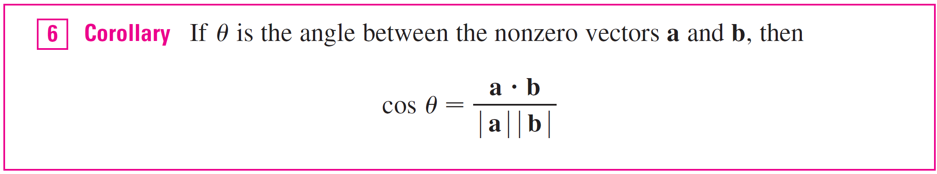
The Dot Product
The formula in Theorem 3 also enables us to find the angle between two vectors.

Slide 12
Example 3
Find the angle between the vectors a = ⟨2, 2, –1⟩ and
b = ⟨5, –3, 2⟩.
Solution:
Since
and since
a  b = 2(5) + 2(–3) + (–1)(2)
= 2

Slide 13
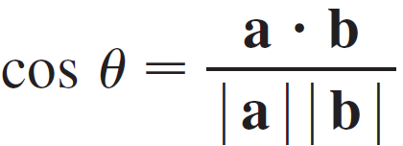
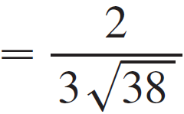
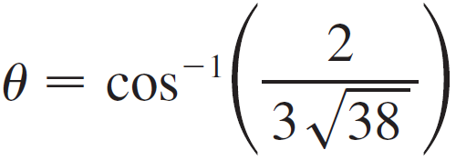

Example 3 – Solution
cont’d
We have, from Corollary 6,
So the angle between a and b is

Slide 14
The Dot Product
Two nonzero vectors a and b are called perpendicular or orthogonal if the angle between them is θ = π /2. Then Theorem 3 gives
a  b = | a | | b | cos(π /2) = 0
and conversely if a  b = 0, then cos θ = 0, so θ = π /2.
The zero vector 0 is considered to be perpendicular to all vectors.

Slide 15
The Dot Product
Therefore we have the following method for determining whether two vectors are orthogonal.

Slide 16

Example 4
Show that 2i + 2j – k is perpendicular to 5i – 4j + 2k.
Solution:
Since
(2i + 2j – k)  (5i – 4j + 2k) = 2(5) + 2(–4) + (–1)(2) = 0
these vectors are perpendicular by

Slide 17
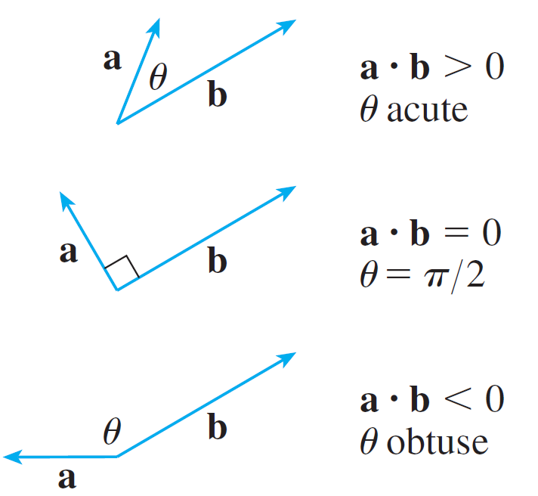
The Dot Product
Because cos θ > 0 if 0 ≤ θ < π /2 and cos θ < 0 if π /2 < θ ≤ π, we see that a  b is positive for θ < π /2 and negative for
θ > π /2. We can think of a  b as measuring the extent to which a and b point in the same direction.
The dot product a  b is positive
if a and b point in the same
general direction, 0 if they are
perpendicular, and negative if
they point in generally opposite
directions (see Figure 2).
Figure 2

Slide 18
The Dot Product
In the extreme case where a and b point in exactly the same direction, we have θ = 0, so cos θ = 1 and
a  b = | a | | b |
If a and b point in exactly opposite directions, then θ = π and so cos θ = –1 and a  b = –| a | | b |.

Slide 19
Direction Angles and Direction
Cosines

Slide 20
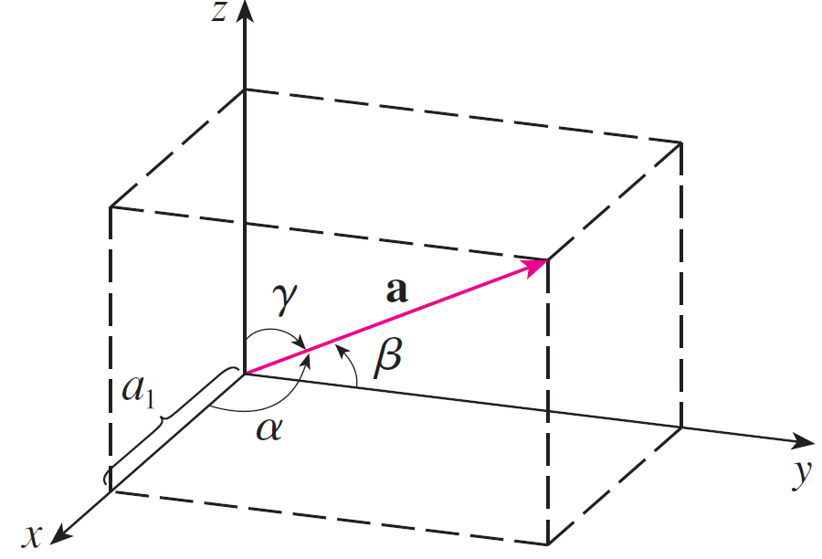
Direction Angles and Direction Cosines
The direction angles of a nonzero vector a are the angles α, β, and γ (in the interval [0, π ]) that makes with the positive x-, y-, and z-axes. (See Figure 3.)
Figure 3

Slide 21
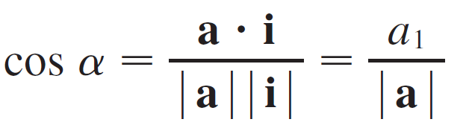


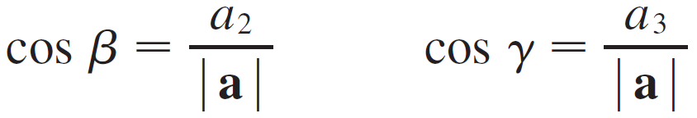
Direction Angles and Direction Cosines
The cosines of these direction angles, cos α, cos β, and cos γ, are called the direction cosines of the vector a. Using Corollary 6 with b replaced by i, we obtain
(This can also be seen directly from Figure 3.) Similarly, we also have

Slide 22

Direction Angles and Direction Cosines
By squaring the expressions in Equations 8 and 9 and adding, we see that
cos² α + cos² β + cos² γ = 1
We can also use Equations 8 and 9 to write
a = ⟨a₁, a₂, a₃⟩ = ⟨|a| cos α, |a| cos β, |a| cos γ⟩
= |a| ⟨cos α, cos β, cos γ⟩

Slide 23
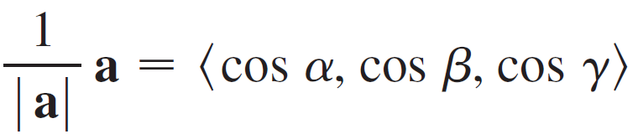

Direction Angles and Direction Cosines
Therefore
which says that the direction cosines of a are the components of the unit vector in the direction of a.

Slide 24

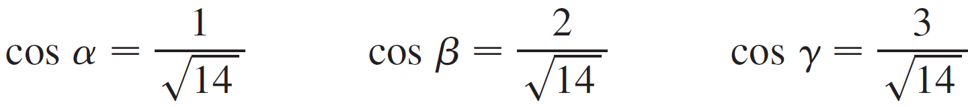
Example 5
Find the direction angles of the vector a = ⟨1, 2, 3⟩.
Solution:
Since Equations 8 and 9 give
and so

Slide 25
Projections

Slide 26
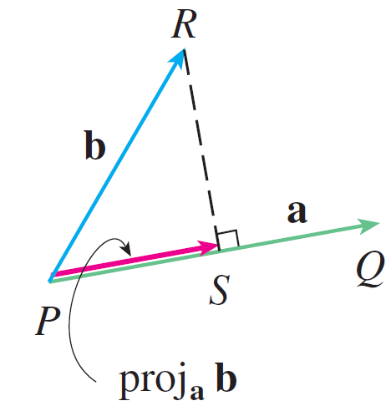
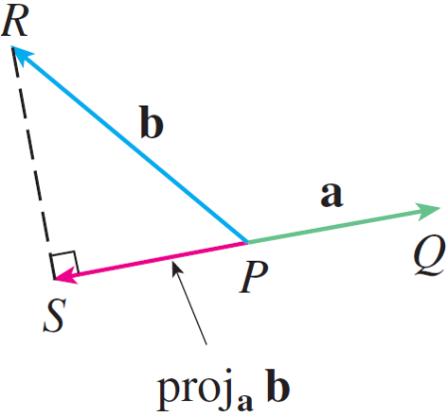
Projections
Figure 4 shows representations PQ and PR of two vectors a and b with the same initial point P. If S is the foot of the perpendicular from R to the line containing PQ, then the vector with representation PS is called the vector projection of b onto a and is denoted by proj_{a} b. (You can think of it as a shadow of b).
Vector projections
Figure 4

Slide 27
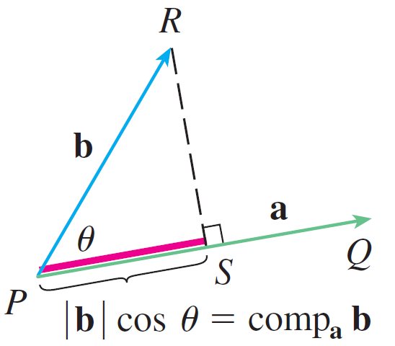
Projections
The scalar projection of b onto a (also called the component of b along a) is defined to be the signed magnitude of the vector projection, which is the number
| b | cos θ, where θ is the angle between a and b.
(See Figure 5.)
Scalar projection
Figure 5

Slide 28
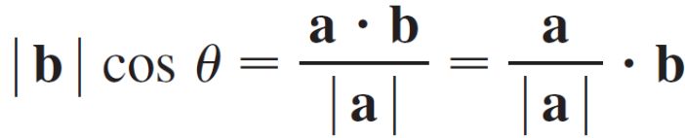
Projections
This is denoted by comp_{a} b. Observe that it is negative if π/2 < θ ≤ π. The equation
a  b = | a | | b | cos θ = | a |(| b | cos θ)
shows that the dot product of and can be interpreted as the length of times the scalar projection of b onto a. Since
the component of b along a can be computed by taking the dot product of b with the unit vector in the direction of a.

Slide 29
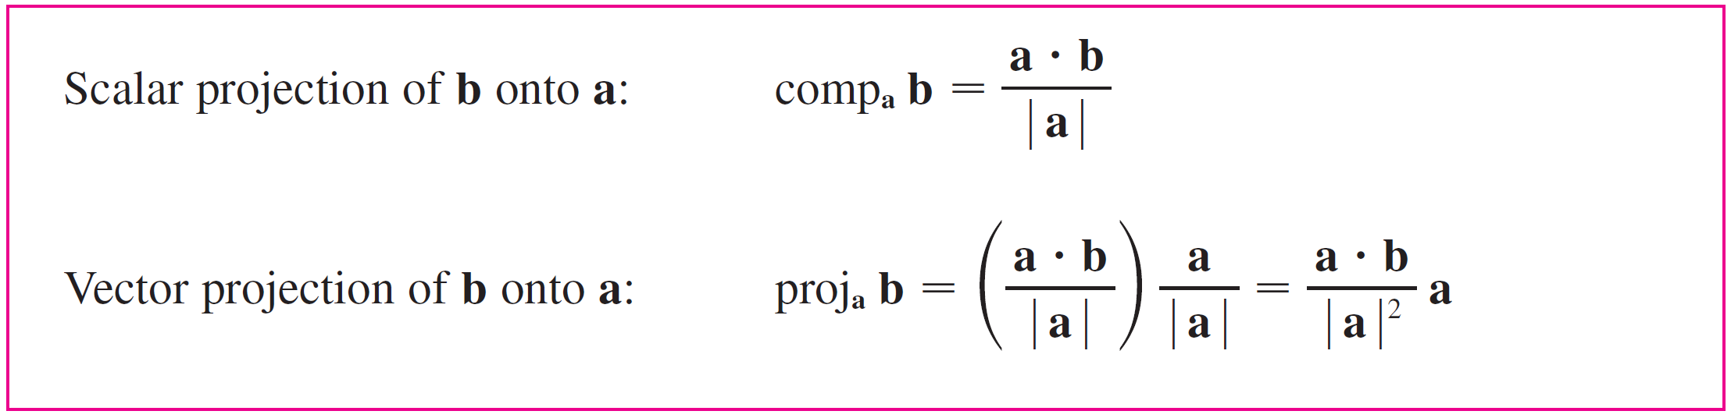
Projections
We summarize these ideas as follows.
Notice that the vector projection is the scalar projection times the unit vector in the direction of a.

Slide 30
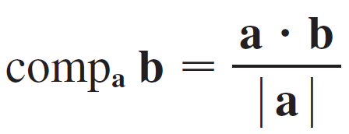
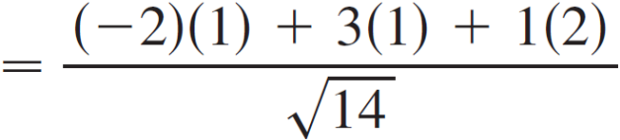
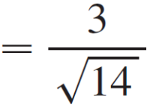
Example 6
Find the scalar projection and vector projection of
b = ⟨1, 1, 2⟩ onto a = ⟨–2, 3, 1⟩
Solution:
Since the scalar projection of b onto a is

Slide 31
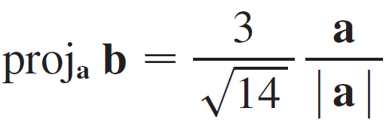
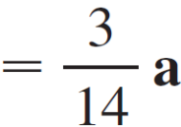
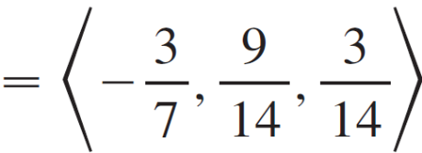
Example 6 – Solution
cont’d
The vector projection is this scalar projection times the unit vector in the direction of a:

Slide 32
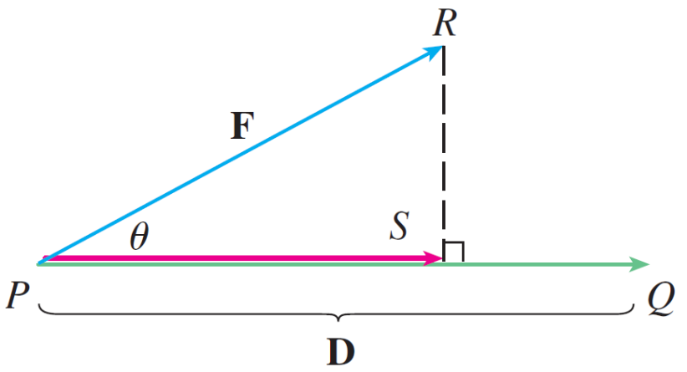
Projections
The work done by a constant force F in moving an object through a distance d as W = Fd, but this applies only when the force is directed along the line of motion of the object. Suppose, however, that the constant force is a vector
F = PR pointing in some other direction, as in Figure 6.
Figure 6

Slide 33

Projections
If the force moves the object from P to Q, then the displacement vector is D = PQ. The work done by this force is defined to be the product of the component of the force along D and the distance moved:
W = (| F | cos θ) | D |
But then, from Theorem 3, we have
W = | F | | D | cos θ = F  D
Thus the work done by a constant force F is the dot product F  D, where D is the displacement vector.

Slide 34
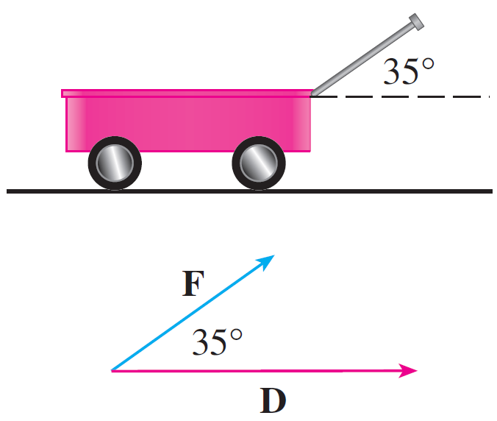
Example 7
A wagon is pulled a distance of 100 m along a horizontal path by a constant force of 70 N. The handle of the wagon is held at an angle of 35° above the horizontal. Find the work done by the force.
Solution:
If F and D are the force and
displacement vectors, as
pictured in Figure 7, then
the work done is
W = F  D
= | F | | D | cos 35°
Figure 7

Slide 35
Example 7 – Solution
cont’d
= (70)(100) cos 35°
≈ 5734 Nm
= 5734 J

