Slide 1


13
Vector Functions
Copyright © Cengage Learning. All rights reserved.

Slide 2

Derivatives and Integrals of Vector Functions
13.2
Copyright © Cengage Learning. All rights reserved.

Slide 3
Derivatives

Slide 4

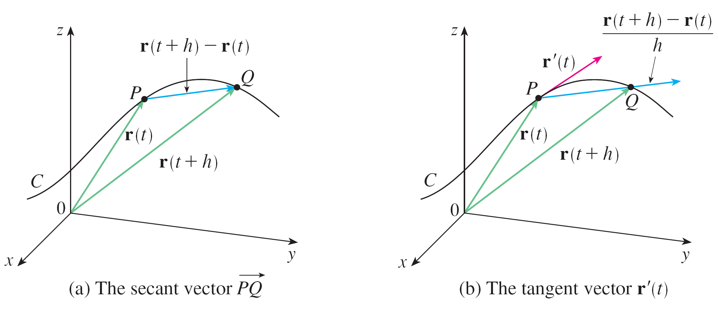
Derivatives
The derivative r′ of a vector function r is defined in much the same way as for real valued functions:
if this limit exists. The geometric significance of this definition is shown in Figure 1.
Figure 1

Slide 5

Derivatives
If the points P and Q have position vectors r(t) and r(t + h), then represents the vector r(t + h) – r(t), which can therefore be regarded as a secant vector.
If h > 0, the scalar multiple (1/h)(r(t + h) – r(t)) has the same direction as r(t + h) – r(t). As h → 0, it appears that this vector approaches a vector that lies on the tangent line.
For this reason, the vector r′(t) is called the tangent vector to the curve defined by r at the point P, provided that r′(t) exists and r′(t) ≠ 0. The tangent line to C at P is defined to be the line through P parallel to the tangent vector r′(t).

Slide 6
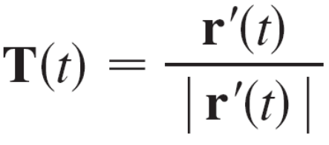
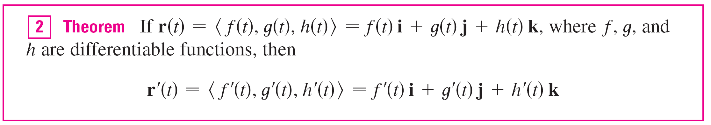
Derivatives
We will also have occasion to consider the unit tangent vector, which is
The following theorem gives us a convenient method for computing the derivative of a vector function r: just differentiate each component of r.

Slide 7
Example 1
Find the derivative of r(t) = (1 + t³)i + te^{–t} j + sin 2t k.
(b) Find the unit tangent vector at the point where t = 0.
Solution:
According to Theorem 2, we differentiate each
component of r:
r′(t) = 3t²i + (1 – t)e^{–t} j + 2 cos 2t k

Slide 8
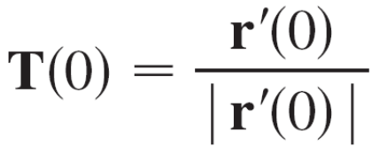
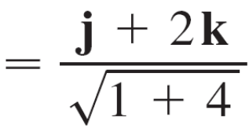
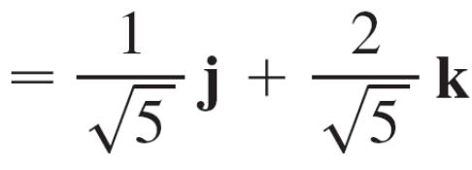
Example 1 – Solution
cont’d
(b) Since r(0) = i and r′(0) = j + 2k, the unit tangent vector
at the point (1, 0, 0) is

Slide 9
Derivatives
Just as for real-valued functions, the second derivative of a vector function r is the derivative of r′, that is, r″ = (r′)′.
For instance, the second derivative of the function, r(t) = ⟨2 cos t, sin t, t⟩, is
r″t = ⟨–2 cos t, –sin t, 0⟩

Slide 10
Differentiation Rules

Slide 11
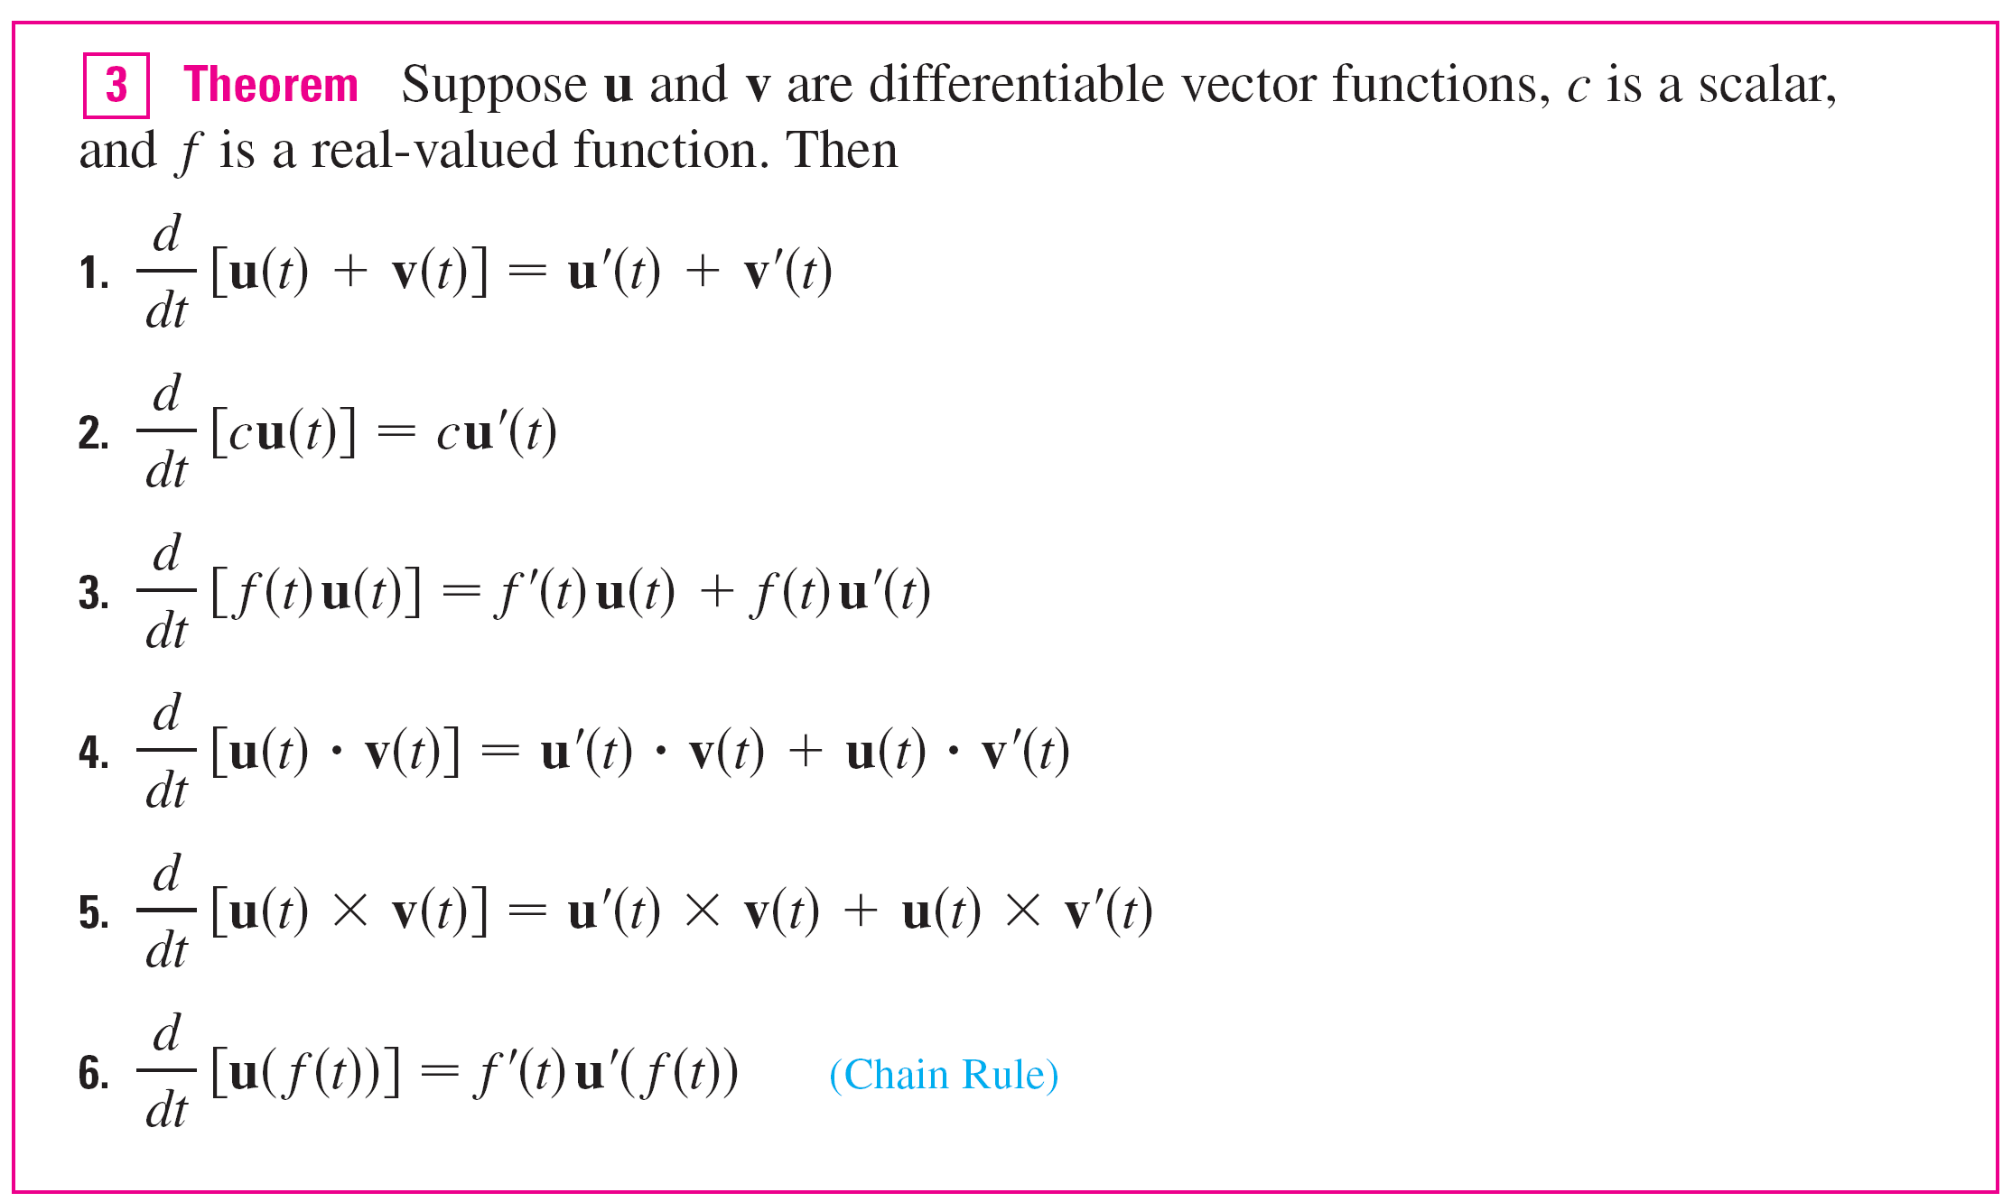
Differentiation Rules
The next theorem shows that the differentiation formulas for real-valued functions have their counterparts for
vector-valued functions.

Slide 12

Example 4
Show that if | r(t) | = c (a constant), then r′(t) is orthogonal to r(t) for all t.
Solution:
Since
r(t)  r(t) = | r(t) |²
= c²
and c² is a constant, Formula 4 of Theorem 3 gives
0 = [r(t)  r(t)]

Slide 13
Example 4 – Solution
cont’d
= r′(t)  r(t) + r(t)  r′(t)
= 2r′(t)  r(t)
Thus r′(t)  r(t) = 0, which says that r′(t) is orthogonal to r(t).
Geometrically, this result says that if a curve lies on a sphere with center the origin, then the tangent vector r′(t) is always perpendicular to the position vector r(t).

Slide 14
Integrals

Slide 15
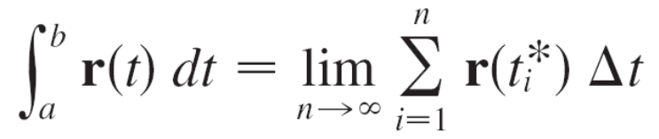
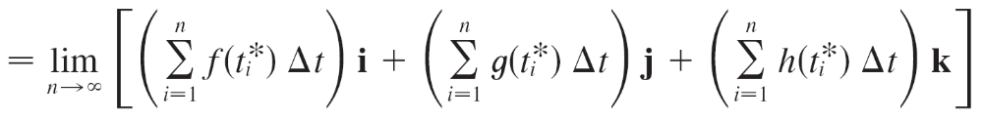
Integrals
The definite integral of a continuous vector function r(t) can be defined in much the same way as for real-valued functions except that the integral is a vector.
But then we can express the integral of r in terms of the integrals of its component functions f, g, and h as follows.

Slide 16
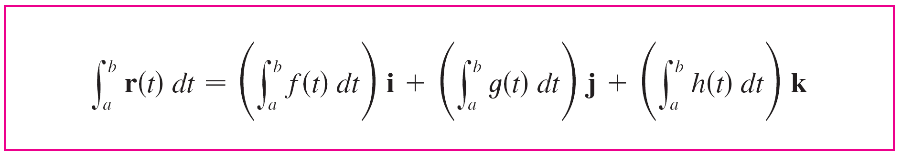
Integrals
and so
This means that we can evaluate an integral of a vector function by integrating each component function.

Slide 17
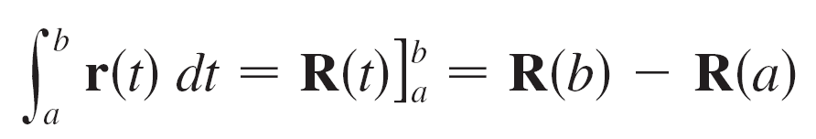
Integrals
We can extend the Fundamental Theorem of Calculus to continuous vector functions as follows:
where R is an antiderivative of r, that is, R′(t) = r(t).
We use the notation ∫ r(t) dt for indefinite integrals (antiderivatives).

Slide 18




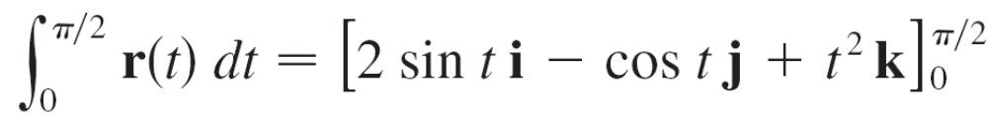
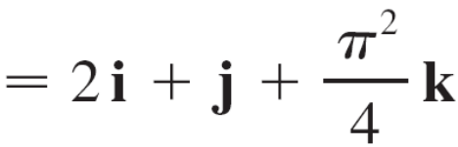
Example 5 – Integral of a Vector Function
If r(t) = 2 cos t i + sin t j + 2t k, then
∫ r(t) dt = ∫ 2 cos t dt i + ∫ sin t dt j + ∫ 2t dt k
= 2 sin t i – cos t j + t² k + C
where C is a vector constant of integration, and

