Slide 1


14
Partial Derivatives
Copyright © Cengage Learning. All rights reserved.

Slide 2

14.3
Partial Derivatives
Copyright © Cengage Learning. All rights reserved.

Slide 3
Partial Derivatives
On a hot day, extreme humidity makes us think the temperature is higher than it really is, whereas in very dry air we perceive the temperature to be lower than the thermometer indicates.
The National Weather Service has devised the heat index (also called the temperature-humidity index, or humidex, in some countries) to describe the combined effects of temperature and humidity.
The heat index I is the perceived air temperature when the actual temperature is T and the relative humidity is H.
So I is a function of T and H and we can write I = f (T, H).

Slide 4
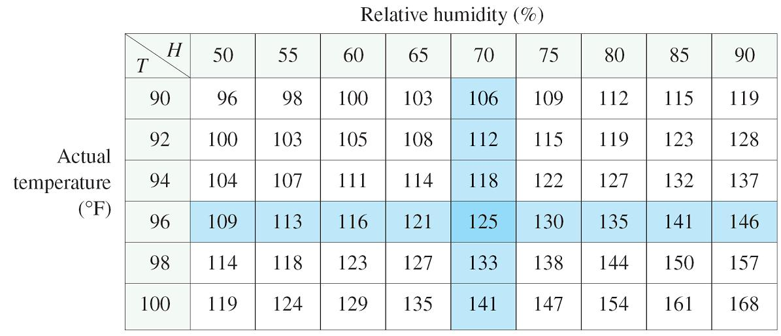
Partial Derivatives
The following table of values of I is an excerpt from a table compiled by the National Weather Service.
Heat index I as a function of
temperature and humidity
Table 1

Slide 5
Partial Derivatives
If we concentrate on the highlighted column of the table, which corresponds to a relative humidity of H = 70%, we are considering the heat index as a function of the single variable T for a fixed value of H. Let’s write g(T ) = f (T, 70).
Then g(T ) describes how the heat index I increases as the actual temperature T increases when the relative humidity
is 70%.
The derivative of g when T = 96°F is the rate of change of I with respect to T when T = 96°F:

Slide 6
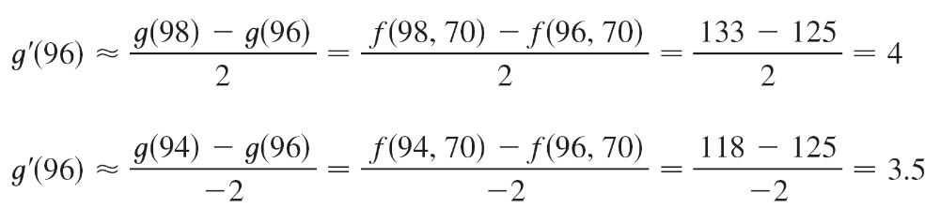
Partial Derivatives
We can approximate g ′(96) using the values in Table 1 by taking h = 2 and –2:
Averaging these values, we can say that the derivative g ′(96) is approximately 3.75.

Slide 7
Partial Derivatives
This means that, when the actual temperature is 96°F and the relative humidity is 70%, the apparent temperature (heat index) rises by about 3.75°F for every degree that the actual temperature rises!

Slide 8
Partial Derivatives
Now let’s look at the highlighted row in Table 1, which corresponds to a fixed temperature of T = 96°F.
Heat index I as a function of
temperature and humidity
Table 1

Slide 9
Partial Derivatives
The numbers in this row are values of the function G(H) = f (96, H), which describes how the heat index increases as the relative humidity H increases when the actual temperature is T = 96°F.
The derivative of this function when H = 70% is the rate of change of I with respect to H when H = 70%:

Slide 10
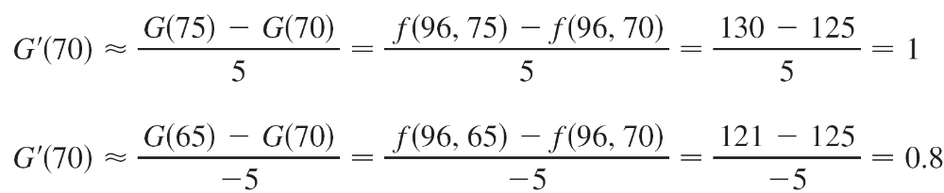
Partial Derivatives
By taking h = 5 and –5, we approximate G′(70) using the tabular values:
By averaging these values we get the estimate
G′(70) ≈ 0.9.This says that, when the temperature is 96°F and the relative humidity is 70%, the heat index rises about 0.9°F for every percent that the relative humidity rises.

Slide 11

Partial Derivatives
In general, if f is a function of two variables x and y, suppose we let only x vary while keeping y fixed, say y = b, where b is a constant.
Then we are really considering a function of a single variable x, namely, g(x) = f (x, b). If g has a derivative at a, then we call it the partial derivative of f with respect to x at (a, b) and denote it by f_{x} (a, b). Thus

Slide 12
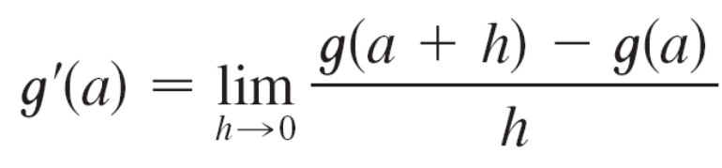
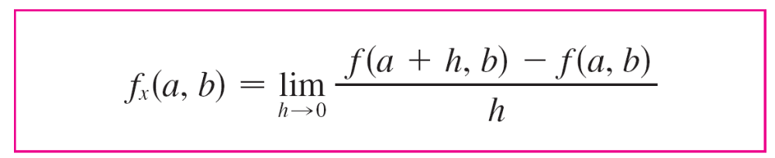

Partial Derivatives
By the definition of a derivative, we have
and so Equation 1 becomes

Slide 13
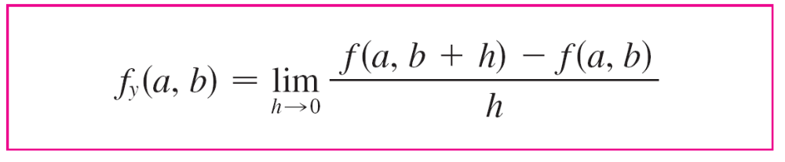

Partial Derivatives
Similarly, the partial derivative of f with respect to y at (a, b), denoted by f_{y}(a, b), is obtained by keeping x fixed (x = a) and finding the ordinary derivative at b of the function G(y) = f (a, y):
With this notation for partial derivatives, we can write the rates of change of the heat index I with respect to the actual temperature T and relative humidity H when T = 96°F and H = 70% as follows:
f_{T} (96, 70) ≈ 3.75 f_{H}(96, 70) ≈ 0.9

Slide 14
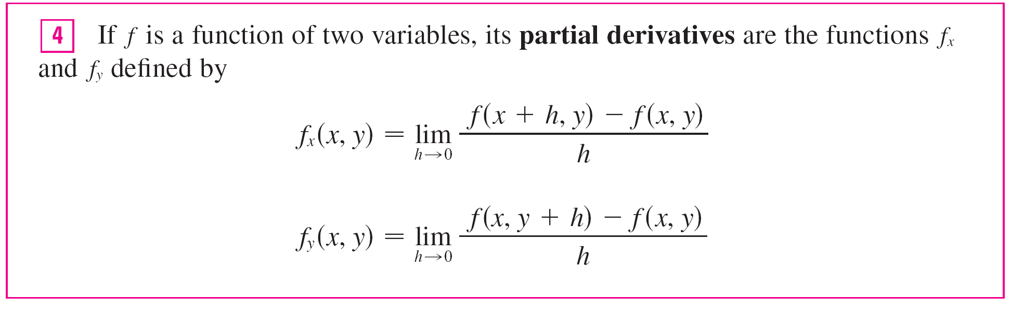
Partial Derivatives
If we now let the point (a, b) vary in Equations 2 and 3, f_{x} and f_{y} become functions of two variables.

Slide 15
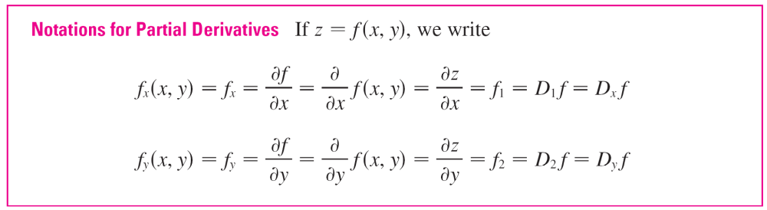
Partial Derivatives
There are many alternative notations for partial derivatives.
For instance, instead of f_{x} we can write f₁ or D₁f (to indicate differentiation with respect to the first variable) or ∂f / ∂x.
But here ∂f / ∂x can’t be interpreted as a ratio of differentials.

Slide 16
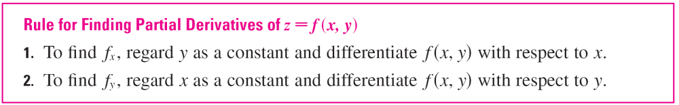
Partial Derivatives
To compute partial derivatives, all we have to do is remember from Equation 1 that the partial derivative with respect to x is just the ordinary derivative of the function g of a single variable that we get by keeping y fixed.
Thus we have the following rule.

Slide 17
Example 1
If f (x, y) = x³ + x²y³ – 2y², find f_{x}(2, 1) and f_{y}(2, 1).
Solution:
Holding y constant and differentiating with respect to x,
we get
f_{x}(x, y) = 3x² + 2xy³
and so f_{x}(2, 1) = 3  2² + 2  2  1³
Holding x constant and differentiating with respect to y,
we get
f_{y}(x, y) = 3x²y² – 4y
f_{y}(2, 1) = 3  2²  1² – 4  1
= 16
= 8

Slide 18
Interpretations of Partial Derivatives

Slide 19
Interpretations of Partial Derivatives
To give a geometric interpretation of partial derivatives, we recall that the equation z = f (x, y) represents a surface S (the graph of f ). If f (a, b) = c, then the point P(a, b, c) lies on S.
By fixing y = b, we are restricting our attention to the curve C₁ in which the vertical plane y = b intersects S. (In other words, C₁ is the trace of S in the plane y = b.)

Slide 20
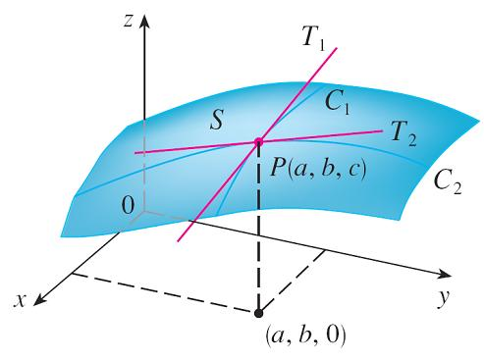
Interpretations of Partial Derivatives
Likewise, the vertical plane x = a intersects S in a curve C₂. Both of the curves C₁ and C₂ pass through the point P. (See Figure 1.)
Notice that the curve C₁ is the
graph of the function
g(x) = f (x, b), so the slope of its
tangent T₁ at P is g ′(a) = f_{x} (a, b).
The curve C₂ is the graph of the
function G(y) = f (a, y), so the
slope of its tangent T₂ at P is
G′(b) = f_{y} (a, b).
The partial derivatives of f at (a, b) are
the slopes of the tangents to C₁ and C₂.
Figure 1

Slide 21
Interpretations of Partial Derivatives
Thus the partial derivatives f_{x}(a, b) and f_{y}(a, b) can be interpreted geometrically as the slopes of the tangent lines at P(a, b, c) to the traces C₁ and C₂ of S in the planes y = b and x = a.
As we have seen in the case of the heat index function, partial derivatives can also be interpreted as rates of change.
If z = f (x, y), then ∂z / ∂x represents the rate of change of z with respect to x when y is fixed. Similarly, ∂z / ∂y represents the rate of change of z with respect to y when x is fixed.

Slide 22
Example 2
If f (x, y) = 4 – x² – 2y², find f_{x}(1, 1) and f_{y}(1, 1) and interpret these numbers as slopes.
Solution:
We have
f_{x}(x, y) = –2x f_{y}(x, y) = –4y
f_{x}(1, 1) = –2 f_{y}(1, 1) = –4

Slide 23
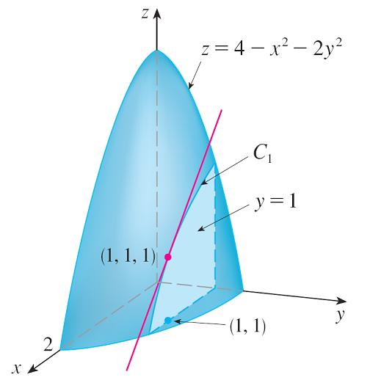
Example 2 – Solution
cont’d
The graph of f is the paraboloid z = 4 – x² – 2y² and the vertical plane y = 1 intersects it in the parabola z = 2 – x², y = 1. (As in the preceding discussion, we label it C₁ in Figure 2.)
The slope of the tangent line to
this parabola at the point
(1, 1, 1) is f_{x}(1, 1) = –2.
Figure 2

Slide 24
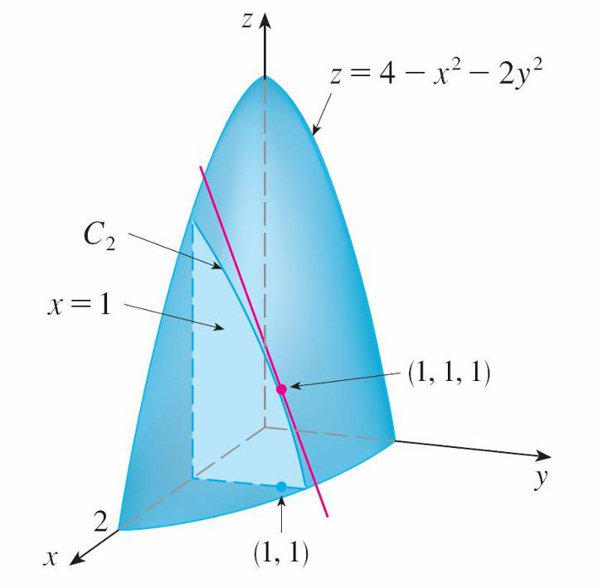
Example 2 – Solution
cont’d
Similarly, the curve C₂ in which the plane x = 1 intersects the paraboloid is the parabola z = 3 – 2y², x = 1, and the slope of the tangent line at (1, 1, 1) is f_{y}(1, 1) = –4. (See Figure 3.)
Figure 3

Slide 25
Functions of More Than Two Variables

Slide 26
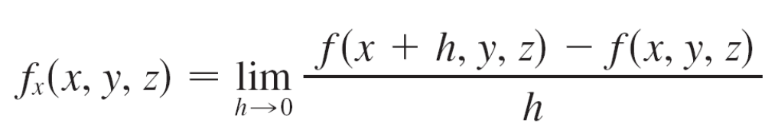
Functions of More Than Two Variables
Partial derivatives can also be defined for functions of three or more variables. For example, if f is a function of three variables x, y, and z, then its partial derivative with respect to x is defined as
and it is found by regarding y and z as constants and differentiating f (x, y, z) with respect to x.

Slide 27
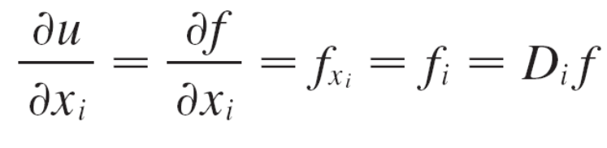
Functions of More Than Two Variables
If w = f (x, y, z), then f _{x} = ∂w / ∂x can be interpreted as the rate of change of w with respect to x when y and z are held fixed. But we can’t interpret it geometrically because the graph of f lies in four-dimensional space.
In general, if u is a function of n variables,
u = f (x₁, x₂,…, x_{n}), its partial derivative with respect to the
i th variable x_{i} is
and we also write

Slide 28
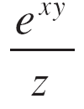
Example 5
Find f_{x}, f_{y}, and f_{z} if f (x, y, z) = e^{xy} ln z.
Solution:
Holding y and z constant and differentiating with respect to x, we have
f_{x} = ye^{xy} ln z
Similarly,
f_{y} = xe^{xy} ln z and f_{z} =

Slide 29
Higher Derivatives

Slide 30
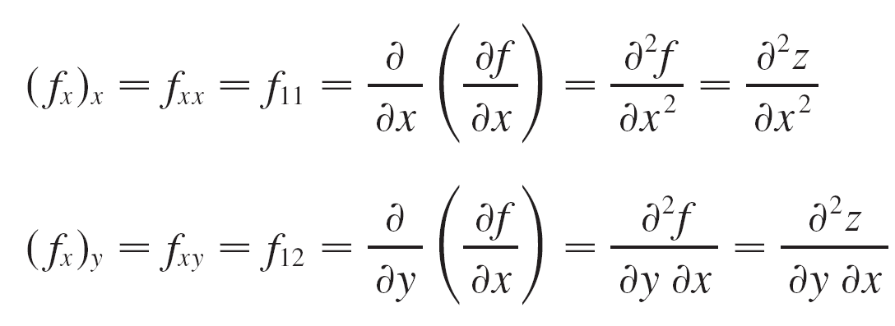
Higher Derivatives
If f is a function of two variables, then its partial derivatives f_{x} and f_{y} are also functions of two variables, so we can consider their partial derivatives (f_{x})_{x}, (f_{x})_{y}, (f_{y})_{x}, and (f_{y})_{y}, which are called the second partial derivatives of f.
If z = f (x, y), we use the following notation:

Slide 31
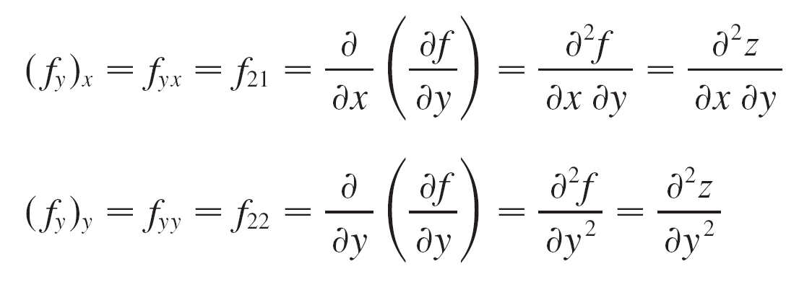
Higher Derivatives
Thus the notation f_{xy} (or ∂²f / ∂y ∂x) means that we first differentiate with respect to x and then with respect to y, whereas in computing f_{yx} the order is reversed.

Slide 32
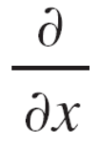
Example 6
Find the second partial derivatives of
f (x, y) = x³ + x²y³ – 2y²
Solution:
In Example 1 we found that
f_{x}(x, y) = 3x² + 2xy³ f_{y}(x, y) = 3x²y² – 4y
Therefore
f_{xx} = (3x² + 2xy³)
= 6x + 2y³

Slide 33
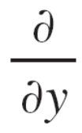
Example 6 – Solution
cont’d
f_{xy} = (3x² + 2xy³)
= 6xy²
f_{yx} = (3x²y² – 4y)
= 6xy²
f_{yy} = (3x²y² – 4y)
= 6x²y – 4

Slide 34
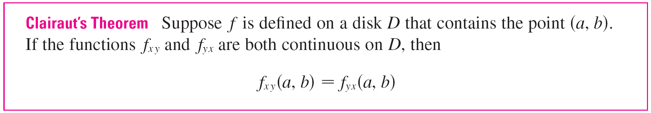
Higher Derivatives
Notice that f_{xy} = f_{yx} in Example 6. This is not just a coincidence.
It turns out that the mixed partial derivatives f_{xy} and f_{yx} are equal for most functions that one meets in practice.
The following theorem, which was discovered by the French mathematician Alexis Clairaut (1713–1765), gives conditions under which we can assert that f_{xy} = f_{yx}.

Slide 35
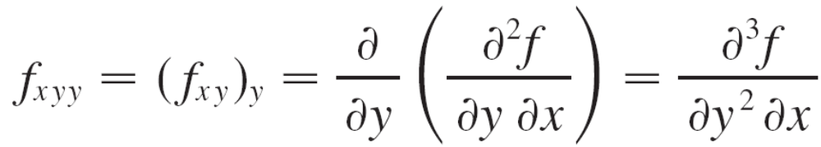
Higher Derivatives
Partial derivatives of order 3 or higher can also be defined. For instance,
and using Clairaut’s Theorem it can be shown that f_{xyy} = f_{yxy} = f_{yyx} if these functions are continuous.

Slide 36
Partial Differential Equations

Slide 37
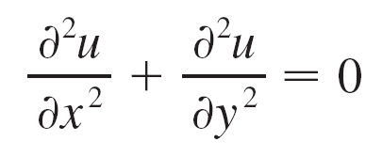
Partial Differential Equations
Partial derivatives occur in partial differential equations that express certain physical laws.
For instance, the partial differential equation
is called Laplace’s equation after Pierre Laplace (1749–1827).
Solutions of this equation are called harmonic functions; they play a role in problems of heat conduction, fluid flow, and electric potential.

Slide 38
Example 8
Show that the function u(x, y) = e^{x} sin y is a solution of Laplace’s equation.
Solution:
We first compute the needed second-order partial derivatives:
u_{x} = e^{x} sin y u_{y} = e^{x} cos y
u_{xx} = e^{x} sin y u_{yy} = –e^{x} sin y
So u_{xx} + u_{yy} = e^{x} sin y – e^{x} sin y = 0
Therefore u satisfies Laplace’s equation.

Slide 39
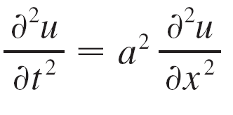
Partial Differential Equations
The wave equation
describes the motion of a waveform, which could be an ocean wave, a sound wave, a light wave, or a wave traveling along a vibrating string.

Slide 40
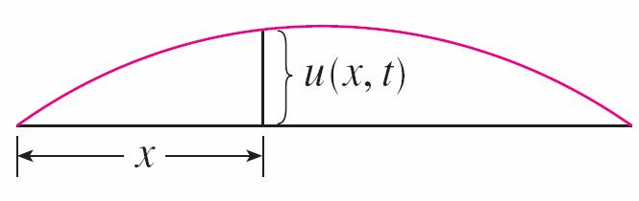
Partial Differential Equations
For instance, if u(x, t) represents the displacement of a vibrating violin string at time t and at a distance x from one end of the string (as in Figure 8), then u(x, t) satisfies the wave equation.
Here the constant a depends on the density of the string and on the tension in the string.
Figure 8

Slide 41
The Cobb-Douglas Production Function

Slide 42
The Cobb-Douglas Production Function
We have described the work of Cobb and Douglas in modeling the total production P of an economic system as a function of the amount of labor L and the capital
investment K.
Here we use partial derivatives to show how the particular form of their model follows from certain assumptions they made about the economy.
If the production function is denoted by P = P(L, K), then the partial derivative ∂P/∂L is the rate at which production changes with respect to the amount of labor. Economists call it the marginal production with respect to labor or the marginal productivity of labor.

Slide 43
The Cobb-Douglas Production Function
Likewise, the partial derivative ∂P/∂K is the rate of change of production with respect to capital and is called the marginal productivity of capital.
In these terms, the assumptions made by Cobb and Douglas can be stated as follows.
(i) If either labor or capital vanishes, then so will production.
(ii) The marginal productivity of labor is proportional to the
amount of production per unit of labor.
(iii) The marginal productivity of capital is proportional to
the amount of production per unit of capital.

Slide 44
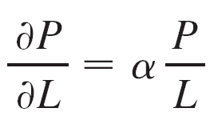

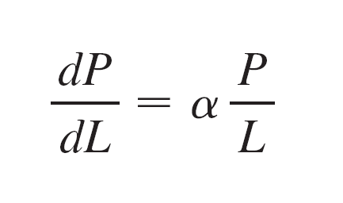
The Cobb-Douglas Production Function
Because the production per unit of labor is P/L, assumption (ii) says that
for some constant α.
If we keep K constant (K = K₀), then this partial differential equation becomes an ordinary differential equation:

Slide 45

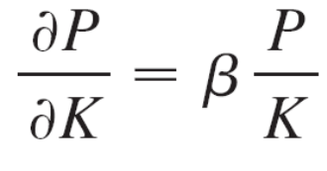

The Cobb-Douglas Production Function
If we solve this separable differential equation, we get
P(L, K₀) = C₁(K₀)L^{α}
Notice that we have written the constant C₁ as a function of K₀ because it could depend on the value of K₀.
Similarly, assumption (iii) says that
and we can solve this differential equation to get
P(L₀, K) = C₂(L₀)K^{β}

Slide 46

The Cobb-Douglas Production Function
Comparing Equations 7 and 8, we have
P(L, K) = bL^{α}K ^{β}
where b is a constant that is independent of both L and K. Assumption (i) shows that α > 0 and β > 0.
Notice from Equation 8 that if labor and capital are both increased by a factor m, then
P(mL, mK) = b(mL)^{α}(mK)^{β} = m^{α + β}bL^{α}K^{β} = m^{α + β}P(L, K)

Slide 47
The Cobb-Douglas Production Function
If α + β = 1, then P(mL, mK) = mP(L, K), which means that production is also increased by a factor of m. That is why Cobb and Douglas assumed that α + β = 1 and therefore
P(L, K) = bL^{α}K^{1 –} ^{α}

