Slide 1


14
Partial Derivatives
Copyright © Cengage Learning. All rights reserved.

Slide 2

Tangent Planes and Linear Approximations
14.4
Copyright © Cengage Learning. All rights reserved.

Slide 3
Tangent Planes

Slide 4
Tangent Planes
Suppose a surface S has equation z = f (x, y), where f has continuous first partial derivatives, and let P(x₀, y₀, z_{o}) be a point on S.
Let C₁ and C₂ be the curves obtained by intersecting the vertical planes y = y₀ and x = x₀ with the surface S. Then the point P lies on both C₁ and C₂.
Let T₁ and T₂ be the tangent lines to the curves C₁ and C₂ at the point P.

Slide 5
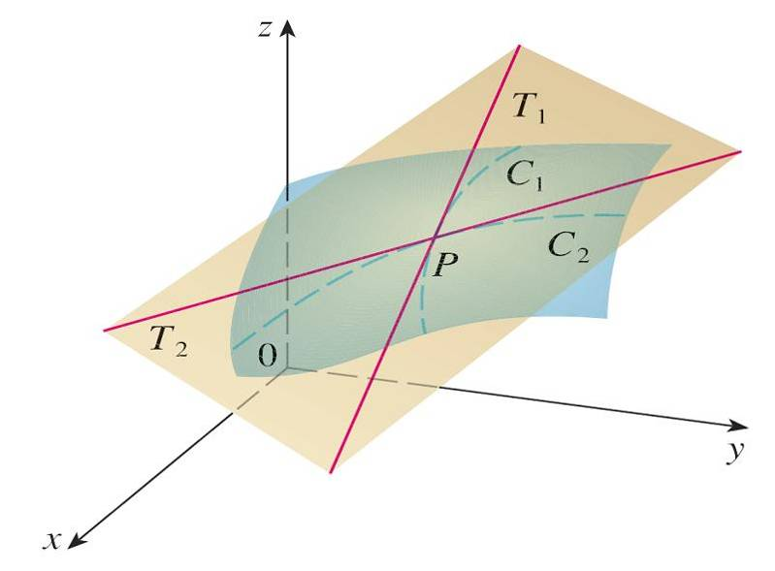
Tangent Planes
Then the tangent plane to the surface S at the point P is defined to be the plane that contains both tangent lines
T₁ and T₂. (See Figure 1.)
Figure 1
The tangent plane contains the
tangent lines T₁ and T₂.

Slide 6
Tangent Planes
If C is any other curve that lies on the surface S and passes through P, then its tangent line at P also lies in the tangent plane.
Therefore you can think of the tangent plane to S at P as consisting of all possible tangent lines at P to curves that lie on S and pass through P. The tangent plane at P is the plane that most closely approximates the surface S near the point P.
We know that any plane passing through the point
P(x₀, y₀, z₀) has an equation of the form
A(x – x₀) + B(y – y₀) + C(z – z₀) = 0

Slide 7

Tangent Planes
By dividing this equation by C and letting a = –A/C and
b = –B/C, we can write it in the form
z – z₀ = a(x – x₀) + b(y – y₀)
If Equation 1 represents the tangent plane at P, then its intersection with the plane y = y₀ must be the tangent line T₁. Setting y = y₀ in Equation 1 gives
z – z₀ = a(x – x₀) where y = y₀
and we recognize this as the equation (in point-slope form) of a line with slope a.

Slide 8
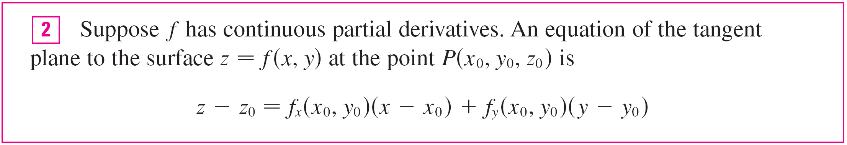
Tangent Planes
But we know that the slope of the tangent T₁ is f_{x} (x₀, y₀).
Therefore a = f_{x} (x₀, y₀).
Similarly, putting x = x₀ in Equation 1, we get
z – z₀ = b(y – y₀), which must represent the tangent line T₂, so b = f_{y} (x₀, y₀).

Slide 9

Example 1
Find the tangent plane to the elliptic paraboloid z = 2x² + y² at the point (1, 1, 3).
Solution:
Let f (x, y) = 2x² + y².
Then
f_{x}(x, y) = 4x f_{y}(x, y) = 2y
f_{x}(1, 1) = 4 f_{y}(1, 1) = 2
Then gives the equation of the tangent plane at
(1, 1, 3) as
z – 3 = 4(x – 1) + 2(y – 1)
or z = 4x + 2y – 3

Slide 10
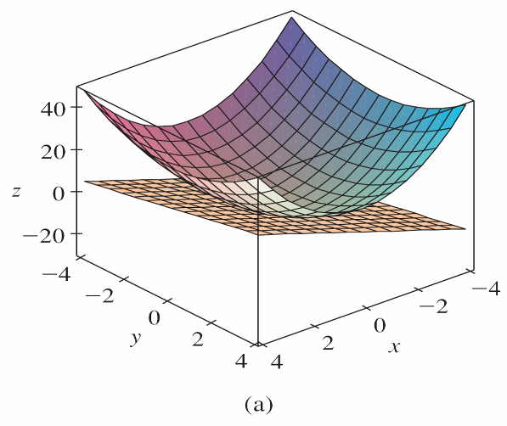
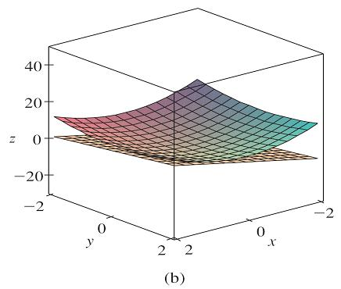
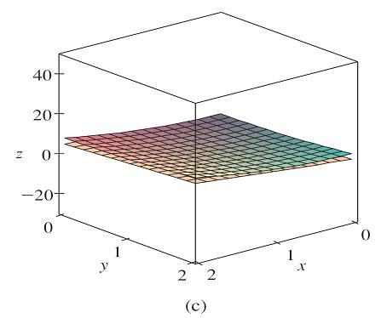
Tangent Planes
Figure 2(a) shows the elliptic paraboloid and its tangent plane at (1, 1, 3) that we found in Example 1. In parts (b) and (c) we zoom in toward the point (1, 1, 3) by restricting the domain of the function f (x, y) = 2x² + y².
The elliptic paraboloid z = 2x² + y² appears to coincide with its
tangent plane as we zoom in toward (1, 1, 3).
Figure 2

Slide 11
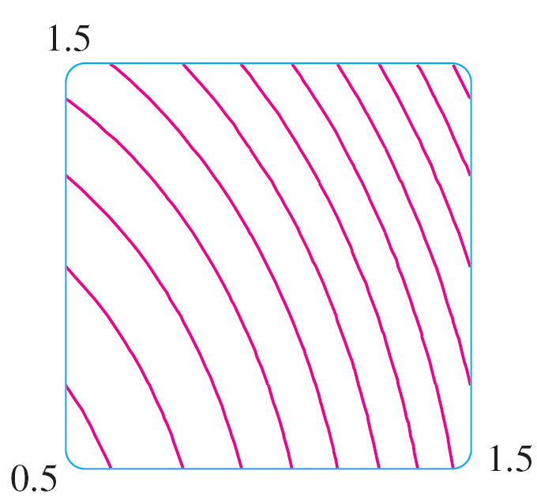
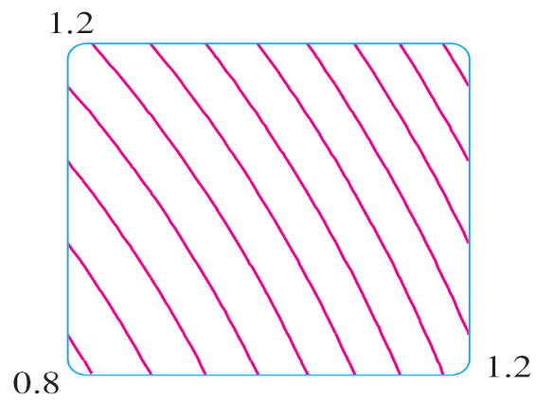
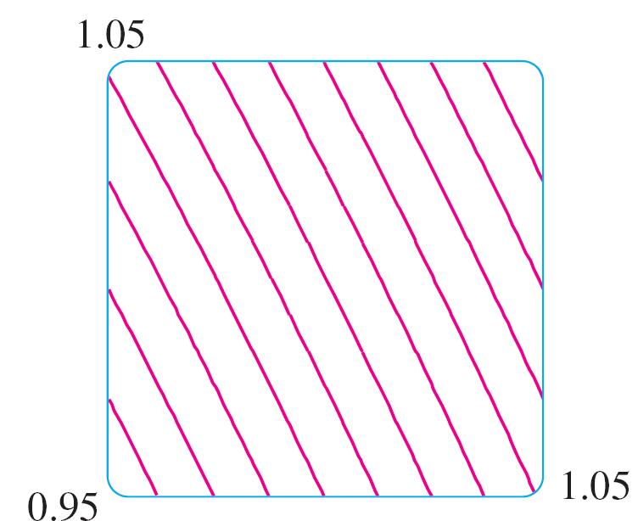
Tangent Planes
Notice that the more we zoom in, the flatter the graph appears and the more it resembles its tangent plane.
In Figure 3 we corroborate this impression by zooming in toward the point (1, 1) on a contour map of the function
f (x, y) = 2x² + y².
Zooming in toward (1, 1) on a contour map of f (x, y) = 2x² + y²
Figure 3

Slide 12
Tangent Planes
Notice that the more we zoom in, the more the level curves look like equally spaced parallel lines, which is characteristic of a plane.

Slide 13
Linear Approximations

Slide 14
Linear Approximations
In Example 1 we found that an equation of the tangent plane to the graph of the function f (x, y) = 2x² + y² at the point (1, 1, 3) is z = 4x + 2y – 3. Therefore, the linear function of two variables
L(x, y) = 4x + 2y – 3
is a good approximation to f (x, y) when (x, y) is near (1, 1). The function L is called the linearization of f at (1, 1) and the approximation
f (x, y) ≈ 4x + 2y – 3
is called the linear approximation or tangent plane approximation of f at (1, 1).

Slide 15
Linear Approximations
For instance, at the point (1.1, 0.95) the linear approximation gives
f (1.1, 0.95) ≈ 4(1.1) + 2(0.95) – 3 = 3.3
which is quite close to the true value of
f (1.1, 0.95) = 2(1.1)² + (0.95)² = 3.3225.
But if we take a point farther away from (1, 1), such as
(2, 3), we no longer get a good approximation.
In fact, L(2, 3) = 11 whereas f (2, 3) = 17.

Slide 16



Linear Approximations
In general, we know from that an equation of the tangent plane to the graph of a function f of two variables at the point (a, b, f (a, b)) is
z = f (a, b) + f_{x}(a, b)(x – a) + f_{y}(a, b)(y – b)
The linear function whose graph is this tangent plane, namely
L(x, y) = f (a, b) + f_{x}(a, b)(x – a) + f_{y}(a, b)(y – b)
is called the linearization of f at (a, b) and the approximation
f (x, y) ≈ f (a, b) + f_{x}(a, b)(x – a) + f_{y}(a, b)(y – b)
is called the linear approximation or the tangent plane approximation of f at (a, b).

Slide 17
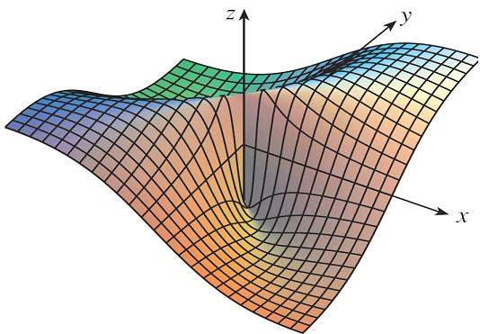
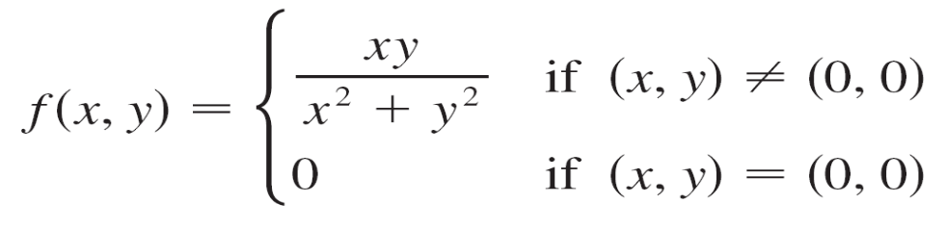
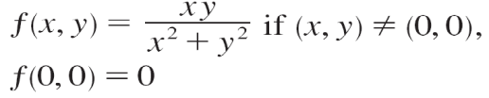
Linear Approximations
We have defined tangent planes for surfaces z = f (x, y), where f has continuous first partial derivatives. What happens if f_{x} and f_{y} are not continuous? Figure 4 pictures such a function; its equation is
You can verify that its partial
derivatives exist at the origin
and, in fact, f_{x}(0, 0) = 0 and
f_{y}(0, 0) = 0, but f_{x} and f_{y} are
not continuous.
Figure 4

Slide 18

Linear Approximations
The linear approximation would be f (x, y) ≈ 0, but f (x, y) =
at all points on the line y = x.
So a function of two variables can behave badly even though both of its partial derivatives exist.
To rule out such behavior, we formulate the idea of a differentiable function of two variables.
Recall that for a function of one variable, y = f (x), if x changes from a to a + Δx, we defined the increment of y as
Δy = f (a + Δx) – f (a)

Slide 19


Linear Approximations
If f is differentiable at a, then
Δy = f ′(a) Δx + ε Δx where ε → 0 as Δx → 0
Now consider a function of two variables, z = f (x, y), and suppose x changes from a to a + Δx and y changes from
b to b + Δy. Then the corresponding increment of z is
Δz = f (a + Δx, b + Δy) – f (a, b)
Thus the increment Δz represents the change in the value of f when (x, y) changes from (a, b) to (a + Δx, b + Δy).

Slide 20

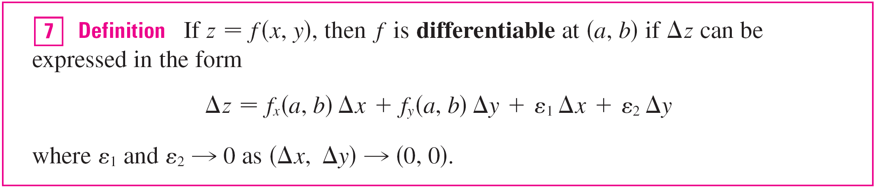

Linear Approximations
By analogy with we define the differentiability of a function of two variables as follows.
Definition 7 says that a differentiable function is one for which the linear approximation is a good approximation when (x, y) is near (a, b).
In other words, the tangent plane approximates the graph
of f well near the point of tangency.

Slide 21
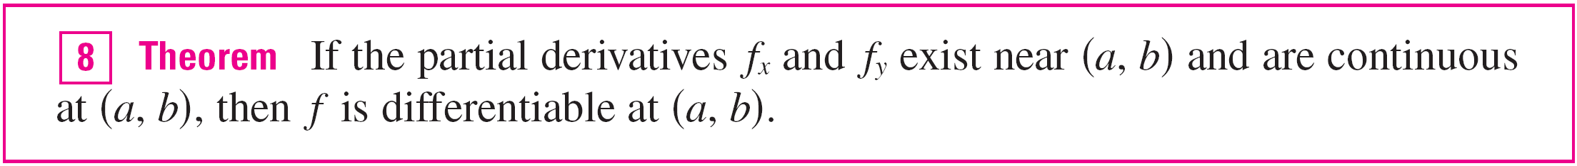
Linear Approximations
It’s sometimes hard to use Definition 7 directly to check the differentiability of a function, but the next theorem provides a convenient sufficient condition for differentiability.

Slide 22
Differentials

Slide 23

Differentials
For a differentiable function of one variable, y = f (x), we
define the differential dx to be an independent variable; that
is, dx can be given the value of any real number.
The differential of y is then defined as
dy = f ′(x) dx

Slide 24
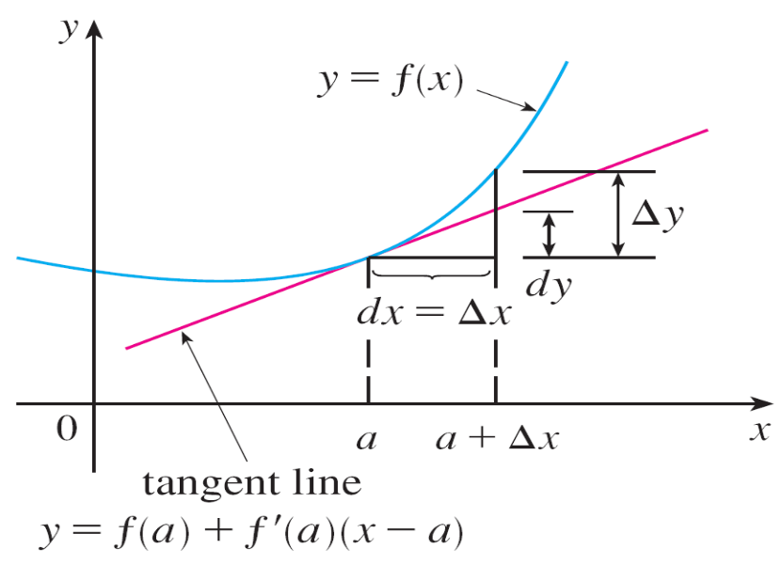
Differentials
Figure 6 shows the relationship between the increment Δy and the differential dy: Δy represents the change in height of the curve y = f (x) and dy represents the change in height of the tangent line when x changes by an amount dx = Δx.
Figure 6

Slide 25
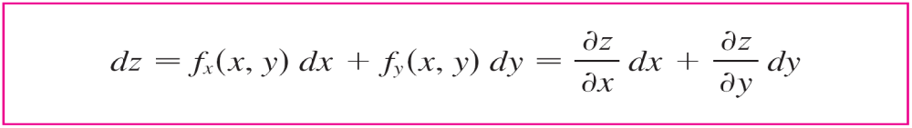

Differentials
For a differentiable function of two variables, z = f (x, y), we define the differentials dx and dy to be independent variables; that is, they can be given any values. Then the differential dz, also called the total differential, is
defined by
Sometimes the notation df is used in place of dz.

Slide 26

Differentials
If we take dx = Δx = x – a and dy = Δy = y – b in Equation 10, then the differential of z is
dz = f_{x}(a, b)(x – a) + f_{y}(a, b)(y – b)
So, in the notation of differentials, the linear approximation
can be written as
f (x, y) ≈ f (a, b) + dz

Slide 27
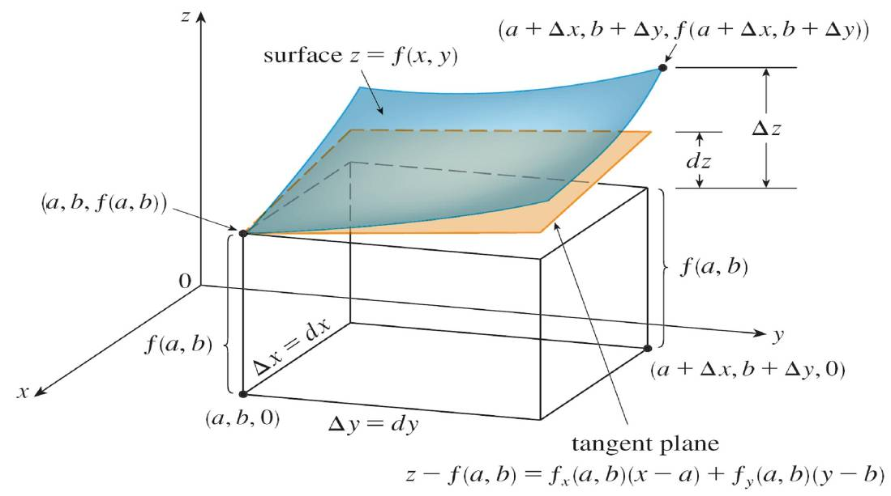
Differentials
Figure 7 is the three-dimensional counterpart of Figure 6
and shows the geometric interpretation of the differential dz
and the increment Δz: dz represents the change in height of the tangent plane, whereas Δz represents the change in height of the surface z = f (x, y) when (x, y) changes from
(a, b) to (a + Δx, b + Δy).
Figure 6
Figure 7

Slide 28
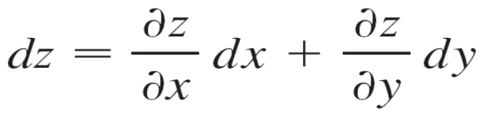

Example 4
(a) If z = f (x, y) = x² + 3xy – y², find the differential dz.
(b) If x changes from 2 to 2.05 and y changes from 3 to
2.96, compare the values of Δz and dz.
Solution:
(a) Definition 10 gives

Slide 29
Example 4 – Solution
cont’d
(b) Putting x = 2, dx = Δx = 0.05, y = 3, and
dy = Δy = –0.04, we get
dz = [2(2) + 3(3)]0.05 + [3(2) – 2(3)](–0.04)
The increment of z is
Δz = f (2.05, 2.96) – f (2, 3)
= [(2.05)² + 3(2.05)(2.96) – (2.96)²] – [2² + 3(2)(3) – 3²]
= 0.6449
Notice that Δz ≈ dz but dz is easier to compute.
= 0.65

Slide 30
Functions of Three or More Variables

Slide 31
Functions of Three or More Variables
Linear approximations, differentiability, and differentials can be defined in a similar manner for functions of more than two variables. A differentiable function is defined by an
expression similar to the one in Definition 7. For such functions the linear approximation is
f (x, y, z) ≈ f (a, b, c) + f_{x}(a, b, c)(x – a) + f_{y}(a, b, c)(y – b)
+ f_{z}(a, b, c)(z – c)
and the linearization L(x, y, z) is the right side of this expression.

Slide 32
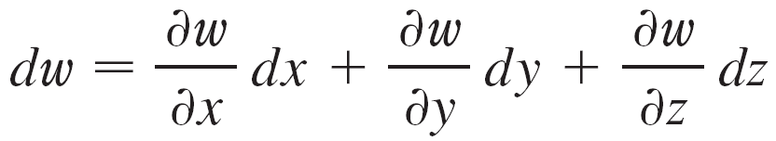
Functions of Three or More Variables
If w = f (x, y, z), then the increment of w is
Δw = f (x + Δx, y + Δy, z + Δz) – f (x, y, z)
The differential dw is defined in terms of the differentials
dx, dy, and dz of the independent variables by

Slide 33
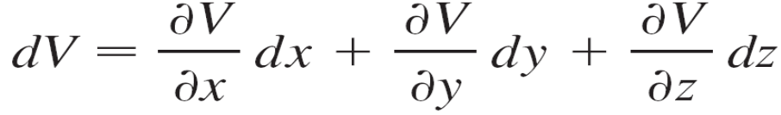

Example 6
The dimensions of a rectangular box are measured to be
75 cm, 60 cm, and 40 cm, and each measurement is correct to within 0.2 cm. Use differentials to estimate the largest possible error when the volume of the box is calculated from these measurements.
Solution:
If the dimensions of the box are x, y, and z, its volume is
V = xyz and so

Slide 34
Example 6 – Solution
cont’d
We are given that | Δx | ≤ 0.2, | Δy | ≤ 0.2, and | Δz | ≤ 0.2.
To estimate the largest error in the volume, we therefore use dx = 0.2, dy = 0.2, and dz = 0.2 together with x = 75, y = 60, and z = 40:
ΔV ≈ dV = (60)(40)(0.2) + (75)(40)(0.2) + (75)(60)(0.2)
= 1980

Slide 35
Example 6 – Solution
cont’d
Thus an error of only 0.2 cm in measuring each dimension could lead to an error of approximately 1980 cm³ in the calculated volume! This may seem like a large error, but it’s only about 1% of the volume of the box.

