Slide 1

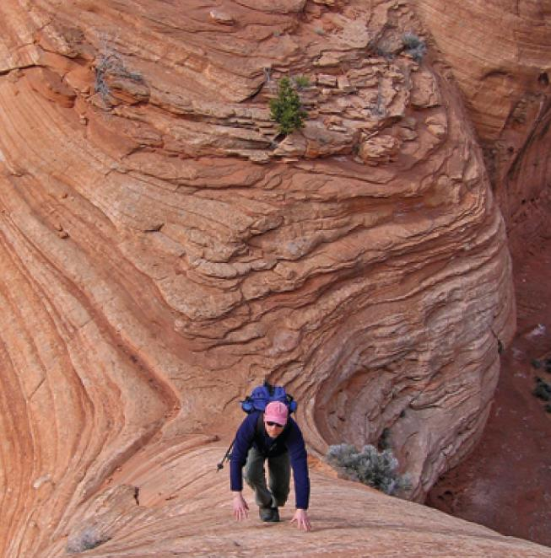
14
Partial Derivatives
Copyright © Cengage Learning. All rights reserved.

Slide 2

14.6
Directional Derivatives and the Gradient Vector
Copyright © Cengage Learning. All rights reserved.

Slide 3
Directional Derivatives and the Gradient Vector
In this section we introduce a type of derivative, called a directional derivative, that enables us to find the rate of change of a function of two or more variables in any direction.

Slide 4
Directional Derivatives

Slide 5
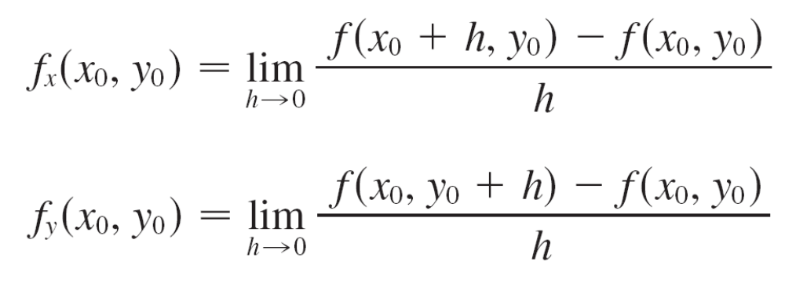

Directional Derivatives
Recall that if z = f (x, y), then the partial derivatives f_{x} and f_{y} are defined as
and represent the rates of change of z in the
x- and y-directions, that is, in the directions of the unit vectors i and j.

Slide 6
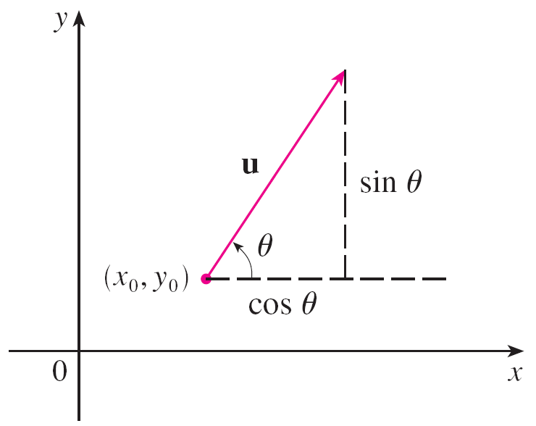
Directional Derivatives
Suppose that we now wish to find the rate of change of z at (x₀, y₀) in the direction of an arbitrary unit vector u = ⟨a, b⟩.
(See Figure 2.)
To do this we consider the surface S with the equation
z = f (x, y) (the graph of f) and we let z₀ = f (x₀, y₀). Then the point P(x₀, y₀, z₀) lies on S.
Figure 2
A unit vector u = ⟨a, b⟩ = ⟨cos θ, sin θ ⟩

Slide 7
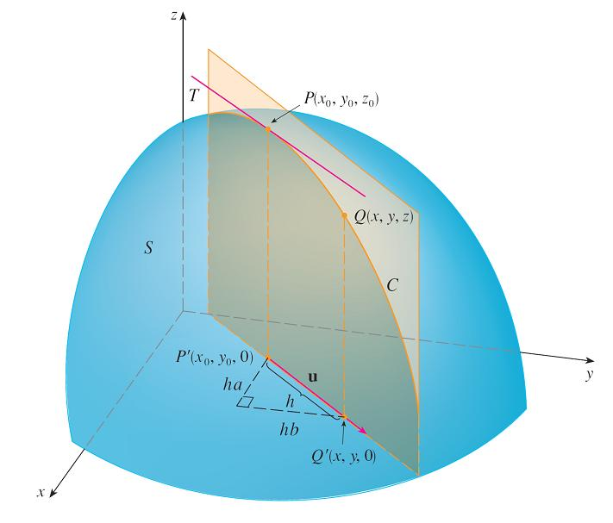
Directional Derivatives
The vertical plane that passes through P in the direction of u intersects S in a curve C. (See Figure 3.)
Figure 3

Slide 8

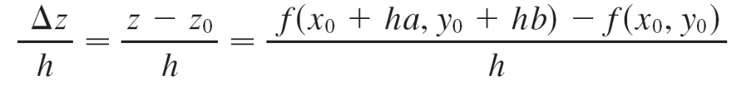
Directional Derivatives
The slope of the tangent line T to C at the point P is the rate of change of z in the direction of u.
If Q(x, y, z) is another point on C and P′, Q′ are the projections of P, Q onto the xy-plane, then the vector is parallel to u and so
= hu = ⟨ha, hb⟩
for some scalar h. Therefore x – x₀ = ha, y – y₀ = hb, so x = x₀ + ha, y = y₀ + hb, and

Slide 9
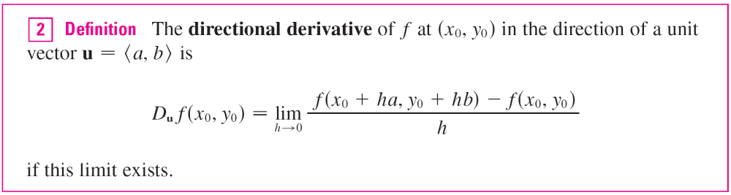
Directional Derivatives
If we take the limit as h → 0, we obtain the rate of change of z (with respect to distance) in the direction of u, which is called the directional derivative of f in the direction of u.

Slide 10

Directional Derivatives
By comparing Definition 2 with Equations , we see that if u = i = ⟨1, 0⟩, then D_{i}f = f_{x} and if u = j = ⟨0, 1⟩, then D_{j}f = f_{y}.
In other words, the partial derivatives of f with respect to
x and y are just special cases of the directional derivative.

Slide 11
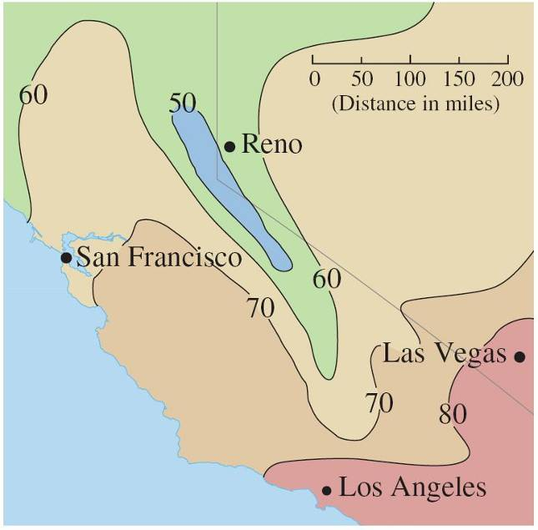
Example 1
Use the weather map in Figure 1 to estimate the value of the directional derivative of the temperature function at Reno in the southeasterly direction.
Figure 1

Slide 12

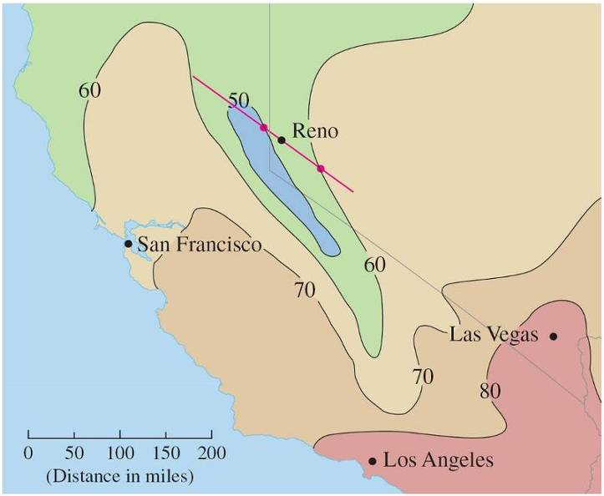
Example 1 – Solution
The unit vector directed toward the southeast is but we won’t need to use this expression.
We start by drawing a line through Reno toward the southeast (see Figure 4).
Figure 4

Slide 13
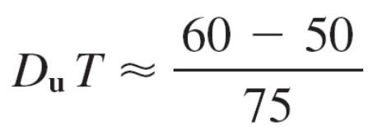
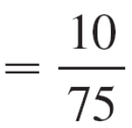

Example 1 – Solution
cont’d
We approximate the directional derivative D_{u}T by the average rate of change of the temperature between the points where this line intersects the isothermals
T = 50 and T = 60.
The temperature at the point southeast of Reno is T = 60°F
and the temperature at the point northwest of Reno is
T = 50°F.
The distance between these points looks to be about
75 miles. So the rate of change of the temperature in the southeasterly direction is

Slide 14
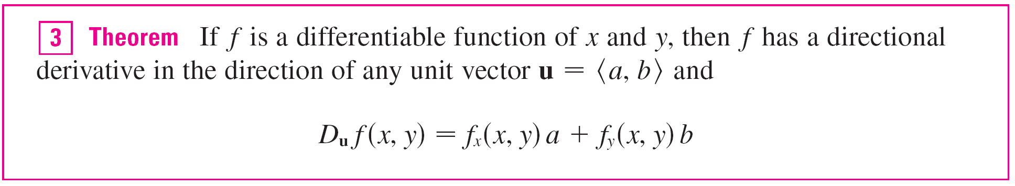
Directional Derivatives
When we compute the directional derivative of a function defined by a formula, we generally use the following theorem.

Slide 15

Directional Derivatives
If the unit vector u makes an angle θ with the positive x-axis (as in Figure 2), then we can write u = ⟨cos θ, sin θ ⟩ and the formula in Theorem 3 becomes
D_{u}f (x, y) = f_{x}(x, y) cos θ + f_{y}(x, y) sin θ
Figure 2
A unit vector u = ⟨a, b⟩ = ⟨cos θ, sin θ ⟩

Slide 16
The Gradient Vectors

Slide 17

The Gradient Vectors
Notice from Theorem 3 that the directional derivative of a differentiable function can be written as the dot product of two vectors:
D_{u}f (x, y) = f_{x}(x, y)a + f_{y}(x, y)b
= ⟨f_{x}(x, y), f_{y}(x, y)⟩  ⟨a, b⟩
= ⟨f_{x}(x, y), f_{y}(x, y)⟩  u
The first vector in this dot product occurs not only in computing directional derivatives but in many other contexts as well.
So we give it a special name (the gradient of f ) and a special notation (grad f or ∇f, which is read “del f ”).

Slide 18
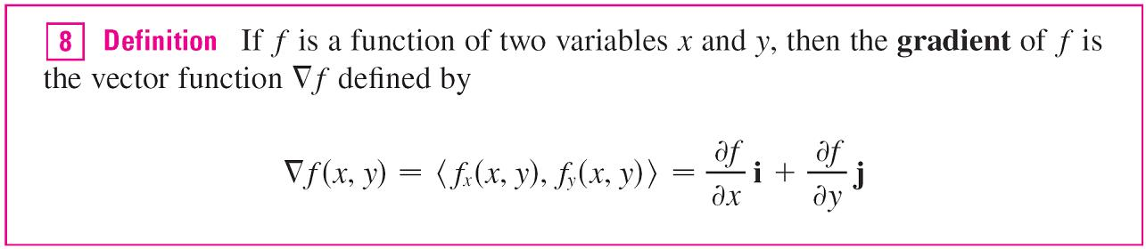
The Gradient Vectors

Slide 19
Example 3
If f (x, y) = sin x + e^{xy}, then
∇f (x, y) = ⟨f_{x}, f_{y}⟩
= ⟨cos x + ye^{xy}, xe^{xy}⟩
and ∇f (0, 1) = ⟨2, 0⟩

Slide 20


The Gradient Vectors
With this notation for the gradient vector, we can rewrite the expression (7) for the directional derivative of a differentiable function as
This expresses the directional derivative in the direction of u as the scalar projection of the gradient vector onto u.

Slide 21
Functions of Three Variables

Slide 22
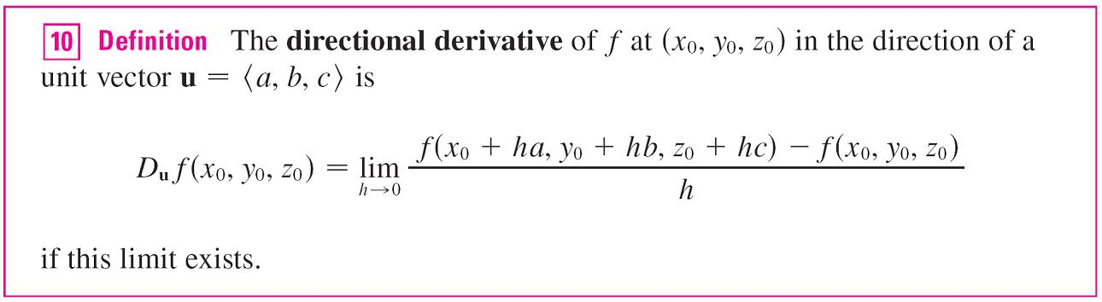
Functions of Three Variables
For functions of three variables we can define directional derivatives in a similar manner.
Again D_{u}f (x, y, z) can be interpreted as the rate of change of the function in the direction of a unit vector u.

Slide 23
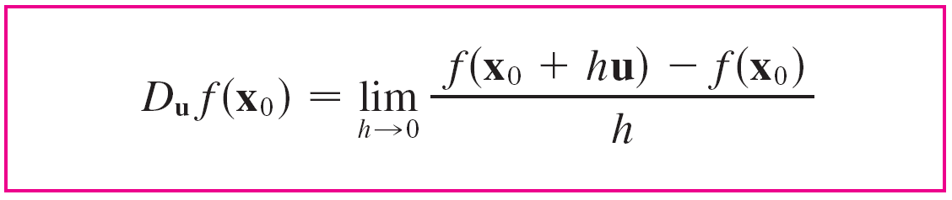

Functions of Three Variables
If we use vector notation, then we can write both
definitions (2 and 10) of the directional derivative in the compact form
where x₀ = ⟨x₀, y₀⟩ if n = 2 and x₀ = ⟨x₀, y₀, z₀⟩ if n = 3.
This is reasonable because the vector equation of the line through x₀ in the direction of the vector u is given by
x = x₀ + t u and so f (x₀ + hu) represents the value of f at a point on this line.

Slide 24

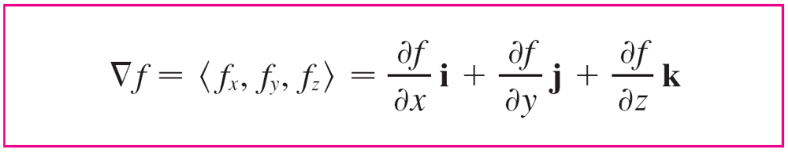

Functions of Three Variables
If f (x, y, z) is differentiable and u = ⟨a, b, c⟩, then
D_{u}f (x, y, z) = f_{x}(x, y, z)a + f_{y}(x, y, z)b + f_{z}(x, y, z)c
For a function f of three variables, the gradient vector, denoted by ∇f or grad f, is
∇f (x, y, z) = ⟨f_{x}(x, y, z), f_{y}(x, y, z), f_{z}(x, y, z)⟩
or, for short,

Slide 25


Functions of Three Variables
Then, just as with functions of two variables, Formula 12 for the directional derivative can be rewritten as

Slide 26
Example 5
If f (x, y, z) = x sin yz, (a) find the gradient of f and (b) find the directional derivative of f at (1, 3, 0) in the direction of
v = i + 2 j – k.
Solution:
(a) The gradient of f is
∇f (x, y, z) = ⟨f_{x}(x, y, z), f_{y}(x, y, z), f_{z}(x, y, z)⟩
= ⟨sin yz, xz cos yz, xy cos yz⟩

Slide 27
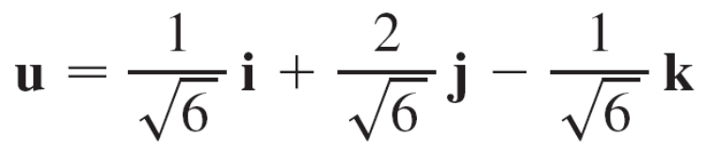
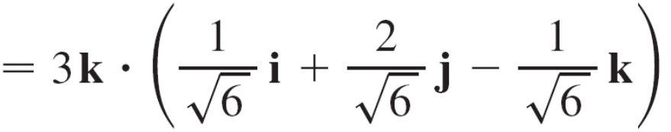
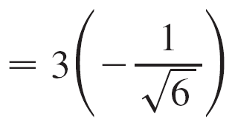
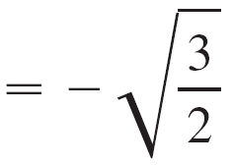
Example 5 – Solution
cont’d
(b) At (1, 3, 0) we have ∇f (1, 3, 0) = ⟨0, 0, 3⟩.
The unit vector in the direction of v = i + 2 j – k is
Therefore Equation 14 gives
D_{u}f (1, 3, 0) = ∇f (1, 3, 0)  u

Slide 28
Maximizing the Directional Derivatives

Slide 29
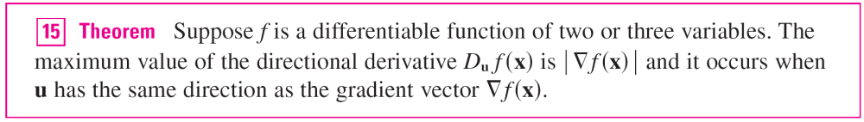
Maximizing the Directional Derivatives
Suppose we have a function f of two or three variables and we consider all possible directional derivatives of f at a given point.
These give the rates of change of f in all possible directions.
We can then ask the questions: In which of these directions does f change fastest and what is the maximum rate of change? The answers are provided by the following theorem.

Slide 30

Example 6
(a) If f (x, y) = xe^{y}, find the rate of change of f at the point
P(2, 0) in the direction from P to .
(b) In what direction does f have the maximum rate of
change? What is this maximum rate of change?
Solution:
(a) We first compute the gradient vector:
∇f (x, y) = ⟨f_{x}, f_{y}⟩ = ⟨e^{y}, xe^{y}⟩
∇f (2, 0) = ⟨1, 2⟩

Slide 31





Example 6 – Solution
cont’d
The unit vector in the direction of = ⟨–1.5, 2⟩ is
u = so the rate of change of f in the direction
from P to Q is
D_{u}f (2, 0) = ∇f (2, 0)  u
(b) According to Theorem 15, f increases fastest in the
direction of the gradient vector ∇f (2, 0) = ⟨1, 2⟩.
The maximum rate of change is
| ∇f (2, 0) | = | ⟨1, 2⟩ | =

Slide 32
Tangent Planes to Level Surfaces

Slide 33

Tangent Planes to Level Surfaces
Suppose S is a surface with equation F(x, y, z) = k, that is, it is a level surface of a function F of three variables, and let
P(x₀, y₀, z₀) be a point on S.
Let C be any curve that lies on the surface S and passes through the point P. Recall that the curve C is described by a continuous vector function r(t) = ⟨x(t), y(t), z(t)⟩.
Let t₀ be the parameter value corresponding to P; that is,
r(t₀) = ⟨x₀, y₀, z₀⟩. Since C lies on S, any point (x(t), y(t), z(t)) must satisfy the equation of S, that is,
F(x(t), y(t), z(t)) = k

Slide 34
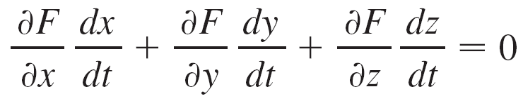

Tangent Planes to Level Surfaces
If x, y, and z are differentiable functions of t and F is also differentiable, then we can use the Chain Rule to differentiate both sides of Equation 16 as follows:
But, since ∇F = ⟨F_{x}, F_{y}, F_{z}⟩ and r′(t) = ⟨x′(t), y′(t), z′(t)⟩, Equation 17 can be written in terms of a dot product as
∇F  r′(t) = 0

Slide 35

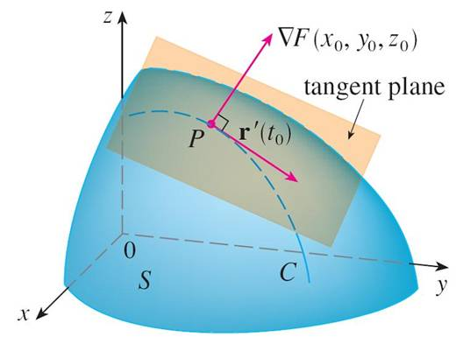
Tangent Planes to Level Surfaces
In particular, when t = t₀ we have r(t₀) = ⟨x₀, y₀, z₀⟩, so
∇F(x₀, y₀, z₀)  r′(t₀) = 0
Equation 18 says that the gradient vector at P, ∇F(x₀, y₀, z₀), is perpendicular to the tangent vector r′(t₀) to any curve C on S that passes through P. (See Figure 9.)
Figure 9

Slide 36
Tangent Planes to Level Surfaces
If ∇F(x₀, y₀, z₀) ≠ 0, it is therefore natural to define the tangent plane to the level surface F(x, y, z) = k at
P(x₀, y₀, z₀) as the plane that passes through P and has normal vector ∇F(x₀, y₀, z₀).
Using the standard equation of a plane, we can write the equation of this tangent plane as

Slide 37

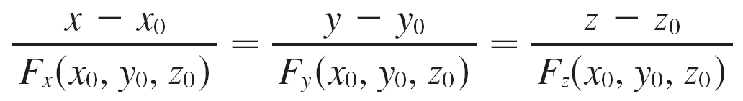
Tangent Planes to Level Surfaces
The normal line to S at P is the line passing through P and perpendicular to the tangent plane.
The direction of the normal line is therefore given by the gradient vector ∇F(x₀, y₀, z₀) and so, its symmetric equations are

Slide 38
Tangent Planes to Level Surfaces
In the special case in which the equation of a surface S is of the form z = f (x, y) (that is, S is the graph of a function f of two variables), we can rewrite the equation as
F(x, y, z) = f (x, y) – z = 0
and regard S as a level surface (with k = 0) of F. Then
F_{x}(x₀, y₀, z₀) = f_{x}(x₀, y₀)
F_{y}(x₀, y₀, z₀) = f_{y}(x₀, y₀)
F_{z}(x₀, y₀, z₀) = –1
so Equation 19 becomes
f_{x}(x₀, y₀)(x – x₀) + f_{y}(x₀, y₀)(y – y₀) – (z – z₀) = 0

Slide 39
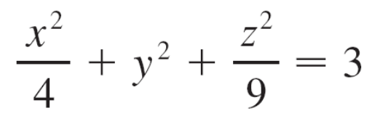
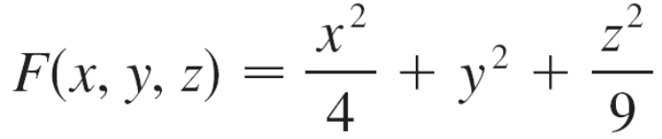
Example 8
Find the equations of the tangent plane and normal line at the point (–2, 1, –3) to the ellipsoid
Solution:
The ellipsoid is the level surface (with k = 3) of the function

Slide 40




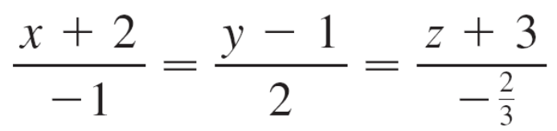
Example 8 – Solution
cont’d
Therefore we have
F_{x}(x, y, z) = F_{y}(x, y, z) = 2y F_{z}(x, y, z) =
F_{x}(–2, 1, –3) = –1 F_{y}(–2, 1, –3) = 2 F_{z}(–2, 1, –3) =
Then Equation 19 gives the equation of the tangent plane at (–2, 1, –3) as
–1(x + 2) + 2(y – 1) – (z + 3) = 0
which simplifies to 3x – 6y + 2z + 18 = 0.
By Equation 20, symmetric equations of the normal line are

Slide 41
Significance of the Gradient Vectors

Slide 42
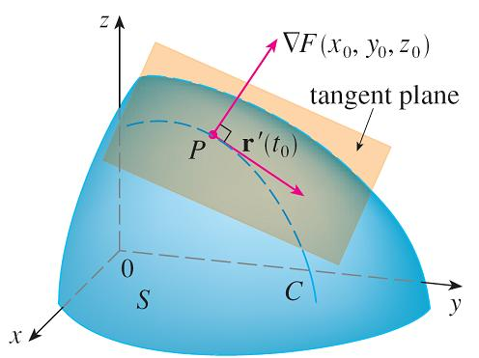
Significance of the Gradient Vectors
We now summarize the ways in which the gradient vector is significant.
We first consider a function f of three variables and a point P(x₀, y₀, z₀) in its domain.
On the one hand, we know from Theorem 15 that the gradient vector ∇f (x₀, y₀, z₀) gives the direction of fastest increase of f.
On the other hand, we know that
∇f (x₀, y₀, z₀) is orthogonal to the
level surface S of f through P.
(Refer to Figure 9.)
Figure 9

Slide 43
Significance of the Gradient Vectors
These two properties are quite compatible intuitively because as we move away from P on the level surface S, the value of f does not change at all.
So it seems reasonable that if we move in the perpendicular direction, we get the maximum increase.
In like manner we consider a function f of two variables and a point P(x₀, y₀) in its domain.
Again the gradient vector ∇f (x₀, y₀) gives the direction of fastest increase of f. Also, by considerations similar to our discussion of tangent planes, it can be shown that ∇f (x₀, y₀) is perpendicular to the level curve f (x, y) = k that passes through P.

Slide 44
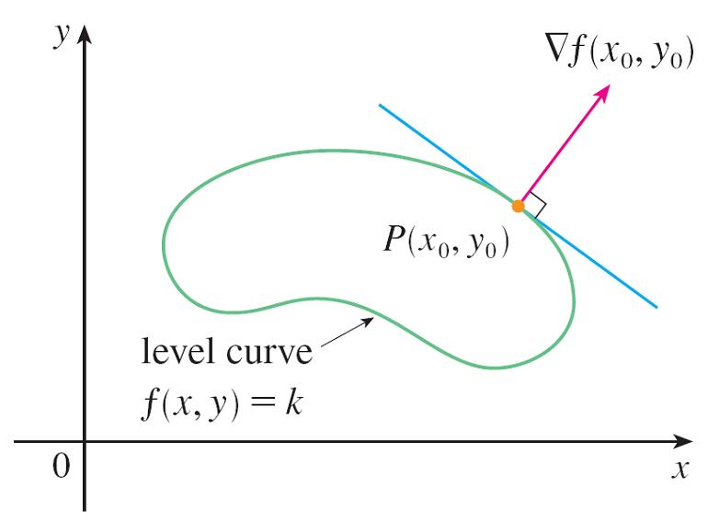
Significance of the Gradient Vectors
Again this is intuitively plausible because the values of f remain constant as we move along the curve.
(See Figure 11.)
Figure 11

Slide 45
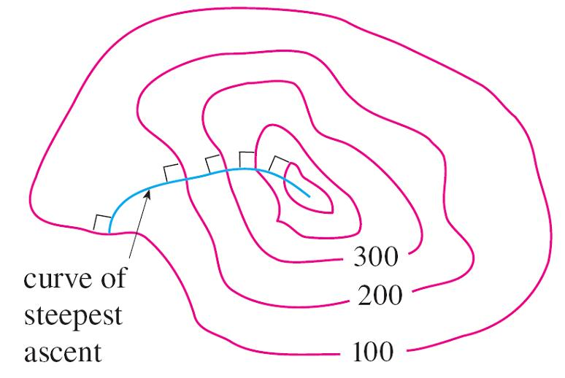
Significance of the Gradient Vectors
If we consider a topographical map of a hill and let f (x, y) represent the height above sea level at a point with coordinates (x, y), then a curve of steepest ascent can be drawn as in Figure 12 by making it perpendicular to all of the contour lines.
Figure 12

Slide 46
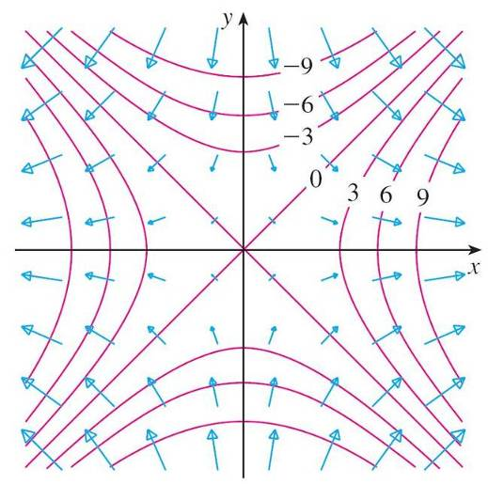
Significance of the Gradient Vectors
Computer algebra systems have commands that plot sample gradient vectors.
Each gradient vector ∇f (a, b) is plotted starting at the point (a, b). Figure 13 shows such a plot (called a gradient vector field ) for the function f (x, y) = x² – y² superimposed on a contour map of f.
As expected, the gradient
vectors point “uphill” and
are perpendicular to the
level curves.
Figure 13

