Slide 1


14
Partial Derivatives
Copyright © Cengage Learning. All rights reserved.

Slide 2

14.7
Maximum and Minimum Values
Copyright © Cengage Learning. All rights reserved.

Slide 3
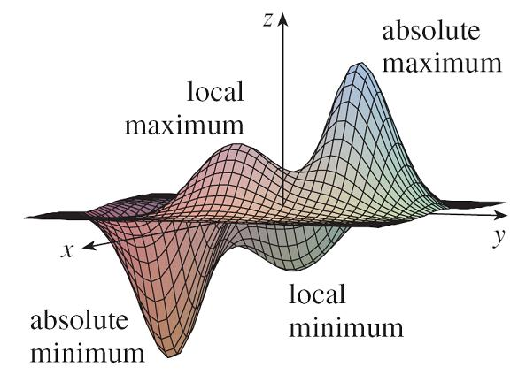
Maximum and Minimum Values
In this section we see how to use partial derivatives to locate maxima and minima of functions of two variables.
Look at the hills and valleys in the graph of f shown in Figure 1.
Figure 1

Slide 4
Maximum and Minimum Values
There are two points (a, b) where f has a local maximum, that is, where f (a, b) is larger than nearby values of f (x, y).
The larger of these two values is the absolute maximum.
Likewise, f has two local minima, where f (a, b) is smaller than nearby values.
The smaller of these two values is the absolute minimum.

Slide 5
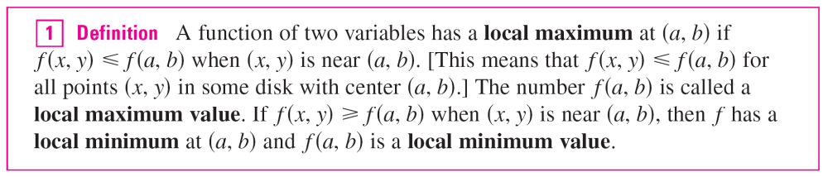
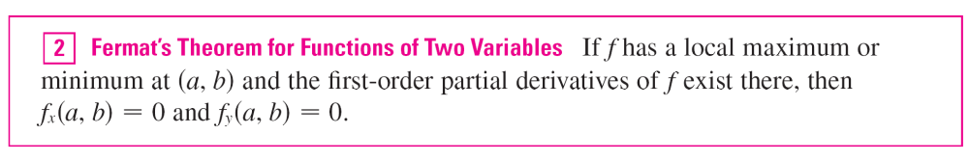
Maximum and Minimum Values
If the inequalities in Definition 1 hold for all points (x, y) in the domain of f, then f has an absolute maximum (or absolute minimum) at (a, b).

Slide 6
Maximum and Minimum Values
A point (a, b) is called a critical point (or stationary point) of f if f _{x} (a, b) = 0 and f _{y} (a, b) = 0, or if one of these partial derivatives does not exist.
Theorem 2 says that if f has a local maximum or minimum at (a, b), then (a, b) is a critical point of f.
However, as in single-variable calculus, not all critical points give rise to maxima or minima.
At a critical point, a function could have a local maximum or a local minimum or neither.

Slide 7
Example 1
Let f (x, y) = x² + y² – 2x – 6y + 14.
Then
f _{x} (x, y) = 2x – 2 f _{y} (x, y) = 2y – 6
These partial derivatives are equal to 0 when x = 1 and
y = 3, so the only critical point is (1, 3).
By completing the square, we find that
f (x, y) = 4 + (x – 1)² + (y – 3)²

Slide 8
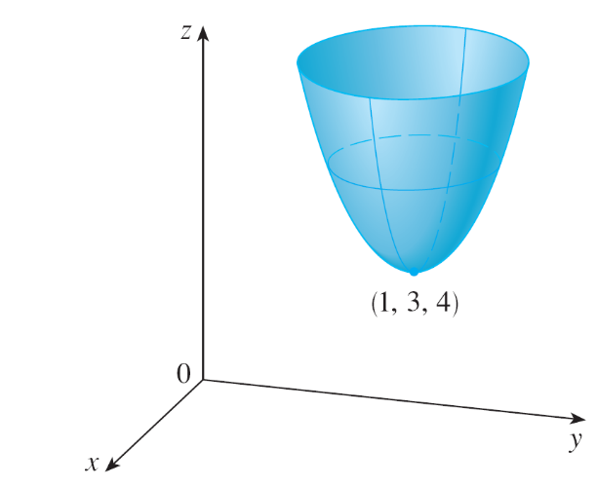
Example 1
cont’d
Since (x – 1)² ≥ 0 and (y – 3)² ≥ 0, we have f (x, y) ≥ 4 for all values of x and y.
Therefore f (1, 3) = 4 is a local minimum, and in fact it is the absolute minimum of f.
This can be confirmed geometrically from the graph of f, which is the elliptic paraboloid with vertex (1, 3, 4) shown in Figure 2.
Figure 2
z = x² + y² – 2x – 6y + 14

Slide 9
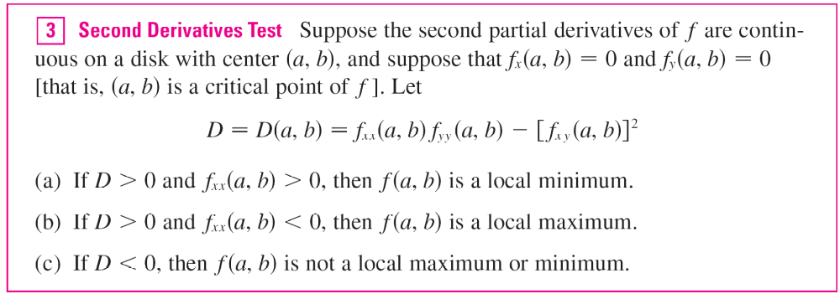
Maximum and Minimum Values
The following test, is analogous to the Second Derivative Test for functions of one variable.
In case (c) the point (a, b) is called a saddle point of f and the graph of f crosses its tangent plane at (a, b).

Slide 10
Absolute Maximum and Minimum Values

Slide 11
Absolute Maximum and Minimum Values
For a function f of one variable, the Extreme Value Theorem says that if f is continuous on a closed interval [a, b], then f has an absolute minimum value and an absolute maximum value.
According to the Closed Interval Method, we found these by evaluating f not only at the critical numbers but also at the endpoints a and b.
There is a similar situation for functions of two variables.

Slide 12

Absolute Maximum and Minimum Values
Just as a closed interval contains its endpoints, a closed set in is one that contains all its boundary points.
[A boundary point of D is a point (a, b) such that every disk with center (a, b) contains points in D and also points not in D.]
For instance, the disk
D = {(x, y)| x² + y² ≤ 1}
which consists of all points on and inside the circle x² + y² = 1, is a closed set because it contains all of its boundary points (which are the points on the circle x² + y² = 1).

Slide 13
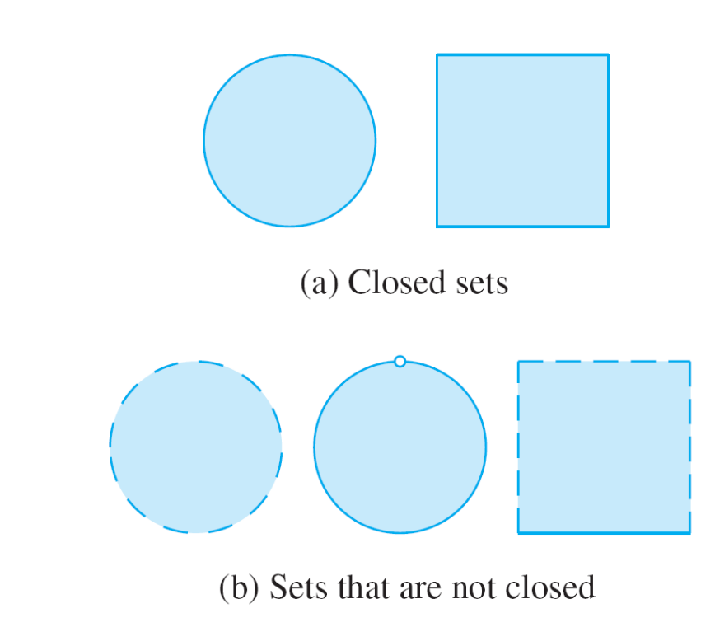
Absolute Maximum and Minimum Values
But if even one point on the boundary curve were omitted, the set would not be closed. (See Figure 11.)
Figure 11

Slide 14
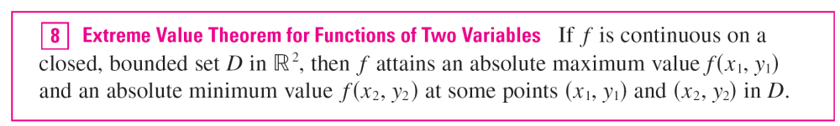
Absolute Maximum and Minimum Values
A bounded set in is one that is contained within some disk.
In other words, it is finite in extent.
Then, in terms of closed and bounded sets, we can state the following counterpart of the Extreme Value Theorem in two dimensions.

Slide 15
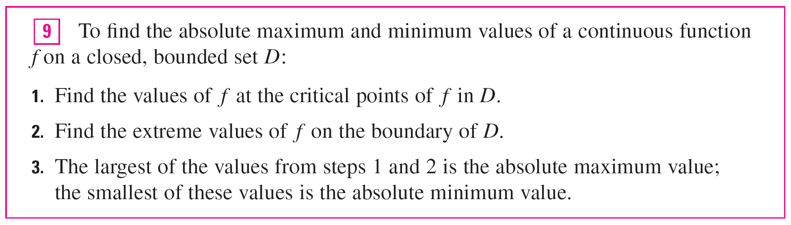
Absolute Maximum and Minimum Values
To find the extreme values guaranteed by Theorem 8, we note that, by Theorem 2, if f has an extreme value at (x₁, y₁), then (x₁, y₁) is either a critical point of f or a boundary point of D.
Thus we have the following extension of the Closed Interval Method.

Slide 16

Example 7
Find the absolute maximum and minimum values of the function f (x, y) = x² – 2xy + 2y on the rectangle
D = {(x, y) | 0 ≤ x ≤ 3, 0 ≤ y ≤ 2}.
Solution:
Since f is a polynomial, it is continuous on the closed, bounded rectangle D, so Theorem 8 tells us there is both an absolute maximum and an absolute minimum.
According to step 1 in , we first find the critical points.

Slide 17
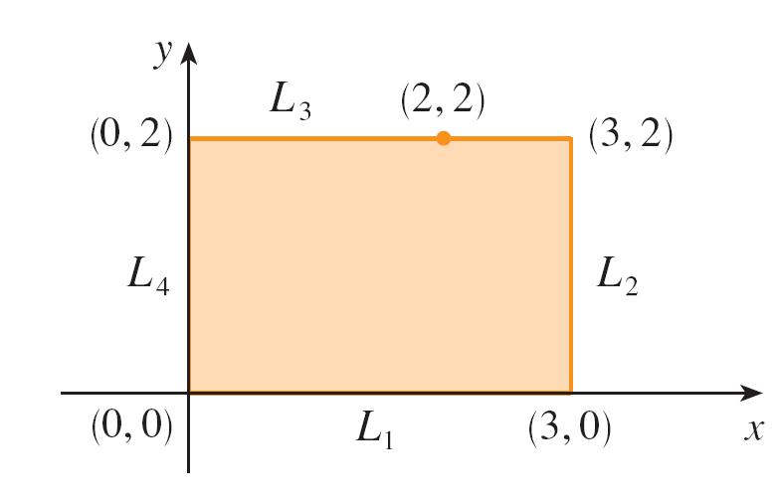
Example 7 – Solution
cont’d
These occur when
f_{x} = 2x – 2y = 0 f_{y} = –2x + 2 = 0
so the only critical point is (1, 1), and the value of f there is f (1, 1) = 1.
In step 2 we look at the values of f on the boundary of D,
which consists of the four line segments L₁, L₂, L₃, L₄
shown in Figure 12.
Figure 12

Slide 18
Example 7 – Solution
cont’d
On L₁ we have y = 0 and
f (x, 0) = x² 0 ≤ x ≤ 3
This is an increasing function of x, so its minimum value is f (0, 0) = 0 and its maximum value is f (3, 0) = 9.
On L₂ we have x = 3 and
f (3, y) = 9 – 4y 0 ≤ y ≤ 2
This is a decreasing function of y, so its maximum value is f (3, 0) = 9 and its minimum value is f (3, 2) = 1.

Slide 19
Example 7 – Solution
cont’d
On L₃ we have y = 2 and
f (x, 2) = x² – 4x + 4 0 ≤ x ≤ 3
Simply by observing that f (x, 2) = (x – 2)², we see
that the minimum value of this function is f (2, 2) = 0 and the maximum value is f (0, 2) = 4.

Slide 20
Example 7 – Solution
cont’d
Finally, on L₄ we have x = 0 and
f (0, y) = 2y 0 ≤ y ≤ 2
with maximum value f (0, 2) = 4 and minimum value
f (0, 0) = 0.
Thus, on the boundary, the minimum value of f is 0 and the maximum is 9.

Slide 21
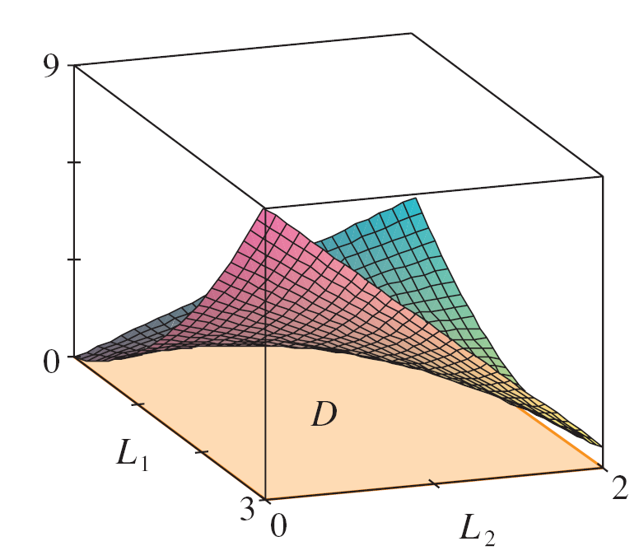
Example 7 – Solution
cont’d
In step 3 we compare these values with the value f (1, 1) = 1 at the critical point and conclude that the absolute maximum value of f on D is f (3, 0) = 9 and the absolute minimum value is f (0, 0) = f (2, 2) = 0.
Figure 13 shows the graph of f.
Figure 13
f (x, y) = x² – 2xy + 2y

