Slide 1


15
Multiple Integrals
Copyright © Cengage Learning. All rights reserved.

Slide 2

15.1
Double Integrals over Rectangles
Copyright © Cengage Learning. All rights reserved.

Slide 3
Review of the Definite Integrals

Slide 4

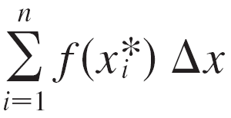


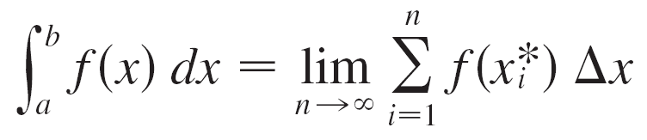

Review of the Definite Integrals
First let’s recall the basic facts concerning definite integrals of functions of a single variable.
If f (x) is defined for a ≤ x ≤ b, we start by dividing the interval [a, b] into n subintervals [x_{i – 1}, x_{i}] of equal width
Δx = (b – a)/n and we choose sample points in these subintervals. Then we form the Riemann sum
and take the limit of such sums as n → to obtain the definite integral of f from a to b:

Slide 5

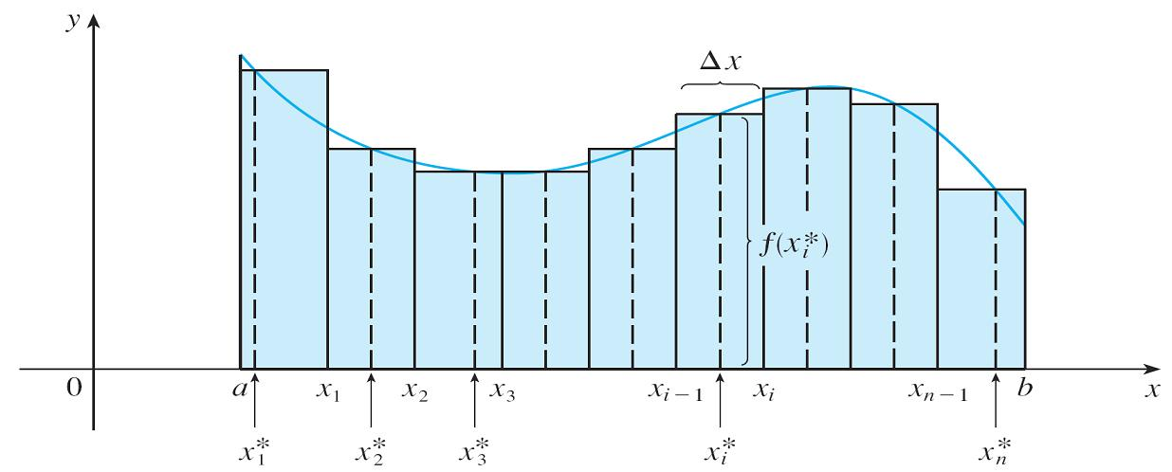
Review of the Definite Integrals
In the special case where f (x) ≥ 0, the Riemann sum can be interpreted as the sum of the areas of the approximating rectangles in Figure 1, and represents the area under the curve y = f (x) from a to b.
Figure 1

Slide 6
Volumes and Double Integrals

Slide 7

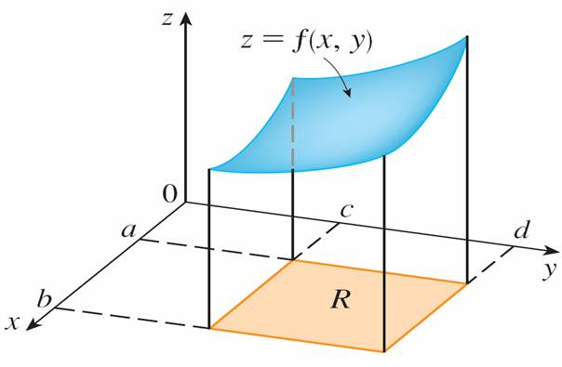

Volumes and Double Integrals
In a similar manner we consider a function f of two variables defined on a closed rectangle
R = [a, b] × [c, d ] = {(x, y) ∈ | a ≤ x ≤ b, c ≤ y ≤ d }
and we first suppose that f (x, y) ≥ 0.
The graph of f is a surface
with equation z = f (x, y).
Let S be the solid that lies
above R and under the
graph of f, that is,
S = {(x, y, z) ∈ | 0 ≤ z ≤ f (x, y), (x, y) ∈ R}
(See Figure 2.)
Figure 2

Slide 8
Volumes and Double Integrals
Our goal is to find the volume of S.
The first step is to divide the rectangle R into subrectangles.
We accomplish this by dividing the interval [a, b] into m subintervals [xi – 1, xi] of equal width Δx = (b – a)/m and dividing [c, d ] into n subintervals [yj – 1, yj] of equal width
Δy = (d – c)/n.

Slide 9
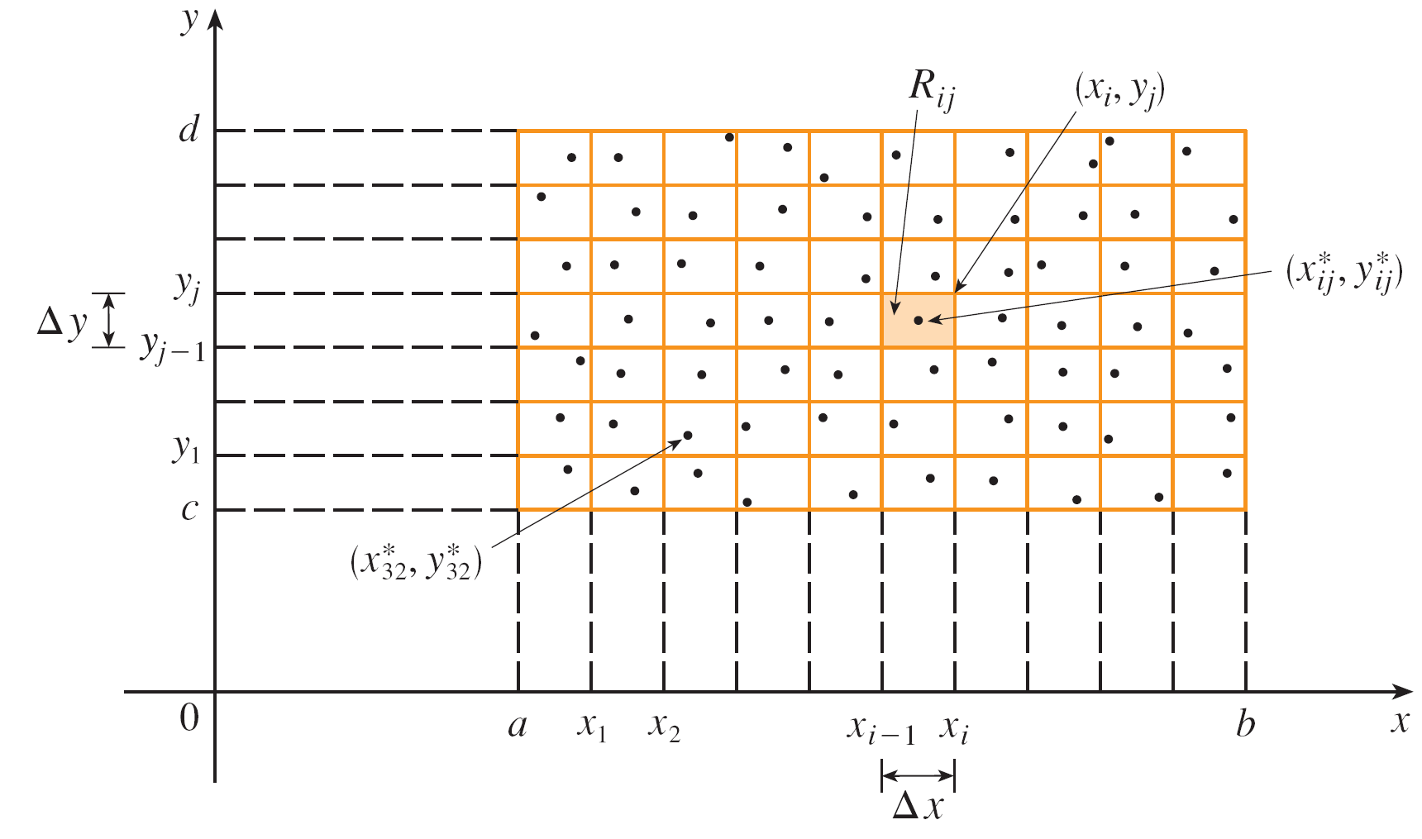
Volumes and Double Integrals
By drawing lines parallel to the coordinate axes through the endpoints of these subintervals, as in Figure 3, we form the subrectangles
R_{ij} = [x_{i – 1}, x_{i}] × [y_{j– 1}, y_{j}] = {(x, y) | x_{i – 1} ≤ x ≤ x_{i} , y_{j– 1} ≤ y ≤ y_{j} }
each with area ΔA = Δx Δy.
Dividing R into subrectangles
Figure 3

Slide 10


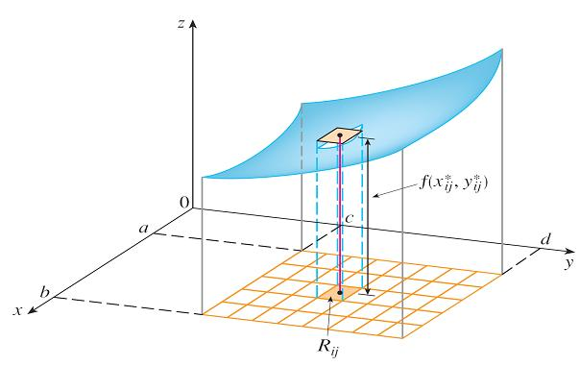

Volumes and Double Integrals
If we choose a sample point in each R_{ij}, then we can approximate the part of S that lies above each R_{ij} by a thin rectangular box (or “column”) with base R_{ij} and height as shown in Figure 4.
The volume of this box is the height of the box times the
area of the base rectangle:
Figure 4

Slide 11
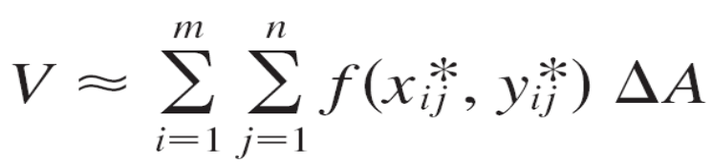

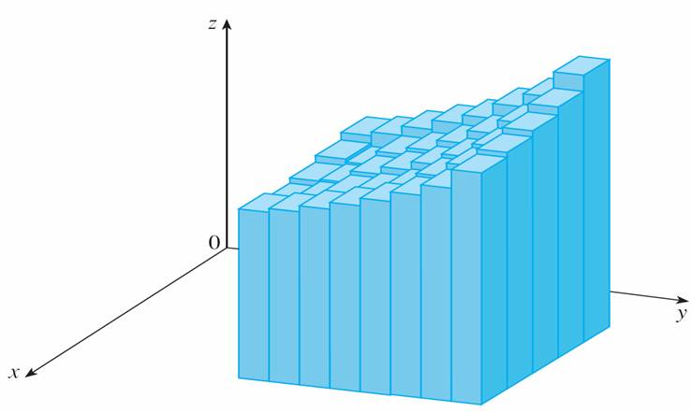
Volumes and Double Integrals
If we follow this procedure for all the rectangles and add the volumes of the corresponding boxes, we get an approximation to the total volume of S:
(See Figure 5.) This double
sum means that for each
subrectangle we evaluate
f at the chosen point and
multiply by the area of the
subrectangle, and then we
add the results.
Figure 5

Slide 12
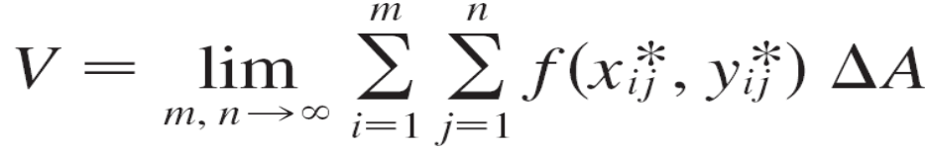

Volumes and Double Integrals
Our intuition tells us that the approximation given in (3) becomes better as m and n become larger and so we would expect that
We use the expression in Equation 4 to define the volume of the solid S that lies under the graph of f and above the rectangle R.

Slide 13

Volumes and Double Integrals
Limits of the type that appear in Equation 4 occur frequently, not just in finding volumes but in a variety of other situations even when f is not a positive function. So we make the following definition.
A function f is called integrable if the limit in Definition 5 exists.

Slide 14
Volumes and Double Integrals
It is shown in courses on advanced calculus that all continuous functions are integrable. In fact, the double integral of f exists provided that f is “not too discontinuous.”
In particular, if f is bounded [that is, there is a constant M such that | f (x, y) | ≤ M for all (x, y) in R], and f is continuous there, except on a finite number of smooth curves, then f is integrable over R.

Slide 15
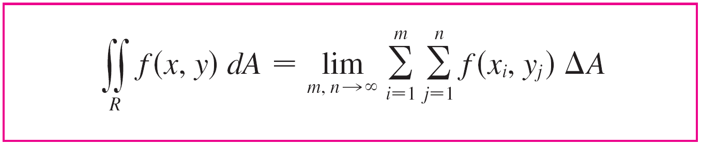

Volumes and Double Integrals
The sample point can be chosen to be any point in the subrectangle R_{ij}, but if we choose it to be the upper
right-hand corner of R_{ij} [namely (x_{i}, y_{j}), see Figure 3], then the expression for the double integral looks simpler:
Dividing R into subrectangles
Figure 3

Slide 16
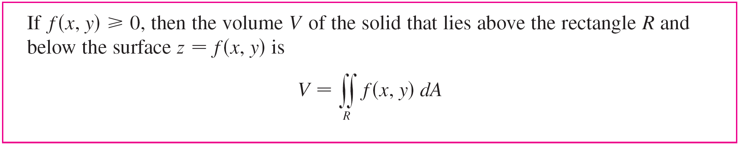
Volumes and Double Integrals
By comparing Definitions 4 and 5, we see that a volume can be written as a double integral:

Slide 17
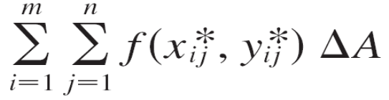

Volumes and Double Integrals
The sum in Definition 5,
is called a double Riemann sum and is used as an approximation to the value of the double integral. [Notice how similar it is to the Riemann sum in for a function of a single variable.]

Slide 18

Volumes and Double Integrals
If f happens to be a positive function, then the double Riemann sum represents the sum of volumes of columns, as in Figure 5, and is an approximation to the volume under the graph of f.
Figure 5

Slide 19
Example 1
Estimate the volume of the solid that lies above the square R = [0, 2] × [0, 2] and below the elliptic paraboloid
z = 16 – x² – 2y².
Divide R into four equal squares and choose the sample point to be the upper right corner of each square Rij. Sketch the solid and the approximating
rectangular boxes.

Slide 20
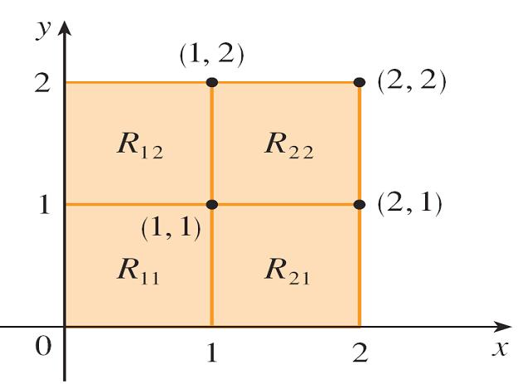
Example 1 – Solution
The squares are shown in Figure 6.
The paraboloid is the graph of f (x, y) = 16 – x² – 2y² and the area of each square is ΔA = 1.
Figure 6

Slide 21
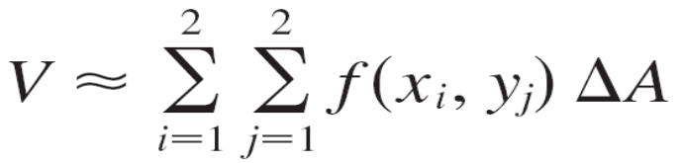
Example 1 – Solution
cont’d
Approximating the volume by the Riemann sum with
m = n = 2, we have
= f (1, 1) ΔA + f (1, 2) ΔA + f (2, 1) ΔA + f (2, 2) ΔA
= 13(1) + 7(1) + 10(1) + 4(1)
= 34

Slide 22
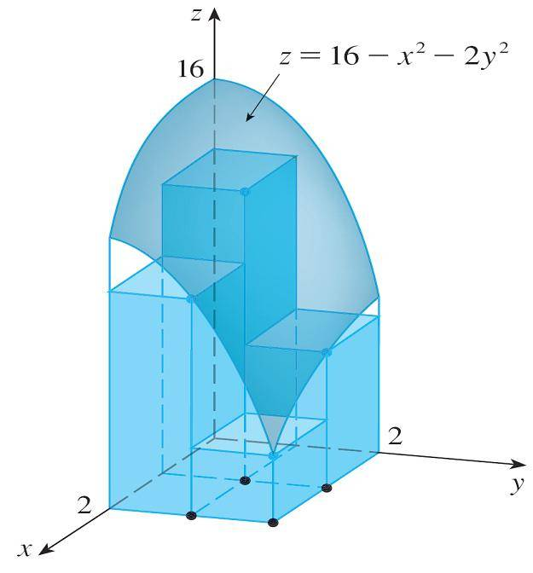
Example 1 – Solution
cont’d
This is the volume of the approximating rectangular boxes shown in Figure 7.
Figure 7

Slide 23
The Midpoint Rule

Slide 24



The Midpoint Rule
The methods that we used for approximating single integrals (the Midpoint Rule, the Trapezoidal Rule, Simpson’s Rule) all have counterparts for double integrals. Here we consider only the Midpoint Rule for double integrals.
This means that we use a double Riemann sum to approximate the double integral, where the sample point in R_{ij} is chosen to be the center of R_{ij}. In other words, is the midpoint of [x_{i – 1}, x_{i}] and is the midpoint of [y_{j – 1}, y_{j}].

Slide 25
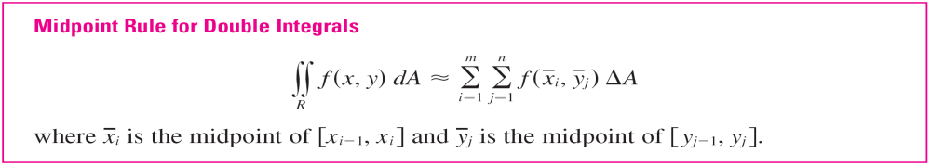
The Midpoint Rule

Slide 26
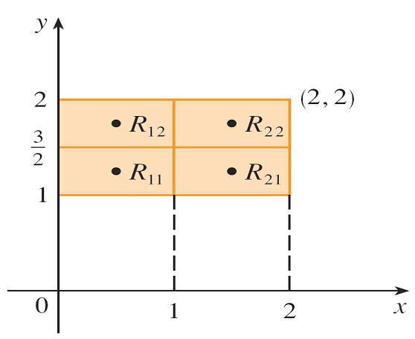
Example 3
Use the Midpoint Rule with m = n = 2 to estimate the value of the integral ∫∫_{R}(x – 3y²) dA, where
R = {(x, y) | 0 ≤ x ≤ 2 , 1 ≤ y ≤ 2}.
Solution:
In using the Midpoint Rule with m = n = 2, we evaluate
f (x, y) = x – 3y² at the centers of the four subrectangles
shown in Figure 10.
Figure 10

Slide 27



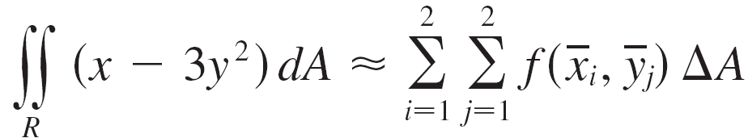
Example 3 – Solution
cont’d
So and
The area of each subrectangle is
Thus

Slide 28


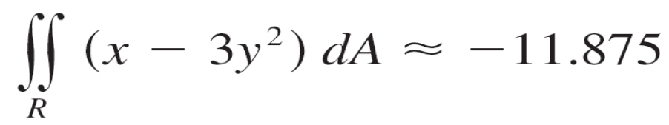
Example 3 – Solution
cont’d
Thus we have

Slide 29
Average Values

Slide 30
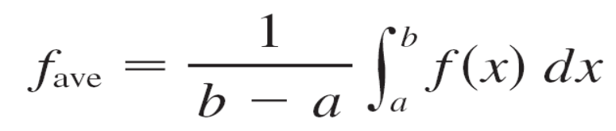
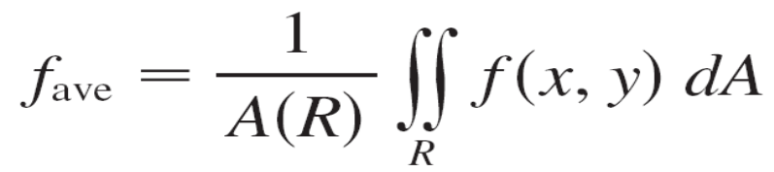
Average Values
Recall that the average value of a function f of one variable defined on an interval [a, b] is
In a similar fashion we define the average value of a function f of two variables defined on a rectangle R to be
where A(R) is the area of R.

Slide 31

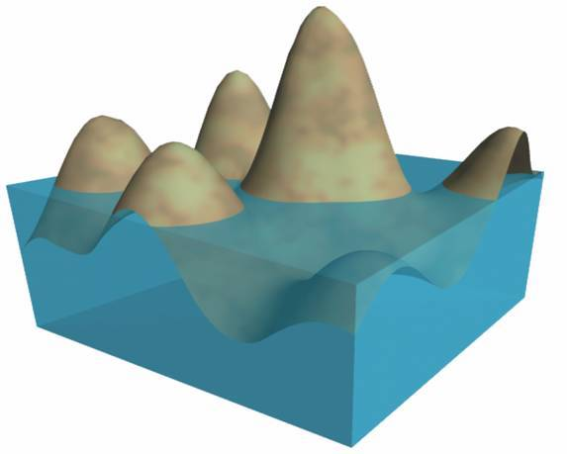
Average Values
If f (x, y) ≥ 0, the equation
A(R) × f_{ave} = f (x, y) dA
says that the box with base R and height f_{ave} has the same volume as the solid that lies under the graph of f.
[If z = f (x, y) describes a
mountainous region and you
chop off the tops of the
mountains at height f_{ave}, then
you can use them to fill in the
valleys so that the region
becomes completely flat.
See Figure 11.]
Figure 11

Slide 32
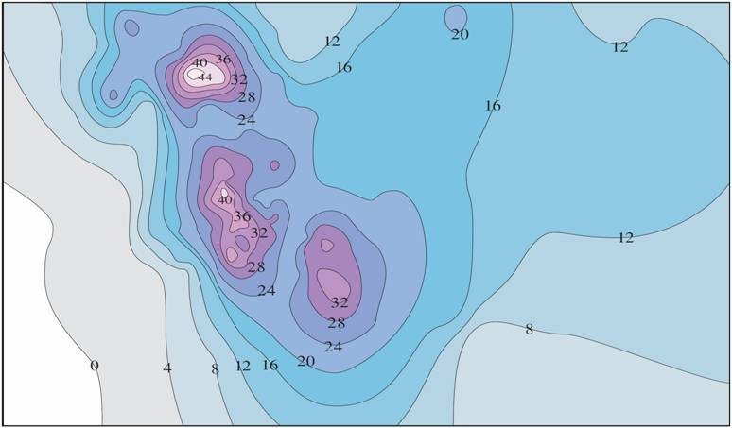
Example 4
The contour map in Figure 12 shows the snowfall, in inches, that fell on the state of Colorado on December 20 and 21, 2006. (The state is in the shape of a rectangle that measures 388 mi west to east and 276 mi south to north.) Use the contour map to estimate the average snowfall for the entire state of Colorado on those days.
Figure 12

Slide 33
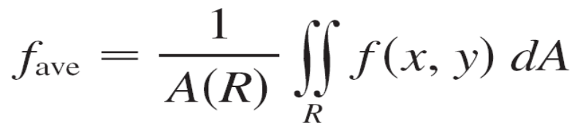
Example 4 – Solution
Let’s place the origin at the southwest corner of the state.
Then 0 ≤ x ≤ 388, 0 ≤ y ≤ 276, and f (x, y) is the snowfall, in inches, at a location x miles to the east and y miles to the north of the origin.
If R is the rectangle that represents Colorado, then the
average snowfall for the state on December 20–21 was
where A(R) = 388  276.

Slide 34
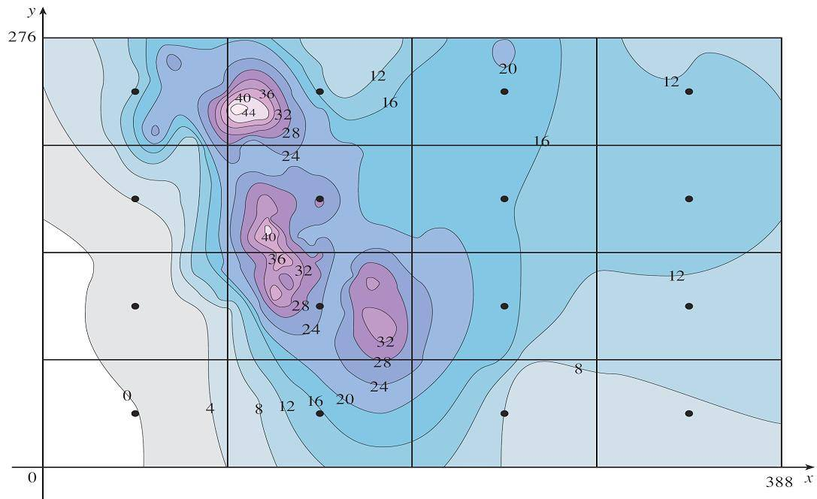
Example 4 – Solution
cont’d
To estimate the value of this double integral, let’s use the Midpoint Rule with m = n = 4. In other words, we divide R into 16 subrectangles of equal size, as in Figure 13.
Figure 13

Slide 35

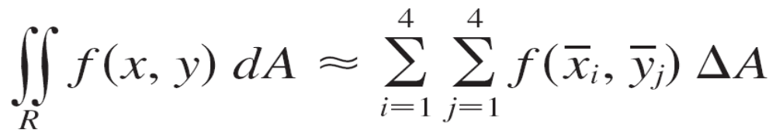
Example 4 – Solution
cont’d
The area of each subrectangle is
Using the contour map to estimate the value of f at the center of each subrectangle, we get
≈ ΔA[0 + 15 + 8 + 7 + 2 + 25 + 18.5
+ 11 + 4.5 + 28 + 17 + 13.5 + 12
+ 15 + 17.5 + 13]
= (6693)(207)
= 6693 mi²

Slide 36
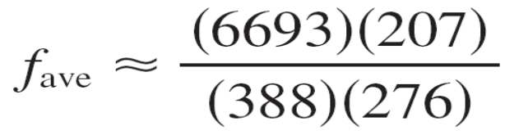

Example 4 – Solution
cont’d
Therefore
On December 20–21, 2006, Colorado received an average of approximately 13 inches of snow.

Slide 37
Properties of Double Integrals

Slide 38



Properties of Double Integrals
We list here three properties of double integrals. We assume that all of the integrals exist. Properties 7 and 8 are referred to as the linearity of the integral.
[f (x, y) + g(x, y)] dA = f (x, y) dA + g(x, y) dA
c f (x, y) dA = c f (x, y) dA where c is a constant
If f (x, y) ≥ g(x, y) for all (x, y) in R, then
f (x, y) dA ≥ g(x, y) dA

