Slide 1


15
Multiple Integrals
Copyright © Cengage Learning. All rights reserved.

Slide 2

15.2
Iterated Integrals
Copyright © Cengage Learning. All rights reserved.

Slide 3

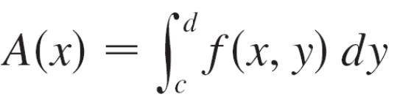
Iterated Integrals
Suppose that f is a function of two variables that is integrable on the rectangle R = [a, b] × [c, d ].
We use the notation to mean that x is held fixed and f (x, y) is integrated with respect to y from y = c to y = d. This procedure is called partial integration with respect to y. (Notice its similarity to partial differentiation.)
Now is a number that depends on the value of x, so it defines a function of x:

Slide 4
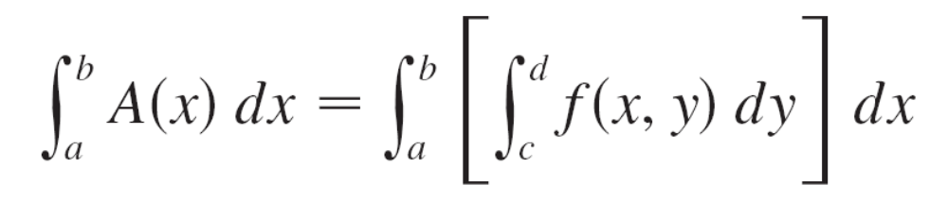

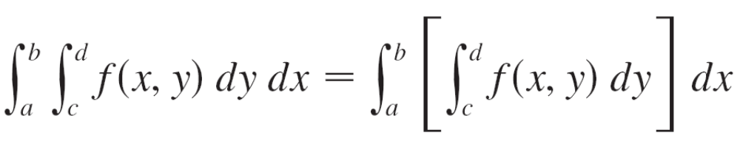

Iterated Integrals
If we now integrate the function A with respect to x from x = a to x = b, we get
The integral on the right side of Equation 1 is called an iterated integral. Usually the brackets are omitted. Thus
means that we first integrate with respect to y from c to d and then with respect to x from a to b.

Slide 5
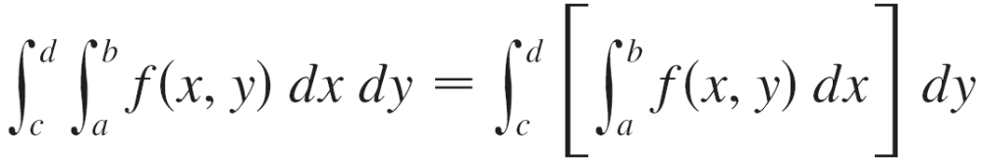

Iterated Integrals
Similarly, the iterated integral
means that we first integrate with respect to x (holding y fixed) from x = a to x = b and then we integrate the resulting function of y with respect to y from y = c to y = d.
Notice that in both Equations 2 and 3 we work from the inside out.

Slide 6
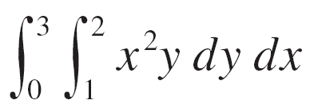
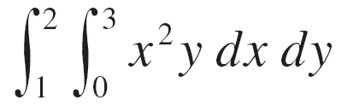
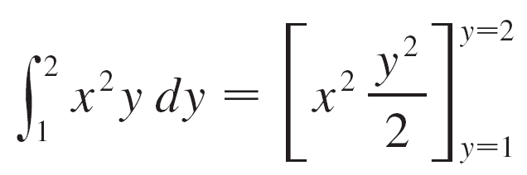
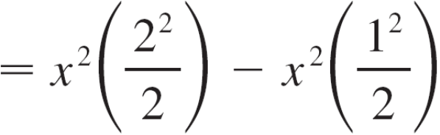

Example 1
Evaluate the iterated integrals.
(b)
Solution:
Regarding x as a constant, we obtain

Slide 7

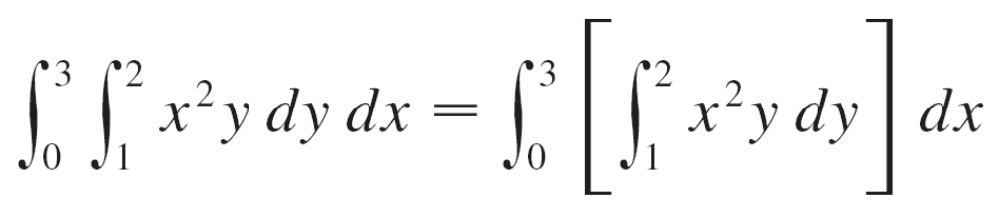
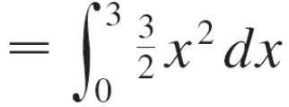
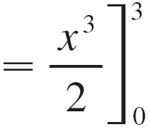
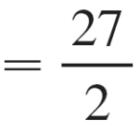
Example 1 – Solution
cont’d
Thus the function A in the preceding discussion is given by in this example.
We now integrate this function of x from 0 to 3:

Slide 8
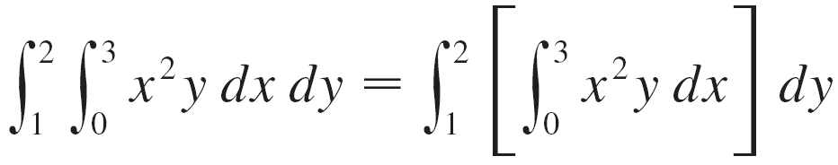
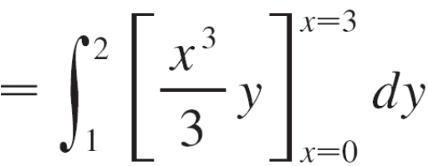
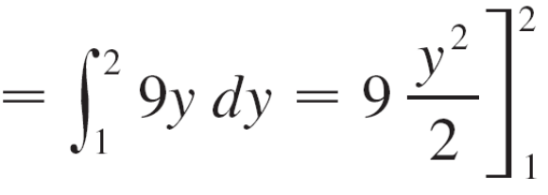
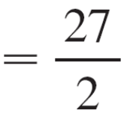
Example 1 – Solution
cont’d
(b) Here we first integrate with respect to x:

Slide 9
Iterated Integrals
Notice that in Example 1 we obtained the same answer whether we integrated with respect to y or x first.
In general, it turns out (see Theorem 4) that the two iterated integrals in Equations 2 and 3 are always equal; that is, the order of integration does not matter. (This is similar to Clairaut’s Theorem on the equality of the mixed partial derivatives.)

Slide 10
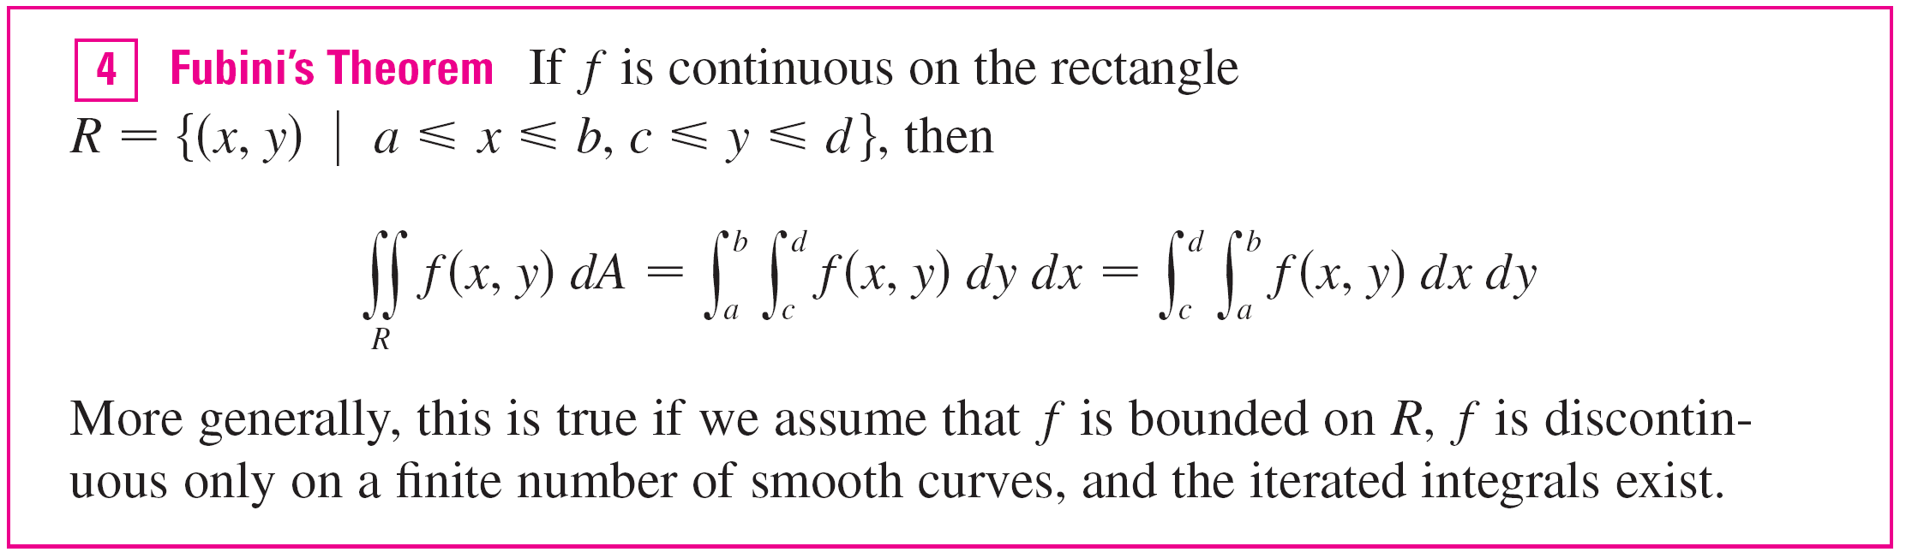
Iterated Integrals
The following theorem gives a practical method for evaluating a double integral by expressing it as an iterated integral (in either order).

Slide 11
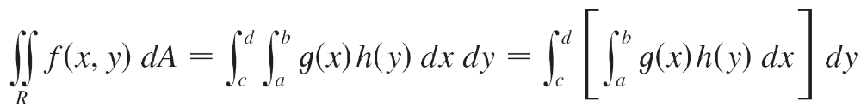
Iterated Integrals
In the special case where f (x, y) can be factored as the product of a function of x only and a function of y only, the double integral of f can be written in a particularly simple form.
To be specific, suppose that f (x, y) = g(x)h(y) and R = [a, b] × [c, d].
Then Fubini’s Theorem gives

Slide 12
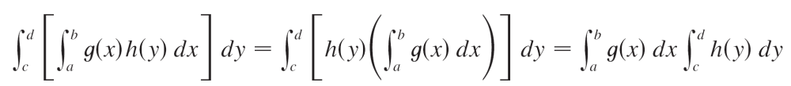

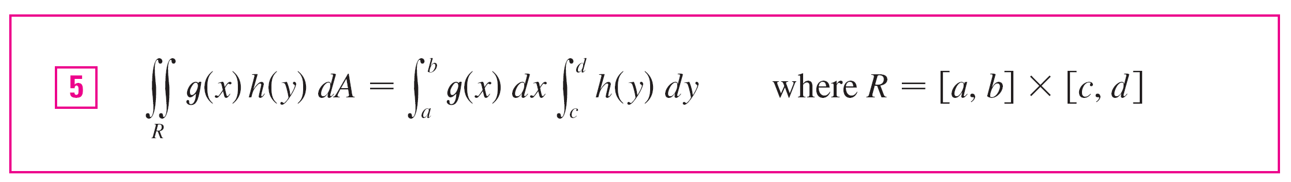
Iterated Integrals
In the inner integral, y is a constant, so h(y) is a constant and we can write
since is a constant.
Therefore, in this case, the double integral of f can be written as the product of two single integrals:

