Slide 1


15
Multiple Integrals
Copyright © Cengage Learning. All rights reserved.

Slide 2

15.4
Double Integrals in Polar Coordinates
Copyright © Cengage Learning. All rights reserved.

Slide 3
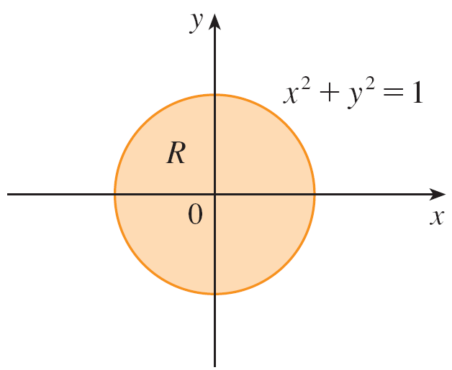
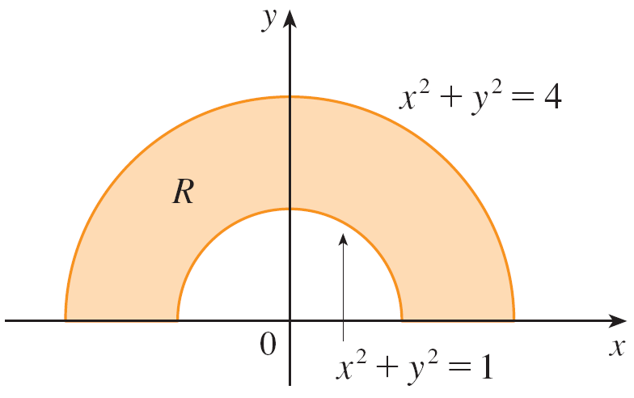
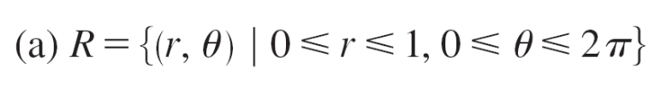
Double Integrals in Polar Coordinates
Suppose that we want to evaluate a double integral
∫ ∫_{R} f (x, y) dA, where R is one of the regions shown in
Figure 1. In either case the description of R in terms of rectangular coordinates is rather complicated, but R is easily described using polar coordinates.
Figure 1

Slide 4

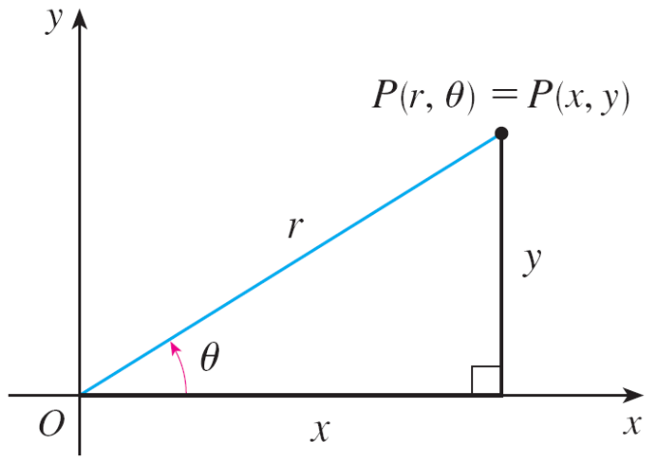
Double Integrals in Polar Coordinates
Recall from Figure 2 that the polar coordinates (r, θ ) of a point are related to the rectangular coordinates (x, y) by the equations
Figure 2

Slide 5
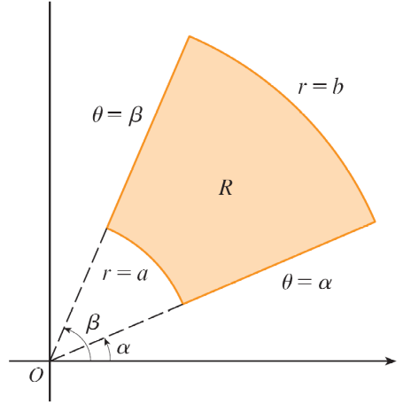
Double Integrals in Polar Coordinates
The regions in Figure 1 are special cases of a polar rectangle
R = {(r, θ ) | a ≤ r ≤ b, α ≤ θ ≤ β }
which is shown in Figure 3.
Polar rectangle
Figure 1
Figure 3

Slide 6
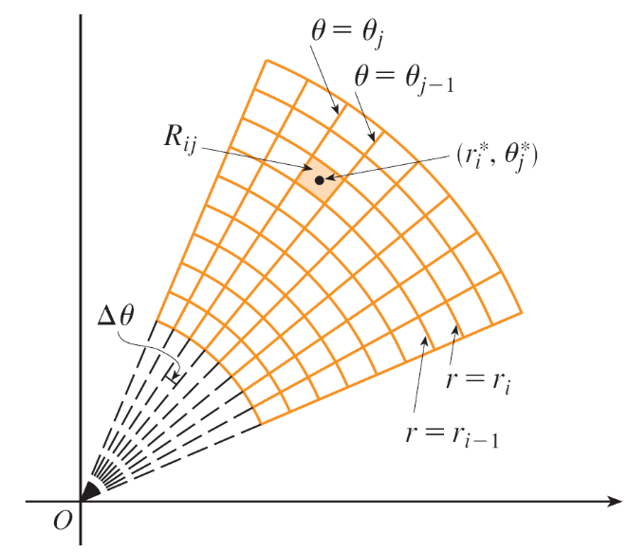
Double Integrals in Polar Coordinates
In order to compute the double integral ∫ ∫_{R} f (x, y) dA, where
R is a polar rectangle, we divide the interval [a, b] into m subintervals [r_{i – 1}, r_{i}] of equal width Δr = (b – a)/m and we divide the interval [α, β ] into n subintervals [θ_{j – 1}, θ_{j}] of
equal width Δθ = (β – α)/n.
Then the circles r = r_{i} and the
rays θ = θ_{j} divide the polar
rectangle R into the small polar
rectangles R_{ij} shown in Figure 4.
Dividing R into polar subrectangles
Figure 4

Slide 7

Double Integrals in Polar Coordinates
The “center” of the polar subrectangle
R_{ij} = {(r, θ ) | r_{i – 1} ≤ r ≤ r_{i}, θ_{j – 1} ≤ θ ≤ θ_{j}}
has polar coordinates
We compute the area of R_{ij} using the fact that the area of a sector of a circle with radius r and central angle θ is .

Slide 8
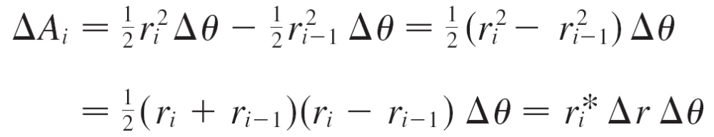
Double Integrals in Polar Coordinates
Subtracting the areas of two such sectors, each of which has central angle Δθ = θ_{j} – θ_{j – 1}, we find that the area of R_{ij} is
Although we have defined the double integral ∫ ∫_{R} f (x, y) dA
in terms of ordinary rectangles, it can be shown that, for continuous functions f, we always obtain the same answer using polar rectangles.

Slide 9

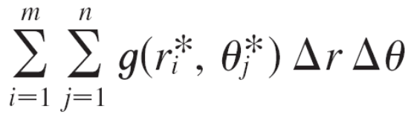
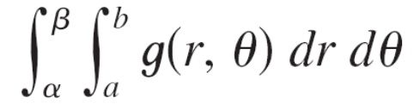
Double Integrals in Polar Coordinates
The rectangular coordinates of the center of R_{ij} are
, so a typical Riemann sum is
If we write g(r, θ ) = r f (r cos θ, r sin θ ), then the Riemann sum in Equation 1 can be written as
which is a Riemann sum for the double integral

Slide 10
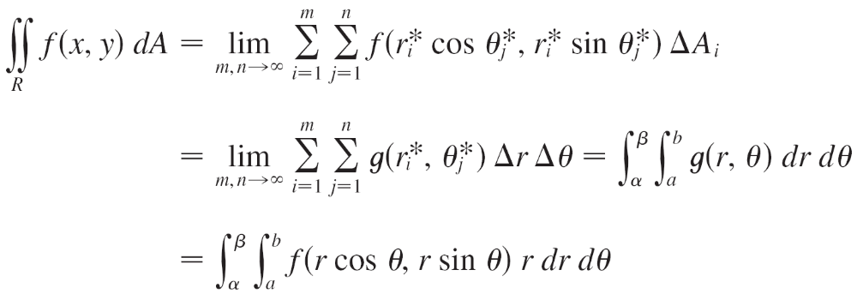
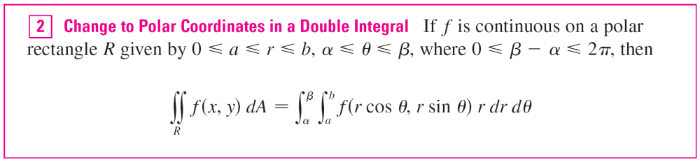
Double Integrals in Polar Coordinates
Therefore we have

Slide 11
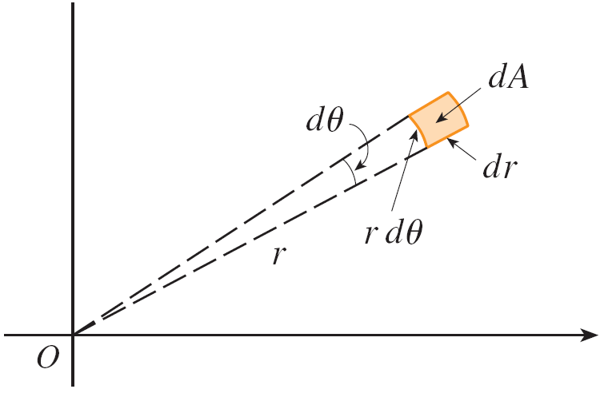
Double Integrals in Polar Coordinates
The formula in (2) says that we convert from rectangular to polar coordinates in a double integral by writing
x = r cos θ and y = r sin θ, using the appropriate limits of integration for r and θ, and replacing dA by r dr dθ.
Be careful not to forget the additional factor r on the right side of Formula 2.
A classical method for remembering
this is shown in Figure 5, where the
“infinitesimal” polar rectangle can be
thought of as an ordinary rectangle
with dimensions r dθ and dr and
therefore has “area” dA = r dr dθ.
Figure 5

Slide 12

Example 1
Evaluate ∫ ∫_{R} (3x + 4y²) dA, where R is the region in the upper half-plane bounded by the circles x² + y² = 1 and
x² + y² = 4.
Solution:
The region R can be described as
R = {(x, y) | y ≥ 0, 1 ≤ x² + y² ≤ 4}
It is the half-ring shown in Figure 1(b),
and in polar coordinates it is given by
1 ≤ r ≤ 2, 0 ≤ θ ≤ π.
Figure 1(b)

Slide 13
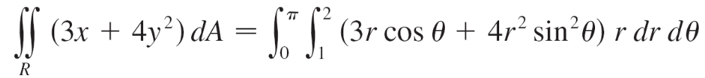
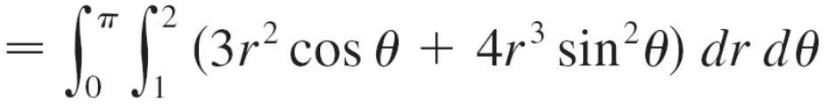
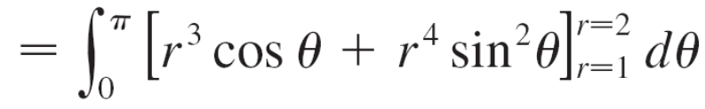
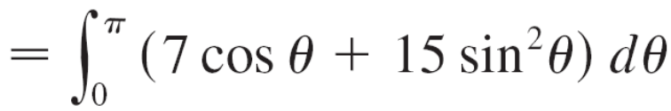
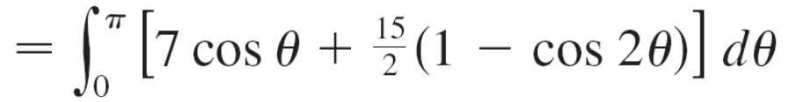
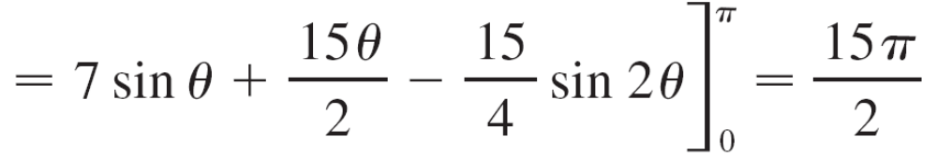
Example 1 – Solution
cont’d
Therefore, by Formula 2,

Slide 14
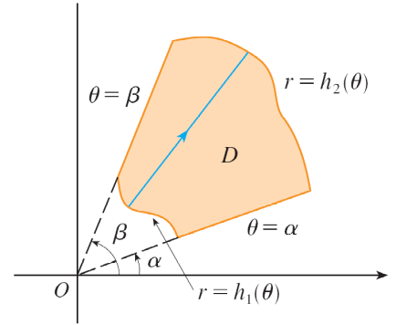
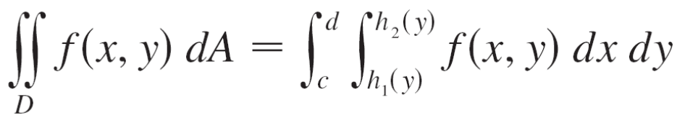
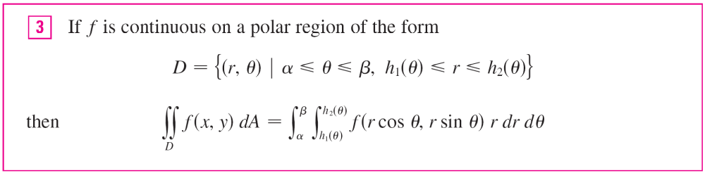
Double Integrals in Polar Coordinates
What we have done so far can be
extended to the more complicated
type of region shown in Figure 7.
In fact, by combining Formula 2
with
where D is a type II region, we obtain the following formula.
Figure 7

Slide 15
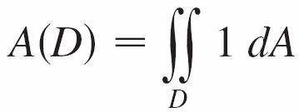
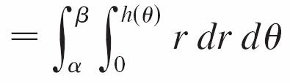
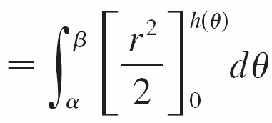
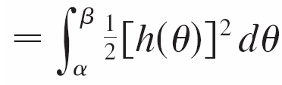
Double Integrals in Polar Coordinates
In particular, taking f (x, y) = 1, h₁(θ ) = 0, and h₂(θ ) = h(θ ) in this formula, we see that the area of the region D bounded by θ = α, θ = β, and r = h(θ ) is

