Slide 1


15
Multiple Integrals
Copyright © Cengage Learning. All rights reserved.

Slide 2

Applications of Double Integrals
15.5
Copyright © Cengage Learning. All rights reserved.

Slide 3
Density and Mass

Slide 4
Density and Mass
We were able to use single integrals to compute moments and the center of mass of a thin plate or lamina with constant density.
But now, equipped with the double integral, we can consider a lamina with variable density.
Suppose the lamina occupies a region D of the xy-plane and its density (in units of mass per unit area) at a point
(x, y) in D is given by ρ (x, y), where ρ is a continuous function on D.

Slide 5
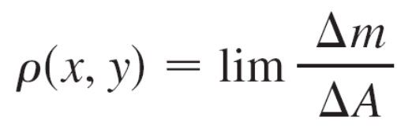
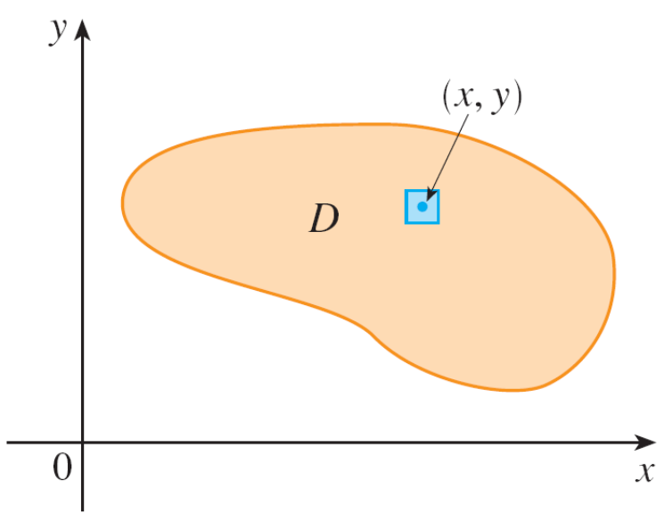
Density and Mass
This means that
where Δm and ΔA are the
mass and area of a small
rectangle that contains (x, y)
and the limit is taken as the
dimensions of the rectangle
approach 0. (See Figure 1.)
Figure 1

Slide 6
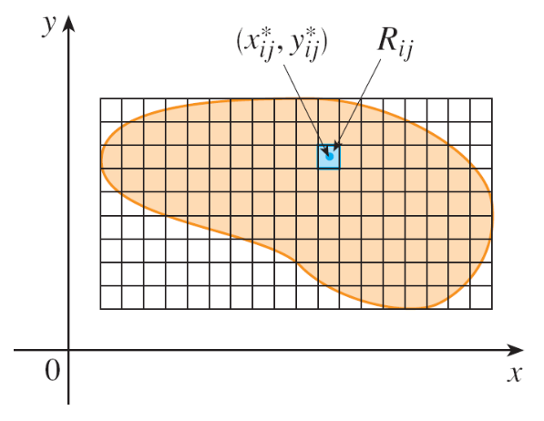

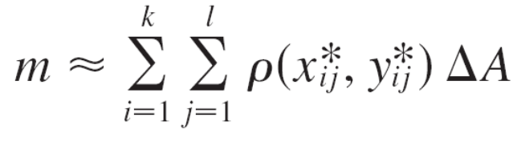
Density and Mass
To find the total mass m of the lamina we divide a rectangle R containing D into subrectangles R_{ij} of the same size (as in Figure 2) and consider ρ (x, y) to be 0 outside D.
If we choose a point in
R_{ij}, then the mass of the part of
the lamina that occupies R_{ij} is
approximately ρ ΔA,
where ΔA is the area of R_{ij}.
If we add all such masses, we get an approximation to the total mass:
Figure 2

Slide 7
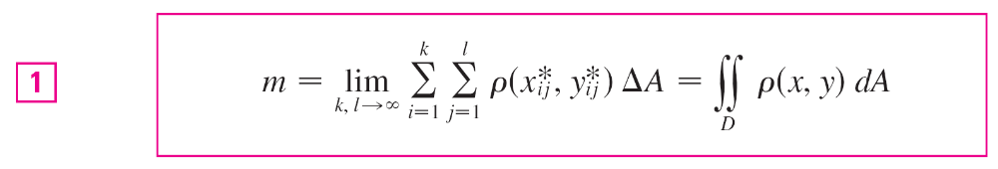
Density and Mass
If we now increase the number of subrectangles, we obtain the total mass m of the lamina as the limiting value of the approximations:
Physicists also consider other types of density that can be treated in the same manner.

Slide 8

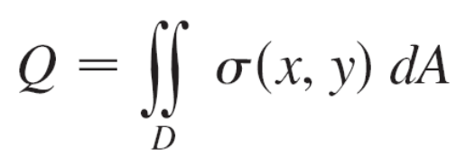
Density and Mass
For example, if an electric charge is distributed over a region D and the charge density (in units of charge per unit area) is given by σ (x, y) at a point (x, y) in D, then the total charge Q is given by

Slide 9
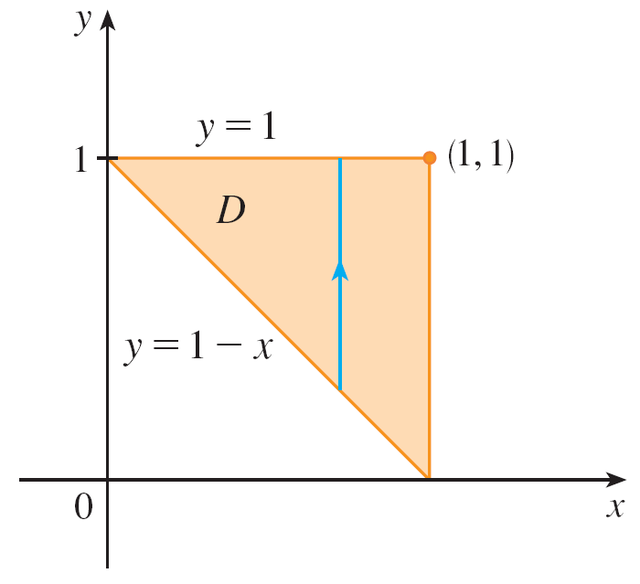
Example 1
Charge is distributed over the triangular region D in Figure 3 so that the charge density at (x, y) is σ (x, y) = xy, measured in coulombs per square meter (C/m²). Find the total charge.
Figure 3

Slide 10
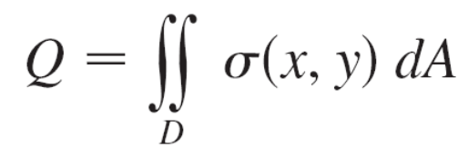
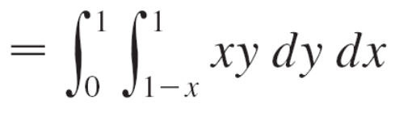
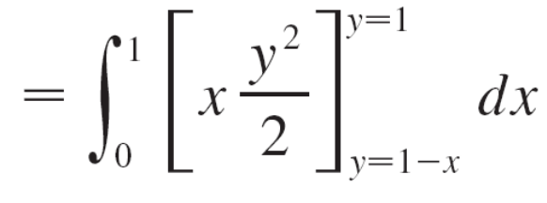
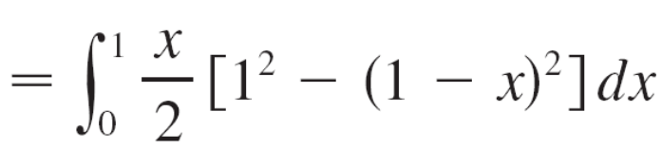
Example 1 – Solution
From Equation 2 and Figure 3 we have

Slide 11
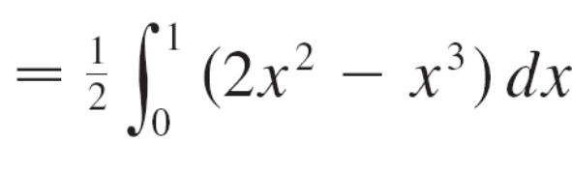
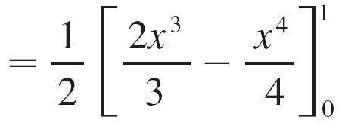
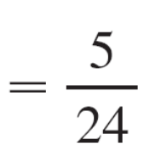

Example 1 – Solution
cont’d
Thus the total charge is C.

Slide 12
Moments and Centers of Mass

Slide 13
Moments and Centers of Mass
We have found the center of mass of a lamina with constant density; here we consider a lamina with variable density.
Suppose the lamina occupies a region D and has density function ρ (x, y).
Recall that we defined the moment of a particle about an axis as the product of its mass and its directed distance from the axis.
We divide D into small rectangles.

Slide 14

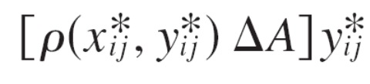
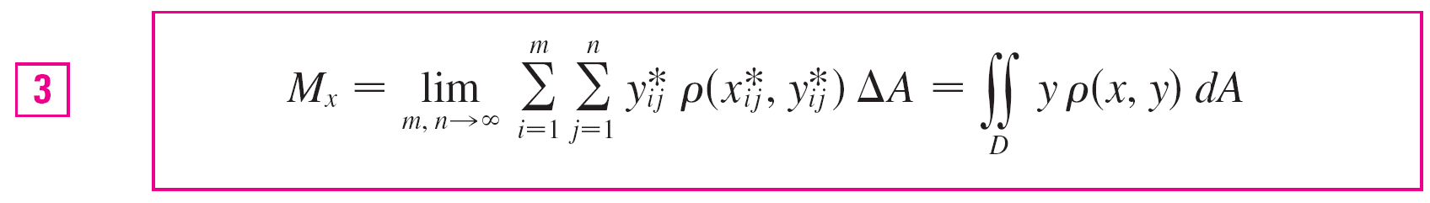
Moments and Centers of Mass
Then the mass of R_{ij} is approximately ρ ΔA, so we
can approximate the moment of R_{ij} with respect to the x-axis by
If we now add these quantities and take the limit as the number of subrectangles becomes large, we obtain the moment of the entire lamina about the x-axis:

Slide 15
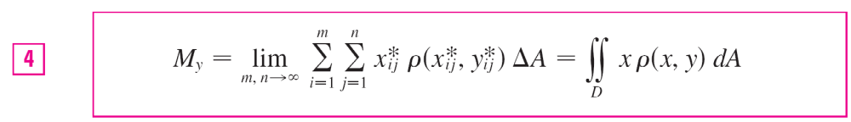



Moments and Centers of Mass
Similarly, the moment about the y-axis is
As before, we define the center of mass so that
and
The physical significance is that the lamina behaves as if its entire mass is concentrated at its center of mass.

Slide 16
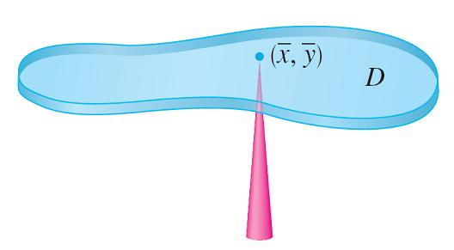
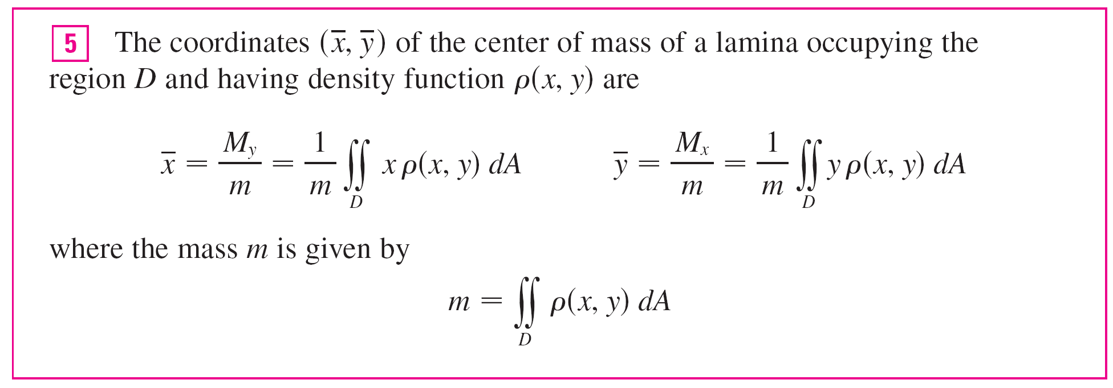
Moments and Centers of Mass
Thus the lamina balances
horizontally when supported
at its center of mass
(see Figure 4).
Figure 4

Slide 17
Moment of Inertia

Slide 18
Moment of Inertia
The moment of inertia (also called the second moment) of a particle of mass m about an axis is defined to be mr², where r is the distance from the particle to the axis.
We extend this concept to a lamina with density function ρ (x, y) and occupying a region D by proceeding as we did for ordinary moments.
We divide D into small rectangles, approximate the moment of inertia of each subrectangle about the x-axis, and take the limit of the sum as the number of subrectangles becomes large.

Slide 19
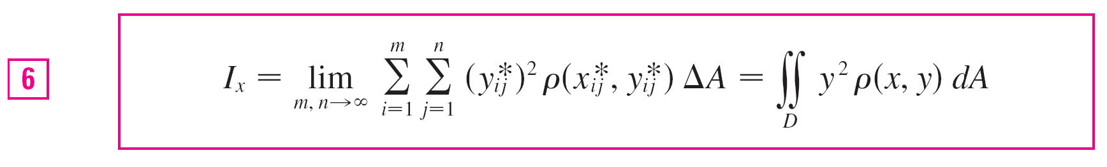
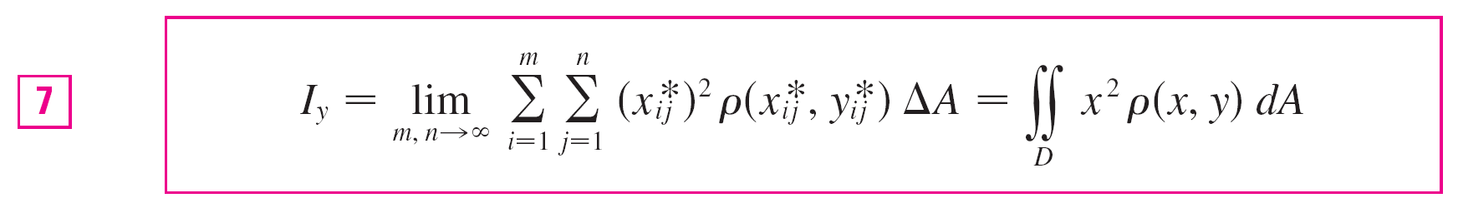
Moment of Inertia
The result is the moment of inertia of the lamina about the x-axis:
Similarly, the moment of inertia about the y-axis is

Slide 20
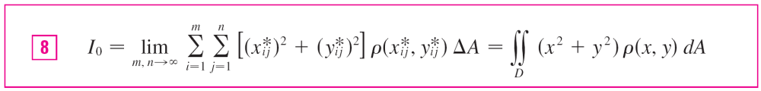
Moment of Inertia
It is also of interest to consider the moment of inertia about the origin, also called the polar moment of inertia:
Note that I₀ = I_{x} + I_{y}.

Slide 21
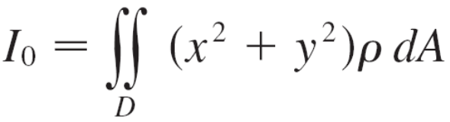
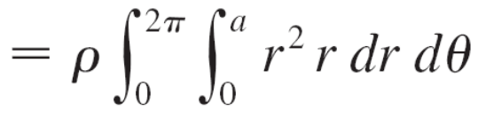
Example 4
Find the moments of inertia I_{x}, I_{y}, and I₀ of a homogeneous disk D with density ρ (x, y) = ρ, center the origin, and radius a.
Solution:
The boundary of D is the circle x² + y² = a² and in polar coordinates D is described by 0 ≤ θ ≤ 2π, 0 ≤ r ≤ a.
Let’s compute I₀ first:

Slide 22
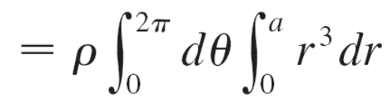
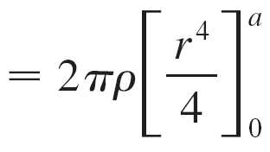
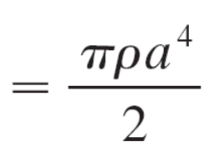

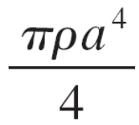
Example 4 – Solution
cont’d
Instead of computing I_{x} and I_{y} directly, we use the facts that I_{x} + I_{y} = I₀ and I_{x} = I_{y} (from the symmetry of the problem).
Thus
I_{x} = I_{y}
=
=

Slide 23
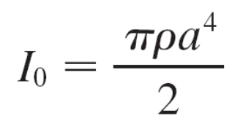
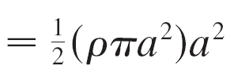
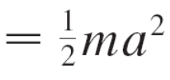
Moment of Inertia
In Example 4 notice that the mass of the disk is
m = density × area = ρ (πa²)
so the moment of inertia of the disk about the origin (like a wheel about its axle) can be written as
Thus if we increase the mass or the radius of the disk, we thereby increase the moment of inertia.

Slide 24

Moment of Inertia
In general, the moment of inertia plays much the same role in rotational motion that mass plays in linear motion.
The moment of inertia of a wheel is what makes it difficult to start or stop the rotation of the wheel, just as the mass of a car is what makes it difficult to start or stop the motion of the car.
The radius of gyration of a lamina about an axis is the number R such that
mR² = I

Slide 25
Moment of Inertia
Where m is the mass of the lamina I and is the moment of inertia about the given axis. Equation 9 says that if the mass of the lamina were concentrated at a distance R from the axis, then the moment of inertia of this “point mass” would be the same as the moment of inertia of the lamina.

Slide 26





Moment of Inertia
In particular, the radius of gyration with respect to the
x-axis and the radius of gyration with respect to the y-axis are given by the equations
Thus is the point at which the mass of the lamina can be concentrated without changing the moments of inertia with respect to the coordinate axes. (Note the analogy with the center of mass.)

Slide 27
Probability

Slide 28

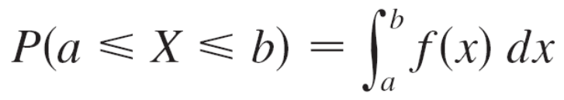
Probability
We have considered the probability density function f of a continuous random variable X.
This means that f (x) ≥ 0 for all x, and the
probability that X lies between a and b is found by
integrating f from a to b:

Slide 29
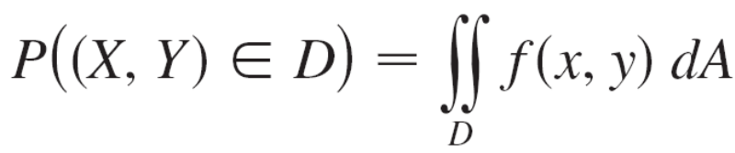
Probability
Now we consider a pair of continuous random variables
X and Y, such as the lifetimes of two components of a machine or the height and weight of an adult female chosen at random.
The joint density function of X and Y is a function f of two variables such that the probability that (X, Y) lies in a region D is

Slide 30
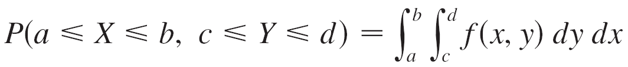
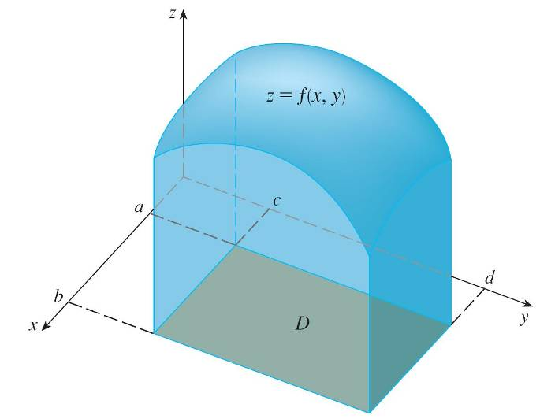
Probability
In particular, if the region is a rectangle, the probability that X lies between a and b and Y lies between c and d is
(See Figure 7.)
The probability that X lies between a and b and Y lies between c and d is the volume that lies above the rectangle D = [a, b] × [c, d ] and below the graph of the joint density function.
Figure 7

Slide 31
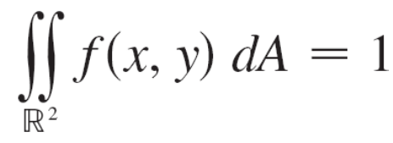

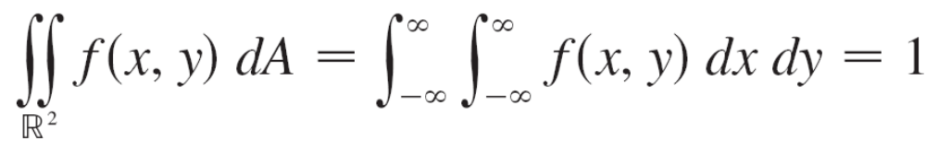
Probability
Because probabilities aren’t negative and are measured on a scale from 0 to 1, the joint density function has the following properties:
f (x, y) ≥ 0
The double integral over is an improper integral defined
as the limit of double integrals over expanding circles or
squares, and we can write

Slide 32

Example 6
If the joint density function for X and Y is given by
C(x + 2y) if 0 ≤ x ≤ 10, 0 ≤ y ≤ 10
0 otherwise
find the value of the constant C. Then find P(X ≤ 7, Y ≥ 2).
f (x, y) =

Slide 33
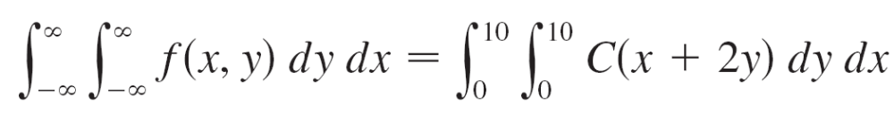
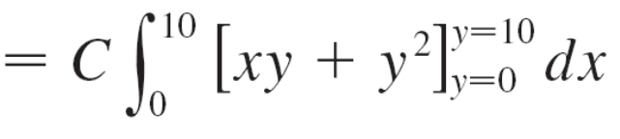
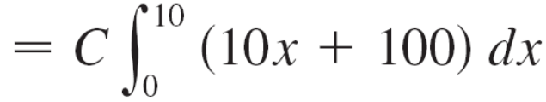

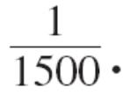
Example 6 – Solution
We find the value of C by ensuring that the double integral of f is equal to 1. Because f (x, y) = 0 outside the rectangle [0, 10] × [0, 10], we have
Therefore 1500C = 1 and so C =

Slide 34
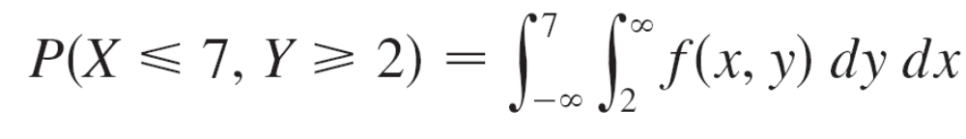
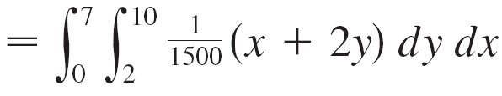
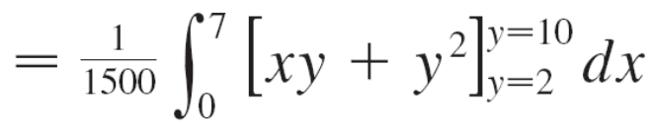
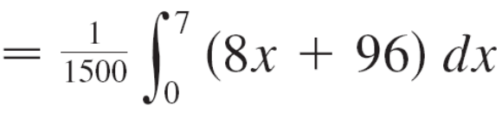
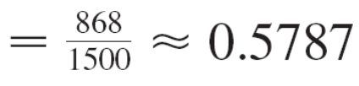
Example 6 – Solution
cont’d
Now we can compute the probability that X is at most 7 and Y is at least 2:

Slide 35

Probability
Suppose X is a random variable with probability density function f₁(x) and Y is a random variable with density function f₂(y).
Then X and Y are called independent random variables if their joint density function is the product of their individual density functions:
f (x, y) = f₁(x)f₂(y)
We have modeled waiting times by using exponential density functions
0 if t < 0
μ ^{–1}e ^{–t /μ} if t ≥ 0
where μ is the mean waiting time.
f (t) =

Slide 36
Expected Values

Slide 37
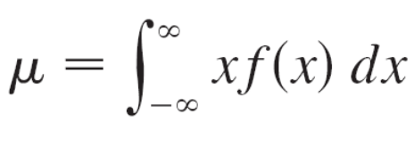

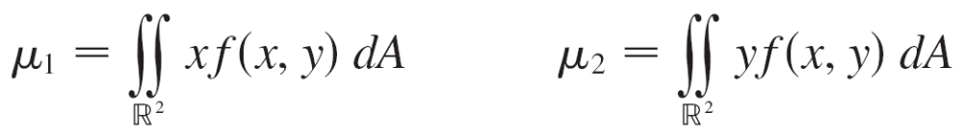
Expected Values
Recall that if X is a random variable with probability density function f, then its mean is
Now if X and Y are random variables with joint density function f, we define the X-mean and Y-mean, also called the expected values of X and Y, to be

Slide 38




Expected Values
Notice how closely the expressions for μ₁ and μ₂ in resemble the moments M_{x} and M_{y} of a lamina with density function ρ in Equations 3 and 4.
In fact, we can think of probability as being like continuously distributed mass. We calculate probability the way we calculate mass—by integrating a density function.
And because the total “probability mass” is 1, the
expressions for and in show that we can think of the
expected values of X and Y, μ₁ and μ₂, as the coordinates of the “center of mass” of the probability distribution.

Slide 39
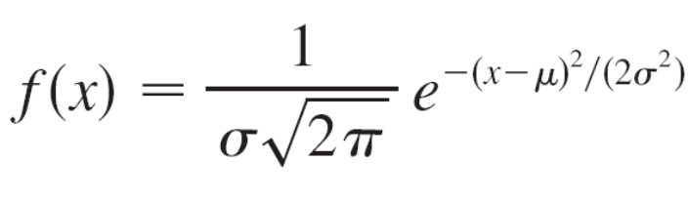
Expected Values
In the next example we deal with normal distributions. A single random variable is normally distributed if its probability density function is of the form
where μ is the mean and σ is the standard deviation.

Slide 40
Example 8
A factory produces (cylindrically shaped) roller bearings that are sold as having diameter 4.0 cm and length 6.0 cm. In fact, the diameters X are normally distributed with mean
4.0 cm and standard deviation 0.01 cm while the lengths Y are normally distributed with mean 6.0 cm and standard deviation 0.01 cm. Assuming that X and Y are independent, write the joint density function and graph it. Find the probability that a bearing randomly chosen from the production line has either length or diameter that differs from the mean by more than 0.02 cm.

Slide 41
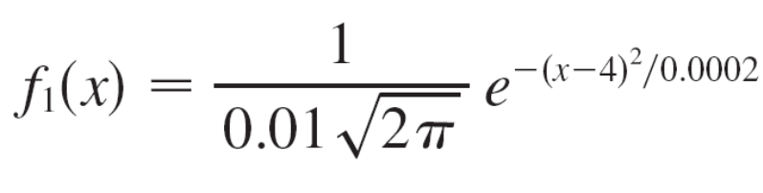


Example 8 – Solution
We are given that X and Y are normally distributed with μ₁ = 4.0, μ₂ = 6.0 and σ₁ = σ₂ = 0.01.
So the individual density functions for X and Y are
Since X and Y are independent, the joint density function is the product:
f (x, y) = f₁(x)f₂(y)

Slide 42


Example 8 – Solution
cont’d
A graph of this function is shown in Figure 9.
Graph of the bivariate normal joint
density function in this example
Figure 9

Slide 43




Example 8 – Solution
cont’d
Let’s first calculate the probability that both X and Y differ from their means by less than 0.02 cm. Using a calculator or computer to estimate the integral, we have
Then the probability that either X or Y differs from its mean by more than 0.02 cm is approximately
1 – 0.91 = 0.09

